Slide 1
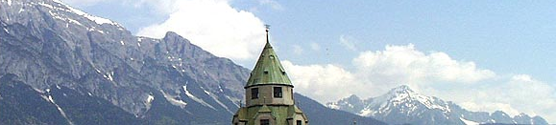


Paternalism in families – burdens of caregivers of elderly family members
4th International Conference on Nursing & Healthcare
Dr. Martin Pallauf
(together with Dr. Benjamin Schmidt)
San Francisco, October 5, 2015

Slide 2

Family-Sociological Perspective
Family-socialization: from the „whole house“ to the nuclear family (statistical appearance). (Peukert 2008; Rosenbaum 1982; Brunner 1978)
Multi-local and multi-generational families. (Bertram 2000)
Socio-demographic changes: beanpole families. (Rosenthal, Burton 1990; Schattovits 2000; Hoff 2006)
Sociopolitical influences: subsidiarity principle, social security, pension reform. (Rosenbaum, Timm 2008)
Autonomy of generations: resources – support. (Attias-Donfut 2000)
Dr. Martin Pallauf Oct 5, 2015

Slide 3
Psychological Perspective
Paternalism (Grill 2010; May 2001; Wicclair 1993; Cicirelli 2003)
Paternal action: patriarchy (pater-father; archy-rule).
Violent intervention in personal freedom and autonomy.
For the benefit of another person.
Medical Ethics – between two poles:
lack of capacity to consent and self-fulfillment.
Informal care - between two poles:
autonomy and paternalism.
Closely linked to dependency.
Conflicts within emotional bonds and loyalties.
Parentification.
Delegation.
Dr. Martin Pallauf Oct 5, 2015

Slide 4
Statistical Data
Germany 2013: People in need of care divided according to types of care.
2.5 million people in need of care
Informal care: 1.76 million people (70%)
Family caregivers unassisted:
1.18 million people
Together with mobile nursing services:
576,000 people
Residential care:
743,000 people (30%)
Dr. Martin Pallauf Oct 5, 2015

Slide 5
Impact on Practice
Informal Care (Blome, Alber et al. 2008; Wingenfeld, Büscher et al. 2008; Hoff 2006; Schattovits 2000)
A new definition of `need of care´ is necessary – in social and health politics.
Increase in very elderly people – decrease in caring family members.
Within four generations mostly two generations are in need of care.
Larger distances and relationship varieties increase burdens of caregivers.
Political and social conditions for family caregivers claim high personal and financial sacrifices.
Dr. Martin Pallauf Oct 5, 2015

Slide 6
Research Project
3 research groups:
First step: 13 informal caregivers of non-institutionalized older family members are interviewed. All caregivers are sandwiched between own children and aging family members.
Second step: 13 informal caregivers of older family members in residential care are interviewed.
Third step: the data obtained in steps one and two are discussed with nine different experts.
Dr. Martin Pallauf Oct 5, 2015

Slide 7
Results – Research Group 1
Categories | Subcategories 1 | Subcategories 2
Intergenerational relationship | Children in debt to their parents | Feel guilty / obligation to care / to give sth. back.
Effects on family relations | Strong conflicts with elderly family members in need of care/ careless towards own family | Parents obstruct care / difficulties to decide for their parents, to make decisions/ little support from family / married life is neglected / children are disadvantaged.
Burdens of caregivers | Permanent stress and strain / fear of the future | Burdens caused by multiple roles in life / no recovery / financial problems / can´t satisfy the expectations / long for the end.
Changes in own life | High personal sacrifices and losses | Sacrifice of personal needs / financial and social restrictions / lack of spontaneity / restrictions in working life / conflicts with social and health authorities
Dr. Martin Pallauf Oct 5, 2015

Slide 8
Results – Research Group 2
Categories | Subcategories 1 | Subcategories 2
Intent for residential care | Exhaustion of the caregiver / better care for elderly (parents) | Workplace, social and personal burdens / deterioration of health / failure of alternative care-systems / third-party advices.
Emotional effects | Strong feelings of guilt / as time passed by the situation improved | Conflicts with elderly persons in residential care/ taking parents back home/mental-emotional stress of former caregivers/mental illness of former caregivers/mental degeneration and increasing morbidity helped managing the situation
Social effects | More time for personal needs / high personal restrictions | Less psychological burdens / less burdens in daily life / more freedom / more social contacts / financial losses / personal and health restrictions / conflicts and disputes with care institutions, official sponsors and authorities
Dr. Martin Pallauf Oct 5, 2015

Slide 9
Results – Research Group 3 / Experts
Categories | Subcategories 1 | Subcategories 2
Conflicts of caregivers | Psychological conflicts / fear of the future | Burdens caused by feelings of guilt / decision conflicts / disputes in the family / fear of social strains / fear of financial conflicts.
Burdens of family caregivers | Family caregivers’ exhaustion / psychological strain | Excessive demands on family caregivers / lack of support and advice / conflicts with caring partners and institutions / long-term stress /
Structural aspects | Lack of advice / inadequacies in structures and social, political and health environments | Need for information and educational work / excessively high requirements for official caregivers / social and health policies don´t facilitate better care and support systems
Dr. Martin Pallauf Oct 5, 2015

Slide 10
Overview of Findings
1. How do people experience burdens of caring for their elderly family members?
Long-term stress and strain – long for the end; can´t satisfy their own or expectations of others; confronted with decision-making; confronted with feelings of guilt; obligation towards older family members; financial loss; restrictions and worries; no support and advice.
2. What impact has care-giving on personal relationships?
Whole family is affected; feelings of guilt; conflicts and arguments; own needs and wishes are not compatible with those of other family members; paternalistic decision-making happens daily – these decisions are very difficult to take; as the disease progresses paternalistic decisions will come easier; more time for privacy.
Dr. Martin Pallauf Oct 5, 2015

Slide 11
Explanatory Approaches
Gerontology: ( Ernst 2008; Opaschowski 2008; Peters 2004)
Transition to retirement is regarded as a critical phase of life.
Caring for parents/elder family members complicates own aging.
Unexpected changes and duties in life.
Sociology: (Kaiser 2007, Ernst 2008)
Changing family structures.
Middle-aged adults in a “sandwich position”.
High burdens due to multiple roles in life.
Conflict-potential arising from diametric expectations.
Dr. Martin Pallauf Oct 5, 2015

Slide 12
Explanatory Approaches
Care science and health care: (Hicks, Lam 1999; Schmidt 2005; Ehrhardt, Plattner 1999; Zank, Schacke et al. 2007)
Dilemmas in care situations – decision-making conflicts.
Complex decision-making processes.
Moving into a nursing facility burdens the whole family.
Lots of difficult bureaucratic processes.
Dr. Martin Pallauf Oct 5, 2015

Slide 13
Explanatory Approaches
Paternalism in daily care-giving (Cicerelli 2003; Wicclair 1993)
Conflicts in daily routines.
Bad conscience/ feelings of guilt / conflicts.
Parentification – the elderly don´t accept decisions by younger family members.
Difficult decision-making towards the end of life.
Burdens of caregivers of middle-stage dementia patients are extremely high.
Dr. Martin Pallauf Oct 5, 2015

Slide 14
Outlook
Family resources will continue to decline.
Burdens of informal (family) caregivers will continue to increase.
Burdens have multidimensional character
>>> need for cross-disciplinary support and advice.
Coaching, supervision.
Care, support, information/advice should be organized in networks.
Not just a health-political problem > cities, communities, welfare, employers etc. are also responsible.
>>> Public-private partnership. (Blome, Alber et al. 2008)
Political reforms are conceptualized too slowly and still have to prove their value.
Dr. Martin Pallauf Oct 5, 2015

Slide 15
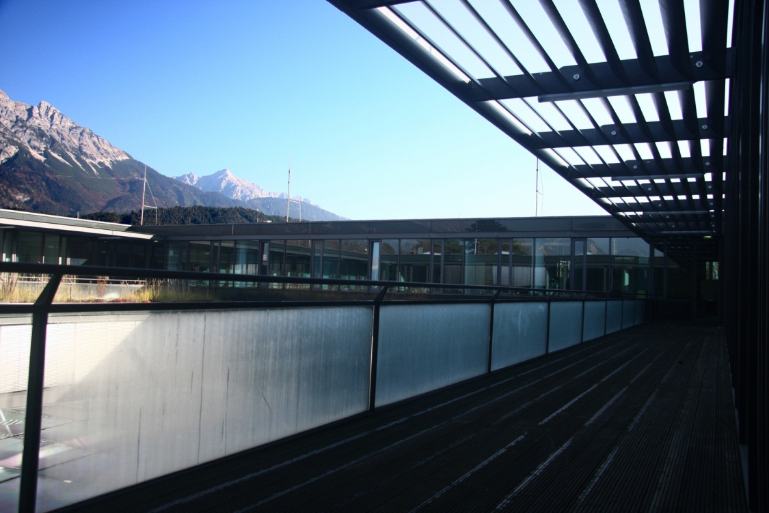
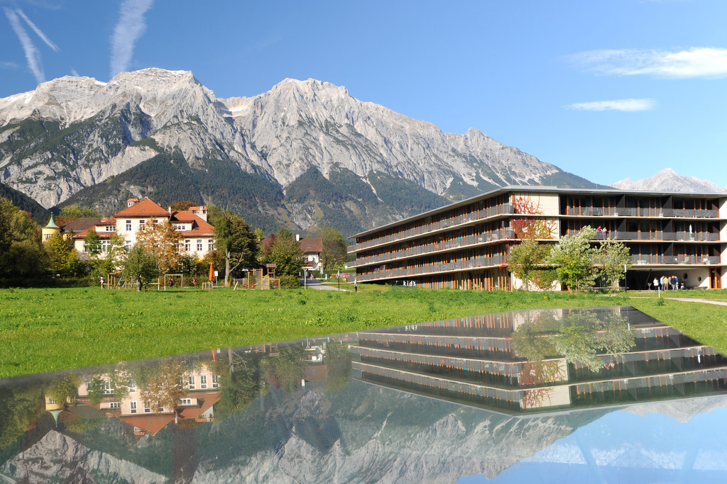
Thank you for your attention!
UMIT - Hall in Tirol
Institute for Gerontology and Demographic Development
Dr. Martin Pallauf
Contact: martin.pallauf@umit.at

Slide 16
References
Attias-Donfut, C. (2000): Familialer Austausch und soziale Sicherung. In: Kohli, M., Szydlik, M. (Hrsg.): Generationen in Familie und Gesellschaft. Opladen, Leske&Budrich.
Bianchi, S., Hotz, V.,McGarry, K, Seltzer, J. (2006): Intergenerational Ties: AlternativeTheories,EmpiricalFindingsandTrends,andRemainingChallenger. University Of California. On-Line Working paper Series. Gesehen am 16.03.2011. Internet: www.soc.duke.edu/~efc/Docs/pubs/Intergenerational Ties_tociruclate17March2007.pdf
Blome, A., Alber, J., Keck, W. (2008): Generationenbeziehungen im Wohlfahrtsstaat. Wiesbaden, VS Verlag für Sozialwissenschaften.
Boszormenyi-Nagy, I., Spark, G. (2006): Unsichtbare Bindungen. Stuttgart, Klett-Cotta.
Brunner, O. (1978): Vom „ganzen Haus“ zur „Familie“. In: Rosenbaum, H. (Hrsg.): Seminar: Familie und Gesellschaftsstruktur. Frankfurt am Main, Suhrkamp.
Bude, H. (2000): Die biographische Relevanz der Generation. In: Kohli, M., Szydlik, M.: Generationen in Familie und Gesellschaft. Opladen, Leske&Budrich.
Bundesamte für Familie, Senioren, Frauen und Jugend (2002): Vierter Altenbericht, Berlin.
Bundesamte für Familie, Senioren, Frauen und Jugend (2005): Fünfter Altenbericht. Berlin.
Chumbler, N., Pienta, A., Dwyer, J. (2004): The Depressive Symptomatology Of Parent Care Among the Near Elderly. The Influence of Multiple Role Commitments. In: Research on Aging 2004, 26. Ohne Verlag.
Cicirelli, V. (2003):Mothers´ and Daughters´ Paternalism Beliefs and Caregiving Decision Making. In: Research On Aging 2003, Vol. 25, 3. Ohne Verlag.
Ernst, H. (2008): Weitergeben. Hamburg, Herder.
Fengler, J. (2001): Helfen macht müde: Zur Analyse und Bewältigung von Burnout und beruflicher Deformation. Stuttgart, Klett-Cotta.
Graeber, D. (2011):Debt The First 5.000Years, New York (USA), Melville House Publishing.
Grill, K. (2010): Paternalism. Preprint. Forthcomingin: Chadwick, R. (Hrsg.): Encyclopedia of Applied Philosophy. Gesehen am 20.03.2011. Internet: kallegrill.se/texts/Paternalismpreprint.pdf
Hicks, M., Lam, M. (1999): Decision-making within the social course of dementia: accounts by Chinese-american caregivers. In: Culture, Medicine and Psychiatry, 23. Ohne Ort, Kluwer Academic Publishers.
Hoff, A. (2006): Intergenerationale Familienbeziehungen im Wandel. In: Tesch-Römer, C., Engstler, H., Wurm, S. (Hrsg.): Altwerden in Deutschland. Wiesbaden, VS Verlag für Sozialwissenschaften.
Kaiser, H. (2007): Work-Life Balance aus der Sicht der Gerontologie. In: Esslinger, A., Schobert, D.: Erfolgreiche Umsetzung von Work-Life Balance in Organisationen. Wiesbaden, Deutscher Universitäts-Fachverlag.
Kofahl, C., Mestheneos, E., Triantfillou, J. (2005): Zusammenfassende Übersicht der Ergebnisse aus der EUROFAMCARE-Sechs-Länder-Studie. Gesehen am: 19.01.2011. Internet: www.uke.de/ extern/eurofamcare/documents/deliverables/summary_of_findingsde.pdf
Dr. Martin Pallauf Oct 5, 2015

Slide 17
References
Kofahl, C. (2008): Motive von Angehörigen, ihre älteren Familienmitglieder zu betreuen: Ergebnisse aus dem europäischen Forschungsprojekt EUROFAMCARE. In: Zank, S., Hedtke-Becker, A. (Hrsg.): Generationen in Familie und Gesellschaft im demographischen Wandel. Stuttgart, Kohlhammer.
Kohli, M., Künemund, H., Motel, A., Szydlik, M. (2000): Grunddaten zur Lebenssituation der 40-85jährigen deutschen Bevölkerung. Ergebnisse des Alters-Surveys. Berlin, Weißensee-Verlag.
Kohli, M. (2007): Von der Gesellschaftsgeschichte zur Familie. In: Lettke, F., Lange, A. (Hrsg.): Generationen und Familie, Frankfurt am Main, Suhrkamp.
Kohli, M., Szydlik, M. (Hrsg.) (2008): Generationen in Familie und Gesellschaft. Opladen, Leske&Budrich.
Künemund, H., Motel, A. (2000): Verbreitung, Motivation und Entwicklungsperspektiven privater intergenerationeller Hilfeleistungen und Transfers. In: Kohli, M., Szydlik, M. (Hrsg.): Generationen in Familie und Gesellschaft. Opladen, Leske&Budrich.
Lamura, G., Mnich, E., Wojszel, B., Nolan, M., Krevers, B., Mesthenenos, L., Döhner, H. (2006): Erfahrungen von pflegenden Angehörigen älterer Menschen in Europa bei der Inanspruchnahme von Unterstützungsleistungen. In: Zeitschrift für Gerontologie und Geriatrie, Nr. 6. Darmstadt, Steinkopf Verlag.
Leisering, L. (2000): Wohlfahrtsstaatliche Generationen. In: Kohli, M., Szydlik, M.: Generationen in Familie und Gesellschaft. Opladen,Leske&Budrich.
Lettke, F., Lange, A. (2007b): Schrumpfung, Erweiterung, Diversität. Konzepte zur Analyse von Familien und Generationen. In: Lettke, F., Lange, A. (Hrsg.): Generationen und Familie, Frankfurt am Main, Suhrkamp.
Lüscher, K. (2000): Die Ambivalenz von Generationenbeziehungen. In: Kohli, M., Szydlik, M. (Hrsg.): Generationen in Familie und Gesellschaft. Opladen, Leske&Budrich.
May, A. (2001): Autonomie und Fremdbestimmung bei medizinischen Entscheidungen für Nichteinwilligungsfähige. Münster, LitVerlag.
Mey, G., Mruck, K. (2010): Grounded Theory Methodologie. In: Mey, G., Mruck, K. (Hrsg.): Handbuch Qualitative Forschung in der Psychologie. Wiesbaden, VS Verlag für Sozialwissenschaften.
Opaschowski, H. (2008): Einführung in die Freizeitwissenschaften. Wiesbaden, VS Verlag für Sozialwissenschaften.
Peters, M. (2004): Klinische Entwicklungspsychologie des Alters. Göttingen, Vandenhoeck& Rupprecht.
Peuckert, R. (2008): Familienformen im sozialen Wandel. Wiesbaden, VS Verlag für Sozialwissenschaften.
Rosenbaum, H. (1982): Formen der Familie. Frankfurt am Main, Suhrkamp.
Rosenbaum, H., Timm, E. (2008): Private Netzwerke im Wohlfahrtsstaat. Konstanz, UVK Verlagsgesellschaft.
Rubin, M., White-Means, S. (2009): Informal Caregiving: Dilemmas of Sandwiched Caregivers. In: Journal Of Family And Economics, 30. (USA), Springer.
Salomon, J. (2005): Häusliche Pflege zwischen Zuwendung und Abgrenzung – Wie lösen pflegende Angehörige ihre Probleme? Köln, Kuratorium Deutsche Altershilfe.
Schattovits, H. (2000): Haushalt und Familienleben: Netzwerke der Kommunikation und Kooperation. In: Amann, A. (Hrsg.): Kurswechsel für das Alter. Wien, Böhlau.
Dr. Martin Pallauf Oct 5, 2015

