Slide 1
Research Interests
The Role of Catecholamines in Cardiac Lineage Commitment
Electrophysiological and pharmacological characterization of ES and iPS cell-derived cardiomyocytes
Martin Lehmann, PhD.
Institute for Neurophysiology
University of Cologne
lehmannm@uni-koeln.de

Slide 2
I. The Role of Catecholamines in Cardiac Lineage Commitment
Catecholamines play an essential role in heart function of the adult heart
Severe developmental effects of Catecholamine Synthesis Gene knockout (TH and DBH) (Kobayashi et al., 1995; Zhou et al., 1995, Thomas et al., 1995)
Paracrine action of catecholamines at developmental stage before neuronal innervation was suggested
In Contrast: In vivo Pnmt k.o. (Ebert et al., 2004) did not lead to fetal mortality
Noradrenaline is most important amongst the catecholamines in respect to cardiac development

Slide 3
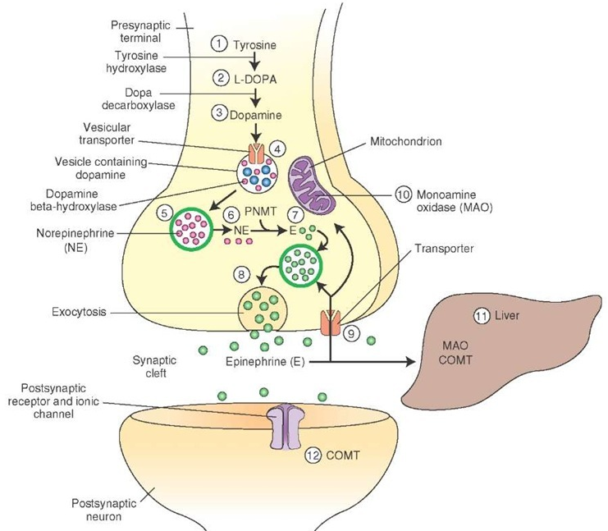
I. The Role of Catecholamines in Cardiac Lineage Commitment
Intracellular Catecholamine Synthesis
* Reserpine - Mechanism of action
*
*
http://what-when-how.com/wp-content/uploads/2012/04/tmp14754_thumb1.jpg

Slide 4
I. The Role of Catecholamines in Cardiac Lineage Commitment
Reserpine-induced catecholamine depletion, reduced cardiomyocyte differentiation efficiency
d2
d4
d10
d14+Puro
Control
DMSO
Reserpine
d2+d4: 50 µm; d10+d14: 200 µm

Slide 5
I. The Role of Catecholamines in Cardiac Lineage Commitment
Reserpine Reduces Numbers of Beating EBs

Slide 6
I. The Role of Catecholamines in Cardiac Lineage Commitment
αActinin
Cardiac TroponinT
Scale bars:
50 µm
Expression of cardiac markers is significantly reduced after catecholamine depletion
qPCRs by Dr. V. Wagh

Slide 7
I. The Role of Catecholamines in Cardiac Lineage Commitment
Interestingly, catecholamine depletion promotes neuronal lineage commitment

Slide 8
I. The Role of Catecholamines in Cardiac Lineage Commitment
Catecholamines play a crucial role in cardiac differentiation exhibiting their action in a paracrine fashion
The critical period for catecholamine action is before day 6
α- and β-adrenergic signaling is critical during cardiac differetiation.

Slide 9

II. Electrophysiological and pharmacological characterization of ES and iPS cell-derived cardiomyocytes

Slide 10
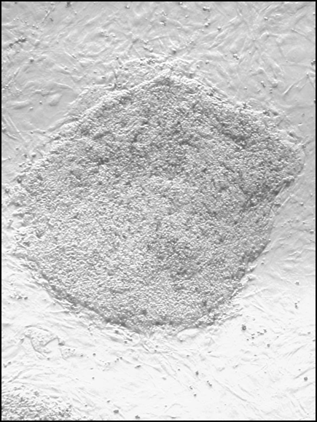
Project Aim
- Drugs can have unexpected cardio-active side effects (e.g. torsade de pointes tachycardia, TdP)
→ Pharmacological Screening Tool to detect possible cardio-active effects before cost-intensive clinical phase
→ MEA-based human ES or iPS cell-derived Cardiomyocyte (rESCM) screen
Why Multielectrode Arrays (MEA)?
non-invasive extracellular measurement (of field potentials (FPs))
long-term recordings
allows for recording of 2D excitation and conduction (slices, monolayer)

Slide 11
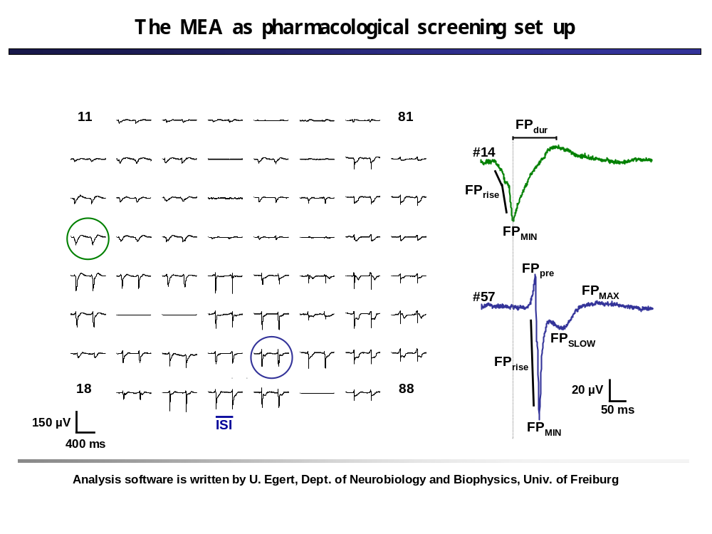
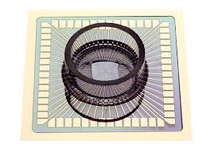
Multielectrode Array (MEA)

Slide 12
Multielectrode Array (MEA)

Slide 13
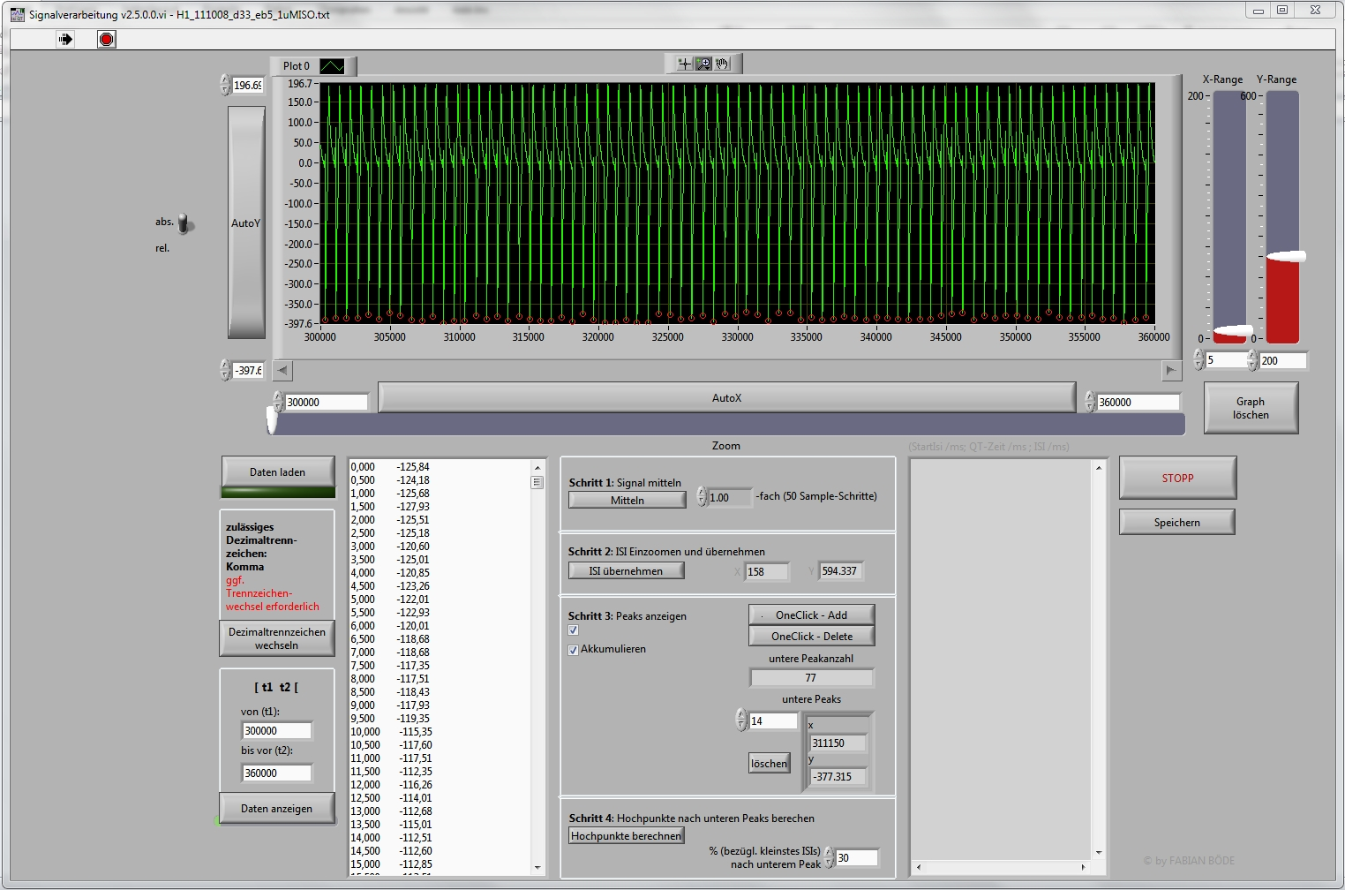
LabView-based Analysis Tool
MEA QT-Tool
Data Display
Data Processing

Slide 14
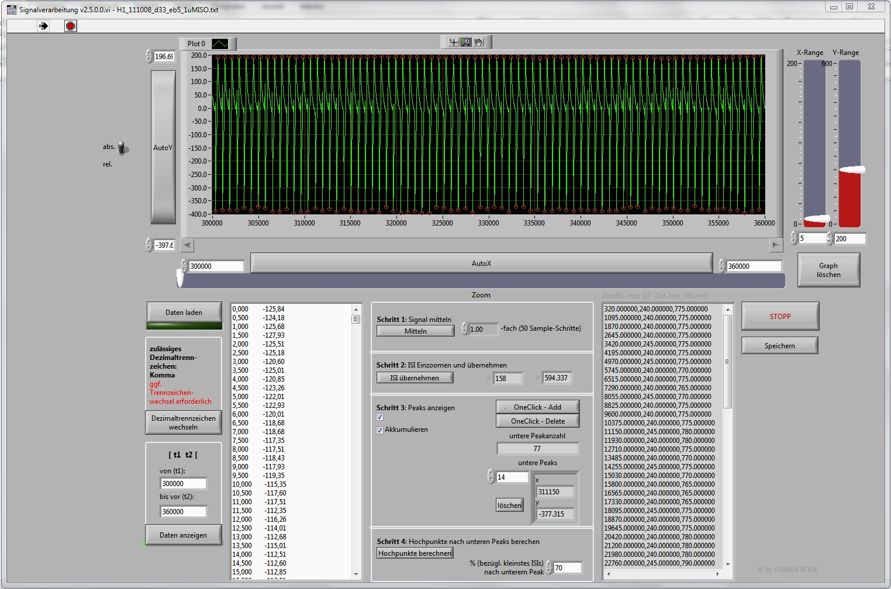
MEA QT-Tool
Analysis Results

Slide 15
FP/f Correlations-
Physiologic Positive Chronotropic Conditions
Normalized averaged values
Negative (linear) FP/f correlation upon physiologic positive chronotropic stimulation
Normalized and averaged value pairs are representative for a population of EBs

Slide 16
FP/f Correlations-
Physiologic Negative Chronotropic Conditions
FP/f correlation during negative chronotropic stimulation

Slide 17
FP/f Correlations-
QT-prolonging conditions
Hypothetically, QT-time and repolarization prolonging drugs should change the FP/f correlation toward less negative values, e.g. E4031
Antiarryhthmic class III drug (K⁺/HERG-Channel blocker)
→ positive FP/f correlation

Slide 18
II. Electrophysiological and pharmacological characterization of ES and iPS cell-derived cardiomyocytes
Conclusions:
Drug effects on different EBs/cells is comparable (normalization!!)
EB-to-EB comparison has to be taken with care (e.g. Long-QT-iPS)
A pharmacological screen is feasible with MEA irrespective of cell type (ES or iPS)

