Slide 1
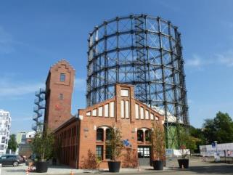
The cartography of alternative policy pathways: A legitimate science-policy model?
Dr. phil. Martin Kowarsch
Global Health Economics Summit–
Berlin, July 25th, 2016

Slide 2
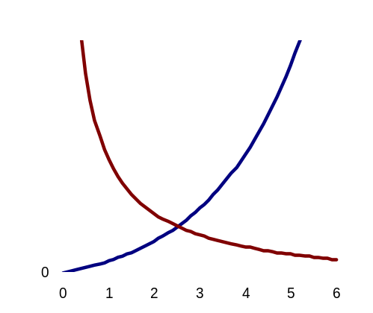
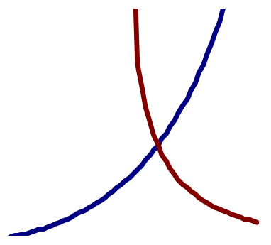
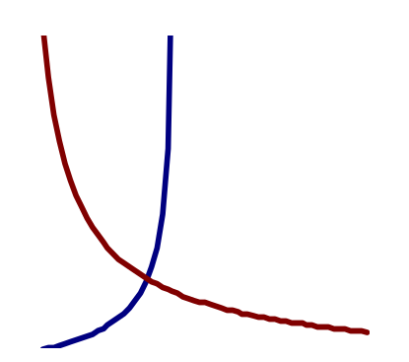
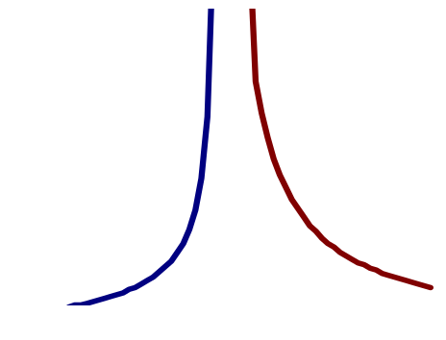
Different worldviews matter
Climate policy: what is the optimal level of global mean temperature?
“Standard cost-benefit analysis“
Δ costs [$]
Δ costs [$]
“Libertarian”
0
5
ΔT [°C]
0
5
ΔT [°C]
“Green
worldview”
“Fatalist”
Δ costs [$]
Δ costs [$]
0
5
ΔT [°C]
0
5
ΔT [°C]

Slide 3
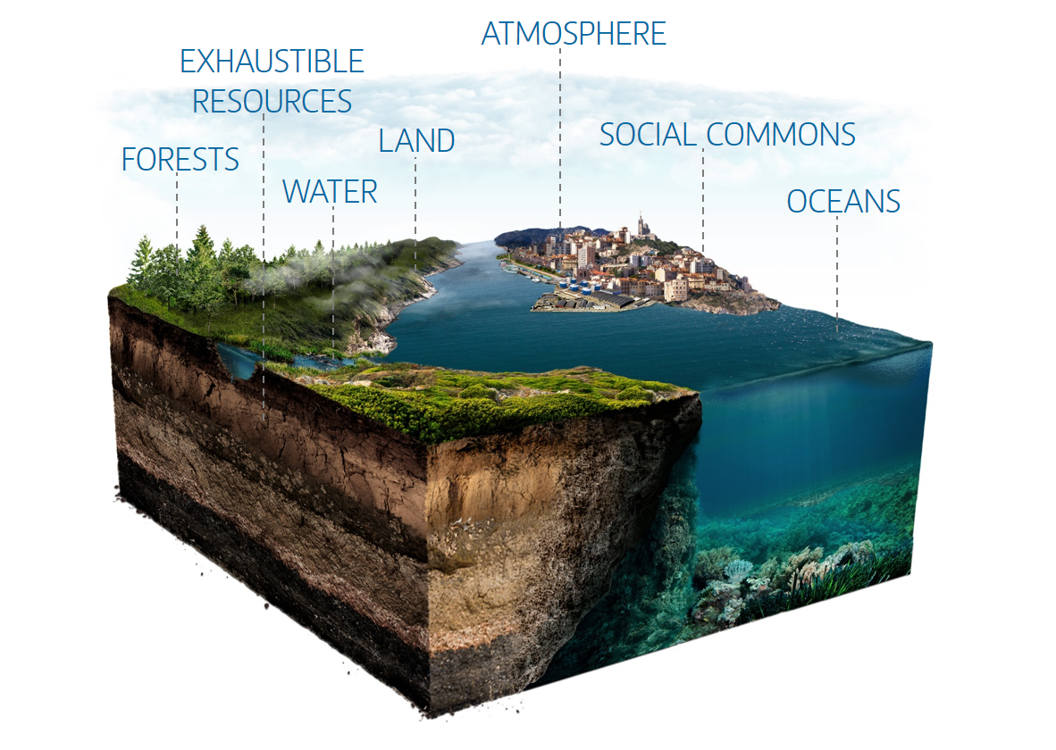
Scientific policy advice: key challenges
Research can help decision-makers under-stand available policy options. However, climate change as “problem from hell”:
inevitable, often disputed normative assumptions, e.g.:
  prioritizing policy goals
  policy evaluation criteria
  evaluation of uncertainty
large-scale, long-term, non-linear risks: new research fields, high uncertainty;
interdependencies between different policy fields (synergies and tradeoffs), across disciplines & approaches.
Kowarsch, forthcoming book, Springer Press

Slide 4
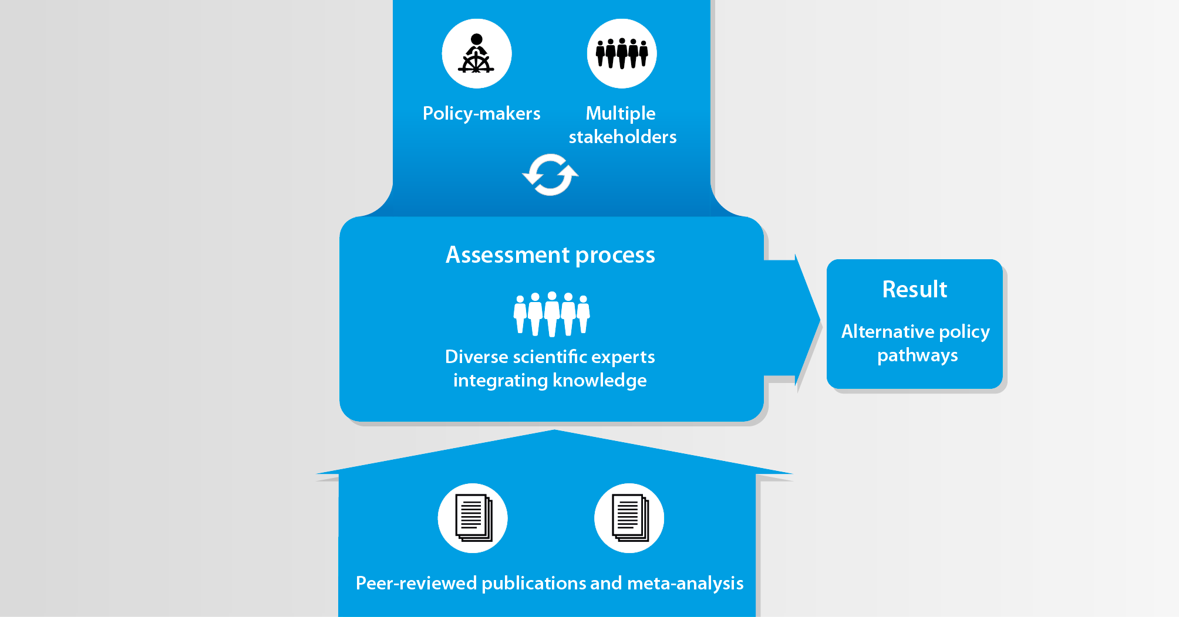
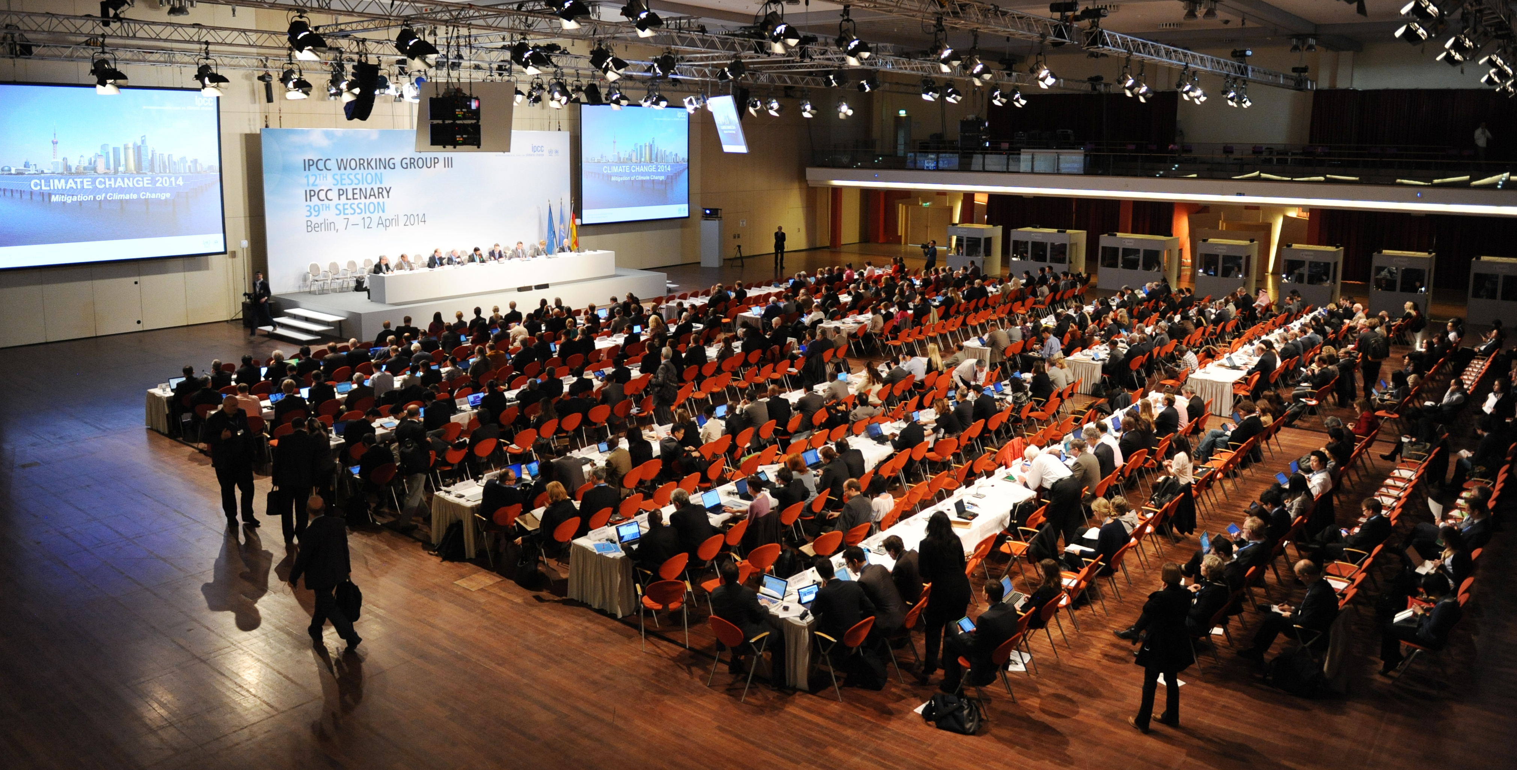
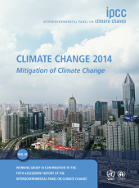
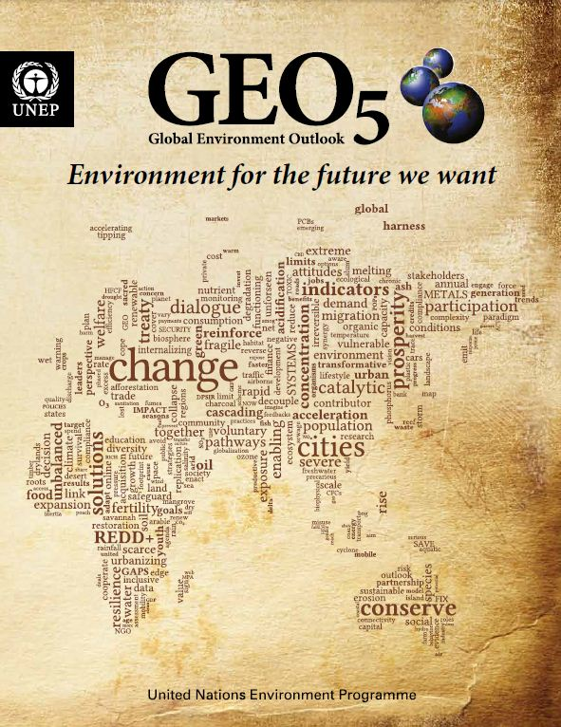
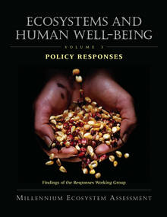


Assessments as promising tools at the science-policy interface
How to be
policy-relevant, legitimate, and credible?
Kowarsch 2015, Nature Climate Change

Slide 5
Technocratic model: Why it doesn’t work
Researchers
Researchers
Policymakers
Objectives
Means
Implementation
DOWNSIDE:
Misguided consensus model of “speaking truth to power” – no linear transfer possible (e.g., Sarewitz 2004)
Actual consequences after the implementation do not matter for this model; unclear who is responsible for them
  Mistakenly presupposes that scientific determination of policy objectives can be value-free, or that there is a value consensus. But: there is (justified) disagreement, and there are different policy narratives
  Peril of “iron cage of bondage” for society through rule of experts: opaque advocacy for a specific policy option
Notes:
Assumption:
In the complex, modern world, objective (value-neutral) scientific consensus can substantially contribute to the design of public policy – both concerning policy objectives and means

Slide 6
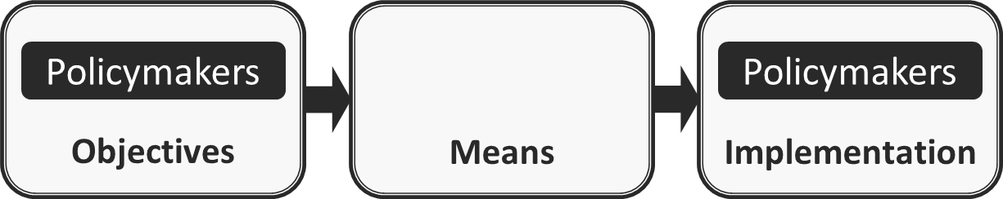
Decisionist model
Researchers
DOWNSIDE:
No possibility at all of rationally discussing policy objectives
In contrast to the “lip service”, most scientists in fact follow the technocratic model
Unclear how science can appropriately judge about policy means, and who is responsible for side-effects etc. in the end
Disputed value judgments implied even in studies on policy means
Notes:
Clear division of labour: Policymakers (somehow) define policy goals; science objectively identifies appropriate means

Slide 7
Evaluate the diverse (co-)effects!
Initial policy objectives
Alternative
means 1
Direct effects
Unwanted side-effects
Alternative
means 2
Direct effects
Unwanted side-effects
Synergies
Synergies
Additional objectives
Goals & means are interdependent via their consequences.
Identify best means (here: “means 2”)
Uninteresting consequences
1
Re-think objectives in
light of co-effects of
the best means
Uninteresting consequences
2

Slide 8
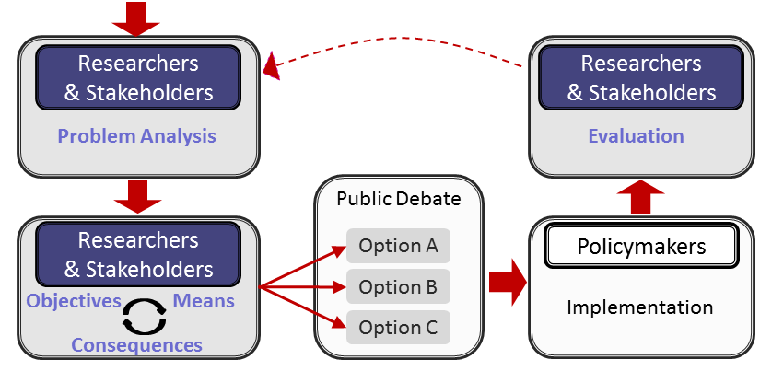
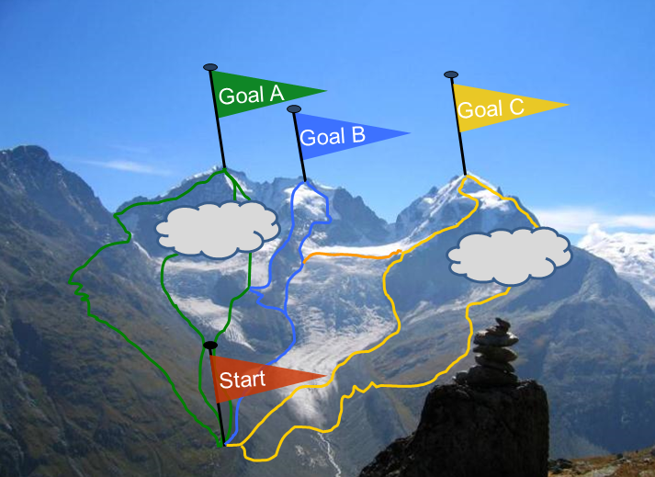
Pragmatic-Enlightened Model (PEM) for large-scale scientific assessments
Cartography of viable pathways:
alternative policy pathways
explore means-implications (effects)
jointly with different stakeholders
→deliberative learning processes
Edenhofer & Kowarsch 2015, Env Sci & Pol

Slide 9
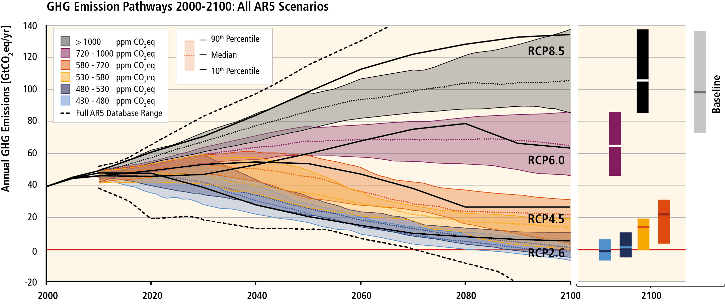
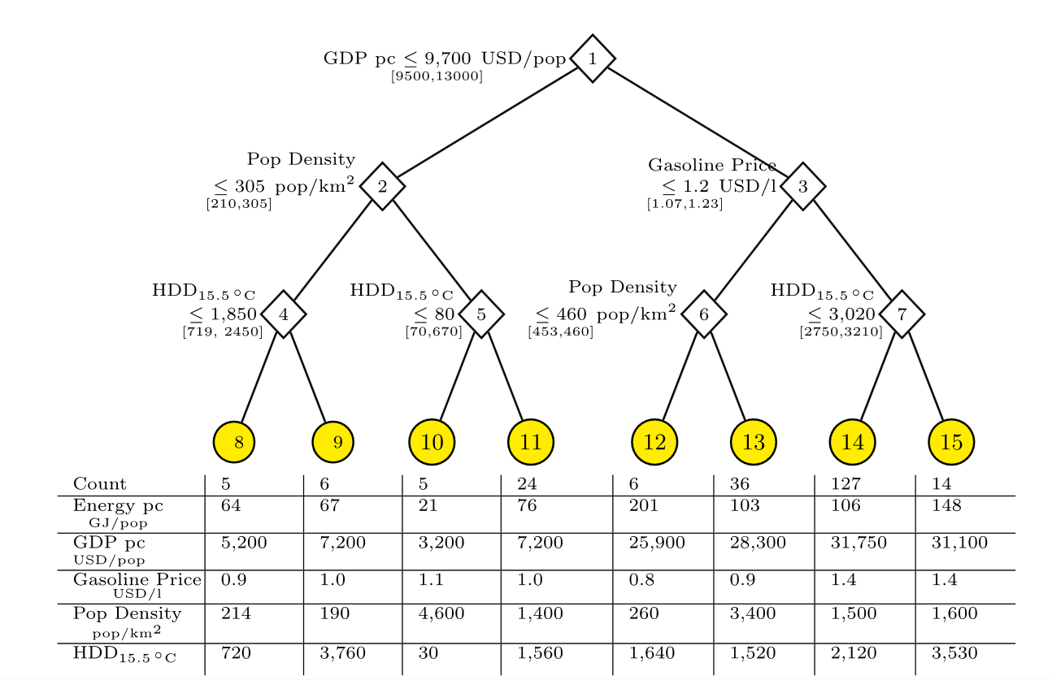
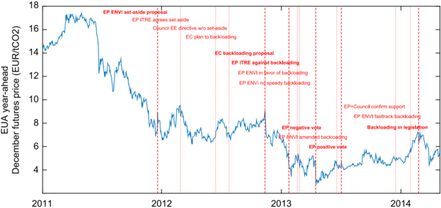
Pathway assessments in practice
Alternative pathways
…and building blocks of assessments:
Meta-Analysis
Empirical ex-post policy analysis
IPCC WG III AR5 SPM.4 (2014) / Creutzig et al 2015, PNAS / Koch et al 2016, JEEM

Slide 10
Thanks for your attention.
Enabling deliberative, multi-stakeholder
learning processes about policy alternatives

