Slide 1
Maintrac®
Therapy control and long-term surveillance by circulating, epithelial tumor cell (CETCs)
www.dmb-diagnostics.de

Slide 2
What we can do with CETCs
CETCs as success parameter, prognostic and predictive marker
for personalised therapy decisions
Quantitative detection of CETCs
Highest sensitivity also for patients with primary tumor
Monitoring and success control during adjuvant tumor therapy
5 or 10 years Tamoxifen? How to recognize when maintenance therapy does not work?
Characterisation of therapy-relevant tumor characteristics
Identification of the most effective therapies
Long-term surveillance even 10 years after a cancer diagnosis
Real time control by a blood sample of 15 ml

Slide 3
Status quo in oncolgy
Today‘s Standard
Doctor‘s Needs
Quantitative, real time monitoring
Therapy based on chemosensitivity of actual tumor (CETCs)
Monitoring of tumor activity by cell count
Better guidance of endocrine therapy
Imaging diagnostics of solid tumors = already too big and too late
Surgery if possible (avoid neoadjuvant)
Treatment decision based only on tumor size, nodal status and organ localization (of a removed tumor)
Longtime surveillance based on imaging techniques and general condition = too late for the patient
Serum markers still used but too unspecific

Slide 4


Major Enemy in Oncology Diagnostics and Treatment
Heterogeneity
Biopsy, paraffin embedded tissue, ctDNA show only a small fraction of the total picture: Are you brave enough to judge, how the whole picture looks like?
?=

Slide 5

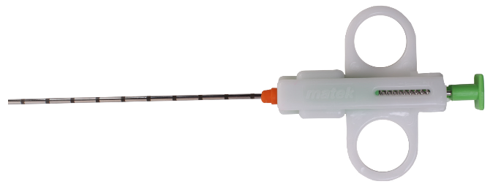
Tumor Heterogeneity in
Reality Even Worse
Good Luck!
I’m sure, you will find the “right” answer!

Slide 6
Methodology we try to get as close as possible to a complete picture of the remaining tumor (CETCs)

Slide 7
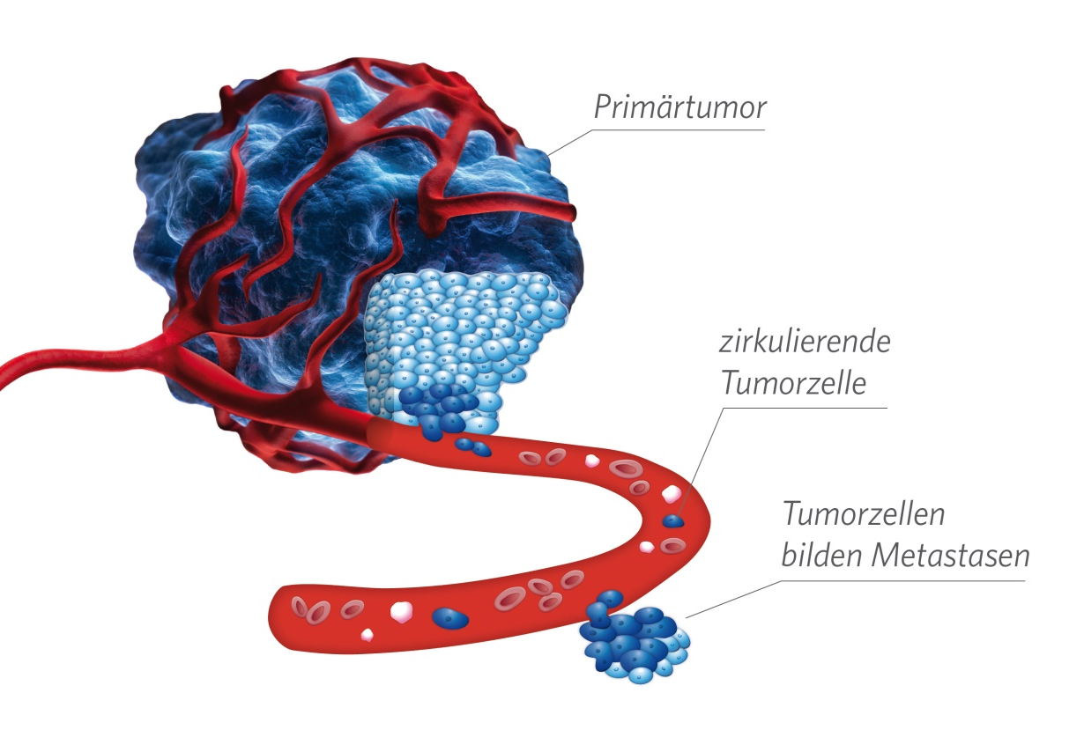
Metastasis Formation Through Circulating Tumor Cells
Carcinoma are of epithelial Origin
Carcinoma seed epithelial cells into the blood
⇒ CETCs
(circulating epithelial
tumor cells)

Slide 8
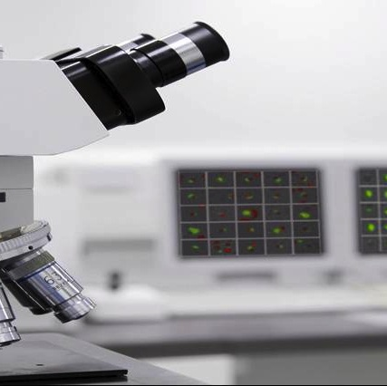
Testing
Microscope based
semi-automated image evaluation
ISO 15189 accredited
>650 patients in published clinical trials
100,000 measurements
(50,000 in clinical routine)
Detection of
ANY solid tumor
NOT for lymphoma
or leukaemia

Slide 9
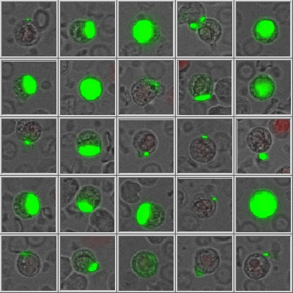
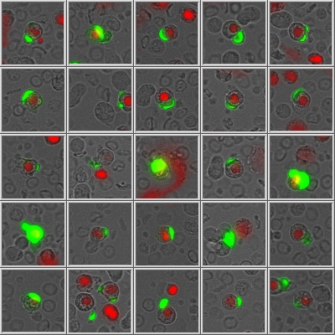
Cell gallery of a patient
red stained nucleus
= dead cell

Slide 10
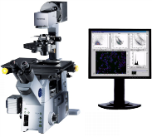
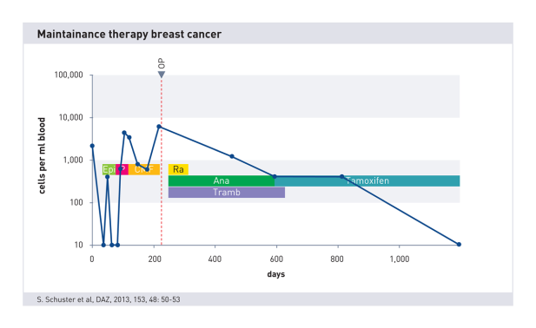
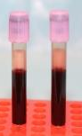
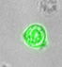
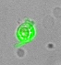
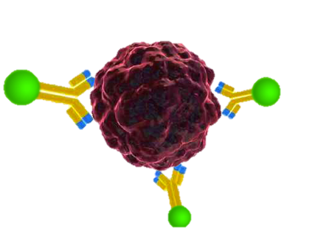

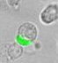
Quantitative, Vital Cell Number Determination
1
4
Blood sample
Trend of cell number
Maintrac® Mikroscope
NO! Selektion
NO! Extraction
Staining with fluorescent antibodies
2
3
Quantitative determination of vital cells
Success control:
    Antihormon therapy
Longtime surveillance
EpCAM antibody
Microscopic identification of vital cells

Slide 11
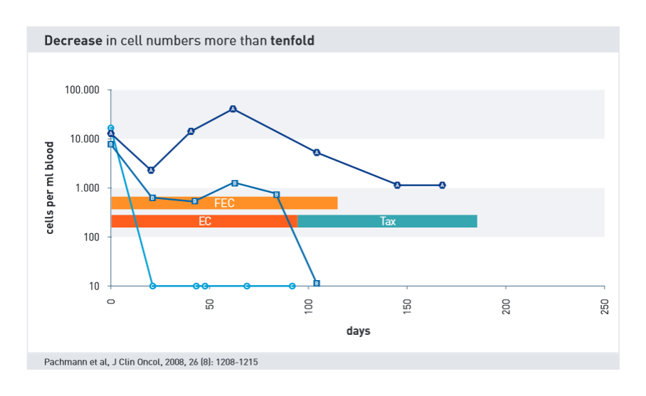
Decreasing Cell Numbers =
Good Prognosis

Slide 12
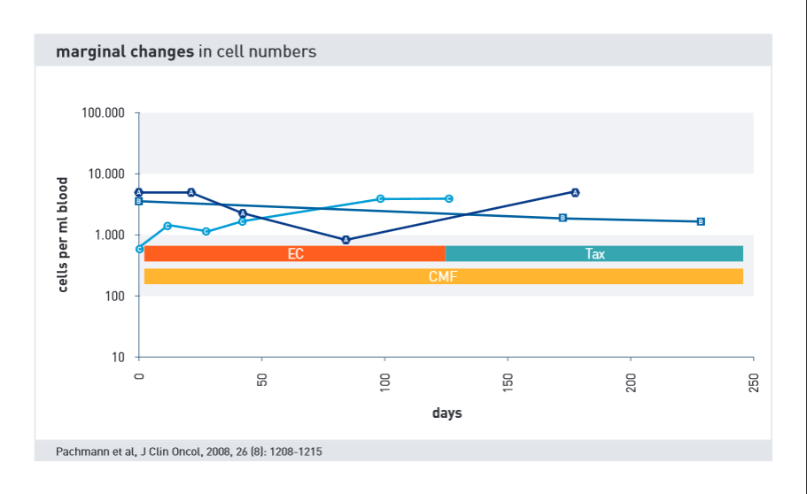
No Change =
Still Quite Good Prognosis

Slide 13
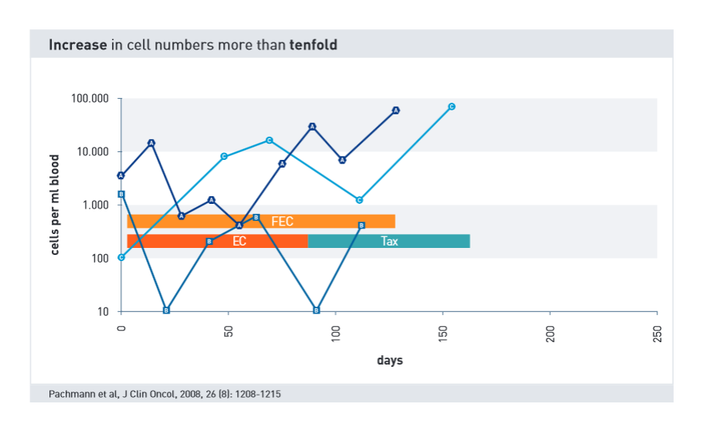
Increasing Cell Number =
Bad Prognosis

Slide 14
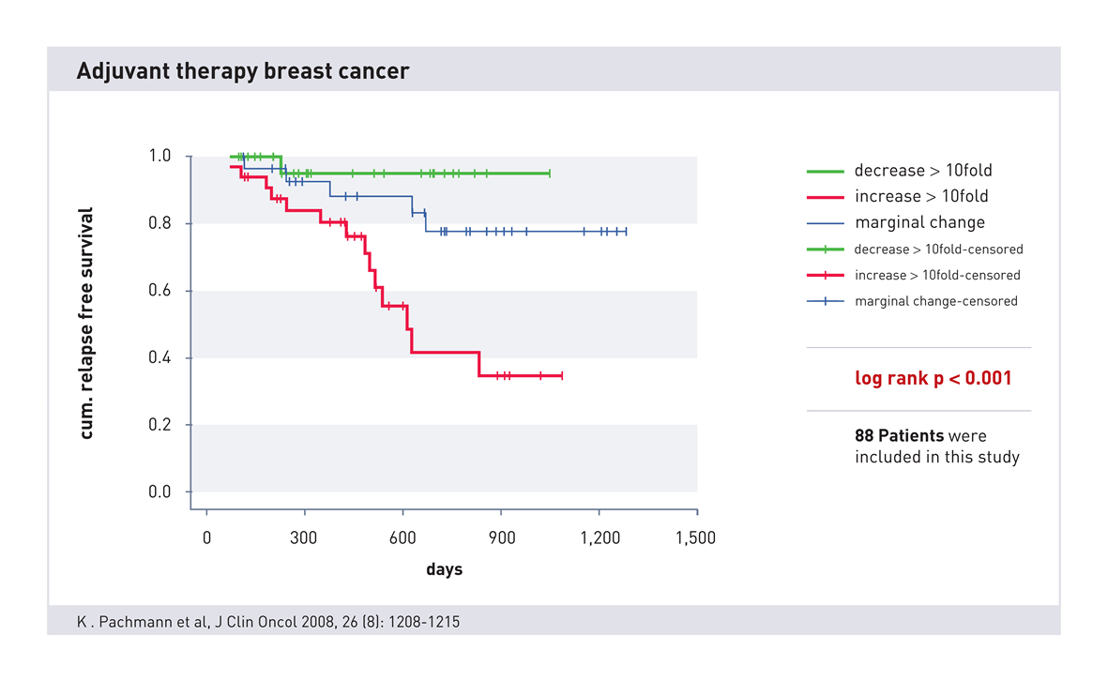
Success Control of Chemotherapy
Increasing
cell numbers correlate highly significant with
a poor prognosis

Slide 15
„Endocrine“ Guideline Situation
Maintenance (German Guideline):
  Monthly self examination of breast through patient
  1.-3. years every 3 month doctor
  4.-5. year half year doctor
  After 5. year yearly doctor
  Yearly mammography
  Early diagnosis potential curable situation
  X-ray of lung, skeletal-scintigraphy, liver ultra sound or tumour marker-diagnostics for patients without symptoms no advantage

Slide 16
General Principals of Adjuvant, Endocrine Therapy AGO ++ (02/2015)
Standard Therapy duration 5 years
Therapy duration up to 10 years after individual risk benefit evaluation especially in case of higher risk (i.e. N+)
Duration, choice & sequence of AI or Tam depending on menopause status and side effects
Change to different endocrine therapy (Tam or AI) is better than to stop
AI as first therapy especially for post menopausal pat. with high risk and lobular carcinoma
Up to date no evidence for AI > 5 years

Slide 17
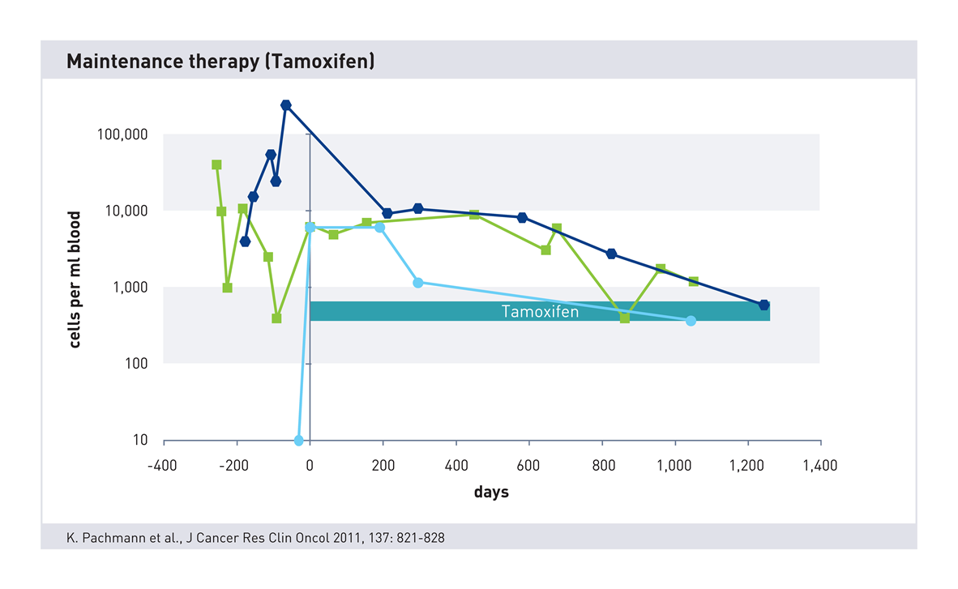
Maintenance Therapy under Tamoxifen
Continuous decrease
during Tamoxifen therapy
is a good sign for a long relapse free survival

Slide 18
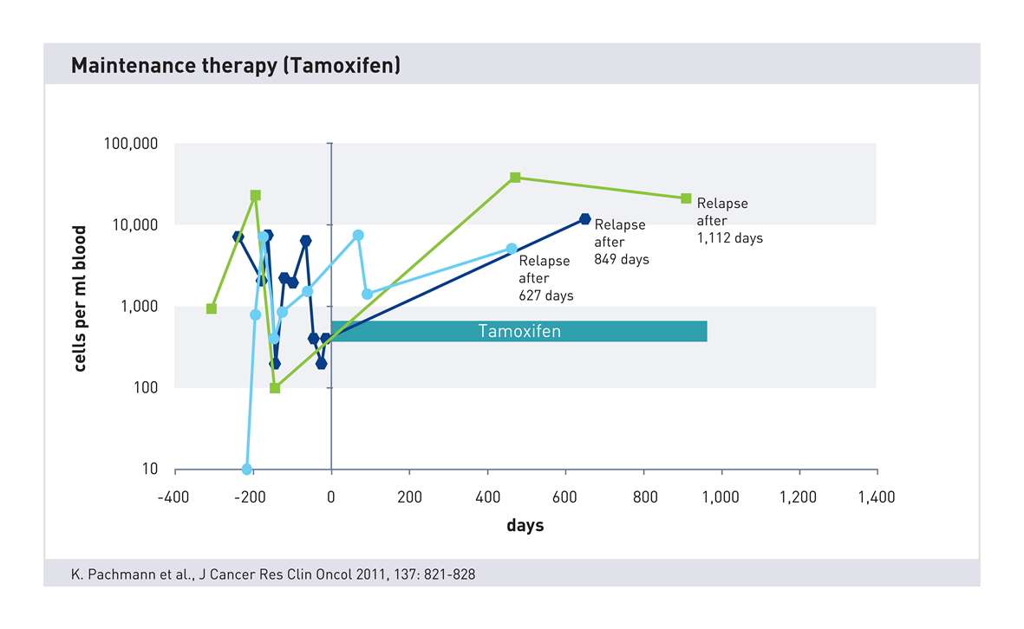
Maintenance Therapy
under Tamoxifen
Continuous increase
during Tamoxifen therapy
(often) leads
to relapse

Slide 19
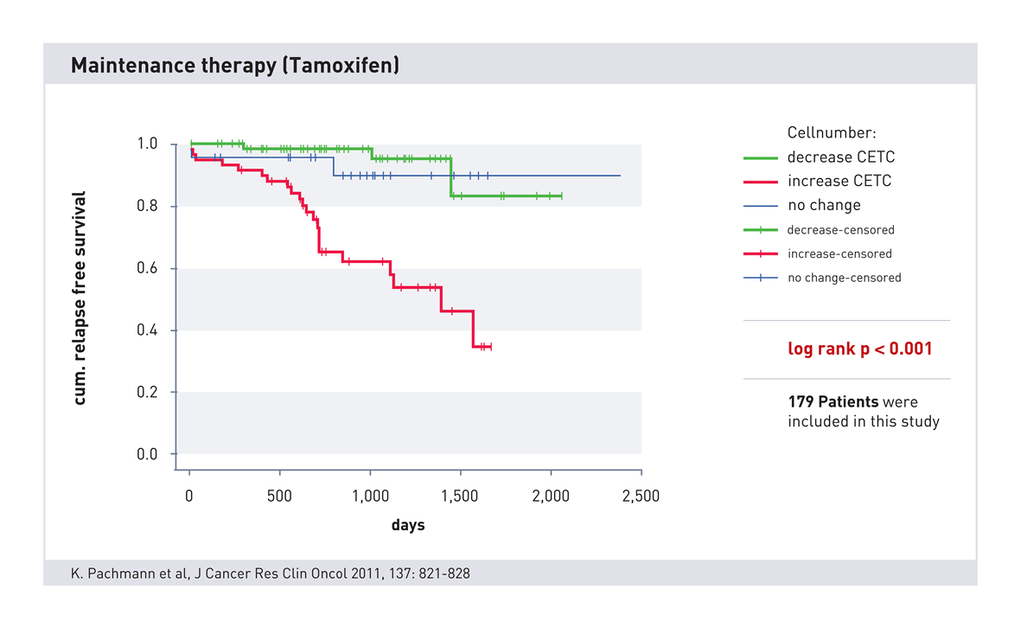
Outcome clinical trial
Notes:
No Change:
Keine Änderung während der Therapie = schlafende Zellen = Anstieg nach der Therapie

Slide 20
THERAPY CONTROL USING CIRCULATING TUMOR CELLS
Surveillance (end of anti-hormone therapy)
or how long to give Tamoxifen

Slide 21
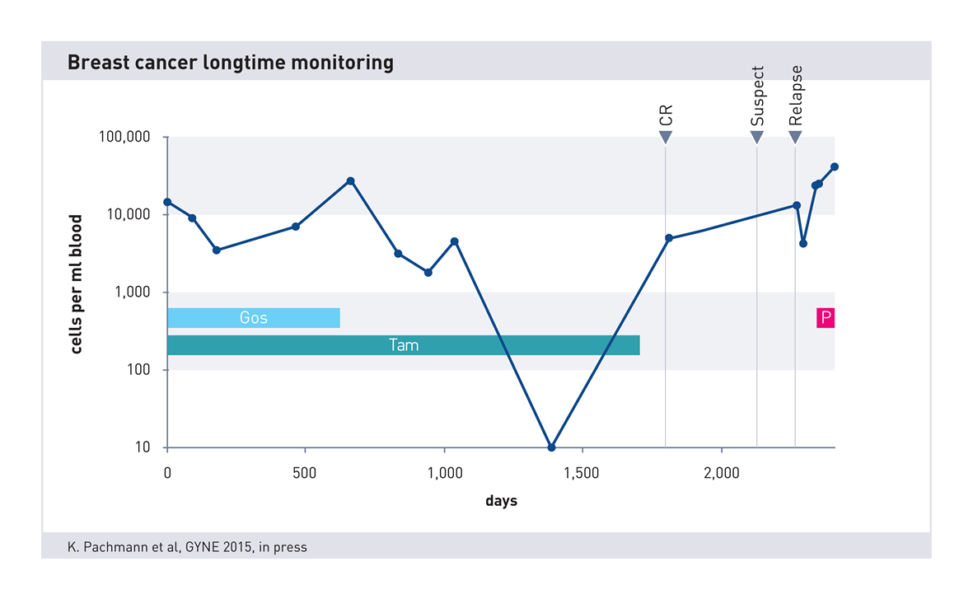
Longtime surveillance

Slide 22
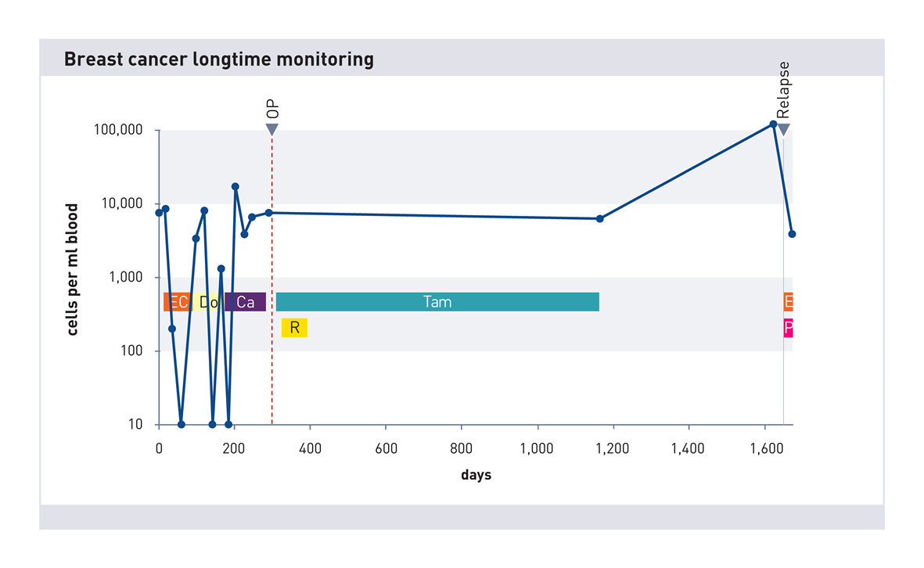
Longtime surveillance

Slide 23
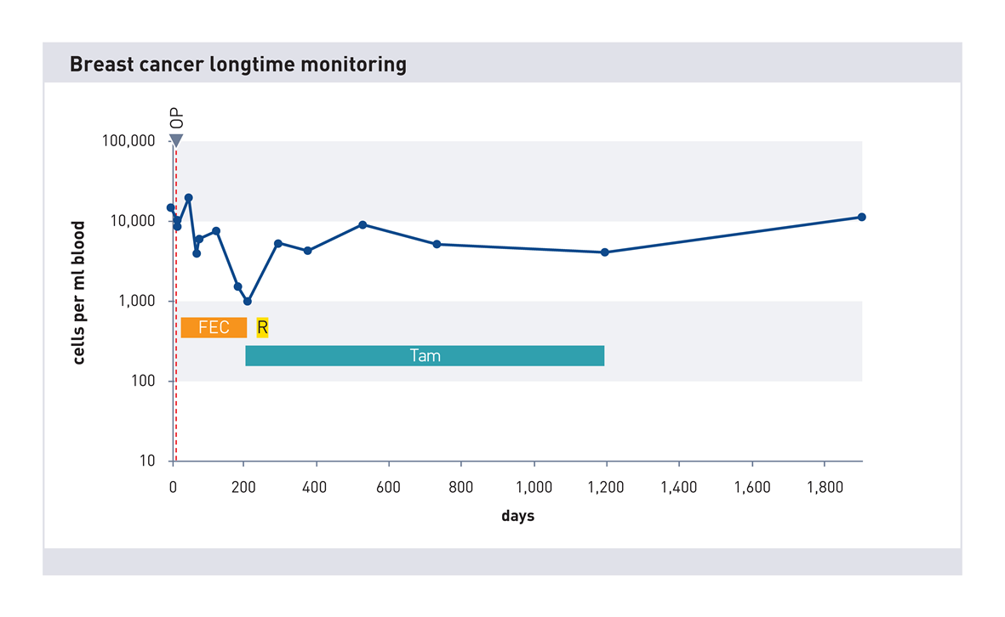
Longtime surveillance

Slide 24
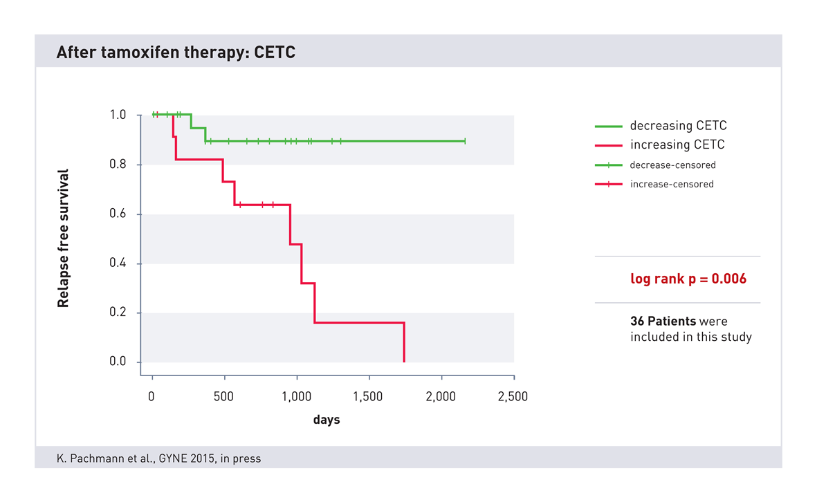
Tamoxifen: 5 or 10 years?

Slide 25
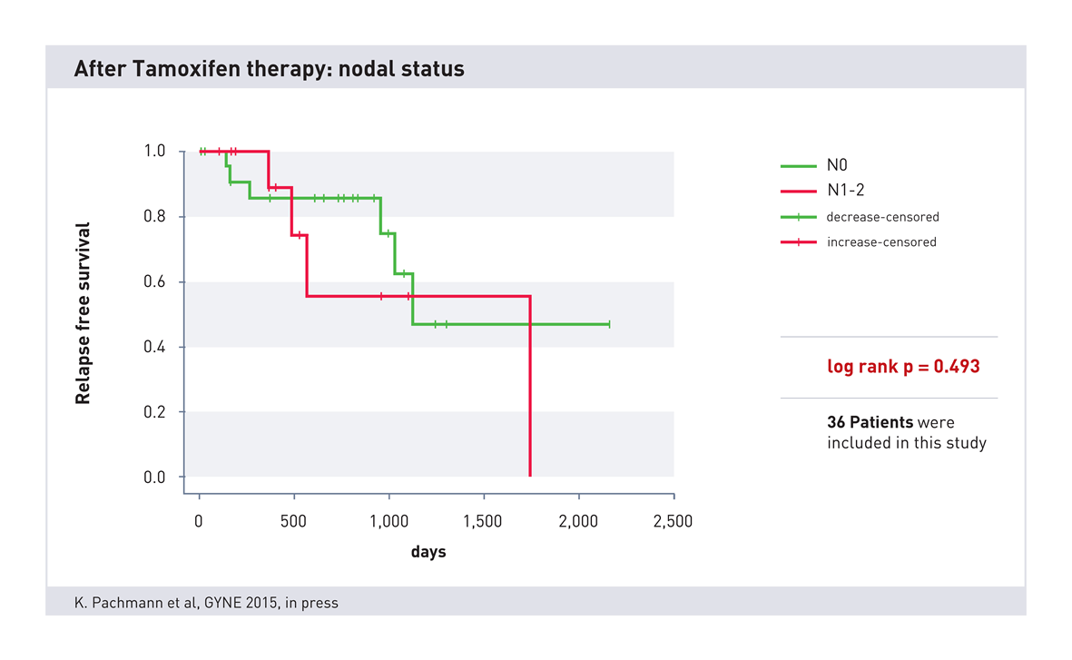
After Tamoxifen Therapy: Nodalstatus

Slide 26
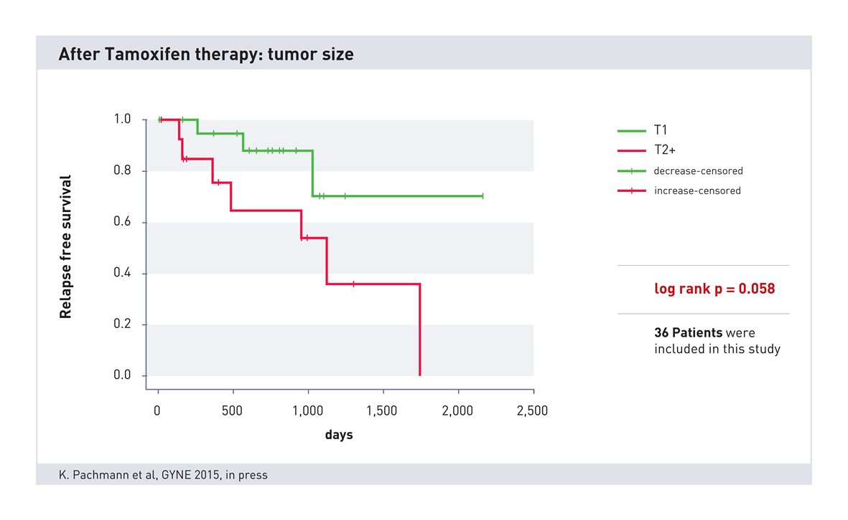
After Tamoxifen Therapy:
Tumor Size

Slide 27
End of therapy
During therapy and 4-6 weeks after end of therapy a measurement
Increase of cell number
Decrease/stable cell numbers
Go ahead with therapy
Restart therapy
After 3 month cell number determination
After 3-6 month cell number determination
If cell number increases,
restart anti-hormon therapy
Every 3-6 month cell number control

Slide 28
Chemosensitivity

Slide 29
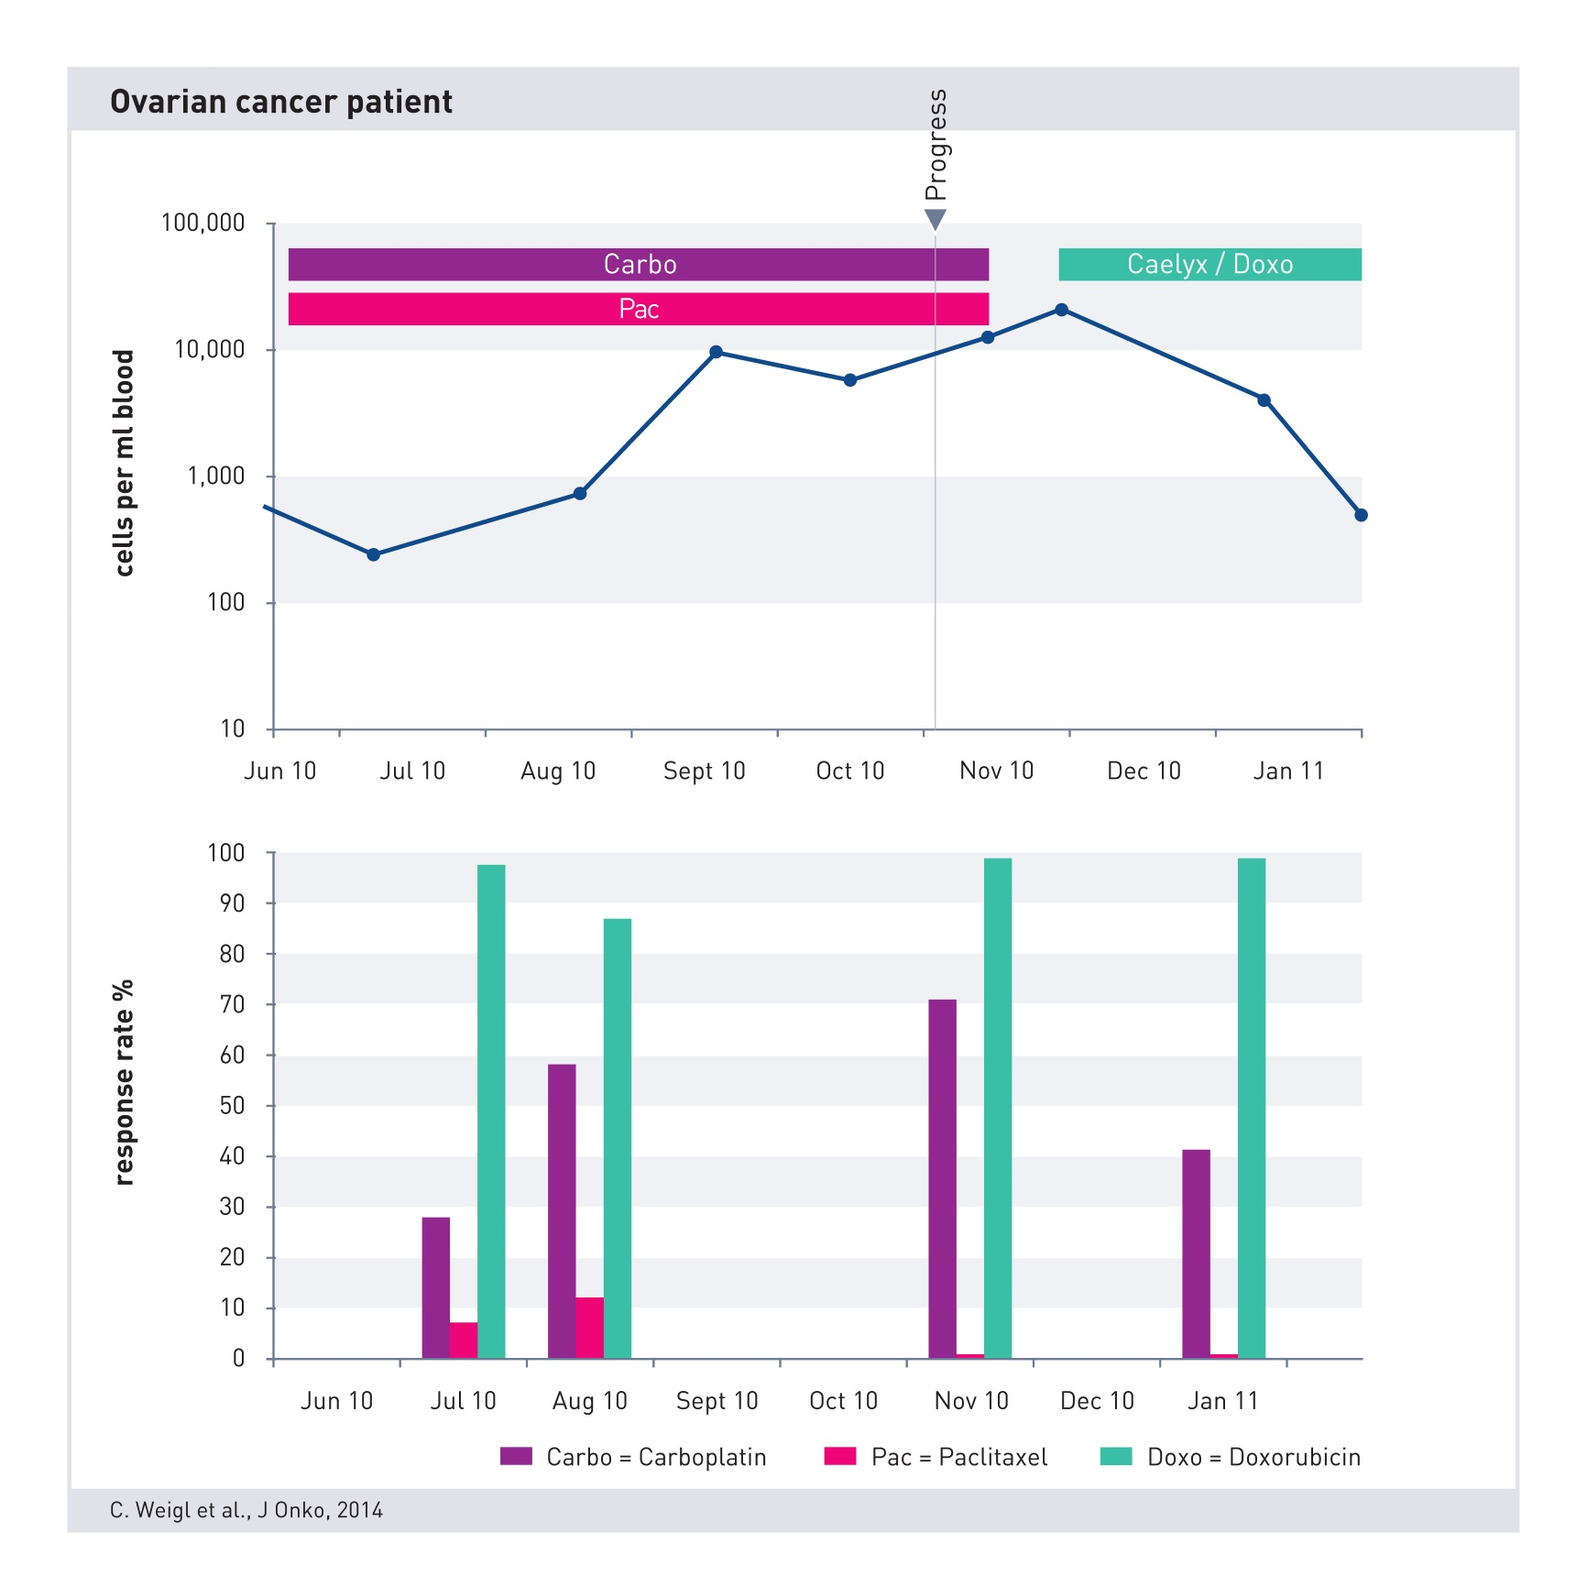
Ovarialkarzinom Patientin

Slide 30
Characterisation of CETCs

Slide 31



Large Range of Markers Can Be Tested
Estrogen receptor
Androgen receptor
Progesteron receptor
PSA/PSMA
FISH EGFR
…

Slide 32
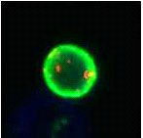
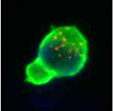
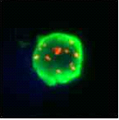
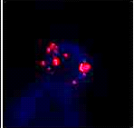
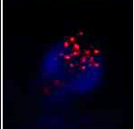
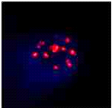
FISH test: HER2/neu
EpCAM positive cells with amplified signal of the Her2/neu genes

Slide 33
Other Diagnostic Methods

Slide 34
CETC/CTC
Maintrac®
Other CTC methods
Quantitative:
  no fixation!
  no isolation!
  no enrichment!
  No cell loss!!!
Living cells
High reproducibility
Therapy control (monitoring)
96 Well based → High throughput
Already used in clinical/all day routine (>100.000 tests)
>650 patients in clinical trials
Almost all methods use selection, fixation, isolation
→ loss of > 90% of CTCs
Measurement of dead cells
Not suitable for repeated measurement (no monitoring!)
No treatment control
All are still scientific methods
Most have no or insufficient clinical data

Slide 35
Maintrac® vs cfDNA/ctDNA
Maintrac®
cfDNA
Maintrac® measures the present tumor state
Quantitative measurement and monitoring
EpCam positive, epithelial cells are measured, covering almost all tumor cells
cfDNA measures only the past of the tumor (dead cells).
origin of DNA is unclear, no reference to actual present tumor cells
Difficult measurement technique
Only targeted genes are detected, missing of other yet unknown tumor mutations

Slide 36
Summary

Slide 37
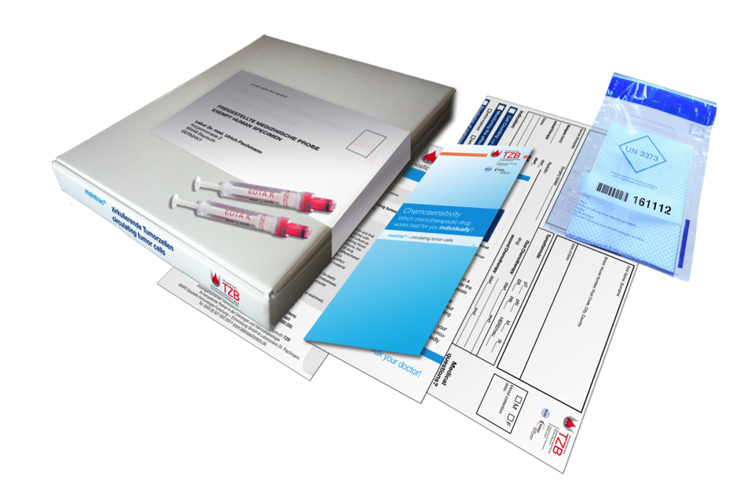
Blood Sample Transportation

Slide 38

Courier Shipment
Within 72 h
At room temperature
To our laboratory in Bayreuth, Germany
Medical result usually 4-5 days after sample arrival

Slide 39
Discussion
Epithelial cells are not necessarily tumor cells!
  Yes, but healthy epithelial cells are after a surgery/inflammation only for a short time in the blood stream; cancer cells remain however very long (up to 10 years)
  Increase by factor 5 or more is important, not from 900 to 1500!
Clinical data?
  >100.000 worldwide maintrac measurements
  650 patients in clinical studies published (80 % Breast cancer)
  Fluctuations observed when patient do not comply with maintenance therapy → restart of therapy very favourable (highly recommended!!)
  Testing of blood samples has no clinical or therapeutic relevance?
  → Change or ongoing medication is not relevant?

Slide 40
Thank you for your attention www.dmb-diagnostics.de

