Slide 1
TRANSFORMATION OF STEARIC ACID IN HYDROCARBONS OVER Pd/ZSM-5 CATALYSTS
MARTA ARROYO
Rey Juan Carlos University, Móstoles, Madrid (Spain)
Group of Chemical and Environmental Engineering.

Slide 2
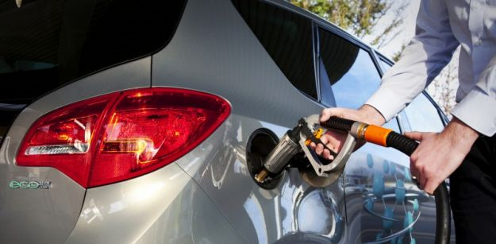
INTRODUCTION
Energy
Petroleum accounts for more than 95% of the energy demand for the transport sector.
10% renewable sources 2020
VEGETABLE OILS
TRANSESTERIFICATION:
Alkyl esteres
(Biodiesel)
High energy density
Structural similarity to petroleum-based fuels
CRACKING:
C₁-C₁₄
Alkenes/alkanes
CRACKING:
C₁-C₁₄
Alkenes/alkanes
Direct use
C₁₂-C₁₈
n-Alkanes
DEOYGENATION:
C₁₂-C₁₈
n-Alkanes
DEOXYGENATION:
Engine compatibility problems

Slide 3
INTRODUCTION
FCC catalysts (zeolites and mesopores aluminosilicates)
High temperatures 400-600ºC
Alkanes, alkenes are generated
CRACKING REACTIONS
DECARBOXYLATION
    R-COOH → R-H + CO₂
DECARBONYLATION
R-COOH + H₂→ R-H+ CO₊ H₂O R-COOH → R’-H+ CO+H₂O
HYDRODEOXYGENATION
    R-COOH+ 3H₂ → R-CH₃+H₂O
DEOXYGENATION REACTIONS
Alkenes, alkanes with the same carbons atoms or one less than the feed acid.
Noble metals are use like catalysts supported over zeolites, oxides and carbons

Slide 4
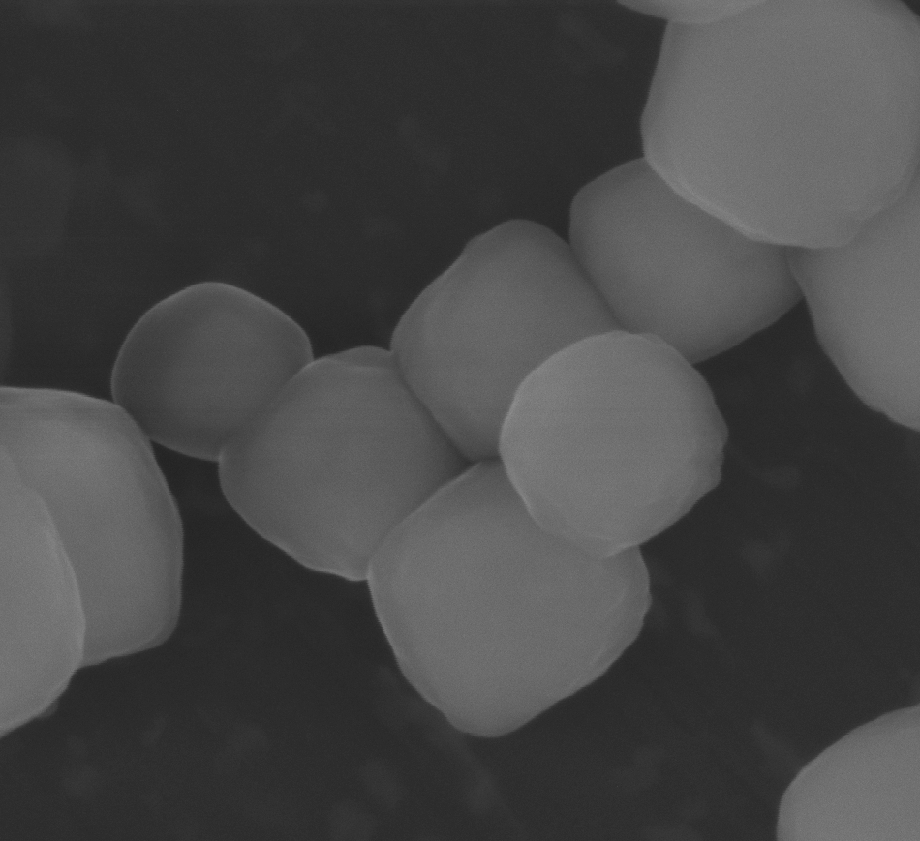
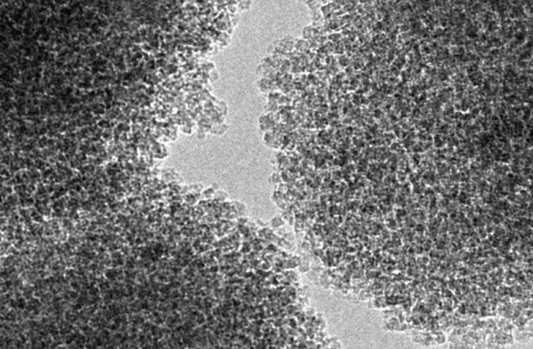
INTRODUCTION
Zeolitic materials
Crystallinity
Uniform microporosity
Strong acidity
Shape selectivity
METAL
Diffusional and steric limitations
in reactions involving bulky substrates
Hierarchical zeolites
- Secondary mesoporosity
- Improvement of the accessibility
BIFUNCTIONAL CATALYST
Acid+metal sites
Reduction of the stearic limitations
Increase in the rate of intracrystalline difusion
Decrease in the deactivating effect of coke

Slide 5
EXPERIMENTAL PROCEDURE
Crystallization of protozeolitic silanized units method
Water
Source of silica (TEOS)
Source of aluminium (AIP)
Structure-directing agent (TPAOH)
Centrifugation
Drying
Calcination
(550ºC 1.8º/min)
Silanization agent
8%
Removal
of alcohol
Ageing
Precrystallization
Silanization
7 d
170 ºC
P_{autogenous}
48 h
Room
temperature
20 h
90 ºC
Reflux
P_{atm}
6 h
90 ºC
Reflux
P_{atm}

Slide 6
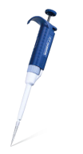

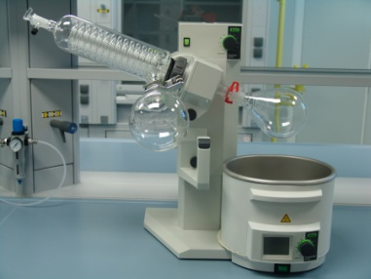
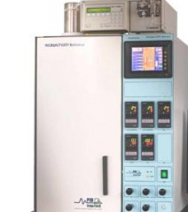
EXPERIMENTAL PROCEDURE
Incipient wetness technique
Aqueous PdCl₂ solution
(1 wt% in the final catalyst)
Sonication for 30’
Solid support was outgassed in a rotavapor under vacuum
Rotation under vacuum for 5h
Catalyst activated by hydrogen reduction
Drying
Calcination
(550ºC, 20ºC/min)
H₂ → 30 ml/min
Tº = 450 ºC
2ºC/min

Slide 7
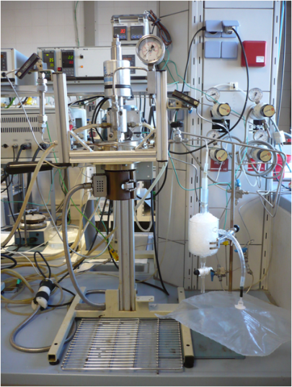
EXPERIMENTAL PROCEDURE
FEED: 10% Stearic acid/n-dodecane
Catalyst: Palladium based ones supported over commercial and hierarchical ZSM-5
Temperature: Variable range 275-325ºC
Atmosfere: 6 bar N₂ or H₂
Time reaction: 3 hours
Products : GASES + LIQUID
Gas chromatography

Slide 8
Characterization:
EXPERIMENTAL PROCEDURE
X-ray diffraction
ICP-AES
Adsorption isotherms at 87 K
Ammonia temperature-programmed desorption
Transmission electron micrographs
Materials:
Pd/c-ZSM-5
Pd/h-ZSM-5 → different Si/Al atomic ratio

Slide 9
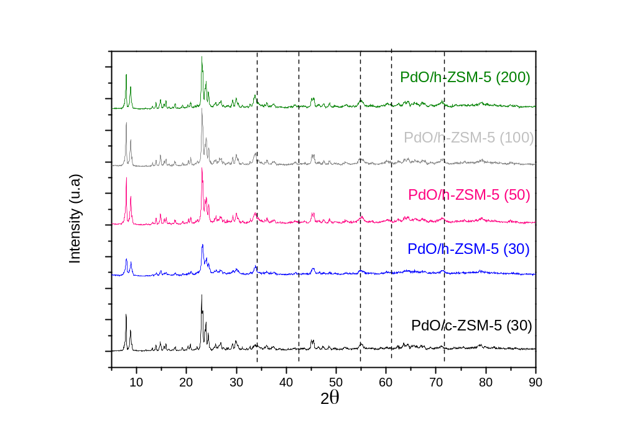
CHARCTERIZATION
OF MATERIALS
XRD
MFI patterns
PdO reflexion main → 34º

Slide 10
CHARCTERIZATION
OF THE CATALYST
TEXTURAL PROPERTIES
 | S_{BET} (m² g⁻¹) | V_{TOTAL} (cm³ g⁻¹) | V_{MP} ª (cm³ g⁻¹) | Si/Al ^{b} | Pd ^{b} (wt %) | T_{MAX} ^{c} (ºC) | Acidity ^{c} (mmol NH₃ g⁻¹)
Pd/c-ZSM-5 (30) | 377 | 0.434 | 0.171 | 32 | 0.84 | 330 | 0.345
Pd/h-ZSM-5 (30) | 477 | 0.497 | 0.130 | 33 | 0.96 | 340 | 0.305
Pd/h-ZSM-5 (50) | 479 | 0.471 | 0.157 | 51 | 0.91 | 340 | 0.242
Pd/h-ZSM-5 (100) | 486 | 0.557 | 0.165 | 122 | 0.94 | 332 | 0.122
Pd/h-ZSM-5 (200) | 467 | 0.521 | 0.172 | 269 | 0.94 | 275 | 0.078
a. Volume of zeolitic micropores (0-7 Å); b. Determinated by ICP analysis; c. Determinated by TPD

Slide 11
CHARCTERIZATION
OF MATERIALS
TEM IMAGES
Pd/c-ZSM-5 (30)
Pd/h-ZSM-5 (30)
200 nm
200 nm
Pd/h-ZSM-5(50)
Pd/h-ZSM-5(100)
200 nm
200 nm

Slide 12
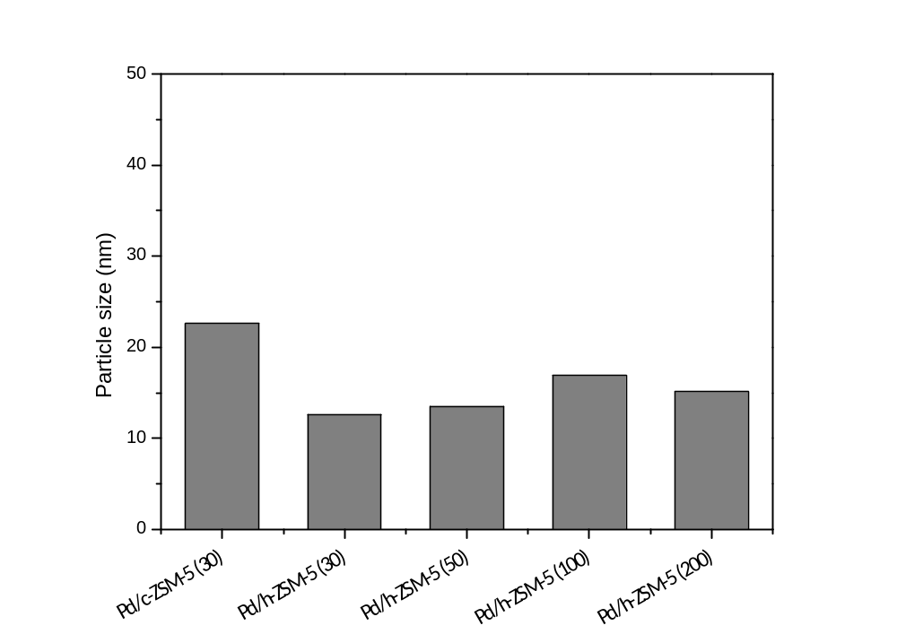
CHARCTERIZATION
OF MATERIALS
TEM IMAGES
Pd/h-ZSM-5(200)
Pd/h-ZSM-5(200)
200 nm
Pd/c-ZSM-5 (30) → Larger palladium particles due to the lower BET surface area and microporosity, 23 nm
Hierarchical zeolites →palladium particle size between 13-17 nm

Slide 13
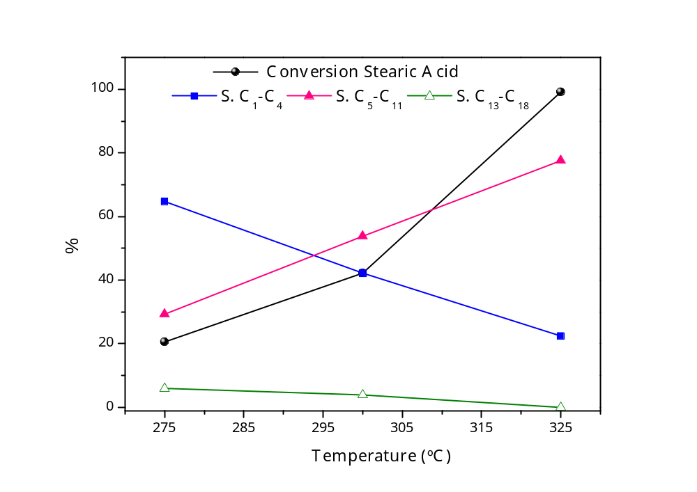
REACTION RESULTS
TEMPERATURE INFLUENCE OVER Pd/c-ZSM-5 (30)
Conversion increase with the temperature
High selectivity to gases products at 275ºC
The selectivity to C₅-C₁₁ increase with higher temperatures
Bencene, toluene and xylene weren’t detected and oxygen was remove like CO₂ mainly.
3 Horus, 6 N₂ bar, Pd/c-ZSM-5 (30), amount 0,8 g

Slide 14
REACTION RESULTS
HIERARCHICAL POROSITY INFLUENCE
Catalyst | Conversion (%) | S.(%) C₁-C₄ | S.(%) C₅-C₁₁ | S.(%) C₁₃-C₁₈
Pd/c-ZSM-5 (30) | 33 | 29,9 | 53,9 | 16,2
Pd/h-ZSM-5 (30) | 67 | 15,1 | 70,6 | 14,3
3 hours, 6 N₂ bar, Pd/ZSM-5 (30) amount 0,4 g
Hierarchical material → higher stearic acid conversion and improved selectivity to C₅-C₁₁ compounds due to the higher accesibility to the acids sites and the better dispersion of the palladium particles.

Slide 15
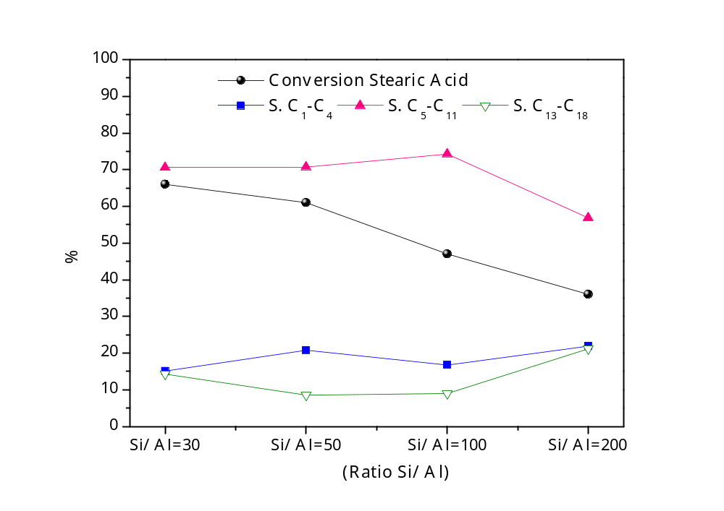
REACTION RESULTS
RATIO Si/Al INFLUENCE
Conversion decreases on increasing the Si/Al atomic ratio of the catalyst
Similar selectivities for Si/Al =30-100
Gases: 15-21wt %
Gasoline : 70-75%
Diesel: 8-15%
3 Horus, 6 N₂ bar, Pd/h-ZSM-5, amount 0,4 g

Slide 16
Transformation of stearic acid over Pd/ZSM-5 in presence of N₂
High selectivity to C₅-C₁₁ products due to cracking reactions
Products derivated from descarboxylation and decarbonylation weren’t detected
H₂ has been generally observed to promote the reaction

Slide 17
REACTION RESULTS
ATMOSPHERE INFLUENCE
 | Nitrogen | Hydrogen
Conversion Stearic acid (%) | 47 | 89
S. (%) C₁-C₄ | 23,2 | 4,5
S. (%) C₅-C₁₁ | 68,5 | 69,2
S. (%) C₁₇ | 0,0 | 18,0
S. (%) C₁₈ | 0,0 | 4,3
S. (%) others C₁₃-C₁₈ | 8,3 | 3,4
3 Horus, 6 N₂ bar, Pd/h-ZSM-5 (100), amount 0,4 g
Conversion incrases in presence of hydrogen → favours the contact between feed and metal sites.
Selectivity increases to descarboxylation/decarbonylation and HDO reactions
Selectivity cracking reactions is disminished

Slide 18
CONCLUSIONS
CONCLUSIONS
The transformation of stearic acid in presence of inert atmosphere allow to obtain high conversion with high selectivity to hydrocarbons in the gasoline range
The presence of secondary porosity in the ZSM-5 materials improves the catalyst properties allowing better dispersion of the palladium particles and enhances catalytic activity.
The presence of hydrogen involve higher conversion and promove the desoxygenation reactions via descarboxylation/decarbonylation and hydrodeoxygenation

Slide 19
CONCLUSIONS
THANK YOU FOR YOUR ATTENTION
Thank
D.P. Serrano
J.M. Escola

