Slide 1
Breast MRI in Radiation Therapy Planning
Marsha Haley, M.D.
Assistant Professor
University of Pittsburgh Cancer Institute
Pittsburgh, Pennsylvania, USA
August 25th, 2015

Slide 2
Outline
Diagnostic MRI in breast cancer
Radiation therapy for breast cancer
Consistency in delineation
CT vs. MRI-based treatment planning
Case studies

Slide 3
Diagnostic MRI in Breast Cancer
American College of Radiology Practice Parameters
  Screening
    High-Risk Patients
    Augmentation history
  Extent of Disease
    Relationship to fascia
    Pre- and Post-chemotherapy
  Additional evaluation of clinical or imaging findings

Slide 4
Radiation Therapy for Breast Cancer
Indications
  After breast conserving surgery (lumpectomy and lymph node assessment)
  2. After mastectomy and lymph node assessment

Slide 5
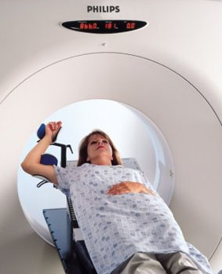
Radiation Therapy for Breast Cancer
Process
  Simulation
    CT-based
  Computer planning
  Radiotherapy treatment
    Typically 5 days per week for 4-6 weeks

Slide 6
Importance of Accurate Delineation
Clinical Data Regarding Breast Cancer:
  Treatment Outcomes
  Importance of local control
  Importance of adequate field design
Adjuvant radiation therapy with an optimal Biological Equivalent Dose and Target Volume is associated with a statistically significant improvement in survival
Lancet 366:2087-2106, 2005
Gebski V., et al. JNCI 98(1):26-38; 2006

Slide 7
Consistency in Definition
Clinical exam
Ultrasound
Surgical clips
CT planning
Glandular breast tissue
Lumpectomy cavity

Slide 8
Consistency in Definition
33 patients with lumpectomy cavities defined by treating radiation oncologist.
Three other breast radiation oncologists redefined the cavity independently
Even among radiation oncologists who specialize in breast radiotherapy, there can be substantial differences in delineation of the post-surgical radiotherapy target volume
Landis D.M., et al. Int J Radiat Biol Phys 67(5):1299-1308, 2007

Slide 9
MRI-based Treatment Planning
Advantages
  Superior anatomic delineation of soft tissue structures
  Fibroglandular breast tissue and fascial planes are well-visualized
  Brachial plexus seen on coronal and sagittal views
  Improved imaging detail for lymph nodes
Taylor, M. 2009. Use of MRI in Breast CancerTreatment Planning. Washington University, St. Louis.
Gregoire V., et al. 2004. Clinical Target Volumes in Conformal and Intensity Modulated Radiation Therapy. Berlin Heidelberg: Springer-Verlag.

Slide 10
CT vs. MRI Planning
14 patients with dense breasts
  Prone position
  Large-bore CT
  3-T large-bore MRI
MRI substantially improved the visibility and accuracy of lumpectomy cavity definition as compared with CT
Huang et al. Oncology Apr 2015; vol 29 (issue 4 Suppl 1)

Slide 11
CT vs. MRI Planning
23 patients were scanned with CT and open MR (no contrast)
Studies were independently contoured by a senior radiologist
CT – tumor bed was missed in 6/23 cases
MR – tumor bed was missed in 0/23 cases
Sabine B., et al. Int J Radiat Oncol Biol Phys 63(2 Suppl):S232-233, 2005

Slide 12
CT vs. MRI Planning
29 patients were scanned with CT and open MR (no contrast)
7 had repeat CT and MRI performed at the time of boost planning
T2 images provided the best cavity visualization score, better demarcated the interface between seroma and chest wall, seroma and skin, and distinguished between seroma and dense breast parenchyma
Jacobson et al. 2011. International Journal of Breast Cancer Volume 2011, Article ID 246265.

Slide 13
Barriers to MRI Planning
Lack of access
Cost
Lack of data
Patient positioning/high BMI
Soft tissue deformation
Extra time for scan vs. CT
Jacobson et al. 2011. International Journal of Breast Cancer Volume 2011, Article ID 246265.

Slide 14
Case #1
40 year-old woman
T1N0 ER/PR + ductal cancer right breast
Right 10:00 lumpectomy
CT revealed dense breast tissue with difficulty visualizing the lumpectomy cavity
MRI T2 sequence clarified cavity

Slide 15
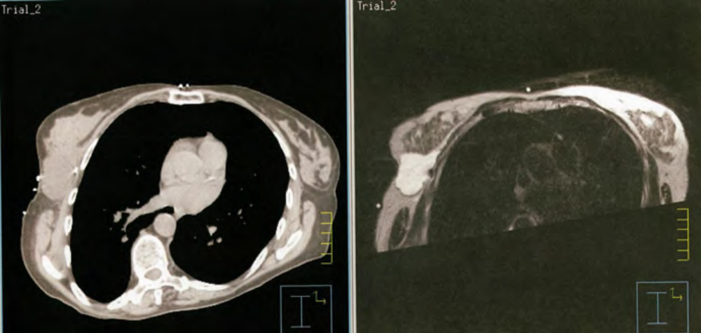
CT vs. MRI Planning

Slide 16
Case #2
32 year-old woman
T2N0 ER/PR + ductal cancer right breast
Neoadjuvant chemo
Right 11:00 lumpectomy with sentinel lymph node biopsy
Difficulty distinguishing tumor bed

Slide 17
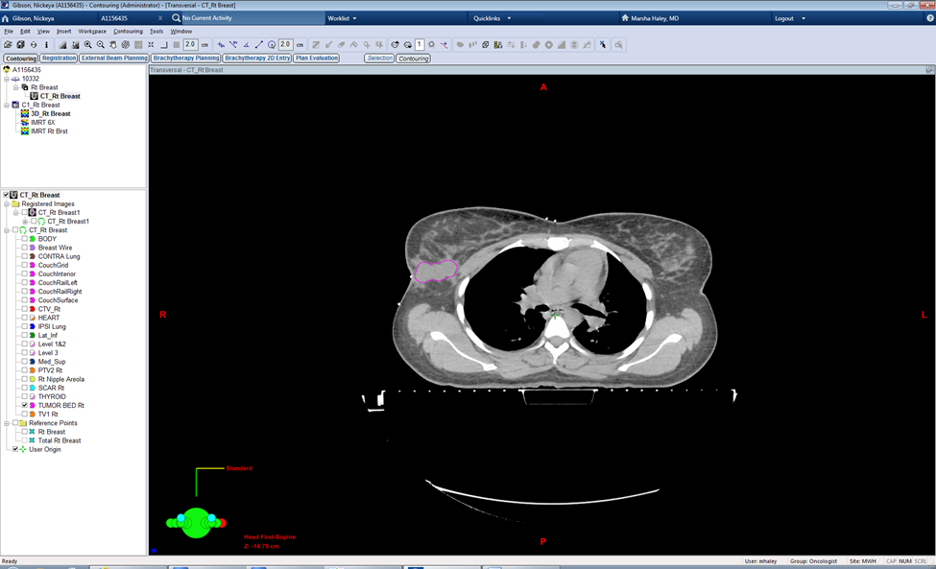
CT Plan

Slide 18
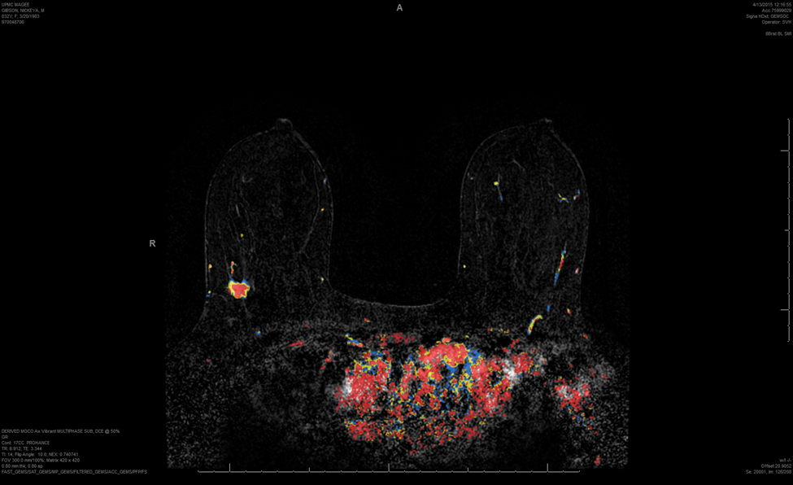
Preop MRI

Slide 19
Thank you!
Questions

