Slide 1
Characterization of inflammation and immune cell modulation induced by low-dose LPS administration to healthy volunteers
M.R. Dillingh¹, E.P. van Poelgeest¹, K.E. Malone², E.M. Kemper³, E.S.G. Stroes³, M. Moerland¹, J. Burggraaf¹
¹Centre for Human Drug Research, Leiden, The Netherlands
²Good Biomarker Sciences, Leiden, The Netherlands
³Amsterdam Medical Center, Amsterdam. The Netherlands

Slide 2
Human endotoxin model – introduction
A model of systemic inflammation
  Flu-like symptoms
  ↑ CRP production
  ↑ Concentrations pro- and anti-inflammatory cytokines
Administration of purified LPS (endotoxin) from E. coli or other Gram-negative bacteria
E. coli: high reproducibility of effects (Andreasen et al.)
High LPS doses, not preferred
  Potential effects of immune-modulating interventions might not be observed
  Not free of risk for the volunteer (a.o. cardiovascular)
  Other homeostatic mechanisms may be temporarily impaired

Slide 3
LPS hyporesponsiveness
Follows upon in vivo LPS challenge
  Altered cytokine production
  ↓ Inflammatory response following LPS rechallenge
Many negative regulators (e.g. SOCS-1, IRAK-M, and SHIP) of the TLR4 signaling pathway (Fu et al. 2012, Morris et al. 2011)

Slide 4
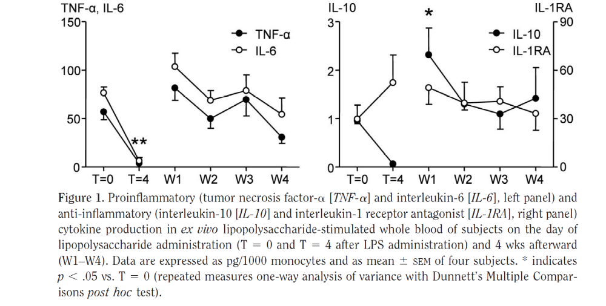
LPS hyporesponsiveness – Kox et al. 2011
pg/1000 monocytes, n=4
T=0: in vivo challenge
T=4hrs and 4 wks: ex vivo challenge
Ex vivo LPS hyporesponsiveness
  Resolved 1 week after in vivo LPS challenge
  Exact time course unclear
  Possible differences between read-outs

Slide 5
Study objectives
To assess the relationship between administration of low doses of LPS (0.5, 1 and 2 ng/kg) and the inflammatory response (cytokine levels and CRP) in healthy male volunteers
To assess the duration of hyporesponsiveness of the immune system after in vivo LPS administration, as determined by ex vivo LPS challenges

Slide 6
Study outline (1)
Randomized, blinded, placebo controlled, sequential-group study
24 healthy male subjects
  3 cohorts (active-pl: 6-2)
Ascending single iv doses of 0.5-2ng/kg LPS
  U.S. Reference E. Coli endotoxin Lot#3 (O113:H, 10:K negative, ~10IE/ng)
IV hydration
  Pre-hydration 2hrs pre-dose: 1500mL glucose/saline
  Hydration 6hrs post-dose: 150mL/hr

Slide 7
Study outline (2)
Inflammatory response, in vivo
  CRP
  IL-1β, IL-6, IL-8 and TNF-α (human 4-plex, MSD)
Inflammatory response, ex vivo
  Whole blood cultures with LPS (E. Coli, O111:B4, ~10IE/ng)
    24 hrs incubation at 37°C, 5% CO₂
  -2hrs, 6, 12, 24, 48 and 72hrs
  IL-1β, IL-6, IL-8 and TNF-α (human 4-plex, MSD)
Safety
  AEs / vital signs / ECG / routine labs

Slide 8
Study results – Safety
Well tolerated, no clinically relevant changes or unexpected treatment-related trends in
  Urinary or blood laboratory parameters
  ECG recordings
  Vital signs
  AEs: mild severity and self-limiting
Most frequent reported AEs
  Headache; 66.7% of the LPS-treated subjects, 33.3% of the placebo-treated subjects
  Feeling cold; 44.4% of the LPS-treated subjects, none of the placebo-treated subjects

Slide 9
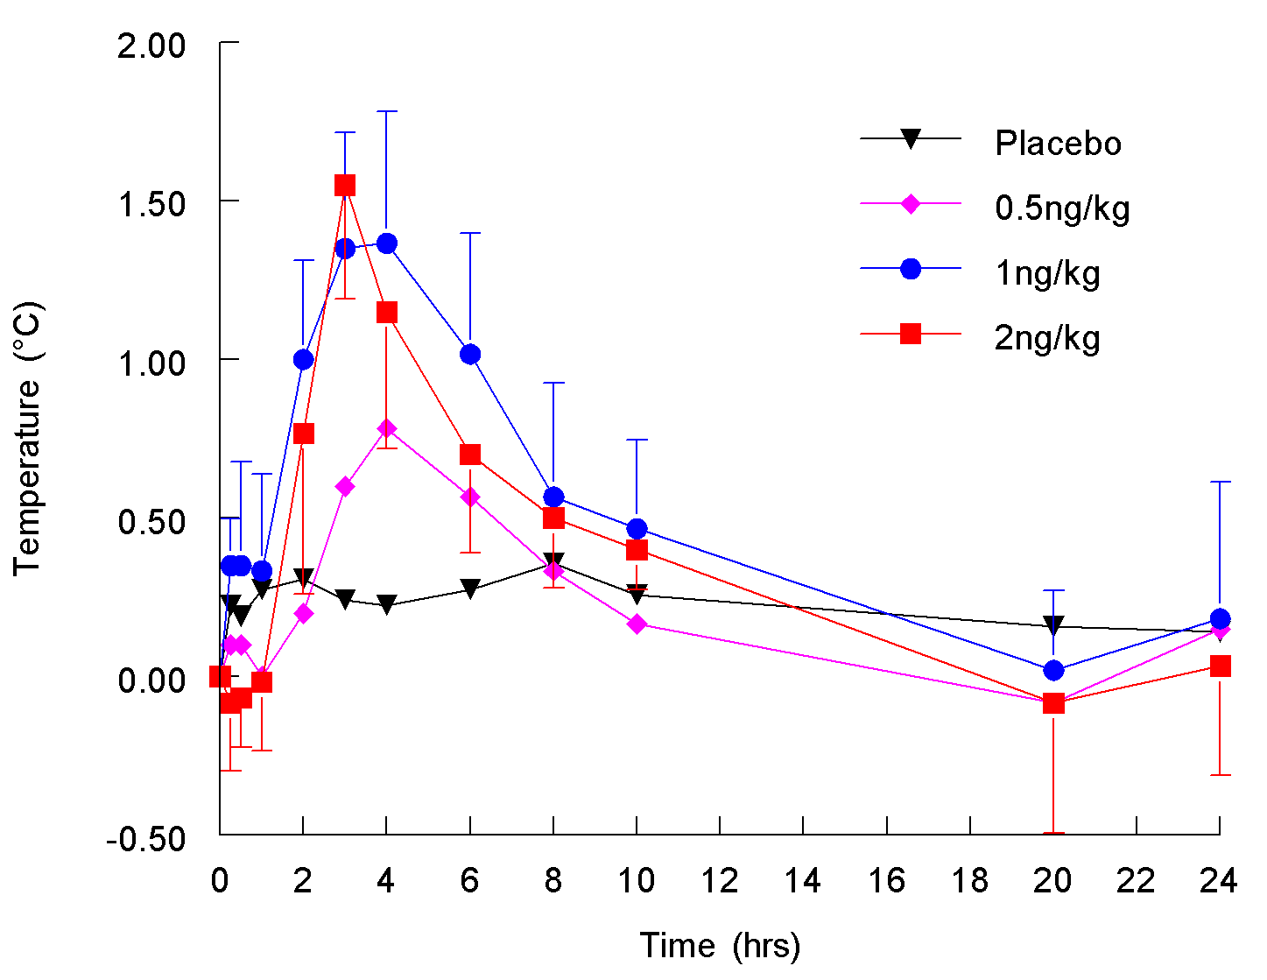
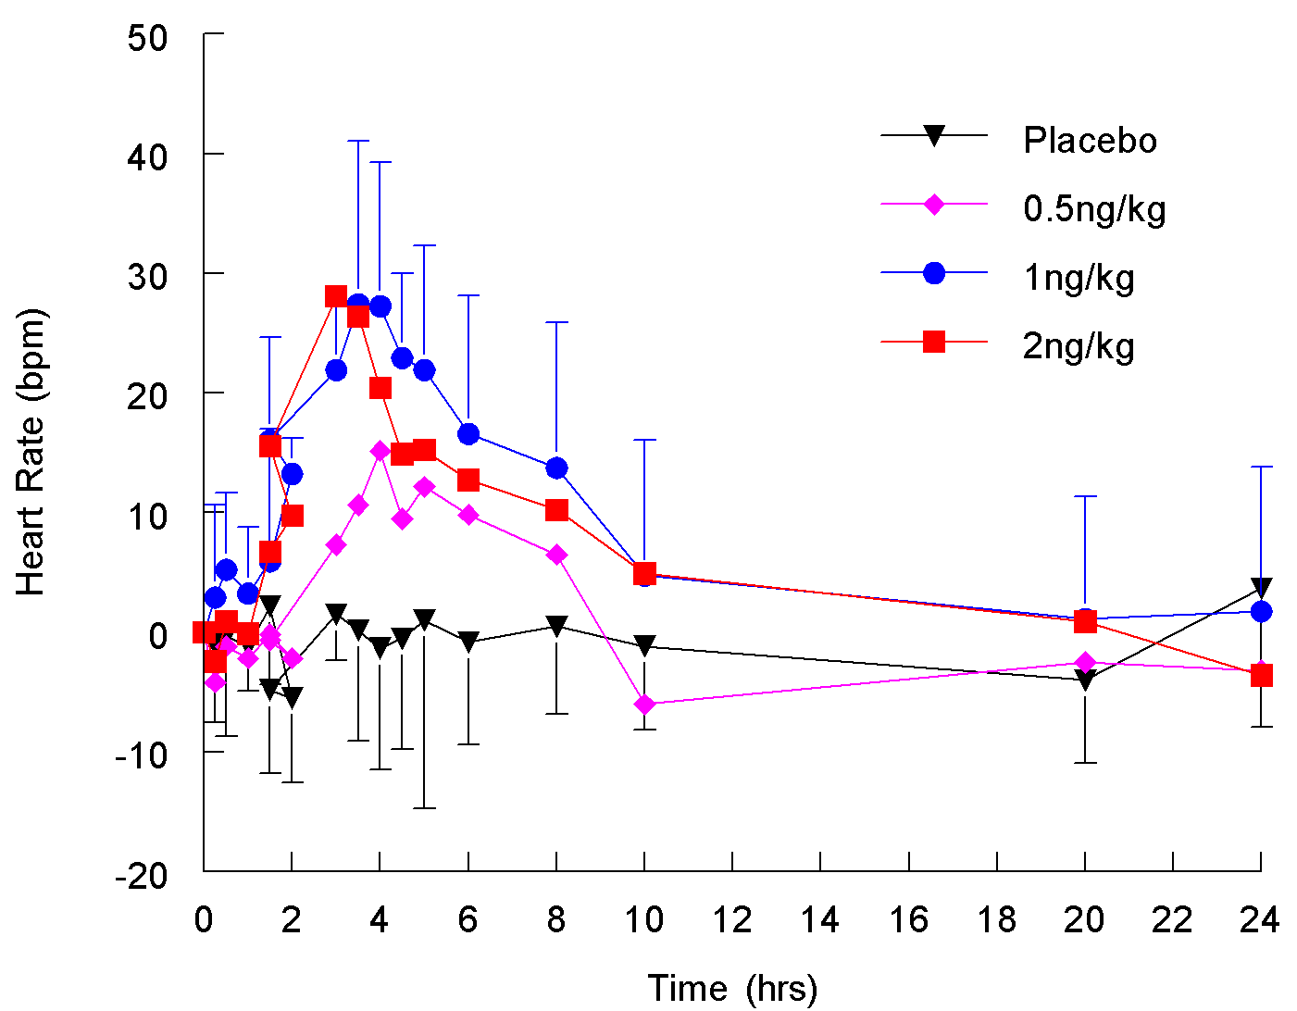
Study results – Safety – Temperature and HR
BP highly variable over time, max. mean decreases in the range of 0 to -13 mmHg

Slide 10
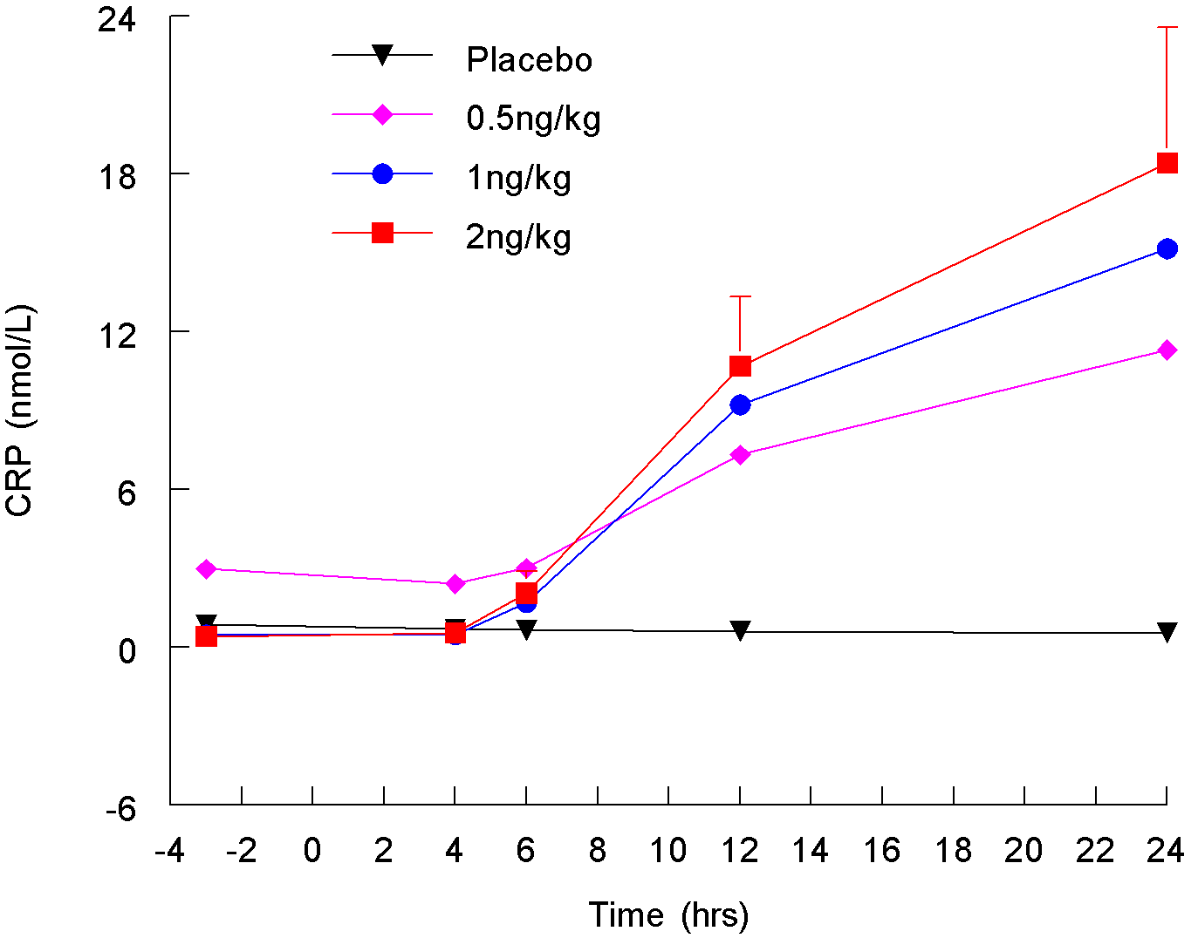
Study results – In vivo CRP
Statistical analysis
  Significant contrasts, dose groups (0.5, 1, 2ng/kg) vs pl: p<0.0001

Slide 11
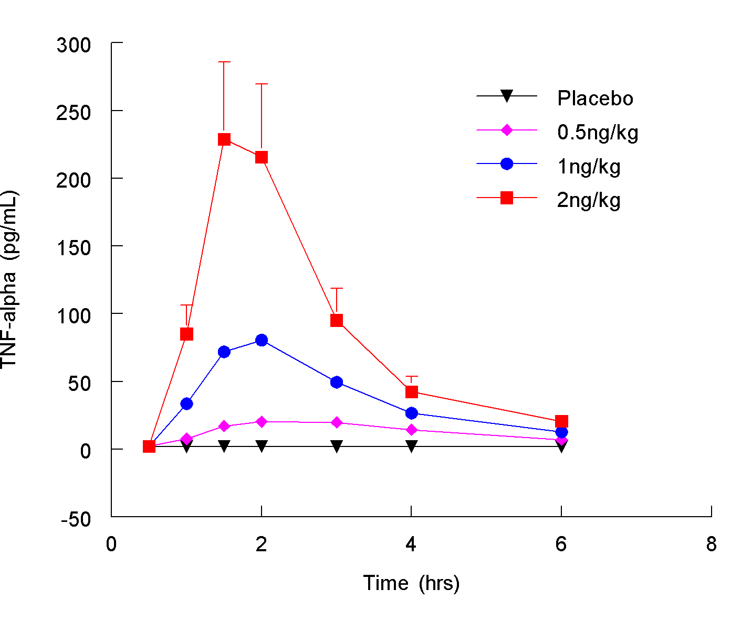
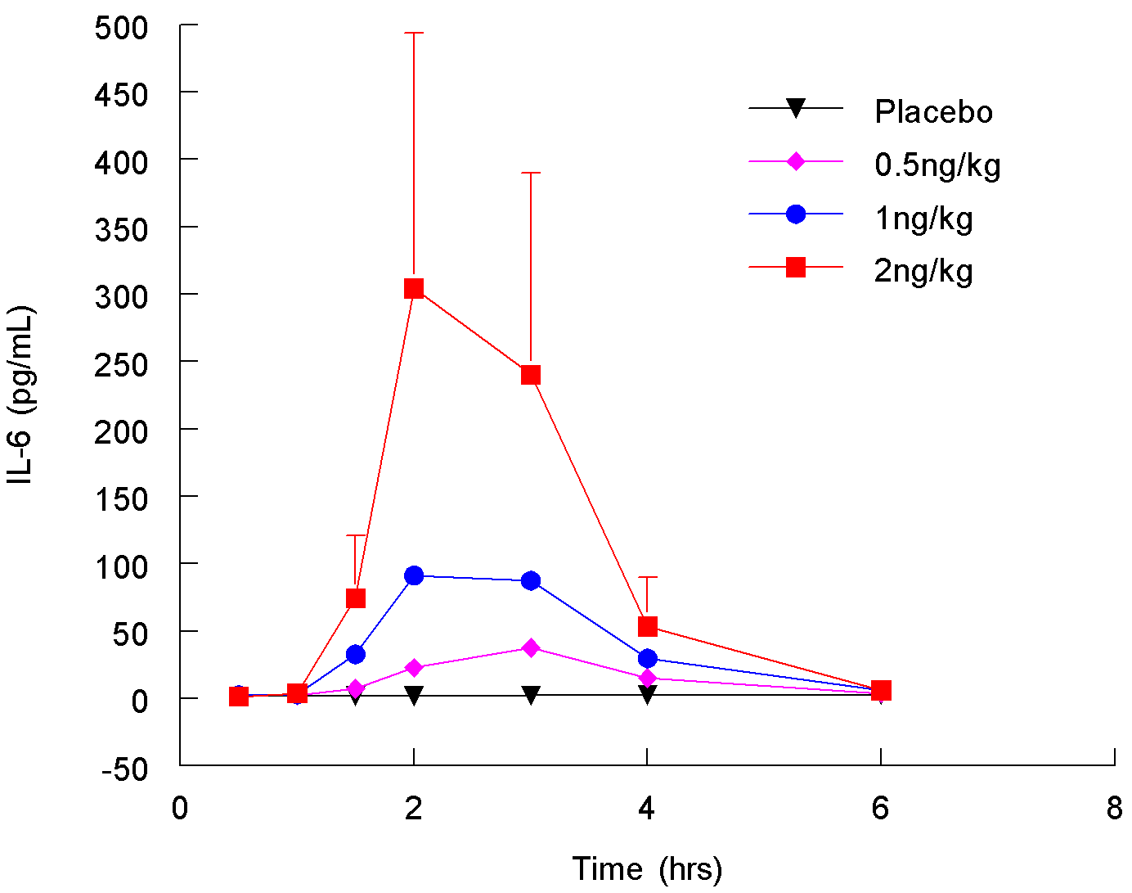
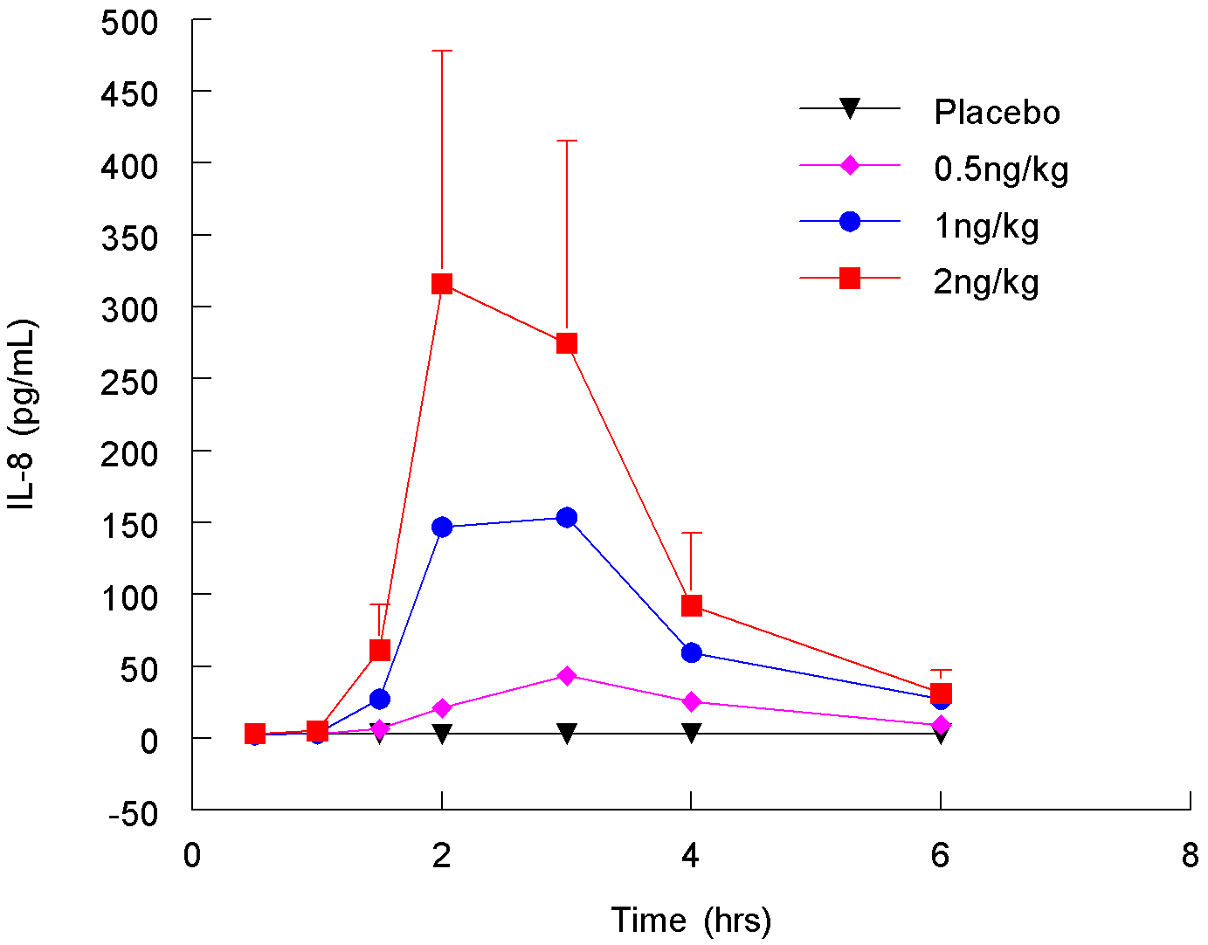
Study results – Circulating cytokines (TNF-α, IL-6, IL-8)
T_{max}: 1.5-3hrs post-dose
Statistical analysis
  Significant contrasts up to t=6hrs:
  (0.5, 1, 2ng/kg) vs pl: p<0.0001
IL-1β: ↑ 3-6hrs post-dose (2ng/kg)

Slide 12
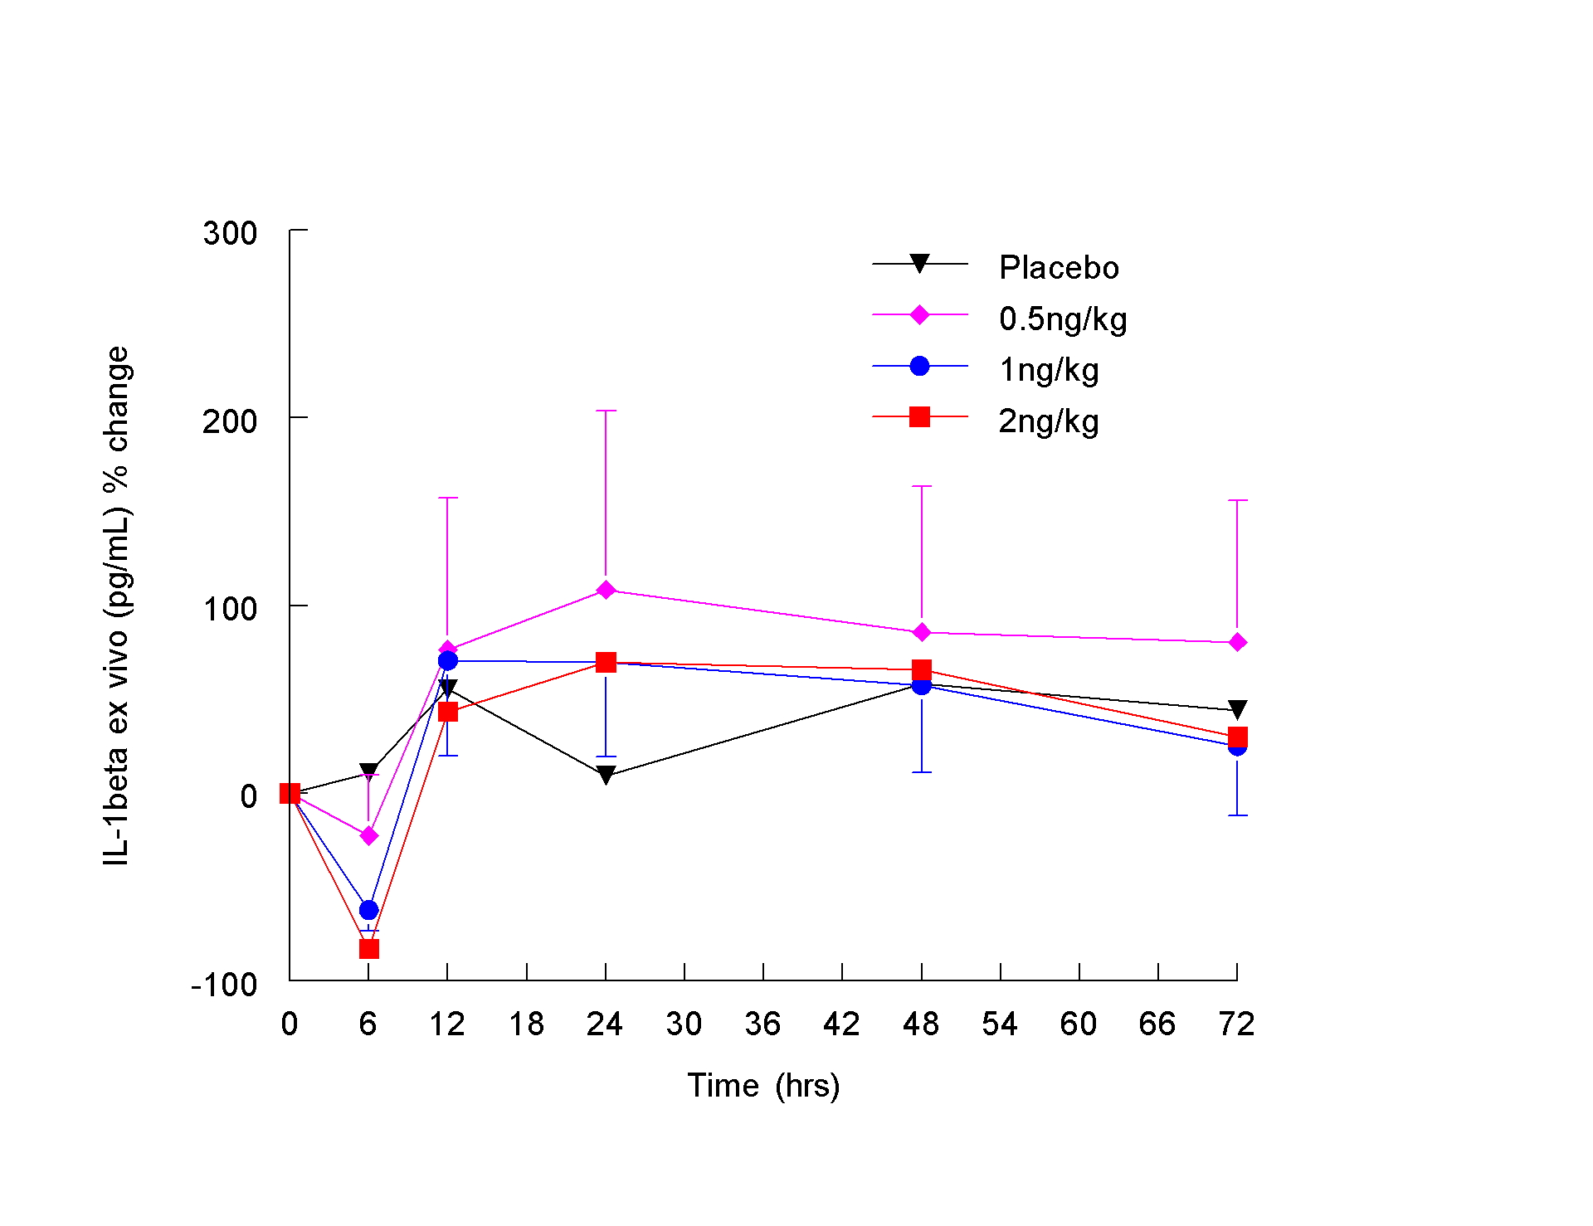
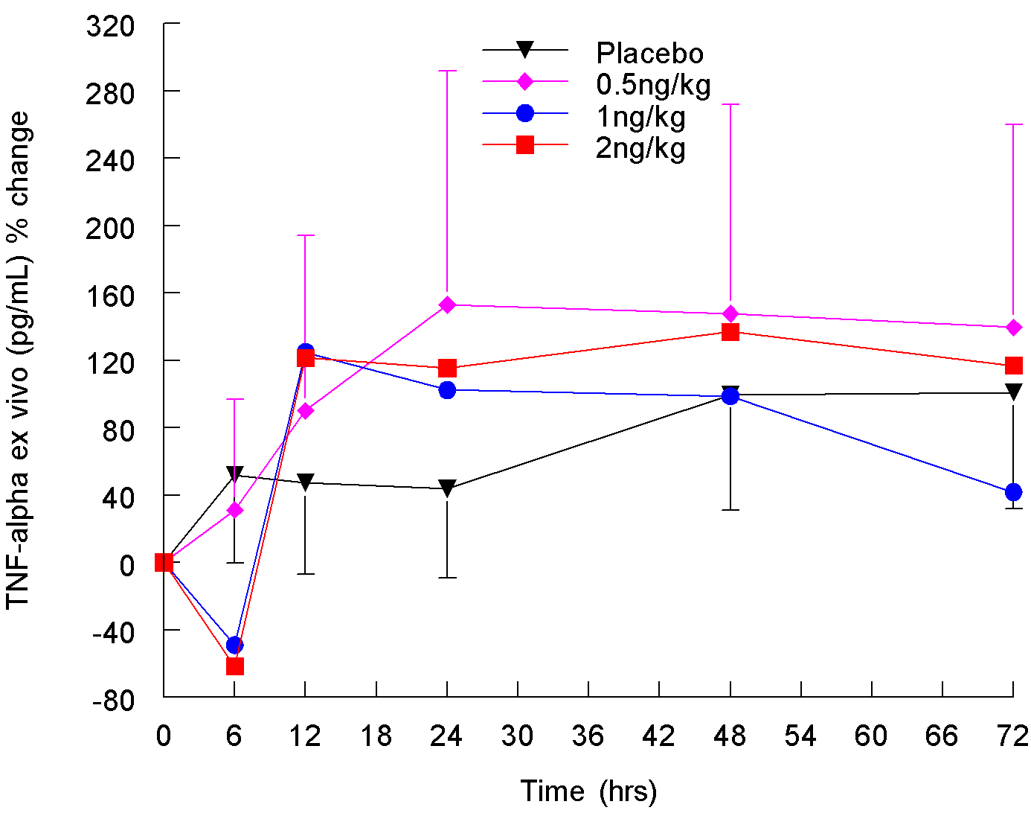
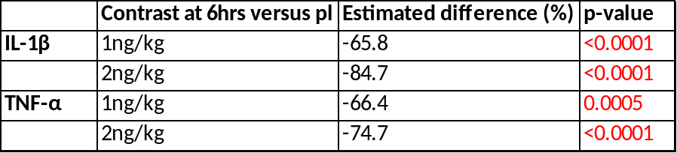
Study results – LPS Hyporesponsiveness
Statistical analysis

Slide 13
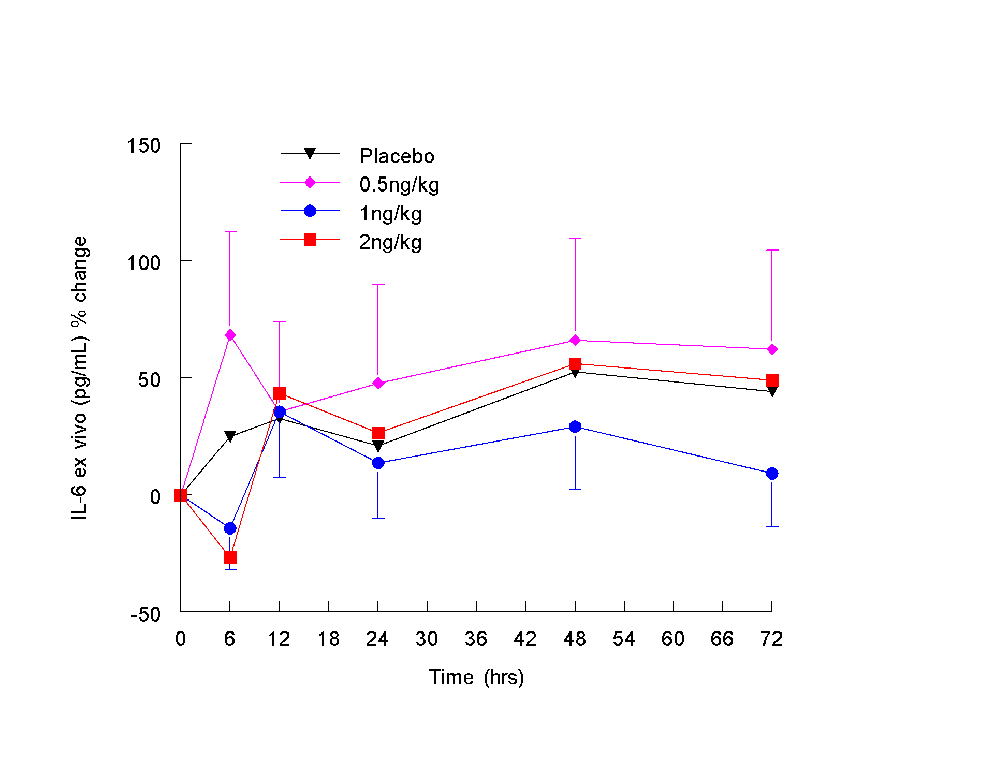
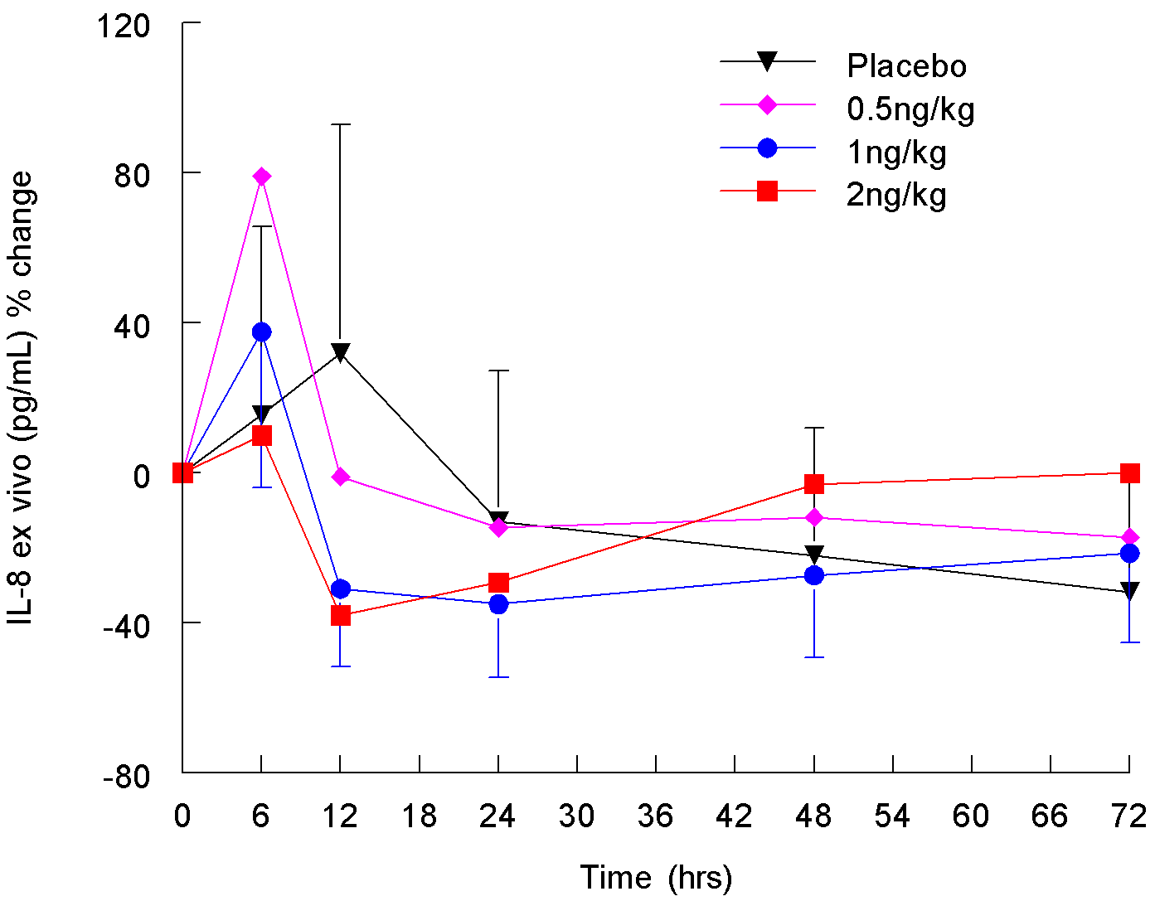
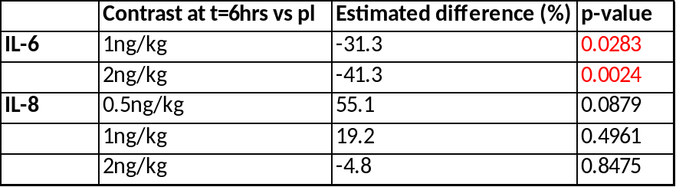
Study results – LPS Hyporesponsiveness
Statistical analysis
[IL-8] and [IL-6] response ≠ [TNF-α] and [IL-1β]: indication for priming?

Slide 14
Conclusions
LPS doses 0.5-2ng/kg: well-tolerated
PD parameters: cytokine release and safety markers (temperature and heart rate)
LPS doses ≥ 0.5ng/kg: distinct inflammatory response
LPS dose-dependent hyporesponsiveness observed for IL-1β, IL-6 and TNF-α after ex vivo LPS stimulation:
  Max. measured 6hrs post-dose
  Total duration of ~12hrs
Clinical pharmacology studies: application of a combination of in vivo LPS administration and repeated ex vivo LPS challenges

Slide 15
unlocking the true potential

Slide 16
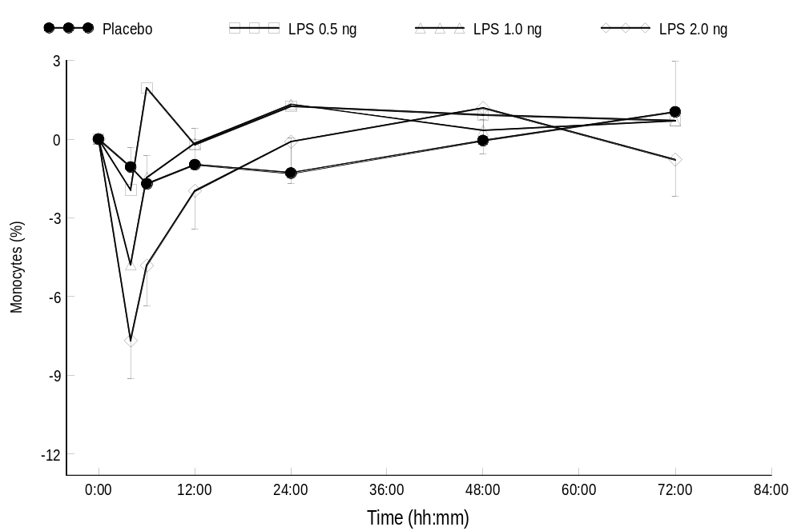
Study results – Safety – Monocytes
Monocyte count: dose-dependent decrease with a minimum change from baseline at 6hrs post-dose, returning to baseline 12-24hrs post-dose
Notes:
Back-up slide

Slide 17
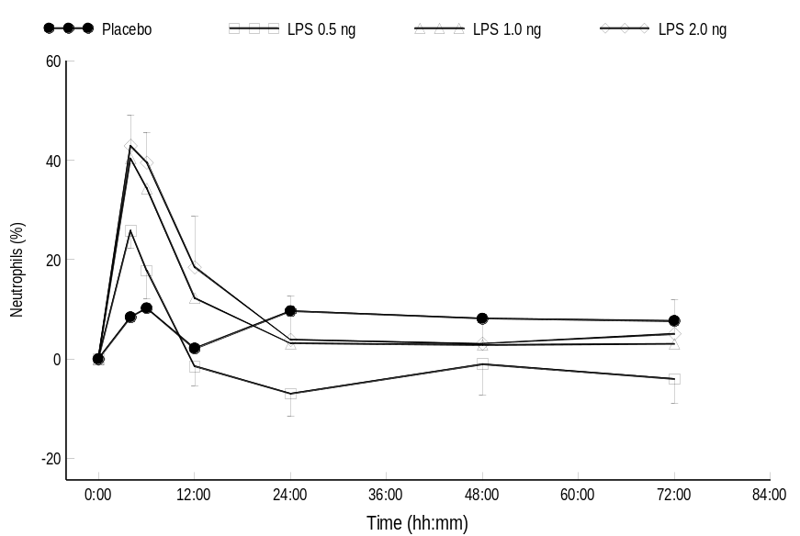
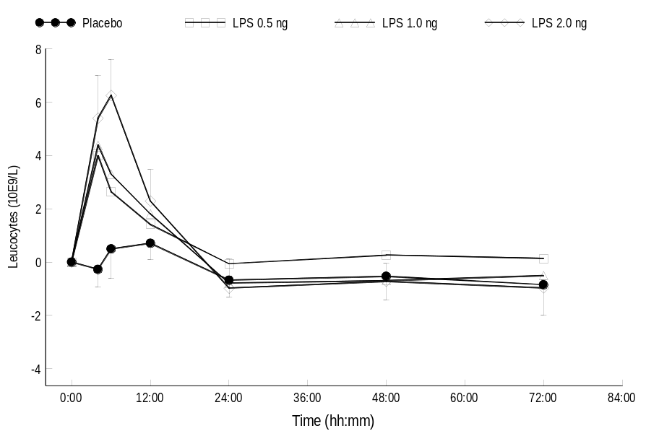
Study results – Safety – Neutrophils / Leucocytes
Neutrophil count: peak levels at 4hrs post-dose
returning to baseline 12-24hrs post-dose
Leucocyte count: peak levels at 4-6hrs post-dose
Notes:
Back-up slide

Slide 18
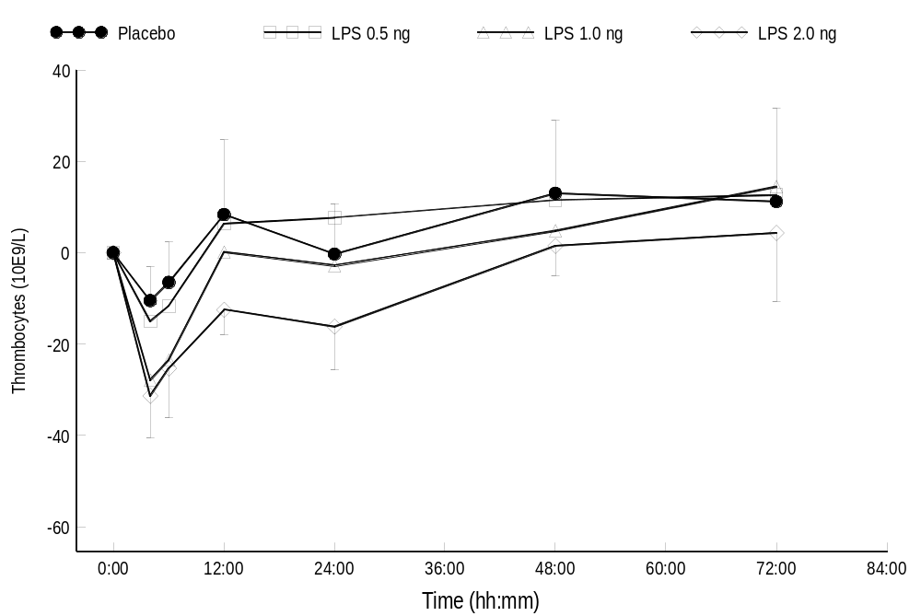
Study results – Safety – Thrombocytes
Blood platelet count (thrombocytes): dose-dependent decrease with min. mean levels ~4hrs post-dose, returning to baseline levels around 12 (0.5 and 1ng/kg) and 48hrs post-dose (2ng/kg)
Notes:
Back-up slide

Slide 19
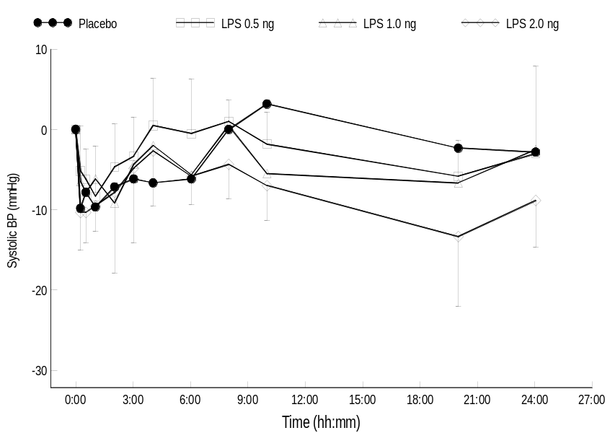
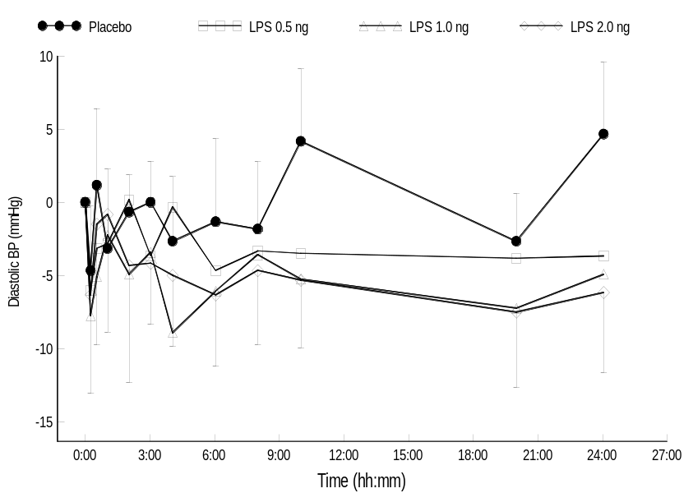
Study results – Safety – BP

Slide 20
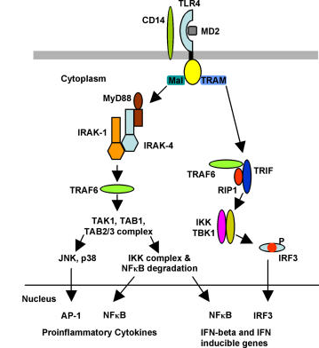
LPS signaling pathways
IRAK-M
SOCS-1
SHIP

Slide 21
Human endotoxin model – Priming
Follows upon in vivo LPS challenge with very low doses
  ↑ Inflammatory response following LPS rechallenge
  May enable the immune system to elicit a strong inflammatory response against potential pathogens (Fu et al.)
Priming in animals described extensively, but underlying mechanisms poorly understood

Slide 22
Power calculation (TNF-α, IL-6 and CRP)
Parallel study design, LPS dose level: 0.5 ng/kg, sample size of 8 subjects per treatment group
  80% power to detect (two-sided significance level of 0.05)
    28% inhibition in the LPS-induced TNF-α response;
    53% inhibition in the LPS-induced IL-6 response;
    49% inhibition in the LPS-induced CRP response.
Inter subject variability on log scale is well comparable between different LPS doses - this power calculation also applies for LPS doses of 1 and 2 ng/kg

