Slide 1


A Psychosocial Instrument to Assess Well Elderly Residing in Privatized
Residential Retirement Communities
Marlene M. Rosenkoetter, PhD, MEd, MSN, RN, FAAN
Professor Emerita, Augusta University
John L. Rosenkoetter, MA, LPA,
Augusta, GA, USA
Notes:
1

Slide 2

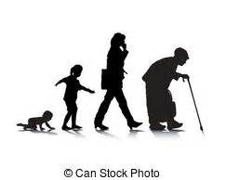
Background
Aging & Retirement Trends

Slide 3
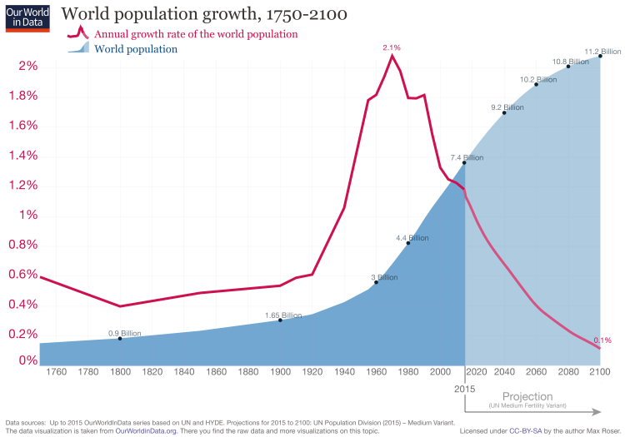

Slide 4


Current Global Population
743,000,000,000

Slide 5
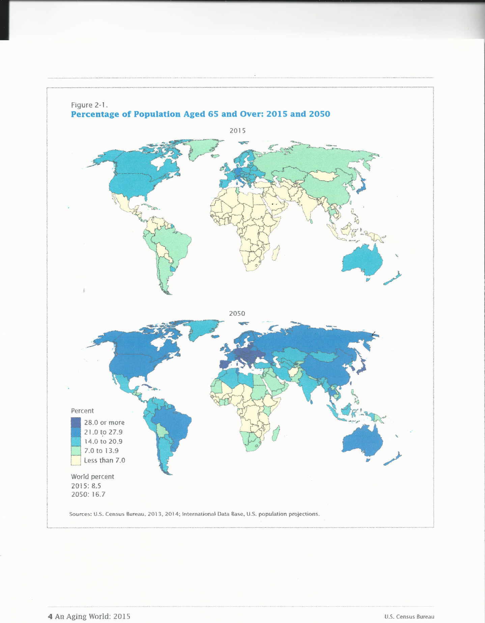
2015
2050
Source: He, W. Goodkind, D., & and Kowal, P. (2015). An aging world. International
population reports. Issued March 2016. P95/16-1

Slide 6

Current Aging Statistics
Source: World Population Ageing 1950-2050, Population Division, DESA, United Nations.

Slide 7
Current Aging Statistics
Source: World Population Ageing 1950-2050, Population Division, DESA, United Nations.

Slide 8

World Aging Trends
Source: World Population Ageing 1950-2050, Population Division, DESA, United Nations

Slide 9

2014
National Population Projections: 2014-based Statistical Bulletin. Office for National Statistics. Available: https://www.ons.gov.uk/peoplepopulationandcommunity/populationandmigration/populationprojections/bulletins/nationalpopulationprojections/2015-10-29#older-people

Slide 10
2014
National Population Projections: 2014-based Statistical Bulletin. Office for National Statistics. Available: https://www.ons.gov.uk/peoplepopulationandcommunity/populationandmigration/populationprojections/bulletins/nationalpopulationprojections/2015-10-29#older-people

Slide 11
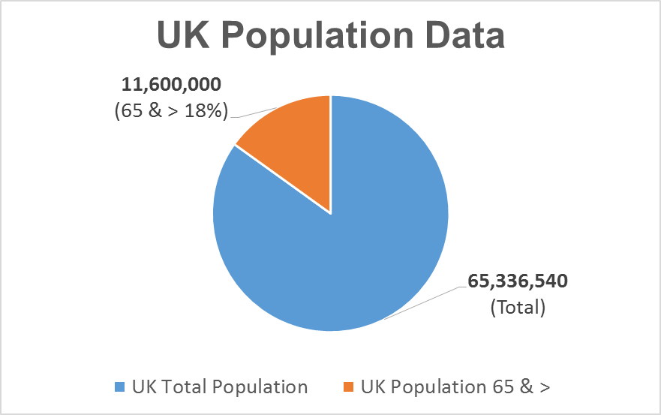

2017
Source: http://www.countrymeters.info/en/United_Kingdom_(UK)/#population_2017
Source: http://www.ageuk.org.uk/Documents/EN-GB/Factsheets/Later_Life_UK_factsheet.pdf?dtrk=true

Slide 12
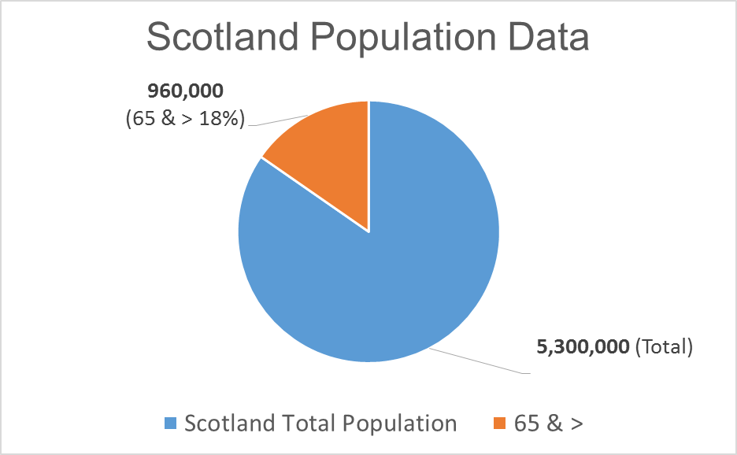

Source: http://www.scotland.org/about-scotland/facts-about-scotland/population-of-scotland
Source: http://www.gov.scot/Topics/People/Equality/Equalities/DataGrid/Age/AgePopMig

Slide 13
Source: https://www.nrscotland.gov.uk/files/statistics/life-expectancy-at-scotland-level/nat-life-tabs-2015/table1-le-1861-2015.pdf

Slide 14
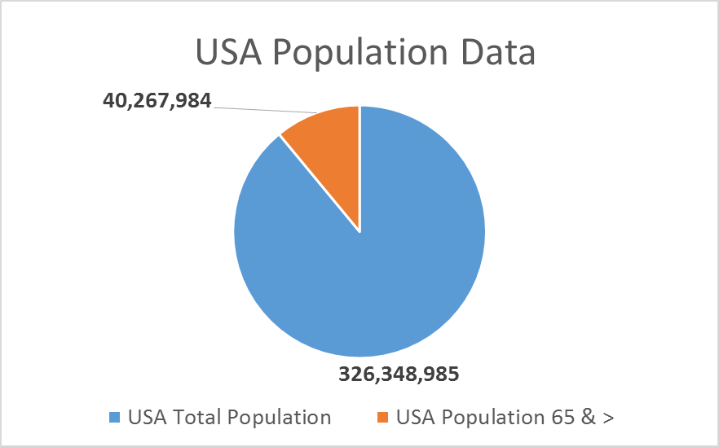
(65 & > 13-15%)
(Total)
Source: https://www.census.gov/prod/cen2010/briefs/c2010br-09.pdf

Slide 15
Source: https://www.cdc.gov/nchs/fastats/life-expectancy.htm

Slide 16

Aging & Mental Health

Slide 17

WHO - Mental Health and Older Adults
Neuropsychiatric disorders = 6.6% of the total disability for older adults.
Most common are dementia and depression.
~15% of adults aged 60 and over have a mental disorder.
Anxiety disorders affect ~3.8%
25% deaths from self-harm are among aged 60 or >.
Source: HO (April, 2016). Mental health and older adults. Fact sheet.
Available: http://www.who.int/mediacentre/factsheets/fs381/en/

Slide 18
Mental Health and Older Adults
Estimate 46.8 million people worldwide with dementia in 2015
Increase to 131.5 million in 2050.
~100 million people globally have Alzheimer’s.
Expected to > to 277,000,000 by 2050
80% of elderly in “nursing homes” have some dementia.
Globally, 13% of people aged 60 & > require long-term care.
Between 2010 and 2050, older people with care needs
will > from 101M to 277,000,000.
Source: Alzheimer’s Disease International. World Alzheimer Report 2016: Improving healthcare for people living with dementia
coverage, quality and costs now and in the future. Available: https://www.alz.co.uk/research/worldalzheimerreport2016sheet.pdf

Slide 19

Aging & Relocation

Slide 20


Aging in Place vs Relocation
Remain in own home with familiar surroundings
Less expensive
Caregiving by family & friends
Family caregiving varies by:
Culture & social class
Political structures
Economics
Country & geographic location
US Caregivers for 70 years & > included:
44% of Latinos
34% of Blacks
25% of non-Hispanic Whites (Weiss et al, 2005).

Slide 21
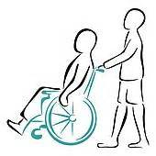
Family Caregiving
~17.7 million people in USA are family caregivers of someone
with a significant impairment age 65 & > older
Source: Families Caring for an Aging America. (September, 2016).. Report in brief. National Academies of Sciences Engineering and Medicine : http://nationalacademies.org/hmd/~/media/Files/Report%20Files/2016/Caregiving-RiB.pdf

Slide 22
Caregiving in UK
~ 6.5 million people (1 in 8 people) in the UK provide care on an unpaid basis for a relative, friend, or neighbor in need of support due to old age, disability, frailty, or illness (http://www.carersuk.org)
45% of caregivers have given up work to care for someone
Caregivers save the UK economy ~£119bn (149 billion US$) per year
49% of caregivers have financial burdens.
Source: https://www.farrlawfirm.com/caregivers/caregiving-in-other-countries-what-we-can-learn/

Slide 23
Relocation Alternatives

Slide 24
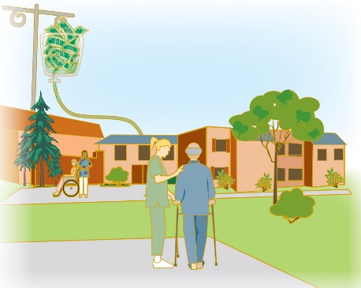


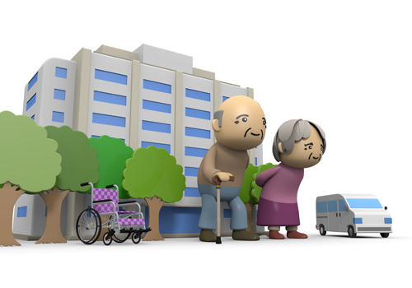

Options for Older Adults (Vary by Country)
Extended Care Facilities (ECF) “nursing homes”
Day Care Programs
Assisted Living Facilities
Home Care Programs
High Rise Senior Living Facilities
Group Homes
Retirement Communities

Slide 25
UK Fact Sheet
5,153 ECFs
7% (530,000) live in specialists housing for people 55 and >
12,525 residential homes
~1.4M age 65+ provide care for someone
58% caretakers in UK are women
25% in UK interested in buying a retirement property – 3.5M nationally

Slide 26
UK Fact Sheet
3.64M in UK 65+ live alone (70% women)
21% men & 30% women need help with ADLs
850,000 with dementia
Average cost per care of older people bed £99,583
40% of adults in care homes have depression
~1.2M 65 years & > are chronically lonely
Worse health associated with depression & lack of family
Source: Source: http://www.ageuk.org.uk/Documents/EN-GB/Factsheets/Later_Life_UK_factsheet.pdf?dtrk=true

Slide 27
USA Extended Care Facilities (ECFs)
USA ECFs = 15,600 (2014)
USA licensed ECF beds = 1.7 million (2014)
Source: https://www.cdc.gov/nchs/fastats/nursing-home-care.htm
ECFs provide 24 hour skilled nursing care
5% of the 65+ USA population in ECFs vs congregate care, assisted living, and board-and-care homes.
USA 65 and > in ECFs decreased 20% from 2000 to 2010 (1.6M to 1.3M).
50% of 95 years & > live in ECFs.
Source: U.S. Census Bureau (2014). From Living Arrangements to Labor Force Participation, New Analysis Looks at State of the Nation's 65-and-Older Population. Available: https://census.gov/newsroom/press-releases/2014/cb14-124.html
USA Cost: ~$50,000/year (limited Medicare & Insurance Coverage)

Slide 28
USA Retirement Communities &
Continuing Care Retirement Communities
CCRC Accreditation:
Commission on Accreditation of Rehabilitation Facilities (CARF)
& Continuing Care Accreditation Commission (CCAC)
(CARF-CCRC)
Accommodations:
Independent living (house, duplex)
Apartment/Condominium
Assisted Living
4) Skilled Nursing Care
5) (Alzeheimer/Dementia unit)
Retirement Community
CCRC

Slide 29
Independent Living Retirement Communities
55 years old & >
Many like all-inclusive resorts
Monthly rental fee includes housing plus:
Some or all meals
Utilities
Light housekeeping, including linen service
Landscaping, exterior and interior maintenance
Activities and transportation
Live-in managers and security
Source: Genworth.com

Slide 30
Independent Living Retirement Communities
Option A: month-to-month lease fees
Option B: contracts and buy-in fees
Option C: purchase of home plus monthly fees
Age-adapted home/apartments
Monthly fees vary widely ($2600-$5000/month)
Cost differs with size of home and geographic location.

Slide 31
Continuing Care Retirement Communities - CCRCs
55 years old & >
Significant financial commitment
Upper middle and upper income residents
Age-adapted home/apartments
Contracts, fees and financial agreements vary
Wide variety of services
Self-contained community living
In 2010, over 2000 CCRCs throughout the USA.
Almost 640,000 residents lived in CCRCs.
http://infomory.com/numbers/number-of-ccrcs-in-the-us

Slide 32
Continuing Care Retirement Communities - CCRCs
Fee guarantees resident access to a "continuum of care" for the rest of his/her life:
Independent living ("active retirement"),
Assisted living, and
Skilled nursing care
Progress through levels of care without leaving the community
Additional fees based on contract & services provided

Slide 33

Cost of CCRCs vs Retirement Communities (USA)
Fees range widely depending on purchase plan,
current level of residence/care and amenities.
CCRC entry costs from $40,000-$600,000
Additional fees $600 to $4,000/month,
Source: https://www.care.com/c/stories/10339/cost-of-ccrcs/
Retirement Communities average cost of one-bedroom
in 2012 was $2,750 a month.

Slide 34


Psychosocial Adjustment in
RCs & CCRCs
Research Study
σ2 = Σ ( Xi - μ )2 / N

Slide 35
Assumptions
Aging population is rapidly increasing.
More older adults are relocating to senior living residences.
Relocation by older adults requires psychosocial adjustments.
Successful adjustments are important for the well-being and health of residents.
No research noted in the literature to assess psychosocial adjustment of retirees relocating to retirement communities or CCRCs.
Data are needed on which to base early identification and subsequent interventions for psychosocial adjustment problems among relocated older adults.

Slide 36
Research Questions
What is the impact of relocation to a Retirement Community or CCRC on the psychosocial adjustment of retirees?
What factors influence the psychosocial adjustment of retirees who have relocated to a Retirement Community or CCRC?

Slide 37

Definitions of Retirement
“Ceased working…”
Retirement is Self-Declared (determined by each person)
Examples:
  Retired school teacher. Then opened a restaurant
  Retired military – Then worked in construction
  Retired small business owner – Worked part-time
  Retired – No longer working
  Number of retirees nearly impossible to determine

Slide 38
Conceptual Framework - Life Patterns Model
Roles – Functions and behaviors or socially expected behavior patterns
Relationships – Interpersonal bonding and interactions with significant others
Support Groups – People that strengthen and reinforce behaviors
Self-Esteem – self-worth
Use of Time – Utilizations of hours and minutes
Life Structure – Daily, weekly, etc. routines in an individual’s life

Slide 39
Conceptual Framework - Life Patterns Model
Based on Open Systems Theory.
Changes in one component cause changes
in each of the others.
Roles
Relationships
Use of Time
Self-Esteem
Support Groups
Life Structure

Slide 40
Life Pattern Transitions to a New Residence
Roles
Changes in Caregiver Roles & Family Responsibilities
Changes in Food & Meal Preparation
Changes in Household & Home Responsibilities
Adjusting to Retirement
Relationships
Leaving Friends & Family
Acquiring Access to Health Care Personnel
Changes in Social & Professional Organization Involvement

Slide 41
Life Pattern Transitions to a New Residence
Use of Time
Involvement in New Activities
Care and Welfare of Pets
Self-Esteem
Changes in Physical & Mental Health Status
Loss of Long Time Residence/Home
Loss of Personal Belongings

Slide 42
Life Pattern Transitions to a New Residence
Support Groups
Acquiring New Friends
Interacting with Facility Staff
Acquiring New Sources of Support
Life Structure
Living in New Environment
Adjusting to Income & Expenses

Slide 43
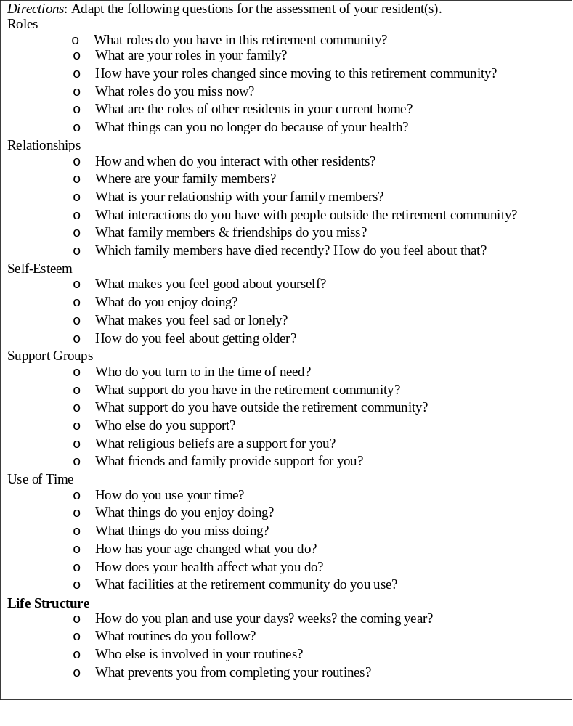
Clinical Assessment
Copyrighted. Issues in Mental Health Nursing

Slide 44
Psychosocial Assessments
Initial assessment by nursing students in RCs & CCRCs
One Life Pattern section each week for six weeks
New Psychosocial Assessment Survey developed for study
Validity & reliability established
Residents surveyed in three facilities

Slide 45
Published Research Citation
Rosenkoetter, M., McKethan, Looney, S. & T., Chernecky, C. (2016). Assessment of the Psychosocial Adjustment of Well Elderly Residing in Retirement Communities. Issues in Mental Health Nursing, Sep 28:1-9 & 13(11),858-867.
Used with permission of the journal

Slide 46
Study Design (IRB approved)
3 Survey Sites (2 CCRCs & 1 RC) in Southeastern USA
A – 86 completed forms of 244 residents (35.6%)
B – 34 of 110 residents (30.9%)
C – 120 of 243 residents (49.4%)
Total: 240 Participants
Survey Instrument Items
Birth year (fill in the blank)
8 demographic multiple choice items
15 psychosocial adjustment perceptions items on 5 point Likert scale
[Cronbach alpha coefficient α= .718]

Slide 47
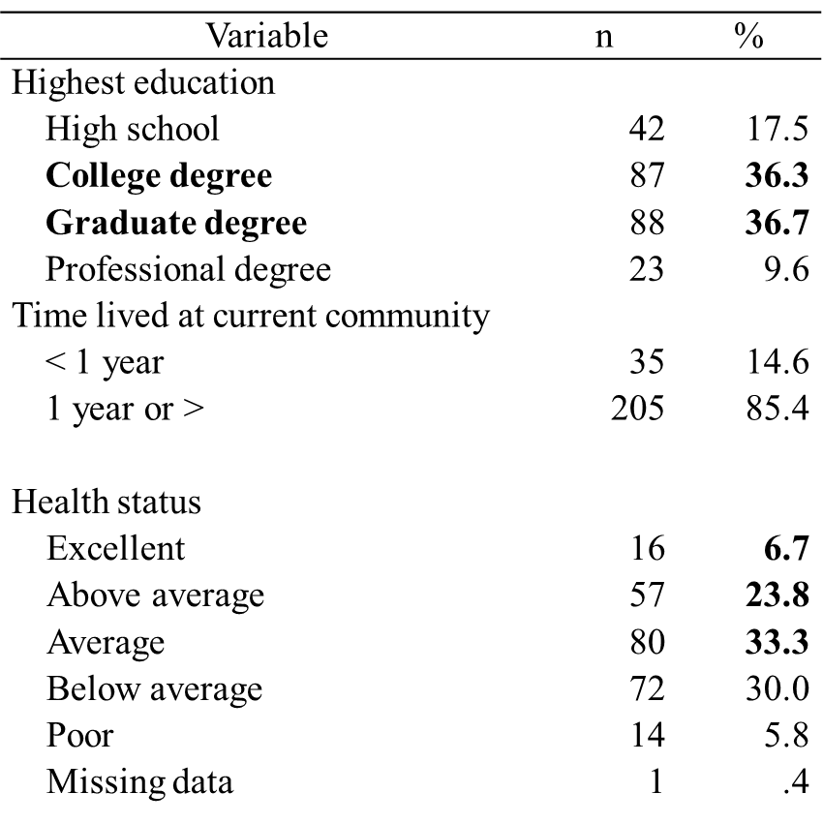
Demographic Characteristics of Respondents (n=240; Mdn age=84)
70%
63.8%

Slide 48
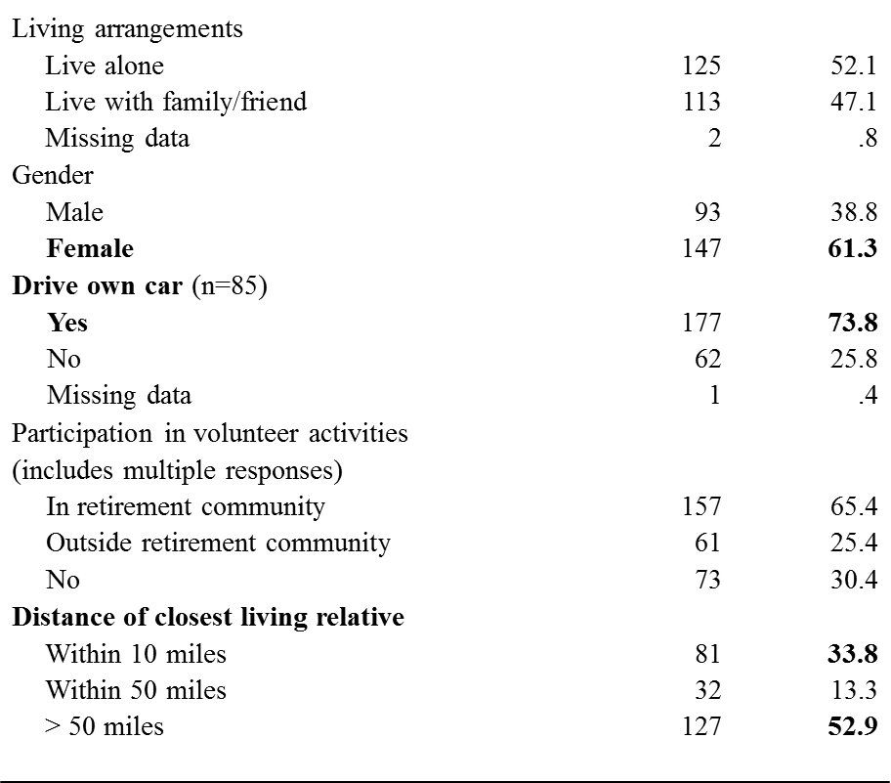
Demographic Characteristics of Respondents (n=240; Mdn age=84)

Slide 49
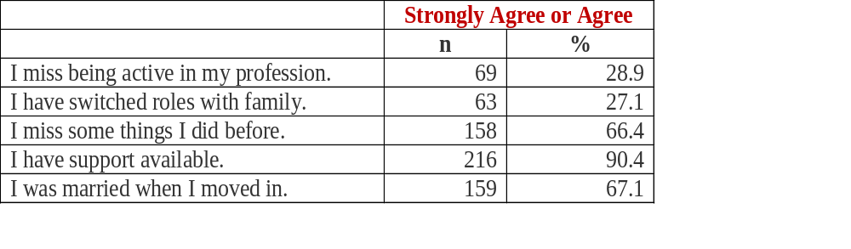
Selected Perception Responses

Slide 50
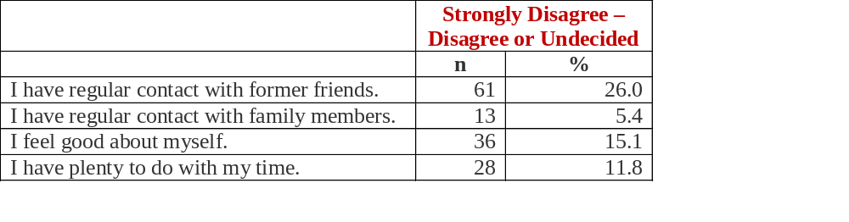
Selected Perception Responses

Slide 51
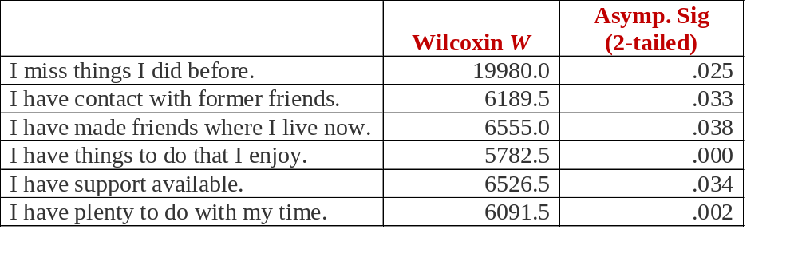
Currently Drive Car Compared to
Perceptions of Adjustment
Significant Findings

Slide 52
Demographics & Significant Relationships with Perceptions
Education Level
Health Status
Gender
Volunteer Activities
Distance of Closest Relative

Slide 53
Conclusions
When older adults relocate to retirement-type communities, there are psychosocial changes that occur.
Assessing the psychosocial adjustment of residents in retirement communities and CCRCs can provide information on changes in life patterns.
The results of assessments can be used by staff members to further assess needed interventions.

Slide 54
Implications for Further Research
Adapt the instrument for:
Country-specific residential housing facilities
Extended care facilities
Group homes
Assessment of newly relocated, mid-term and long-term residents
Family members/friends of older adults in residential facilities
Develop intervention plans based on findings
Reassess validity and reliability of adapted instruments

Slide 55

Advice from Grandma
“Remember to Do One Brave Thing Each Day”
Z z z z…!!!

Slide 56
References: Conceptual Framework - Life Patterns Model
Rosenkoetter, M. & Stachura, M. (2015a). Perceptions of patients and significant others regarding CSSI and MDII on lifestyle and diabetes management. Diabetes Technology &Therapeutics, 17(S1): A-64.
Rosenkoetter, M., McDonough, JE, McCall, A., Smith, D., Looney, S. (2015b). A flex-model for long-term assessment of community-residing older adults following disasters, Journal of Emergency Management, 13(5), 401-416.
Rosenkoetter, M. & Garris, J. (2001). Retirement planning, use of time, and psychosocial adjustment. Issues in Mental Health Nursing, 22(7), 703-722.
Rosenkoetter, M., Smith, D., Stachura, M., McDonough, JE, Hunter, C. (2014). Video Analysis Tool (VAT) System: Implementation and Evaluation of Use with Clinical Nursing Assessments of Older Adults. Nursing Administration Quarterly, 38, 11-22.
Rosenkoetter, M., Stachura, M, Dias, J., Wood, E., & Brown, D. (2013). CSII and MDII for intensive diabetes management: Impact perceptions of older adult patients and their significant others. Geriatric Nursing, 34(6), 469-476.

Slide 57

?
Discussion

