Slide 1


Acoustic CR neuromodulation therapy for subjective tonal tinnitus: clinical outcomes in an independent audiology practice setting
Presentation by:
Mark Williams BSc, MSc, Dip CCA
Aug 2015

Slide 2
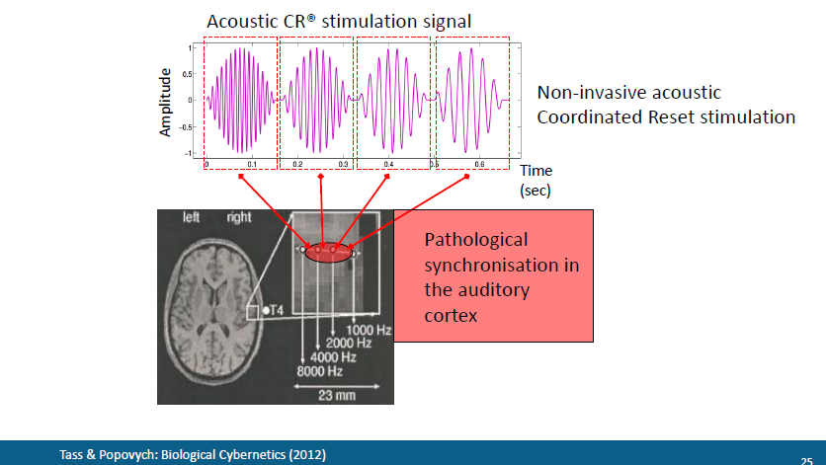
Fitting and Stimulation Protocol
Subject characteristic tinnitus frequency was assessed using a pure tone matching protocol that combined similarity measures and forced choice pair testing
All participants received stimulation for 4-6 hours per day either continuously or divided into several sessions of a time period no shorter than one hour
© The Tinnitus Clinic

Slide 3
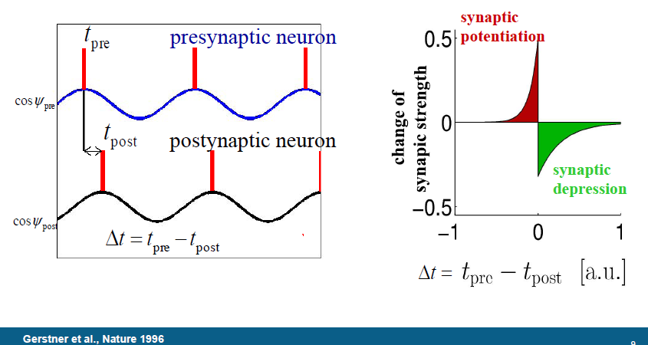
Spike Timing Dependent Plasticity
Repeated presynaptic spike arrival a few milliseconds before postsynaptic action potentials leads in many synapse types to long-term potentiation (LTP) of the synapses, whereas repeated spike arrival after postsynaptic spikes leads to long-term depression (LTD) of the same synapse
© The Tinnitus Clinic

Slide 4
CR® PUBLICATIONS
Theoretical studies
P. A. Tass and C. Hauptmann (2007) Therapeutic modulation of synaptic connectivity with desynchronizing brain stimulation. Int. J. Psychophysiol. 64, 53-61
P.A. Tass (2003) A model of desynchronizing deep brain stimulation with a demand-controlled coordinated reset of neural subpopulations. Biological cybernetics, 89(2), 81-88.
C. Hauptmann, J.-C. Roulet, J.J. Niederhauser, W. Döll, M.E. Kirlangic, B. Lysyansky, V. Krachkovskyi, M.A. Bhatti, U.B. Barnikol, L. Sasse, C.P. Bührle, E.-J. Speckmann, M. Götz, V. Sturm, H.-J. Freund, U. Schnell, and P A Tass (2009) External trial deep brain stimulation device for the application of desynchronizing stimulation techniques. Journal of Neural Engineering 6, 066003
P.A. Tass, O.V. Popovych (2012) Unlearning tinnitus-related cerebral synchrony with acoustic coordinated reset stimulation: theoretical concept and modelling. Biological cybernetics, 106(1), 27-36.
O.V. Popovych, P.A. Tass (2012) Desynchronizing electrical and sensory coordinated reset neuromodulation. Frontiers in Human Neuroscience 6, 58
M. Ebert, C. Hauptmann, P.A. Tass (2014) Coordinated reset stimulation in a large-scale model of the STN-GPe circuit. Front. Comput. Neurosci. 8, 154
Tinnitus: non-invasive Acoustic CR Neuromodulation
Clinical
H. Wurzer (2011) First Treatment Experience With Acoustic CR Neuromodulation In 70 Patients With Chronic Subjective Tinnitus in an outpatient setting. TRI Buffalo (Poster # 59)
85 patients were treated with Acoustic CR Neuromodulation (T30)
Regarded as a new, safe and well tolerated therapy for treating chronic tinnitus
Significant TQ improvement after 6 months (22% were ‘winners’, 30% ‘responders), 12 months (32% ‘winners’ and 34% ‘responders’) and after 18 months (41% ‘winners’ and 29% ‘responders’)
VAS reduced from 57.5% to 34.8% (on average)
P.A. Tass, I. Adamchic, H.J. Freund, T. von Stackelberg & C. Hauptmann (2012) Counteracting tinnitus by acoustic coordinated reset neuromodulation. Restorative neurology and neuroscience, 30(2), 137-159.
CR treatment was safe, well-tolerated and caused a significant decrease of tinnitus loudness and symptoms.
Placebo treatment did not lead to any significant changes.
Effects gained in 12 weeks of treatment persisted through a pre-planned 4-week therapy pause and showed sustained long-term effects after 10 months of therapy.
A reduction of at least 6 TQ points, was obtained in 75% of patients with a mean TQ reduction of 50% among responders.
M. Williams, C. Hauptmann, N. Patel. Acoustic CR neuromodulation therapy for subjective tonal tinnitus: a review of clinical outcomes in an independent audiology practice setting. Frontiers International Journal, March 2015.
Sixty-six patients with subjective tonal tinnitus were treated with Acoustic CR Neuromodulation
Significant reduction in VAS scores for tinnitus loudness and annoyance
59.1% of patients demonstrated a clinically significant reduction in symptoms at 22-26 weeks.
THQ scores were significantly reduced compared to baseline with clinical effect more robust at 22-26 weeks
C. Hauptmann, A. Ströbel, M. Williams, N. Patel, B. Langguth, H. Wurzer, P.A. Tass. Acoustic Coordinated Reset Neuromodulation in a Real Life Patient Population with Chronic Tonal Tinnitus. BioMed Research International
200 patients were treated with Acoustic CR Neuromodulation for 12 months
TBF-12 reduction: -37.9% after 12 monthsCGI-17 improvement: 66.5% indicate a “slightly too strong improvement”
Good compliance
No severe adverse events
EEG
A.N. Silchenko, I. Adamchic, C. Hauptmann & P.A. Tass (2013) Impact of acoustic coordinated reset neuromodulation on effective connectivity in a neural network of phantom sound. Neuroimage, 77, 133-147
I. Adamchic, T. Toth, C. Hauptmann, P.A. Tass (2014) Reversing pathologically increased EEG power by acoustic CR neuromodulation. Human Brain Mapping 35, 2099-2118
I. Adamchic, B. Langguth, C. Hauptmann, P.A. Tass (2014) Abnormal brain activity and cross-frequency coupling in the tinnitus network. Frontiers in Neuroscience 8, 284
Parkinson studies (invasive)
J. Wang, A. Muralidharan, L. Venkatesan, C. Vetruba, J.L. Vitek, K.B. Baker (2014) Coordinated reset deep brain stimulation produces long-lasting, dose-dependent improvement in bradykinesia in the parkinsonian non-human primate. Society for Neuroscience. Poster
I. Adamchic, C. Hauptmann, U.B. Barnikol, N. Pawelcyk, O.V. Popovych, T. Barnikol, A. Silchenko, J. Volkmann, G. Deuschl, W. Meissner, M. Maarouf, V. Sturm, H.-J. Freund, P.A. Tass (2014) Coordinated Reset Has Lasting Aftereffects in Patients with Parkinson's Disease. Movement Disorders 29(13), 1679-84
Patient case-studies
U.B. Barnikol, O.V. Popovych, C. Hauptmann, V. Sturm, H.-J. Freund, P.A. Tass 2008) Tremor entrainment by patterned low-frequency stimulation. Phil. Trans. Roy. Soc. A 366, 3545-3573
D.A. Smirnov, U.B. Barnikol, T.T. Barnikol, B.P. Bezruchko, C. Hauptmann, C. Bührle, M. Maarouf, V. Sturm, H.-J. Freund, and P.A. Tass (2008) The Generation of Parkinsonian Tremor as Revealed by Directional Coupling Analysis. Europhysics Letters 83, 20003

Slide 5
Subjects
66 - fee paying - participants (44 male and 22 female) ranging in age from 31 to 76 years ( = 57, SD = 13).
21 subjects pre existing hearing aid users
17 subjects had tried hearing aids in the past 4 years
42 of the subjects had received tinnitus therapy previously
Onset ranging from 3 months to 27 years ( = 7, SD = 8)
© The Tinnitus Clinic

Slide 6
Subject Exclusion Criteria
Objective tinnitus
Paroxysmal somatosensory tinnitus,
Atonal tinnitus percept,
History of Ménière's disease,
Symptomatic otology disorders
History of cervical or mandibular disorders
Brainstem diseases
Diagnosed psychiatric disorders
Undergoing another structured treatment for tinnitus
PTA thresholds exceeding 70dBHL
Dominant tinnitus pitch <0.2KHz or >10KHz
© The Tinnitus Clinic

Slide 7
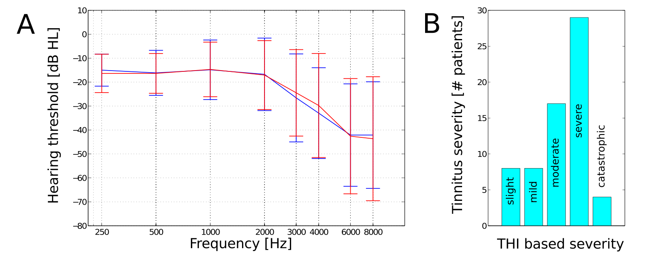
Subjects
Fig 1: (A) Mean hearing thresholds and standard deviations and (B) THI based tinnitus severity for the n=66 subjects.
© The Tinnitus Clinic

Slide 8
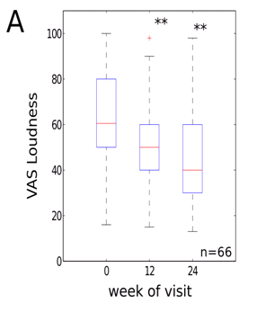
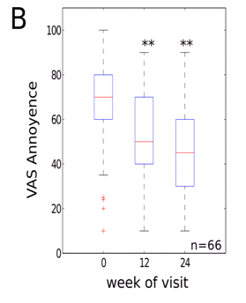
VAS Loudness/Annoyance Results
12 weeks = -16.5% (10.2)
24 weeks = -25.8% (15)(p<0.01)
ES = 0.81
Clinically Significance = 59.1%
12 weeks = -21.3% (14.4)
24 weeks = -32% (20.3) (p<0.01)
ES = 1.09
Clinically Significance = 73.1%

Slide 9
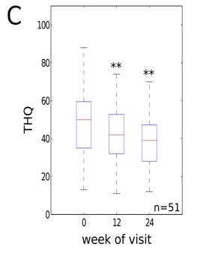
Tinnitus Handicap Questionnaires (THQ) Results
12 weeks = -10.3% (8.6)
24 weeks = -19.4% (12.8)(p<0.01)
ES = 0.6
Clinically Significance = 58.8%
Tinnitus Frequency
Tinnitus frequency was reduced by 7.3% at 12-14 weeks (p<0.01 compared to baseline) and by 11.1% at 22-26 weeks (p<0.01 compared to baseline).
© The Tinnitus Clinic

Slide 10
Discussion
The data for this small sample group demonstrates a statistically significant and clinically relevant concordant decrease of VAS scores for tinnitus loudness / annoyance and THQ scores.
No correlation, for treatment effect, was determined with respect to patient age, gender and audiometric configuration.
For VAS loudness and annoyance 39 & 48 patients, respectively, recorded a clinically significant score change at 22-26 weeks. THQ scores were only obtained for 51 patients from this subgroup with 32 subjects recording a clinically significant change over the same time period.
A similar reduction of tinnitus loudness and distress has been shown in a randomized proof-of-concept trial (Tass et al., 2012) and an outpatient study (TRI conference 2011, Buffalo, USA, Abstract H. Wurzer).
© The Tinnitus Clinic

Slide 11


Clinical results – Reset Real Life (RRL) Study
Purpose:
  Confirmation of efficacy and safety of Acoustic CR® Neuromodulation for the treatment of chronic tinnitus patients using the CE marked T30 CR®-system in a real life outpatient setting
  23 ENT clinics and 200 patients
Primary Outcome Measures:
  Improvement of TBF-12 Score or CGI Score
ClinicalTrials.gov Identifier:
  NCT01435317

Slide 12
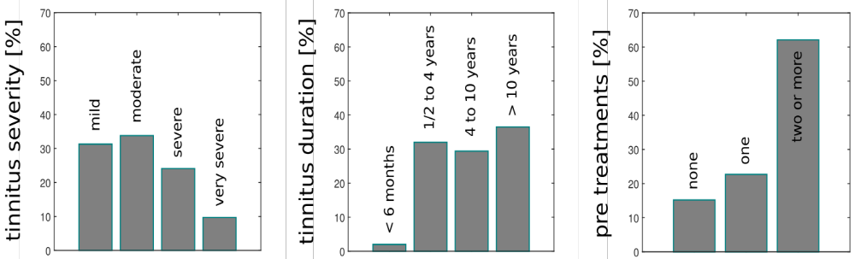
RRL Study – patient population
Gender: 76.3% male and 23.7% female
Age: 50.6 (±10.4) years average age
Perception of tinnitus: unilateral in 31.8% and bilateral in 68.2% of patients
mild
slight
moderate
severe

Slide 13
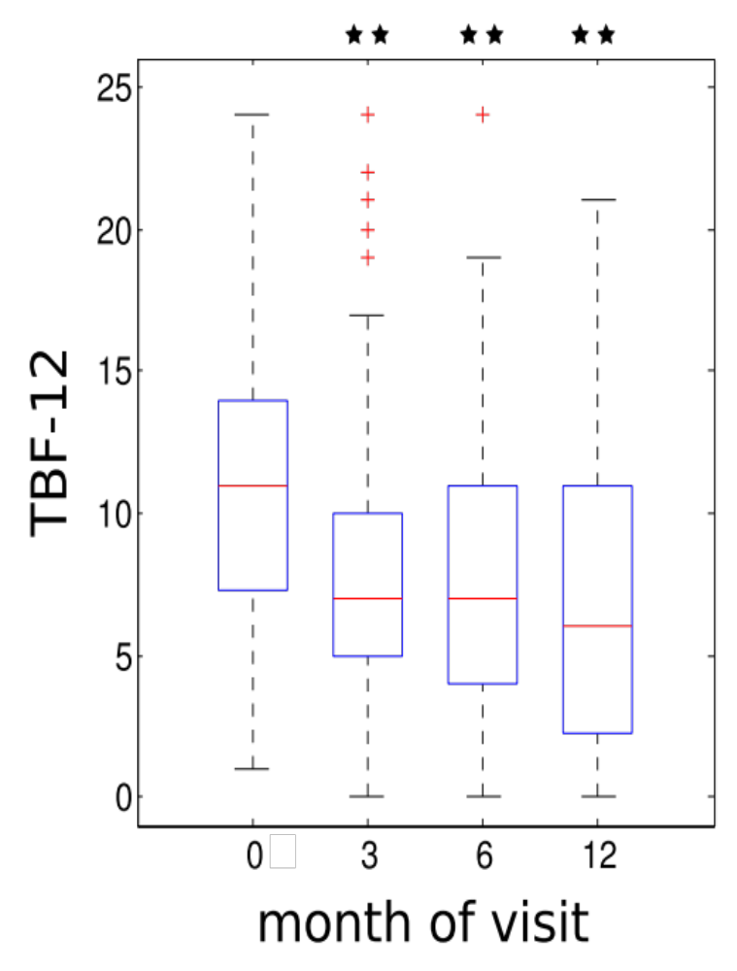
Clinical results – Results TBF-12
TBF-12 reduction
  -27.3% after 3 months
  -30.8% after 6 months
  -37.9% after 12 months
  N=195 data points
  All results are statistically and clinically significant

Slide 14
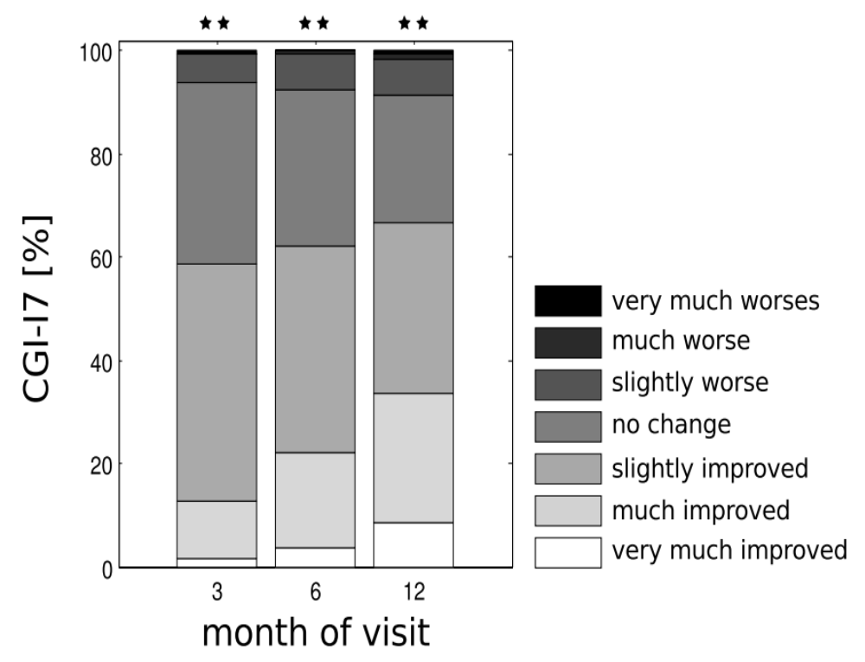
Clinical results – Results CGI-I7
CGI-I7 categories
  Majority (66.5%) indicates a slightly too strong improvement
  54.4% indicate that tinnitus is no burden to their life any more

Slide 15
Limitations
Benefit from being repeated with the addition of a control group of patients who receive counselling and appropriate amplification as this would provide a direct comparison intervention with which to gauge the intervention under scrutiny.
extended test period would provide more information on the sustainability of the intervention therapeutic effect.
Addition of qualitative metrics for outcoming
Use of depression and anxiety metrics for outcoming

Slide 16
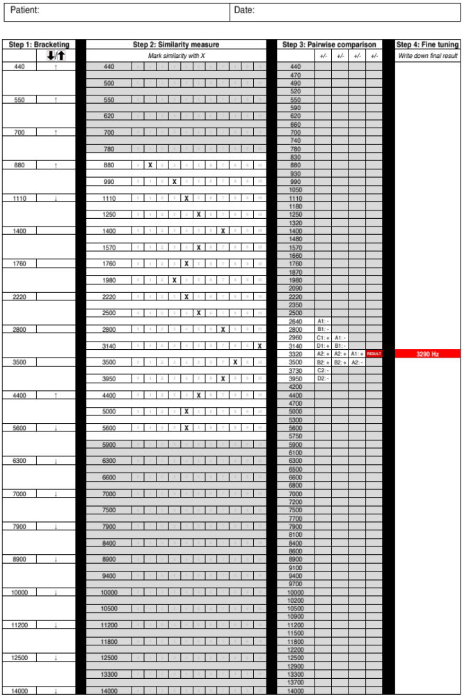
Pitch Matching – Table
Bracketing
private and strictly confidential

Slide 17
Pitch Matching – Table
Similarity measure
private and strictly confidential

Slide 18
Pitch Matching – Table
Pairwise
comparison
private and strictly confidential

Slide 19
Pitch Matching – Table
Fine
tuning
private and strictly confidential

Slide 20
Validation
Goal: To show that new tool is superior to existing tool
15 healthy subjects (i.e. 30 ears) received an artificial tinnitus (sinusoidal continuous tone)
Pitch matching procedure was used to assess the frequency of the test tone Established Vernon method was used to assess the frequency of the test tone Results from both methods are compared with frequency of the test tone
Test criteria: plus/minus 5% (one semi tone) is accepted as inaccuracy Rationale: closest CR tones are plus and minus 10% apart from the tinnitus frequency

Slide 21
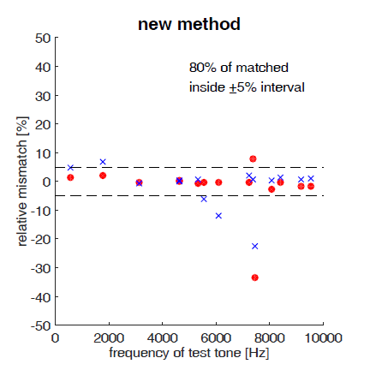
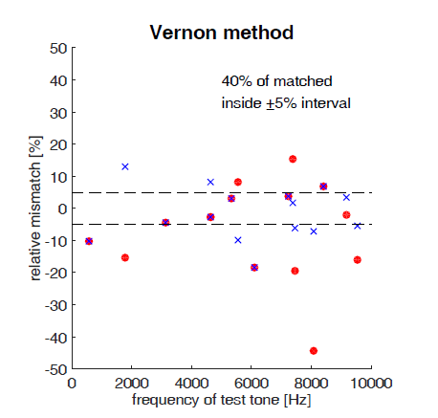
Validation by Mark Williams

