Slide 1
Intervention Approaches in Management of Neck Pain Among Computer Users
Presenter:
Balwinder Singh
Associate Professor Computer Science
Govt. College of Education, Patiala (India)
Email: gcepta_govt@yahoo.com

Slide 2
Introduction

Slide 3
Click of a button of the mouse
Computers can do amazing things
Bring us power and convenience
Help us in many ways

Slide 4
However,
Excess of anything is not a good thing.

Slide 5
Computer, a hallmark in technological advancement has ushered in a new genre of occupational health problems i.e. of computer related health problems (Suparna et al., 2005).

Slide 6
The shift from manufacturing and resource-based jobs to the service industry has transformed the nature of work injuries and disability

Slide 7
The high rate of acute and fatal injuries observed in most countries at the beginning of the 20th century has been replaced by a sharp increase in the incidence of compensated musculoskeletal disorders such as back and neck pain (Cote et al., 2008).

Slide 8
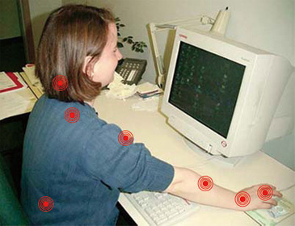

Slide 9
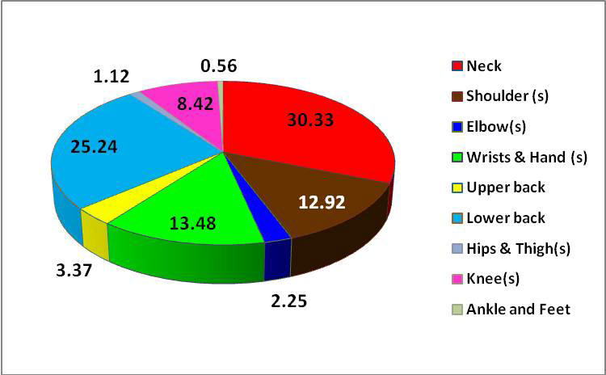
Figure 1: Pie-Chart Showing the Annual Prevalence of WRMSDs Reported Among the IT Professionals
(S Arun Vijay (2013) Work-related musculoskeletal health disorders among the information technology professionals in india:a prevalence study. Int. J. Mgmt Res. & Bus. Strat. 2013

Slide 10
People at higher risk:
Computer professionals such as Data entry operators
Medical transcription staff
Students spending too much time browsing the net
Research scholars

Slide 11
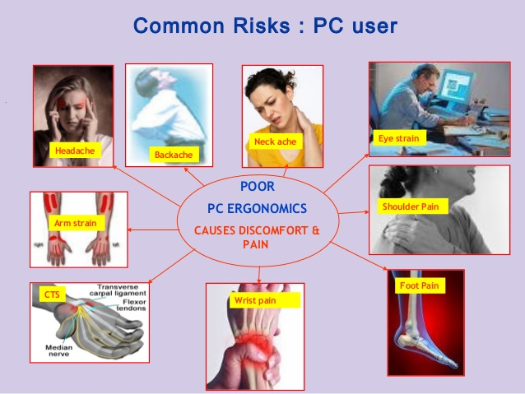

Slide 12
Repetitive strain injury
Deep vein thrombosis
Eye and vision problems
Mental stress
Neck and back problems

Slide 13
1. Repetitive strain injury (RSI)

Slide 14
Musculoskeletal system consists of
Muscles
Tendons
Ligaments
Joints
Bones
Cartilage
Disc in the spine

Slide 15
Working with computers for a long period
Repetitive physical actions at the same point
Stress (A force that distorts a body)
Distortion (pulling apart or pressing together)
Strain of affected structures
Injury

Slide 16
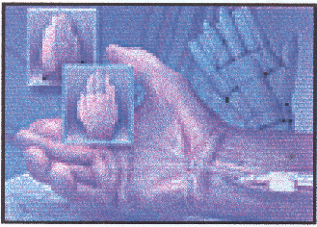
Carpal Tunnel Syndrome

Slide 17
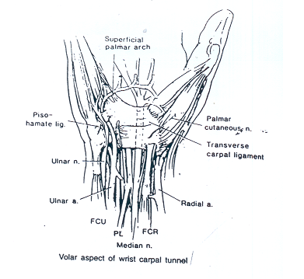

Slide 18
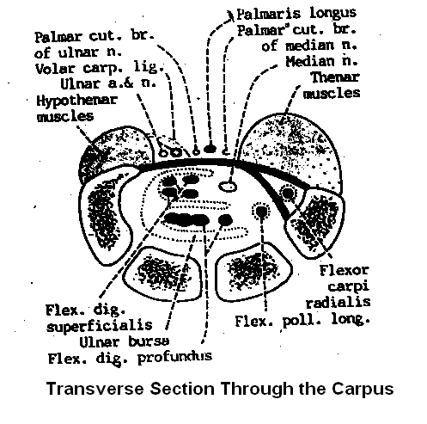

Slide 19
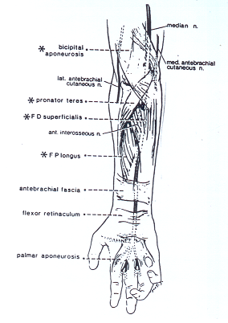

Slide 20
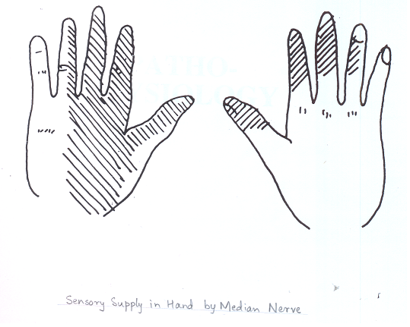

Slide 21
Tendon Disorders
Chord like structure that joins muscle to bones, and are liable to get frayed or torn.

Slide 22
Overuse or awkward functioning
Production of too much fluid in a sheath
Swelling and pain in the tendons

Slide 23
2. Deep Vein Thrombosis
Poor static posture
Sluggish blood circulation
Blood clotting inside the vein
Deep vein thrombosis

Slide 24
3. Eye and Vision:
Strain
Burning sensation
Reddening
Dryness in eyes
Headaches
Worsening the vision problem

Slide 25
causes
Lack of sufficient exercise leading to weakness and fatigue of eye muscles
Lack of blinking leading to dry and itchy eyes
Flickering screen
Unclear characters on the monitor
Reflection of light on the monitor

Slide 26
4. Mental Stress:
Low self-esteem
Depression
Loss of appetite
Headaches
Sleeplessness

Slide 27
Causes:
Unreasonable expectations of employers from workers
Monotonous job
No decision making role

Slide 28
5. Back and neck problems
Sitting in an awkward position for a longer period
Continuous, tremendous pressure on certain parts of neck and back
Fatigue in concerned muscles
Pain in Neck and Back

Slide 29
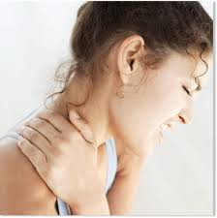
Viewing the consequences of the computer usuage and its related neck pain and disability, the present study comes out with its first aim to find a relationship of computer usage with neck pain and disability.

Slide 30
Ethical Clearance
Ethical clearance for the study was taken from Institutional Ethics Committee (IEC), Punjabi University, Patiala.

Slide 31
Sampling
60 office workers with neck pain using computer for >15 hours/week and >3 years were included in the study.
Out of this 30 subjects were randomly chosen for the first part of the study.
These subjects were compared with 30 office workers who did not use computer at all but had neck pain.

Slide 32

SELECTION CRITERIA

Slide 33
Inclusion criteria
Exclusion criteria
Subjects with history of trauma, spondylosis, periarthritis, rheumatoid arthritis, any neurological disorder, suspected psychosomatic pain, neck deformity and history of surgery for neck or shoulder were excluded.
All the subjects were in age ranging from 20 - 35 years.
computer usage for >15 hours/week and >3 years.

Slide 34

Procedures

Slide 35
Neck pain and neck disability were the outcome measures assessed by Visual Analogue Scale (VAS) and Neck Disability Index (NDI) respectively.

Slide 36
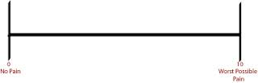
Assessment of pain
Description- Pain was be measured using VAS scale. It consists of 10 cm line with two endpoints representing `no pain ’and` worst pain imaginable’. The score can be used as a baseline assessment of pain with follow-up measures providing an indication of whether pain is reducing
Scoring – Patients rated their pain by placing a mark on the line corresponding to their current level of pain, the distance along the line from the `no pain’ marker is then measured with a ruler giving a pain score out of 10. The scores will be used to evaluate treatment effectiveness.

Slide 37
Neck disability index (Vernon and Mior, 1991)
Description- The NDI consists of 10 items: pain intensity, personal care, lifting, reading, headaches, concentration, work, driving, sleeping and recreation. It measures the functional status of patients with disabling neck pain. The 10 items with 6 possible answers in each are scored 0 (no activity limitation) to 5 (major activity limitation) are summed up to yield a total score (Vernon and Mior., 1991).

Slide 38
The demographic characteristics of subjects in first part of the study
Table 1: Demographic data - Age and Years of job of both the groups
Demographic data | Computer users (n = 30) Mean (SD) | Non computer users (n = 30) Mean (SD)
Age (years) | 32.06 (5.46) | 32.36 (5.27)
Years of job | 7.0 (3.89) | 6.56 (4.08)

Slide 39
Table 2: Comparison of mean of NDI and VAS of both groups
Outcome Measures | Computer users Mean (SD) | Non computer users Mean (SD) | t value
VAS | 3.63 (1.59) | 2.4 (1.45) | 3.10 S
NDI | 5.73 (4.01) | 3.13 (3.55) | 2.66 S
Notes:
S = p<0.05; NS = p>0.05

Slide 40
The results suggested that office workers using computers demonstrated a significantly higher levels of neck disability (t=2.66) and pain (t=3.10) in comparison to non-users.
Various other studies (Gerret al., 2002; Talwar et al., 2009), concluded that the computer users are at greater risk of developing musculoskeletal disorders in neck and upper limb than non users.
Among Computer users work typically involves remaining for a long time in a fixed position
Wrong acquired postures such as holding neck in Forward Head Posture
Leading to Neck pain and its related disability
(Cagnieet al., 2007).

Slide 41
Vicious circle hypothesis
Repetitive, static muscle contractions
(in primary muscles)
Production of metabolites
Activates gamma-motor neurons projecting to both primary and secondary muscles
Increases the static and dynamic stretch sensitivity
& Discharges of primary and secondary muscle spindle afferents.

Slide 42
Solution…?

Slide 43
In the second part of the study, all of the computer users (n=60) were administered different kinds of therapeutic interventions for the duration of 4 weeks.
For this purpose they were randomly divided into three groups i.e., Group A, B & C.

Slide 44
DESCRIPTION OF INTERVENTIONAL PROGRAM

Slide 45
Group A: Conventional physiotherapy treatment:
Conventional physiotherapy treatment for the cervical spine included application of hydrocollateral pack for 10 min followed with:
Stretching of tightened cervical muscles (trapezius -upper, middle and lower fibers , Scalene, Leveator scapulae.
Active range of motion exercises of neck.
Strengthening exercises includes isometrics; core exercises 10-15 repetitions.
Posture awareness - erect sitting and standing posture was guided to the patient.
Home exercise program- use of hydrocollateral pack for 10 min, active range of motion exercises, self stretching and strengthening exercises.
The entire treatment takes about 20 minutes.

Slide 46
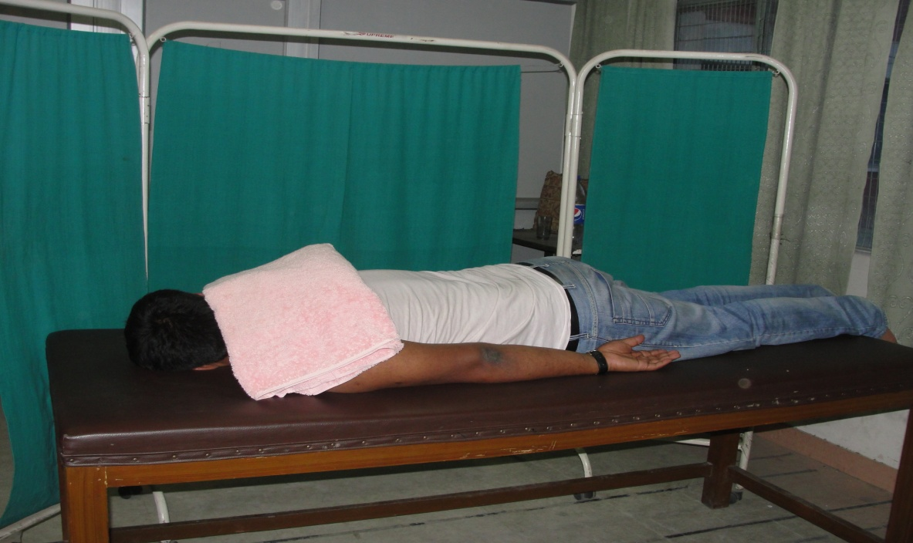
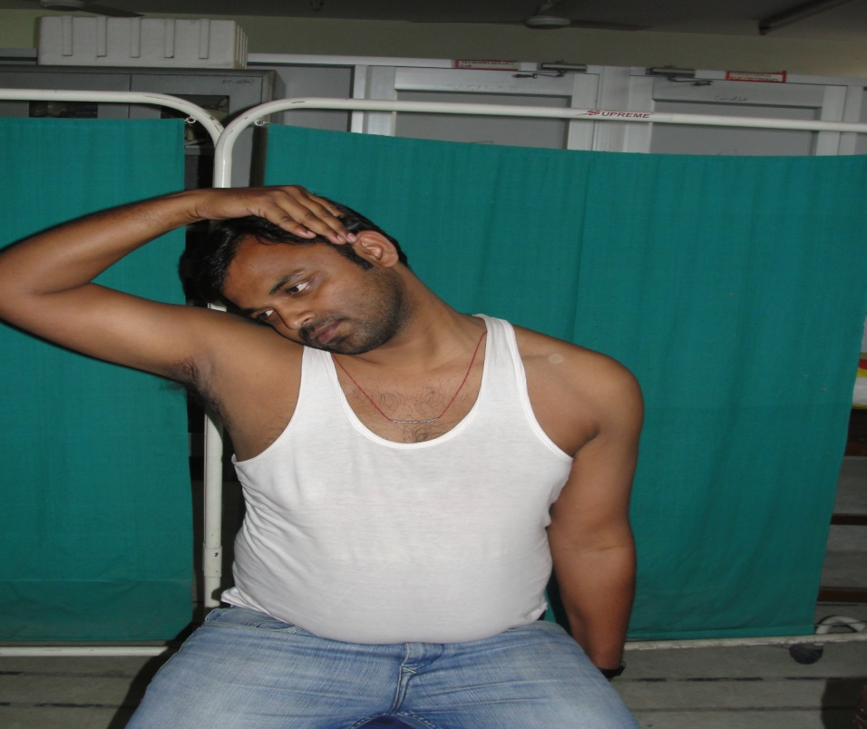
Application of Hydrocollateral pack on neck
Self stretching for trapezius

Slide 47
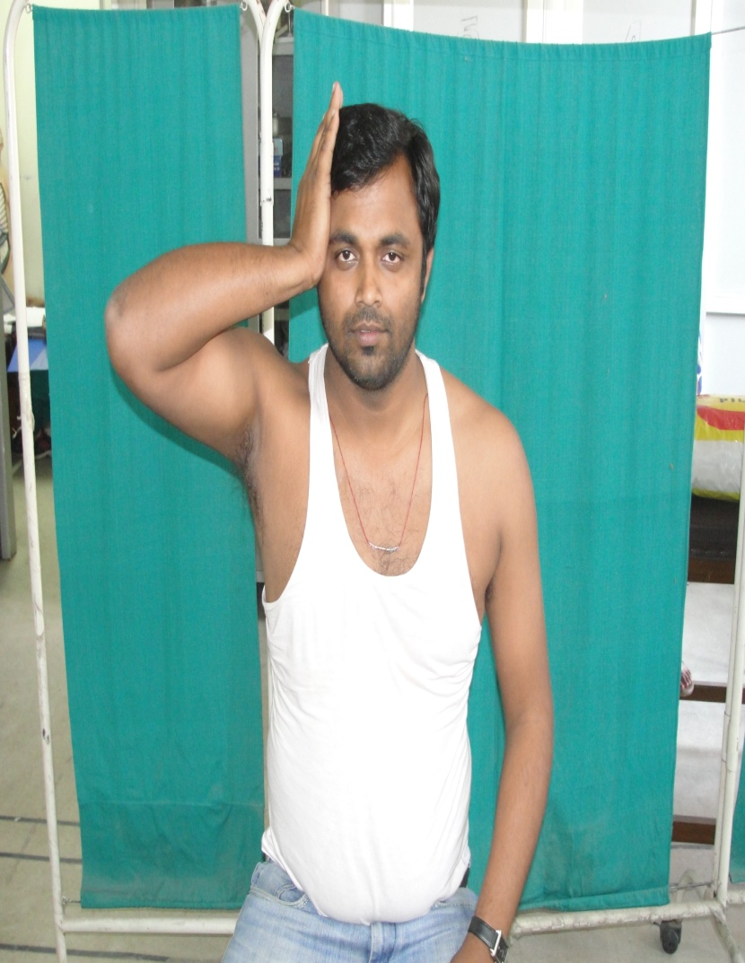
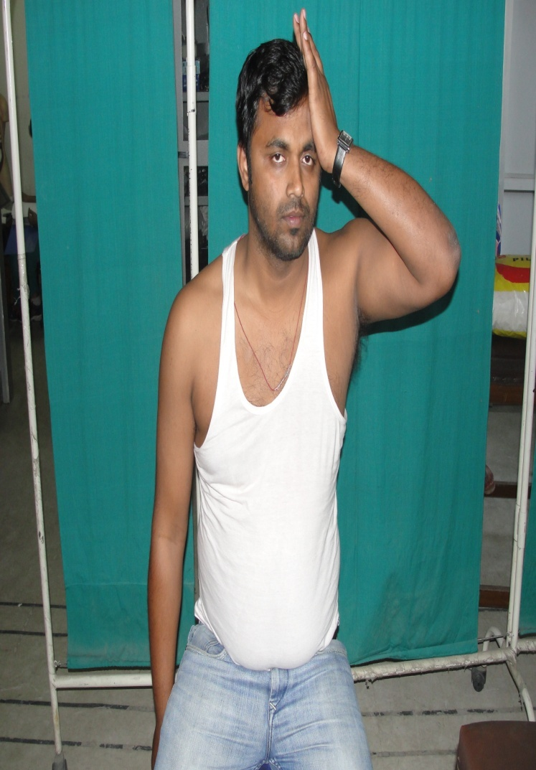
Isometrics for lateral flexors
Isometrics for rotators

Slide 48
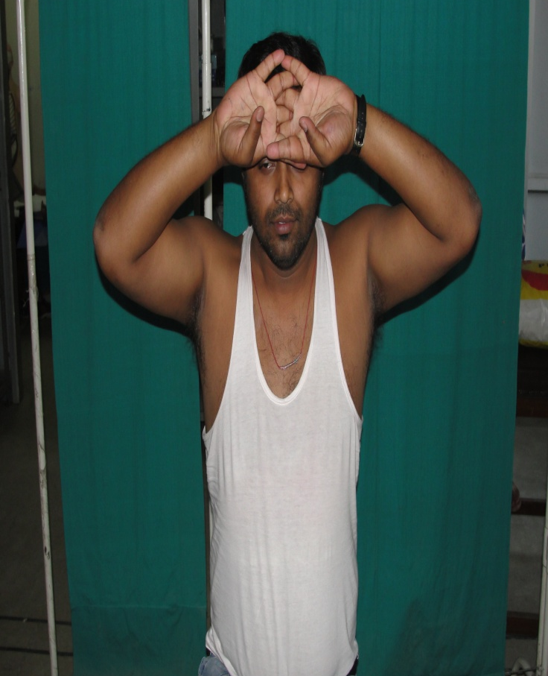
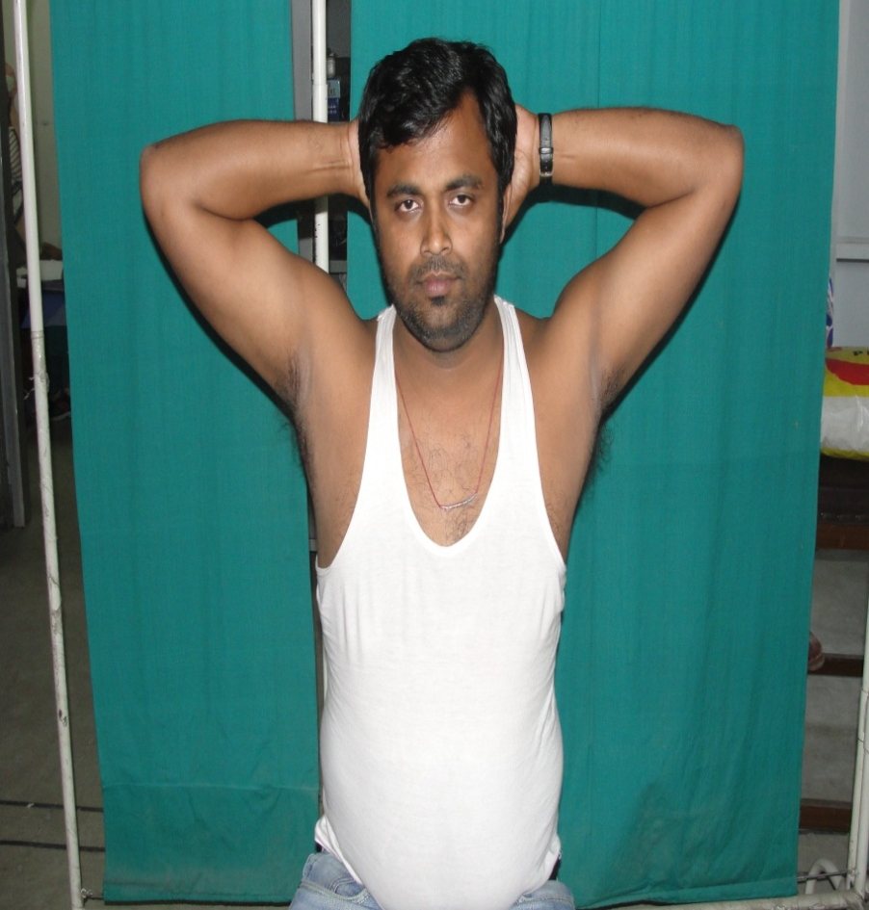
Isometrics for flexors
Isometrics for extensors

Slide 49
Posture
workstation

Slide 50
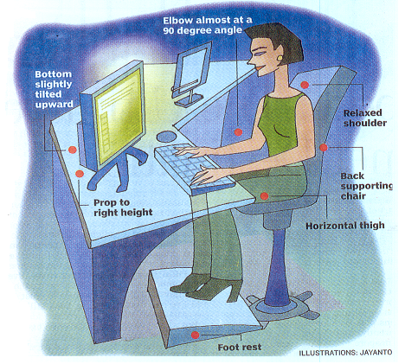
Important guidelines to maintain a good posture while working with computers

Slide 51
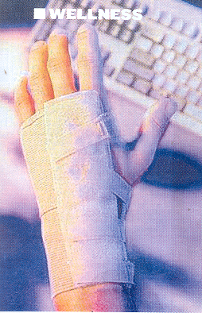

Slide 52
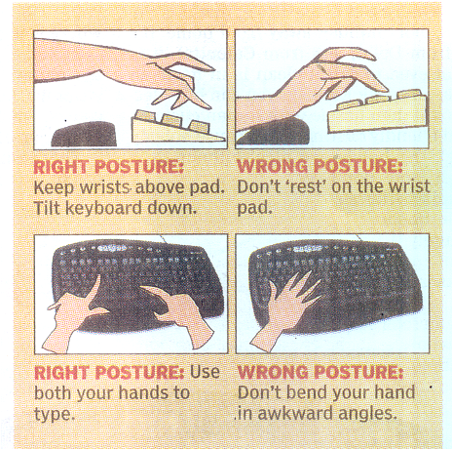

Slide 53
1. Work desk
Sufficiently large to allow all work related materials
Non reflective surface
Typical height = 29 inches
Preferably adjustable desk

Slide 54
2. Height of the chair should be such that it provides
Full support to thigh
Feet resting flat on the floor
Proper support to the lower back of the worker (100°-110°)

Slide 55
3. Footrest
It may help to achieve the desired position of lower limb

Slide 56
4. Monitor
A brand new monitor of a renowned company
High safety standard
Sharp and flicker free image
Adjustable brightness and contrast
Adjustable tilt and angle of the monitor
The top of the monitor should be at level or just below the viewer’s eyes
Cont.

Slide 57
There is a lot of debate about the harmful effects of electromagnetic and electrostatic fields around the monitor.

Slide 58
Precautions:
Keep the monitor at a proper distance
Maintain a distance of 3 feet from the back of any monitor
Keep the screen clean

Slide 59
5. Keyboard
AS thin as possible
Free to move
Legible
Giving a distinct feel when pressed

Slide 60
6. Ambience
Brightly lit room
Light points on the sides of the workers
Temperature(18°-22°)
Humidity (About 50%)
Controlled noise level

Slide 61
7. Work organization
No burden of work
No electronic supervision without the workers knowledge
A few minutes break every hour

Slide 62
GROUP B: Muscle Energy Technique and conventional treatment
The Procedure of Muscle energy technique, for the cervical spine was given to the subject according to the procedure given by (Chaitow et al., 1996).
Position of Patient : supine lying
Therapist localizes the joint or the body tissue into the position of initial range of motion resistance to a specific movement (rotation or lateral flexion).
Therapist will position the subject’s cervical spine to bend contra laterally to just short of restriction barrier
The therapist stabilized affected side shoulder by one hand and other hand cupped the ear & mastoid area of same side of head in a crossed manner

Slide 63
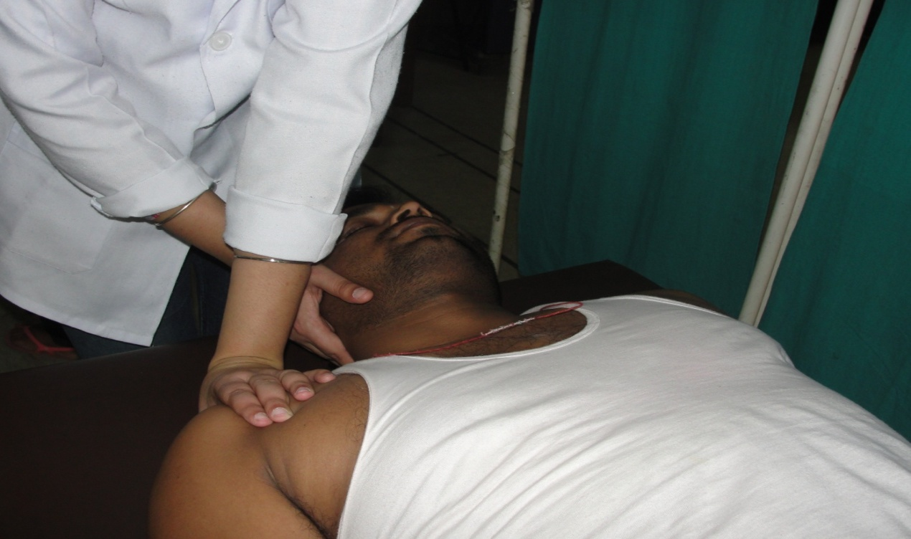
GROUP B: Muscle Energy Technique and conventional treatment:
Demonstration of Muscle energy technique (MET)

Slide 64
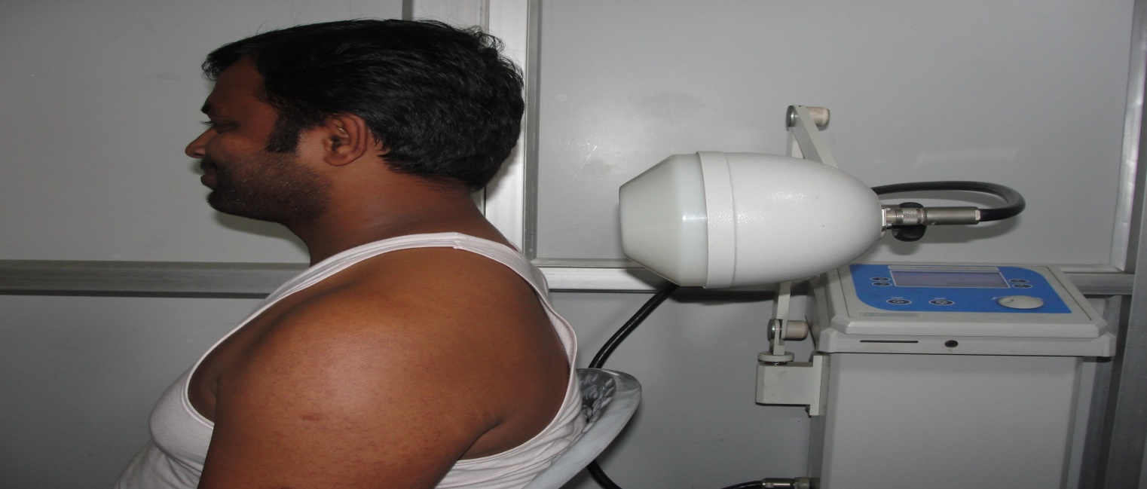
Group C: Conventional treatment MET and Microwave diathermy (MWD).
Conventional treatment and MET was given to the subjects as explained above followed with application of Microwave diathermy (MWD).
Set up –
Model of equipment - Aurasalus SRL(Radar 250 CP)
Mode of Intervention - Pulsed Microwave diathermy.
Electrode - Circular
Frequency - 2450MHz.
Distance of the subject from the emitter -15cm.
Duration - 15 min.

Slide 65

Results

Slide 66
Table 4: Demographic characteristics of subjects included in different
Interventional groups.
Interventional Groups | No of subjects:60 |  | Age (years) Mean (SD) | Height (m) Mean (SD) | Weight (kg) Mean (SD) | BMI Mean (SD)
 | Males | Females
Group A (Conventional) | 7 | 13 | 26.47 (3.59) | 1.61 (0.06) | 58.07 (7.22) | 22.31(3.23)
Group B (Conventional and MET) | 8 | 12 | 25.60 (3.45) | 1.62 (0.06) | 59.99 (4.74) | 22.73(1.73)
Group C (Conventional, MET and MWD) | 8 | 12 | 24.05 (2.43) | 1.65 (0.05) | 59.82 (3.79) | 22.00(1.25)

Slide 67
Table 5: Comparison of pre and post intervention mean scores for pain (VAS) and Neck disability (NDI) for groups A, B and C.
Within the Group Comparison | Pre intervention VAS vs Post intervention VAS t-value | Pre intervention NDI vs Post intervention NDI t-value
Group A (Conventional) | 6.2 S | 10.8 S
Group B (Conventional and MET) | 14.12 S | 10.7 S
Group C (Conventional, MET and MWD) | 19.9 S | 14.9 S
Notes:
S = p<0.05; NS = p>0.05

Slide 68
Table 6: Comparison of the improvement scores for Pain (VAS) and Neck Disability (NDI) between groups A, B and C (one way ANOVA)
Variable | Group A Mean (SD) | Group B Mean (SD) | Group C Mean (SD) | F value | Tukey’s Kramer post hoc test Group A Group A Group B vs vs vs Group B Group C Group C
Pain (VAS) | 2.55(1.05) | 5.5 (1.23) | 5.15 (1.63) | 29.46 S | S S NS
Neck Disability (NDI) | 12.5(7.22) | 42.8 (12.84) | 31.15(12.91) | 36.51 S | S S S
Notes:
S = p<0.05; NS = p>0.05

Slide 69


DISSCUSSION

Slide 70
The observations of the study in context to decrease in pain and disability after the interventions could be attributed to components of the interventional programs.
The superficial heating given in first intervention was attributed to reduce pain because application of hot pack reduces the sympathetic palmar sweating response.
Heat when applied to body
Increases the local blood flow
Cause the removal of pain provoking metabolites
Stretching and Isometric exercises
Increase in muscle excitability
Results in pain relief.
Induces analgesic effect (pain gate theory)
Reduces pain by decreasing the level of spasm.

Slide 71
MET used in the second and the third intervention is known for its hypo analgesic effect.
Isometric contraction
Activation of Inhibitory golgi tendon reflex
Reflex relaxation of muscle
Activation of muscle and joint mechanoreceptors
Sympathetic excitation evoked by somatic efferent’s and localized activation of Peri Aqueductal Gray matter (PAG)
Causes descending modulation of pain.
Changes in pacinian corpuscles
Results in relaxation of musculotendinous unit tension
Decreases perception of pain

Slide 72
Post isometric relaxation was claimed to be an effective method for acute tension in soft tissue problems that preclude
This phenomena could be related to the greater decrease in pain in the second and third intervention in comparison to the first.
Post isometric relaxation (Digiovanna and Schiowitz, 1996).
Immediate spinal adjustments
Reduces muscle spasm that is responsible for spinal fixation
Reduces pain
Lengthen the tightened neck muscles to normalize gross cervical range of motion

Slide 73
However in the current study addition of MWD in the third intervention did not had any additional benefits on pain reduction.
Similar to our study Gupta et al., (2008) in their study compared the effect of Post Isometric Relaxation (PIR) and isometric exercises in neck pain.
They also concluded that Post isometric relaxation is more effective technique in decreasing pain and disability and increasing cervical range of motion in patients with neck pain.

Slide 74
The observations of the current study suggesting no additional effect of MWD when added to MET and conventional interventions on reducing pain are supported by a study done by Ortega et al., (2013), which stated that microwave diathermy does not provide additional benefit to a treatment regimen of chronic neck pain that already involves other treatment approaches

Slide 75
Conclusion

Slide 76
The study elicited that there was a significant effect of computer usage on neck pain. Although increasing hours per week of computer usage had a seemingly positive relation with neck disability, years of computer usage did not seem to have a substantial effect on neck disability or neck pain.
With references to interventional approaches, it is concluded that Microwave diathermy and Muscle Energy Technique (MET) when added to the conventional physiotherapy programs may enhance the effectiveness of the protocol in the management of neck pain and disability among computer users.

Slide 77
Modern machines can perform
flawlessly for hours on end.
Unfortunately,
The operators behind them are
only human.

Slide 78


Times up….
….any Questions?
?
?
?
?
?
?
?
?

Slide 79
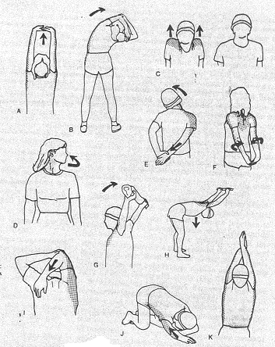

Slide 80
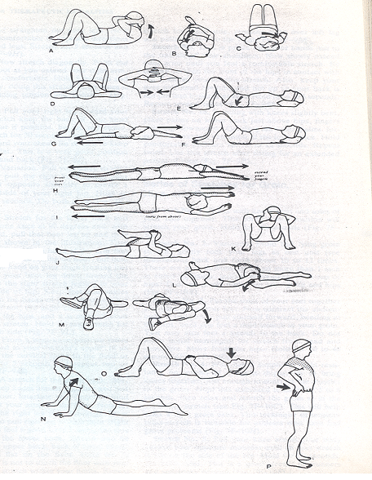

Slide 81
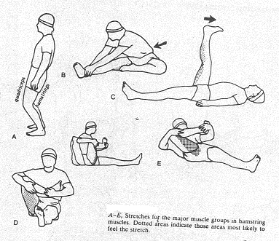

Slide 82
