Slide 1

Key steps in moving a vaccine from proof of concept in mice to human clinical trials
29 July 2015
Notes:
5th Asia Pacific Global Summit and Expo on
Vaccines & Vaccination
July 27-29, 2015 Brisbane, Queensland, Australia

Slide 2
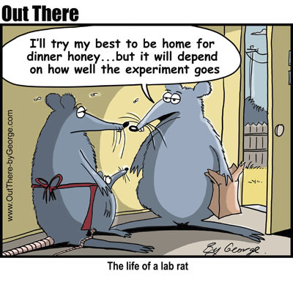
Introduction
Overview of vaccine development using university invented ChimeriVax™-JE as the template
How would I do things now if I was developing a vaccine as a University researcher?

Slide 3
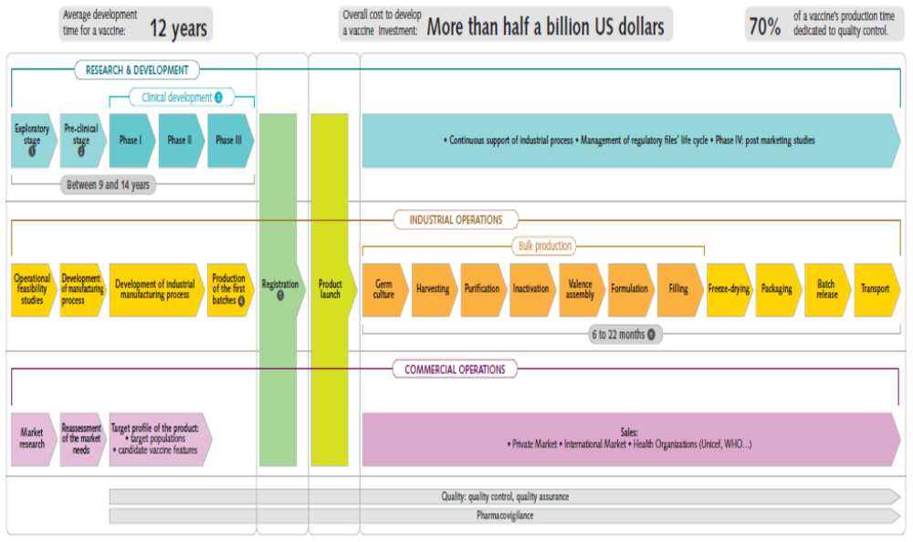
Industry overview of vaccine Development
Source: www.sanofipasteur.com

Slide 4
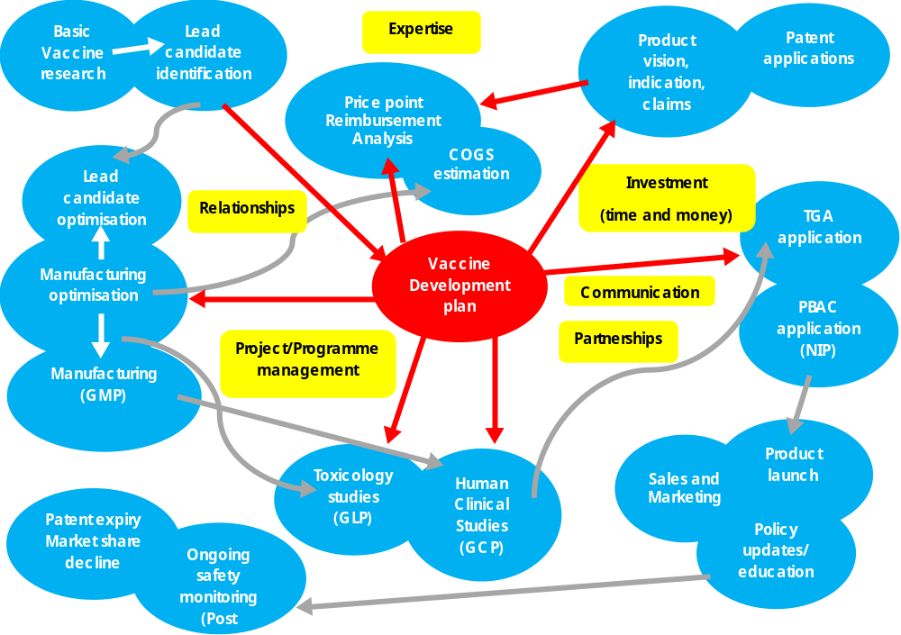
Activity map for vaccine development

Slide 5
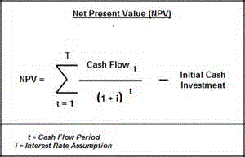
Why plan?
Investors want to see:
  The vaccine can be sold
  The Costs of Goods Sold (COGS) allows a profit to be made on the price point
  The Return on Investment (ROI) is achieved in a commercially reasonable time frame

Slide 6
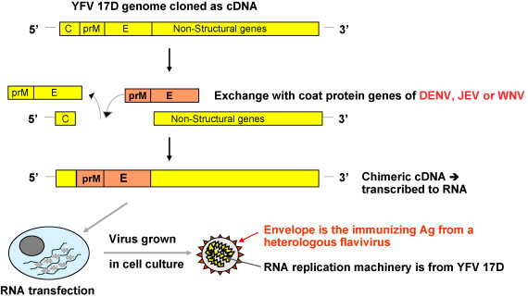
University Research (St Louis)
Chambers 1999
  Vaccine immunogenic in small animals
  Could be made in Vero cells
  Not neurovirulent in mice following IC challenge
  Characterised the attenuation sites of the vaccine
Chambers 1999. J Virol 73(4): 3095-101

Slide 7
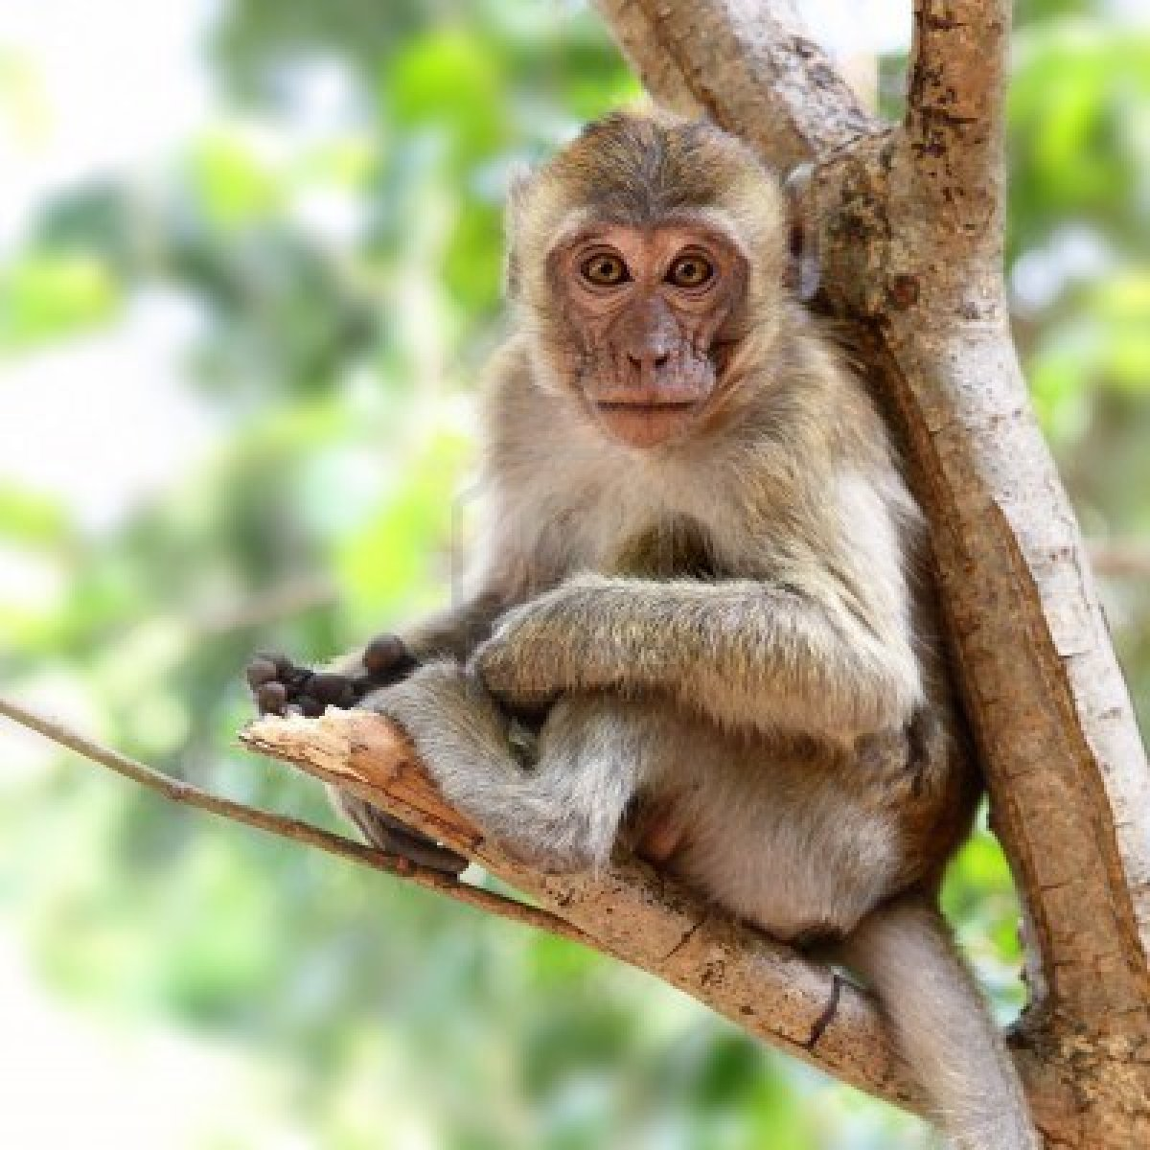
POC animal research –OroVax Inc (later Acambis Inc)
Monath 1999
  ChimeriVax™-JE was not neurovirulent in Rhesus monkeys (IC 6.6 log₁₀ PFU)
  Immunogenic
  Virulent JEV caused encephalitis in Rhesus challenged IC
  Vaccinated SC
  1/6 (17%) developed encephalitis vs. 4/4 (100%) in the unvaccinated controls
Monath 1999. Vaccine 17(15-16):1869-82

Slide 8
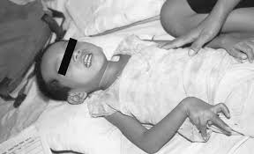
ChimeriVax™-JE (Imojev®)
Introduction
  ChimeriVax™-JE (now Imojev®) is a prophylactic vaccine to prevent Japanese encephalitis
Product vision
  Formulated to reduce reactogenicity associated with mouse-brain derived JE vaccines
  Cheaper to make
  Requires 1-dose instead of 3 to achieve equivalent immunogenicity to licenced vaccines
  Protection responses last > 3 years

Slide 9
Indication and Key claims
Indication
  Imojev® is indicated for prophylaxis of Japanese encephalitis caused by the Japanese encephalitis virus, in individuals from 12 months of age and over.
Key claims:
  Attenuated virus replicates inside host and elicits neutralising antibodies and a CMI immune response specific to JEV
  As a single dose, Imojev® is as immunogenic as a 3-dose regimen of JEV comparator vaccine
  Seroprotection (PRNT₅₀ titre > 10) is reached within 14-30 days
  Protective antibodies are present > 3 years
  Neutralising antibodies protect against wild-type JEV strains from the four genotypes
  Safe and immunogenic in paediatrics
  Safe and immunogenic in children (2-5 years of age) and adults who have already received JEV vaccine

Slide 10
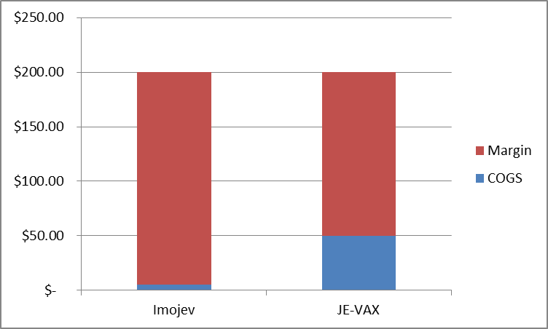
Price point/reimbursement analysis and COGS estimate
JE-VAX® (mouse-brain derived comparator vaccine) required 3-doses at Day 0, 7 and 30. $200/per course (2005 prices)
Imojev® could therefore be priced at $200/single injection (2005 prices)
CSL Jespect $120/dose (2-doses required (2013 price)
Imojev® expected $250-$280/dose
Imojev® manufactured in Vero cells would have a COGS < than a vaccine manufactured in suckling mouse brain
Source: IMS and TMVC

Slide 11
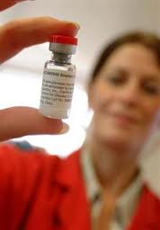
Formulations
Research material
  Harvested cell culture media – from Vero cells
Lead candidate
  Pilot wet-frozen formulation in 3-mL vials (Vero cells – not grown free of FCS)
Final commercial formulation
  Lyophilised, Japanese encephalitis virus: 4.0-5.8 log PFU (free of FCS)
  Excipients: Mannitol, lactose, glutamic acid, potassium hydroxide, histidine, human serum albumin, sodium chloride, water for injections. No adjuvant or antimicrobial preservative is added.

Slide 12
Manufacturing programme
Manufacturing
Culture of continuous Vero cells
Use of microcarriers in bioreactor to improve yields
SF medium used to lower adventitious agent risk
No antibiotics are used to reduce risk of hypersensitivity
Specifications:
Identity (and confirm attenuation sites)
Purity
Biological and physical characteristics
Sterility
Endotoxins
Vero cell DNA
Safety test (FDA)
Culture of Vero cells
Virus inoculation and propagation
Virus harvest
Down stream purification and filtration
Filing in a PETG bottles and storage
Thawing , filing vials and lyophilisation

Slide 13
Animal studies
Type | Species | Doses | Route | Endpoint
Immunogenicity (primary pharmacology) | Rhesus, Cynomolgous | 2-5 log₁₀ PFU | SC | Viraemia, antibodies, IC challenge, neutralisation
Secondary pharmacology | Not done | CPMP/SWP/465/95 guidance review
Safety pharmacology (GLP) | ICR mice, Rhesus, Cynomolgous | 0.1, 1, 2, 3, 5.85-6.22 log₁₀ PFU | IC | Survival, antibodies, viraemia, clinical, laboratory, necropsy, histology
Genotoxicity | Not done | CPMP/SWP/465/95 guidance review

Slide 14
Animal studies
Type | Species | Doses | Route | Endpoint
Toxicology (single dose only)* (local tolerance) | Cynomolgous | 5.2 log₁₀ PFU | SC | Survival, antibodies, viraemia, clinical, laboratory, necropsy, histology
Biodistribution | Cynomolgous | ? | SC | Viral shedding, distribution
Genetic stability | Cynomolgous | ? | SC | Attenuation sites maintained
* Consideration now given to clinical number of doses + 1 in repeat-dose toxicology in a immunologically relevant toxicological species
Carcinogenicity and reproductive toxicity – not required/not performed. Future vaccine studies should consider embryo-foetal toxicity risk.

Slide 15
Clinical programme
Subject number:
3476 healthy adult subjects (Australia and USA)
1500 children and toddlers (Thailand and Philippines)
Study number:
11 major studies
Pivotal Phase III endpoint:
PRNT₅₀ > 10 (WHO recommendation) as an agreed surrogate efficacy endpoint
Generally a WHO recommended safety database for a prophylactic vaccine is > 5000 subjects (WHO 2005)

Slide 16
Main Human studies
Study No. | Type | Reference
H-040-001 | Dose-ranging | Monath 2003. J Inf Dis 188(8): 1213-30
H-040-002 | Memory response
H-040-003 | Dose-ranging | Monath 2002. Vaccine 20(7-8): 1004-18
H-040-005 | Long term immunogenicity | Nasveld 2010. Hum Vaccine 6(11): 906-14
H-040-006 | Vaccine interaction | Nasveld 2010. Human Vaccine 6(12):1038-46
H-040-007 | Bioequivalence (pilot and lyophilised formulation) | Not published
H-040-009 | Pivotal adult Phase III | Torresi 2010. Vaccine 28(50):7993-8000
H-040-010 | Confirmatory adult Phase III
JEC01 | Paediatric study (toddlers) | Chokenhoibukit 2010. Pediatr Infect Dis 29(12): 1111-7
JEC02 | Paediatric study (toddlers and children Phase III) | Feroldi 2012. Hum vaccine Immunother 8(7): 929-37

Slide 17
Regulatory strategy
Joint US/Australian strategy for adult programme
Discussions with PFDA and TFDA about paediatric studies?
FDA – Type B meetings and IND filed
  Pre-IND meeting
  IND opened and maintained
  End of Phase II meeting
TGA
  Scientific advice meeting
  Filed for CTX for H-040-005. Used for subsequent studies
OGTR
  DNIR covering clinical studies in Australia
  DIR covering commercial use

Slide 18
Deals and Imojev® registration
Date | Deal | Value
~1999 | Bench research published and licensing agreement St. Louis university and OraVax (later Acambis) | Unknown
10 Nov 2005 | Acambis signs manufacturing and marketing agreement with Bharat Biotech International Ltd for India market | Unknown
20 Apr 2006 | Acambis completes enrolment for the pivotal adult Phase 3 studies of ChimeriVax™JE | Not publicly released
Feb 2007 | Acambis grants Sanofi Pasteur marketing, distribution and manufacturing rights for ChimeriVax™-JE | €30 million
26 Mar 2008 | Expanded agreement with Sanofi Pasteur for rights to Indian market. Bharat Biotech compensated | Unknown
25 Sep 2008 | Sanofi Pasteur acquires Acambis Inc. | £285 million
23 Aug 2010 | Registered on the ARTG | n/a

Slide 19
Recommendations
Answer core questions:
  What is the vaccine vision, indication and key claims?
  Can the vaccine be sold and reimbursed?
  Where is the vaccine now and where is my exit point?
Obtain your patent protection
Plan with the end in mind:
  Use a vaccine development plan to:
    Estimate your manufacturing, toxicology and human study requirements
    Plan should show the key milestones
    Estimate costs
    Show timelines
    Show resource requirements

Slide 20
Continued…
Talk to key people
  Discuss the plan, costs and potential value with regulators, investors and potential buyers under confidentiality agreements
  Get help to present the plan to regulators (TGA scientific advice meeting)
  Get help with your Investor /potential buyer slides. Have to be simple and to the point – few slides to convey the key messages upfront
Use and manage competencies
  Keep invested in the programme and maximise core competencies
  Build a nimble, virtual team to manage what is not your core competencies
  Outsource to competent companies

Slide 21
Core competencies

Slide 22
Acknowledgments
Professor Thomas Monath (Harvard School of Public Health, Cambridge MA)
Professor John Aaskov (QUT, Brisbane, Australia)
Professor Sutee Yoksan (Center for Vaccine Development, Institute for Molecular Biosciences, Mahidol University at Salaya, Thailand
Dr Niranjan Kanesa-thasan (Novartis vaccines and diagnostics, Cambridge, MA)
Dr Claude Meric and Dr Emmauel Feroldi (Sanofi Pasteur, Lyon France)
Dr Simon Coggins and Karen McCarthy (PPDI Inc, Granta Park, UK)
Ms Jenny Herz (Biointelect, Sydney, Australia)
Staff of the Australian Army Malaria Institute
Conflicts of Interest:
  Mark Reid is a current employee of Clinical Network Services (CNS) Pty Ltd and has acted as paid consultant to Acambis, Sanofi Pasteur, Novartis and the QUT

Slide 23
Level 4, 88 Jephson St
Toowong QLD 4066
AUSTRALIA
Tel: +61 (0)7 3719 6000
Fax: +61 (0)7 3719 6011
cns@clinical.net.au
www.clinical.net.au

Slide 24
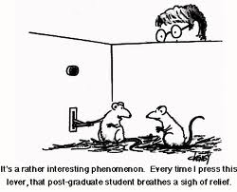
Introduction
Overview of vaccine development using university invented ChimeriVax™-JE as an example
How would I do things now if I was developing a vaccine as a University researcher?

