Slide 1

About OMICS Group
OMICS Group International is an amalgamation of Open Access publications and worldwide international science conferences and events. Established in the year 2007 with the sole aim of making the information on Sciences and technology ‘Open Access’, OMICS Group publishes 400 online open access scholarly journals in all aspects of Science, Engineering, Management and Technology journals. OMICS Group has been instrumental in taking the knowledge on Science & technology to the doorsteps of ordinary men and women. Research Scholars, Students, Libraries, Educational Institutions, Research centers and the industry are main stakeholders that benefitted greatly from this knowledge dissemination. OMICS Group also organizes 300 International conferences annually across the globe, where knowledge transfer takes place through debates, round table discussions, poster presentations, workshops, symposia and exhibitions.

Slide 2
About OMICS Group Conferences
OMICS Group International is a pioneer and leading science event organizer, which publishes around 400 open access journals and conducts over 300 Medical, Clinical, Engineering, Life Sciences, Pharma scientific conferences all over the globe annually with the support of more than 1000 scientific associations and 30,000 editorial board members and 3.5 million followers to its credit.
OMICS Group has organized 500 conferences, workshops and national symposiums across the major cities including San Francisco, Las Vegas, San Antonio, Omaha, Orlando, Raleigh, Santa Clara, Chicago, Philadelphia, Baltimore, United Kingdom, Valencia, Dubai, Beijing, Hyderabad, Bengaluru and Mumbai.

Slide 3
The Theoretical Optimization of a Cylindrical Body of Rotation Using Magnus Effect Lift
Nate Callender
Middle Tennessee State University

Slide 4

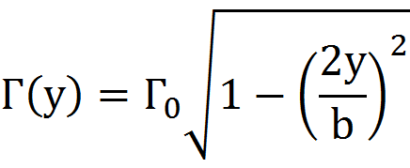
Background
Kutta-Joukowski theorem gives lift as a function of circulation
Prandtl’s lifting line theory leads to an optimized circulation distribution
Robins-Magnus effect produces lift via friction driven circulation

Slide 5
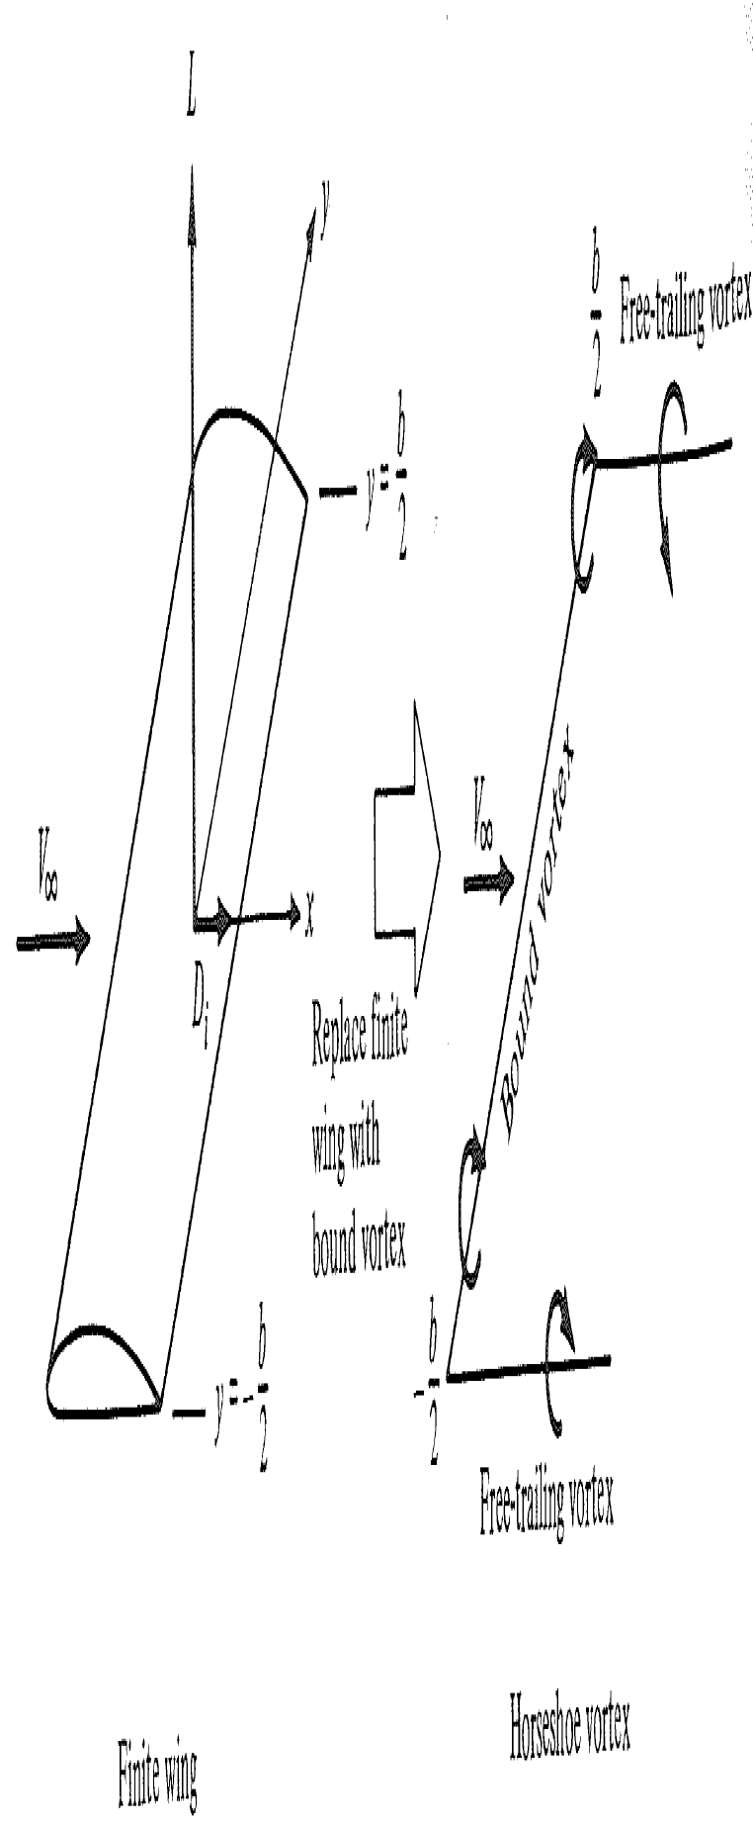
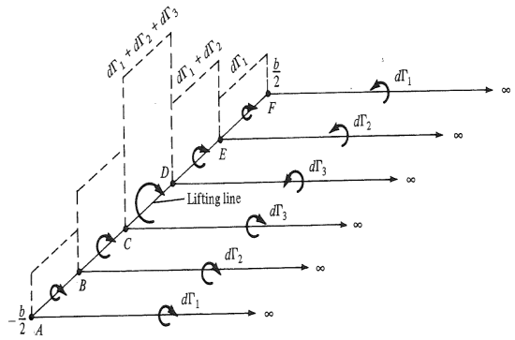
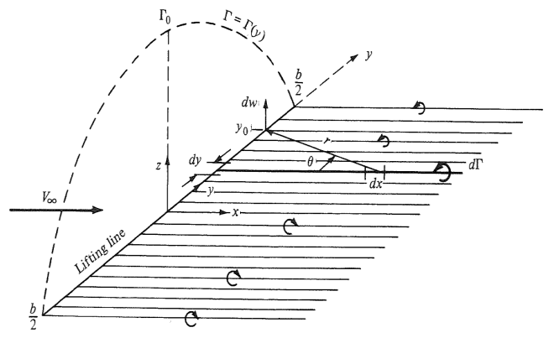
Lifting Line Theory
Finite wing represented by horseshoe vortex
Superposition of a finite number of horseshoe vortices
Superposition of an infinite number of horseshoe vortices yielding a distribution of circulation

Slide 6
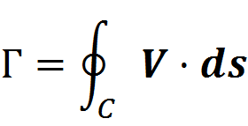
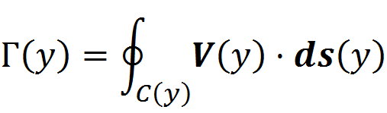
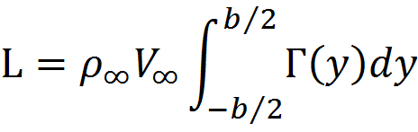
Lifting Line Theory cont.
Circulation distribution
Lift from integration
Notes:
This adapts the two dimensional lift calculated via the Kutta-Joukowski theorem to the lift created by an object with span (a third dimension)!

Slide 7
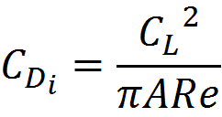
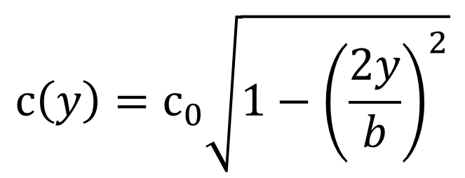
Minimum Induced Drag
Induced drag coefficient from lifting line theory
  Span efficiency factor
    General circulation distribution 0 ≤ e ≤ 1
    Elliptical circulation distribution
    e = 1
Munk derived the theoretically optimum chord distribution for a finite wing
$$c\left(y\right)=c_{0}\sqrt{1−{\left(\frac{2y}{b}\right)}^{2}}$$
Notes:
Munk, a student and colleague of Prandtl’s, coined the term induced drag in 1918, aided Prandtl along with Albert Betz in developing the lifting line theory, and determined the necessary condition for achieving the minimum induced drag value (i.e. a constant downwash along the lifting line). This was accomplished via the elliptical circulation distribution.

Slide 8
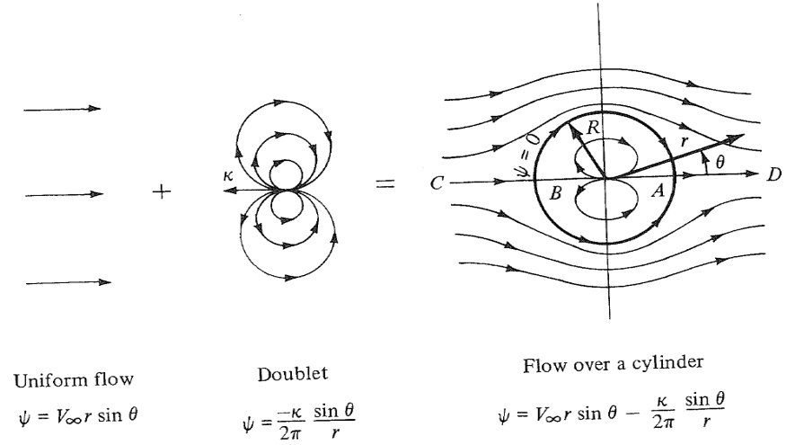
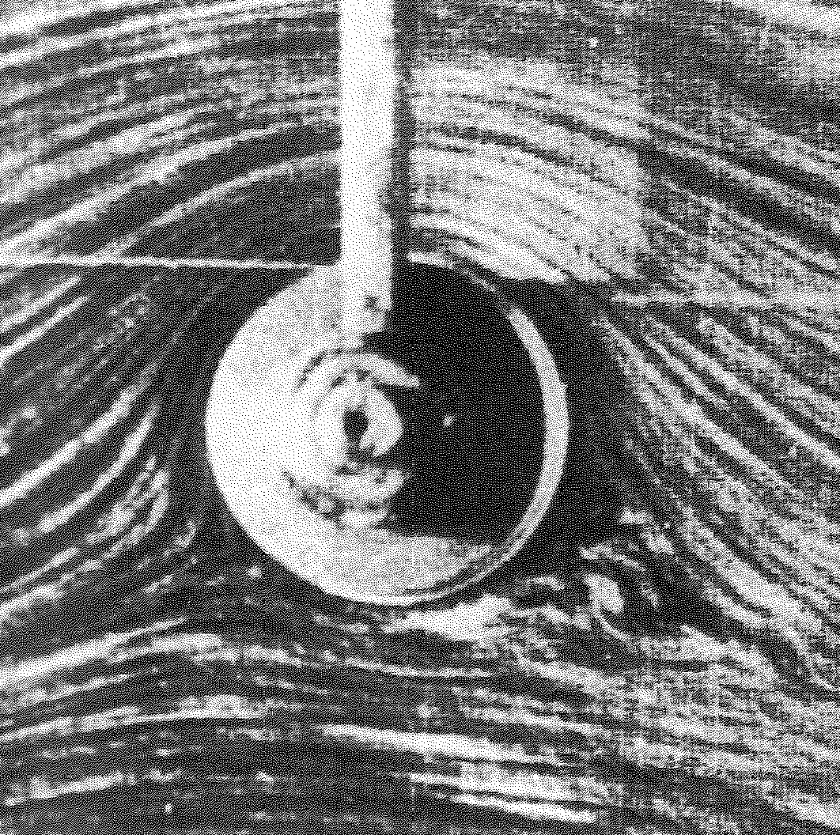
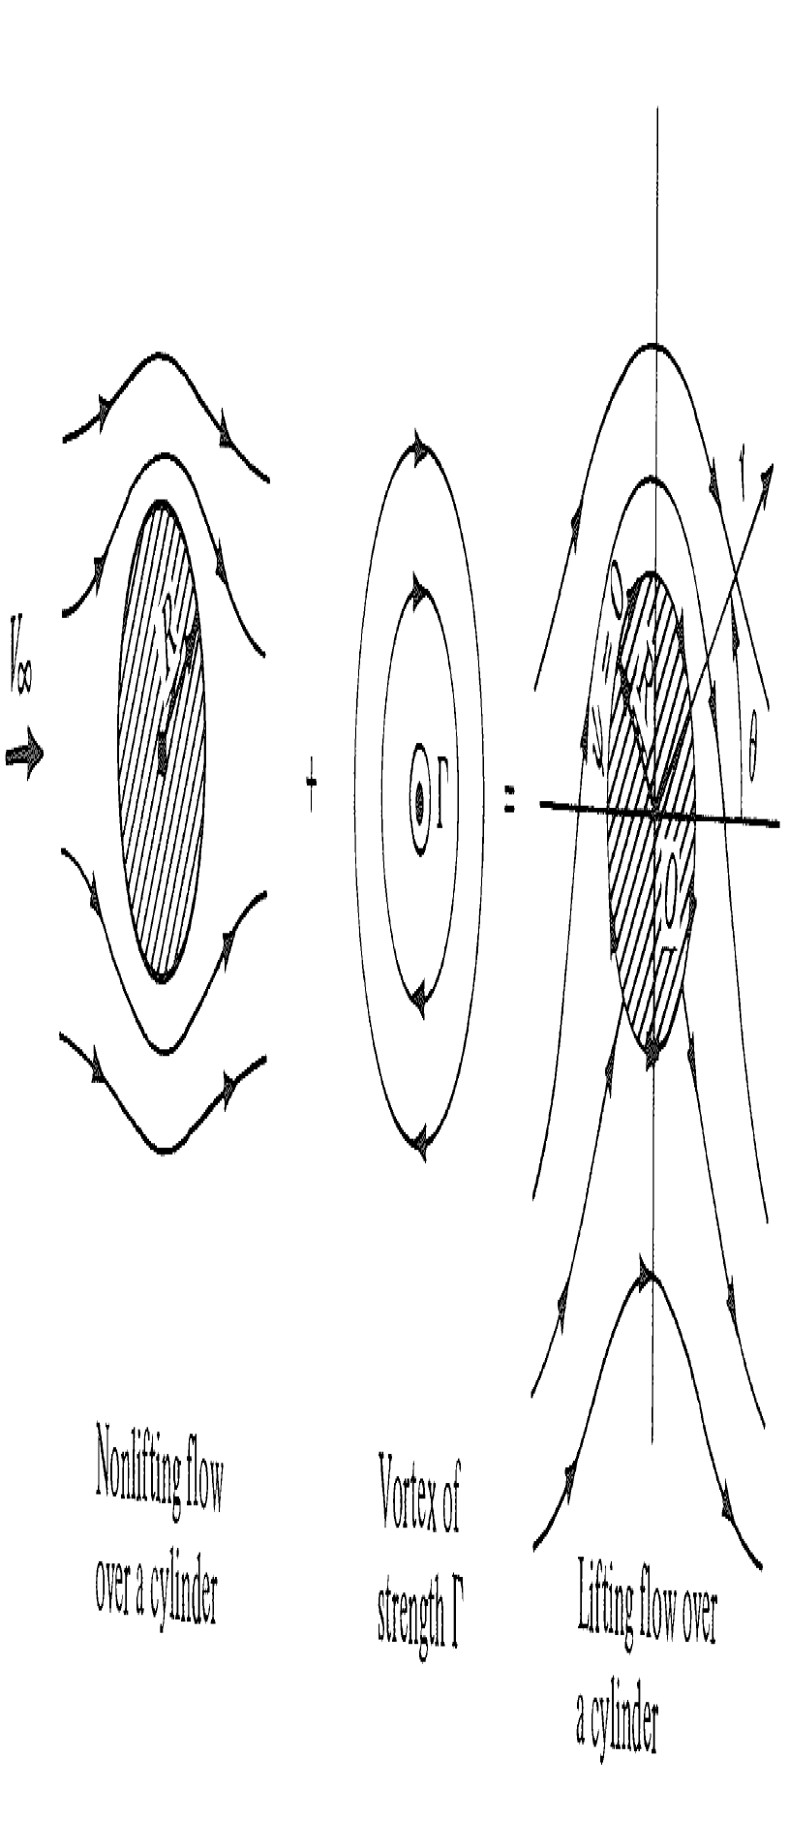
Robins-Magnus Effect

Slide 9
Current State of the Art
Nonrotating infinite cylinders
Rotating 2D cylinders

Slide 10
Nonrotating Circular Cylinders
Notes:
Re:
0-4: Creeping, Stokes flow, nearly symmetric streamlines
4-40: Stable attached vortices symmetric about the flow axis
40-up: Karman vortex street, oscillatory separating vortices

Slide 11



Rotating Circular Cylinders
Prandtl’s theoretical maximum lift coefficient
Experiment has shown higher values
Numerical studies have shown values even higher
Notes:
These have been 2D or with cylinder tips capped.

Slide 12


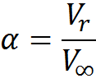
Rotating Circular Cylinders
Definitions:
Uniform stream:
Tangential velocity of the cylinder’s surface:
Ratio of surface velocity to uniform stream:

Slide 13
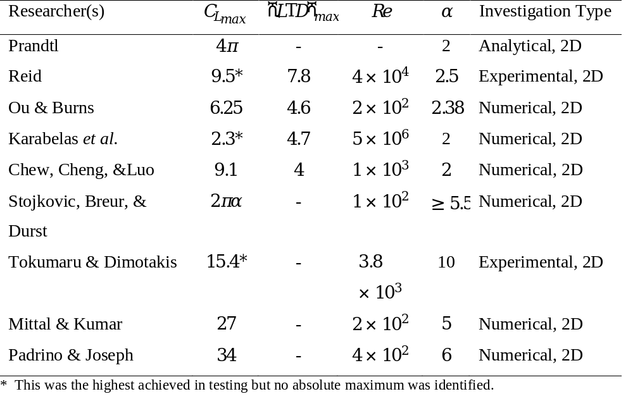
Rotating Circular Cylinders
Studies to date have been two dimensional
  Analytical:
    2-D
  Experimental:
    Full span
    End plates
  Numerical:
    2-D
    End plates

Slide 14
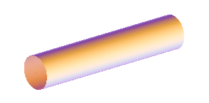
Rotating Circular Cylinders
Constant Diameter Circular Cylinders (CDCC)

Slide 15
Theoretical Goal
The goal is to theoretically optimize the lifting, rotating cylinder by developing the three dimensional cylindrical geometry that will create an elliptical circulation distribution.

Slide 16
Bodies of Revolution
Spheroids were considered first
  Elliptic planform
  Elliptic velocity distribution at the surface due to rotation
  however…

Slide 17
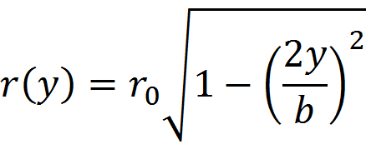
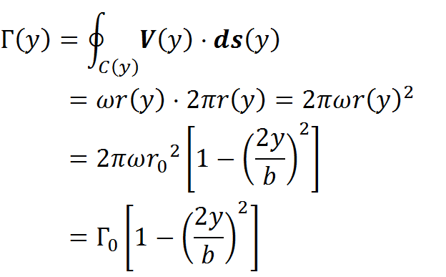
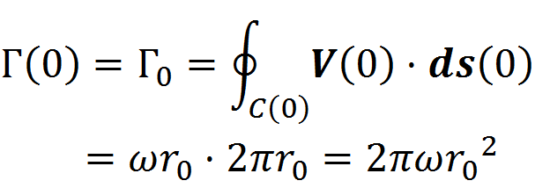
Bodies of Revolution cont.
When beginning with a prolate spheroid geometry:
Parabolic circulation distribution

Slide 18
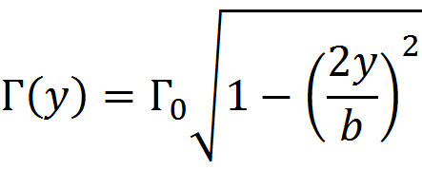
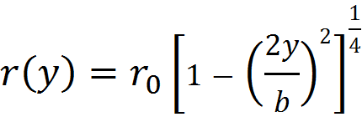

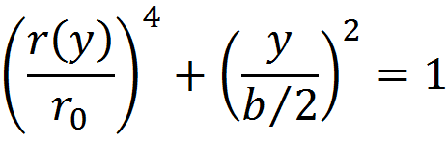
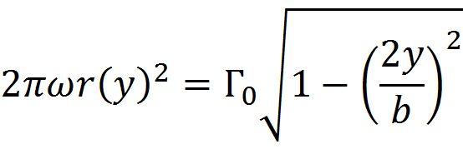
Bodies of Revolution cont.
Must begin with the elliptic circulation distribution and solve for the appropriate geometry:
Biquadratic Body of Revolution (BBOR)

Slide 19
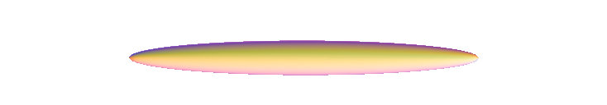
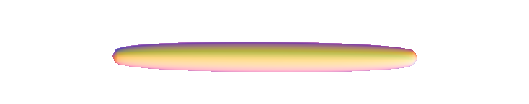
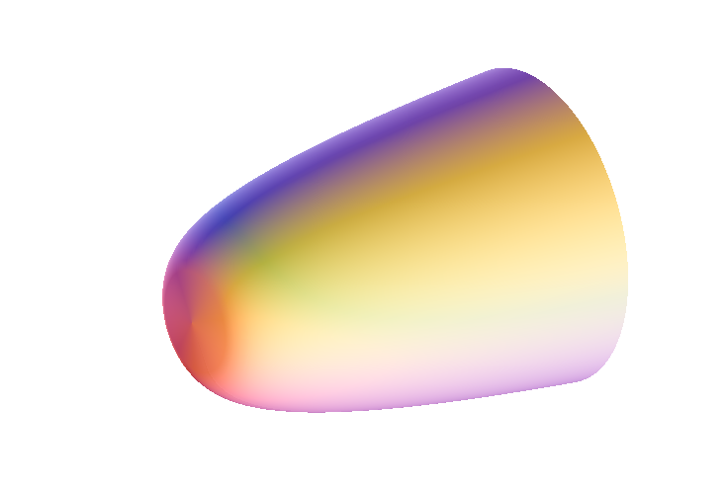
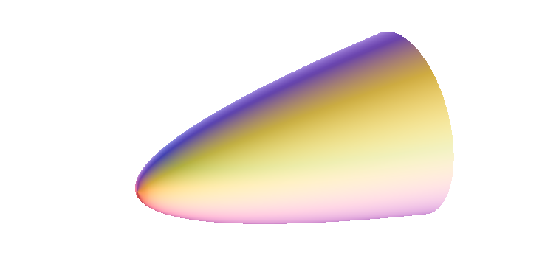
Bodies of Revolution cont.
Prolate Spheroid
Biquadratic Body of Revolution

Slide 20
Circulation Distributions
Elliptical (Biquadratic)
Parabolic (Spheroid)

