Slide 1
When Investment for Medical Countermeasures Against Rare, but Dangerous Agents Becomes Cost-Effective – The Ebola Case
MJ Lawrence Consulting +
Université Panthéon-Assas (LEMMA)
Presented by
Mark Lawrence Johnson
15th Annual Summit on Vaccines and Immunization
Berlin, Germany
February 20-21, 2017

Slide 2





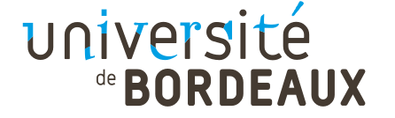
When Investment for Medical Countermeasures Against Rare, but Dangerous Agents Becomes Cost-Effective – The Ebola Case
PhD Co-Direction
Frederic Dorandeu¹, Marianne Guille²
^{1.} Armed Forces Biomedical Research Institute (IRBA), Brétigny-sur-Orge, France +
Ecole du Val-de-Grace, Paris, France
^{2.} Université Panthéon-Assas (LEMMA), Paris, France & Labex MME-DII
Also supporting and monitoring progress:
Jean Belin: University Bordeaux 4 (Gretha -UMR CNRS 5113), Pessac cedex, France +
Armament and defence economy chair (cercle des partenaires de l’IHEDN)

Slide 3
Context
“The rise in terrorist related events over the past year has reinforced that our collaborative efforts in response to CBRN threats remain a high priority”
(Global Health Security Initiative, 2016)
Ministers/Secretaries/Commissioner from Canada, France, Germany, Italy, Japan, Mexico, the United Kingdom, the United States and the European Commission. Ministers of Health established this initiative in November 2001, with a call for “concerted global action to strengthen the public health response to the threat of international biological, chemical and radio-nuclear terrorism”
GHSI. (2016). 16th Ministerial Meeting. Washington D.C., USA.

Slide 4
Agenda
The R&D Process of Drugs and Vaccines
CBRN Market Characteristics
Ebola Outbreak 2014
  Factors Inhibiting MCM Readiness
  Reasons to Act
  Learnings
Discussion

Slide 5
Agenda
The R&D Process of Drugs and Vaccines
CBRN Market Characteristics
Ebola Outbreak 2014
  Factors Inhibiting MCM Readiness
  Reasons to Act
  Learnings
Discussion

Slide 6
Examples of Medical Countermeasures (MCM)
The R&D Process of Drugs and Vaccines
Medical Countermeasures (MCM)
A drug, biological product or device that treats, identifies or prevents harm from a biological, chemical, radiological or nuclear agent that may cause a public health emergency.¹
Examples
Drugs
Antidote
Vaccines
Antivirals
Point of Care (POC) diagnostic devices
Benefits
Protecting human life by providing a medical treatment for disease or making one immune against it
Quick & easy field devices that can determine human exposure to chemical, biological, radiological nuclear (CBRN) agents
  To initiate early treatment
  Issue early warnings
  Allow mass screening of the “worried well” population so that hospital resources can be reserved for the injured during a real event
In the event of CBRN exposure, MCMs must not only be developed and manufactured, but they must also be readily available onsite when and where a CBRN Event occurs
1. Stroud, C., Nadig, L., & Altevogt, B. M. (2010). Medical Countermeasures Dispensing: Emergency Use Authorization and the Postal Model. Washington, D.C. USA: National Academy of Sciences.

Slide 7
Agents as Classified by the US CDC*
The R&D Process of Drugs and Vaccines
Biological Agents - Category A
Chemical Agents
Definition:
Can be easily disseminated or transmitted from person to person
Chemical agents already known to be used as weaponry;
Availability of chemical agents to potential terrorists
    Result in high mortality rates and have the potential for major public health impact;
    Might cause public panic and social disruption; and
    Require special action for public health preparedness
Agents/Diseases:
Anthrax (Bacillus anthracis)
Botulism (Clostridium botulinum toxin)
Plague (Yersinia pestis)
Smallpox (variola major)
Tularemia (Francisella tularensis)
Viral hemorrhagic fevers (filoviruses [e.g., Ebola, Marburg] and arena viruses [e.g., Lassa, Machupo])
Nerve (Organophosphates)
Blood
Blister
Heavy metals
Volatile toxins
Pulmonary, incapacitating, pesticides, persistent/non-persistent, etc.
Top threats include the Ebola virus (already identified as “Category A” no later than the year 2000) and Nerve agents (Chemical agents born during War World II)
(US CDC, 2000)
* Centers for Disease Control and Prevention
US CDC. (2000). Biological and Chemical Terrorism: Strategic Plan for Preparedness and Response. 49 (RR04); 1-14. Atlanta, Georgia USA. Retrieved from http://www.cdc.gov/mmwr/preview/mmwrhtml/rr4904a1.htm

Slide 8
Trial Phases of Vaccines
The R&D Process of Drugs and Vaccines
Trial Phase | Description
Pre-clinical trials | Carried out in laboratories and animals and aim to: 1) determine whether a vaccine works as intended and 2) to identify any harmful effects.
Phase I trials | Involve 20 to a few hundred healthy individuals and examine safety and immune response. They also identify commonly-occurring adverse reactions.
Phase II trials | Involve several hundred to a few thousand people and determine the optimum vaccine composition for achieving protection while ensuring safety.
Phase III trials | involve thousands to tens of thousands of people and examine the vaccine's ability to prevent a disease as intended. They also provide further safety information.
Post-licensure monitoring | Also known as formal Phase IV trials involve the target population. These surveillance activities identify, through spontaneous reporting systems to health authorities, less common adverse events, events which could occur after a long time, or events that may occur in specific subgroups of the target population.
(WHO, 2015)
In addition to extensive study requirements, the transformation from small-scale to large-scale manufacturing is a major project – Often a new facility must be built (or an old one reconstructed).
(PhRMA, 2007)
WHO. (2015). Ebola vaccines, therapies, and diagnostics. Retrieved February 16, 2016, from http://www.who.int/medicines/Ebola-RD-QA-Updated-July-2015.pdf?ua=1
PhRMA. (2007). Drug Discovery and Development: Understanding the R&D Process. Washington DC, USA.

Slide 9
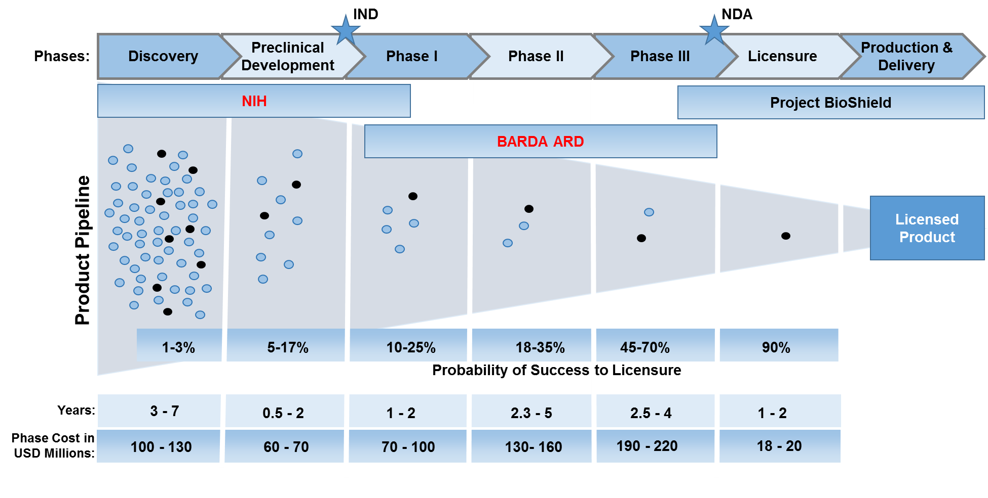
Phase Development for MCM against CBRN Agents
The R&D Process of Drugs and Vaccines
ARD = Advanced Drug Research
IND = Investigational New Drug
NDA = New Drug Approval
NIH = US National Institute of Health
(Robinson, BARDA Industry Day 2015)
One new drug or vaccine takes ~10-20 years¹ with out-of-pocket expenses estimated from ~850 million² up to 1.5 billion USD¹
1. Robinson, Robin A. BARDA Industry Day. Ronald Reagan Building, Washington DC, USA. Oct 14, 2015.
2. Reeves, Stephen V., interview by Mark Lawrence Johnson. Major General, USA (Ret) (Oct 20, 2015)

Slide 10
Characteristics that can inhibit R&D initiatives for CBRN MCM
The R&D Process of Drugs and Vaccines
Barrier | Characteristics Relevant for CBRN MCM
ANIMAL STUDIES | Since patients exposed to rare and highly dangerous CBRN agents are often not available to test MCM efficacy, animal studies must be designed and proven relevance to humans must be established. Such animal studies are highly complex, time consuming, and costly.
BIOSAFETY LEVEL (BSL) | Given that many CBRN MCM target highly dangerous agents, access to BSL-3 & 4 labs is most often a must. However, gaining access to such labs can be difficult; resulting in waiting times (e.g. 1 year) and significant costs.
RELIANCE ON GOVERNMENT FUNDING | CBRN MCM development is often dependent on government funding. However, government money is not always available when needed. In addition, transitions from one government agency to another are not always smooth.
Financial Risk | Few customers, severely limited market potential, unknown time that governments will remain committed to procurement plans.
The combination of additional barriers posed to R&D initiatives together with undesirable market characteristics can work to deter industry
Johnson, Virginia G., interview by Mark L. Johnson. President at Regulatory Science, LLC (Oct 21, 2015).
Reeves, Stephen V., interview by Mark Lawrence Johnson. Major General, USA (Ret) (Oct 20, 2015).
Tong, Xiaomi, interview by Mark L. Johnson. Sr. Regulatory & Quality Affairs Consultant at Smart Consulting Group, LLC (Oct 22, 2015).

Slide 11
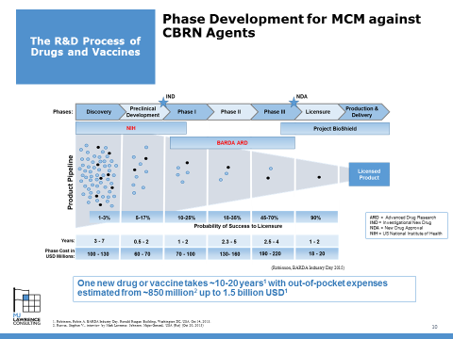
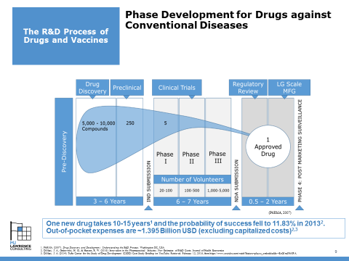
Comparison of R&D Effort to Achieve Drugs and vaccines (CBRN Agents vs. Conventional Diseases)
The R&D Process of Drugs and Vaccines
DRUGS & VACCINES AGAINST | TIME | COSTS (Out-of-Pocket) | COST OF CAPITAL
CBRN AGENTS | ~10 to 20 years¹ | ~850 million² to 1.5 billion¹ | N/A when funded by government
CONVENTIONAL DISEASES | 10 to 15 years³ | ~1.395 Billion USD^{4,5} | ~1.163 Billion USD
TOTAL COST MULTIPLIERS
Success Rates: According to data based on conventional diseases, only 1 out of 8 candidates are likely to be successfully approved^{4,5}
Cost of Capital (Opportunity Costs): Applies when R&D funding is provided by private investors and represents the return on investment that investors require in order to put these funds at risk – THIS CAN INCREASE OVERALL COSTS BY ALMOST 100%.
When comparing available R&D data concerning time and costs (CBRN vs. Conventional Diseases), many similarities can be recognized
1. Robinson, Robin A. BARDA Industry Day. Ronald Reagan Building, Washington DC, USA. Oct 14, 2015.
2. Reeves, Stephen V., interview by Mark Lawrence Johnson. Major General, USA (Ret) (Oct 20, 2015)
3. PhRMA. (2007). Drug Discovery and Development: Understanding the R&D Process. Washington DC, USA
4. DiMasi, J. A., Grabowski, H. G., & Hansen, R. W. (2016). Innovation in the Pharmaceutical Industry: New Estimates of R&D Costs. Journal of Health Economics
5. DiMasi, J. A. (2014). Tufts Center for the Study of Drug Development (CSDD) Cost Study Briefing on YouTube. Retrieved February 12, 2016, from https://www.youtube.com/watch?feature=player_embedded&v=EcGJm5FrMPA.

Slide 12
Agenda
The R&D Process of Drugs and Vaccines
CBRN Market Characteristics
Ebola Outbreak 2014
  Factors Inhibiting MCM Readiness
  Reasons to Act
  Learnings
Discussion

Slide 13
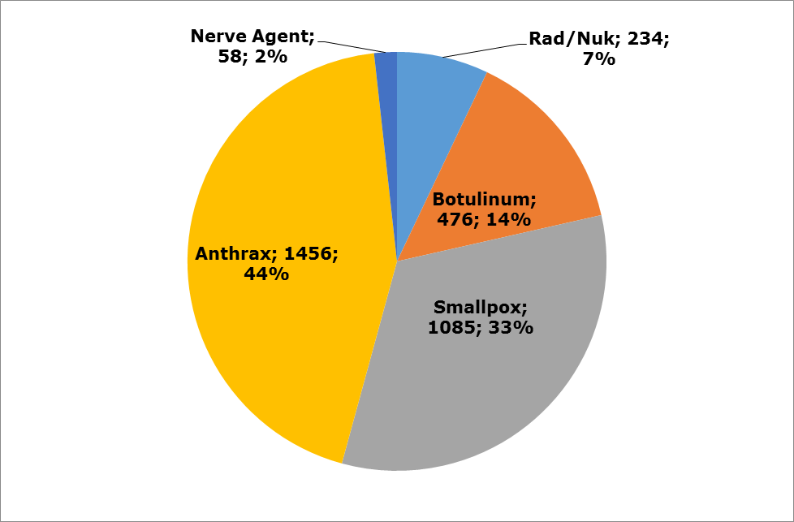
Project BioShield Procurement Activity (2004-14) by CBRN Therapy Group
CBRN Market Characteristics
Top Priority in the US was on Anthrax and Smallpox
Not including US Military. There are, of course, other global customer purchases; however, they remain ambiguous and far less substantial.
A total of 3.3 Billion USD over 10 years (2004-14) through Project BioShield
(Gottron, 2014)
NOTE: BioShield’s Pandemic and All-Hazards Preparedness Reauthorization Act of 2013 authorized up to 2.8 billion USD for the fiscal years 2014 through 2018 (PHEMCE, 2014) – an average of 560 million per year. However, it is likely not all will be spent on MCM procurement
Gottron, F. (2014). The Project BioShield Act : Issues for the 113th Congress. Congressional Research Service.

Slide 14
Project BioShield Procurement Activity (2004-14) by Company
CBRN Market Characteristics
A modest number of developers/manufacturers with active procurement activity makes up the industry base.
Threat | Product | Doses (in 000) | Cost (USD mio) | Company | Award Date
Anthrax | rPA vaccine | 0 | 2 | VaxGen | 11/2004
 | AVA vaccine | 28,750 | 700 | Emergent BioSolutions | 5/2005, 5/2006, 9/2007, 4/2012
 | Raxibacumab | 125 | 530 | GlaxoSmithKline | 6/2006, 7/2009, 9/2013
 | Anthrax Immune Globulin | 20 | 224 | Cangene Corp. | 7/2006, 4/2012, 9/2013
SmallPox | MVA vaccine | 24,000 | 652 | Bavarian Nordic | 6/2007, 4/2012, 9/2012, 4/2013
 | Arestvyr | 1,700 | 433 | SIGA Technologies | 5/2011
Botulinum Toxin | Botulinum Antitoxin | 200 | 476 | Cangene Corp. | 6/2006, 6/2011
Radiological/Nuclear | Potassium Iodide | 4,800 | 18 | Fleming Pharmaceuticals | 3/2005, 2/2006
 | Calcium/Zinc DTPA | 474 | 22 | Akorn | 2/2006
 | Neupogen | 541 | 157 | Amgen USA | 9/2013
 | Leukine | 67 | 37 | Sanofi US | 9/2013
Nerve Agent | Midazolam | 776 | 58 | Pfizer | 9/2013
Total |  |  | 3,309 | (Average Annual Sales of 330 Million USD)
NOTE: BioShield’s Pandemic and All-Hazards Preparedness Reauthorization Act of 2013 authorized up to 2.8 billion USD for the fiscal years 2014 through 2018 (PHEMCE, 2014) – an average of 560 million per year. However, it is likely not all will be spent on MCM procurement
(Gottron, 2014)
Gottron, F. (2014). The Project BioShield Act : Issues for the 113th Congress. Congressional Research Service.

Slide 15
Putting the Global Market Sales Volume into Perspective
CBRN Market Characteristics
Single Year of 2013 (in USD billions)
(Gottron, 2014)
(Walsh, 2014)
Despite similar R&D costs (conventional vs. CBRN MCM), sales opportunities are considerably lower for CBRN MCM
NOTE: BioShield’s Pandemic and All-Hazards Preparedness Reauthorization Act of 2013 authorized up to 2.8 billion USD for the fiscal years 2014 through 2018 (PHEMCE, 2014) – an average of 560 million per year. However, it is likely not all will be spent on MCM procurement
Walsh, G. (2014). Biopharmaceutical benchmarks 2014. Nature Biotechnology, 32(7)
Gottron, F. (2014). The Project BioShield Act : Issues for the 113th Congress. Congressional Research Service
PHEMCE. (2014). Public Health Emergency Medical Countermeasures Enterprise (PHEMCE) Strategy and Implementation Plan. Washington, D.C. USA.

Slide 16
Lack of Market Demand for MCM against CBRN Agents
CBRN Market Characteristics
Low historical prevalence/incidence caused by rare, but highly dangerous CBRN agents severely limits natural demand in the free market
Market Size
Threat Perception
Low Volume Market Sales
Policy Phase
Pre-Marketing Phase
Sales & Marketing Phase
No National Government Policy
Time in Years
NOTE 1: Flu and Antibiotics are not considered in model since a natural market demand exists
(Simplified Model)

Slide 17
Government Policy and Budgeting Alignment
CBRN Market Characteristics
Multiple government demand and long-term policy commitment to achieve responsible CBRN preparedness plans can drive required R&D initiatives to meet current and future demands
Prerequisites
R&D Funding
Procurement
Contracts
Product Definition & Market Predictability
Budgets
High Volume Market Sales
Policy
S&M Activity
Guidelines
Pre-Marketing Activity
Market Size
Threat
Perception
Product Registration (license)
Threat Perception
Product Manufacturing & Operations
Product Development
Policy Phase
Pre-Marketing Phase
Sales & Marketing Phase
National Government Policy
Time in Years
Industrial Investment Areas
(Simplified Model)

Slide 18
Agenda
The R&D Process of Drugs and Vaccines
CBRN Market Characteristics
Ebola Outbreak 2014
  Factors Inhibiting MCM Readiness
  Reasons to Act
  Learnings
Discussion

Slide 19
The Unprecedented Magnitude of Ebola in 2014
Ebola Outbreak 2014:
Build-up and Impact
EARLY WARNINGS: Since the first outbreak of Ebola in 1976, there have been over 30 separate known natural outbreaks resulting in over 1000 deaths¹.
EARLY RECOGNITION: Although these outbreaks were of natural origin, a strategic planning workgroup of the United States Centers for Disease Control and Prevention (US CDC) identified Ebola as a top “Category A” biological threat – e.g. easy to disseminate intentionally – no later than the year 2000².
LACK OF PREPAREDNESS: Nonetheless, in March 2014, the outbreak of Ebola virus in Guinea made it evident that a MCM (e.g. vaccine) had not been sufficiently fostered; thus, a vaccine was not available.
(WHO, 2016)
Despite multiple Ebola outbreaks and even the recognized potential to disseminate the virus as a biological weapon, availability of a vaccine was not a top priority
1. US CDC. (2016). Outbreaks Chronology: Ebola Virus Disease. Retrieved March 6, 2016, from http://www.cdc.gov/vhf/ebola/outbreaks/history/chronology.html
2. US CDC. (2000). Biological and Chemical Terrorism: Strategic Plan for Preparedness and Response. Retrieved February 13, 2016, from http://www.cdc.gov/mmwr/preview/mmwrhtml/rr4904a1.htm
3. WHO. (2016). Ebola Situation Reports. Retrieved March 6, 2016, from http://apps.who.int/ebola/ebola-situation-reports

Slide 20
The Unprecedented Response to Achieve Vaccines and Therapeutics
Ebola Outbreak 2014:
Response
Total Accumulated Investment as of Oct 2015 (in USD millions)
 | Company | Funding (USD Millions)
Vaccines | Merck & NewLink Genetics | 49,8
 | GSK | 12,98
 | Janssen & Bavarian Nordic | 28,6
 | Profectus BioSciences | 5,9
 | Total: | 97,28
Therapeutics | Mapp Biopharmaceutical | 19,9
 | BioCryst Pharmaceuticals | 17,8
 | Regeneron | 17,1
 | CIADM* & Genentech | 19,8
 | CIADM* & DuPont | 0,4
 | Medicago | 2
 | Fraunhofer | 1,8
 | Total: | 78,8
*CIADM = A BARDA center for Innovation in Advanced Development and Manufacturing
 |  | 176,08
FIRST RESPONSE: During the initial outbreak, the experimental drug from Mapp Biopharmaceuticals, ZMapp, received much press coverage, but the ability to scale up supply in the short-term was extremely limited and its efficacy was unproven¹
MORE COMPHEHENSIVE RESPONSE: More recently, BARDA* presented its total accumulated investments for numerous Ebola vaccines and therapeutics, manufacturing, diagnostics, and studies had reached almost 215 million USD – specifically for vaccines and therapeutics ~176 million USD².
(Disbrow, 2015)
* The US Department of Health and Human Services’ Office (HHS) of the Assistant Secretary for Preparedness and Response (ASPR) their Biomedical Advanced Research and Development Authority (BARDA)
The unprecedented magnitude of the Ebola outbreak was able to trigger significant investment from government and draw industrial attention (incl. large companies)
1. Tully, C. M., Lambe, T., Gilbert, S. C., & Hill, A. V. S. (2015). Emergency Ebola response: a new approach to the rapid design and development of vaccines against emerging diseases. The Lancet Infectious Diseases, 3099(14).
2. Disbrow, G. L. (2015, Oct 15). BARDA Industry Day Conference 2015. Ronald Reagan Building, Washington DC, USA.

Slide 21

Economic Forces driving Vaccine Readiness: Do Nothing vs. Reason to Act
Ebola Outbreak 2014:
Response
Questions to Address:
DO NOTHING: While free market demand did not justify independent industry initiative to develop MCM, why was funding not appropriated well before the latest outbreak (e.g. by government)?
REASON TO ACT: What changed in 2014 to trigger government’s high demand for a MCM (e.g. vaccine and therapeutics)?
Given that the brutal Ebola killer virus was discovered in 1976 and periodically re-emerged multiple times since then, why did the international community not initiate earlier preparation of a MCM program and what exactly drove the decision to do so now?

Slide 22

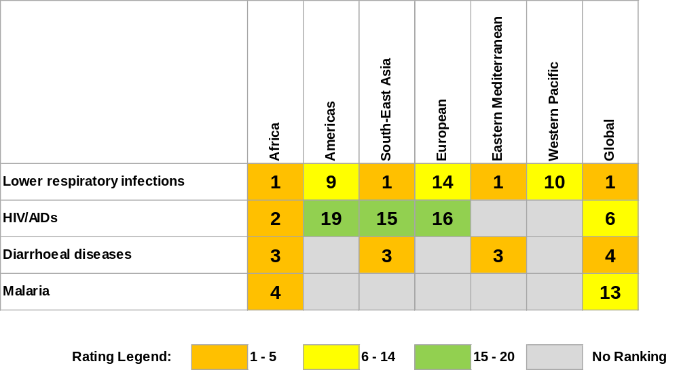
Even in Terms of Regional Disease Burden (measured in DALYs), the Ebola Virus has been Historically Insignificant
Ebola Outbreak 2014:
Do Nothing
Regional Ranking of Leading Causes of Disease Burden
(measured in DALYs) – 2011
LOW RANKING THREAT LEVEL - on a global scale (or even for the African region), there are several widespread diseases which cause far higher fatality rates*
DISABILITY-ADJUSTED LIFE YEARS (DALYs):
Number of Years of Life Lost +
Years of life lived with disability
* e.g. pneumonia, HIV, malaria, diarrhea, tuberculosis, measles, whooping cough, tetanus, meningitis, syphilis
Alone for Malaria in 2015, an estimated 214 million new cases were reported to have resulted in 438,000 deaths (~80% of malaria deaths are concentrated in just 15 countries, mainly in Africa²
WHO. (2014b)
When combining the DALYs of the top 4 leading causes of disease burden in Africa (a 24% share of DALYs for developing nations), these diseases represent less than 5% of DALYs for developed nations³
1. WHO. (2014b). The Health of the People: What Works – the African Regional Health Report 2014. Brazzaville, Republic of Congo.
2. WHO. (2015). World Malaria Report 2015. Geneva, Switzerland.
3. Bloom, D. E. (2014). The Shape of Global Health -- Finance & Development December 2014. Finance and Development, (December).

Slide 23
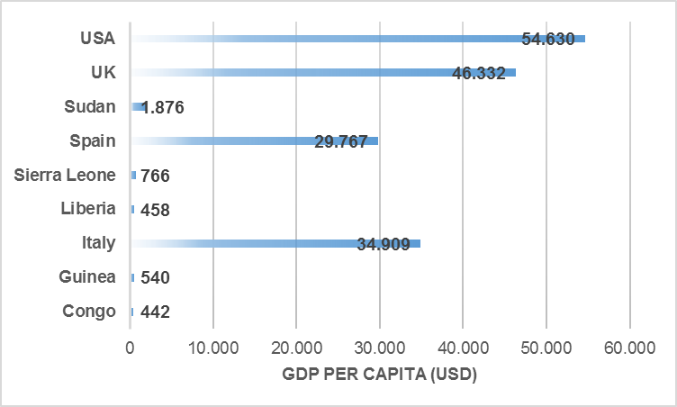
DALYs Share and GDP influence the Amount of Money Donors are Willing to Invest in Medical Intervention
Ebola Outbreak 2014:
Do Nothing
In addition to low DALY share, funding for Ebola was limited because countries most impacted by Ebola have particularly low GDP per Capita
(The World Bank, 2014b)
DETERMINING COST EFFECTIVENESS: WHO threshold values consider medical intervention as very cost-effective if the cost per DALY averted is less than the gross domestic product (GDP) per capita – no longer cost-effective once three times the GDP per capita is exceeded²
1. The World Bank. (2014b). GDP per capita (current US$). Retrieved March 14, 2016, from http://data.worldbank.org/indicator/NY.GDP.PCAP.CD
2. WHO. (2016a). Cost effectiveness and strategic planning (WHO-CHOICE). Retrieved February 13, 2016, from http://www.who.int/choice/costs/CER_levels/en/

Slide 24

Political Implications
Ebola Outbreak 2014:
Reason to Act
GUINEA ONE OF WEST AFRICA’s MOST MINERAL RICH COUNTRIES: Although the economy is in ruins after decades of corruption, dictatorship, and misrule, Guinea has the world’s largest reserves of bauxite and some of the highest grade iron ore deposits.²
NIGERIA HAS OIL: Nigeria experienced at least 20 cases of Ebola during the 2014 outbreak.³ With crude oil production of ~1,000 barrels per day, the oil and gas sector accounts for about 35 per cent of their gross domestic product, and petroleum exports revenue represents over 90 per cent of total exports revenue.⁴
TERRORIST ACTIVITY: There are already several terrorist groups throughout the West African region (e.g. Nigerian-based Boko Haram). Additionally, there is Al Qaeda in the Islamic Maghreb (AQIM) who has several operational bases in West Africa, Movement for Oneness and Jihad in West Africa (MUJAO) and the National Movement for the Liberation of Azawad (MNLA)⁵
POTENTIAL ISIS ALLIANCE: More recently there was a report that Boko Haram appears to at least show interest to gravitate towards ISIS.⁶
Ebola could render political instability in countries impacted; thus, valuable natural resources in some countries within the African region could attract rise of terrorist presence¹
1. Sorensen, C. H. (2015, May 6). Director-General of the European Commission, Humanitarian Aid and Civil Protection (ECHO). (M. L. Johnson, Interviewer)
2. Condé, A. (2013). In Guinea we want our resource wealth to work for all the people. The Guardian. London, UK. Retrieved from http://www.theguardian.com/global-development/poverty-matters/2013/jun/14/guinea-resource-wealth-work-people
3. WHO. (2016). Ebola Situation Reports. Retrieved March 6, 2016, from http://apps.who.int/ebola/ebola-situation-reports
4. OPEC. (2015). Nigeria Facts and Figures. Retrieved March 8, 2016, from http://www.opec.org/opec_web/en/about_us/167.htm
5. FATF. (2013). Terror Financing in West Africa. Paris, France. Retrieved from http://www.fatf-gafi.org/media/fatf/documents/reports/tf-in-west-africa.pdf
6. Rosen, A. (2015). Africa’s deadliest terror group wants to team up with ISIS but don't expect much of an alliance. Business Insider. New York, USA. Retrieved from http://uk.businessinsider.com/africas-deadliest-terror-group-wants-to-team-up-with-isis-2015-3?r=US

Slide 25
Economic Implications: Avoiding Public Panic/Social Disruption
- Impact on Gross Domestic Product (GDP) -
Ebola Outbreak 2014:
Reason to Act
DAMAGE TO WEST AFRICAN ECONOMY
INITIAL ESTIMATES: In October 2014, the World Bank publically warned that Ebola could cause up to 33 billion USD in losses for West Africa’s economy.¹
WORKFORCE PRODUCTIVITY LOSS: Reduced output which is inflicted by changed behavior in various economic sectors (e.g. workers/farmers not showing up for work, shop owners closing their stores, reduced tourism).²
ADJUSTED ESTIMATES: Given international efforts and treatment capabilities; Economic damage for the 3 countries most heavily hit was more recently estimated at 1.6 billion USD (~12% of their combined GDP). An additional financial loss of 0.5 billion USD will accumulate for surrounding countries such as the Gambia through Kenya to South Africa due to reduced tourism there.²
The Ebola Outbreak demonstrated that pubic panic and social disruption can have a significant negative impact on a country’s GDP
1. The World Bank. (2014). World Bank Warns of Economic Threat to West Africa from Ebola Crisis. Retrieved February 14, 2016, from http://www.worldbank.org/en/news/press-release/2014/10/08/ebola-new-world-bank-group-study-forecasts-billions-in-economic-loss-if-epidemic-lasts-longer-spreads-in-west-africa
2. Thomas, M. R. (2015). Estimating the Economic Cost of Ebola. Retrieved from http://blogs.worldbank.org/developmenttalk/estimating-economic-cost-ebola

Slide 26
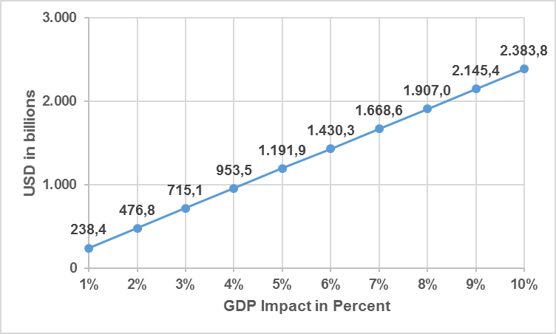

Economic Implications: Avoiding Public Panic/Social Disruption
- Impact on Gross Domestic Product (GDP) -
Ebola Outbreak 2014:
Reason to Act
WESTERN INTERESTS: The combined total GDP of those Western countries that experienced an Ebola case; namely the US, UK, Italy, and Spain, reaches almost 24 trillion USD¹
> Trillion
Even if only a fraction of the Ebola fear would have spread to those western economies that experienced an Ebola case, a negative impact of just 1% to the total combined GDP would calculate to an overall economic loss of over 200 billion USD
1. The World Bank. (2015a). Gross Domestic Product 2014. Retrieved March 8, 2016, from http://databank.worldbank.org/data/download/GDP.pdf

Slide 27
Elimination of Costs for Treatment and International Activities
- Return on Investment (ROI) -
Ebola Outbreak 2014:
Reason to Act
LEARNING FROM THE SMALLPOX EDRADICATION
As a result of the WHO’s enormous Smallpox eradication program over the period from 1967 to 1979, costs totaled ~300 million USD. However, savings are estimated to be more than 2 billion USD each year¹, the US has recouped nearly 500-fold the value of its contribution to that effort.²
A FEW COST EXAMPLES FOR EBOLA
THE WORLD BANK: As of December 1st, 2015, the World Bank Group announced it had mobilized US$1.62 billion in financing for Ebola response and recovery efforts to support the countries hardest hit by Ebola.³
THE USA: In its attempt to end the Ebola epidemic in West Africa as well as advance its own domestic preparedness against Ebola, the United States announced on February 11, 2015 that it had signed legislation that included 5.4 billion USD in emergency funding.⁴
Developing MCM is expensive, but not doing so can in some cases be much more expensive
1. Ehreth, J. (2003). The global value of vaccination. Vaccine, 21(7-8), 596–600. http://doi.org/10.1016/S0264-410X(02)00623-0
2. Kenny, C. (2014). The Economic Case for Wiping Out Ebola. Bloomberg. Retrieved from http://www.bloomberg.com/bw/articles/2014-08-25/the-economic-case-for-wiping-out-ebola
3. The World Bank. (2016). World Bank Group Ebola Response Fact Sheet. Retrieved February 14, 2016, from http://www.worldbank.org/en/topic/health/brief/world-bank-group-ebola-fact-sheet
4. US White House. (2015). Fact Sheet: Progress in Our Ebola Response at Home and Abroad. Retrieved February 14, 2016, from https://www.whitehouse.gov/the-press-office/2015/02/11/fact-sheet-progress-our-ebola-response-home-and-abroad

Slide 28
Agenda
The R&D Process of Drugs and Vaccines
CBRN Market Characteristics
Ebola Outbreak 2014
  Factors Inhibiting MCM Readiness
  Reasons to Act
  Learnings
Discussion

Slide 29
Take Messages concerning the Availability of CBRN MCM
Discussion
In the absence of an acute CBRN threat, free market characteristics most often do not provide sufficient market incentives for MCM developers and manufacturers; hence, only early government/donor enticement can enhance a timely availability.
Although current metrics for determining cost-effective medical intervention (e.g. DALYs) can guide priorities based on historical prevalence/incidence data, it may in some cases fail to recognize a profitable business case for rare, but highly dangerous diseases (e.g. regional/local impact, international response implications).
Determining spending volume and its sustainability could be enhanced via cost-effective business case analysis (e.g. consideration of political implications, ROI, vulnerability presented to GDP).
Because economic parameters and the nature of specific CBRN threats are unique by country and/or regional basis, business case analysis should be based on the particular threat within the geographical area which is to be budgeted.

Slide 30

Questions?
Premise of Frog in the Pot Metaphor:
A frog placed in boiling water will jump out
If placed in cold water that is slowly heated, it will not perceive the danger and will be cooked to death.
Mark Johnson, MBA
Managing Director
Munich, Germany
Mobile: +49 (0)162 446 8922
Email: johnson@mjlconsulting.eu
Internet: www.mjlconsulting.eu

