Slide 1
Thermally Targeted Drug Delivery
Mark Hurwitz, M.D.
Professor and Vice-Chair for Quality,
Safety and Performance Excellence
Director of Thermal Oncology
Department of Radiation Oncology
Sidney Kimmel Medical College at Thomas Jefferson University
Philadelphia, PA

Slide 2
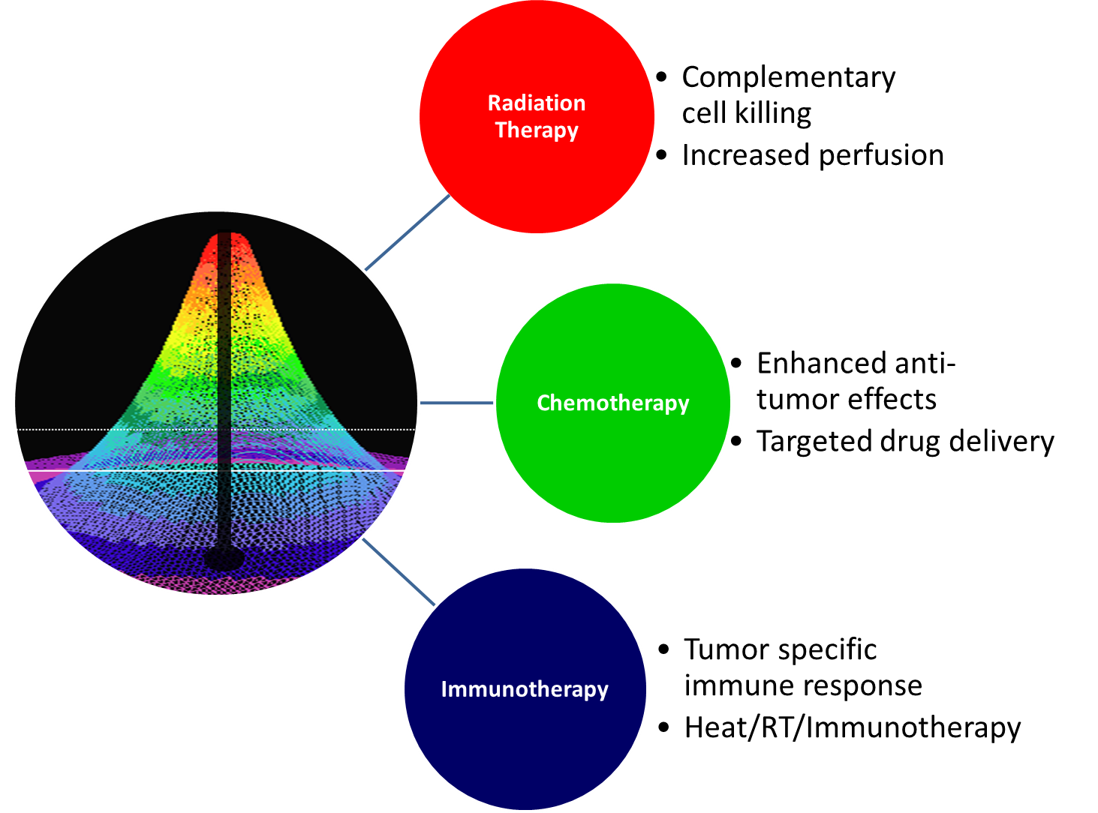
Hyperthermia Makes Other Cancer Treatments More Effective

Slide 3
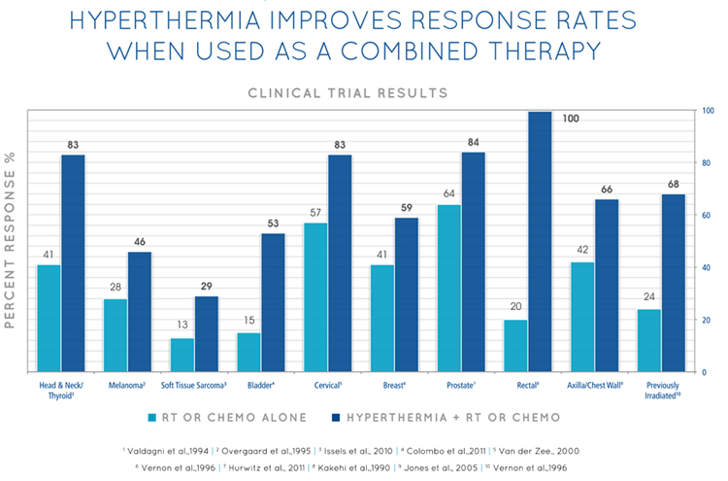
Hyperthermia Has Meaningful Clinical Impact
Reference | Treatment | Tumor | Endpoint | Lesions | - HT | + HT
Hua 2011 | RT+CT | Nasopharynx | 5yr PFS | 180 | 63% | 73%
Huilgol 2010 | RT | Head and Neck | CR | 54 | 42% | 79%
Issels 2010 | CT | Soft tissue sarcoma | DFS | 340 | 18 m | 32 m
Jones 2005 | RT | Breast, CW, superficial | CR | 109 | 42% | 64%
Colombo 2003 | CT | Bladder | 2yr pfs | 75 | 40% | 83%
Verwaal 2003 | CT (hipec) | Colorectal | med. Surv. | 105 | 126 m | 223 m
Harima 2001 | RT | Cervix | CR | 40 | 50% | 85%
Van der Zee 2000 | RT | Bladder, Cervix, Rectum | 3yr OS Cervix | 358 | 27% | 51%
Sneed 1998 | RT | Glioblastoma | 2yr OS | 112 | 15% | 31%
Vernon 1996 | RT | Breast | CR | 308 | 41% | 59%
Wang 1996 | RT | Esophagus | 3yr S | 125 | 24% | 42%
Overgaard 1995 | RT | Melanoma | 2yr NED | 134 | 28% | 46%
Kitamura 1995 | RT,CT | Esophagus | CR | 66 | 6% | 25%
Valdagni 1994 | RT | Neck Nodes | 5yr OS | 44 | 0% | 55%
You 1993 | RT, surg. | Rectum | pCR | 122 | 5% | 23%
Sugimachi 1992 | RT, CT, surg. | Esophagus | Palliation | 53 | 8% | 70%
Strotsky 1991 | RT, surg. | Bladder | 3yr S | 102 | 67% | 94%
Berdov 1990 | RT, surg. | Rectum | 5yr S | 115 | 7% | 36%
Kakehi 1990 | RT | Rectum | Response | 14 | 20% | 100%
Engelhardt 1989 | CT | Lung | Response | 44 | 36% | 60%
Egawa 1989 | RT | Various | Response | 92 | 63% | 82%
Datta 1987 | RT | Cervix | CR | 64 | 31% | 55%
Kohno 1984 | CT | Vulva/vagina | Response | 65 | 19% | 59%

Slide 4
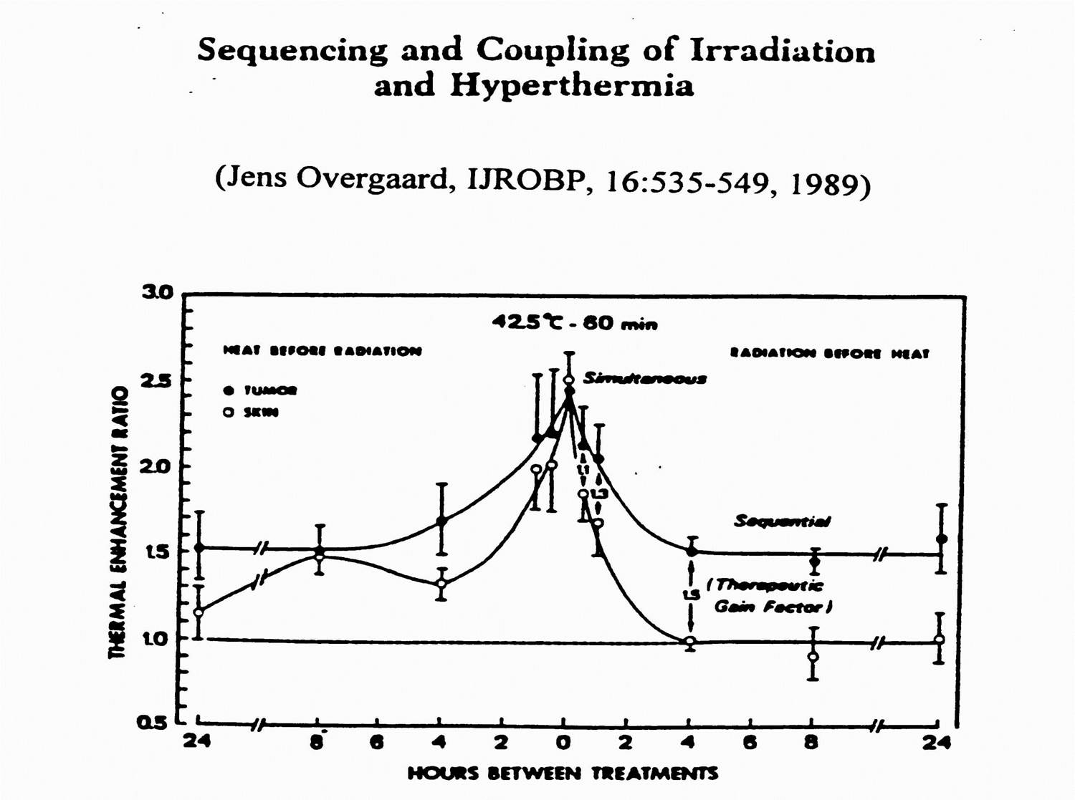
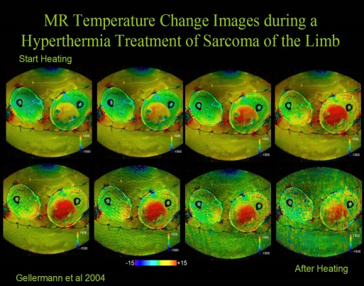
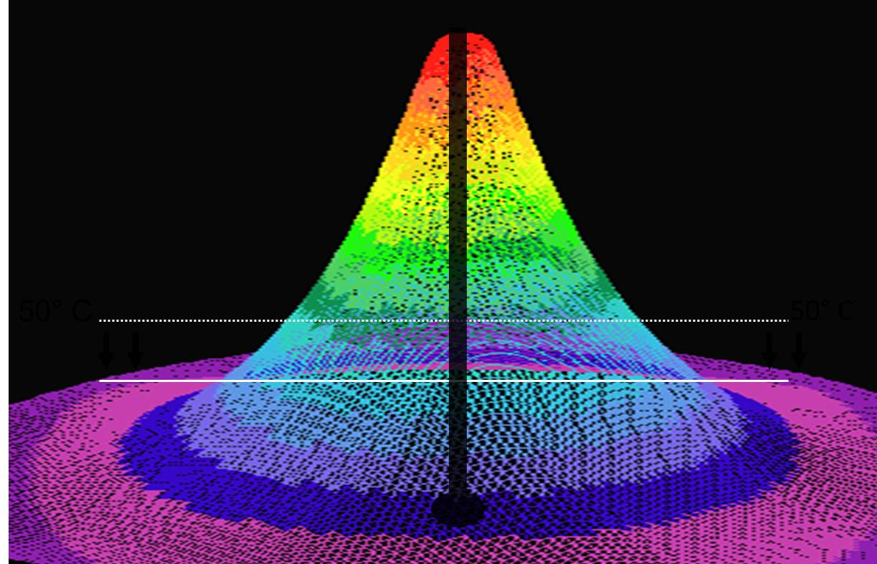
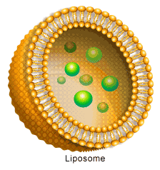
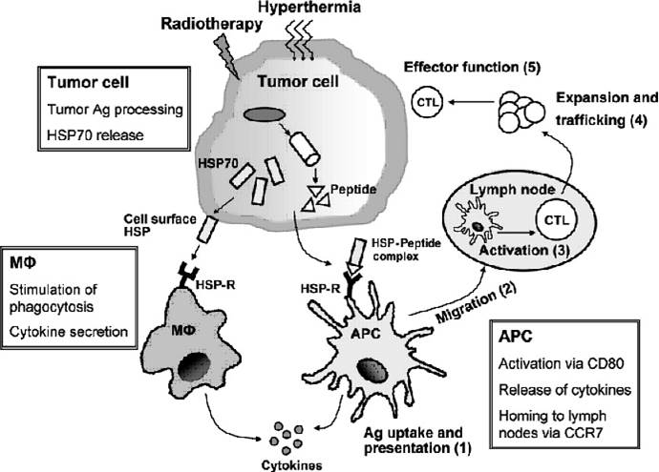
The Future of Thermal Therapy
Radiation Sensitization Enhanced Thermal Ablation
Targeted Drug Delivery Augmented Immunotherpy

Slide 5
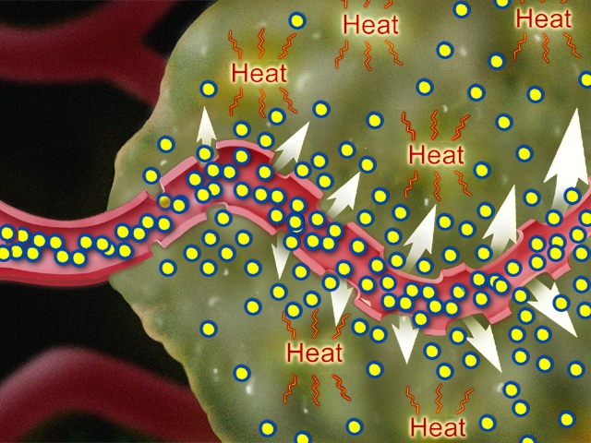
Targeted Drug Delivery
Deliver drugs in high concentrations
  Precisely where needed
  Minimizing systemic toxicity
  Maximizing therapeutic effect
Delivery vehicles
  Sonically activated:
  Microbubbles
  Thermally activated:
  Liposomes
  Nanoparticles
39 < T <42°C

Slide 6
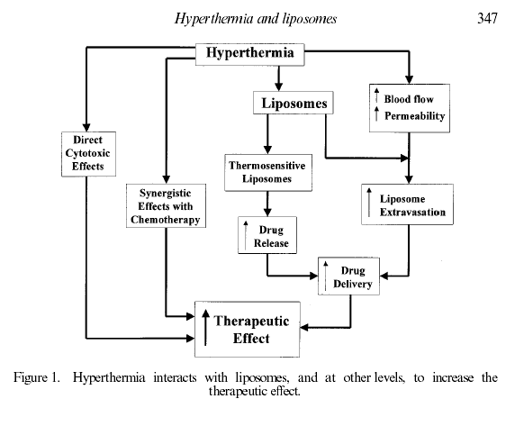
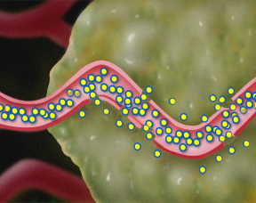
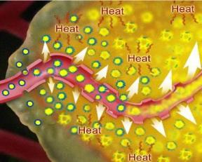
Hyperthermia and Liposomes
Several mechanisms enhance therapeutic effect
37°C
39 < T <42°C
Add Thermal Sensitive Liposomes
Hyperthermia has some effects alone, with drug, and in enhancing liposome extravasation
New concept of rapid triggered release leads to an increased therapeutic effect
G. Kong ; M. W. Dewhirst. 1999, Int. J. Hyperthermia, 15, 345-370
Notes:
Tumors are known to have leaky blood vessels. We knew from the literature that folks were hoping that liposomes containing their drug would extravasate into the tumor tissue through small holes in the blood vessel lining, but this is not the case for all tumors in animals, and is turning out to have limited applicability to human tumors.
The reason we turned to Hyperthermia was because Dr Dewhirst knew that Hyperthermia has some effects alone, with drug, and in enhancing this leakiness of tumor blood vessels for liposomes
And so our New concept was not to rely on such extravasation but to trigger a rapid release of drug using hyperthermia leading to an increased therapeutic effect
6

Slide 7
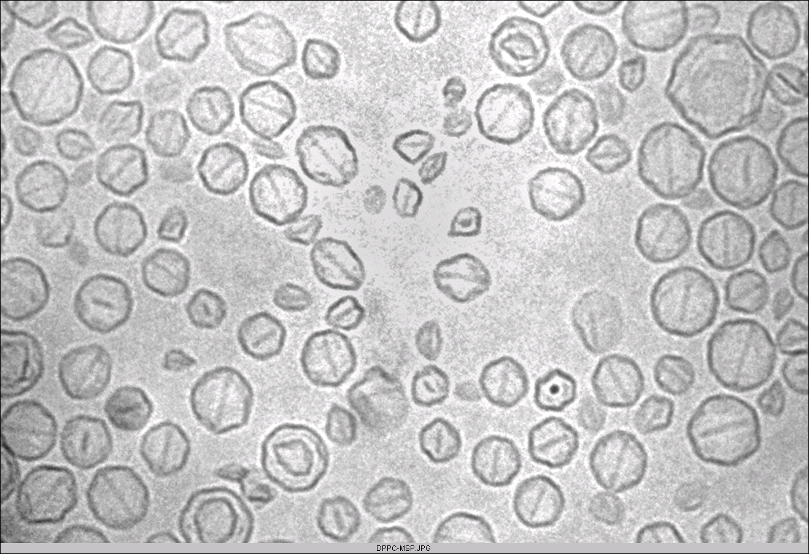
Thermally Sensitive Liposome:
ThermoDox®
100 nm
Protective Layer
of PEG
Drug
Crystal
Solid-phase Thermally
Sensitive
Lipid Bilayer
Schematic of Thermodox Liposome

Slide 8
ThermoDox Followed by Mild Hyperthermia
Leaky Tumor Vasculature
37°C
Normo-thermic zone
ThermoDox below 39°C
Heated Tumor and Surrounding Margin
Doxorubicin Released above 39.5°C
HEATED TUMOR
40°C - 42°C
High concentrations of doxorubicin deposited by ThermoDox in these thermal zones
Hyperthermia
Applicator
> 39.5°C

Slide 9
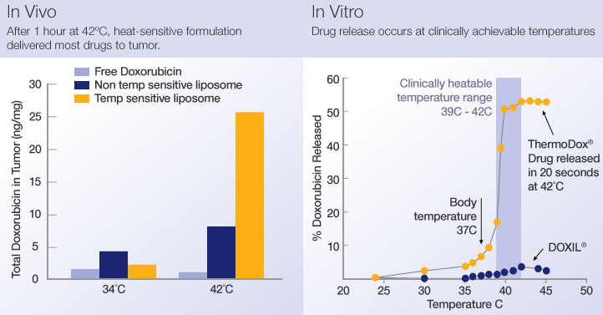
Thermodox
ThermoDox delivers 25 times more doxorubicin than IV doxorubicin into tumors, and five times more doxorubicin than standard liposomal formulations of the drug.

Slide 10
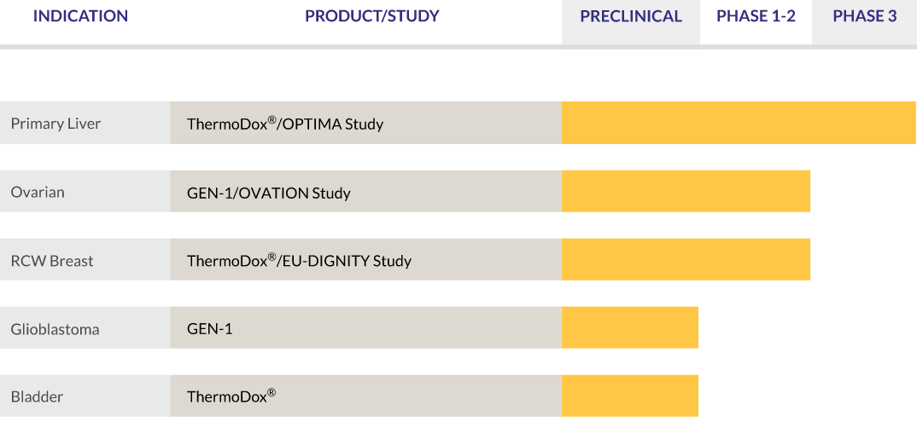
Thermodox Clinical Status

Slide 11

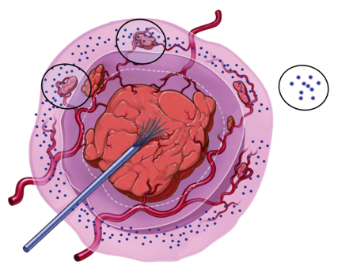
RF Liver Ablation + ThermoDox
Expanding the Treatment Zone Addresses RFA Limitations
ThermoDox
+
RFA misses micro-metastases outside ablation zone
ThermoDox
Ablation Zone
Ablation
Thermal Zone
RFA Electrode
      ThermoDox infused IV ~15 minutes prior to sRFA
      ThermoDox concentrates in the “Thermal Zone” over a 45 minute period
      Ablation releases doxorubicin in “Thermal Zone” expanding treatment area

Slide 12
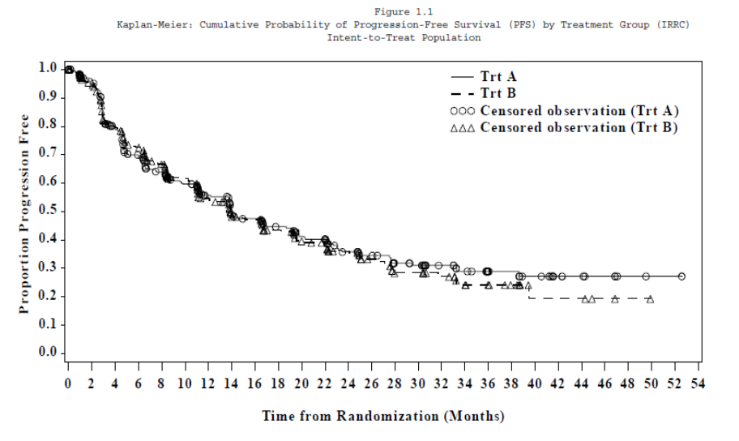
HEAT Study
Top Line Results
    Study did not meet Primary Endpoint
      PFS: 13.97 vs. 13.87 (HR = 0.958)
    Safety consistent with anthracyclines
      Most important Adverse Event: Neutropenia
    Local recurrence does not seem to be affected

Slide 13
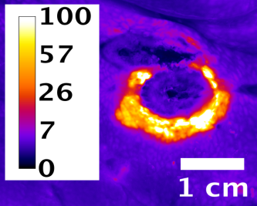
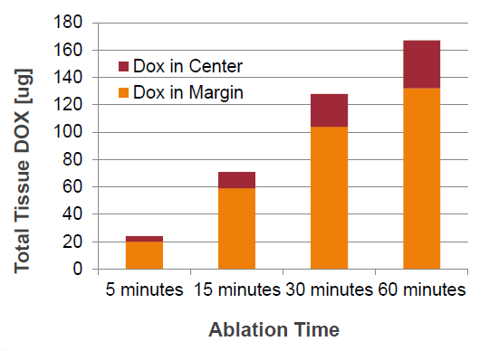
RFA Dwell Time Matters!
Learnings from the 700 patient HEAT Study
Pre-specified analysis of HEAT Study data showed that patients with smaller lesions appeared to do better with ThermoDox.
When standardized for dwell time and lesion number then the ThermoDox patients demonstrated difference in OS.
The hypothesis that dwell time increases local doxorubicin concentration was then tested and demonstrated in a computer simulation study.
The hypothesis was further tested and demonstrated in an in vivo porcine model.
Gasselhuber et al, Int J Hyperthermia, 2012
9
15 Minutes
45 Minutes

Slide 14

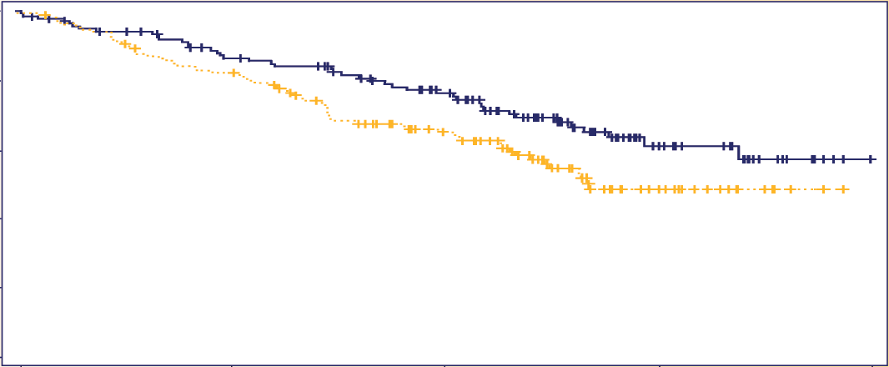

ThermoDox: HCC
Sub-Group Analysis of HEAT Study Data
285 Patients with Standardized RFA > 45 minutes (sRFA)
1
0.8
0.6
Survival Probability
0.4
sRFA + ThermoDox® – Median OS: > 80 + months
sRFA Alone – Median OS: < 59 months
0.2
Chart Legend
Two Years Overall
Survival Benefit
0
0
20
40
60
80
Months
Overall Survival as of 7/15/2016
HR = 0.65 (95% Cl 0.45 - 0.94) P Value = 0.02

Slide 15
ThermoDox + RFA vs TACE
Intermediate HCC
HEAT Study | Lesion size | N | Median OS (mos) | Year 1 (%) | Year 2 (%) | Year 3 (%)
ITT Population | Overall: 2.7 - 7.5 cm Mean: 4.2 cm Median: 4 cm | 223 | 48 | 85 | 76 | 64
 | 3 cm – 5 cm | 183 | NE | 87 | 80 | 66
 | 5 cm – 7 cm | 40 | 45 | 75 | 58 | 54
ThermoDox + RFA ≥ 45 min. | Overall: 2.7 - 6.9 cm Mean: 4.3 cm Median: 4.2 cm | 138 | >80 | 94 | 85 | 77
RFA alone time ≥ 45 min. | Overall: 3 - 6.9 cm Mean: 4.2 cm Median: 3.9 cm | 147 | <59 | 88 | 79 | 69
Ikeda et al (TACE) 2013 | Median: 3.9; range 1-11 | 99 | 37 | 90 | 75 | NR
 | > 3.0 | 64 | NR | NR | 66 | NR
Burrel (DEB TACE) 2012 | BCLC A | 41 | 54 | 89.7 | NR | 67.8
 | BCLC B | 63 | 48 | 88.2 | NR | 64.4
HEAT Study Subgroup
11
DEB TACE – Doxorubicin Eluding Beads

Slide 16



Phase 3 OPTIMA Study Design
ThermoDox Plus sRFA*
    General Eligibility
    Non-resectable HCC
    Single lesions
    Lesion > 3 cm but not > 7 cm
    Treatment naïve
    Child-Pugh A
    Stratification
    Lesion size: 3-5 cm / 5-7 cm
    Geography
    N=275
    ThermoDox plus sRFA*
    Randomize
    1:1
    N=275
    Dummy Infusion + sRFA*
Primary Endpoint Secondary Endpoints | Overall Survival (OS) Progression Free Survival; Safety
Interim Efficacy Analysis | 118 OS Events HR < 0.61 158 OS Events HR < 0.70
Final Efficacy | 197 OS Events HR < 0.75
* Standardized Radiofrequency Ablation

Slide 17
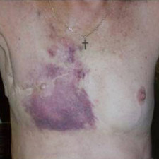
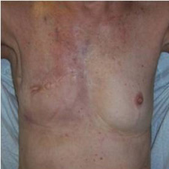
ThermoDox: RCW Breast Cancer
Difficult to Treat with Severe Complications
Breast cancer recurring in the chest wall
affects ~35,000 post-mastectomy patients
in the US and Europe annually
  Up to 40% of women undergoing a
  mastectomy as primary treatment will
  experience local recurrence
  Local tumor control is a primary objective in treating these patients
Limited Treatment Options
Complete Response
Combined Phase 1 Data (n = 29)
Phase 2 US DIGNITY Study
Evaluate local-regional breast tumor response
17 patients enrolled; 12 evaluable for efficacy
  All evaluable patients experienced stabilization of disease; 67% of patients in evaluable population observed local responses –
  5 CRs & 3 PRs
  47% Local Response (ITT)
Progressive Disease
Partial Response
Stable Disease
Complete Response
15
48% Local Response (ITT)
10
3
Subjects
5
5
1
3
2
3
2
0
1
1
2
13
20 mg/m²
30 mg/m²
40 mg/m²
50 mg/m²
Dose (mg/m²)
Notes:
17

Slide 18
Phase II EURO-DIGNITY Study
Tri-Modal Treatment Plan
Patients with locally recurrent carcinoma of the breast, chest wall and/or overlying skin, without metastatic disease exception being stable bone metastasis, who in the opinion of the investigator are unsuitable for surgery and have received at least one standard treatment modality, will be eligible to be screened for this study
N = 70 Patients
Cycle 3
Cycle 4
Cycle 1
Cycle 5
Baseline
Cycle 2
Cycle 6
EOT
Follow-Up
-2 weeks to Day 0
Baseline Screening Procedures
ThermoDox
+
Hyperthermia
+
Radiation Therapy
ThermoDox
+
Hyperthermia
Scheduled 21-42 days following final ThermoDox treatment
Patients with SD, PR or CR @ EOT will be assessed every 3 months for a year
ThermoDox Administration: 30 minute IV infusion at 40 mg/m²
Hyperthermia: Applied between the start of infusion and completed within 4 hours post infusion. Hyperthermia will be delivered to the tumor site to attain a temperature of 40 -42°C in approximately 90% of measured points for 60 minutes consistent with site local heating procedures.
Radiation Therapy: A total of 40 Gy in 20 fractions of 2 Gy per fraction will be administered.
Cycle = 21 days

Slide 19

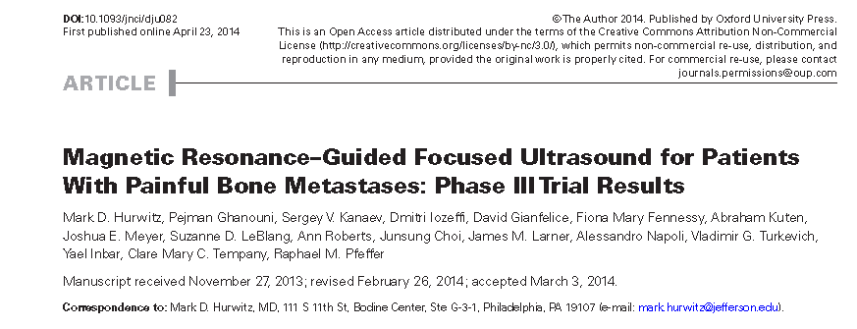
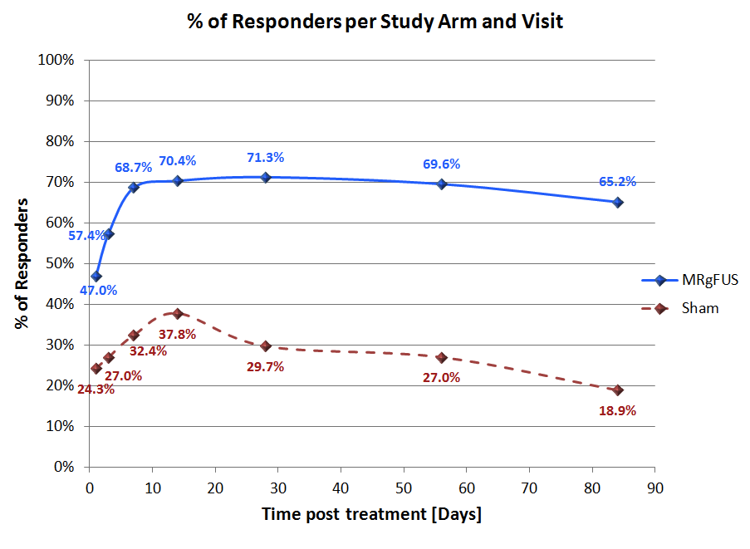
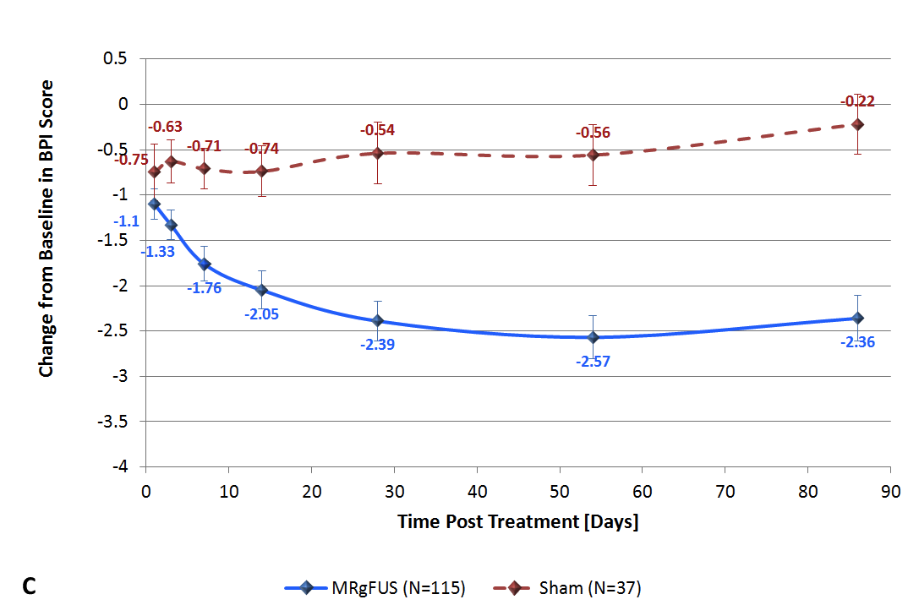

Slide 20
Thermally Targeted Drug Delivery By MRgFUS Directed Hyperthermia
Modeling and Validation
HIFU heating in tissue was simulated using a heat transfer model based on the bioheat equation, including heat-induced cessation of perfusion.
A model simulated intravascular release of doxorubicin from TSL, its transport into interstitium, and cell uptake.
  Two heating schedules were simulated, each lasting 30 min:
    1) hyperthermia at 43C (HT)
    2) hyperthermia followed by a high temperature (50C for 20 s) pulse (HTþ).
  In vivo studies were performed in thigh muscle of a New Zealand White rabbit, where local hyperthermia with a clinical magnetic resonance-guided HIFU system was applied following TSL administration.
  Gasselhuber A et al International Journal of Hyperthermia, 2012; 28:4, 337-348

Slide 21
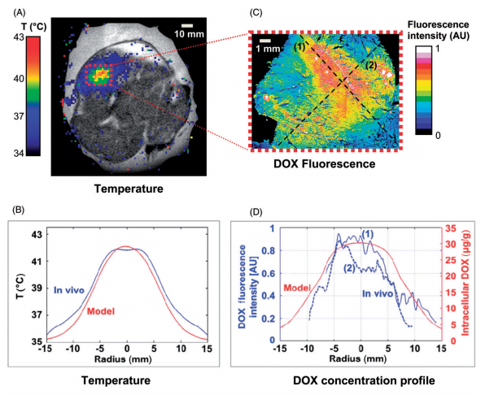
MRgFUS Hyperthermic Targeted Drug Delivery
Gasselhuber A et al International Journal of Hyperthermia, 2012; 28:4, 337-348
Temperature map during HT measured via MR Thermometry, overlaid on pre-procedural coronal image of rabbit thigh muscle.
Radial temperature profile (time-averaged over HT duration) from in vivo study (blue), compared to model (red). Mean temperature deviation between simulation and in vivo study was 0.54C
DOX distribution measured via fluorescence microscopy in extracted tissue sample.
DOX fluorescence profile (blue) in two orthogonal directions (dashed lines marked (1) and (2) in (C), compared to DOX concentration profile from computer model (red).

Slide 22
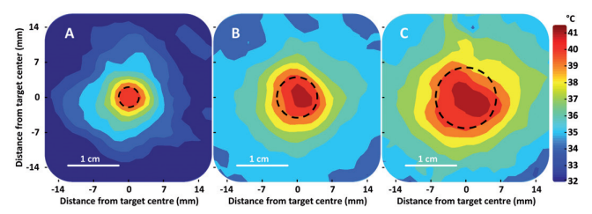
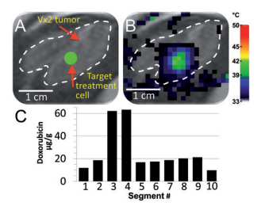
MRgFUS Hyperthermic Targeted Drug Delivery
Representative examples of time-averaged spatial temperature distributions for 4 mm, 8 mm, and 12 mm treatment cells in vivo (coronal plane). The treatment cell is outlined in black dashed line.
Demonstration of heterogeneous drug delivery:
VX2 tumor was clearly identified (white dashed line) on the proton density-weighted planning images and a target region within the tumor was chosen (green circle).
Temperature maps (color scale) overlaid on planning images (grey scale) during a mild hyperthermia treatment with a 4 mm treatment cell, showing typical temperature distribution after 1 min of heating.
Doxorubicin concentration in tumor segments was determined by HPLC.
Partanen A et al. Int. J. Hyperthermia, 2012; 28(4): 320–336

Slide 23
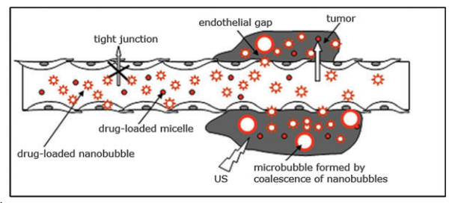
MIcrobubbles
Schematic representation of drug targeting through the defective tumor microvasculature using an echogenic drug delivery system.
The system comprises polymeric micelles ( small circles), nanobubbles ( stars), and microbubbles ( large circles).
Micelles are formed by a biodegradable block copolymer (e.g., poly[ethylene glycol]-block-poly[L-lactide]); bubbles are formed by perfluorocarbon stabilized by biodegradable block copolymer. Lipophilic drug (e.g., doxorubicin) is localized in the micelle cores and in the walls of nano/microbubbles.
Rapaport N et al J Natl Cancer Inst 2007;99: 1095 – 106

Slide 24
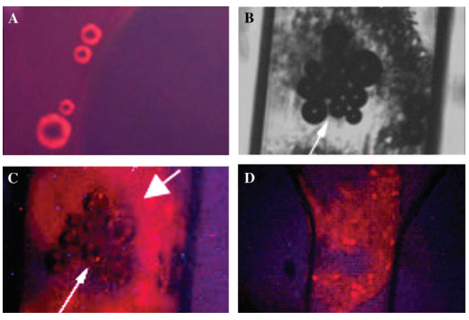
Microbubble Targeted Drug Delivery – Proof of Principle
Heating to 44 °C resulted in a formation of large microbubbles due to coalescence. The doxorubicin-derived fluorescence ( red) of the microbubbles was clearly localized in the bubble walls formed by the bubble-stabilizing copolymer.
Optical image of the MDA MB231 cell and bubble aggregates (arrow) formed in the capillary during a 150-second US sonication
Fluorescence image of the same sample site as presented in B with focus on the bubbles (thin arrow). Fluorescence of the bubbles decreased whereas the cells (thick arrow) acquired strong fluorescence after sonication.
Fluorescence image of another cell aggregate with the focus on the cells. When the sample was exposed to ultrasound, doxorubicin was internalized by the cells as indicated by the red fluorescence.
Fluorescence images of a Dox/0.5% PEG-PLLA/2% perfluoropentane formulation placed in a plastic capillary (internal diameter 340 mm) of a snake mixer slide.

Slide 25
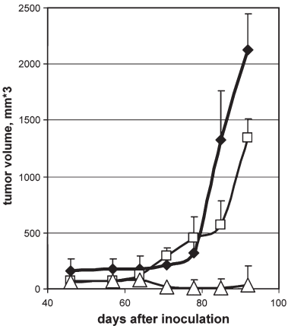
Microbubble Targeted Drug Delivery – In Vivo Results
Tumor growth curves for control mice (closed diamonds)
Mice treated by four tail vein injections of 100 mL Dox-loaded microbubbles administered twice weekly without ultrasound ( open squares)
Mice treated by the same regimen combined with tumor sonication by 3-MHz ultrasound for a 30-second ultrasound exposure time at a 2 W/cm 2 (open triangles)
Mean values ± 95% confidence intervals are shown.
The effect of ultrasound on tumor growth in mice treated with microbubble-encapsulated doxorubicin

Slide 26

Conclusions
Hyperthermia has been shown to enhance radiation and chemotherapy in several ways to the benefit of cancer patients
Targeted drug delivery is a promising therapeutic arena within thermal oncology
Clinical trials have shown promise to TSL drug delivery
Additional drug carriers and methods of heating have potential to accelerate development of thermally induced TDD

