Slide 1


The protease fibroblast activation protein [FAP] as a biomarker and therapeutic target
in chronic liver injury
Mark D Gorrell
Sumaiya Chowdhury, Fiona Keane, Stephen Twigg, Geoff McCaughan
A.W. Morrow Gastroenterology and Liver Centre
Department of Endocrinology
Royal Prince Alfred Hospital
Centenary Institute.
Charles Perkins Centre.
Sydney Medical School
University of Sydney

Slide 2
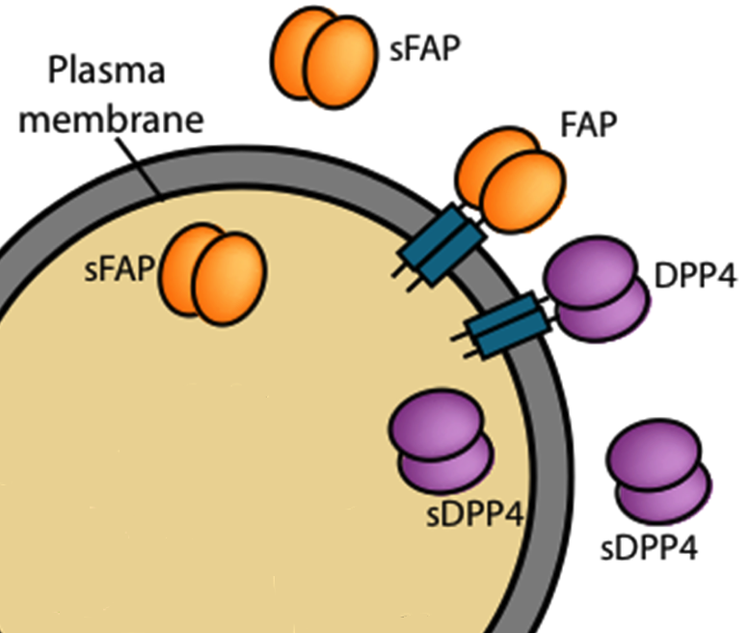
Fibroblast Activation Protein (FAP)
- similarity to Dipeptidyl Peptidase 4 (DPP4)
Protease Activity:
Dipeptidyl Peptidase
Endopeptidase
N-term X - P - X - X - X - …. C-term
N-term…. - X - X - G - P - X - X - …. C-term
DPP4 roles:
Type 2 Diabetes
Tumor growth
Liver fibrosis & fatty liver
FAP roles:
Fibrinolysis
Tumor growth
Atherosclerosis
Liver fibrosis & fatty liver
Gorrell 2005 Clinical Science 108: 277
Hamson, Gorrell 2014 Proteomics Clin Appl 8(6): 454

Slide 3
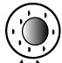
DPP4 in Chronic liver injury
Healthy liver
Injured liver
DPP4
To bile
DPP4
DPP4 in blood
Hepatocyte
Non-polarised Hepatocyte
DPP4 increases in epithelial cells and lymphocytes

Slide 4
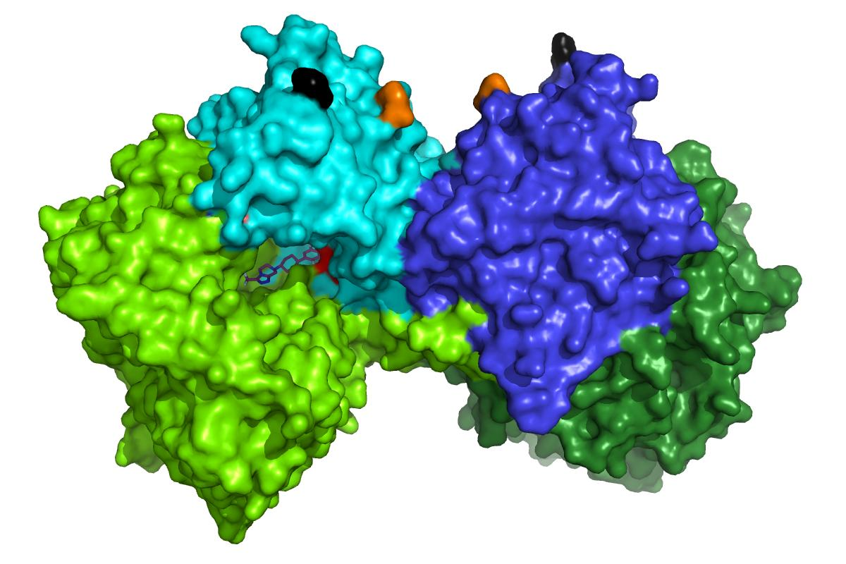
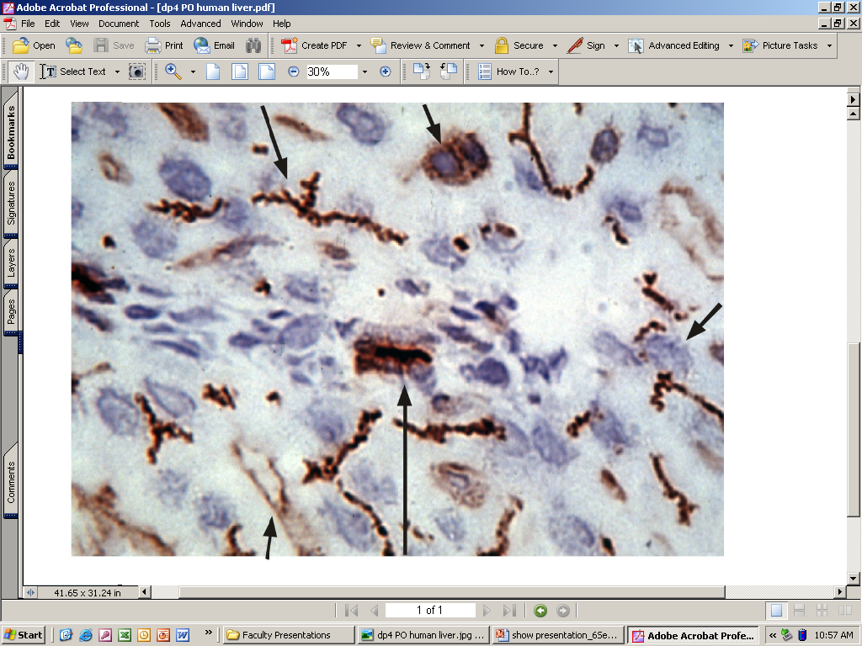
DPP4 in Chronic Liver Injury
DPP4 is ubiquitous. But liver is a large organ…
DPP4 expression increases in fibrosis and cirrhosis: Both in liver and blood. [Williams K, Gorrell, Zekry, Twigg et al 2014 J. Diabetes in press; doi 10.1111/1753-0407.12237]
Preclinically, DPP4 inhibition lessens steatosis.
Review: Itou 2013 World J Gastro 19: 2298
Hepatocyte
Lymphocyte
Endothelial cell
Bile Duct

Slide 5
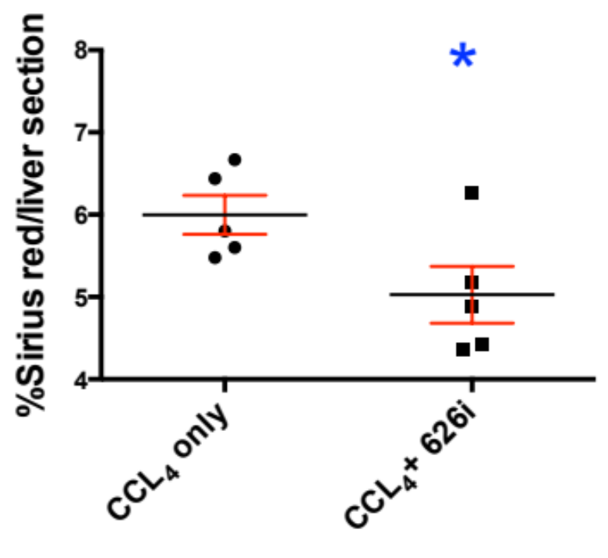
DPP4 inhibition can lessen liver fibrosis
CCl₄ only
CCl₄ + 626
4 weeks of CCl₄
With DPP4 inhibition
[MK626 ; MSD]
P < 0.05
Sirius red staining in liver

Slide 6
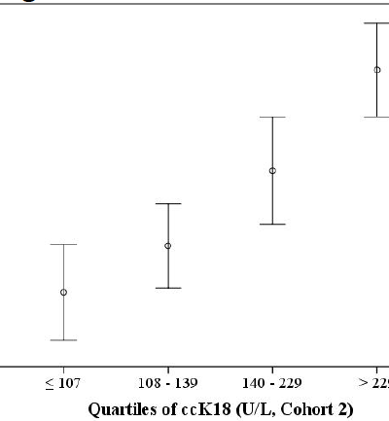
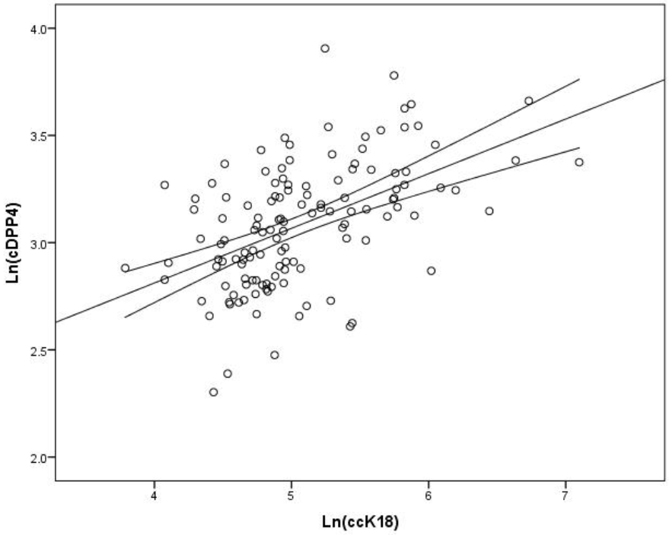
DPP4 as a biomarker
Williams K, Gorrell, Zekry, Twigg et al 2014 J. Diabetes in press; doi 10.1111/1753-0407.12237
Ln cDPP4
Notes:
The other way that FAP is different to the other members of the DP family, is in it’s expression profile. While the other members are all ubiquitously expressed, FAP has quite a unique and restricted expression profile. It’s thought to be expressed at low levels in normal, resting adult tissue. Where it is upregulated is at sites of tissue remodelling such as in embryogenesis and wound healing. As per it’s name, it’s expressed in activated fibroblasts, such as in stromal fibroblasts around epithelial tumours and a lot of labs study FAP in relation to cancer. It’s in fibroblasts associated with conditions such as arthritis and atherosclerosis.
Its also found in activated myofibroblasts in liver and lung fibrosis.

Slide 7

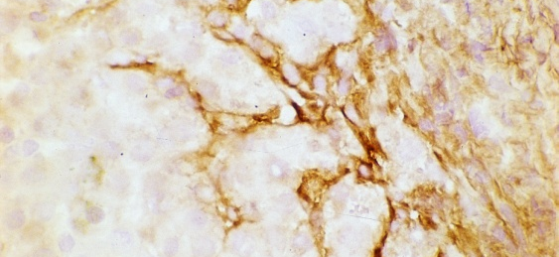
Fibroblast activation protein:
[FAP]: Unique Expression
LOW expression in normal resting adult tissue
Tissue Remodelling
  Embryogenesis
  Wound healing
Activated Fibroblasts
  Epithelial tumours
  Arthritis
  Atherosclerosis
  Liver and lung fibrosis
    Activated myofibroblasts
    Activated Stellate cells
FAP in human liver
Notes:
The other way that FAP is different to the other members of the DP family, is in it’s expression profile. While the other members are all ubiquitously expressed, FAP has quite a unique and restricted expression profile. It’s thought to be expressed at low levels in normal, resting adult tissue. Where it is upregulated is at sites of tissue remodelling such as in embryogenesis and wound healing. As per it’s name, it’s expressed in activated fibroblasts, such as in stromal fibroblasts around epithelial tumours and a lot of labs study FAP in relation to cancer. It’s in fibroblasts associated with conditions such as arthritis and atherosclerosis.
Its also found in activated myofibroblasts in liver and lung fibrosis.

Slide 8

FAP in Chronic liver injury
Quiescent Hepatic
Stellate cell (HSC)
FAP very low
myofibroblast
FAP high on HSC and myofibroblast
FAP
Activated HSC
FAP
FAP
S
FAP correlates with fibrosis severity
(Levy, 2002)
Lymphocyte
Cytokines
Macrophage
P

Slide 9
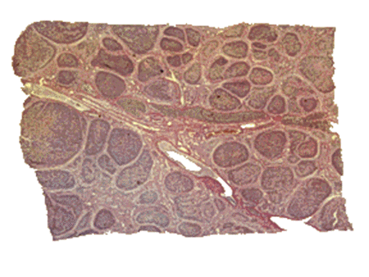
FAP in human liver is pro-fibrotic
Expressed by activated hepatic stellate cells [HSC] and myofibroblasts in chronic liver injury (Levy Gorrell et al 1999 Hepatology)
Intensity of FAP expression correlates with fibrosis severity (Levy, Gorrell 2002 Liver Internat)
FAP expression is stimulated by TGFβ and retinoic acid.
Gelatinase (collagen-I) and DPP activities in liver (Park 1999; Levy, Gorrell 1999 Hepatology)
Collagen cleavage by FAP is enhanced by MMP1 cleavage.
Fibrinolysis inhibition by cutting human α2-antiplasmin (Lee 2012 J Thromb Haemost)
See: Gorrell & Park 2013 Fibroblast activation protein alpha. In Handbook of Proteolytic Enzymes 3rd Edition.
See: Hamson, … Gorrell 2014 Proteomics Clin Appl 8(6): 454.
S
FAP in human cirrhotic liver
(Wang, Gorrell 2005 Hepatology)
P

Slide 10
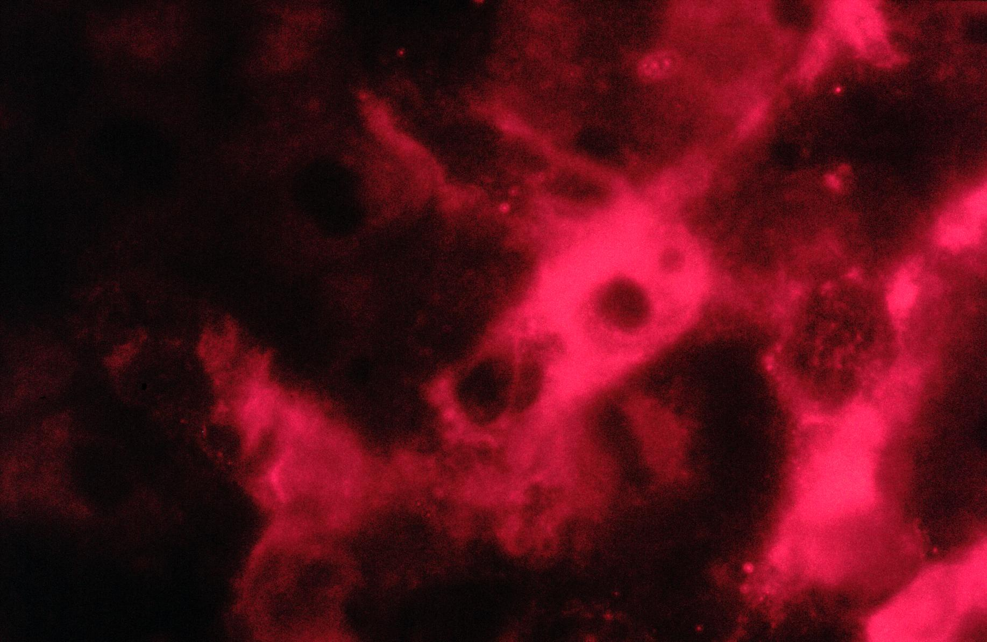
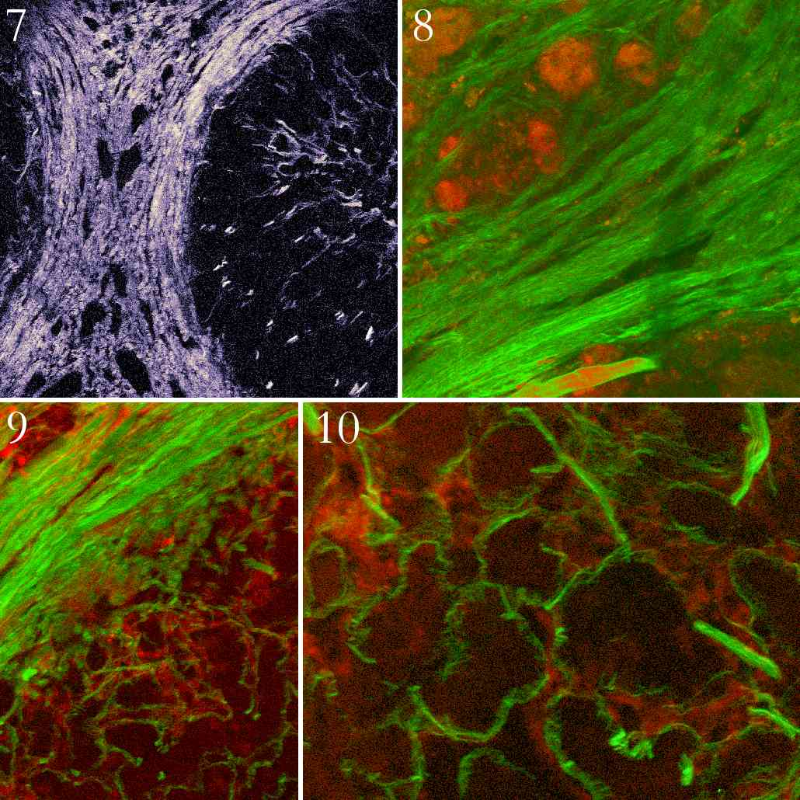
FAP [red] and
Collagen [green] in human cirrhotic liver
Activated stellate cell
Cirrhosis
Cox, … Gorrell
J. Struct. Biol. 2003

Slide 11
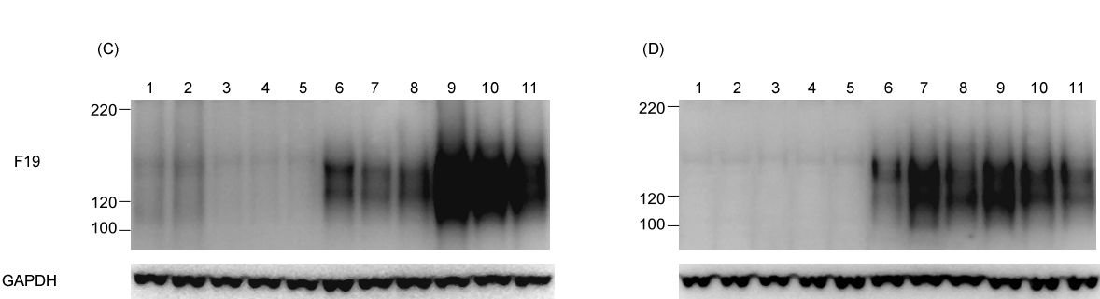
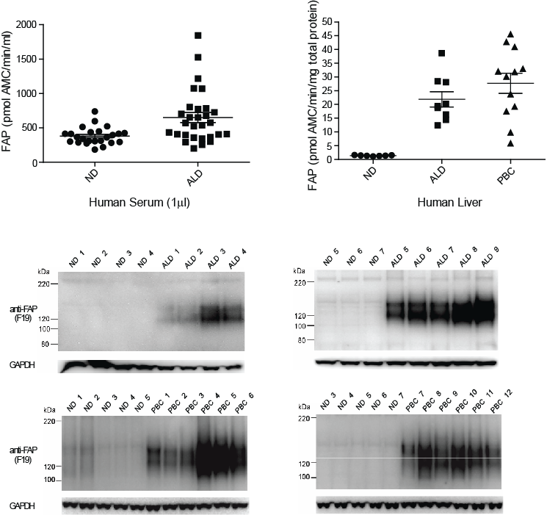
FAP is elevated in human cirrhosis
Immunoblot on human liver: Anti-human FAP
Non-diseased
Cirrhotic
Non-diseased
Cirrhotic
1 2 3 4 5 8 9 10 11 12 13
3 4 5 6 7 14 15 16 17 18 19
FAP
160kDa
GAPDH
FAP enzyme activity in livers
FAP enzyme activity in sera
Keane, Yao, et al, ….. Bachovchin , Twigg, Gorrell FEBS OpenBio 2014

Slide 12
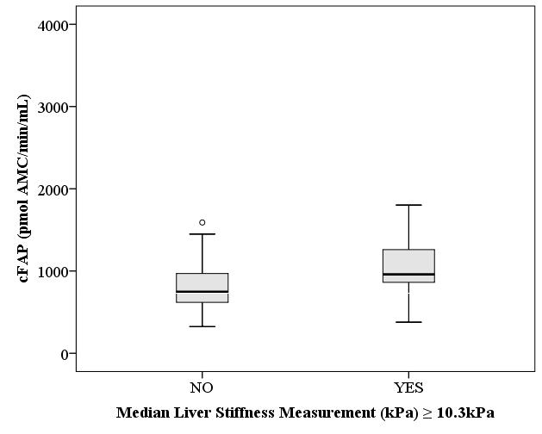
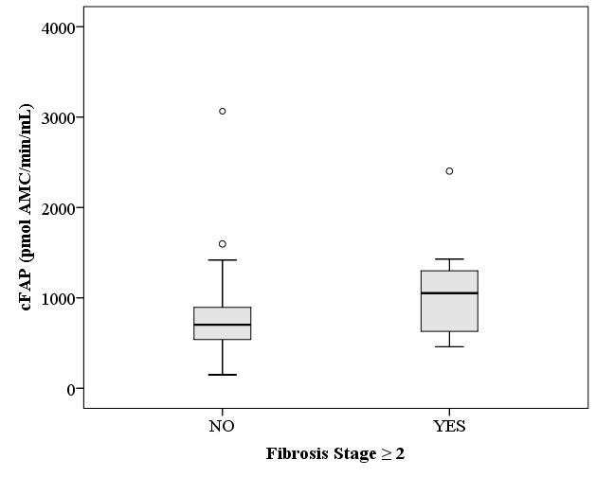
Relationship between clinically significant liver fibrosis and cFAP
Cohort 1, diabetes Cohort 2, obesity
p = 0.006
p = 0.021
K. Williams, F. Keane, M. Gorrell, A. Zekry, S. Twigg
Notes:
State definitions for clinically significant liver fibrosis in each cohort, indicate small number of events in Cohort 2 likely to impact upon p value….
Outlier in F>/=2 has cirrhosis and DM
Outliers in F < 2: one has elevated (AST and GGT) liver enzymes but no other documentation, anaemia noted not explained, age 36.2
one has DM2 and metabolic syndrome and iron deficiency anaemia, age 60.2

Slide 13
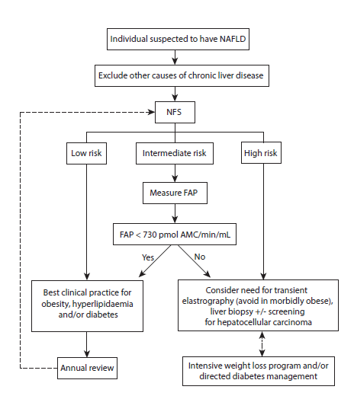
Suggested clinical use of cFAP:
40% of Pts:
Intermediate NFS
low cFAP
No fibrosis
K. Williams
S. Twigg
Notes:
Use of serum FAP after application of the NFS could be simple and relatively low cost method of screening a patient population at increased risk of liver fibrosis secondary to NAFLD
NFS – simple test, cheap and readily avaialble; followed by FAP to further enrich the population before requiring referral to a centre with TE +/- liver biopsy characteristics
highly acceptable to both patient and clinician.
NFS and serum FAP would help to identify patients that may need further investigations that would include non-invasive measure of liver stiffness, such as is possible with TE, and/or liver biopsy, in addition to liver ultrasound to document advanced cirrhosis, portal hypertension or HCC. As data becomes available for effective treatments in NAFLD, diabetes treatment decisions may also be altered in patients determined to be at increased risk for current severe hepatic fibrosis particularly in regard to the possible use of DPP4 inhibitors, GLP-1 agonists and/or bariatric surgery

Slide 14
Substrates in liver: potential biomarkers?
FAP:
DPP4 and FAP:
DPP4:
Alpha-2-antiplasmin
Collagen I
Neuropeptide Y
CXCL9
CXCL10
CXCL12

Slide 15
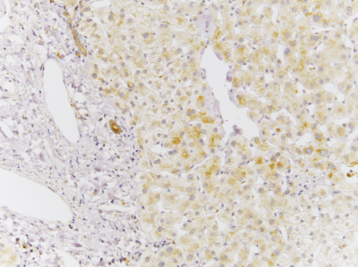
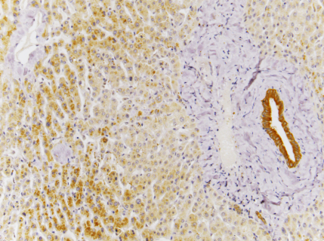
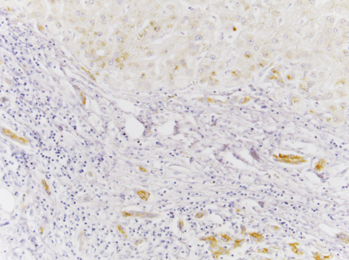
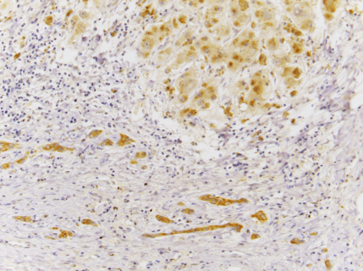
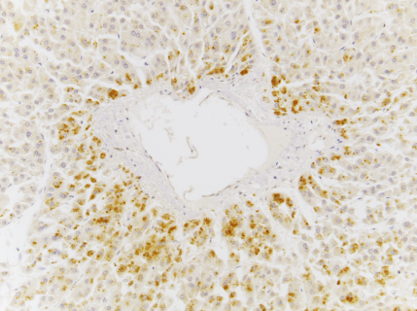
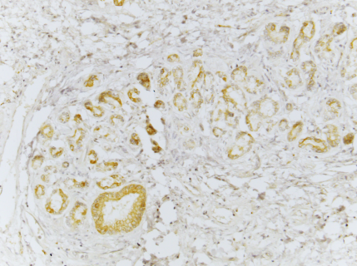
NPY [neuropeptide Y] expression in human liver
Patient A Patient B
non-diseased | A | B
cirrhosis | C | D
HCC | E | F
BD
h
h
h
h
DR
DR
DR
t
PF Wong

Slide 16
Neuropeptide Y
Mouse Human
WT
FAP GKO
WT
+ DPP4i
FAP GKO
+ DPP4i
Untreat
DPP4i
non-sel.
DPPi
Intensity (%)
Intensity (%)
Mass (m/z)
● Full length
● N cut
● C cut
Mass (m/z)
PF Wong

Slide 17
Neuropeptide Y with carboxypeptidase inhibition
Mouse Human
WT
FAP GKO
WT
+ DPP4i
FAP GKO
+ DPP4i
no DPPi
DPP4i
non-sel.
DPPi
Intensity (%)
Intensity (%)
Mass (m/z)
● Full length
● N cut
● C cut
Mass (m/z)
PF Wong

Slide 18
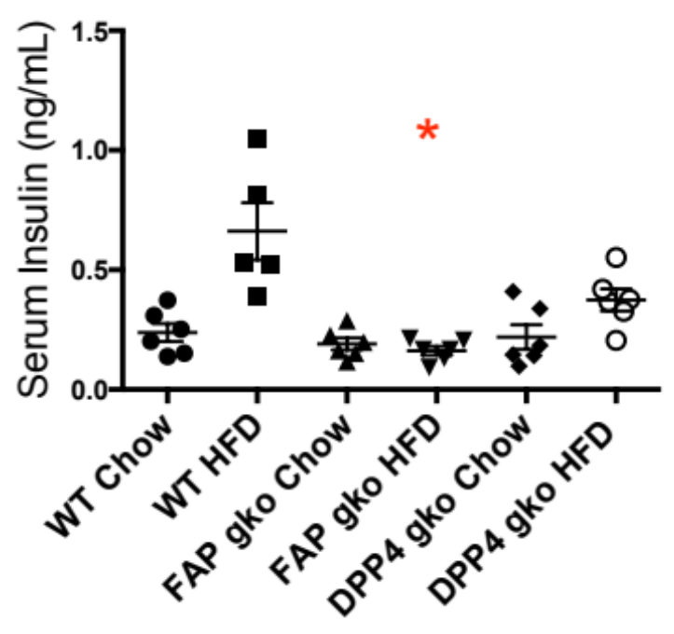
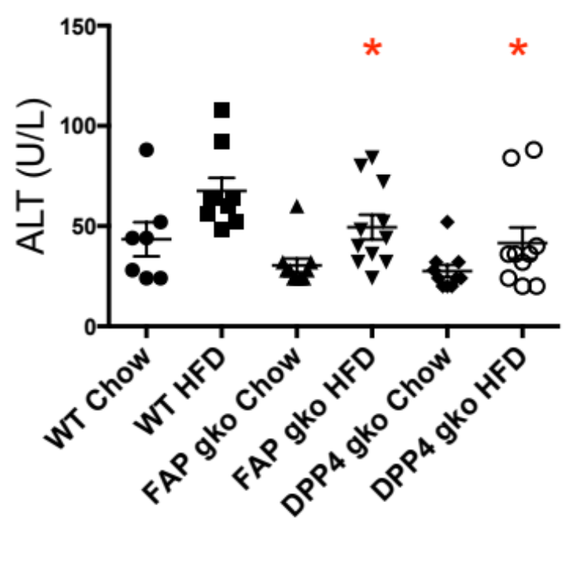
FAP gene knockout [gko] Mouse Phenotype:
Humans lacking active FAP have no adverse effects [Osborne, …Gorrell 2014 BBA Proteins]
FAP gko mouse:
Healthy and viable
In liver fibrosis models:
  Less fibrosis
  Less inflammation
In high fat diet (HFD) induced obesity (DIO) model:
  Less liver lipid
  Greater glucose tolerance
  Less insulin resistance [HOMA-IR]
  Less liver injury[ALT]
*p<0.05 compared to WT HFD
S. Chowdhury
Notes:
20 weeks HFD

Slide 19
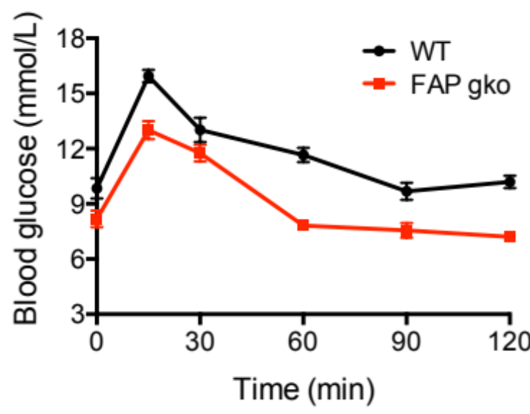
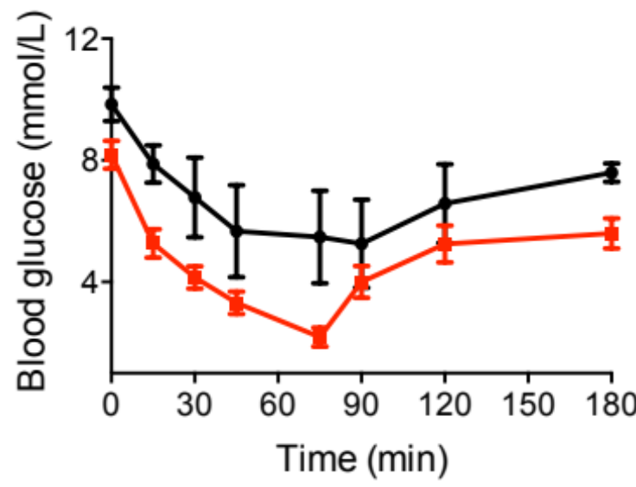
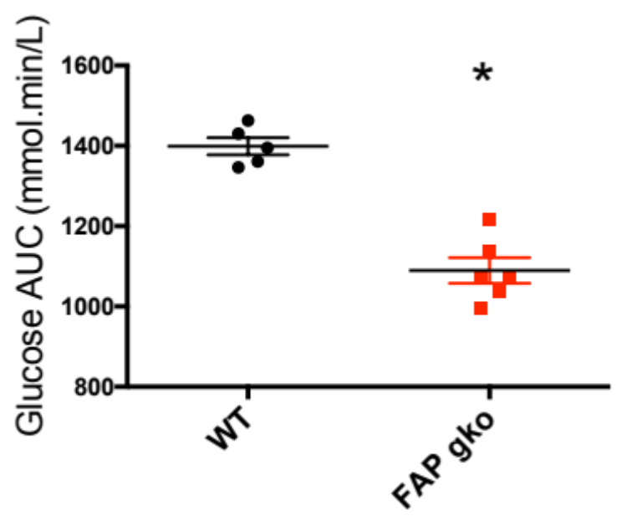
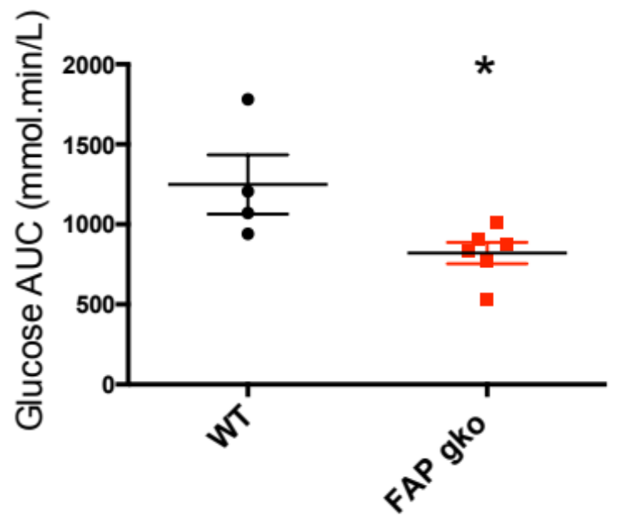
FAP gko mouse: improved glucose tolerance and insulin tolerance at 20 weeks DIO
GTT
ITT
S. Chowdhury
*P<0.05 compared to WT

Slide 20
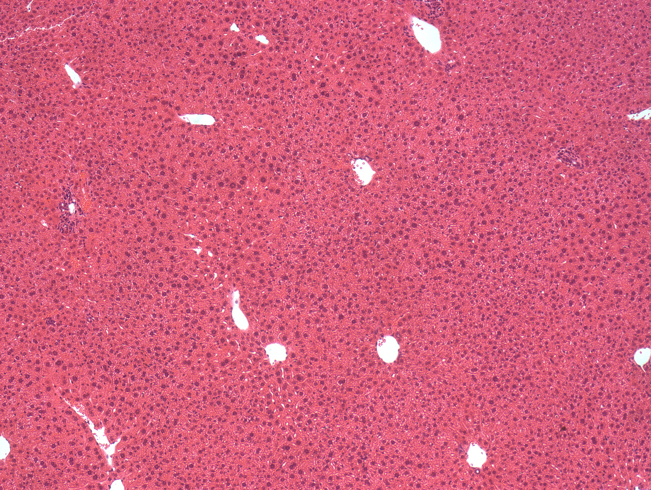
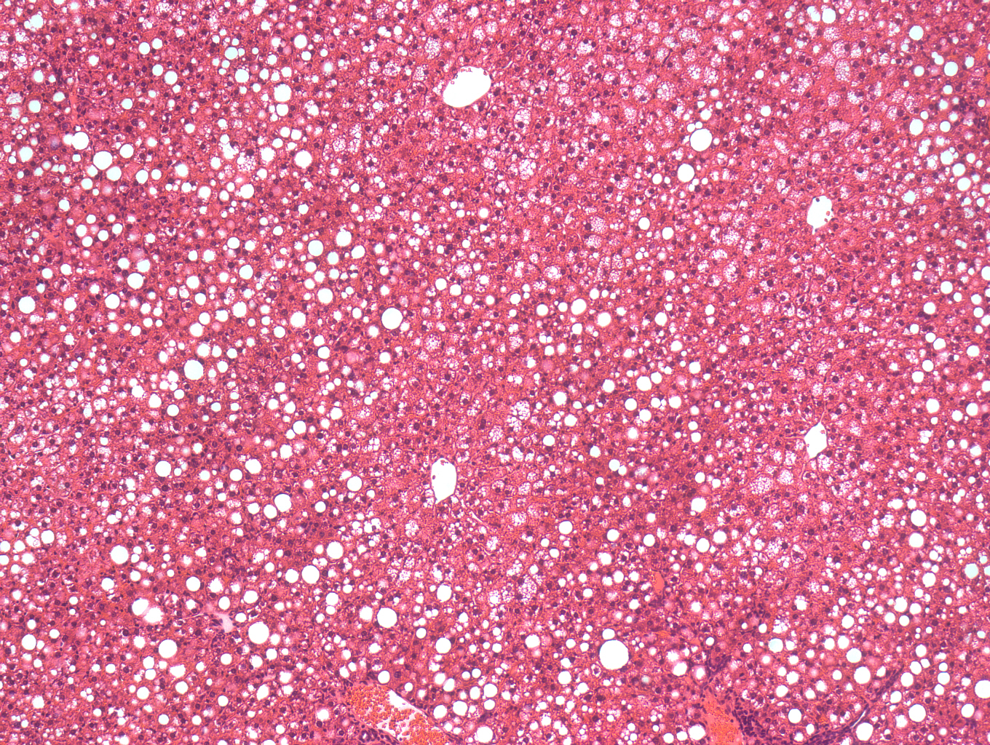
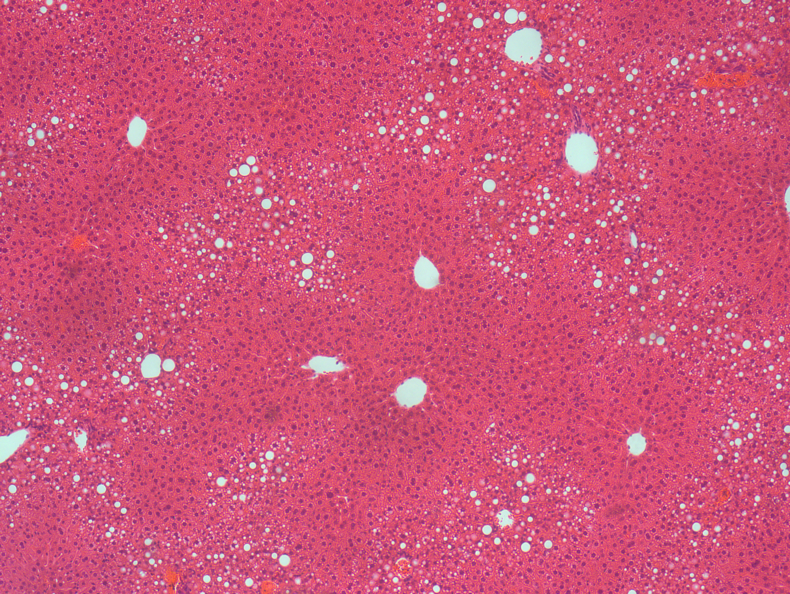
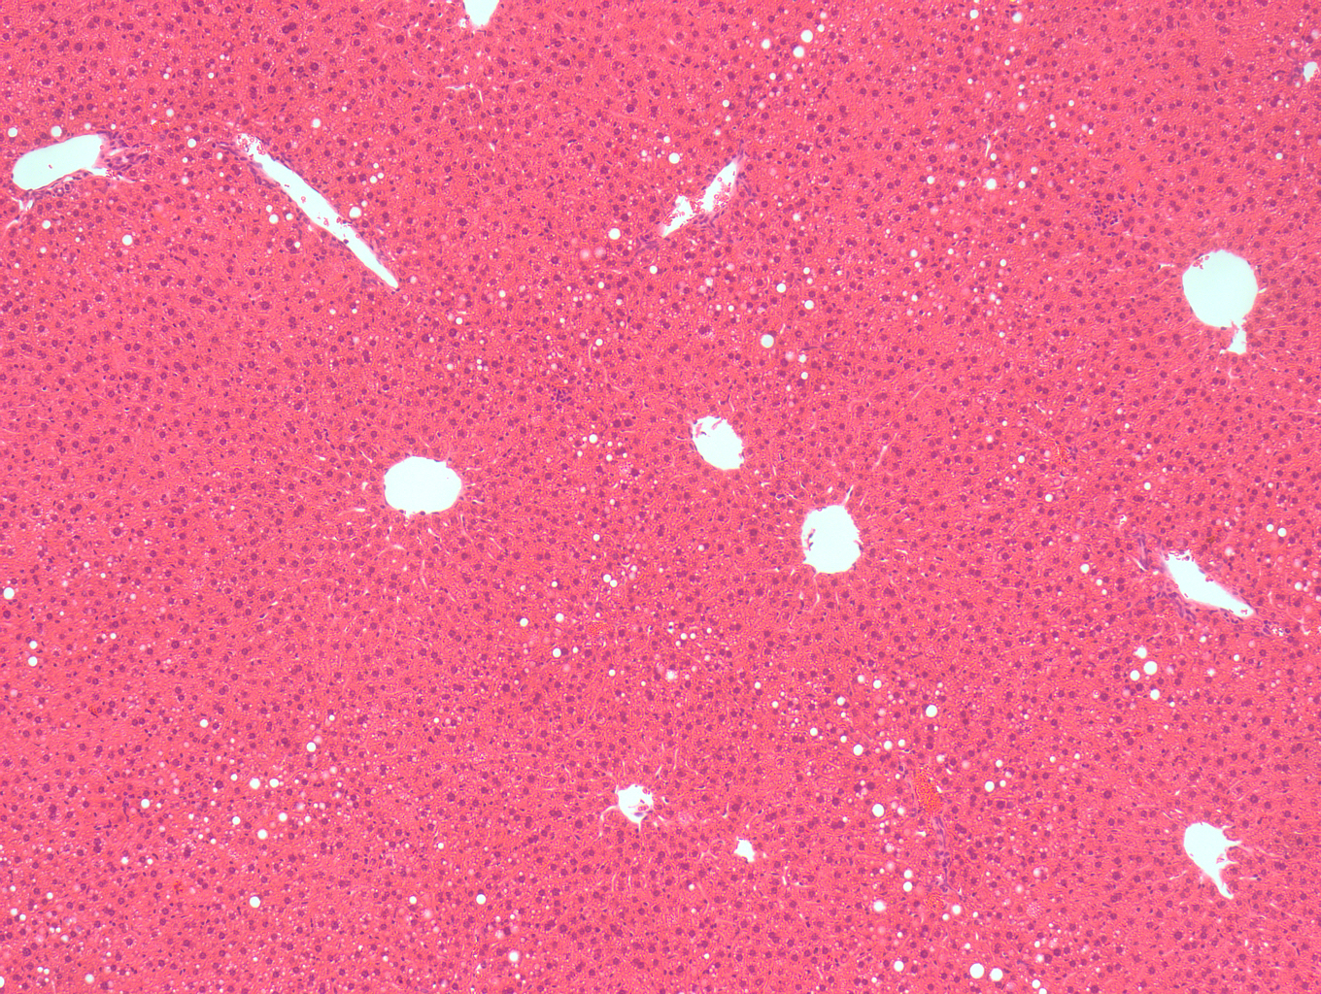
FAP gko mice 20 weeks DIO:
Less severe liver histology (H&E)
WT Chow
WT HFD
FAPgko
qPCR
FoxO1
ApoC3
PPAR g
TNF
DPP4 gko HFD
FAP gko HFD
no change SREBP1c
PPARα
S Chowdhury, M Gall, S Song
Notes:
Macro and micro vasicular inclusions These are H and E stained liver sections. This is a normal liver. As can be seen here, the WT HFD mice had extensive macro and microvesicular inclusions that most likely represents lipid and glycogen accumulation. And under higher magnification we could also see hepatocyte ballooning. Compared to WT, DPIV gko and FAP gko on HFD had fewer clear areas, mostly localized only near the portal tracts, while the central zone surrounding the central veins had normal histology and healthy hepatocytes, similar to the chow fed control groups

Slide 21
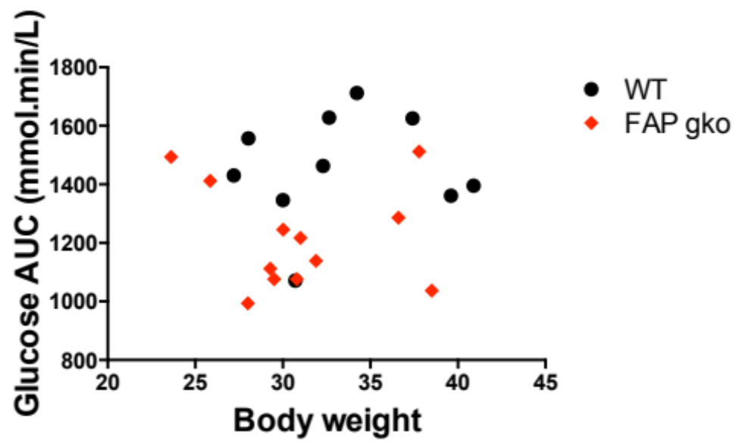
Improved oGTT is unrelated to body weight
20 weeks DIO.
n = 10-12 per group
Level of intact GLP1 unchanged in FAPgko
S. Chowdhury

Slide 22
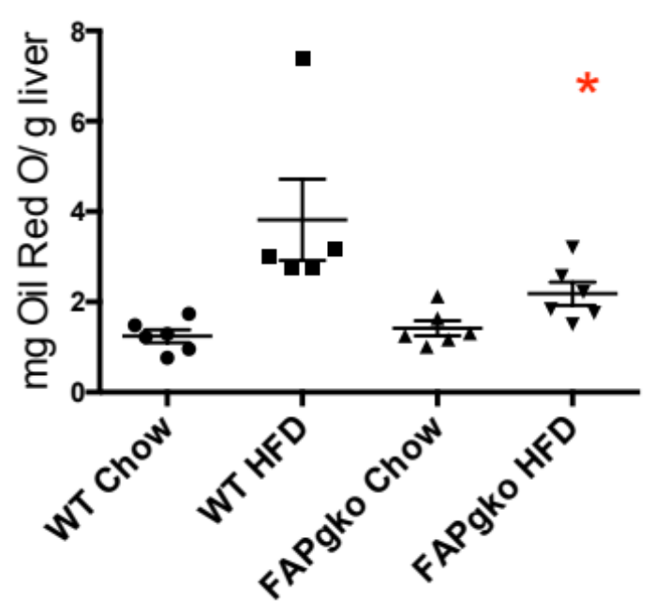
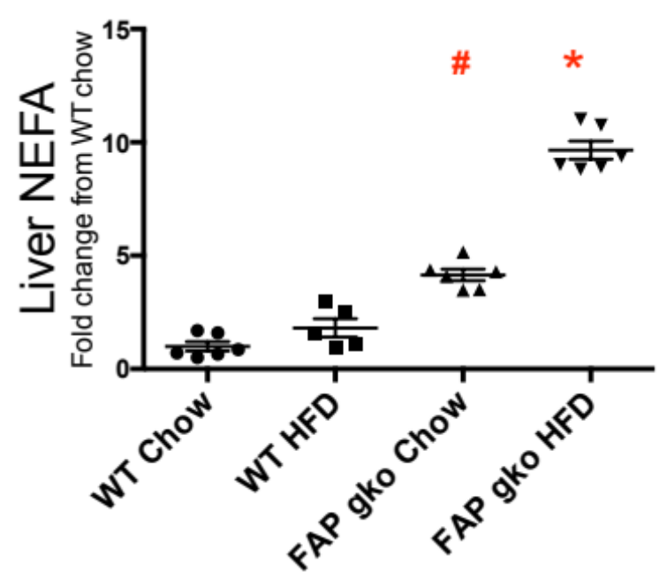
Mechanisms in FAP gko liver:
Less lipid: Non-esterified fatty acids elevated
[consistent with increased fat burning]
FA import (CD36) and lipogenic (GK) genes down
# p < 0.05 compared to WT Chow
* p < 0.05 compared to WT HFD
Lower levels of CD36 and glucokinase

Slide 23
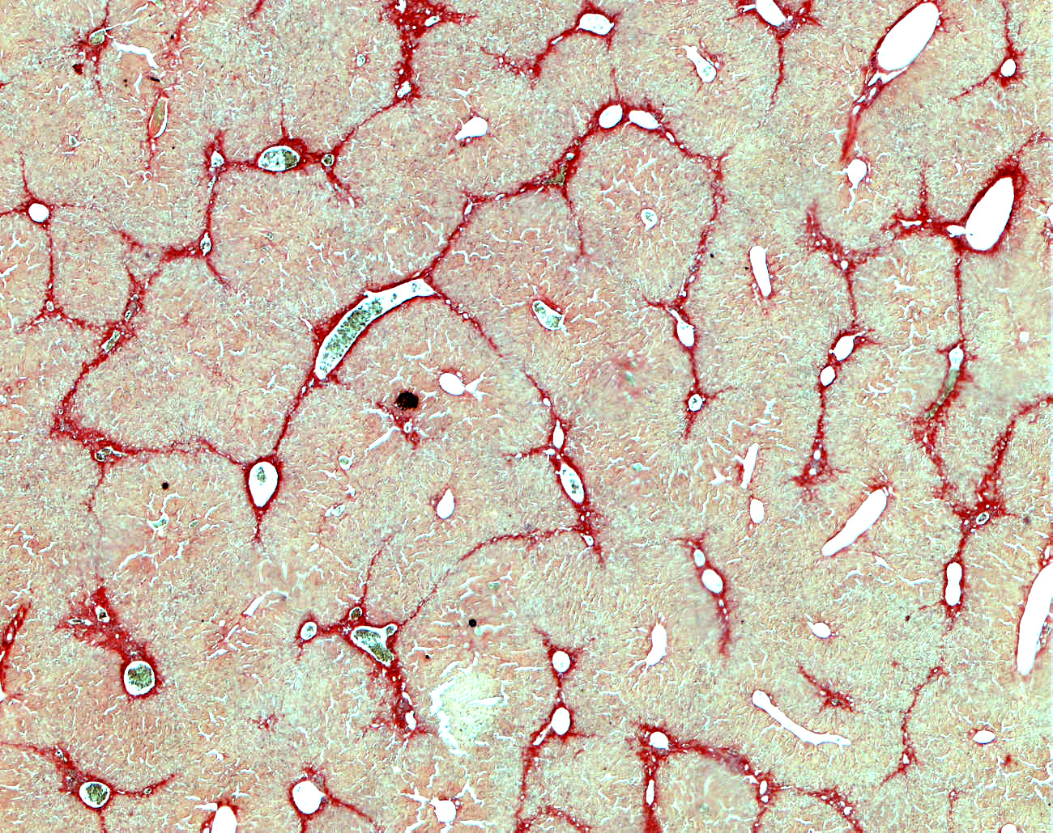
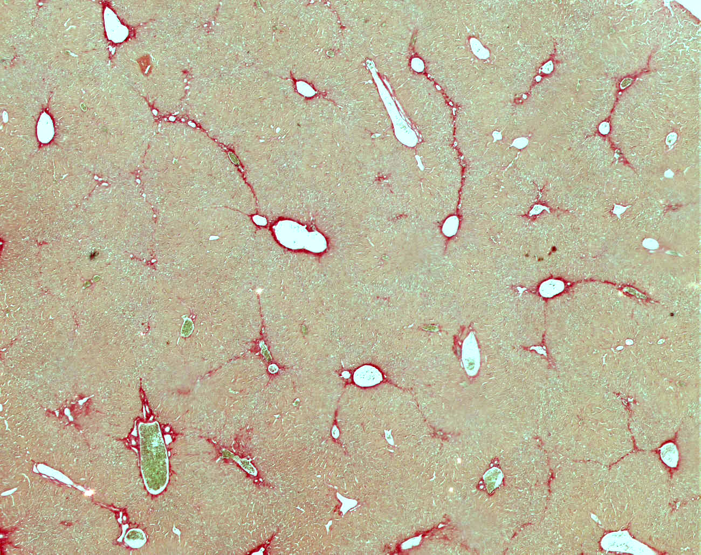
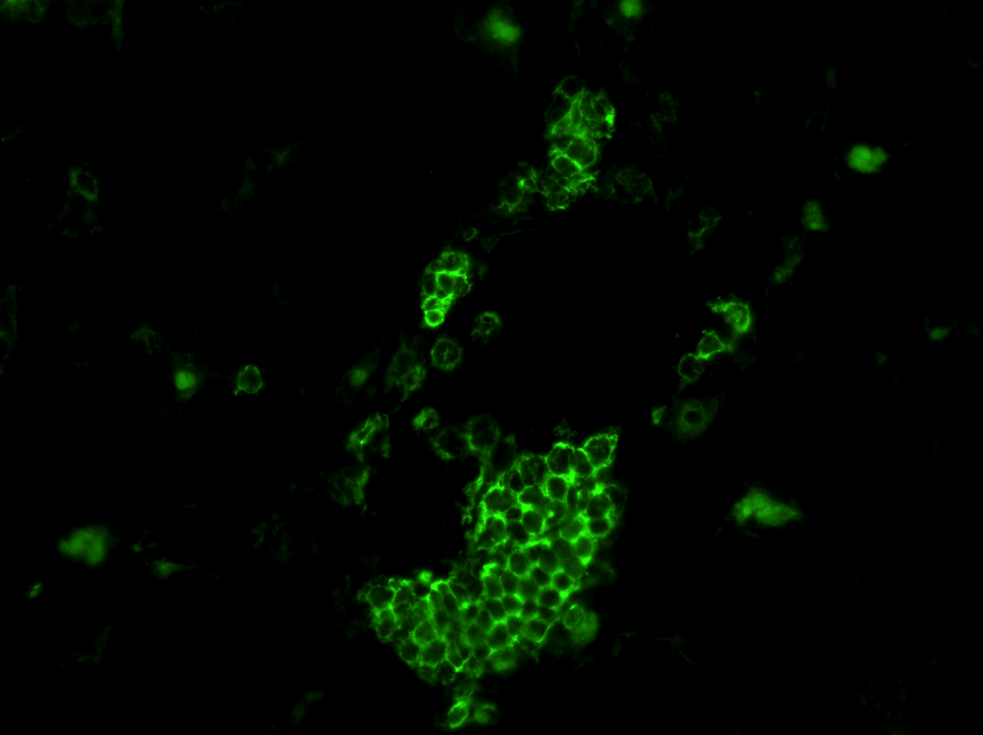
FAP gko Mouse Phenotype
  Liver fibrosis CCl₄ model:
  Less fibrosis
  Less inflammation [B cell clusters]
WT
KO
Sirius red stain of crosslinked collagen
B cell clusters in liver
XM Wang
Notes:
The fig legend explains the fig for you but is a bad look, so I inserted just the H and E image
Red = cross-linked CN which is made my activated HSCs

Slide 24
Discussion:
DPP4 inhibition lessens steatosis and possibly fibrosis.
DPP4 may be a liver damage biomarker; possibly of apoptosis.
FAP is fibrosis associated; highly upregulated in activated mesenchymal and stellate cells in liver.
FAP gko mouse has less fibrosis and less steatosis, and improved glucose tolerance and insulin sensitivity.
Mechanism may involve increased fat burning, less FA uptake, less lipogenesis.
How FAP lowers insulin is not known [not GLP1]. [leptin?]
Need to discover FAP substrates.
Potential for dual blockade of DPP4 and FAP to improve glycaemic parameters.
Potential for DPP4, FAP and/or their substrates to become biomarkers.

Slide 25


ACKNOWLEDGEMENTS
GORRELL LAB
MD Gorrell PhD
FM Keane PhD
S Chowdhury
AJ Ribeiro
EJ Hamson
MG Gall
XM Wang PhD
DMT Yu PhD
SYDNEY Univ / RPAH / Charles Perkins Centre
SM Twigg MD PhD
KH Williams MD
SV McLennan PhD
L Lo PhD
TUFTS University
W W Bachovchin PhD
Jack Lai PhD
W Wu PhD
For 3144-AMC, ARI-3996
UNSW: ZEKRY / LLOYD LAB
A Lloyd MD PhD
A Zekry MD PhD
N Nguyen PhD
K Bu
S Teutsch PhD
CI: BOWEN LAB
D Bowen MD PhD
B Maneck PhD
CI: McCAUGHAN LAB
GW McCaughan MD PhD
C Grezlak PhD
CI: HABER LAB
PS Haber MD PhD
D Seth PhD
Merck USA and MSD for MK626
Boehringer Ingelheim for FAP gko mouse
D Marguet for DPP4 gko mouse
CI: SHACKEL LAB
NA Shackel MD PhD
E Prakoso MD PhD
GARVAN INSTITUTE
G Cooney PhD
N Turner PhD
Funding: NHMRC
Equipment: Rebecca L Cooper Foundation, Perpetual Trustees, ARC
A.W. Morrow Gastroenterology and Liver Centre
Department of Endocrinology
Royal Prince Alfred Hospital
Sydney Medical School
and Charles Perkins Centre
University of Sydney

Slide 26
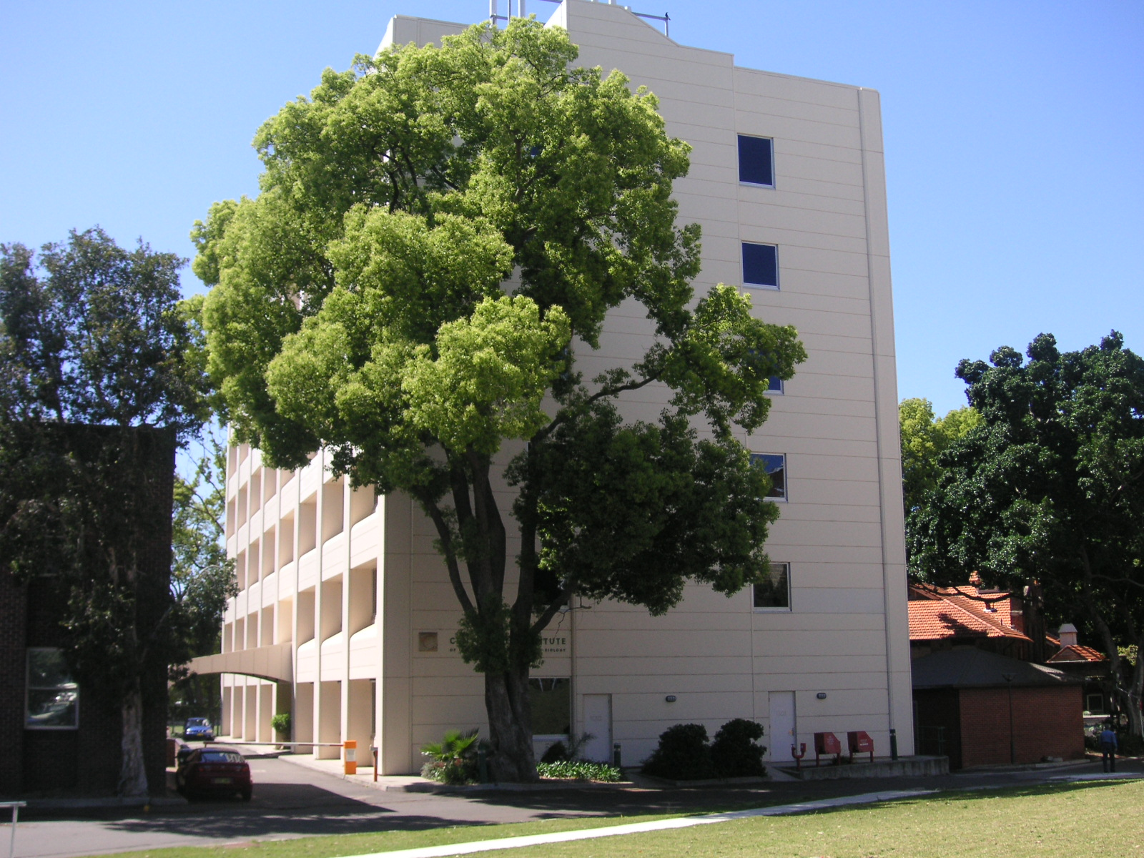
END

