Slide 1

Documentation of surgical ward rounds
Dr Mariyah Selmi Dr Aaron Smith, Dr Andrew Madden

Slide 2
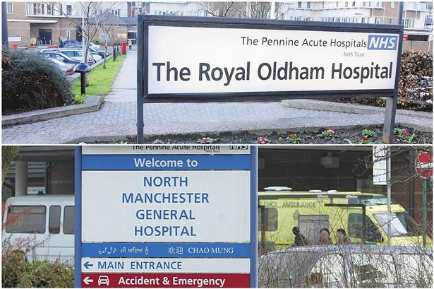
Pennine Acute Trust
Pennine Acute Hospitals, North East Manchester, UK;
Serve population of 820,000
Four hospital sites with 400,000 admissions per year
Surgical services at all sites

Slide 3
There are three general surgical wards at Oldham
  T4 acute admissions
  T5 for post-op care and longer duration of stay
  T6 mainly day case surgeries and overflow from T5 on rare occasions
Each ward staffed with three foundation year 1 trainees, with more senior doctors working within a team.

Slide 4
Reasons for audit
Surgical ward rounds are fast paced
Documentation is routinely done by the ward based F1 doctors
Omissions in documentation can lead to a detrimental impact on patient care

Slide 5
Aims
To quantify the amount of information documented following surgical ward rounds - on wards T4, T5, T6.
Set documentation standards and improve quality of documentation
Standards collated from:
  GMC good practice guidelines
  Trust Guidelines
  MDT questionnaire circulated

Slide 6
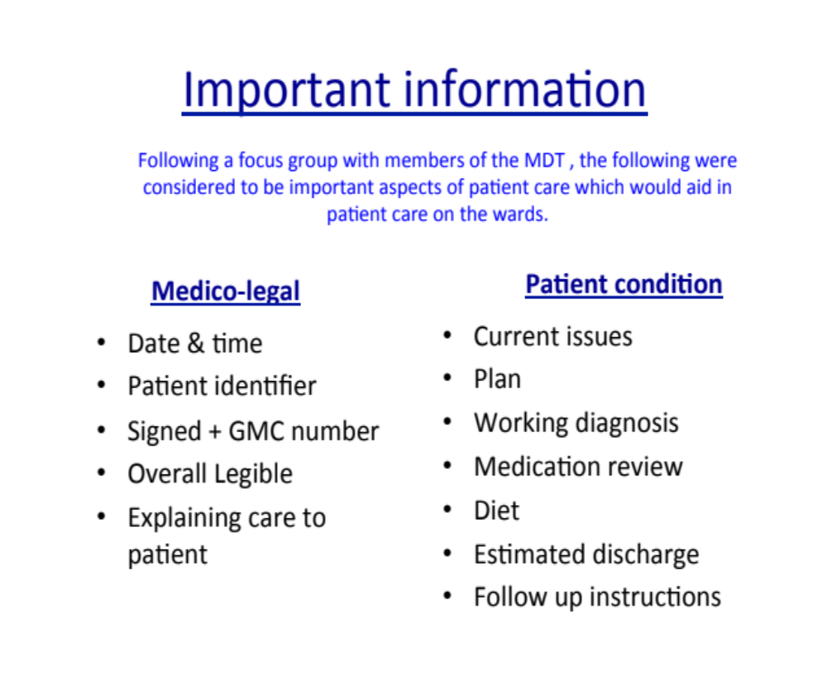
Documentation standard

Slide 7
Method
Retrospective audit of 3 general surgical wards
Last ward round entry analysed

Slide 8
Results n= 47

Slide 9
Results n=47

Slide 10
Results n=47

Slide 11
Summary of Results
Areas requiring improvement
Working diagnosis
Explanation given to patient
Medication review
Diet
Estimated discharge date

Slide 12
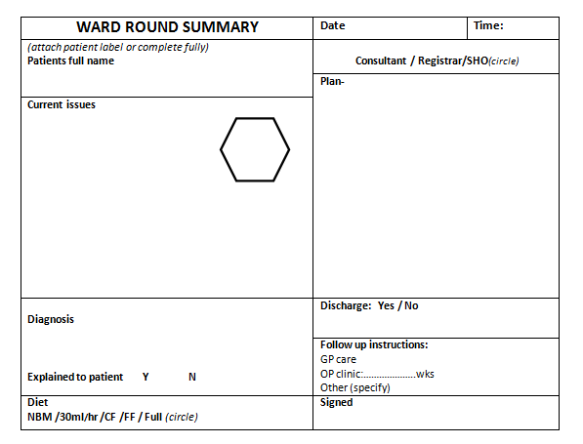
Action Plan
Implement new pro-forma to improve documentation

Slide 13
Implementation of pro-forma
Initial feedback for the pro-forma
  More detailed information
  Reduced delays on ward round
  All boxes were filled by both juniors and seniors
  Positive MDT response
  Patient aware of current plan and further investigations
  Teaching opportunity for senior to juniors to explain decision making process

Slide 14
Re-audit
Ward round proforma initially implemented on T4 and T5
T5 had stopped using pro-forma ~2 months into implementation
A comparison between T4- with pro-forma and T5- without pro-forma
As T6 mainly elective surgical cases. The pro-forma had limited benefits on this ward so data was not included in the re-audit

Slide 15
T4 Result- Pro-forma Used
N=13

Slide 16
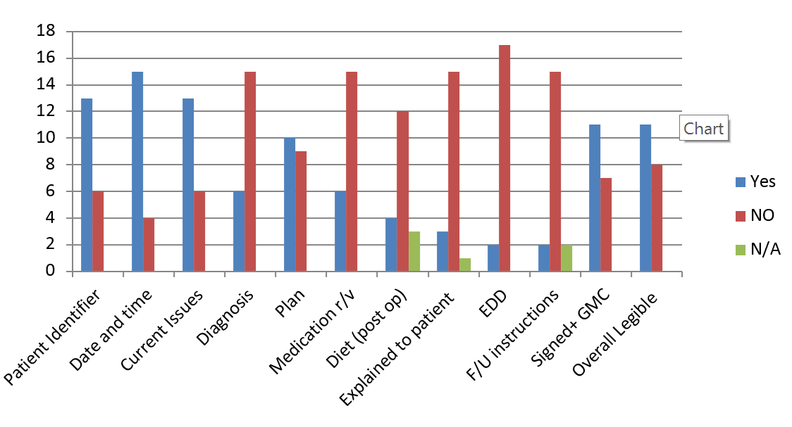
T5- Pro-forma not in use
N=19

Slide 17
Summary of results
T4 all documentation was up-to-date with an appropriate amount of information in each patients notes
T5 limited detail in most notes re-audited
On T5 4 patients did not have any documentation in their notes for the days ward round.

Slide 18
Re-audit Discussion
Pro-forma improved documentation when used.
T5 doctors felt that cutting and sticking completed pro-forma into notes was not effective use of their time
Factors that may have influenced results:
  Staffing levels
  Workload
  Individual doctors and their standards
  Patient complexity

Slide 19
Plan for the future
Proforma rolled out site wide within surgical wards
Regular re-audits
Proforma to be printed as stickers
Teaching sessions on good documentation

Slide 20
Questions please?

