Slide 1
COST EFFECTIVENESS OF ADDING CLOSTRIDIAL COLLAGENASE OINTMENT TO STANDARD OF CARE IN INDIVIDUALS WITH STAGE IV PRESSURE ULCERS
Carter M¹, Gilligan A², Waycaster CR³, Schaum K⁴
¹Strategic Solutions Inc., Cody, WY, USA
²Truven Health Analytics, Ann Arbor, MI, USA, ³Smith & Nephew Inc., Fort Worth, TX, USA, ⁴Smith & Nephew Inc., Lake Worth, FL, USA

Slide 2
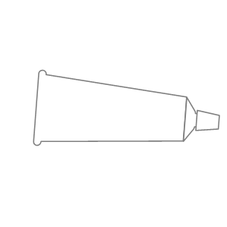

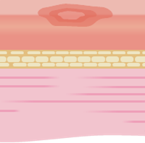
Study Objectives
Determine cost effectiveness of adding CCO to standard of care
Understand effects of changing various cost inputs
Understand effects of changing treatment parameters and healing rates
Notes:
Determine the cost effectiveness (from a payer’s perspective) of adding CCO to standard of care in the treatment of stage IV PUs among outpatients seen at wound care clinics.
Understand the effects of changing various cost inputs
Understand the effects of changing treatment parameters and healing rates

Slide 3
Pressure Ulcers
Stage 1
Stage 2
Stage 3
Stage 4
Skin
Fat
Muscle
Bone
Notes:
A pressure ulcer is localized injury to the skin and/or underlying tissue usually over a bony prominence, as a result of pressure, or pressure in combination with shear.

Slide 4
Pressure Ulcer Prevalence
Medicare patients
Long-term care
facility residents
Rates for combined care settings
4.5%
1 new PU during hospitalization ¹
11-19%
Developed PUs ^{2,3}
13.5%
in 2008 ⁴
12.3%
in 2009 ⁴
¹Lyder CH, Yu C, Stevenson D, et al. Ostomy Wound Manage 1998;44(3A Suppl):42S-9S.
²Park-Lee E, Caffrey C. NCHS data brief, no 14. 2009.³Horn SD, Bender SA, Bergstrom N, et al. J Am Geriatr Soc 2002;50:1816-25.
⁴VanGilder C, Amlung S, Harrison P, et al. Ostomy Wound Manage 2009:55:39-45.
Notes:
0- Prevalence of pressure ulcers (PUs) greatly depends on the population being studied
1- 4.5% of Medicare patients (USA) developed at least 1 new PU during hospitalization
2- 11-19% of residents in long-term care facilities developed PUs
3- Rates for combined care settings (acute care, long-term care, rehabilitation facilities) were 13.5% in 2008 and 12.3% in 2009

Slide 5
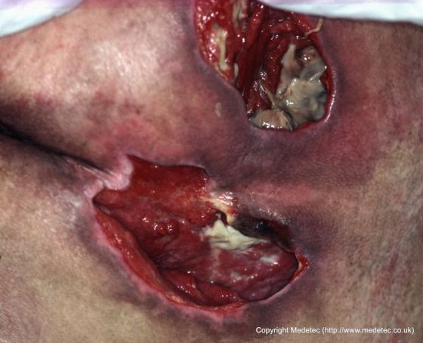
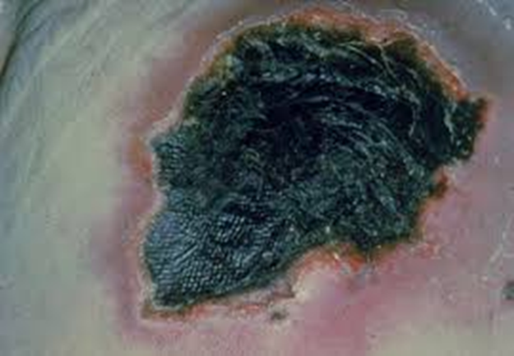
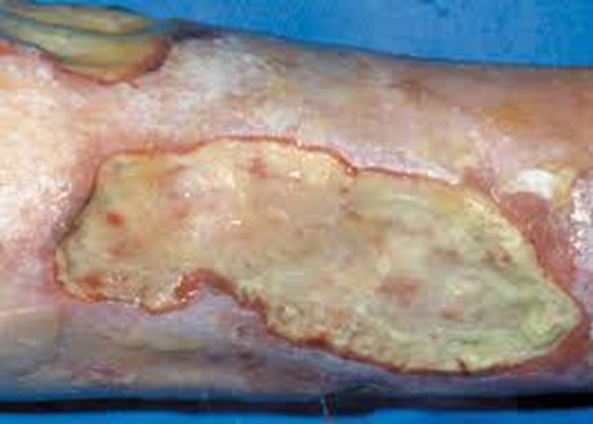
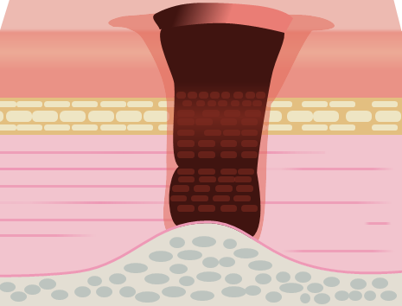
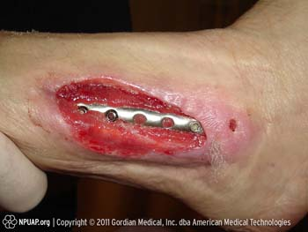
Stage IV Pressure Ulcers
Stage 4
Eschar
Slough
Exposed bone
Tunneling and undermining
Notes:
Stage IV PUs are categorized by full thickness tissue loss with exposed bone, tendon or muscle. Slough or eschar may be present on some parts of the wound bed. Often include undermining and tunneling.1

Slide 6

Standard of Care
Wound cleansing
Debridement
Infection management
Skin care surrounding wound
Appropriate local treatment
Offloading
Patient repositioning
Nutritional assessment
Notes:
Wound cleansing
Debridement (removal of necrotic/senescent tissue)
Infection management (detection of wound bioburden or infection) and appropriate local treatment with dressings and/or systemic antibiotics
Skin care surrounding wound (prevent maceration)
Offloading (ensuring that the PU doesn’t experience further pressure)
Patient repositioning (acute care/long-term care) as needed
Nutritional assessment

Slide 7
Role of Clostridial Collagenase Ointment (CCO)
Wound
Dead tissue
Granulation
Slough
Eschar
CCO
FDA approved enzymatic debridement agent
Subsequent cleansing
Notes:
0- CCO is an FDA-approved enzymatic debridement agent
It penetrates the wound surface by migrating through the edges of the wound and between pockets of slough, eschar, and dead tissue
1- Collagen is selectively attached, cleaving the fiber at its attachment point, and detaching the fiber from the wound bed, freeing the wound of necrotic debris
2- Resultant necrotic debris can be successfully removed through subsequent cleansing and dressing changes
3- CCO does not affect granulation.

Slide 8
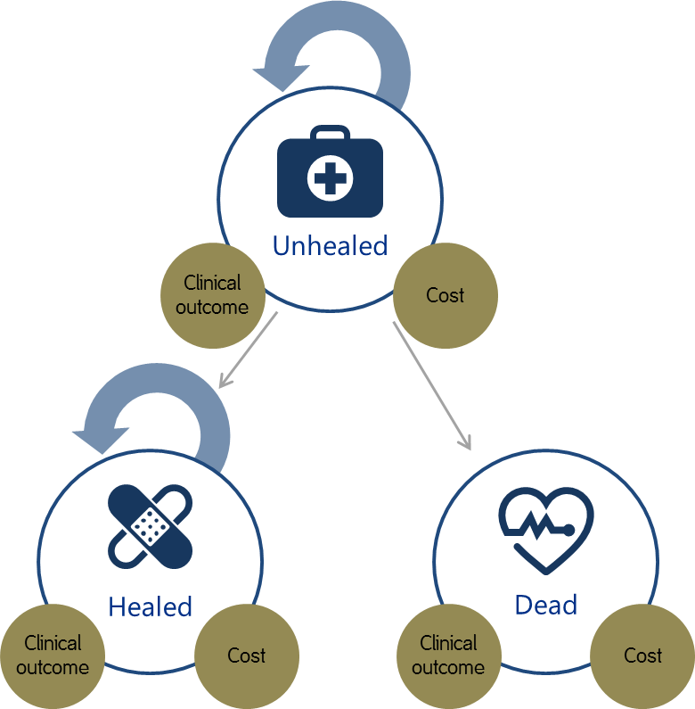
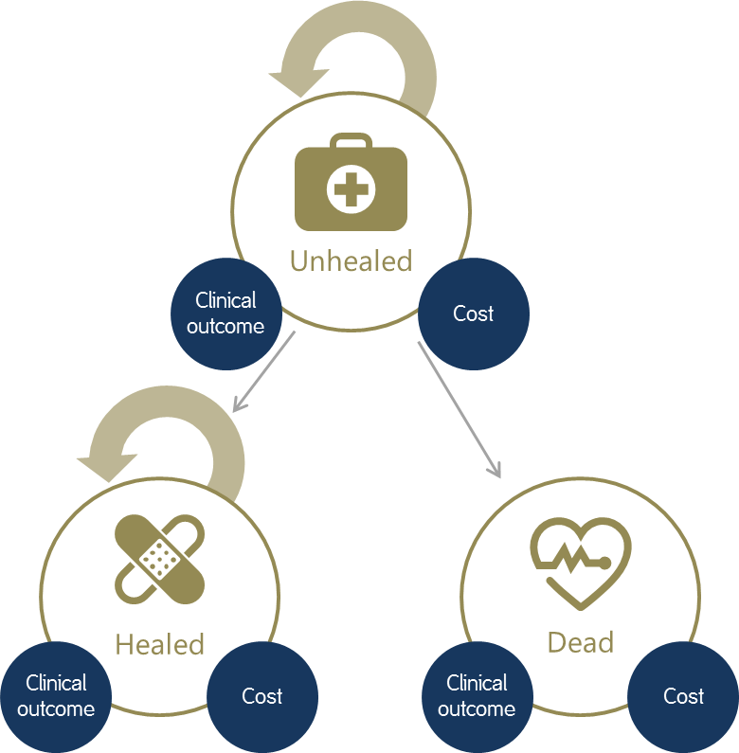
Markov Diagram
Cumulative cost (2015 US dollars)
CCO
Standard of care alone
Unhealed
Clinical outcome
Cost
Clinical outcome (ulcer-free weeks)
Final
Output
Incremental cost effectiveness (ICER)
Healed
Dead
Clinical outcome
Cost
Clinical outcome
Cost
2 years
Notes:
0- Markov simulation model was designed to evaluate the cost-effectiveness of CCO in stage IV PUs.
1- Four-week cycles were used to examine the costs and outcomes associated with the 3 Markov health states. Unhealed state was equated to having a PU and healed state equated to having a healed PU. Clinical outcome and costs were calculated for each cycle with half-cycle corrections. Markov health states included unhealed, healed, and death,
2- and evaluated 2 comparative pathways: CCO added to standard of care versus standard of care alone.
3- A time horizon of 2 years was chosen as a compromise between a timeframe that was too short in which few PUs would heal and a longer timeframe in which a high percentage of patients would die or experience other complications that could create large uncertainties in the model.
4- Final model outputs included cumulative costs (in 2015 US dollars), clinical outcome (ulcer-free weeks), and incremental cost effectiveness (ICER)

Slide 9

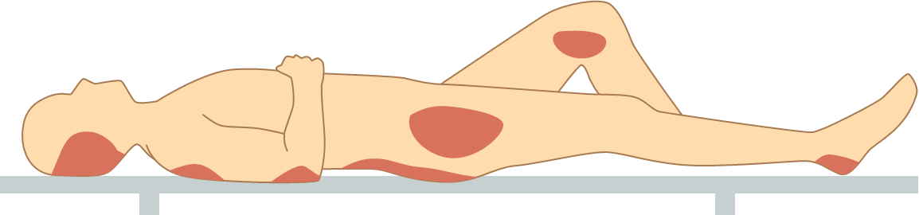


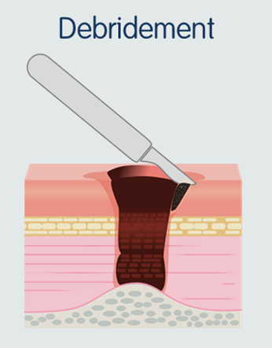
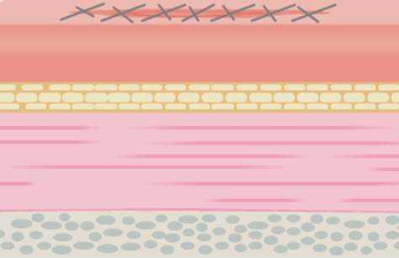
Model Inputs
Offloading devices
COSTS
POPULATION
&
TREATMENT
PARAMETERS
PU body locations (weights)
Healing rates
Clinic visits
(including evaluation
and debridement)
Mortality rates
Debridement frequency
Surgical closure
Clinic visit frequency

Slide 10
Healing Rates
Proportion of stage IV PUs closed double for PUs treated with CCO
CCO
14
Non - CCO
Most probable healing rate is based on actual wounds healed + estimating the number of wounds healed that were censored in the interval.
12
10
Healing rates modeled on wound closure rates
8
Healing rate (%)
6
4
Y= -0.0371x + 4.5026
R² = 0.0085
2
Y= -0.0333X + 1.9198
R² = 0.0324
0
0
5
10
15
20
25
30
Cycle Number
2 year span, 28 day cycles
¹Carter MJ, Gilligan AM, Waycaster CR, et al. Wound Repair Regen 2015; Submitted for publication
Notes:
0- Proportion of stage IV PUs closed at 1 and 2 years, respectively, was double for PUs treated with CCO (22.2%, 26.7%, n=336) compared to those not treated with CCO (11.0%, 13.7%, n=337).¹
1- Data used were heavily right censored, so an actuarial table for each group was created based on dividing the 2-year data into equal increments of 28 days to reflect cycle length.
2- Most probable healing rate of censored wounds was calculated based on number of wounds actually healed in the interval and number of wounds at the beginning of the interval at risk minus the number of censored wounds.
3- Death rates were applied at each cycle. Healing rates were modeled based on wound closure rates using linear regression equations.

Slide 11
Mortality Rates
Key
Mean 4-week mortality rates
_{n}
1.26%
1.03%
(Fi / 100) * Pi
_{i = 1}
F
Percentage of patients in the age ith group
p_{i}
Percentage of death in moving from the ith age group to the ith + 1 age group
CCO
Standard of Care
% of patients in each interval calculated
Age (Years)
F₁
F_{n}
10
20
30
40
50
60
70
80
90
100
Notes:
Mortality rates were modeled using age structure in 5-year increments for each treatment group and adjusted using national census data. Percentage of patients in each age interval was then calculated.
Mean age-adjusted annual mortality rate for each treatment group:
F = percentage of patients in the age ith group; P_{i} = probability of death in moving from the ith age group to the ith+1 age group and F₁ is associated with the age group ≥20 years, and F_{n} is associated with the age group ≥95 years. Mean 4-week mortality rates were 0.0126 and 0.0103 for the CCO and standard of care groups, respectively.

Slide 12
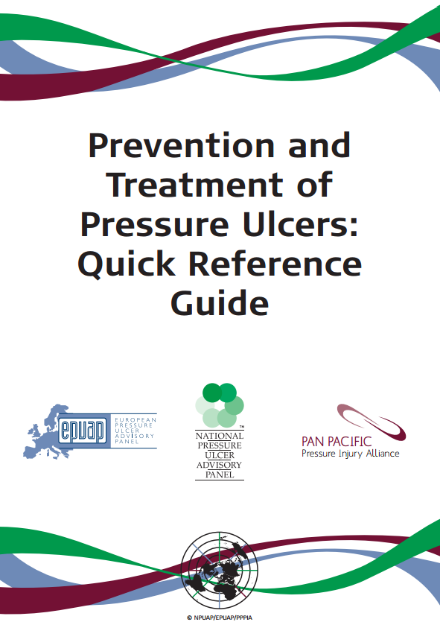
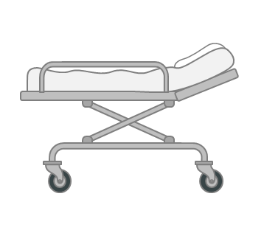
Cost Elements
Category | Item | CPT/ HCPCS Code | Medicare 2015 Allowable Charges ($) (Medicare Pays 80%, Patient Pays 20%)
 | Physician, evaluation | G0463 | 77.5
 | Facility | G0463 | 96.25
 | Physician, debridement | 11042 | 63.29
 | Facility, debridement | 11042 | 283.14
 | Facility, debridement with Santyl | 97602 | 146.14
 | Physician, evaluation | G0463 | 51.13
 | Facility | G0463 | 96.25
 | Physician, debridement | 97597 | 24.31
 | Facility, debridement | 97597 | 146.14
 | Facility, debridement with Santyl | 97602 | 146.14
 | Roho high profile cushion or equivalent$ | E2625 NU mod | 469.58
 | Group 2 low air loss mattress¶ | E0277 RR mod | 663.22
 | Heel protector** | E0191 NU mod | 10.52
 | Heelift traction boot or equivalent†† | E0945 mod NU | 46.61
 | Pillows (2) and body wedges (2) ‡‡ | N/A (lowest commercial cost) | 133
2015 Medicare national average reimbursement rates
Unit costs (unhealed state)
Initial clinic visit*†
Discussion with PU care practitioner
Established clinic visit*†‡
Offloading
Table 1. Unit costs (US dollars).
*A “clinic” is a hospital-based outpatient wound care department. †The clinic visit includes everything but debridement. Level 3 complexity was assumed for evaluation and management at all visits. Only 97602 had a facility charge associated with it and no other kind of debridement codes were billed with it. ‡If any debridement was performed at an established clinic visit, separate billing for evaluation and management charges was not permitted. $For wheelchair-bound patients having PUs located on the sacrum, back, buttocks, ischium, or hips. ¶For patients with PUs located on the sacrum, back, buttocks, ischium, or hips; cost was per month. **For patients with heel or ankle PUs; cost was every 12 weeks. ††For patients with foot PUs; cost was every 26 weeks. ‡‡For patients with PUs located on sacrum, buttocks, ischium, hips. CPT: Current Procedural Terminology; HCPCS: Healthcare Common Procedure Coding System; N/A: not applicable
Notes:
0- Proportion of stage IV PUs closed at 1 and 2 years, respectively, was double for PUs treated with CCO (22.2%, 26.7%, n=336) compared to those not treated with CCO (11.0%, 13.7%, n=337).¹
1- Data used were heavily right censored, so an actuarial table for each group was created based on dividing the 2-year data into equal increments of 28 days to reflect cycle length.
2- Most probable healing rate of censored wounds was calculated based on number of wounds actually healed in the interval and number of wounds at the beginning of the interval at risk minus the number of censored wounds.
3- Death rates were applied at each cycle. Healing rates were modeled based on wound closure rates using linear regression equations

Slide 13
Sensitivity Analysis
PU location proportions
X%
X%
X%
X%
X%
X%
X%
X%
X%
X%
X%
X%
X%
Healing rate
Cost
Standard of care healing rate
50%
Offloading cost
CCO healing rate
Level 5
75%
-10%
+10%
100%
Initial visit clinic cost
30%
Cost of surgical closure
.65 and .85 used to approximate uncertainty
Total surgical cost
Notes:
PU location proportions changed to be more reflective of commonly cited percentages of PUs by location and equal by group
Standard of care healing rates were set to 75% of the CCO healing rates at each cycle as the baseline, and values of 0.65 and 0.85 used to approximate uncertainty
Costs associated with muscle or bone debridement were assessed along with a more complex initial visit (level 5) for the initial visit clinic costs.
More expensive but not necessarily more effective options were chosen to explore offloading costs (50% increase)
Surgical costs were assessed by including them when a PU healed

Slide 14

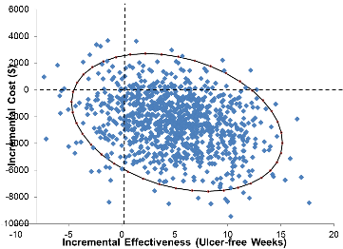
Sensitivity Analysis (II)
Model inputs
PU location proportions
Monte-Carlo simulation of 10,000 trials
Healing rate
Cost
Probabilistic
sensitivity analysis
Notes:
PU location proportions changed to be more reflective of commonly cited percentages of PUs by location and equal by group
Standard of care healing rates were set to 75% of the CCO healing rates at each cycle as the baseline, and values of 0.65 and 0.85 used to approximate uncertainty
Costs associated with muscle or bone debridement were assessed along with a more complex initial visit (level 5) for the initial visit clinic costs.
More expensive but not necessarily more effective options were chosen to explore offloading costs (50% increase)
Surgical costs were assessed by including them when a PU healed

Slide 15
Model Validation
Accuracy check
Wounds closed at 2 years
Cost
(Goodness of fit: 65.4%, 32.0%)
Literature
65.9%
Healing
32.1%
Model input stage
By cycle in
cumulative model
results
Mortality rates
CCO
Standard of Care
Stage 1
Stage 2
Stage 3
Real-world data
Within prescribed
limits
Notes:
Current data from the literature were used as model inputs
“Real-world” data used as this population is likely to be significantly different from acute/long-term care populations
Accuracy checked in stages: (1) with costs, healing; and mortality rates; (2) at the model input stage; and (3) by cycle in cumulative model results
Proportion of wounds calculated as closed at 2 years without any censoring was 65.9% and 32.1% for the CCO and standard of care groups, respectively. Goodness of fit for this stage of the model was 65.4% and 32.0%
Markov model was calibrated in stages using a dependent validity method to ensure that final results were within prescribed limits when compared against dataset parameters.

Slide 16
Results
Population Changes
Cumulative Cost
Healed Wound Weeks
Unhealed CCO
Unhealed non-CCO
Healed CCO
Healed non-CCO
CCO
Non-CCO
100
Dead CCO
Dead non-CCO
CCO
Non-CCO
90
20,000
80
Over 20% increase in
healed PUs with CCO
40
18,000
70
Lower cumulative cost with CCO
16,000
35
60
14,000
30
Faster healing with CCO
50
25
12,000
Population (%)
Cumulative Cost ($)
Healed Wound Weeks
40
10,000
20
30
15
8,000
20
10
6,000
10
5
4,000
0
2,000
0
0
8
16
24
32
40
48
56
0
0
8
8
16
16
24
24
32
32
40
40
48
48
56
56
64
72
80
88
96
104
64
64
72
72
80
80
88
88
96
96
104
104
Weeks of Therapy
Weeks of Therapy
Weeks of Therapy

Slide 17
Results: ICER
Results: ICER
Cost
$17,596
$20,000
$17,500
Standard of care
$15,000
$11,151
$12,500
Additional 17.2 weeks
$6,445 saved per patient
ICER -$375 per week
$10,000
Standard of care + CCO
$7,500
$5,000
16.75
33.94
$2,500
5
10
15
20
25
30
35
40
45
50
55
Ulcer-free weeks
Notes:
Relative to standard of care alone, CCO + standard of care incurred lower costs and higher benefits: $11,151 vs. $17,596, and 33.94 vs. 16.75 ulcer-free weeks, resulting in a dominated ICER of –$375 per ulcer-free week.
This indicates that for each additional ulcer-free week that can be gained there is a concurrent cost savings of $375 if the additional CCO treatment is selected.
Over a 2-year period, an additional 17.2 ulcer-free weeks can be gained with a concurrent cost savings of $6,445 for each patient.

Slide 18
One-Way Sensitivity Analysis
Change in Costs over Base Case
Change in Benefits over Base Case
Parameter | Method | Change in Benefit (Ulcer-free Weeks)
Location proportions | Standardize between groups | -11.7
Healing rates | 0.65 and 0.85 of CCO rate | 0.65: -8.6 0.85: -14.5
CCO application rate | Increase by 100% | 3.5
Parameter | Method | Change in Cost ($)
Location proportions | Standardize between groups | 3,539
Healing rates | 0.65 and 0.85 of CCO rate | 2,883 & 4,155
Surgical closure | Add cost if wound heals | 1,469
Debridement | Deeper level at first visit | 183
CCO application rate | Increase by 100% | 60
Initial visit | Level 5 complexity | 0
Reimbursement rates | Increase by 20% | –1,296
Offloading | 50% increase in costs | –1,421

Slide 19
Probabilistic Sensitivity Analysis
Additional ulcer-free weeks
ICER below zero
Better
patient care
Significant
cost savings
Notes:
Relative to standard of care alone, CCO + standard of care incurred lower costs and higher benefits: $11,151 vs. $17,596, and 33.94 vs. 16.75 ulcer-free weeks, resulting in a dominated ICER of –$375 per ulcer-free week.
This indicates that for each additional ulcer-free week that can be gained there is a concurrent cost savings of $375 if the additional CCO treatment is selected.
Over a 2-year period, an additional 17.2 ulcer-free weeks can be gained with a concurrent cost savings of $6,445 for each patient.

Slide 20
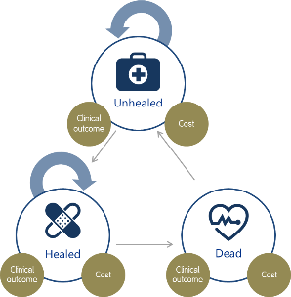
Conclusions
Limitations
Strengths
Simplified rates of healing/mortality
+17.2
ulcer free weeks
Comprehensive healthcare provider cost
Real-world data
$375
ICER
+$6,445 saved per patient
Realistic health states
Small samples for model inputs
Cost
savings
Increased
benefits
Notes:
Adding CCO to standard of care in the treatment of stage IV PUs resulted in an ICER of −$375 per ulcer-free week with 17.2 additional ulcer-free weeks and a cost savings of $6,445 per patient over a 2-year period.
Sensitivity analyses demonstrated that this result was robust with all variations still yielding costs savings and increased benefits
Study strengths: Use of “real-world” data; realistic simulation of health states; comprehensive health care provider costs
Study limitations: relatively small samples for model inputs; simplified healing/mortality rates.

