Slide 1
Characterization of microparticles derived from cultured macrophages and cerebrospinal fluid of patients with schizophrenic and affective disorders
E. Marion Schneider
Anesthesiology
University Hospital Ulm, Germany

Slide 2
Inflammation in the brain can be detected in peripheral blood
Background
Leboyer et al. 2012
„Bipolar disorder can be effectively conceptualized as a multi-systemic inflammatory disease“
Dantzer et al. 2008
„When activation of the peripheral immune system continues unabated (...) the ensuing immune signalling to the brain can lead to (...) development of symptoms of depression in vulnerable individuals“
Hope, et al. 2012
„Immune profile of bipolar disorder and schizophrenia suggests inflammatory disturbances related to neuroplasticity, endothelial function and calcium regulation“
Scientists have known for a while now that inflammation contributes to long-term neurodegenerative conditions such as AD and PD. But lately they have been turning up evidence that inflammation can affect the brain more directly and acutely, and might underlie a wider range of problems, from impaired cognition during infections to depression and even schizophrenia. - See more at: http://www.dana.org/BrainWork/2014/The_Brain_Inflamed/#sthash.QFa2Orpw.dpuf

Slide 3

Patients
Case
Age[ ],
Disease
Autoimmune
Medication
 | Male/female |  | characteristics | A, B, C, D, F
SZ1 | [25] male | F20.0 | no | B, B, F
BD1 | [47] female | F32.2 | yes | D, F
BD2 | [51] female | F32.2 | yes | C, F, B
SZ2 | [33] female | F20.0 | yes | none
BD3
[40] male
F42.2 F60.7
no
none
BD4
[28] male
F33.2
yes
B, Bupropione 300 mg
 |  | F60.3
BD5 | [51] male | F.45.0 | no | Bupropione 200 mg + Amitriptyline 25 mg
BD6 | [31] male | F42.2 | yes | B, Antibiotics
BD7 | [41] male | F06 | no data | no data
BD8 | [28] female | F43.0 | no | no data
SZ3 | [59] female | F20.0 | no | B, B
3

Slide 4

Aims
To characterize inflammatory pathways in
enriched antigen presenting cells
To clarify the involvement of
damage vs. pathogen related inflammation

Slide 5



Aims
Dangers
Strangers

Slide 6
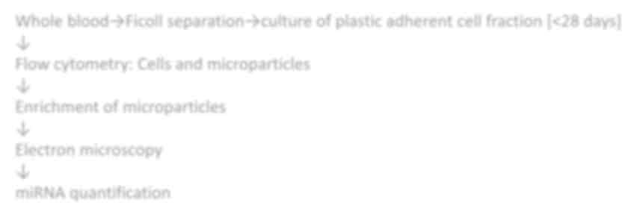


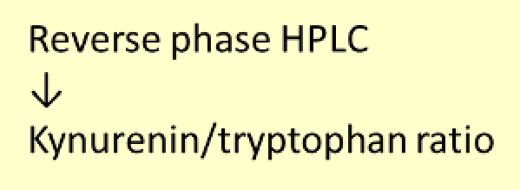
Methods
Whole blood→Ficoll separation→culture of plastic adherent cell fraction [<28 days]
↓
Flow cytometry: Cells and microparticles
↓
Enrichment of microparticles
↓
Electron microscopy
↓
miRNA quantification

Slide 7

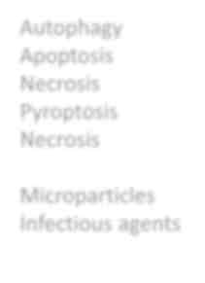
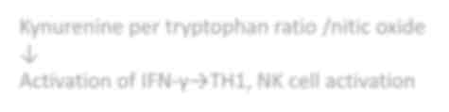



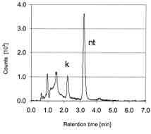

Methods
Transelectron Microscopy
Metabolism
Cell enrichment→chemical fixation
↓
microscopy
High Pressure Liquid Chromatography (HPLC)
↓
indoleamine 2,3-dioxygenase (IDO), tryptophan, nitric oxide
Autophagy Apoptosis Necrosis Pyroptosis Necrosis
Microparticles Infectious agents
Kynurenine per tryptophan ratio /nitic oxide
↓
Activation of IFN-γ→TH1, NK cell activation
ELISA for biomarkers
D. Fuchs, Clin Chem 2002 vol. 48 (3) p.3 579-581

Slide 8

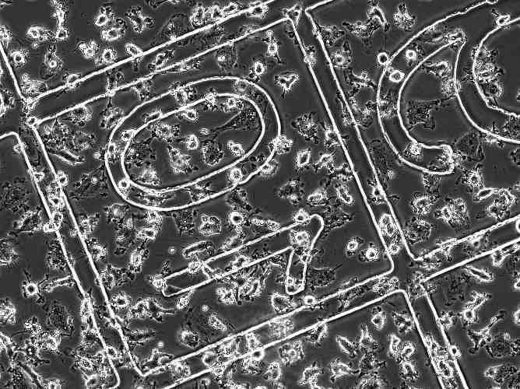

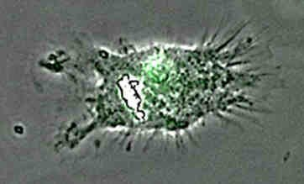
Methods
Cell Culture
plastic adherent cell fraction [<28 days]

Slide 9


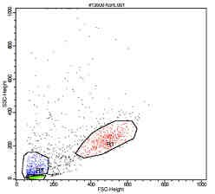
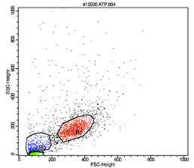



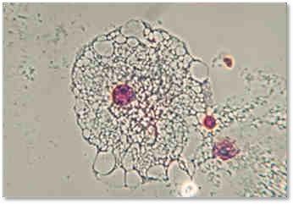
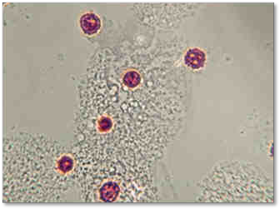

Results
ATP stimulation induces
microparticle release
1 mM ATP

Slide 10
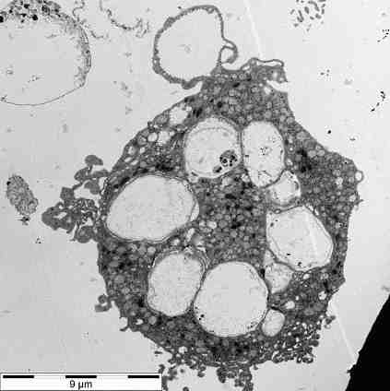
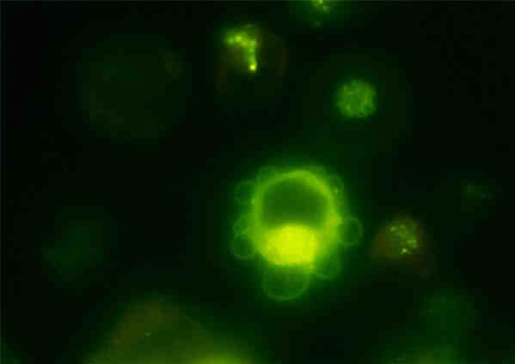
Results
Microparticles are derived from
the plasma membrane

Slide 11

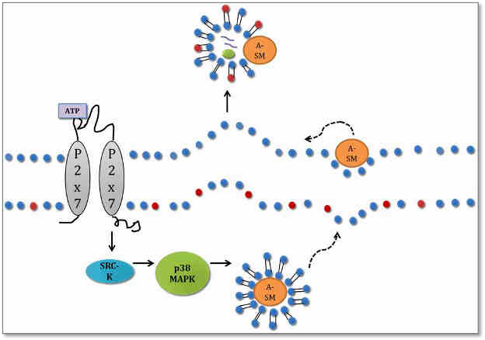
Results
Mechanism of ATP induced
microparticle release
Bianco, F. et al. EMBO J 2009; 28, 1043-1054

Slide 12



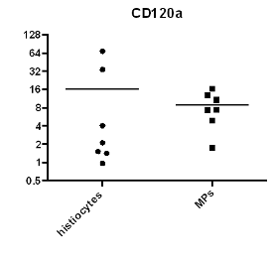


Results
Microparticles are derived from the plasma membrane
S-100
128
64
32
16
8
4
2
1
0.5
Arginase1
CD36
64
32
16
8
4
2
1
0.5
0.25
0.125
128
64
32
16
8
s s
te P
_{o}y M
_{st}i _{h}i
s
_{e}s _{MP}
_{y}t _{o}c
_{st}i
_{h}i
4
s
_{t}e
_{c}y
_{ti}o _{i}s
h
s _{M}P
CD120b
APC
APC-derived microparticles
1024
32
1
0.03125
s _{M}P
APC
APC-derived
s
_{t}e _{c}y
o
APC-derived
APC
microparticles
histi
microparticles

Slide 13
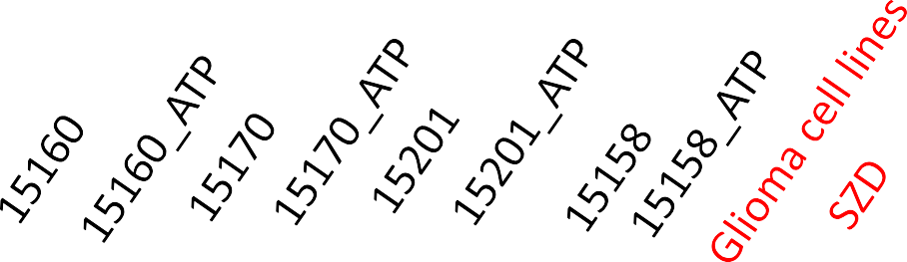


Western Blot of MPs prepared from cultured antigen-presenting cells
(APC) following ATP stimulation
70
55
MIC-A
beta-Actin

Slide 14


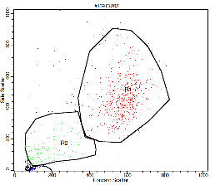
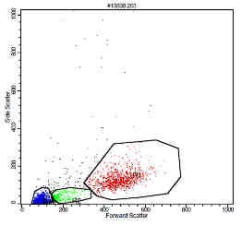






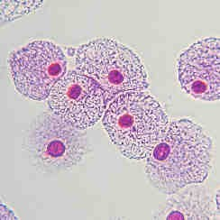
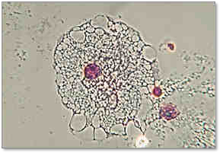
Results
Phenotype analysis
microparticles
APC
microparticles
APC
iDC
MФ
15794

Slide 15
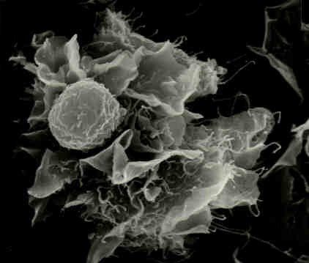
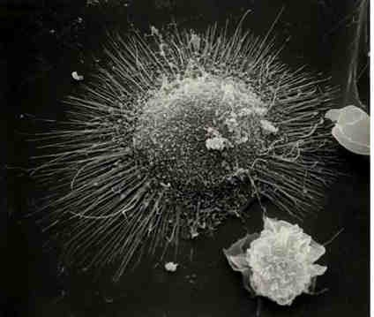
Results
Morphology
M1
M2

Slide 16




M1/M2 phenotype in AD (affective disorder) and SZ (schizophrenia)
Results
S-100
100
80
60
40
20
0
Arginase1
40
30
20
10
0
%-positive cells
%-positive cells
AD
SZ
AD
SZ
TLR3
40
30
20
10
0
TLR9
0.05
0.04
0.03
0.02
0.01
0.00
%-positive cells
%-positive cells
AD
SZ
AD
SZ

Slide 17





M1/M2 characteristics in AD
(affective disorders and SZ
(schizophrenia)
CD206
6
4
2
0
CD68
25
20
15
10
5
0
%-positive cells
%-positive cells
AD
SZ
AD
SZ
P2X7-Receptor
3
2
1
0
01.07.2014
%-positive cells
AD
SZ

Slide 18

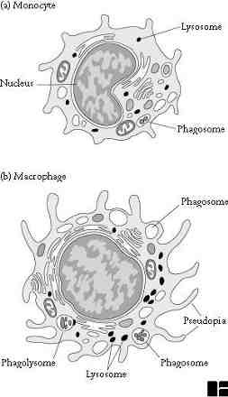
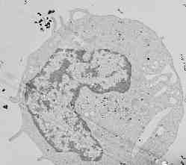
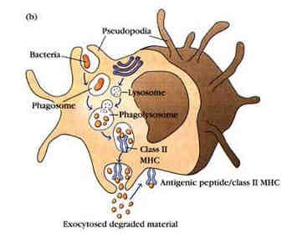
Results
Cell types to be detected in CSF
#15040
http://www2.hawaii.edu/~johnb/micro/medmicro/medmicro.7.html

Slide 19


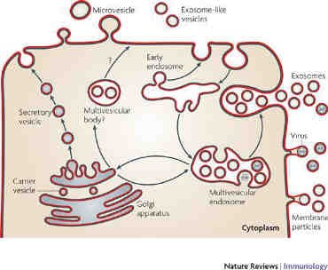
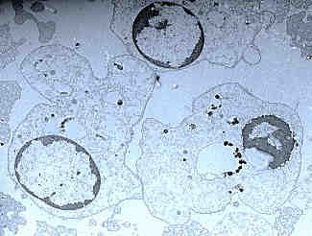

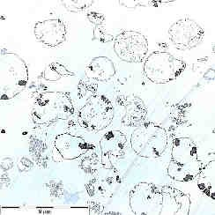
Results
Cell derivatives to be detected in CSF
5µm
#15159
Clotilde Théry et al Nature Rev Immunol. 2009; (9) 581-593

Slide 20



















ATP induced release of microparticles
and target cell fusion
ATP
P2X7 positive M2 macrophage
Microparticle release
Target cells
MP induce phenotypical and functional changes
20

Slide 21
Results
Typical microparticle derived from cultured antigen presenting cells

Slide 22

miRNA expression in ATP-induced MP
relative miRNA expression in APC derived microparticles
32
16
8
4
2
1
0.5
0.25
0.125
0.0625
Cq
2ΔΔ
miR.146a
miR.21
miR.132.3p
miR.146b
Four patients‘ cultured antigen presenting cells were stimulated with ATP and qPCR was performed for the expression of miRNA species. All patients suffered from AD or SZ.

Slide 23
Summary
An inflammatory phenotype of in vivo activated APC in AD and
SZ has been shown.
Prominent release of MPs from cultured APC occurs upon ATP- induced P2X7 ion channel activation
MPs are derived from the plasma membrane
MPs transport miRNA species related to inflammation and
stress or infection induced cognitive impairments

