Slide 1
Multimodality endoscopic approach of benign tracheal stenosis BTS
Mărioara Simon, Cluj-Napoca România
Notes:
I’m going to present an endoscopical approach of Tracheal stenosis because

Slide 2

A HUGE CHALLENGE !
THE MANAGEMENT OF TRACHEAL STENOSIS
Notes:
Might be a huge challenge

Slide 3
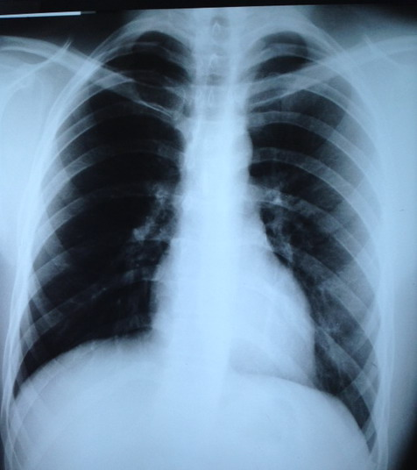
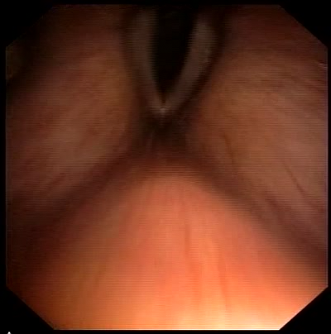
A 24 - year old patient, admitted in emergency for acute respiratory failure, stridor, post prolonged intubation due to a vehicle crush. The chest radiography was normal.
Fibrobronchoscopy reveals 3mm diameter subglotic web-like stenosis at 1,5 cm below the vocal cords.
Notes:
I will present a clinical case for underlying the dificulty to make a decision in TS.
Indeed in this case we had more options:
We could send this patient to the surgeon but amucus plug could have obstructed the stenosis and the patient might have die..
We could do only dilatation,cross electrocautery incisions followed by dilatations,laser therapy,dilatations and after that surgery.

Slide 4
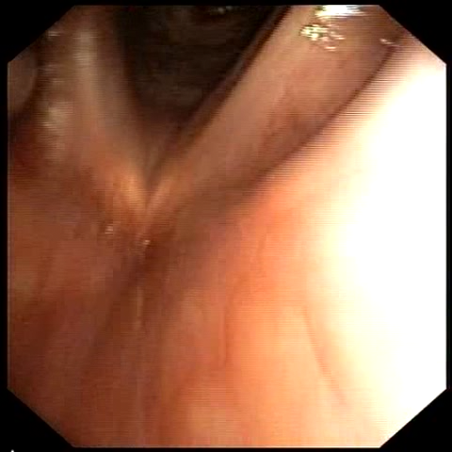
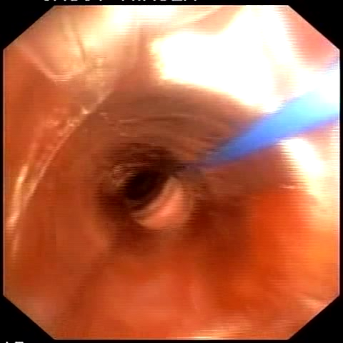
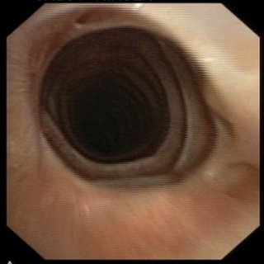
Electrocautery cross-incisions, surgical knife incisions, mechanical resection with forceps followed by sessions of progressive dilatation using a dilatation balloon afterwards we place endotracheal tube of increasing diameter.
15 bronchoscopies were performed: 12 fibrobronchoscopies and 3 rigid bronchoscopies.
Endoscopic control showed a stabilized lumen of 14 mm diameter.
Endoscopic treatment
ETT Dilations
Final aspect
Notes:
I present a clinical case of PITS for underlying the dificulty to make a decision in TS.

Slide 5
Agenda
1. Definition and classification of BTS.
2. The role of interventional pulmonology in the management of BTS
        Assessment of BTS
        Bronchoscopic interventional techniques in BTS.
3.Therapeutic algorithm in BTS
4.Clinical cases.
5.Conclusions.

Slide 6
Tracheal stenosis (TS) is defined as a cicatricial narrowing of the endotracheal lumen.
TS is a potentially life-threatening condition.
The management of tracheal stenosis is not well - defined.
Surgical series usually ignore the large number of patients not amenable to surgery.
Bronchoscopic series exclude those undergoing surgery.
Indications and interventional options for non-resectable tracheal stenosis,Jenny Louise Bacon, Caroline Marie Patterson, Brendan Patrick Madden J Thorac Dis. 2014 Mar; 6(3): 258–270.

Slide 7
Surgical Resection or Interventional Bronchoscopy ?
In benign tracheal stenoses
Surgeons argue that
-sleeve resection is the only solution
-stent placement does more harm than good.
Pulmonologists show how
-repeated dilatations, incisions and stents “saved” patient from surgical procedure
“Anywhere this topic guarantees an emotional debate between interventional pulmonologists and surgeons”
Bolliger CT, Sutedja TG, Strausz J, Freitag L Therapeutic bronchoscopywith immediate effect laser, electrocautery, argon plasma coagulation and stents.Eur Respir J 2006;27:1258–1271

Slide 8
INTERVENTIONAL BRONCHOSCOPY restore airway lumen patency and improve symptoms
ENDOSCOPIC INTERVENTIONS - less risk
morbidity
discomfort
SURGERY INTERVENTIONS - mortality 2,5%
- failure 2,5%
should be performed promptly when indicated !
Grillo HC. Management of idiopatic tracheal stenosis. Chest Surg Clin of North Am 1996; 6(4): 811-818
Grillo HC, Donahue DM. Postintubation tracheal stenosis. Chest Surg Clin of North Am 1996; 6(4): 725-731
Jantz MA, Silvestri GA. Controversy: silicone stents versus metal stents for management of benign tracheobronchial disease. Pro: Metal stents. J Bronchol 2000; 7: 177-183
Dineen KM, Jantz Ma, Silvestri GA. Review: tracheobronchial stents. J Bronchol 2002; 9:177-183
William Lunn, Obstruction of central airways: evaluation and management”, in Michael J. Simoff, Daniel H. Sterman, Armin Ernst, Thoracic Endoscopy – Advances in Interventional Pulmonology, 2007, 22: 323-329

Slide 9

Which is the treatment of choice
Surgical Resection and Reconstruction
or Interventional bronchoscopy ?
…. THAT IS THE QUESTION

Slide 10

Which is the treatment of choice:
Surgical Resection and Reconstruction
or
Interventional bronchoscopy ?
…. THAT IS THE QUESTION….
Notes:
the treatment should be individualized base on the following parameters.

Slide 11
Management of tracheal stenosis (TS) varies with:
  type and extent of the disease
  patient's age and general health status.
  available techniques
  patient agreement.
IMPORTANT FACTORS FOR EVALUATE T.S
Etiology of the stenosis
Location (supraglottic, glottic, subglottic, tracheal or combined)
Extent (Cranio-caudal length)
Severity (degree of airway lumen obstruction) according to the Myer-Cotton criteria
Functional impairment ( dyspnea, associated vocal cord mobility defects)
Morphology
Management decision was made during initial bronchoscopy.
The best method is a flexible bronchoscopy in an awake and cooperative patient.
Notes:
It is important the type

Slide 12
BRONCHOSCOPY - GOLD STANDARD for
THE EVALUATION of tracheal stenosis
Locate the lesion
Measurements of the diameter and length
Evaluate the surrounding tissues (EBUS)
Vocal cord mobility
Aspects of the mucosa ( inflammation,secretions)
http://bestpractice.bmj.com/best-practice/monograph/1069/treatment/step-by-step.htm
Ruxandra Ulmeanu et all, TERAPIA ENDOSCOPICA IN STENOZELE DE CAI AERIENE MARI – INDICATII SI LIMITE in „Actualitati in endoscopia toracica diagnostica si terapeutica”, Editura Universitara „Carol Davila” Bucuresti 2009, ISBN 978-973-708-405-7
Notes:
It is important the time for surgery

Slide 13
Etiology of tracheal stenosis
Idiopathic
- GERD
Secondary-iatrogenic
- Post intubation PITS
- Post tracheostomy PTTS
Connective Tissue Disorders
- Wegener’s Granulomatosis
  - Rheumatoid Arthritis
  - Sarcoidosis
  - Amyloidosis
Post end-end anastomosis
Infections: TB, histo, diphteria, papilomatosis
Ashiku et al. J Thorac Cardiovasc Surg 2004;127:99-107
Taylor SC et al. JAMA Otolaryngol Head Neck Surg. 2013;139(1):76-81
Kastanos N, Estopa Miro R, Marin Perez A, Xaubet Mir A, Agusti-,Vidal A: Laryngotracheal injury due to endotracheal intubation:incidence, evolution, and predisposing factors. A prospective long-term study. Critical care medicine 1983,11(5):362-367
Notes:
Before labeling a patient with idiopathic tracheal stenosis, physicians must exclude post intubation and postTracheostomy and TS due to CTD

Slide 14
Iatrogenic tracheal stenosis
Prolonged intubation and tracheostomy may cause
iatrogenic tracheal stenosis !
Patient related factors
Operator dependent factors :
- high volume-low pressure cuffs
- performing tracheostomy without cartilaginous damages
- preventing infections.
Incidence of PI and PT stenosis are 10 to 22% but only 1–2% are symptomatic or have severe tracheal stenoses.
1.Cooper JD, Grillo HC. Experimental production andprevention of injury due to cuffed tracheal tubes. Surg Gynecol Obstet 1969; 129: 1235-41.
2. Knowlson GTG, Bassett HFM. The pressure exerted on the trachea by tracheal inflatable cuffs. Br J Anaesth 1970; 42: 834-7.
3. Stauffer JL, Olson DE, Petty TL. Complications and consequences of tracheal intubation and tracheotomy. A prospective study of 150 critically ill adult patients. Am J Med 1981; 70: 65-76.
4. S. Cavaliere, M. Bezzi, C. Toninelli, P. Foccoli,Monaldi Arch Chest Dis 2007; 67: 2, 73-80
Notes:
Predisposing factors ; prolonged intubations, pts with keloids , pts with gerd; pressure in the cuff should be measured rotinely in the ICU; pressure should be less than 25 mm Hg

Slide 15
It is common for patients with TS to be treated for
ASTHMA or COPD…
MONTHS or even YEARS
….before we make the diagnosis….
http://bestpractice.bmj.com/best-practice/monograph/1069/treatment/step-by-step.htm

Slide 16
THE PHYSICIANS MUST FOCUS
ON THE DETAILED HISTORY!
severity and duration of the symptoms
surgery involving the head and neck
critical illness- intubation, tracheostomy
signs and symptoms of connective tissue disease ( eg. RP, GPA)
http://bestpractice.bmj.com/best-practice/monograph/1069/treatment/step-by-step.htm

Slide 17
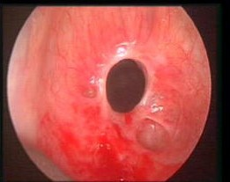
Most patients do not complain of dyspnea until the lumen of the central airway is obstructed by approximately 50% !
At 70% narrowing there are symptoms at rest.
William Lunn, Obstruction of central airways: evaluation and management”, in Michael J. Simoff, Daniel H. Sterman, Armin Ernst, Thoracic Endoscopy – Advances in Interventional Pulmonology, 2007, 22: 323-329
Sachin Kumar , “Interventional Bronchoscopy”,2007
Notes:
When the tracheal lumen is reduced to 50% the flow trough the stenosis is the same as the flow trough the vocal cords.

Slide 18
There are a lack of uniformity of classification.
There are two major groups of stenosis:
Structural
Exophytic/intraluminal
Extrinsic
Distortion
Scar/stricture
Dynamic or functional
Damaged cartilage/malacia
Floppy membrane
Severity of TS Classification by Cotton 3 grades:
mild (<70%)
moderate (71–90%)
severe (>90%).
Locations of stenosis :
glottic
cervical
thoracic.
Lengths <1 cm , 1–3 cm . >3 cm.
A proposed classification system of central airway stenosis
^{L. Freitag 1} ^{, A. Ernst 2} ^{, M. Unger 3} ^{, K. Kovitz 4} ^{and C. H. Marquette,ERJ 2007}
Notes:
There are two major groups of stenosis

Slide 19
There is a lack of uniformity of classification…
Need of common language!
There are two major groups of stenosis:
Structural
Dynamic or functional
Classification by Cotton Severity of TS :
    mild (<70%)
    moderate (71–90%)
    severe (>90%)
Classification by McCaffrey :
  Stage 1 in the subglottis or trachea, <1 cm in length.
  Stage 2 in the subglottis, >1 cm in length.
  Stage 3 in the subglottis and upper trachea.
  Stage 4 in the glottis with vocal cord fixation and paralysis
Tracheal stenosis diagnosis and management-B.E. Mostafa,C Chaoukh,A Halafawi,2012
Notes:
There are several classifications of TS
Regarding the severity in
Regarding the location and extent

Slide 20
A proposed classification system of central airway stenosis,^{L. Freitag} ^{, A. Ernst , M. Unger} , K. Kovitz and C. H. Marquette.ERJ, 2007
DEGREE OF STENOSIS
0 No stenosis
1 <25%
2 26–50%
3 51–75%
4 76–90%
5 90–complete obstruction
LOCATION
I Upper third of the trachea
II Middle third of the trachea
III Lower third of the trachea
IV Right main bronchus
V Left main bronchus

Slide 21
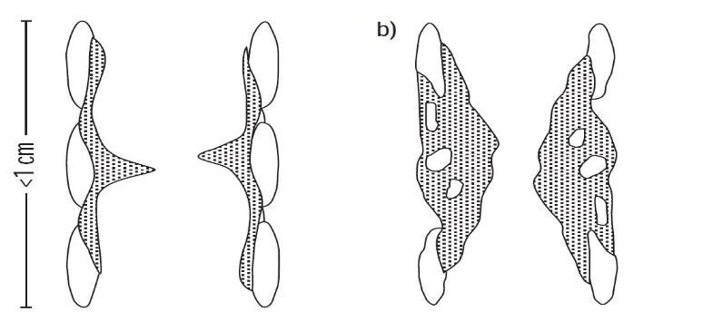
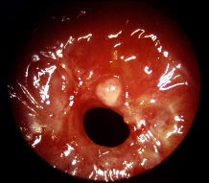
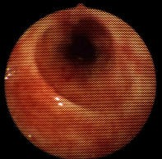
MORPHOLOGICAL ASPECTS OF TS
SIMPLE STENOSIS (Web-like stenosis)
mucosal disease
membranous concentric stenosis
short segment <1 cm
without any damage to the cartilages.
COMPLEX STENOSIS
intramural disease
long lesion > 1 cm
involvement of tracheal wall
malacia.
Bronchoscopy and Central Airway Disorders
A Patient-Centered Approach, Henri Colt, Septimiu Dan Murgu, 2012
Notes:
The Morphological aspects are very important in decision making

Slide 22
When should we apply Interventional bronchoscopy in TS?
Patients are inoperable due to extensive airway disease.
The extent of the stenosis
      >50% of the trachea
      multi-focal involvement
For all contraindications of an open surgery.
  The presence of comorbidities.
Before surgery to facilitate patient’s ventilation.
For emergency desobstruction of the airways.
1.Couraud L, Jougon JB, Velly JF. Surgical treatment of nontumoral stenoses of the upper airway. Ann Thorac Surg 1995; 60: 250-9.
2. Grillo HC, Donahue DM, Mathisen DJ. Postintubation tracheal stenosis. Treatment and results. J Thorac Cardiovasc Surg 1995; 109: 486-93.
3.. Cavaliere, M. Bezzi, C. Toninelli, P. Foccoli,Monaldi Arch Chest Dis 2007; 67: 2, 73-80
Notes:
There are some situations when BTS should be refer to the bronchological treatment

Slide 23
Benign tracheal stenosis
Endoscopic treatment should be performed:
only in cases when patient is inoperable
before surgery to facilitate patient’s ventilation
for emergency desobstruction of the airways.
Cordos I, Bolca C, Paleru C, Posea R, Stoica R. Sixty tracheal resections single center experience. Interact CardioVasc Thorac Surg 2009;8:62–65.
Notes:
Inoperable :respiratory failure, sequelae of head injury or neurosurgery (that are usually
related to the disease that caused the prolonged intubation),cardiovascular disease

Slide 24
STEPS IN ENDOLUMINAL TREATMENT
1.LUMINAL RESTORATION:
  Laser: CO2, Nd-YAG
  Diathermy , surgical Knife
  Argon plasma
  Mechanical dilatation (dilators, rigid bronchoscopes, CRE Balloons)
2.MAINTAINING PATENCY:
  Mitomycin
  Steroids
  Brachytherapy
  Stents
Rigid bronchoscopy remains the method of choice for the treatment of TS.
Technological advances allow effective treatments using the flexible bronchoscope.
Tracheal stenosis diagnosis and management-B.E. Mostafa,C Chaoukh,A Halafawi,2012

Slide 25

THE TECHNIQUE OF ND YAG LASER THERAPY.
The laser fibre is moved in a circumferential fashion.
Laser are used to devitalise or resect diseased tissue and haemostasis.
The lowest possible power is recommended, 15-20 watts, 1-5 seconds laser pulses, wavelength of 1,064 nm.
Indications and interventional options for non-resectable tracheal stenosis
Journal of Thoracic Disease. 2014 Mar; 6(3)258,Bacon JL, Patterson CM, Madden BP

Slide 26
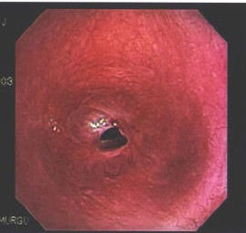
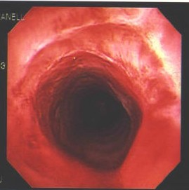
LASER THERAPY is delivered via fibres inserted into the working channel of the fibroscope, radial incisions
Case series report complication rates below 1%
Central airway obstruction.Ernst A, Feller-Kopman D, Becker HD, Mehta AC,Am J Respir Crit Care Med. 2004 Jun 15; 169(12):1278-97.

Slide 27
ELECTROCAUTERY, knife
Electrosurgery knife in the cut mode through flexible bronchoscope performed 1-2 mm radial incisions at 2,10,6 (9,12,3) o’clock followed by balloon dilatation.
Mehta et all . showed that bronchoscopy alone can be curative.
Weblike stenoses can be treated by the mucosal sparring technique
with a 60% success rate after 1±3 sessions.
Multidisciplinary approach to management of postintubation tracheal stenoses,A. Brichet*, C. Verkindre*, J. Dupont, M.L. Carlier*, J. Darras+, A. Wurtz,P. Ramon*, C.H. Marquette,Eur.Resp.J,1999
Mehta AC, Lee FY, Cordasco EM, Kirby T, Eliachar I, De,Boer G. Concentric tracheal and subglottic stenosis. Management using the Nd±YAG laser for mucosal sparing followed by gentle dilatation. Chest 1993; 104: 673±677.
Role of electrocautery and balloon dilatation as treatment modality for patient of benign tracheal or bronchial stenosis, Bhupendra Jain, Nikhilesh Pasari, Ashok Bajpai, Ravindra Chordiya, Satish Motiwale

Slide 28
Freitag et all. - The use of electrosurgery knife is effective for the treatment of TS as all the patients showed clinical and functional improvement, and less than 50% required a second intervention.
In comparison with laser therapy, an advantage of this technique is that less fibrin is produced.
APC can be used for radial incisions.
Mitomycin C and Methylprednisolone were used locally for destruction of granulation tissue.
The electrosurgical knife in an optimized intermittent cutting mode for the endoscopic treatment of benign web-like tracheobronchial stenosis.,Lutz Freitag and all. Archivos de Bronconeumologia,2012

Slide 29
Balloon bronchoplasty (BB) = endoscopic balloon dilatation
BB can be performed by flexible or rigid bronchoscope, balloon should be made of silicone and cause gentile radial pressure.
BB is associated with less mucosal injury, are available in different sizes and it is maintained for 2 minutes.
Dilatation may be used in combination with other therapeutic techniques such as laser ablation and stent insertion, and can be repeated if necessary (NICE guideline).
Benign noninflammatory bronchial stenosis: treatment with balloon dilation.,Ferretti G1 et all,Radiology. 1995 Sep;196(3):831-4.
McArdle JR, Gildea TR, Mehta AC. Balloon Bronchoplasty. Its Indications, Benefits, and Complications. J Bronchol. 2005;12:123–7

Slide 30
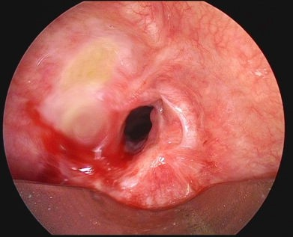
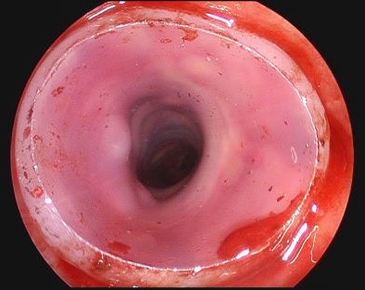
TREATMENT OPTION: STENT INSERTION
Should only be considered after tracheal dilatation and/or tissue destruction - for sustaining airway patency.
Bridge to surgery, enabling optimization of a patient’s functional and physical state prior to surgical intervention.
Endobronchial stenting in the management of large airway pathology.Ranu H, Madden BP,Postgrad Med J. 2009 Dec; 85(1010):682-7.
Prognostic factors for endotracheal silicone stenting in the management of inoperable post-intubation tracheal stenosis.
Lim SY, Kim H, Jeon K, Um SW, Koh WJ, Suh GY, Chung MP, Kwon OJ,Yonsei Med J. 2012 May; 53(3):565-70.

Slide 31
Galluccio et all. - Silicone stent insertion achieved airway patency in 96% of simple lesions at two years follow up but only 69% of complex lesions.
H.Dutau et al - Management of benign dynamic "a-shape" tracheal stenosis: stent placement was successful in 63% of cases.
Silicone stent insertion is considered the treatment of choice in the presence of inflammation and/or when removal is desirable.
Metallic non-covered stents are generally not recommended, except in selected patients with poor short-term prognosis.
Interventional endoscopy in the management of benign tracheal stenoses: definitive treatment at long-term follow-up.,Galluccio G, Lucantoni G, Battistoni P, Paone G, Batzella S, Lucifora V, Dello Iacono R,Eur J Cardiothorac Surg. 2009 Mar; 35(3):429-33; discussion 933-4.
Management of benign dynamic "a-shape" tracheal stenosis: a retrospective study of 60 patients- stent, H.Dutau et all ,Ann.Thorac.Surg,2-15
Silicone stents, the rigid bronchoscope, and the standard of care in central airway stenosis,Hervé Dutau,Fabien MaldonadoSophie LaroumagnePhilippe Astoul, Current Respiratory Care Reports, Mar 2012

Slide 32
Martinez-Ballarin et al. reported tracheal stenting with silicone Dumon stents in 64 patients with fibrous or fibroinflammatory benign tracheal stenosis, mainly postintubation or post-tracheostomy.
Puma et al reported tracheal silicone stenting (Montgomery T-tube, Dumon stent, Dynamic Y stent) in 45 patients with cicatricial stenoses (mild, with residual lumen >50%, moderate, with residual lumen 30-50%; and sever with residual lumen <30%, and a length of 2 to 6 cm).
Park et al. reported insertion of a silicon stent (Natural stent) in 32 patients with postitubation tracheal stenosis.
Lim et al. reported silicon stent insertion (Natural stent) in 55 patients with postintubation tracheal stenosis
H.Dutau et al -Management of benign dynamic "a-shape" tracheal stenosis: a retrospective study of 60 patients- stent placement was successful in 63% of cases
Park HY, Kim H, Koh WJ, et al. Natural stent in the management of post-intubation tracheal stenosis. Respirology 2009;14:583-8
Puma F, Ragusa M, Avenia N, et al. The role of silicone stents in the treatment of cicatricial tracheal stenoses. J Thorac Cardiovasc Surg 2000;120:1064-9
Martinez-Ballarin JI, Diaz-Jimenez JP, Castro MJ, et al. Silicone stents in the management of benign tracheobronchial stenoses. Tolerance and early results in 63 patients. Chest 1996;109:626-9
Prognostic factors for endotracheal silicone stenting in the management of inoperable post-intubation tracheal stenosis.,Lim SY, Kim H, Jeon K, Um SW, Koh WJ, Suh GY, Chung MP, Kwon OJ,Yonsei Med J. 2012 May; 53(3):565-70.

Slide 33

For tracheal stenosis the stent is the last option
…sometimes is the only possible option

Slide 34
Interventional bronchoscopy
Fundamental principles
minimal thermal and mechanical mucosa trauma
the association of methods
rigid + flexible brohoscopy
mechanical dilatation + stent
mechanical dilatation + stent + electrocautery
mechanical dilatation + stent + Laser + electrocautery
electrocautery + stent
electrocautery + laser + stent
interventional bronchoscopy + surgery
interventional bronchoscopy +surgery +oncology
interventional bronchoscopy + oncology
http://bestpractice.bmj.com/best-practice/monograph/1069/treatment/step-by-step.htm
Ruxandra Ulmeanu et all, TERAPIA ENDOSCOPICA IN STENOZELE DE CAI AERIENE MARI – INDICATII SI LIMITE
in „Actualitati in endoscopia toracica diagnostica si terapeutica”, Editura Universitara „Carol Davila” Bucuresti 2009, ISBN 978-973-708-405-7

Slide 35
PRACTICAL ASPECTS
MORPHOLOGY IMPACTS RESPONSE TO INTERVENTIONS
The associated chondritis predicts poor results and failure of endoscopic treatment
Simpson GT, Strong MS, Healy GB, Shapshay SM, Vaughan CW. Predictive factors of success or failure in the endoscopic management of laryngeal and tracheal stenosis. Ann Otol Rhinol Laryngol 1982; 91: 384–388
The completely circumferential strictures were shown to lead to poorer outcomes when compared with eccentric lesions.
Simpson GT, Ann Otol Rhinol Laryngol 1982; 91: 384–388;
Roediger FC. Laryngoscope, 118:1542–1546, 2008
Endoscopical treatment is less effective for circumferential disease and for stenoses greater than 1 cm in length.
Involvement of the cricoid cartilage and stenosis over 3 cm are associated with a poor chance of success.
Indications and interventional options for non-resectable tracheal stenosis,Jenny Louise Bacon, Caroline Marie Patterson, Brendan Patrick Madden J Thorac Dis. 2014 Mar; 6(3): 258–270.
Notes:
I want to highlight

Slide 36
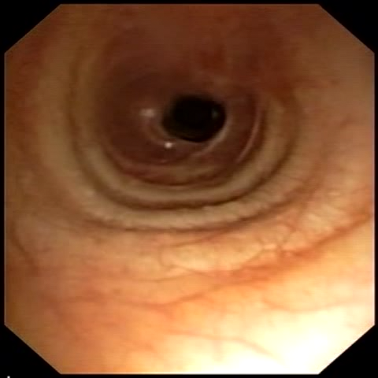
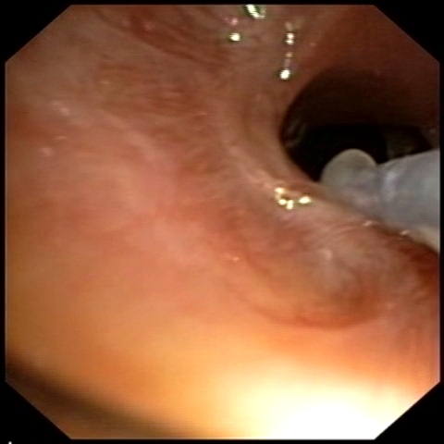
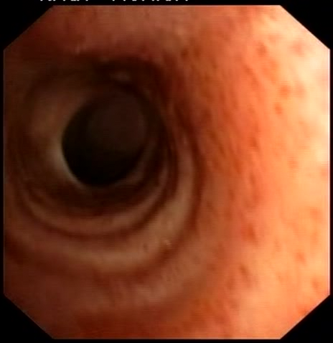
A 51 - year old, female, was admitted for stridor and PITS.
Fibrobronchoscopy show a complex tracheal stenosis.
We performed 2 bronchoscopies with Knife cross incisions EC and dilatations and the TS was stabilized after 1 year and the patient was asimptomatic.
Notes:
Another case that we had

Slide 37
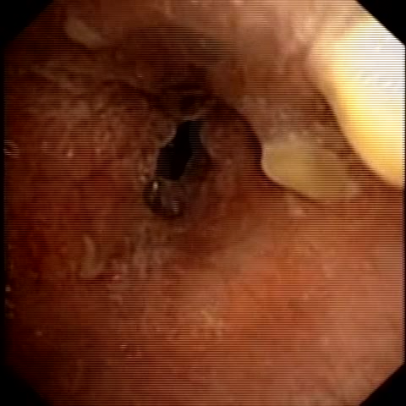
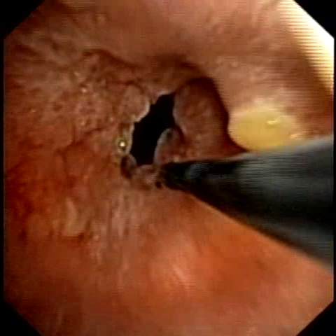
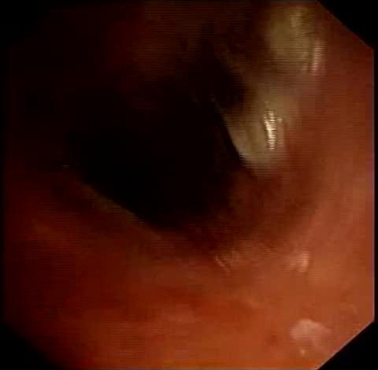
A 49 - year old patient, known for recurrent tracheal papillomatosis, with repeated tracheal disobstructions is admitted for dyspnea, stridor.
Fibrobronchoscopy showed a complex TS at 2,5 cm below the vocal cords (post tracheostomy.)
We performed papilloma electrocautery and mechanical resections with forceps, balloon dilatations.
7 bronchoscopies were performed : 6 fibrobronchoscopies and one rigid bronchoscopy.
Notes:
I’m going to present The next case which didn’t have indication for surgery and we performed endoscopica treatment

Slide 38
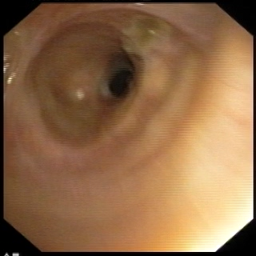
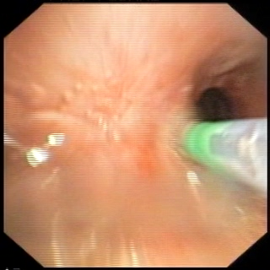
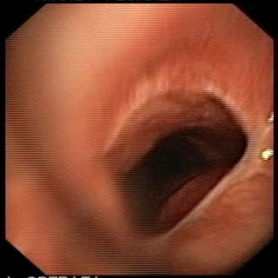
A 67- year old patient, was admitted for dyspnea on exertion and stridor, respiratory failure, PITS.
Fibrobronchoscopy – Eccentric, complex tracheal stenosis, 3,5 cm below the vocal cords, with malacia.
We performed knife incisions, balloon dilations, stent placement.
Surgery was performed after 8 months.
Initial aspect
Endoscopic treatment
Postsurgery aspect
Notes:
It is very important to establish the time for surgery. This patient refused surgery in the beginning .we performed

Slide 39
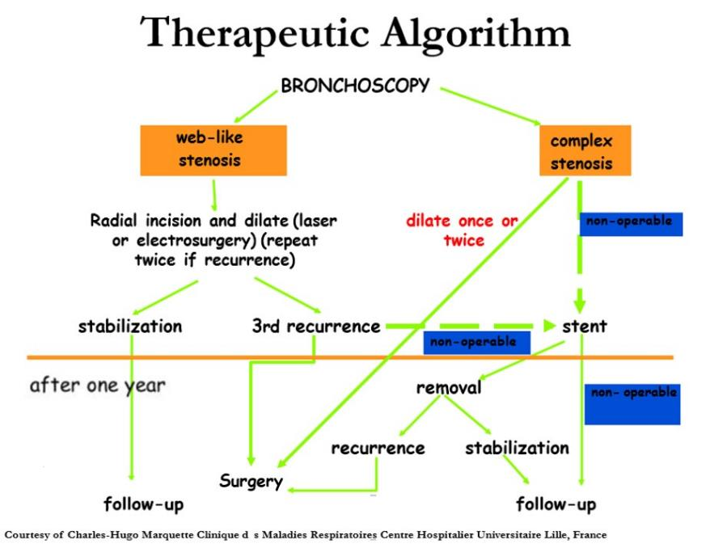
Notes:
There are a lot of algorthms and I have chosen this one
You don’t know which treatment is the best. This algorithm show that in simple stenosis is better to do radial incisions and dilate first for two times and at the third recurrence is better to refer the patient to the surgery.if the TS is stabilised after one year we have to follow-up.
In complex stenosis first surgery,the bronchoscopy is only abridge to surgery in emergency situations.
If the patient is inoperable we can place a stent .and folow-up the patient.

Slide 40
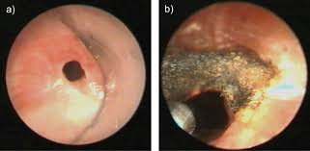
CONCLUSIONS
Tracheal stenosis can be difficult to treat and patients benefit from a multidisciplinary approach in order to offer the best available solution.
Bronchoscopic treatment can provide durable successful results in selected patients.

Slide 41


Slide 42


