Slide 1
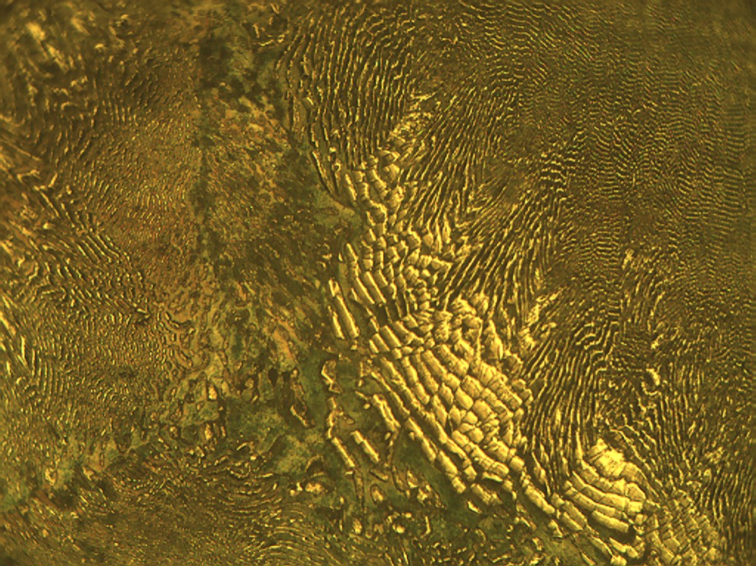
Teaching: from practice to theory
.
Mario Spector - Liliana Ferrari- Graciela Yugdar
National Technological University at Paraná
Entre Ríos
Argentina

Slide 2








Traditional Teaching Methodology
Low learning interest rates among students

Slide 3
demotivated students

Slide 4
Cognitive processes seem to be highly activated when curiosity intervenes as motivational energy in the classroom. This conclusion is reached after a teaching experience in a Metallurgy class, with students from a technical school with low interest in learning and studying.
“Curiosity” as the key internal drive that promotes learning.

Slide 5





“Curiosity” as the key internal drive that promotes learning.
Teaching from Practice
To Theory
Basic principles:
“knowing as knowing
how to do something”
“studying something
to be applied”

Slide 6
Unlike the traditional sequence of teaching materials in which crystalline and atomic models are studied from the literature to later arrive at a phase diagram. This experience begins directly in the laboratory with students doing cooling curves for the alloy of two metals.
Teaching: from practice to theory

Slide 7
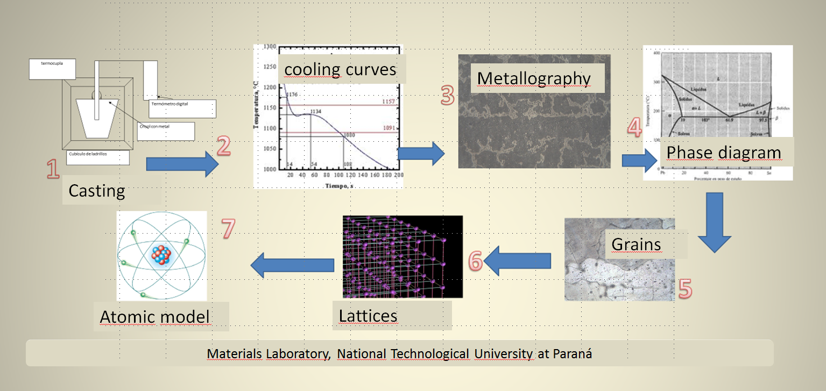
Laboratory Sequence: From Practice to Theory
Melting

Slide 8
Thank you.
“The true educator not only teaches facts but also teaches the young person to think for themselves, to find answers to their own questions based on the learned principles without the need to depend on a teacher or their parents to solve a problem”
Menahem Shnirtzon (1997) (p. 68).
Zn Al 5% 6to Electromecánica
Notes:
Nota

