Slide 1

NUTRIZIONE & PREVENZIONE ONLUS 94081990486
5th European Nutrition and Dietetics Conference – June 16-18, 2016 Rome, Italy
“A subjective limit in intake”
Mario Ciampolini
supported by the Italian Ministry of University, Research, Science and Technology grants for the years 1998–2002 and ONLUS Nutrizione e Prevenzione, Firenze for subsequent years.
The author has no competing interests.

Slide 2
Energy availability
(in blood and tissues) is the purpose of meals and the cause of unwanted feedback reflexes.
Blood glucose (BG) is representative of all other nutrients.
Before meals, BG assesses the energy balance between meals and is stable, but it varies among individuals.
Mean BG (= mean of 21 measurements from week diary) is stable over 5 months and characterizes individual, habitual energy balance..

Slide 3
Home BG measurements reliability In the Hospital a blood sample was divided.
A heparinized blood sample for the autoanalyzer
A sample for the patient who soon measured it by his/her own glucometer
autoanalyzer = 89.9 ± 11.3 mg/dL (N = 85). Subjects = 89.0 ± 12.5 mg/dL by Glucometer
The mean difference (0.9 ± 7.1) was not significant. On absolute values, the mean difference was: 5.7 ± 4.3 mg/dL with no bias. .

Slide 4
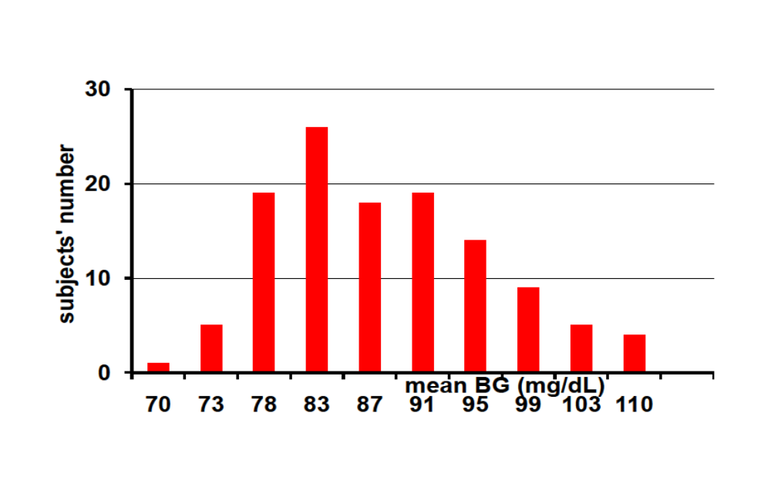
At recruitment, mean BG is stratified
120 subjects stratified by significant differences in mean weekly BG

Slide 5
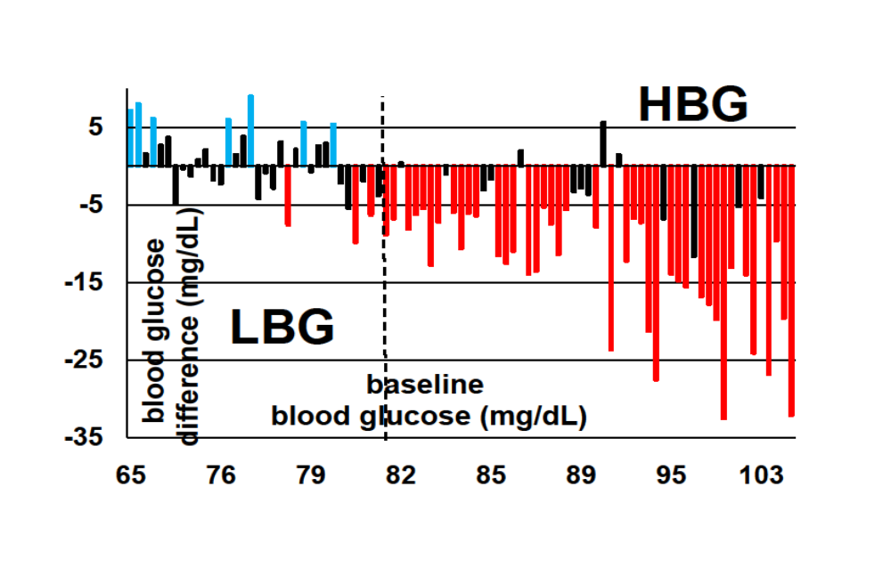
IHMP on 34 low mean Blood Glucose (LBG) and 55 high mean BG (HBG)
Mean BG at recruitment and decreases after 5 month training

Slide 6
After training, Initial Hunger (IH) corresponded just to 76.6 ± 3.7 mg/dL in 4 separate studies on mean weekly BG (Mean BG) ➔ A limit in intake!
➔IH
Nutr Metab (Lond) 2010;7:1–4; J Nutr Metab 2010, Article ID 286952; I J Gen Med 2011, 4, 403-412.; I J Gen Med 2012:5 1–9.

Slide 7
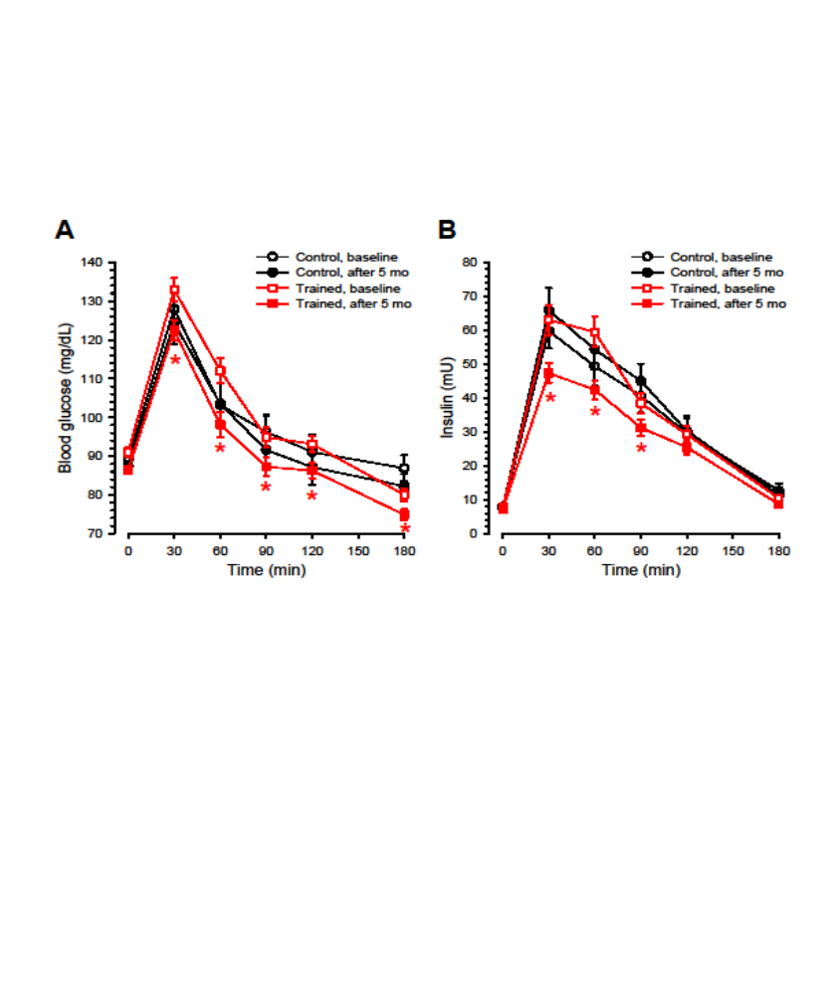
J Nutr Metab 2010, Article ID 286952, 7 pages. doi:10.1155/2010/286952
The lower red line pertains to a trained group. The final value indicates exhaustion of previous intake.

Slide 8
Higher MeanBG is associated with higher:
metabolic rate,
insulin resistance,
growth of immunogenic bacteria in the intestine,
4. overall inflammatory tone
(sterile inflammation)

Slide 9
Through overall inflammation, the level of Mean BG causes functional disorders (joint, intestinal etc.), deteriorations, worsening of infections, vascular diseases and also many malignant diseases

Slide 10
International Journal of General Medicine June 2013
Hunger can be taught:,
= You can become aware of your current BG

Slide 11
Training protocol
1: Suspend meals for up to 48 hours
2: Locate physical sensation of hunger
3: Measure blood glucose concentration (BG)
4: Mentally associate the physical sensation with the BG concentration
5: Begin with a meal of about 300 kcal
6: Repeat 1-5 increasing the meal size in proportion to the desired interval
7: Repeat the above procedure for two weeks. At each appearance of physical hunger, compare the sensation and the measured BG with the previous sensations.

Slide 12
two months after training for two weeks (Groningen 2003), Nutr Metab (Lond). 2006; 3:42.
http://www.nutritionandmetabolism.com/content/3/1/42
64 trained and 72 control subjects attended the hospital lab before breakfast after an overnight fasting.
All declared current presence or absence of hunger and estimated BG. Actual BG was measured by a glucose autoanalyzer.

Slide 13
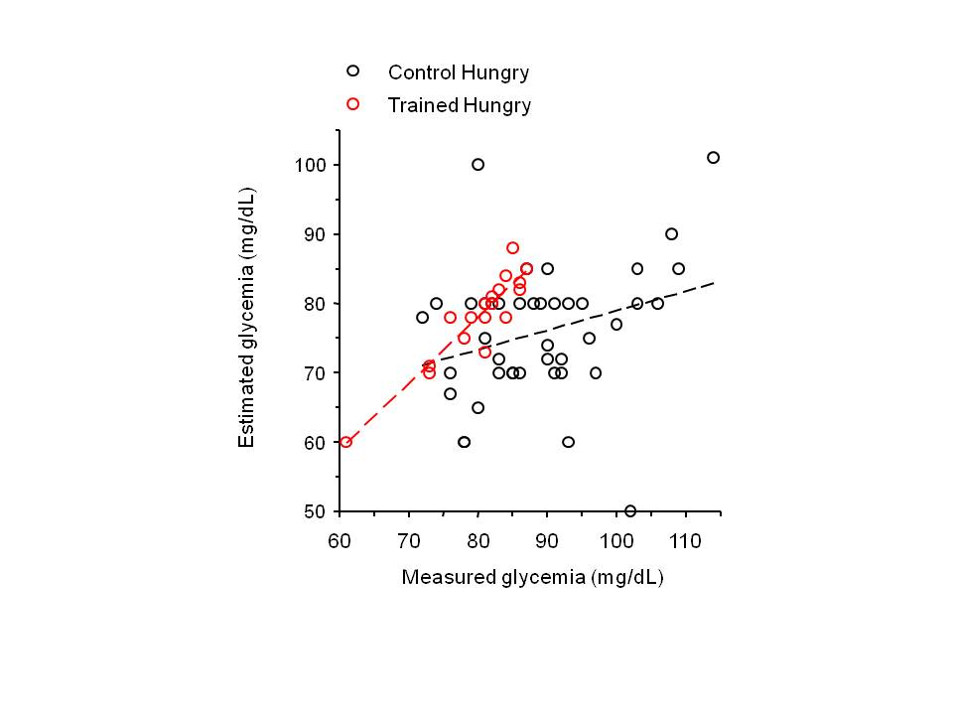
BG estimation versus BG measurement in subjects with hunger

Slide 14
Initial Hunger Meal pattern (IHMP) consists of two mental habits:
1) The learned skill to recognize sensations of Initial Hunger (= low estimation error of BG).
2) Stopping meal intake to have Initial Hunger three times a day.

Slide 15
Endurance
We contacted 17 out of 26 trained HBG OW subjects 9 – 15 years after end training protocol.
3 out of 17 subjects decreased 10 kg body weight after training, but increased again 20 kg after 13 yrs.
14 out of 17 subjects maintained the IHMP and a mean weight decrease of 5 kg from pre-training value (P = 0.001) after 10 years

Slide 16
149 subjects (104 trained and 45 controls) completed the 5 month study on weight;
120 subjects (89 trained and 31 controls) completed the 5 month study on insulin sensitivity.
Multivariate analysis of variance ➔ IHMP and Mean BG were the most significant predictors of variations in BMI and body weight.

Slide 17
BMI = Multivariate analysis of variance ➔ IHMP and Mean BG were the most significant predictors of variations in BMI and body weight. Thus, we studied subjects with high Mean BG.
Normal Weight & High mean BG (>81.8 mg/dL)
40 Trained out of 104 out of 45 15 Controls
before after before after
21.8 ±2.4 ==>20.7±1.9 20.2±2.3==>21.4±2.1
***a,***b
a = longitudinal difference between groups
b = pre/post *** = P < 0.001

Slide 18
Overweight & High mean BG (>81.8 mg/dL)
26 Trained out of 104 out of 45 13 Controls
before after before after
29.0 ±4.1==>26.5 ± 4.0 *a,***b 29.2±3.9 ==>27.8±4.2 *b
Significance
* P <0.05 ** P<0.01 *** P<0.001
a = on longitudinal difference between groups b = pre/post

Slide 19
Insulin area under curve (in mU/l) before and after training IHMP
Trained Controls
55 HG 19 HG before after before after 244±138==>164±92 222±81==>214±98 a***
34 LG 12 LG
before after before after
180±98 ==>183±83 192±106 ==>243±133 *
*** & * significant longitudinal difference between groups.

Slide 20
Significant changes in 55 High BG: decreases of Energy intake, mean BG, HbA1c and during oral glucose tolerance tests: insulin Area (AUC), Insulin and BG peaks, insulin at 60 and 90 minutes. Increases of insulin sensitivity index from 5.9±3.3 to 9.8±5.6 and the index of beta cell function from 1.0 ± 0.7 to 1.4 ± 1.1
(P < 0.05 on the pre-post differences vs. controls)

Slide 21
The End

Slide 22
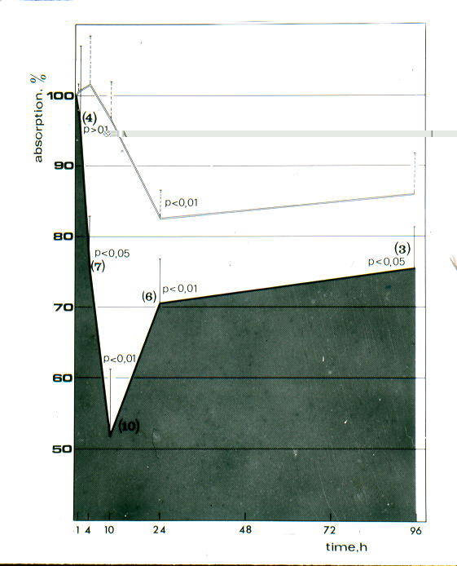
Absorption in 30°C % of absorption in 4°C
(Absorpt. = black area)

Slide 23
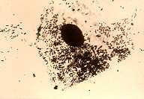

Slide 24
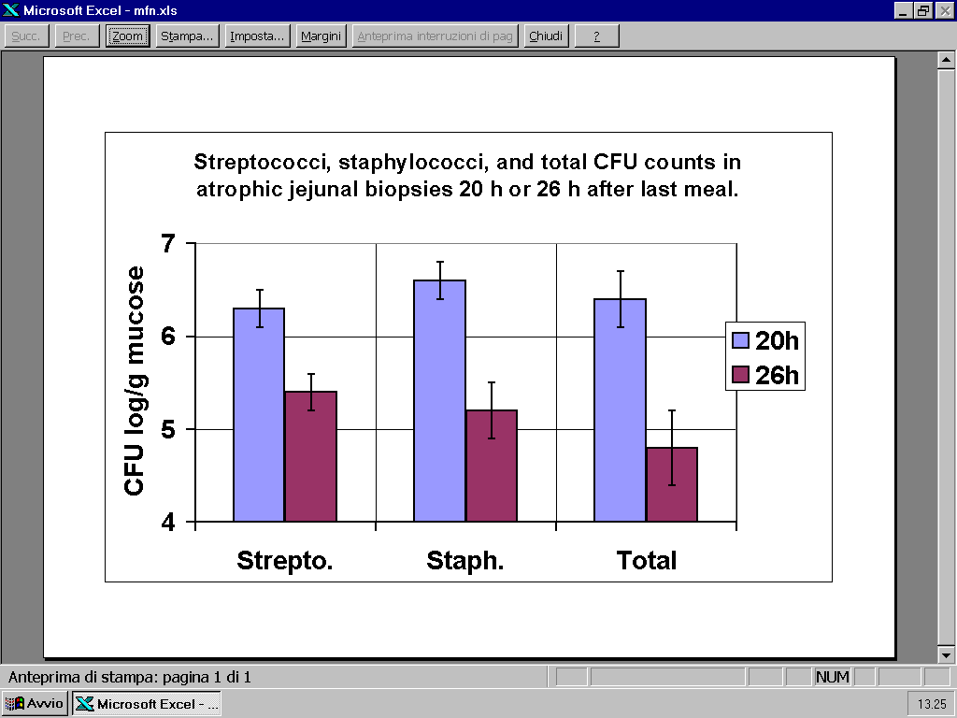
From 42 and 38 atrophic mucosae

Slide 25
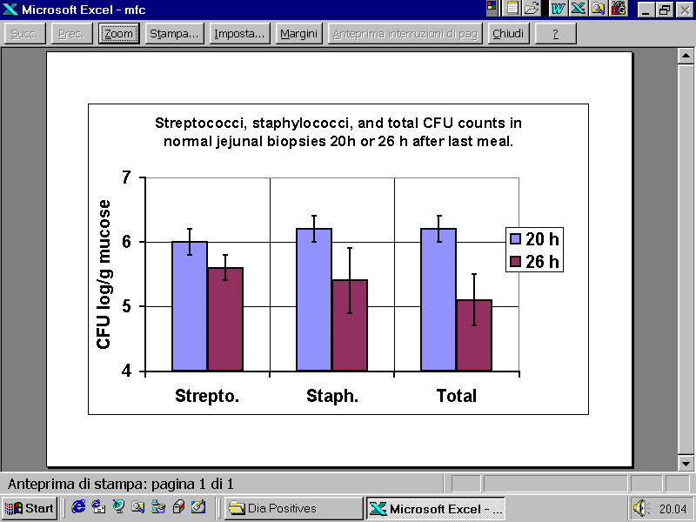
From 20 and 26 normal mucosae

Slide 26
by doubly labeled water
Effects of training (IHMP) on intakes and total daily expenditure in 10 toddlers (mean ± SD).
Recruitment After 50 days Decrease
Diary (kcal/d/kg) 85.7±15.3 70.3±15.8 ***-15.3±17.0 (-18%)
TEE (kcal/d/kg) 80.1±6.9 67.8±10.0 ***-12.3±7.2 (-15.5% P between Diary & TEE
0.39 0.90 0.28 (on Δ)
Energy content (kcal/d/kg) calculated by McCance [16] with addition of 2 kcal per gram of fiber. Asterisks indicate that pre/post difference is significant (Student’s t-test: *, P < 0.05; **, P < 0.01; ***, P < 0.001).

Slide 27
Effects of training (IHMP) on Resting Metabolic Rate and….
in 14 toddlers (mean ± SD)
Recruitment After 50 days Decrease
Mean BG (mg/dL) 91.3±7.2 76.9±6.7b*** in 70 infants
RMR (kcal/kg/d) 58.6±7.8 49.0±9.1 -9.6±8.6 (-15.4%) ***
Outdoor Hours 1.9 ± 1.4 3.2 ±1.7 **
Fecal weight (g/d) 62.3 ± 26.7 88.2 ± 36.4 **
Fecal energy ( kcal/d) 94± 40 78 ± 32

Slide 28
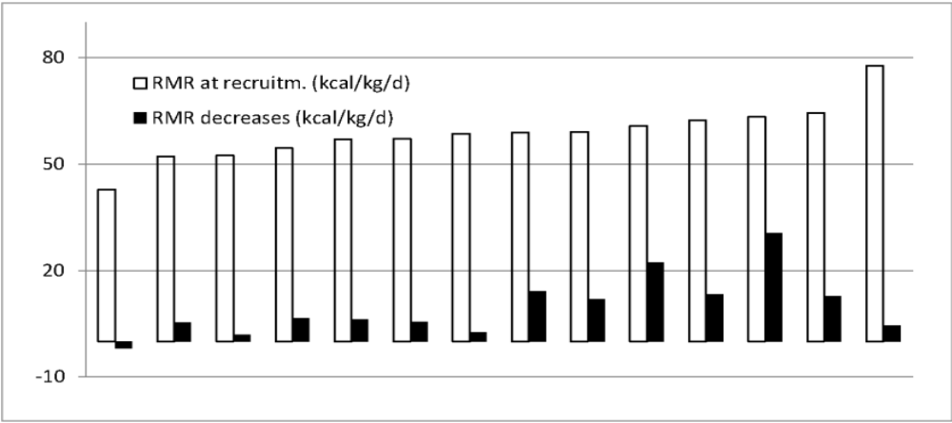

Slide 29
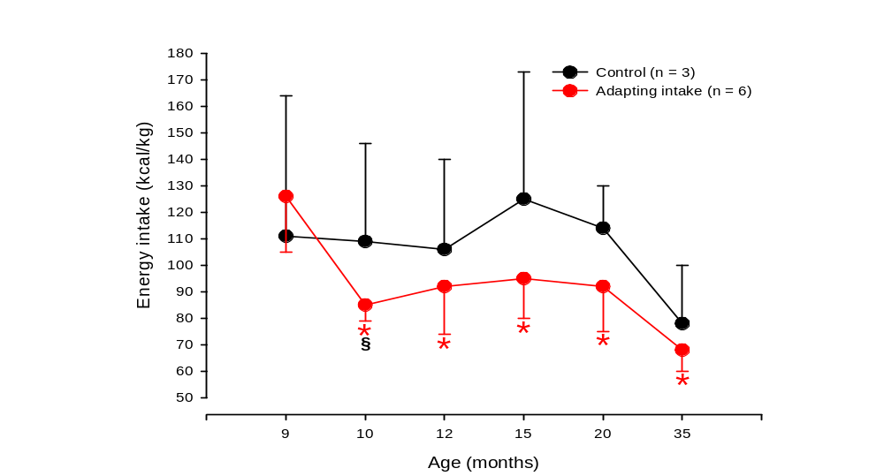
Ciampolini et al.“Initial Hunger” for All? A Study on Undernourished Infants. Journal of Pediatrics & Neonatal Care. Volume 1 Issue 2 – 2014 1, 00008.
Figure 1

Slide 30
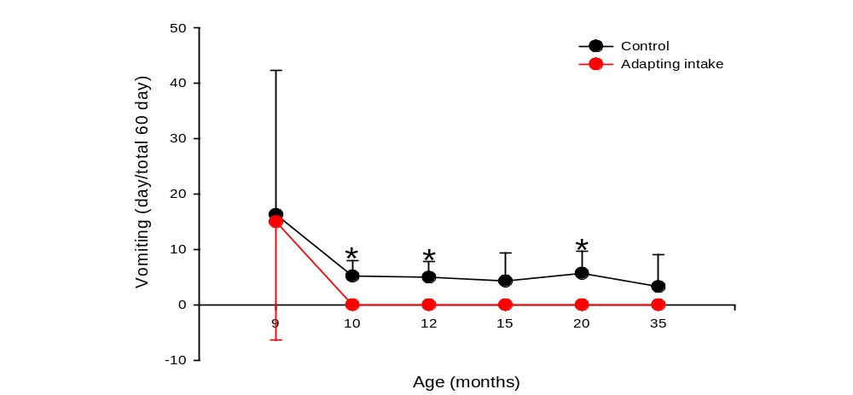
Figure 2

Slide 31
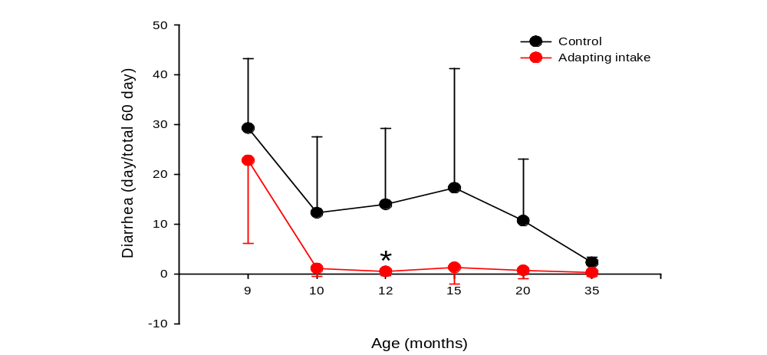
Figure 3

Slide 32
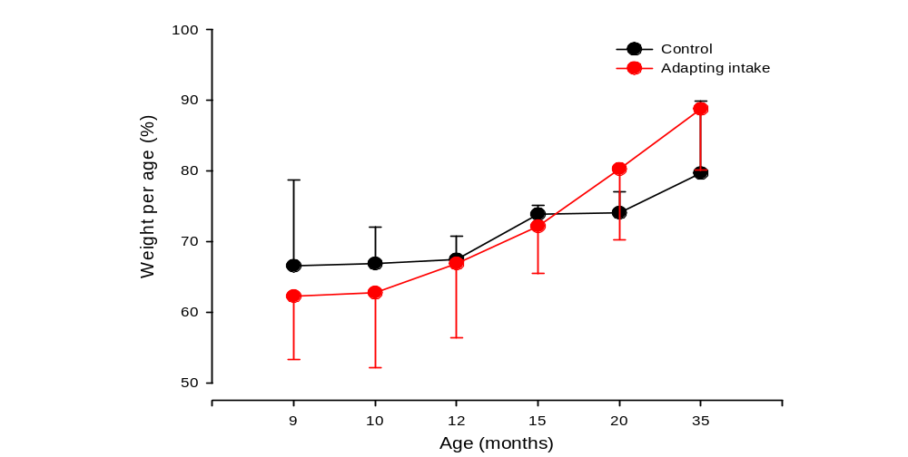
Figure 4

Slide 33
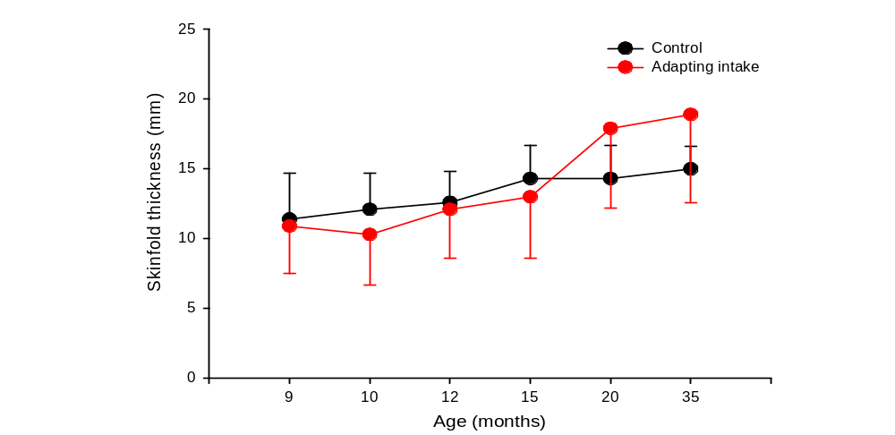
Figure 5

Slide 34
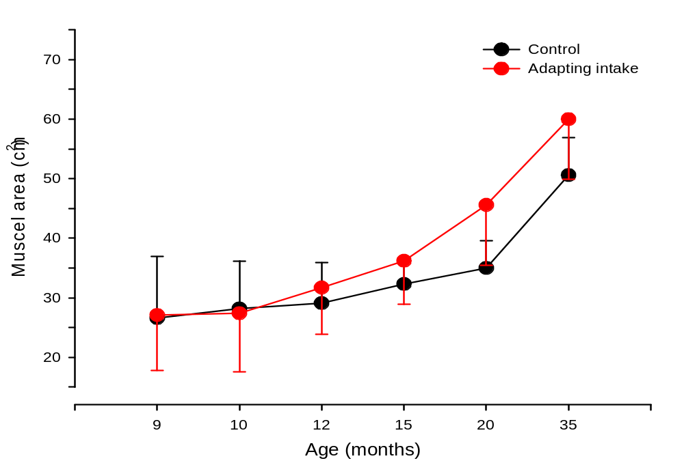
Figure 6

Slide 35
Non-starchy vegetables = NSV
http//www.nutritionandmetabolism.com/content/7/1/4
In all trained Normal Weight subjects (Low BG and High BG together), the longitudinal correlation of vegetable intake vs. energy intake (ρ = -0.26; P = 0.007; n=66) and also vs. mean pre-meal BG in all trained OW subjects (ρ = -0.32; P = 0.05; N = 38) were significant

Slide 36
Vegetable intake significantly increased in both trained and control OW HBG subjects without any longitudinal difference and without any final difference between groups.
C o n t r o l T r a i n e d BMI = 29.2 ± 3.9 => 27.8 ± 4.2 *,b 29.0 ± 4.1 => 26.5 ± 4.0 a*,***b NSV = 278 ± 225 => 460 ± 284 *,b 247 ± 160 => 420 ± 224 ***,b http//www.nutritionandmetabolism.com/content/7/1/4
Although NSV increased equally, BMI decreased significantly only after training, i.e. during IHMP.

Slide 37
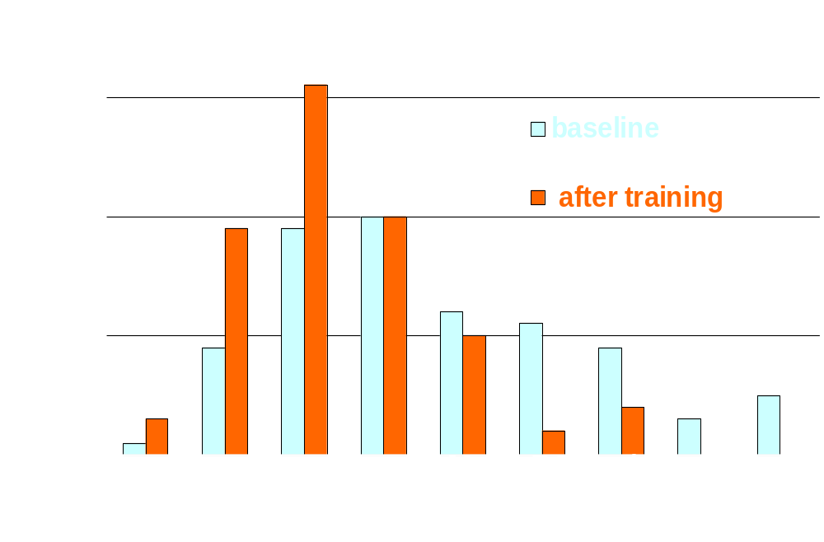

Slide 38
Circulation trial on decreases in systolic and diastolic blood pressures, total/HDL cholesterol, triglycerides and increase in HDL cholesterol.
In the high BG group, the training caused significant longitudinal difference between trained and control subjects in the trend of this trial (P=0.02).
Moreover, the decreases in the diastolic blood pressure and the total to HDL cholesterol ratio and the increase in the HDL cholesterol were significantly larger in trained than control HG group, (P = 0.005).

Slide 39
Physiology versus Pharmacology. Journal of Pediatrics and Neonatal Care 3, 3 – 2015
“A Plea to Mothers”. EC Endocrinology and Metabolic Research 1.1 (2016): 1-3.
“Uneasy Acceptation of Novelty Impairs Any Solution For Fattening/Diabetes”. EC Nutrition 3.4 (2016): 680-684
The Feeding Colloquium. J Pediatr Neonatal Care 2016 4(3): 00141. DOI: 10.15406/ jpnc.2016.04.00141
Ciampolini M (2016) Fact and Value. J Pediatr Neonatal Care 4(4): 00149. DOI:10.15406/jpnc.2016.04.00149
Recovery of Hunger Sensations Associated with Low Preprandial Blood Glucose: An Easy Exit from Diabetes? OJPM, 2016, 6, 149-159. http://dx.doi.org/10.4236/ojpm.2016.65014

Slide 40
Well-being trial: Structured interviews on the number of days of 90 previous days with functional complaints (diarrhoea, vomiting, headache, epigastric and abdominal pain), increase in hours of daily physical activity and bedtime decrease.
Nutrition trial: higher increase in Hb, MCV, transferrin saturation, plasma ferritin, Zinc, folates and B12.
In the HG group, no significant longitudinal difference in the single assessments between trained and control subjects; six of 7 parameters in both trials however improved more after training, and the difference in trend was significant (P=0.007) from the respective control group.

Slide 41
Factors precipitating errors in BG estimation
In our patients, a laboratory autoanalyzer measured BG immediately after patients‘ BG estimation. The estimation error was the difference between estimation and measurement. During training, we observed an increase in this estimation error during 30 – 90 minutes after physical exercise, after food tasting, after intake of one – two grams of food, after indoor entry into non-ventilated closed environment, after increase in clothing or after a stressful event, or during a feverish or not feverish infection.

Slide 42
Effects of heavy outdoor work in 6 vs. 21 sedentary subjects out of 27 trained subjects who remained with high blood glucose at end of investigation.
 |  | 6 heavy outd. Laborers Post training |  | 21 sedentary Post training
Mean BG (mg/dL) a) |  |  | 86.4 ± 4.0 | 87.1 ± 5.3
Post insul.AUC mU/L/3h) |  |  | 124 ± 26 | 207 ± 99**
Post BG AUC (mg dL/3h) |  |  | 536 ± 56 | 601 ± 82*
Insulin sensitivity index |  |  | 11.4 ± 2.9 | 6.68 ± 4.0***
Beta-cell function index |  |  | 1.29±0.66 | 1.43 ± 1.22
 | Mean ± SD. *P , 0.05; **P , 0.01; ***P , 0.001. a) In 6 heavy outdoor laborers at recruitment, Mean BG was = 86.9 ± 5.3 mg/dL, and all other variables were similar to the post training values.

Slide 43
Weight (kg) before and during IHMP
Trained Controls
55 HG 19 HG before after before after
66.8±13.4 ==> 62.7±12.1 60.9±12.2 ==> 62.9±8.4 ***
34 LG 12 LG
before after before after
62.4 ±11.1==> 60.8 ± 9.9e 57.5 ± 8.4 ==> 57.7 ± 8.9
*** Highly significant longitudinal difference between groups.
e significant pre/post difference

Slide 44
SD of diary BG
before and after learning ‘IHMP’
Trained Controls
55 HG 19 HG before after before after
9.4±4.8 ==> 6.6±2.6 9.0±3.3 ==> 9.3±3.9 ***
34 LG 12 LG
before after before after
7.6±2.3 ==> 6.8±3.0 5.4±2.3 ==> 8.7±1.7 ***
*** Highly significant longitudinal difference between groups.

Slide 45
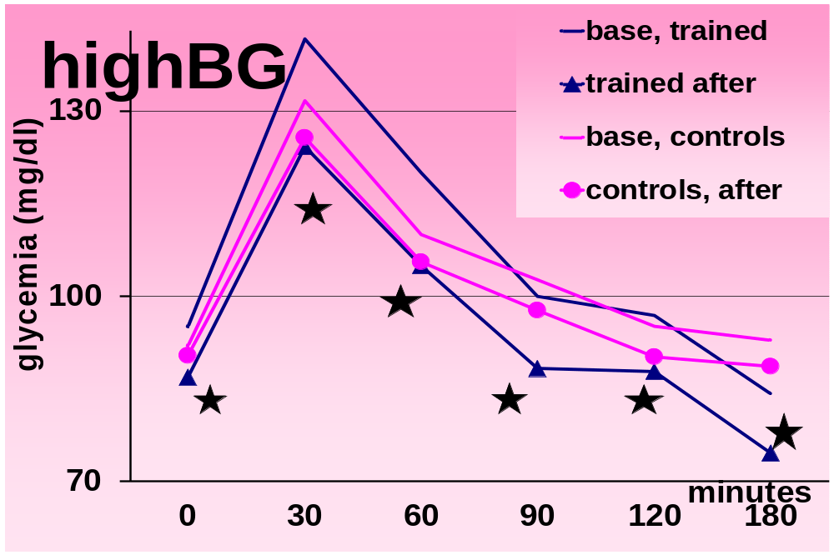

Slide 46
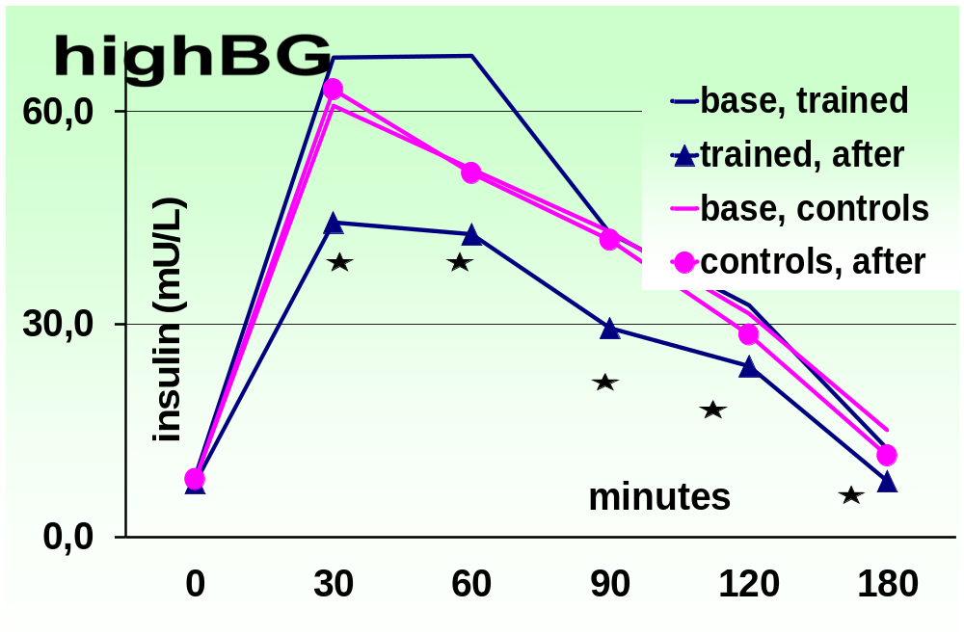

Slide 47
In 21 control and 38 trained subjects, all OW
Subjects 21 Control 38 Trained
Vegetable intake⁵ 246±188 427±263^{**b} 274±166 449±218 ^{***b}
BMI 29.1±5.6 28.2±5.6 28.7±3.5 26.5±3.5
^{**a,***b}
Energy intake 1728±551 1310±532 1756±585 1069±487 ^{***b}
Mean premeal BG 85.7±9.0 89.3±8.2 ^{*,b} 86.8±8.7 78.8±6.8
^{***,a***,b}
Mean ± SD. *P , 0.05; **P , 0.01; ***P , 0.001.
a = longitudinal differences b = pre/post

Slide 48
Low mean BG naturally occurred in a minority of healthy people before the meals and could be learned by the majority who showed higher levels.
Given its novelty, only people with functional complaints (from abdominal pain or diarrhea to insulin resistance, hypertension or overweight) might seek to train ‘Hunger Recognition’.

Slide 49
A significant longitudinal decrease was found in body weight (trained NW: -2.5 ± 4.6 kg; OW -6.7 ± 4.5 kg; controls: NW +3.5 ± 4.0 kg and OW -3.4 ± 4.0 kg; P = 0.006 and 0.029) and in energy intake, mean BG, standard deviation of diary BG (BG as recorded by subjects’ 7-day diary), BMI, and arm and leg skin-fold thickness in (OW and NW) HBG subjects. OW LBG subjects significantly decreased body weight (trained: -4.0 ± 2.4 kg; controls: -0.4 ±3.7 kg; P = 0.037).
29.1 ± 7.9➔28.9 ± 7.6 27.9 ± 2.0➔26.5 ± 1.9 *,a***,b

Slide 50
Weight
Hunger Recognition was associated with significant decreases in body weight and body mass index (BMI) in OW subjects compared to controls after 7 weeks of training and after 3 further months of application.
After training, BMI decreased from
28.7 ± 3.5 to 26.5 ± 3.5
The decrease was significant in comparison to controls (P = 0.004) and in comparison with baseline values of the same group (P = 0.0001).

