Slide 1

Metabonomic: principles, applications in the pediatric field and epidemiology.
Duquesne Marilyn
University of Mons, Belgium

Slide 2
Plan
Introduction on metabonomic
  Definition
  Objectives
  Procedure
    Nuclear Magnetic Resonnance
Examples in pediatric domain
Concret example on epidemiological study
Conclusion

Slide 3
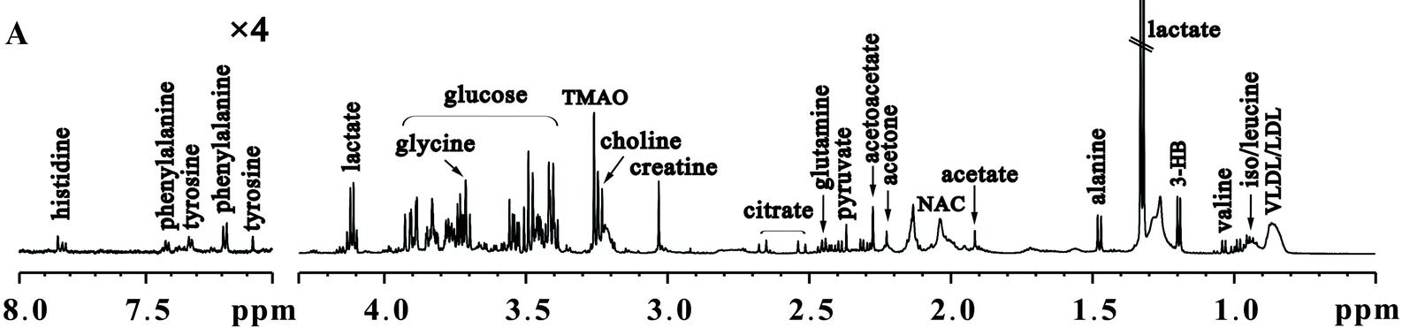
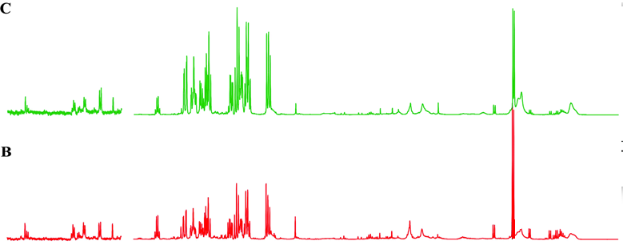
Introduction :
Metabonomic – Definition
Complete portrait of metabolites (<1000 Da) levels
Temporal changes
24h
48h

Slide 4
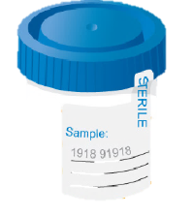
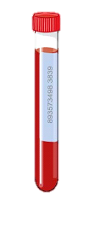
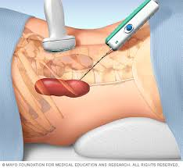
Introduction :
Metabonomic – Definition
Mass spectrometry
NMR

Slide 5

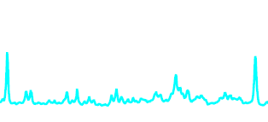

Introduction :
Metabonomic – Objectives
Identification of biomarker(s) characteristic of
  pathology
  treatment efficacy
  toxicity

Slide 6
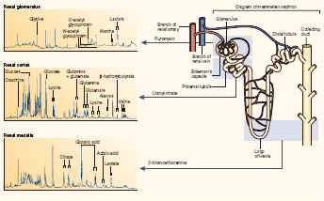
Introduction :
Metabonomic – Objectives
Specific signature
Metabolic pathways modification

Slide 7
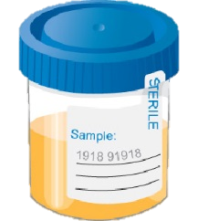
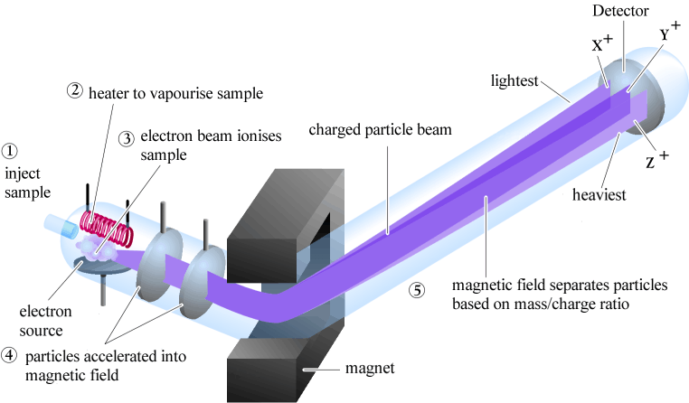
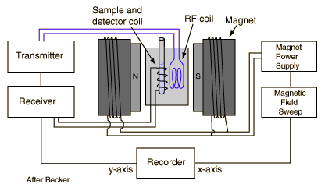
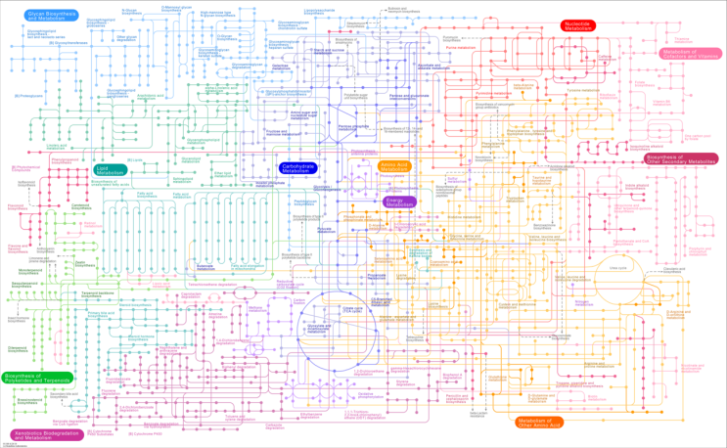
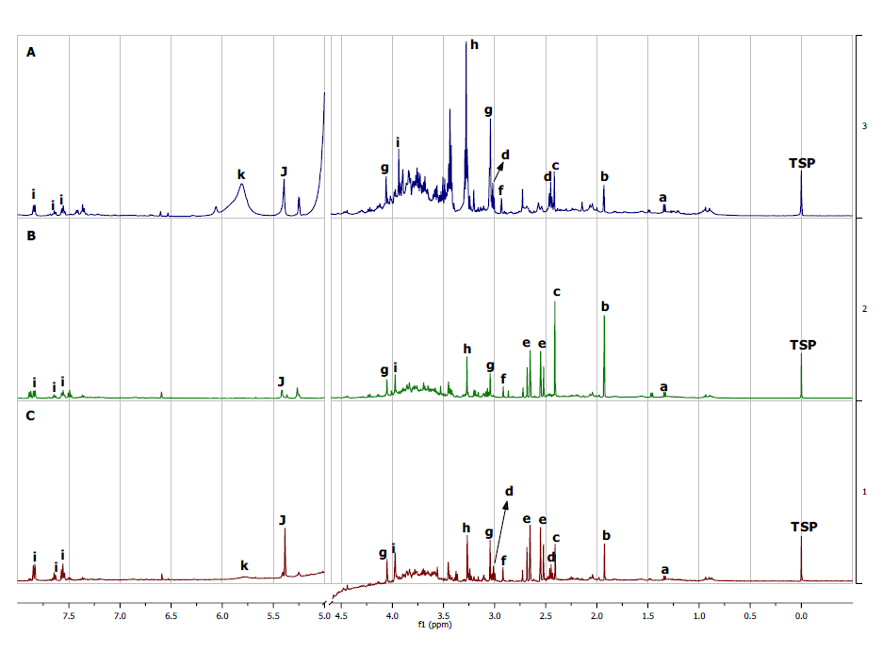
Introduction :
Metabonomic – Procedure
Spectroscopic analysis
Samples collection & preparation
Biological interpretation
Spectrum treatment & MVA

Slide 8
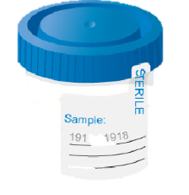
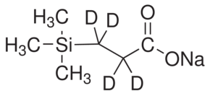
Introduction :
Metabonomic – Procedure
Samples collection
  Biofluids
    Urines
    Blood
    Saliva
    CSF
    …
Samples preparation
  Phosphate buffer
    ➔ Chemical shift variation
  TSP / TMS
  ➔ Reference
  3-(Trimethylsilyl)propionic-2,2,3,3-d4 acid sodium salt

Slide 9
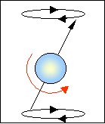
Introduction :
Metabonomic – Procedure
Spectroscopic analysis
NMR spectroscopy
¹H RMN
  2/3 of atoms
  Hydrogen nucleus = 1 proton
  Magnetic properties

Slide 10

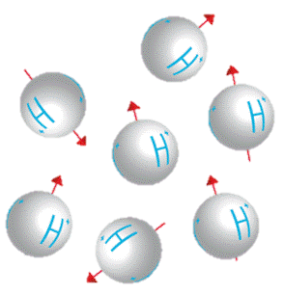
Introduction :
Metabonomic – ¹H-NMR
Magnetic field
Electron
Proton
Bo

Slide 11
Introduction :
Metabonomic – ¹H-NMR
Bo
Z
Equilibrium phase
m0
Excitation phase
m0
Relaxation phase
O
Y
RF
X
Intensity
Intensity
Fourier
transform
Time
Frequency
(ppm)

Slide 12
Introduction :
Metabonomic – ¹H-NMR
Intensity
triplet
singlet
Chemical shift
Peak multiplicity
quadruplet
3,66
2,46
1,18
Frequency
(ppm)
Metabolite | Chemical Shift | Multiplicity
Hippurate | 3,97 | Doublet
Phenylalanine | 4,00 | Multiplet
Creatinine | 4,06 | Singlet
Proline | 4,14 | Multiplet
….. | …. | ….

Slide 13
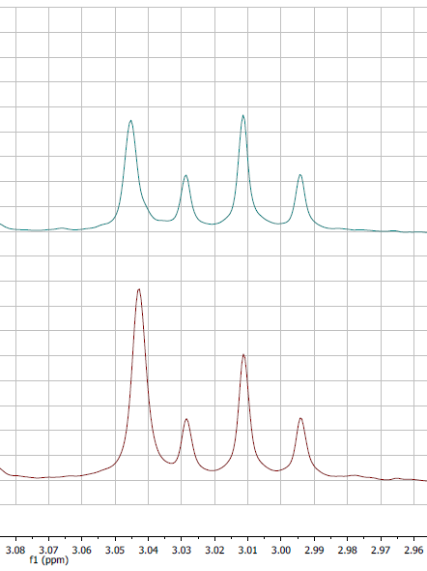

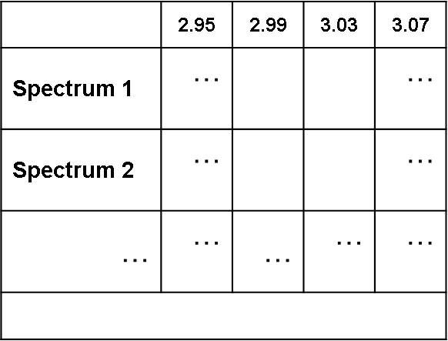
Introduction :
Metabonomic – Spectra treatment & MVA
Corrections
0,04ppm
0,04ppm
Binning
7,52
11,68
Spectrum 1
11,68
7,52
9,86
Spectrum 2
11,75
9,86
11,75

Slide 14
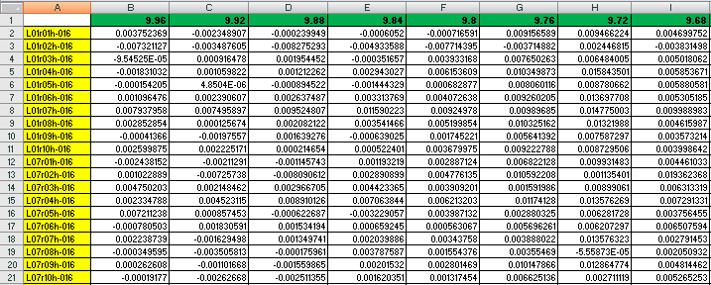
Introduction :
Metabonomic – Spectra treatment & MVA
➔ variables
Subregions (chemical shifts)
Samples spectrum
➔ observations
MVA

Slide 15
Introduction :
Metabonomic – Multivariate analysis
Principal Component Analysis (PCA)
SCORES plot
LOADINGS plot
PC2
PC2
3.40
3.80
PC1
&
1.24
PC1
2.50
5.70
0.80
3.24
Observations
Variables

Slide 16



Examples of metabonomic
applications in pediatric domain
Metabonomic & pregnancy
  Preeclampsia : carnitines, amino acids (alanine, phenylalanine, methionine..) and energy intermediates (citrate, glycerol, hydroxyvalerate)
  Fetal malformations : ↗ urinary excretion of hypoxanthine, Krebs cycle metabolites, glucogenic amino acids ; alteration of blood lipid composition.
  Fetal macrosomia : ( risk of chilhood obesity)
  Gestationnal age : Preterm/full-term
  Delivery mode :Vaginal/ cesarean

Slide 17


Examples of metabonomic
applications in pediatric domain
Metabonomic & premature birth
  Necrotizing enterocolitis (ischemic necrosis of intestinal mucosa) :
  Low plasma citrulline level.
  Respiratory distress syndrome : Metabolic signature in bronchoalveolar lavage fluid
Metabonomic & pediatric research
  Nephrouropathies : Metabolites patterns associated with different nephrouropathies

Slide 18
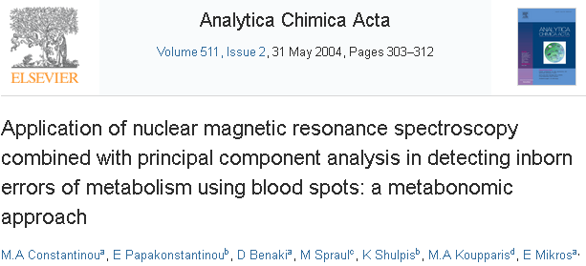

Examples of metabonomic
applications in pediatric domain
Metabonomic & neonatal screening
  Inborn errors of metabolism
    Phenylketonuria and maple syrup urine disease
      ↗ branched amino acids in blood
    Aminoacidemias, fatty acid oxydation disorders, organic acidurias
  Gut colonization

Slide 19

Examples of metabonomic applications in pediatric domain
Mother’s biofluids
  Urine
  Blood
Child’s biofluids
  Urine
  Blood
  Bronchoalveolar lavage fluid
  Umbilical cord blood
Amniotic fluid
  Preterm delivery
  Fetal malformations
  Gestational diabetes

Slide 20
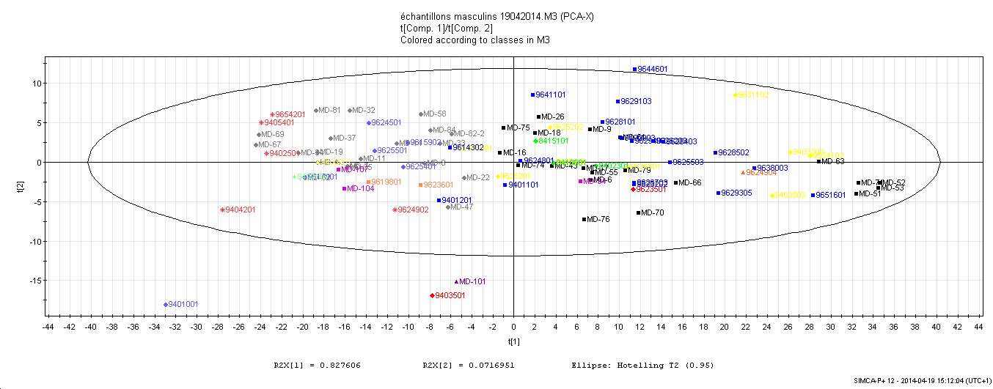
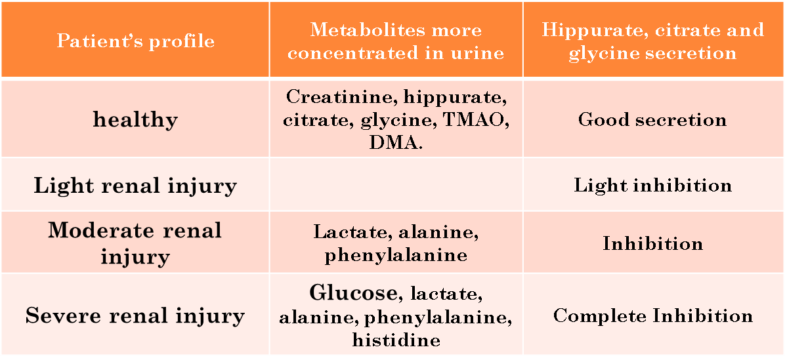
Concret example of metabonomic study in an epidemiological context
Scores plot of urine samples collected in Balkan patients.
Creatinine filtration : X
Hippurate secretion : X
Glucose reabsorption : V
Creatinine filtration : V
Hippurate secretion : V
Glucose reabsorption : V
Metabonomic profile:
Moderate renal injury
Metabonomic profile : Healthy
Metabonomic profile:
Severe renal injury
Creatinine filtration : X
Hippurate secretion: X
Glucose reabsorption : X

Slide 21
Conclusion :
Simplicity, safety
Noninvasiveness
  sterile cotton wool balls in the infants’ diapers
  Except for blood ➔ low volume required
Time-averaged homeostatic metabolic changes
Large of biofluids ( blood, urines, amniotic fluid,…)
  breast milk
    explore the relationship among mother’s nutrition, breastfeeding, and child’s nutrition for optimal growth and development

Slide 22

Thank you for your attention !
marilyn.duquesne@umons.ac.be

