Slide 1
Neuroprotective and remyelinating agents, the future of clinical trials in MS?
Novel therapeutic approaches in multiple sclerosis
Marie Trad, M.D., Lynne Hughes, Cathy VanBelle, Amy Del Medico
3rd International conference
& Exhibition on Neurology
and Therapeutics
08 September 2014

Slide 2
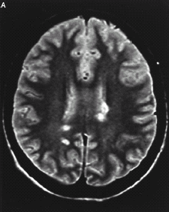
Multiple sclerosis
Multiple sclerosis (MS) is the most frequent inflammatory disease of the central nervous system (CNS) and most common cause of neurological disability in young adults (> 2.5 M patients WW, mainly females)
The inflammation results in Myelin destruction (demyelination) that will progressively lead to axonal injury and neuronal degeneration
Characterized clinically by recurrent (Remitting relapsing forms) or chronically progressive neurological dysfunction (Progressive forms)
Leads to diverse clinical signs and symptoms of neurological dysfunction; unpredictable clinical course, variable prognosis
Cause unknown but might be a result of combined, environmental, immunological and genetic susceptibility factors

Slide 3
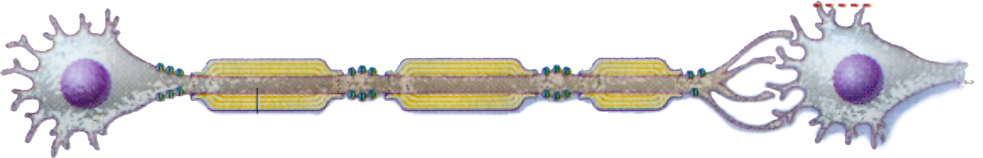
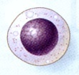
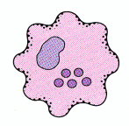
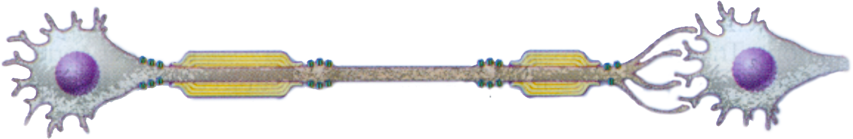
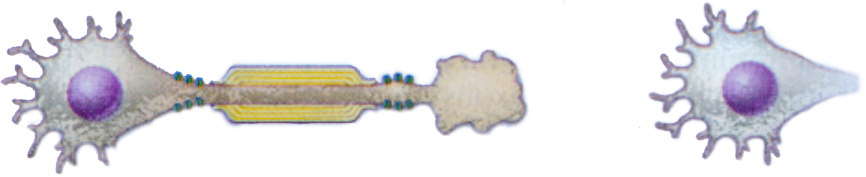
Pathophysiology of MS
Demyelination and axonal loss
A Normal Neuron
Information flows
Demyelination
Remyelination
Relapse
A demyelinated neuron
Partial information flow
A degenerated neuron
Neurological symptoms
Disability
No information flow

Slide 4
Therapies
Treatments modifying the outcome of acute relapses
Therapies aimed at modifying the course of the disease: immunomodulators e.g. interferons, glatiramer, natalizumab and immunosuppressants ex. Mitoxantrone
Symptomatic therapies
Largely injectables, three oral therapies approved since 2010
Future therapies focusing on neuroprotection or restoration of neurological function (ex. Promoters of remyelinisation)

Slide 5
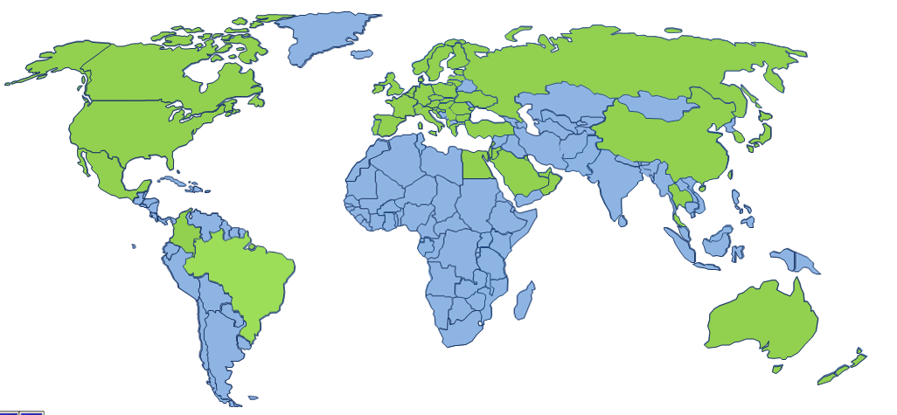
Quintiles Multiple Sclerosis experience
2000-2013
43 studies enrolled
19,000+ MS patients recruited
1100+ recruiting sites
Pool of 3,500+ sites in 65 countries
230 CNS Project Managers
25 Medical Specialists in CNS
DMT’s: Beta interferon
Immunomodulators
Biosimilars
Gene therapy
V-CAMs
B cell depleting therapies
Anti-Cancer Agents
S1P Receptor Modulator
BAFF antagonists
Our experience includes:
Source: Quintiles Proprietary Data 11Jul2014

Slide 6
Quintiles’ contribution per MoA
With three decades of experience and unmatchable therapeutic expertise
Quintiles is the number one CRO in MS – we have worked on 16
of the MS compounds developed since 2000
Quintiles has developed an internal, proprietary database using illustrative,
de-identified data from many sources.

Slide 7
Top 10 most studied compounds
Industry sponsored, interventional studies
by patient contribution

Slide 8
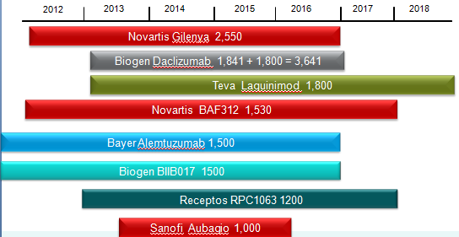
Current competitive landscape in the area of RRMS

Slide 9
The MS market is forecast to peak in 2020, driven by the continuing uptake of novel oral therapies
The MS market in EU5# is expected to grow by $2.2b by 2020
Generic and biosimilar entrants post 2020 will start to erode the market
Injectable treatments will retain 50% share of the MS market
In addition to continued growth from Gilenya. Tecfidera, Aubagio and Plegridy are expected to make the greatest market share gains.
Source: Datamonitor Forecast 14/08/13 *ABCR Brands = Avonex†, Betaseron†, Copaxone¥, Rebif† († ß-interferon & ¥ glatiramer acetate therapies) # EU 5 (France, Germany, Italy, Spain, UK)
WORK^{UP}

Slide 10
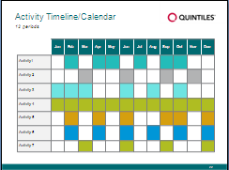
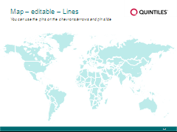
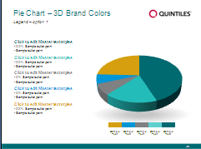
Background
With the ever-growing competitive landscape in conducting Multiple Sclerosis (MS) clinical trials and the unmet needs for more robust effects on long term disability and disease progression, novel therapies targeting different
MS clinical forms and acting beyond relapse outcomes, are needed.
Notes:
How to Use the Formatted Notes Pages
Why the Notes Page helps you extend your story and clear content off your slides
Can be used as a pre-read, follow-along or leave-behind for a deeper level of understanding.
Gives you more space for your content, helping to keep the slides of your presentation more concise and focused.
Using and formatting your notes
To view the Notes Pages, go to the View Tab, select Notes Page.
To print the Notes Pages, go to Print, Print What, Notes Pages.
To add a header to your Notes Page, go to View, Notes Page, Insert, then Insert Header & Footer. Click the check box next to Header, and insert the title of your presentation. Click Apply to All.
To use the Notes Pages and format your text:
Enter your notes similar to how you would on a slide, using the “Decrease List Level” and “Increase List Level” under the Home tab/Paragraph portion of the ribbon to promote and demote bullets.
Sharing the formatted notes with your audience
To send just the formatted notes: email Notes Pages via PDF, go to Print, Print What, Notes Pages, then under Printer Name, select Adobe PDF or Cute PDF Writer.
Increasing the size of the slide image on the note pages
Go to View > Notes Master
Click on the slide in the lower right corner
Expand the size by dragging the upper
left corner of the slide
Then close Notes Master

Slide 11
Objectives
By 2020, more than 19 compounds would have been put on the market essentially, modifying the outcome of acute relapses in Relapsing Remitting forms of MS (RRMS)
No approved therapies for progressive forms
Clinical trials in primary and secondary progressive MS forms (PPMS and SPMS) remain more confidential
The underlying mechanisms leading to neuronal loss and degeneration as a consequence of the initial demyelinating process are becoming more understood
Agents providing neuroprotection or promoting remyelination are a growing necessity and need to be the focus of future clinical trials

Slide 12
Methods
Retrospective analysis of Quintiles MS performance on 40 trials, as well as a review of more than 350 global clinical MS studies, available in the public domain (clinicaltrials.gov), has shown that the main focus of clinical research remains RRMS

Slide 13
Results
Over 37,000 RRMS patients are currently participating in global interventional clinical trials where ARR remains the primary objective (> 70,000 RRMS patients in total, if observational studies added)
Approximately 7,000 patients with progressive forms of MS are taking part in clinical research where effect on disability is studied as a primary outcome.
When it comes to patients with CIS (Clinically Isolated Syndrome)
and NMO (Neuromyelitis Optica), this number drops below 1500.
The search on drugs in development reveals 25 investigational injectable compounds from phase 1 to phase 3b and another 15 investigational oral compounds, both currently developed, primarily, in RRMS.
Only very few neuroprotective and remyelination therapeutic trials for MS are ongoing, six and four respectively.
Furthermore, there are 16 stem cell trials being investigated as potential remyelinating agents.

Slide 14
Active MS studies
Total patients targeted by study type and MS sub-indication
Sub-Indication | Diagnostic | Interventional | Observational
All MS | 914 | 8,436 | 79,484
CIS | 375 | 796 | 120
NMO |  | 284 | 30
Pediatric MS |  | 202 | 1,970
Progressive MS | 100 | 7,048 | 700
RRMS |  | 28,754 | 41,138
Grand Total | 1,389 | 45,520 | 123,442
Over 170,000 MS patients will be recruited into 339 interventional, observational and diagnostic studies

Slide 15
Patient contribution to remyelinating/neuroprotective agents studies

Slide 16
Conclusion
The current MS clinical trials environment focuses mainly on developing drugs targeting the reduction of the ARR in RRMS patients in a consistently increasing competitive arena.
Thus, it is becoming more and more challenging finding patients willing to participate in clinical research with so many therapies available to them and additional products scheduled to arrive on the global market in the near future.
Our analysis reveals that it is essential that more effort is deployed in developing agents in more progressive forms of MS and those that have more significant effect on disability outcomes.
Although clinical trials with compounds developed as remyelinating agents remain limited for different scientific and methodological reasons, it is crucial that this area expands to meet an unmet need: robust and positive effect on long term disability and disease progression in MS patients.

