Slide 1
About Omics Group
OMICS Group International through its Open Access Initiative is committed to make genuine and reliable contributions to the scientific community. OMICS Group hosts over 400 leading-edge peer reviewed Open Access Journals and organize over 300 International Conferences annually all over the world. OMICS Publishing Group journals have over 3 million readers and the fame and success of the same can be attributed to the strong editorial board which contains over 30000 eminent personalities that ensure a rapid, quality and quick review process.

Slide 2
About Omics Group conferences
OMICS Group signed an agreement with more than 1000 International Societies to make healthcare information Open Access. OMICS Group Conferences make the perfect platform for global networking as it brings together renowned speakers and scientists across the globe to a most exciting and memorable scientific event filled with much enlightening interactive sessions, world class exhibitions and poster presentations
Omics group has organised 500 conferences, workshops and national symposium across the major cities including SanFrancisco,Omaha,Orlado,Rayleigh,SantaClara,Chicago,Philadelphia,Unitedkingdom,Baltimore,SanAntanio,Dubai,Hyderabad,Bangaluru and Mumbai.

Slide 3

Manufacturing and performance of quantum cascade lasers for industrial applications
Mariano Troccoli
Director, Product Development
AdTech Optics Inc.

Slide 4
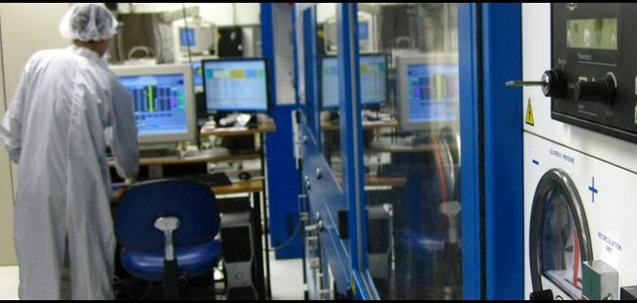
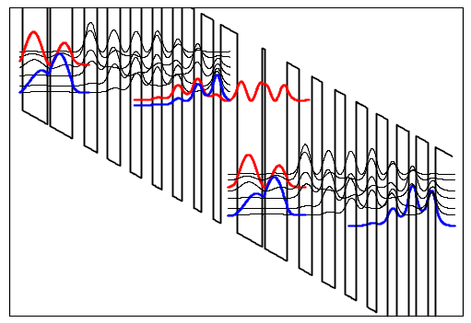
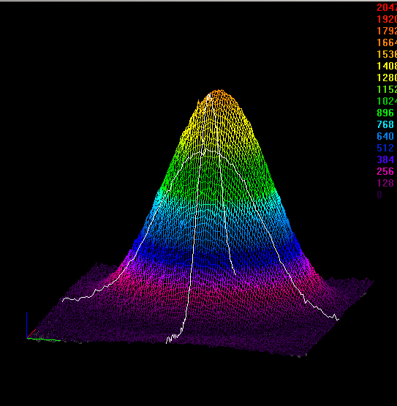
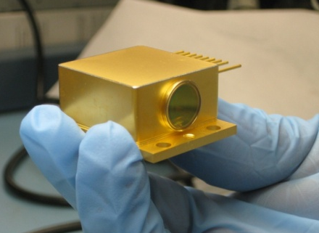
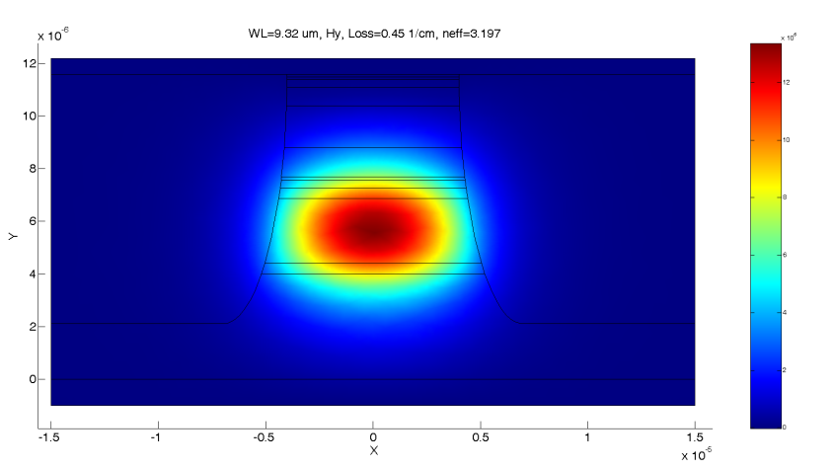
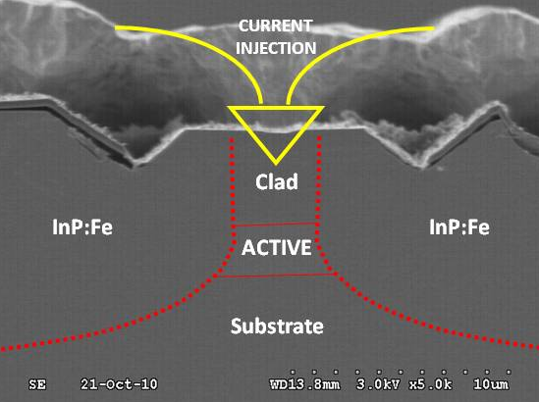
In-house capabilities at ATO
FROM CONCEPT
12 YRS in business
25 PPL on QCLs
11,000 SQFT
ITAR compliant
Laser Design
full modeling of QCL devices
with proprietary software
MOCVD Growth
2 reactors dedicated
to QCLs production
Device Fabrication
buried-het process
for RT CW operation
Test and Mounting
C or CS open-mount, TO-3, HHL
TO PRODUCTION

Slide 5
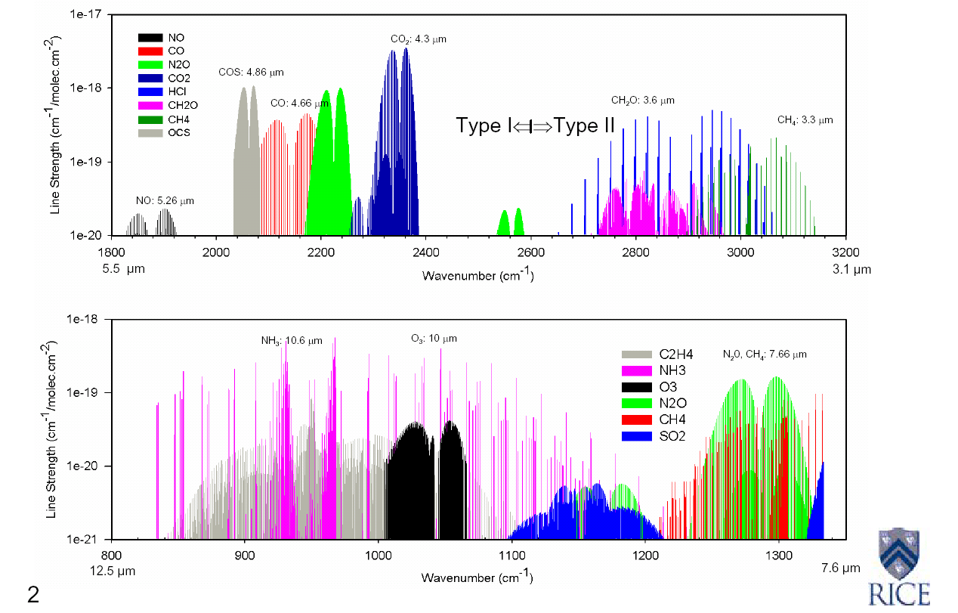
Mid-IR “molecular fingerprints”

Slide 6
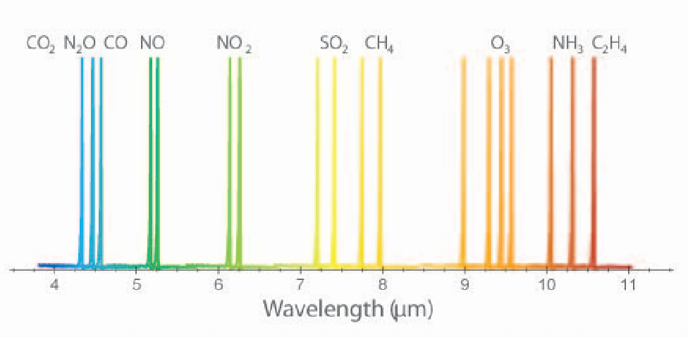
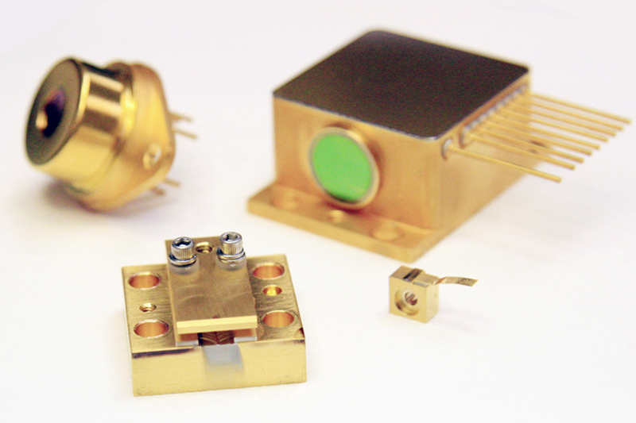
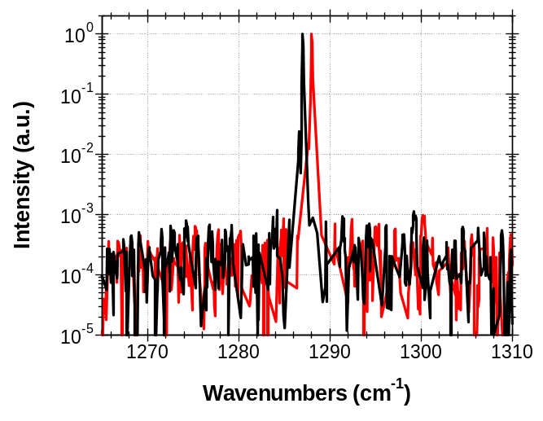
CW DFB QC Lasers: wide range coverage of the mid-IR
New: 12um
30dB SMSR
CW, RT Operation
3-4 cm⁻¹ tunability
Broad coverage of mid-IR
Scalable technology for affordable, portable sensors
Full list of DFB wavelengths is available at www.atoptics.com/laser_specs.html

Slide 7
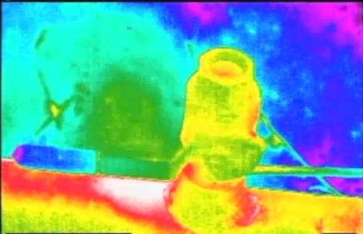
Applications of Mid-IR spectroscopy
Analytical
Hyper-spectral imaging
Microscopy
Analysis of food, water, fluids, etc.
Environmental
Emissions & pollutant monitoring
Power generation & catalytic processes
Combustion processes
Defense & Security
IRCM
IED detection
Stand-off haz-mat detection
Industrial
Process monitoring and optimization
Leak detection
Quality control
Bio-medical
Advantages of
Optical Detection:
Non-invasive
Highly Selective
Highly Sensitive
In-situ or stand-off
Clean

Slide 8
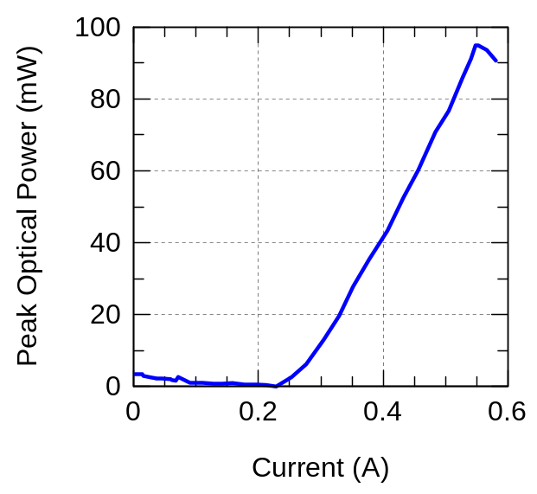
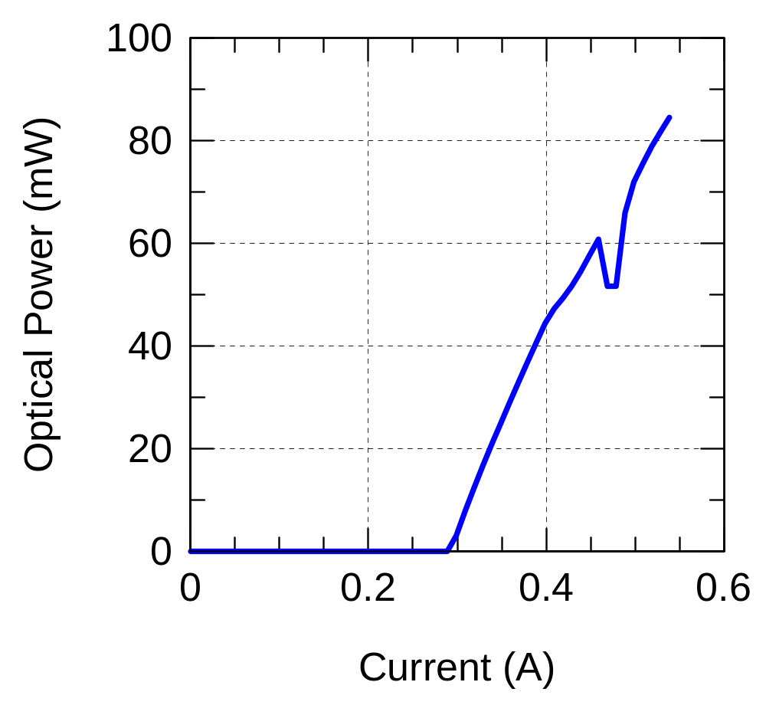
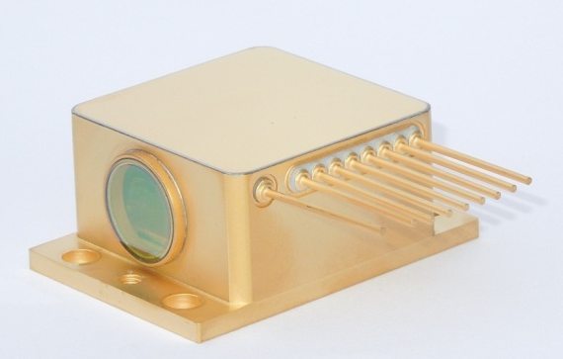
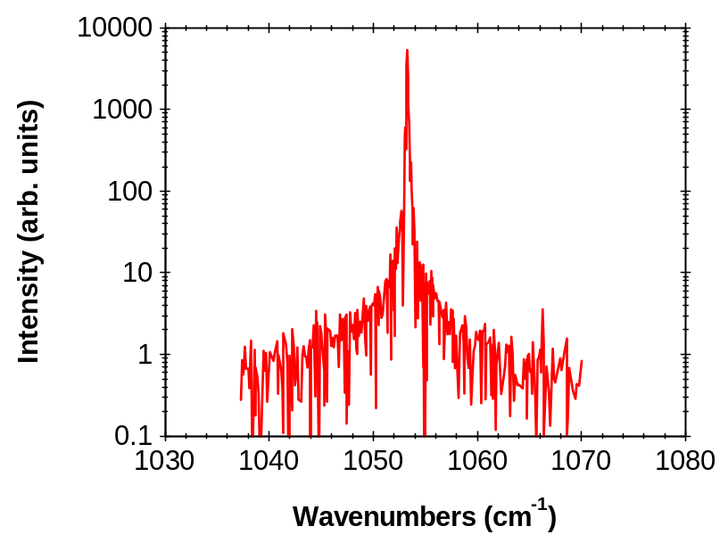
Direct Absorption measurements with a DFB QCL: detector saturation issues
!!
Line scanning by current tuning

Slide 9
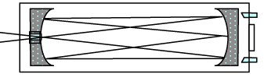
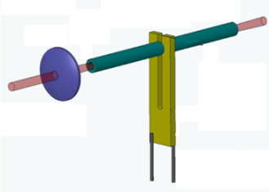
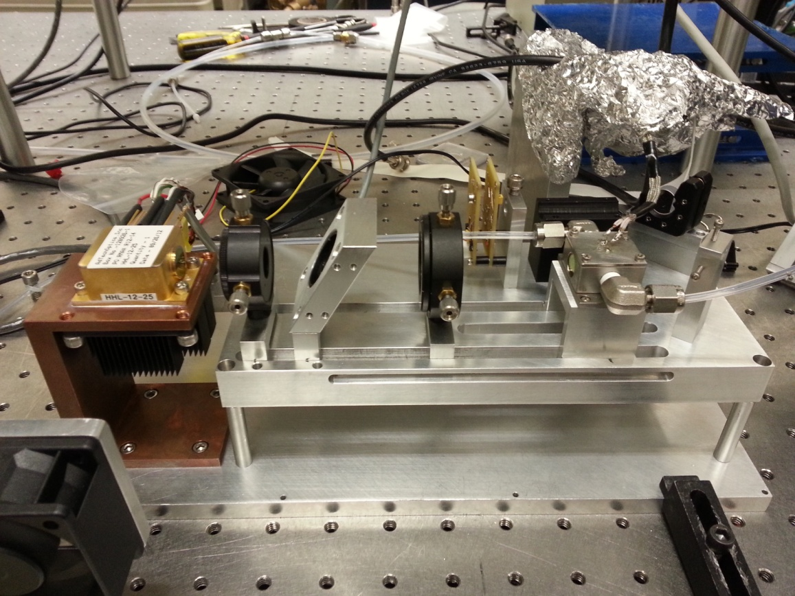

Photo-Acoustic Sensing systems benefit from Hi Power QCLs
Sensor system | Multipass system | QEPAS system
Cell volume | 225 ml | 7.5 ml
Response τ | ~1 minute | Several seconds
Optical path | 57 m (17 cm cell length) | 1 cm
Laser power | 1-10 mWs | 120−150 mW
BG noise | Etalon fringe | Optical/thermal noise
MDC (1s) | CH₄: 5.9 ppb, N₂O: 2.6 ppb | CH₄: 13 ppb, N₂O: 6ppb
GAS
OPTICS
ADTECH
QCL
QEPAS CELL

Slide 10
The challenges of low-power QCLs
Fundamental limits:
QCL intrinsically a high current device
Short intraband lifetimes
Unipolar device
2-electrode configuration
Material-related:
Optimizing injection & conversion efficiency
Minimizing losses / reducing operating current
Minimizing voltage “defect”
Reducing voltage drop on contacts / claddings
Optimizing mode confinement
Fabrication-related:
Reducing device size
Optimizing fabrication
Optimizing coatings
Optimizing mounting and heat transfer

Slide 11
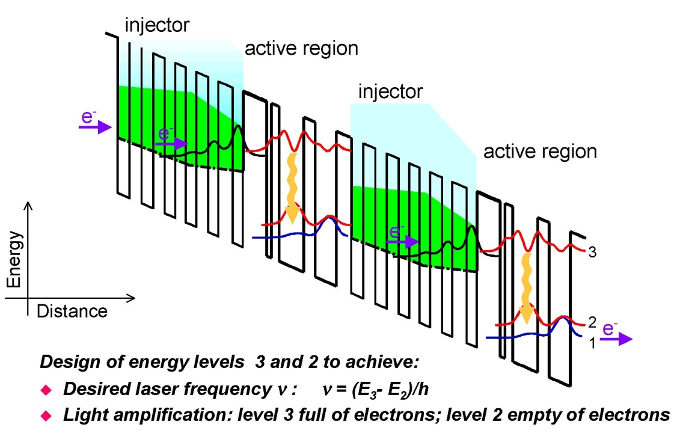
QCL band structure
V_{tot} ≅ N x hν
V_{tot} ≅ N x hν x V_{def} + V_{c}
Contact res.
Gain / overlap
Backfilling
Wavelength

Slide 12
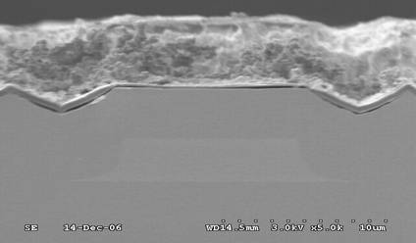
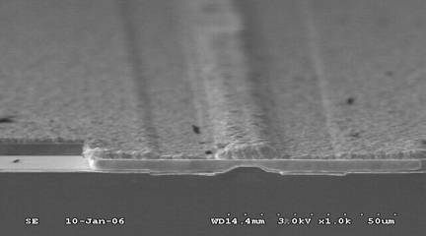
BH process: fabrication challenges for low-Power QCLs
waveguide
i-InP
ACTIVE
i-InP
Laser emission
I = J x A
Narrow device fabrication:
Etching (aspect ratio, intf. smoothness, …)
Doping optimization
Re-growth quality / background impurities
Material:
- Losses
- Coatings
Geometry:
Emitter width
Cavity

Slide 13
Threshold density vs. wavelength
J = 1.5 kA/cm²

Slide 14
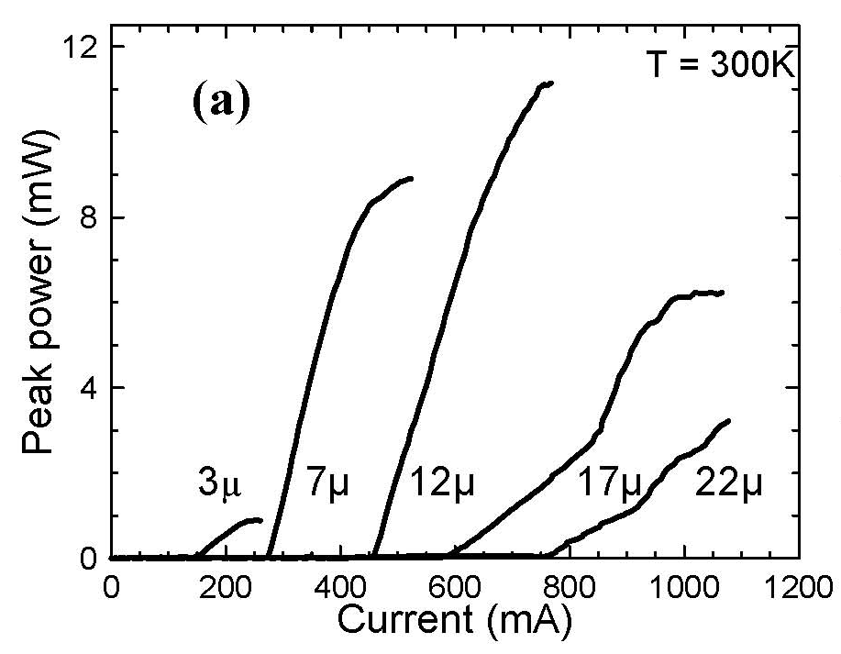
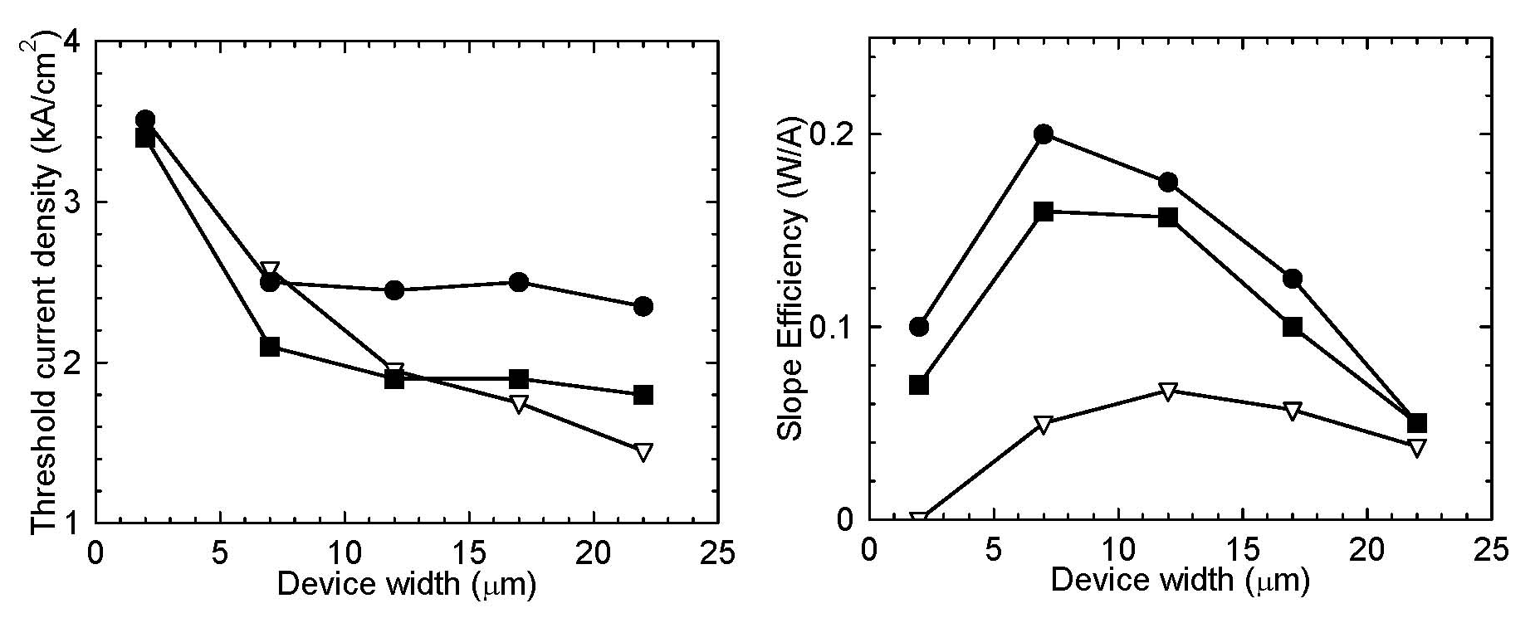
J_{th} vs. device width
Device wavelength: 4.7um

Slide 15
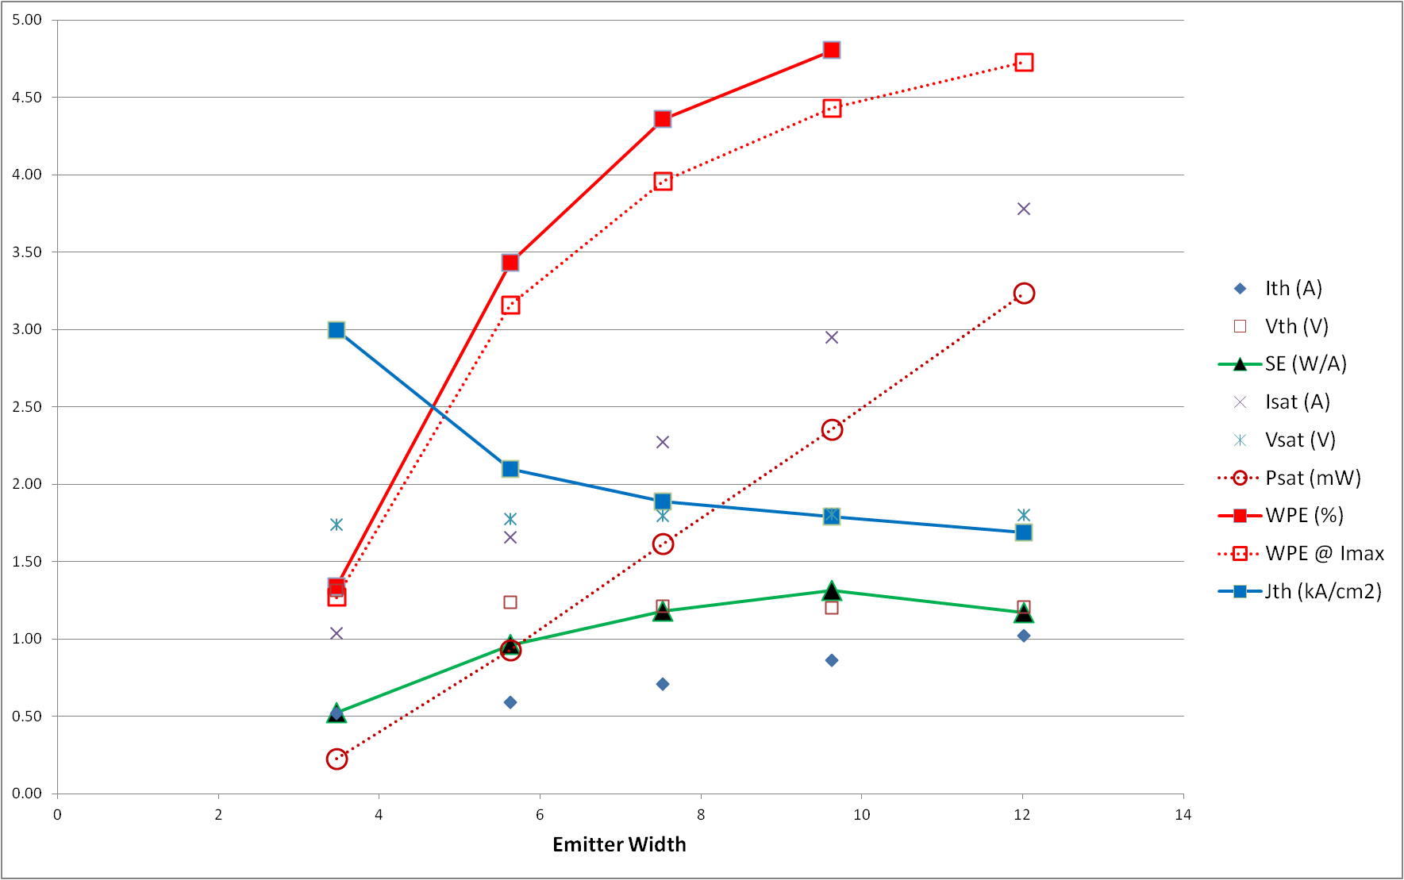
Narrow BH devices @ 5um
(pulsed operation, RT, no heat sinking)
/10
(W)

Slide 16
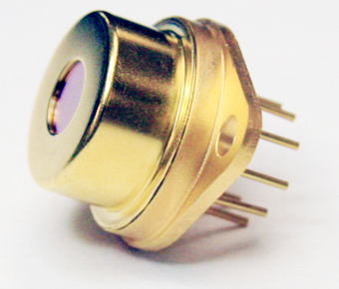
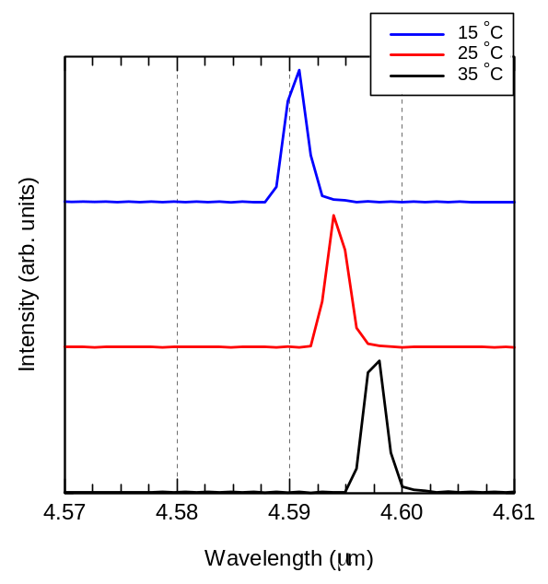
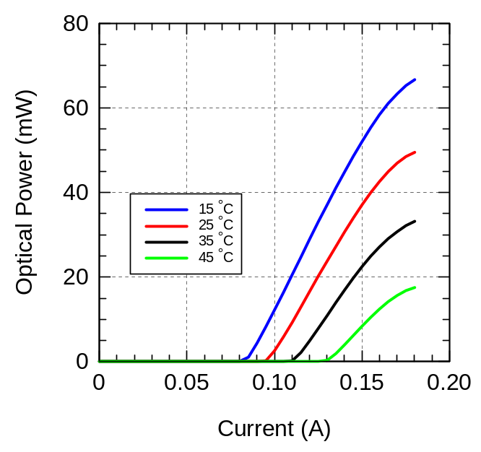
Low-Consumption DFB QCL
50mW
λ= 4.5um ; Emitter Width= 3.7um
P^{E}_{th} = 0.8W ; P^{E}(50mW) = 1.9W

Slide 17

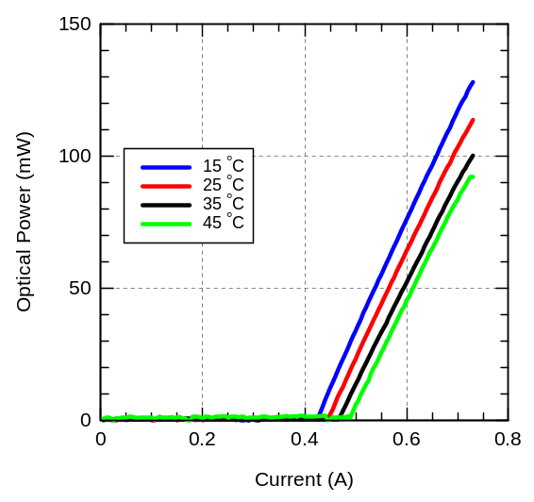
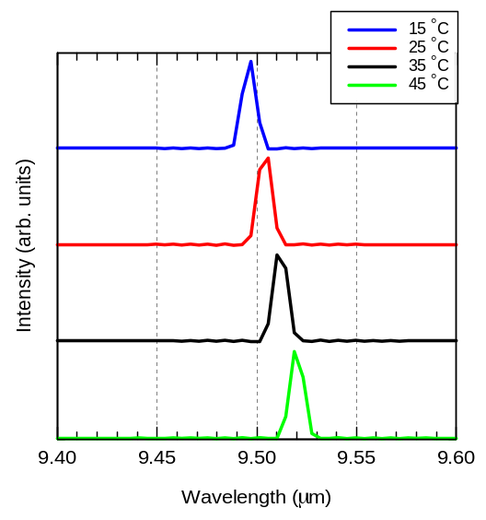
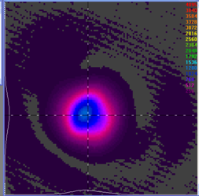
LWIR narrow device results
λ=9.5um ; Emitter Width= 7um
P^{E}_{th} = 3.3W ; P^{E}(50mW) = 4.7W

Slide 18
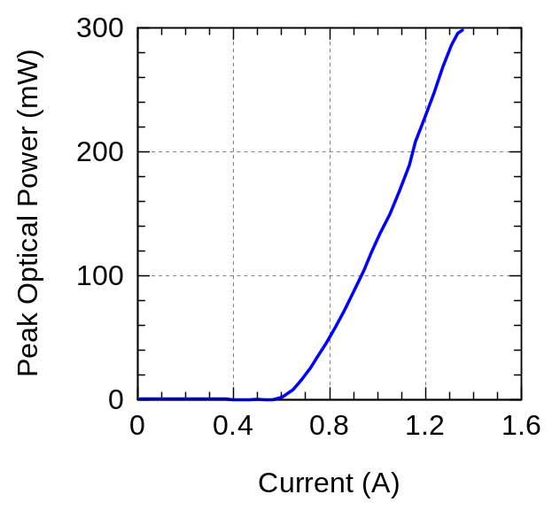
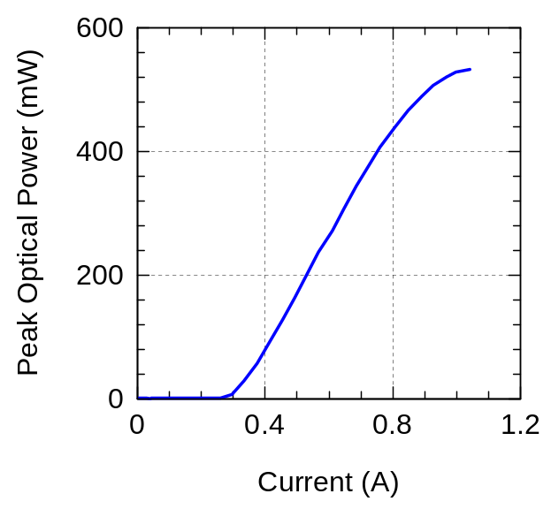
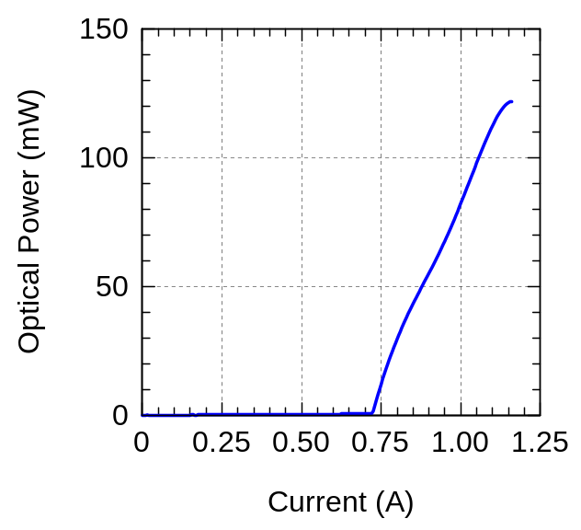
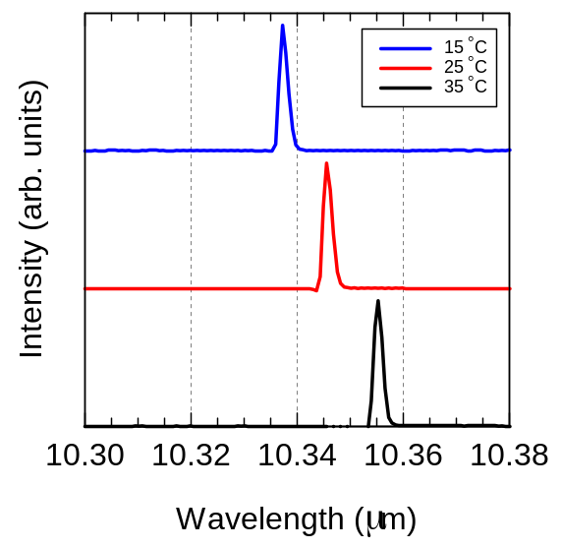
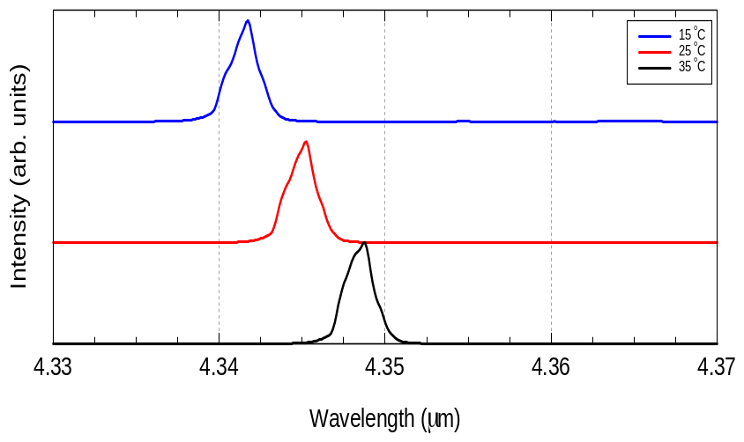
TO-3 DFBs for NH₃ and CO₂

Slide 19
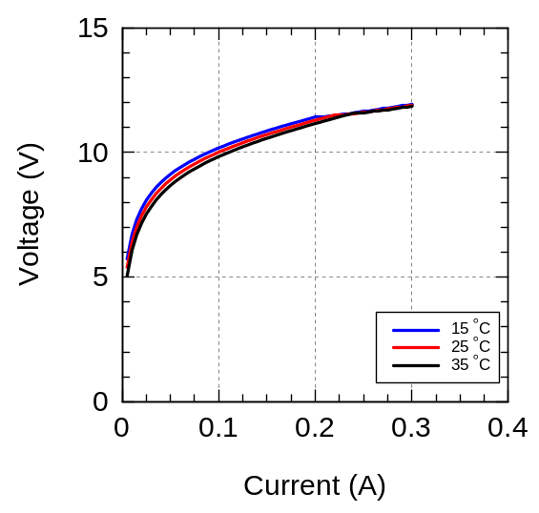
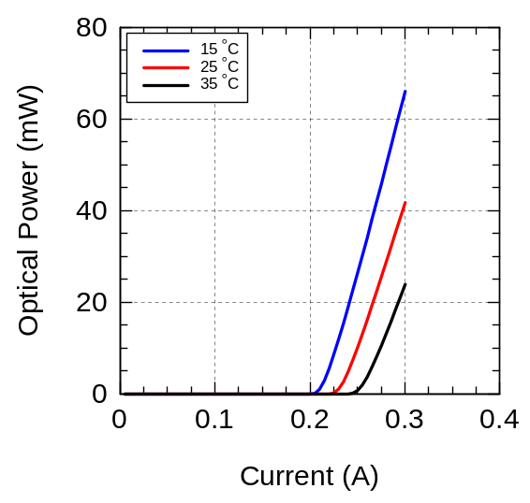
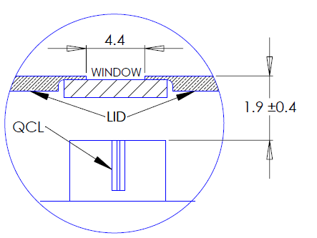
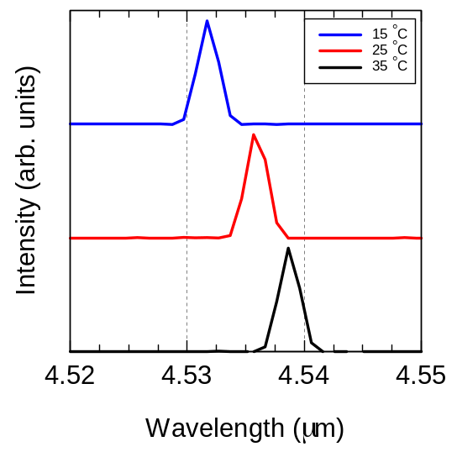
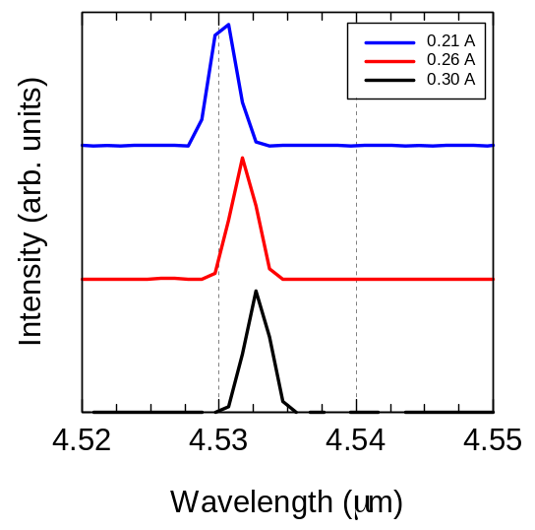
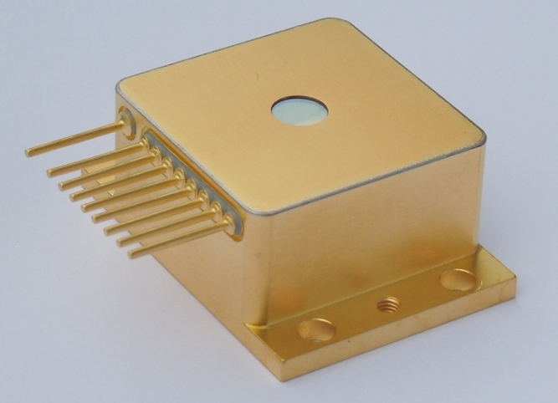
VHL DFBs: 5.26 and 4.53um

Slide 20
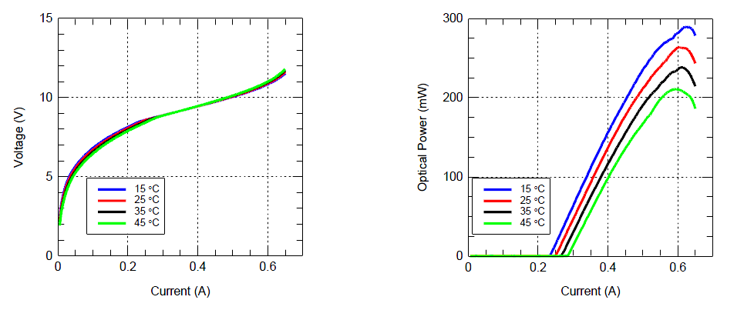
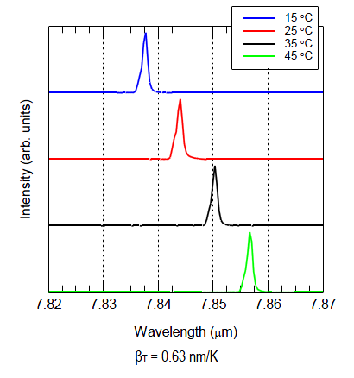
High power DFBs
(a)
(b)
(c)
η_{max} = P_{out}/P^{E} = 250mW/5W = 5%

Slide 21
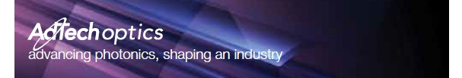
Conclusions & Perspectives
QCLs are becoming a mature technology and becoming production/manufacturing ready :
laser performances are being tuned to the application requirements
product development is steadily moving forward
field testing of QCLs is successful and integration is following
customers need industry-wide standards and reliable suppliers
AdTech has the manufacturing capabilities, technical expertise and financial stability to pursue the full development of QCL-based products. We are committed to support the scientific community and our customers throughout this process.

Slide 22
Acknowledgements
AdTech Optics Team
Jenyu Fan (fab operations)
Xiaojun Wang (material development)
Rommel Ceballos (processing)
Hien Quach (testing)
Ulisses Gamboa (packaging)
Gene Lin (coating)
Charles Luu (tech sales)
Ed Ho (Finance)
Mary Fong (CEO)
Support from DARPA, ONR, MDA

Slide 23
QCL Manufacturing
Different stages of laser manufacturing process
Target specs
Wafer
analysis
Device Design
Specs verific.
and approval
-targets
-tolerances
-critical thresholds
Material growth
Quickturn fab
Review
and release
BH Fab
RW device test
Data compliance
BH control
BH Test
Material release
Data compliance
Coating
Burn-in &
Custom-test
Mounting
Coating inspection
Packaging
CW - full test
User qualification
Field Test

Slide 24
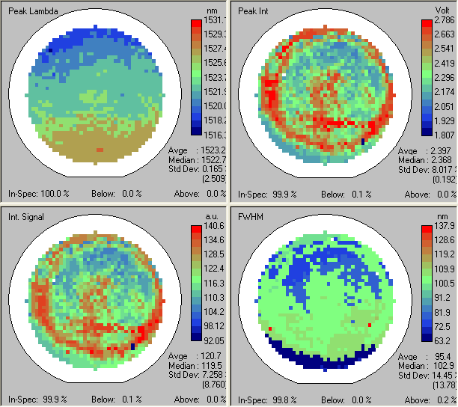
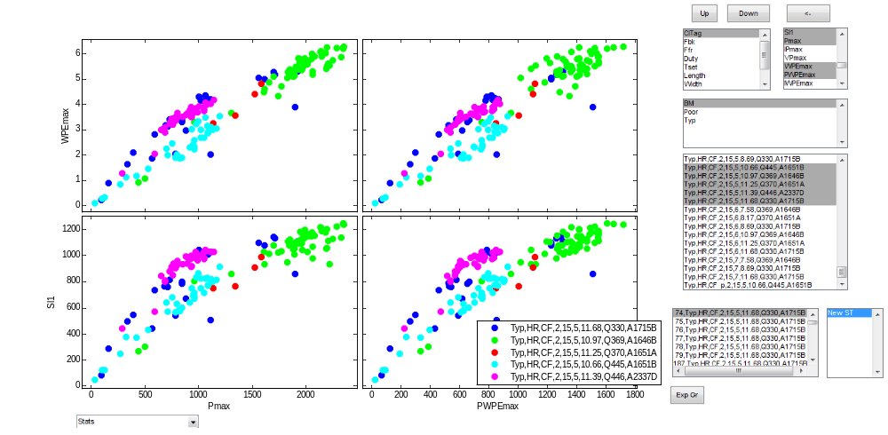
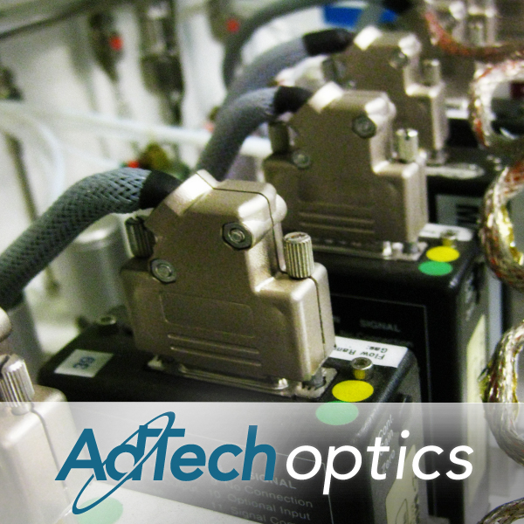
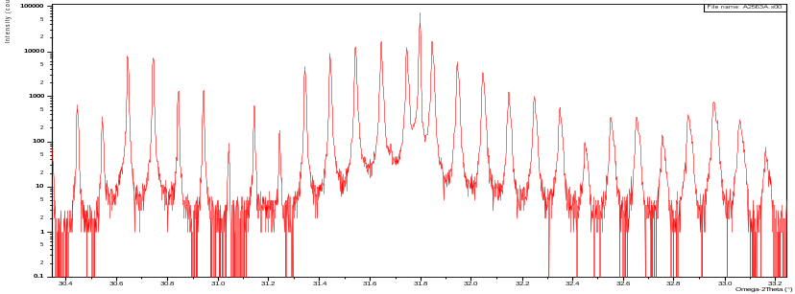
QCL Manufacturing – quality control
Measurements and technologies for manufacturing control and repeatability
Hi Eff
Hi Pow
Luminescence mapping
Yields across processes
Xray-scattering mapping

Slide 25
Let Us Meet Again
We welcome all to our future group conferences of Omics group international
Please visit:
www.omicsgroup.com
www.Conferenceseries.com
http://optics.conferenceseries.com/

