Slide 1



Acidogenic valorisation of food industry wastes for polyhydroxyalkanoate (PHA) biosynthesis
Mariana Matos · Carlos Silva · Pedro Cardoso · Rafaela Cruz · Gilda Carvalho · Adrian Oehmen · Maria Reis
International Conference and Exhibition on August 10-12,2015 San Francisco, USA
Biopolymers and Bioplastics

Slide 2
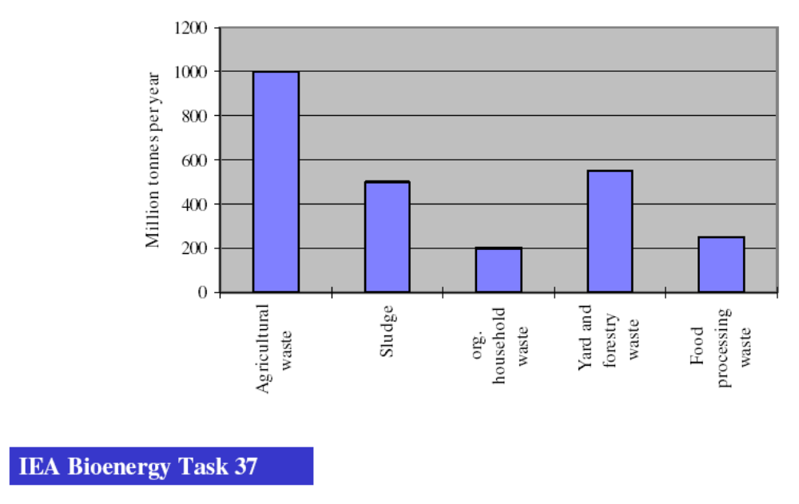

Byproducts and biowastes types and amounts produced in Europe
Source: Eur. Fed.Biotechnol
Convert the wastes into added value products: bioplastics
International Conference and Exhibition on August 10-12,2015 San Francisco, USA
Biopolymers and Bioplastics

Slide 3
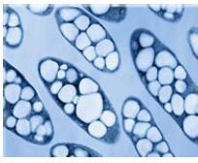
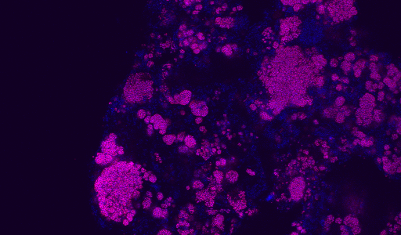
Production of PHA
Pure Microbial Cultures
Mixed Microbial Cultures (MMCs)
High efficiency
Expensive Feedstocks
Need for sterility and restrict control
High energy consumption
High investment costs
Surplus/waste-based feedstocks
Non sterile conditions-less energy consumption
Economically competitive
International Conference and Exhibition on August 10-12,2015 San Francisco, USA
Biopolymers and Bioplastics

Slide 4
Selection of PHA storing MMC
Engineering microbial consortia (“survival of the fittest”)
Aim: Engineering the ecosystem rather than individual organisms through the ecological selection principles
Selection of a MMC with high PHA-accumulating ability occurs naturally due to the applied operational conditions – selective pressure
Substrate
Selective
Pressure
m.o. unable of using the substrate
m.o. able of using the substrate
m.o. able of using the substrate and accumulating PHA
International Conference and Exhibition on August 10-12,2015 San Francisco, USA
Biopolymers and Bioplastics

Slide 5
Selective Pressure: Feast & Famine Regime -FF
Famine
Feast
Famine
Biomass
Substrate, PHA, Biomass
PHA
Carbon
Substrate
0
Time after pulse feeding
Long famine period
Pulse feeding – carbon excess (feast)
External substrate exhaustion (famine)
Polymeric reserves (PHA) used for growth and cellular maintenance
Competitive advantage of PHA-accumulating microorganisms (survival and growth during famine)
International Conference and Exhibition on August 10-12,2015 San Francisco, USA
Biopolymers and Bioplastics

Slide 6
PHA production by MMCs
PHA production involving MMCs are commonly operated in three-stages:
Acidogenic fermentation of the organic carbon to produce mixtures of short chain fatty acids (SCFAs) – the precursors for PHA biosynthesis;
Culture selection, where microorganisms are selected based on PHA storage ability;
PHA production, where the selected microorganisms accumulate PHA up to the culture’s maximum capacity.
Organic byproducts and wastes
Anaerobic Stage
Acidogenic fermentation
SCFA-rich stream
SCFA-rich stream
selection Stage
Production of biomass with high storage ability
Enriched biomass with high storage ability
Accumulation Stage
PHA accumulation (fed-batch mode)
Biomass with high PHA content
To PHA extraction
International Conference and Exhibition on August 10-12,2015 San Francisco, USA
Biopolymers and Bioplastics

Slide 7
Project EuroPHA case study
Main goals:
Reduce the production costs of PHA biopolymers, using low cost feedstocks and mixed microbial cultures (MMCs).
Expand PHA applications as 100% compostable food packaging bioplastic.
Assessment of potential agro-food waste/surplus for PHA production :
- Selection of feedstock (acidogenic tests, availability/market information);
Maximise the PHA production using selected agro-food wastes; obtain a defined PHA precursors profile for food packing applications:
    - Optimization of fermentation to produce HB (acetate, butyrate and ethanol) and HV
    (propionate, valerate, lactate) precursors with a % of 85:15 (HB:HV);
    - Selection of eficient PHA storing cultures with fermented feedstock;
- Maximizing PHA accumulation capacity of selected culture;
International Conference and Exhibition on August 10-12,2015 San Francisco, USA
Biopolymers and Bioplastics

Slide 8
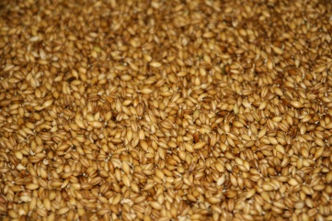
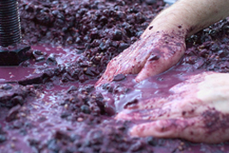
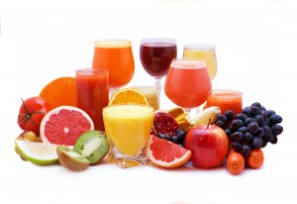
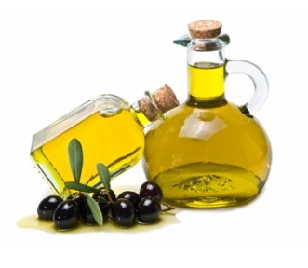
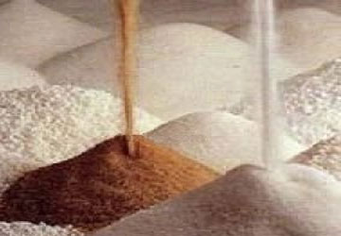
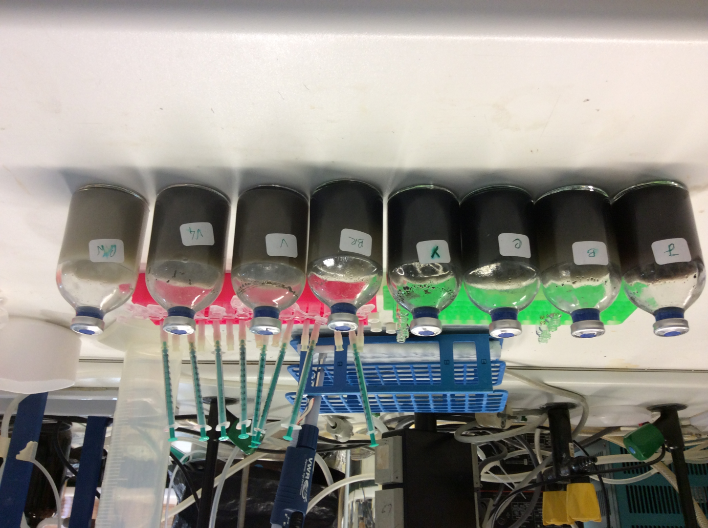
Feedstock selection
12 agro-food wastes (wine, fruit juice, beer, sugar, olive oil);
Batch Acidogenic tests
100-mL rubber sealed serum flasks ;
80 mL of feedstock, supplemented with nitrogen and a phosphorus;
20 mL anaerobic sludge;
4 days, 220 rpm, 30°C;
International Conference and Exhibition on August 10-12,2015 San Francisco, USA
Biopolymers and Bioplastics

Slide 9
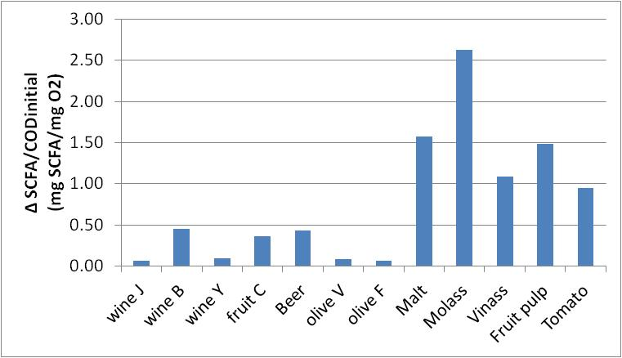
Feedstock selection
Malt, molasses, vinasses, fruit pulp and tomato pulp gave the highest SCFA production;
All non-seasonal;
Results of acidogenic fermentation
Malt is a solid (requires pre-treatment);
Beetroot molasses has market value;
Short chain fatty acids (SCFA): Acetate+Propionate+Butyrate+Valerate+Lactate
Feedstock selected-Waste fruit pulp
-Around 200Ton/year are discharged
by the Portuguese industry
International Conference and Exhibition on August 10-12,2015 San Francisco, USA
Biopolymers and Bioplastics
Notes:
le.

Slide 10
Acidogenic fermentation
Impact of pH on the acidogenic fermentation:
two acidic values (pH 5 and 6) , which have more commonly been used to hamper methanogenesis.
one alkaline (pH 10), which was claimed to enable a higher degree of hydrolysis in some feedstocks.
International Conference and Exhibition on August 10-12,2015 San Francisco, USA
Biopolymers and Bioplastics

Slide 11
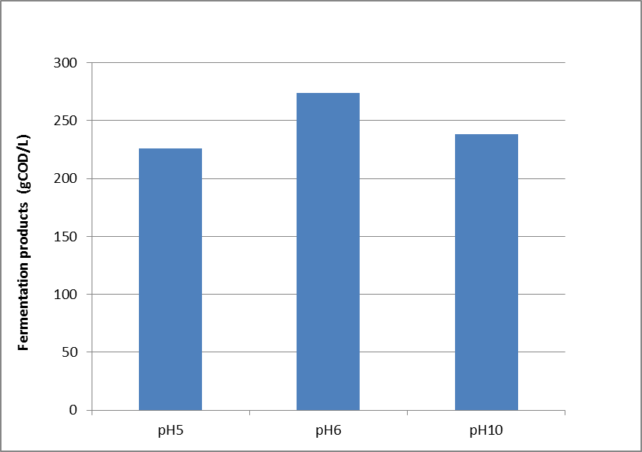
Acidogenic optimization
pH batch tests
 | Acidification degree (%) | FP production rate (g COD/L.h)
pH 5 | 76 | 4.76
pH 6 | 92 | 6.44
pH 10 | 80 | 4.78
The higher fermentation rates were obtained at pH 6
International Conference and Exhibition on August 10-12,2015 San Francisco, USA
Biopolymers and Bioplastics

Slide 12
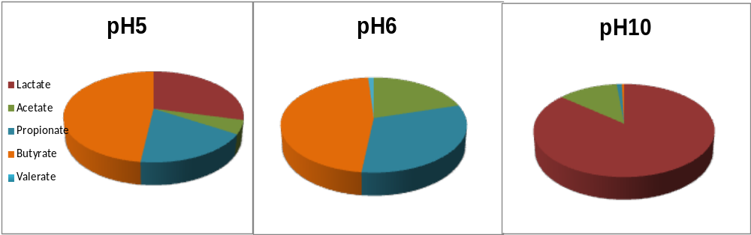
Acidogenic optimisation
pH batch tests
The profile of SCFAs at pH 10 is less interesting since it will give almost an homopolymer (HV);
pH 5 and 6 will give a copolymer (HB:HV);
International Conference and Exhibition on August 10-12,2015 San Francisco, USA
Biopolymers and Bioplastics
Notes:
Looking into the acids profile obtained we observe that a pH between 5 and 6 seems to be adequate to obtain the PHA composition defined for food applications. Using pH 10 the profile of fatty acid is less interesting, since will give an homopolymer.
With those results, we select a pH value of 5.5 to operate the acidogenic reactor.

Slide 13
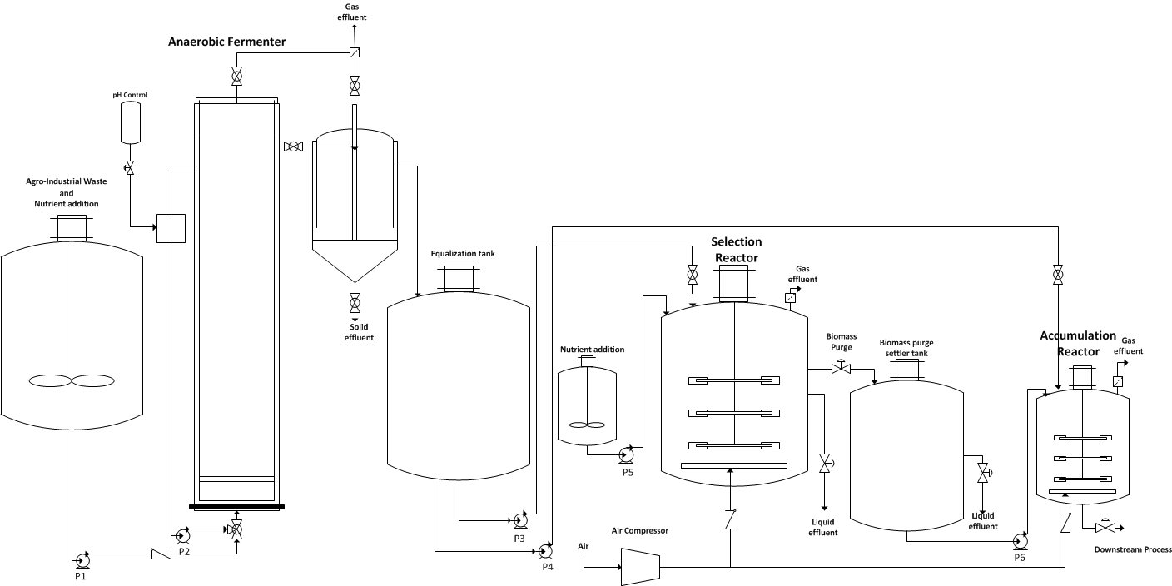

Three-stage PHA production process-Pilot scale
Carbon conversion into organic acids+ethanol
Anaerobic Bioreactor
PHA-accumulating MMC selection under FF regime
Aerobic Bioreactor
PHA production
Aerobic Bioreactor
International Conference and Exhibition on August 10-12,2015 San Francisco, USA
Biopolymers and Bioplastics

Slide 14
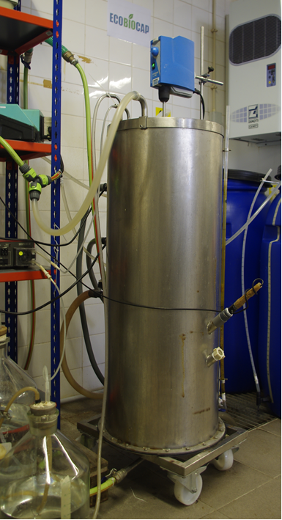
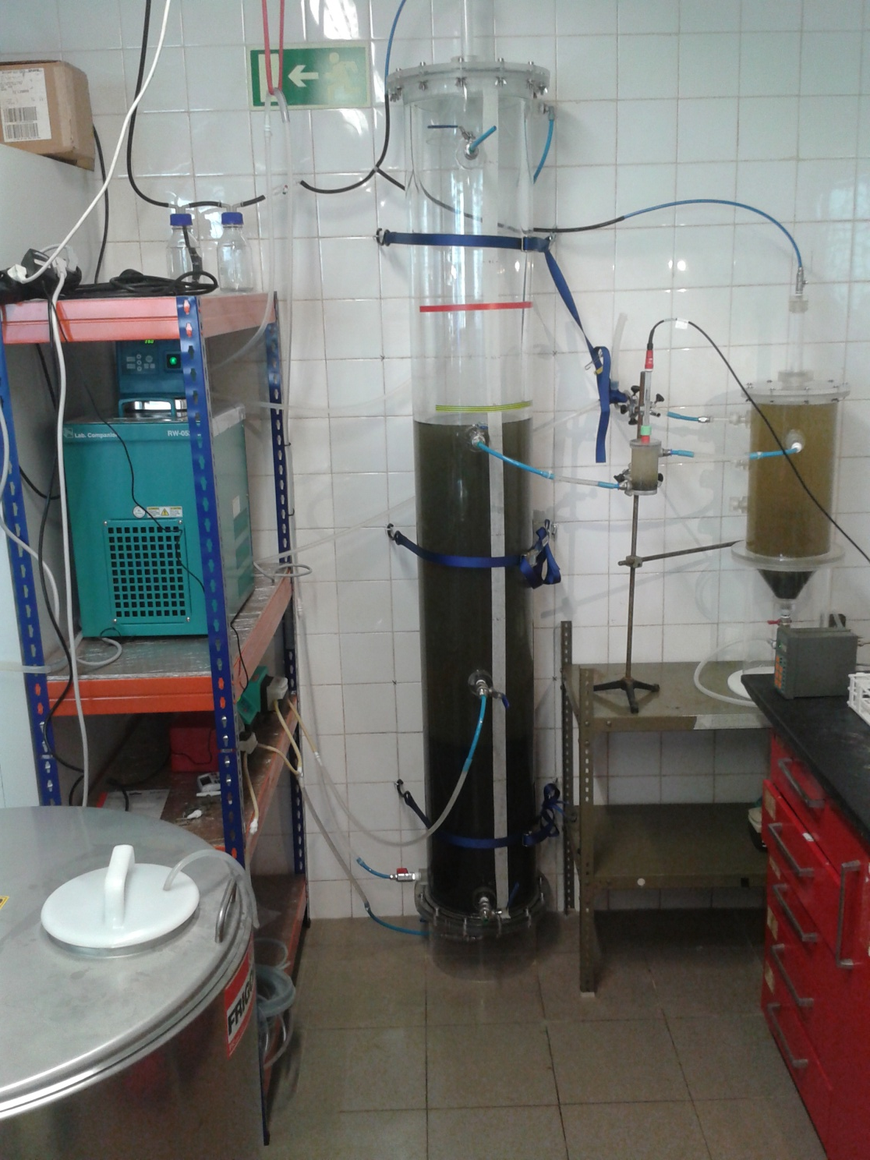
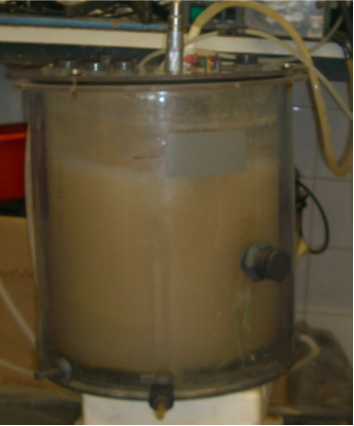
Three-stage PHA production process-Pilot scale
STR 20 L reactor
UASB 100 L reactor
SBR 100 L reactor
International Conference and Exhibition on August 10-12,2015 San Francisco, USA
Biopolymers and Bioplastics

Slide 15
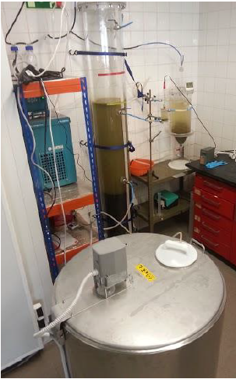
Acidogenic Fermentation
Feedstock:
• Waste fruit pulp (Sumol+Compal, Portugal)
- Sugar content: 200g/L
- Solids content: 80g/L
Inoculum:
  • Excess granular sludge from a full scale anaerobic digestor.
Upflow Anaerobic Sludge Blanket (UASB):
•working volume 65 L bioreactor
•External Decanter
•Constant OLR (20±2 gCOD/L.d) and HRT (1d) •Controlled T (30ºC) and pH (6.0)
International Conference and Exhibition on August 10-12,2015 San Francisco, USA
Biopolymers and Bioplastics

Slide 16
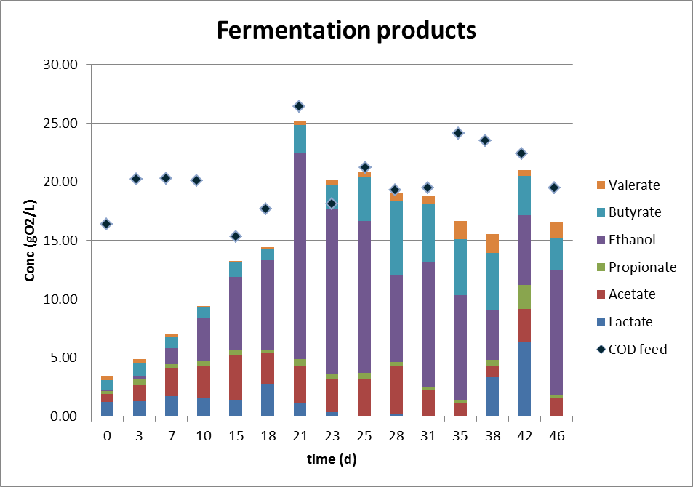
Acidogenic operation
Continuous operation
UASB reactor is suitable for fermentation of waste fruit pulp
High degree of fermentation (> 90%) was obtained
Fermentation products profile and concentration were almost stable after 20 days of startup
International Conference and Exhibition on August 10-12,2015 San Francisco, USA
Biopolymers and Bioplastics

Slide 17
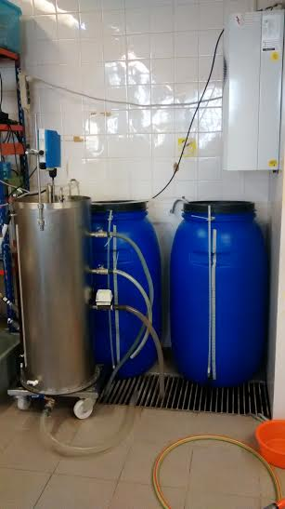
Selection of PHA storing organisms
Feedstock:
•Fermented waste fruit pulp (Cmol%: lactate 9; acetate 16; propionate 3; ethanol 46; butyrate 21; valerate 4)
Inoculum:
• Sludge from the recirculation line at Mutela’s WWTP in Lisbon.
Sequencing Batch Reactor (SBR):
•100 L bioreactor
•HRT(1d), SRT (4d) and OLR (50 Cmmol L⁻¹d⁻¹)
•T (20-22ºC) and pH (8.0-9.0)
  • C|N|P ratio (100|6.5|1)
International Conference and Exhibition on August 10-12,2015 San Francisco, USA
Biopolymers and Bioplastics

Slide 18
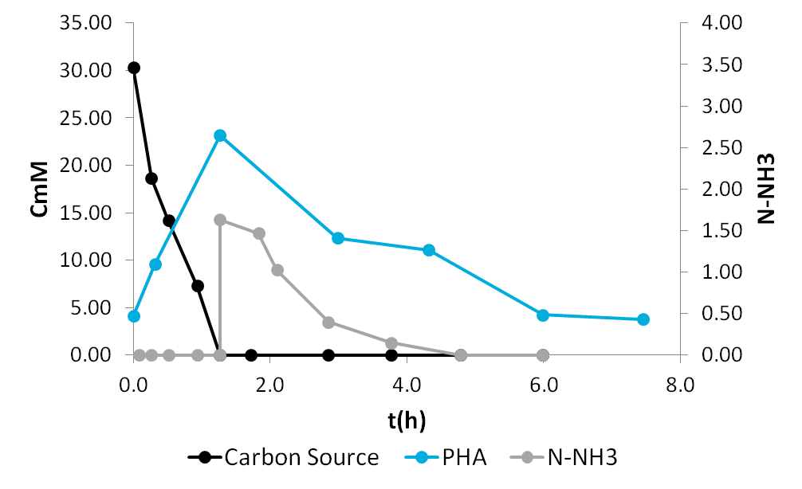
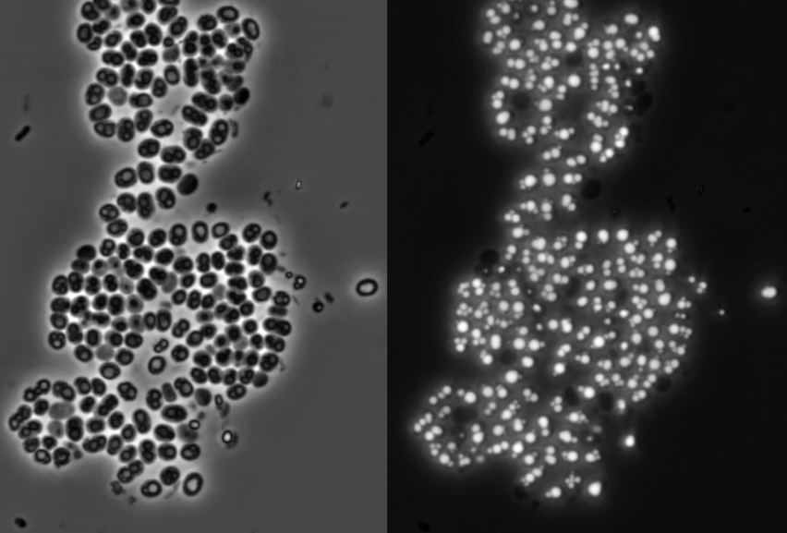
Selection stage
Microscopy photographs (100x) of selected biomass in contrast phase (left), and under UV light with Nile Blue dye (right).
Feast and famine cycle
The selected biomass was highly enriched in PHA storing organism resulting in a high PHA yield:
Y(CmolPHA/CmolS)
0.85±0.18
International Conference and Exhibition on August 10-12,2015 San Francisco, USA
Biopolymers and Bioplastics

Slide 19
PHA accumulation stage
Feedstock:
•Fermented waste fruit pulp (Cmol%: lactate 9; acetate 16; propionate 3; ethanol 46; butyrate 21; valerate 4)
Fed-batch reactor:
• 10 L bioreactor
• Continuous aeration and mixing (250 rpm)
• T (20-22ºC ) and pH (8.5)
• Pulse wise feed was controlled by DO response. Carbon depletion is detected by an abrupt decrease in oxygen uptake rate (OUR).
International Conference and Exhibition on August 10-12,2015 San Francisco, USA
Biopolymers and Bioplastics

Slide 20
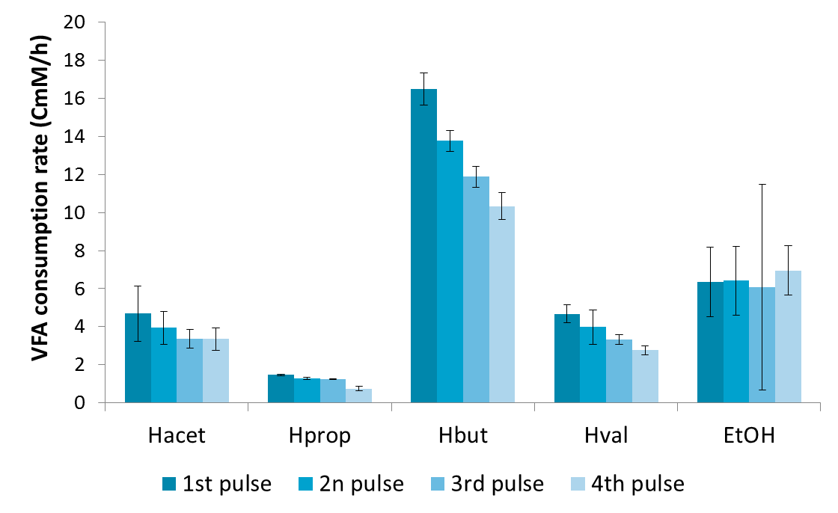
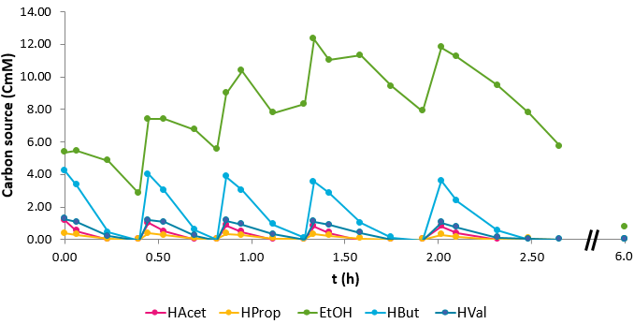
PHA accumulation stage
Profile of FPs during fed-batch operation
FPs consumption rates during fed batch operation
Butyric acid is consumed at higher rate
Rate of ethanol consumption increases after exhaustion of the VFAs
International Conference and Exhibition on August 10-12,2015 San Francisco, USA
Biopolymers and Bioplastics

Slide 21
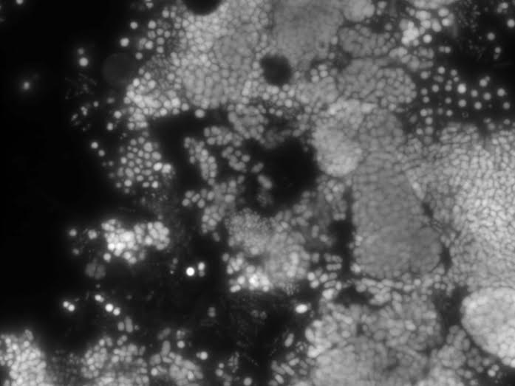
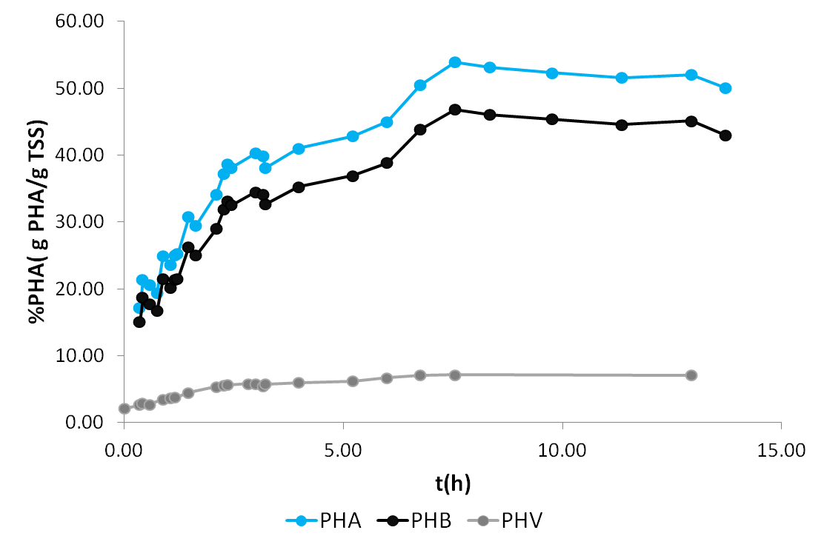
PHA accumulation stage
% PHA = 54%
Selected biomass under UV light with Nile Blue staining.
Polymer composition: 86:14 (HB:HV)
International Conference and Exhibition on August 10-12,2015 San Francisco, USA
Biopolymers and Bioplastics

Slide 22
PHA accumulation stage
Y(PHA/S) Cmol basis | Y(PHA/S) COD basis | Specific Production rate Cmmol.Cmmol X⁻¹h⁻¹ | Productivity g PHA L⁻¹ h⁻¹
0.79±0.11 | 0.53±0.03 | 0.184±0.025 | 0.301±0.023
The composition of the polymer obtained (86:14 HB:HV) was consistent with that intended for the purpose of the project.
Maximum PHA content : 54%
International Conference and Exhibition on August 10-12,2015 San Francisco, USA
Biopolymers and Bioplastics

Slide 23
Conclusions
Waste fruit pulp is an interesting feedstock for PHA precursors production.
The UASB reactor is suitable for fermentation of waste fruit despite the high solids content.
Efficient PHA storing culture was selected with fermented fruit pulp.
High PHA accumulation yields were obtained with fermented fruit pulp (despite the high ethanol concentration).
The polymer composition has adequate HB:HV content for food packaging applications.
International Conference and Exhibition on August 10-12,2015 San Francisco, USA
Biopolymers and Bioplastics

Slide 24



Aknowledgments
EuroPHA is supported by the European Commission under the Grant Agreement FP7-604770.
SFRH/BD/104767/2014, Fundo Social Europeu and Fundos Nacionais do MEC
International Conference and Exhibition on August 10-12,2015 San Francisco, USA
Biopolymers and Bioplastics

