Slide 1
The role of endothelial biomarkers in breast cancer metastasis
Maria Walczak, PhD, Assoc. Prof.
Chair and Department of Toxicology, Faculty of Pharmacy
Jagiellonian University Medical College, Krakow, Poland
Jagiellonian Centre for Experimental Therapeutics (JCET)
Jagiellonian University, Krakow, Poland

Slide 2
The significance of the problem…
Breast cancer is one of the most common tumors and a leading cause of death among women.
The early diagnosis and the effective treatment of breast cancer is still out of success.
Murine models of breast cancer in order to more precisely understand the mechanisms of cancer development and formation of cancer metastases.
The importance of the endothelial biomarkers as a novel risk factors, diagnostic and prognostic markers in the metastatic niche formation.

Slide 3
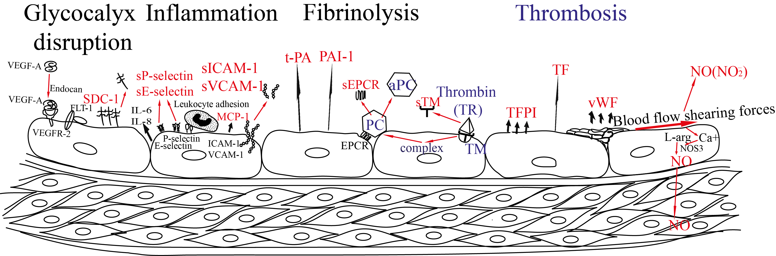
PROCOAGULANT
Endothelium
ANTICOAGULANT
60 trillion cells; surface area of 4000 – 7000 m²
Walczak M et al. Towards a comprehensive endothelial biomarkers profiling and endothelium-guided pharmacotherapy. Pharmacol Rep. 2015;67(4):771-7.

Slide 4
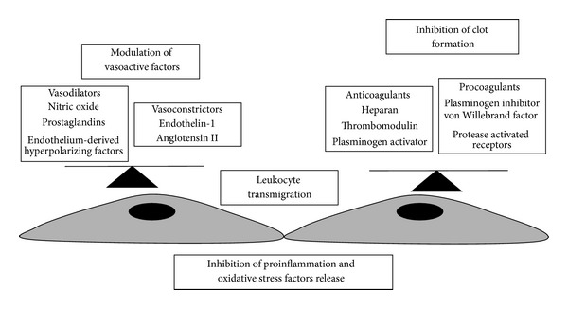
Endothelial functions
Gaia Favero et al. BioMed Research International 2014, 801896.

Slide 5
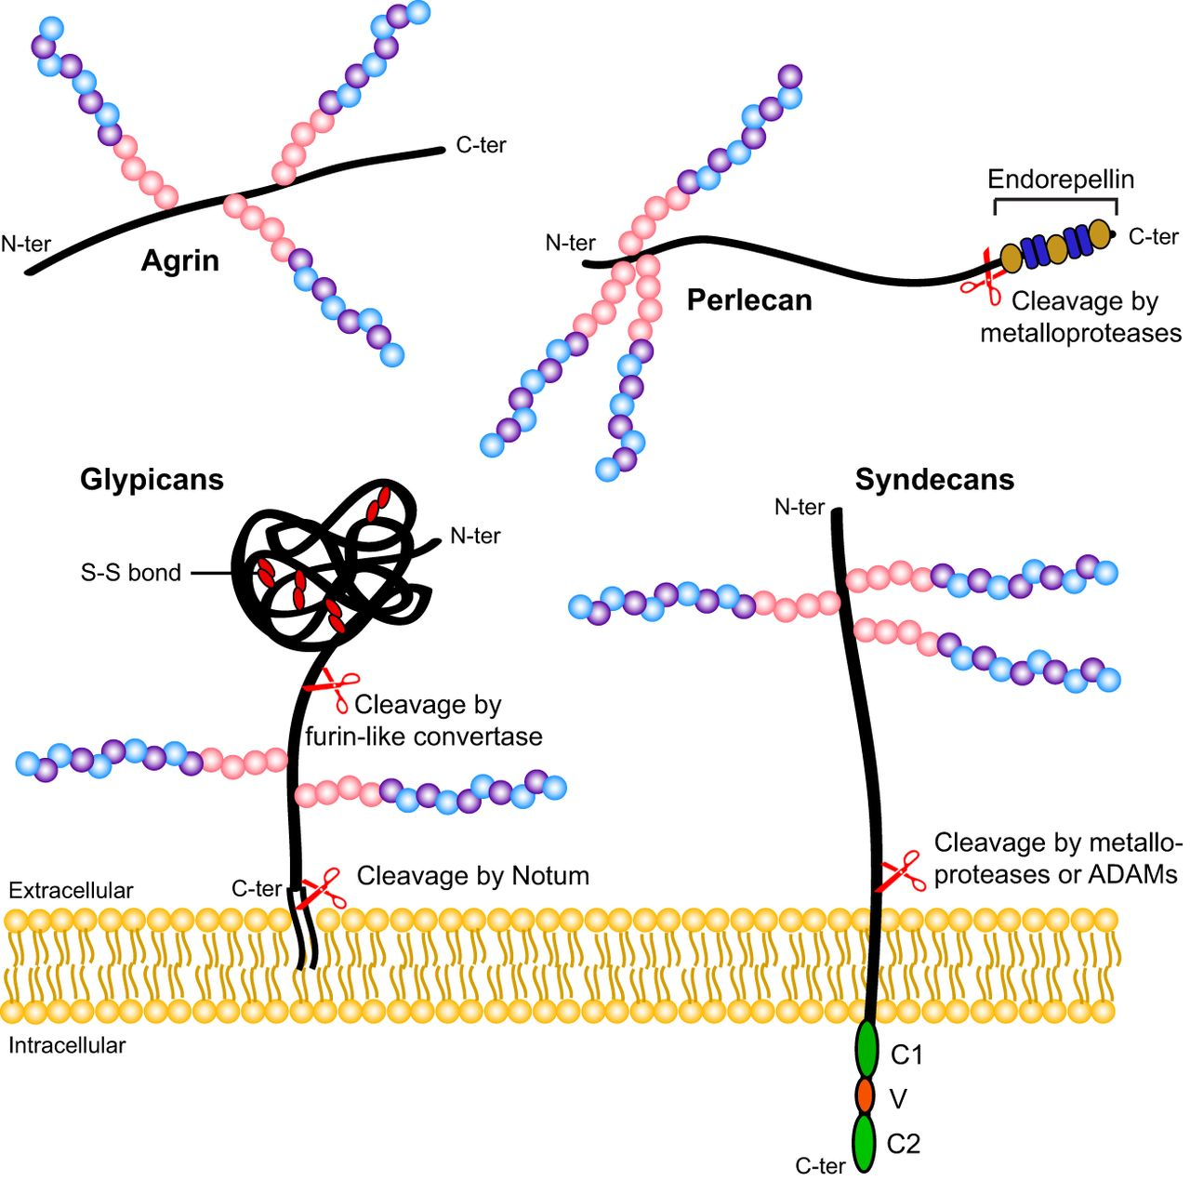
Syndecan-1 (SDC-1)
Glycocalyx dysruption
negatively charged surface:
proteoglycans
glycosaminoglycans
glycoproteins
20 – 3000 nm
VEGF
TGF
FGF2
Fibronectin
Antithrombin-1
heparan sulfate
Fabienne E. Poulain et al. Development 2015, 142: 3456-3467.

Slide 6
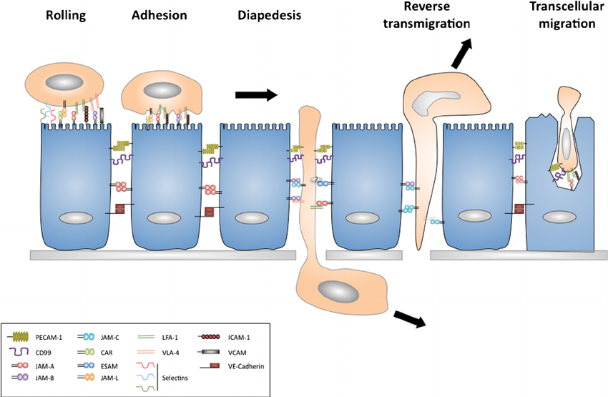
Inflammation
leucocyte movement
E-selectin, P-selectin, VCAM-1, ICAM-1
Sarah Garrido-Urbani et al. Cell and Tissue Research 2014, 355(3).

Slide 7
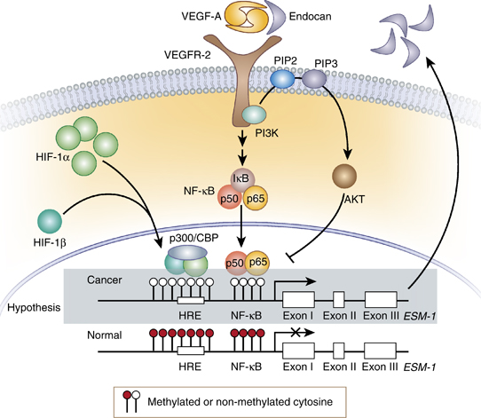
Endocan (ESM-1)
soluble form of dermatan sulfate proteoglycan
http://www.ncbi.nlm.nih.gov/pubmed

Slide 8
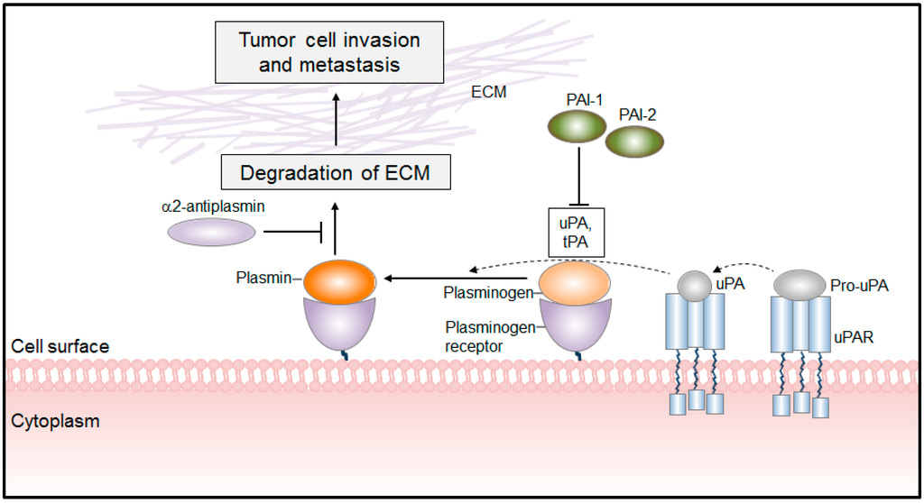
t-PA and PAI-1
Fibrinolysis and thrombosis
Miroslava Didiasova Int. J. Mol. Sci. 2014, 15(11), 21229-21252.

Slide 9
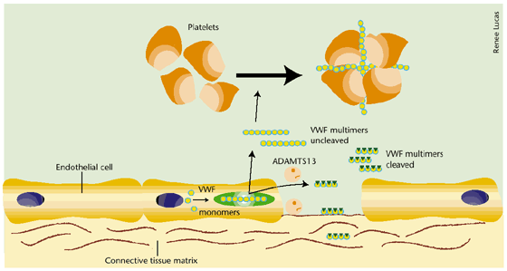
vWF
Lawrence Brass: Nature Medicine 2001, 7, 1177 – 1178.

Slide 10
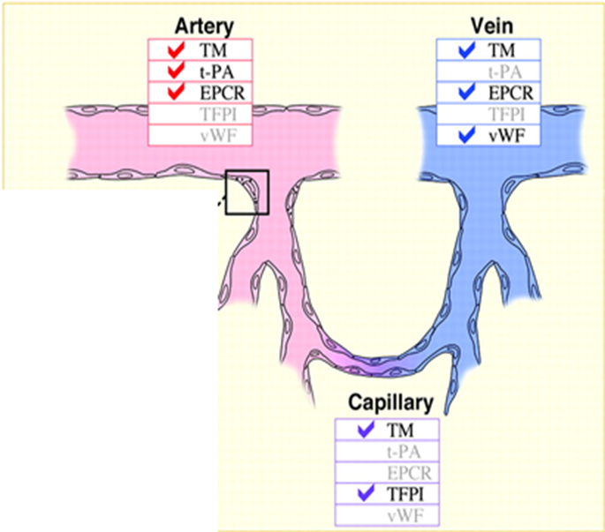
Endothelial cell heterogeneity
Protein | Type of vessels
vWF | veins/liver capillaries
TFPI | capillaries/liver capillaries
EPCR | veins/arteries
t-PA | arteries/lung capillaries
TM | arteries/veins/capillaries
ESM-1 | lung, kidney, gastrointestinal tract, tumor endothelium
TR | lung capillaries
William C. Aird: J Thromb Haemost 2005, 3:1392-1406.

Slide 11
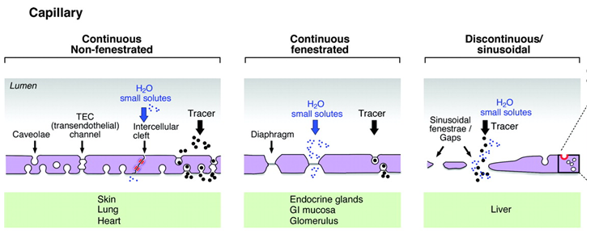
Endothelial permeability
arteries, veins
William C. Aird: Circulation Research. 2007, 100:158-173.

Slide 12
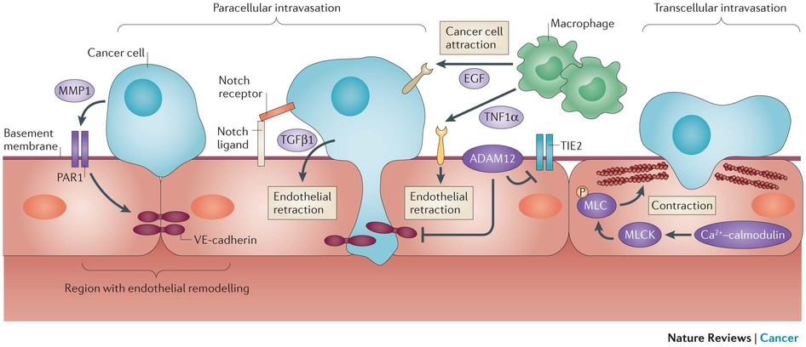
Endothelial cells and cancer
Nicolas Reymond: Nature Reviews Cancer 2013, 13, 858–870.

Slide 13
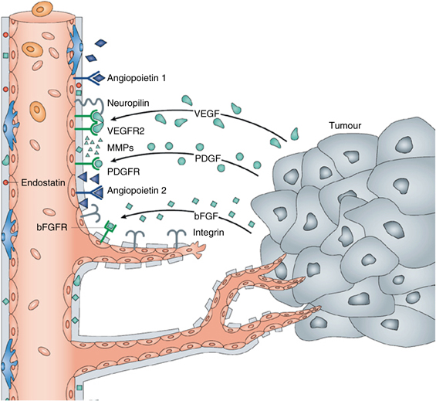
Tumour – Endothelial Cell Communication
Bruno M. Lopes-Bastos: ANTICANCER RESEARCH, 2016, 36: 1119-1126.

Slide 14
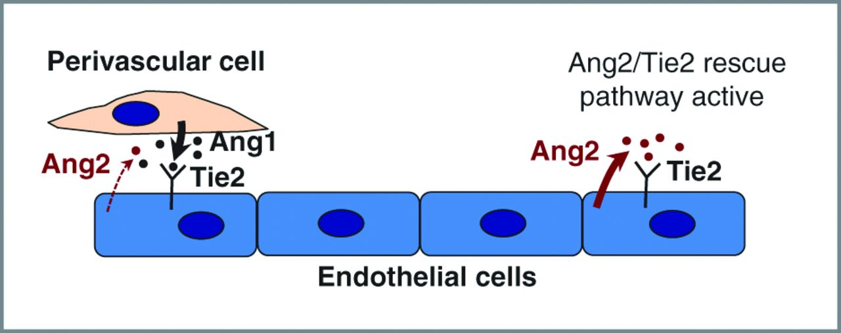
Angiopoietin-2
Christopher Daly et al.: Cancer Research 2013, 10.1158/0008-5472.

Slide 15
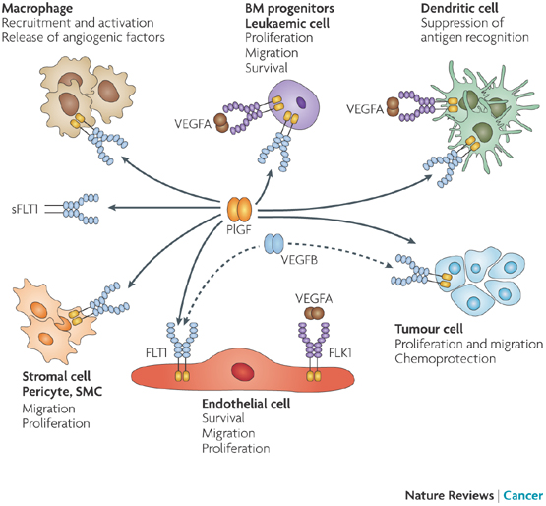
sFLT-1 (soluble form fms-like tyrosine kinase 1)

Slide 16
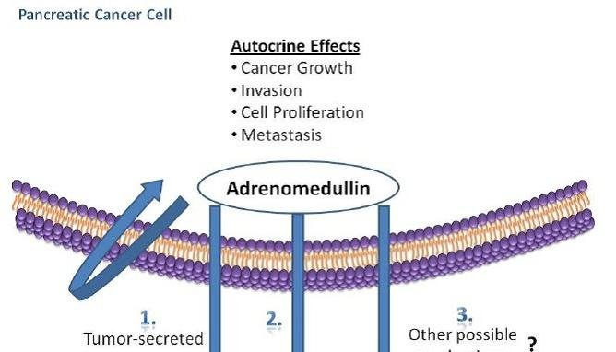
Adrenomedullin
calcitonin gene-related peptide (CGRP) and amylin
Nikitenko L. et al.: British Journal of Cancer 2006, 94(1), 1 – 7.

Slide 17
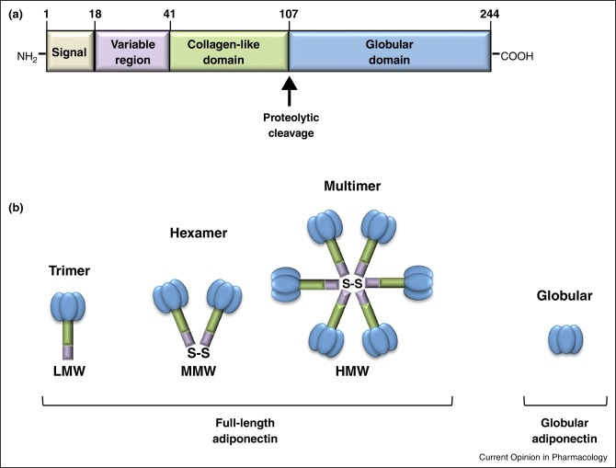
Adiponectin
- obesity
metabolic syndrome
insulin resistance
type 2 diabetes
coronary heart disease
Inflammation
several types of cancer
Maria Luisa Panno et al.: Current Opinion in Pharmacology 2016, 31, 1–7.

Slide 18
Endothelial biomarkers in disease diagnosis
Biomarker | Disease | Concentration
 |  | Healthy volunteers | Disease
sICAM-1 [ng/mL] | Metabolic syndrome | 546 ± 130 (n=237) | 612 ± 173 (n=71)
 | Peripheral arterial disease | 174.9 ± 36.3 (n=74) | 265.5 ± 65.5 (n=78)
sVCAM-1 [ng/mL] | Metabolic syndrome | 709 ± 327 (n=136) | 819 ± 411 (n=73)
 | Kidney transplant | 449 ± 18 (n=50) | 1495 ± 107 (n=52)
 | Type 1 diabetes | 518 ± 151 (n=64) | 661 ± 215 (n=155)
PAI-1 [ng/mL] | Metabolic syndrome | 56 ± 36 (n=136) | 83 ± 48 (n=73)
 | Sepsa | 25.3 (17.6 - 36.8) (n=221) | 76.7 (49.4 - 136) (n=221)
t-PA [ng/mL] | Metabolic syndrome | 3.6 ± 4.4 (n=237) | 5.8 ± 4.8 (n=71)
sE-sel [ng/mL] | Type 1 diabetes | 27.9 ± 14.3 (n=64) | 40.7 ± 20.1 (n=155)
Ang2 [ng/mL] | Sepsa | 2.71 (2.15 - 3.61) (n=45) | 12.44 (8.47 - 33.44) (n=85)
Endocan [ng/mL] | Lang cancer Sepsa | 0.63 ± 0.06 (n=25) 0.77 ± 0.44 (n=20) | 3.34 ± 0.37 (n=50) 2.71 ± 4.88 (n=63)
sFLT-1 [pg/mL] | Sepsa | 41 (31 - 51) (n=221) | 243 (137 - 449) (n=221)

Slide 19
Multi-protein-based microLC/MS-MRM method
Protein | Amino acid sequence mouse/human
sVCAM-1 | GSYSLVEAQK SLEVTFTPVIEDIGK ILETTFIPTIEDTGK
sICAM-1 | LDTPDLLEVGTQQK TFDLPATIPK EITFTVLASR ASVSVTAEDEGTQR ANLTVVLLR
SDC-1 | DEGSYSLEEPK VEGGGTSVIK ETVQLPITQR EGEAVVLPEVEPGLTAR EQEATPRPR
ADN | IFYNQQNHYDGSTGK SAFSVGLETR VTVPNVPIR GDIGETGVPGAEGPR GDPGLIGPK
vWF | HIVTFDGQNFK ISRPIAPIFIR YTLFQIFGK ILAGPAGDSNVVK LSGEAYGFVAR
Protein | Amino acid sequence mouse/human
sE-selektyna | EEINYLNSNLK DYTHLVAIQNK
ADM | ISPQGYGR LAHQIYQLTDK
Angp-2 | DELQVLVSK ISSISQPGSDFSTK DAPLDYDDSVQR
EMS-1 | TSASHTER
PAI-1 | FSLETEVDLR GAVDELTR TPFLEASTHQR
t-PA | DVPGVYTK TNSQALGLGR HEASSPFFSDR
sFLT-1 | VTEEDEGVYR YLPTSTSK YLVHGYSLIIK

Slide 20
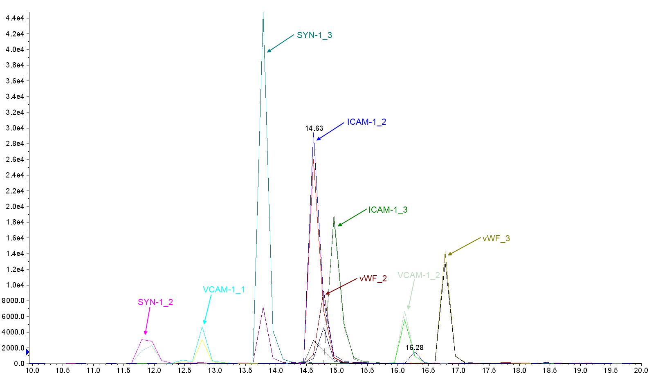
Extracted ion chromatogram in scheduled MRM
Intensity [cps]
Time [min]
microLC Nexera (Shimadzu) coupled to QTRAP 5500 mass spectrometer (ABSciex )

Slide 21
Mouse model of breast cancer (4T1)
orthotopic inoculation of 4T1 breast cancer cells into the mammary fat pad of the immune–competent BALB/c female mice
desease progression in every week throughout the experimental period
plasma, lungs and tumor samples collection 1, 2, 4 and 5 weeks after cancer cells inoculation
measurements: proteins in plasma, lungs and tumors
assessment: body and organ weight, tumor growth, metastastatic and hematological parameters

Slide 22
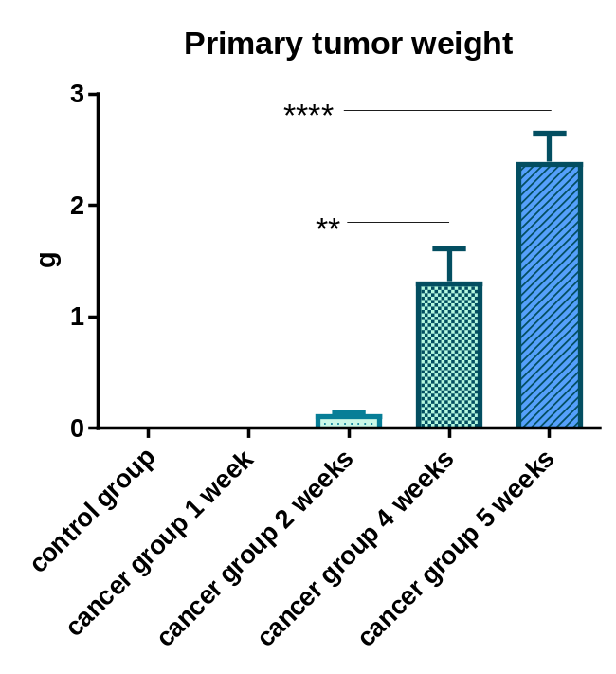
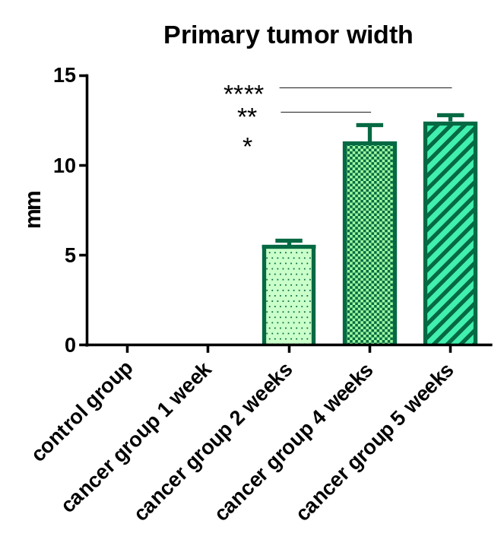
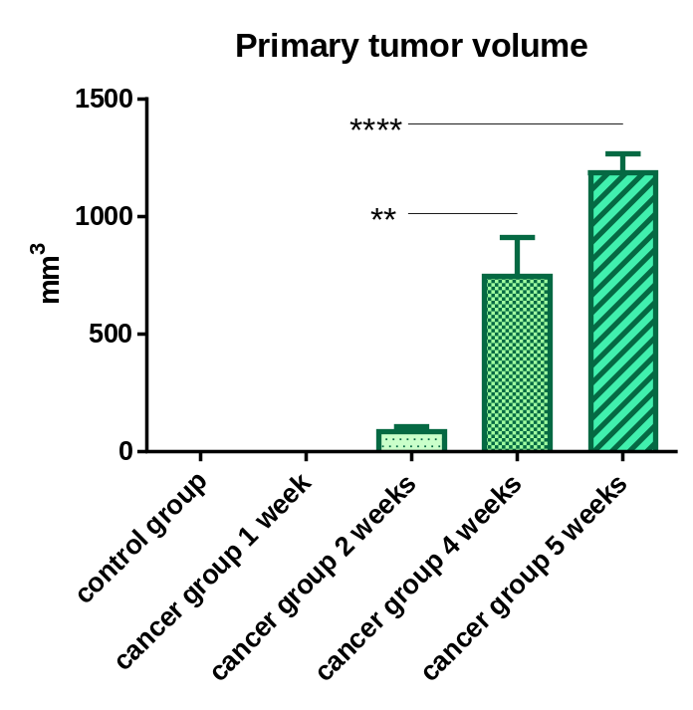
Tumor progression

Slide 23
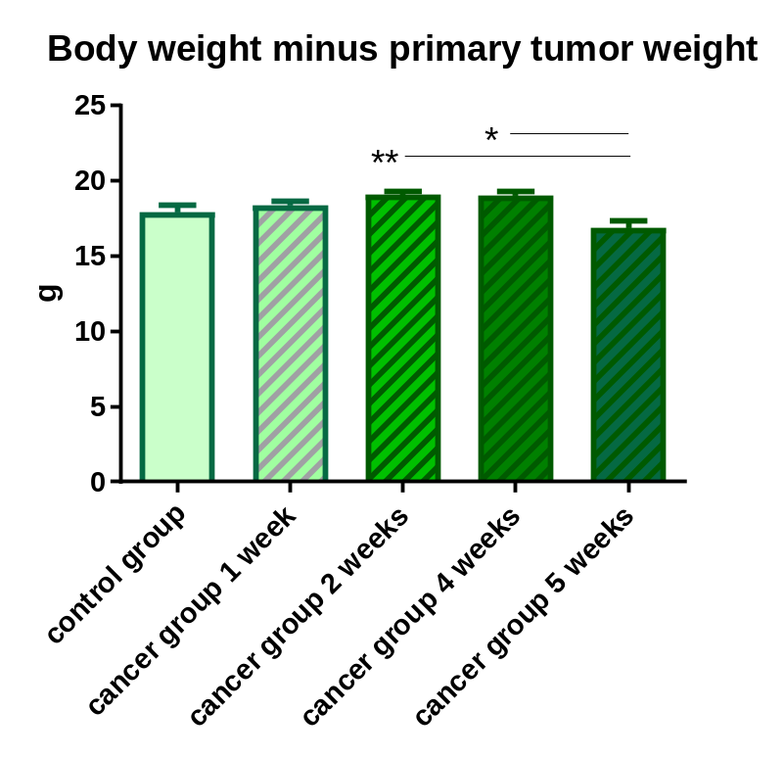
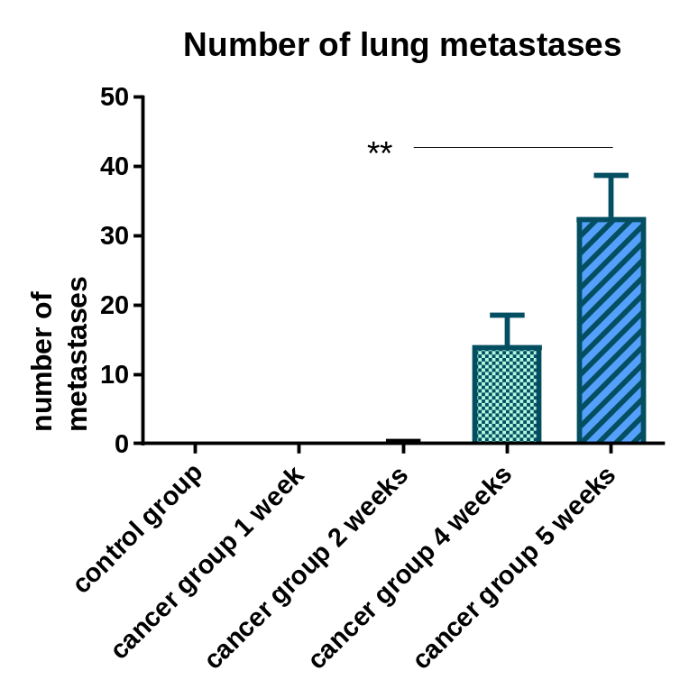
Metastases

Slide 24
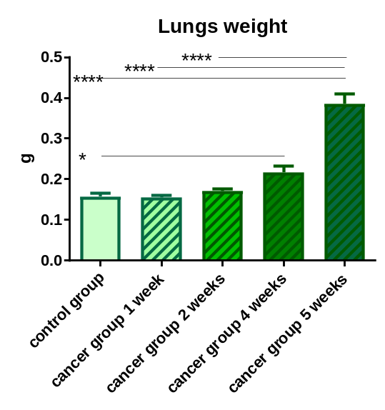
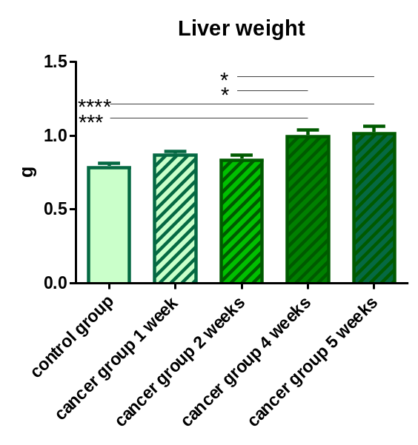
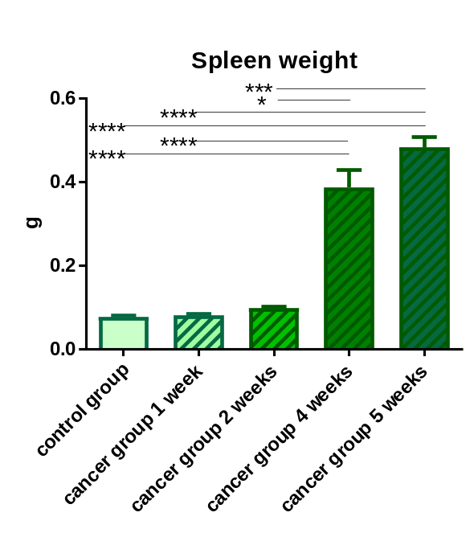
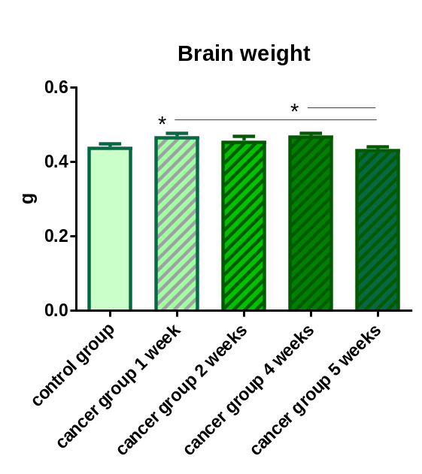
Tissue weight

Slide 25
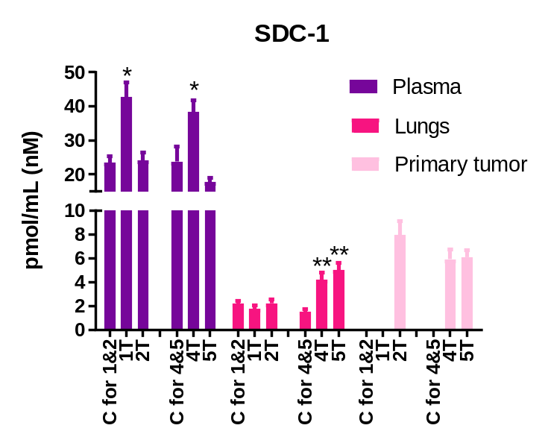
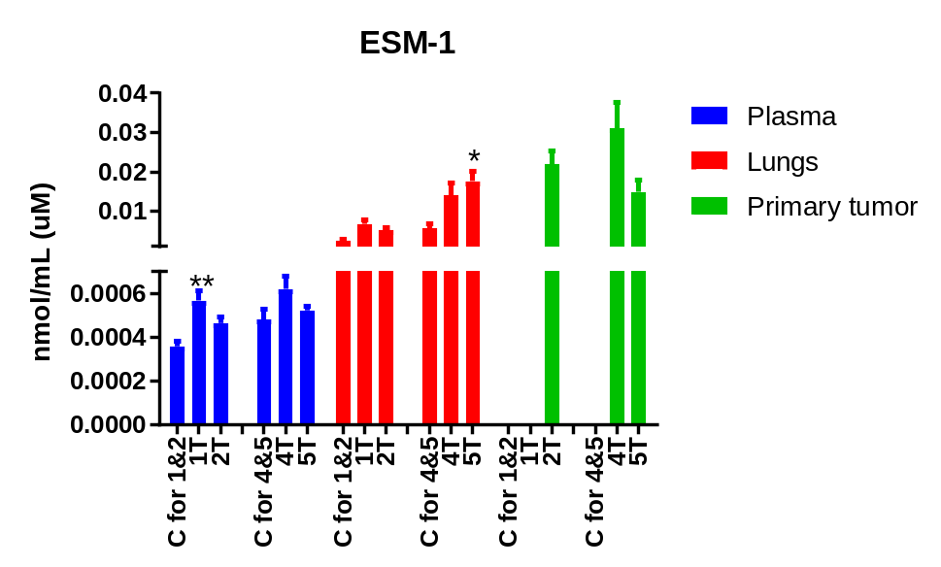
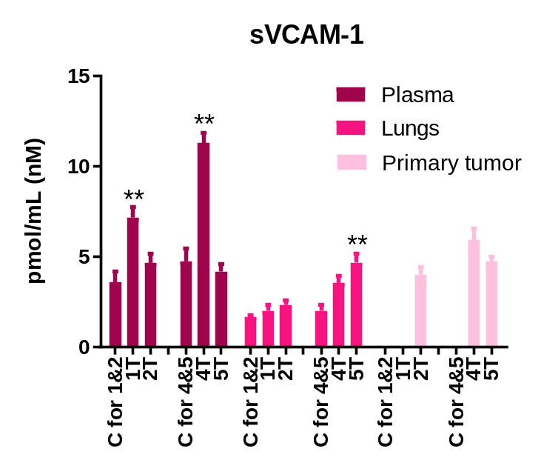
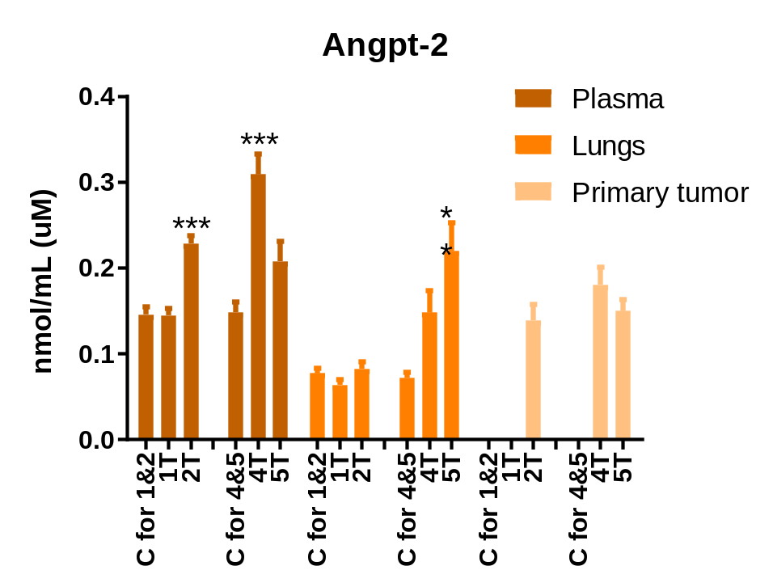
Biomarkers of early metastasis

Slide 26
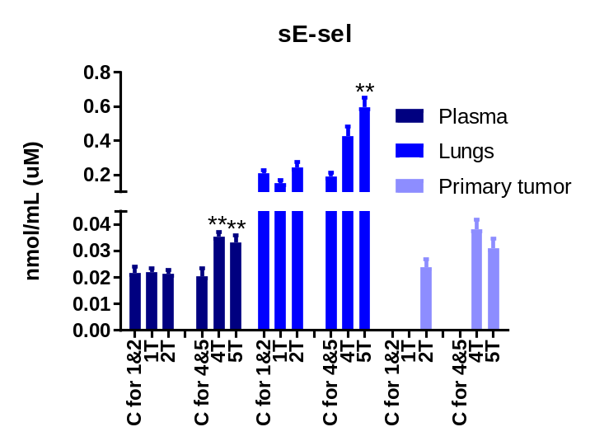
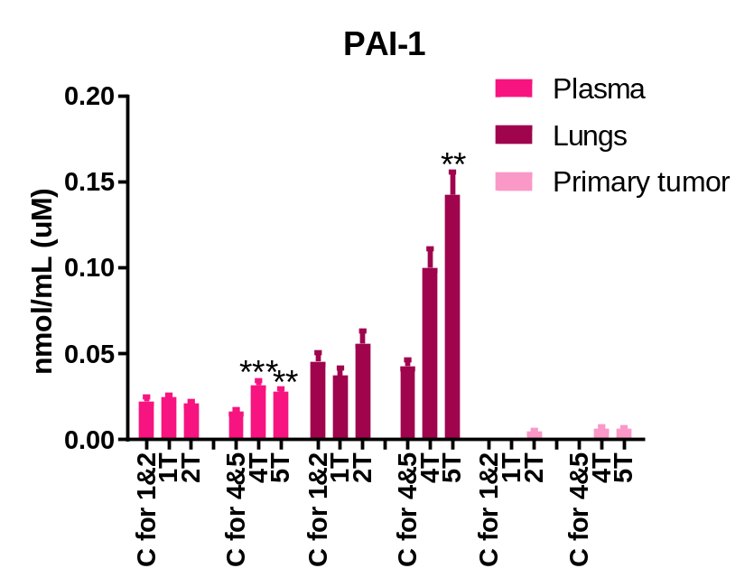
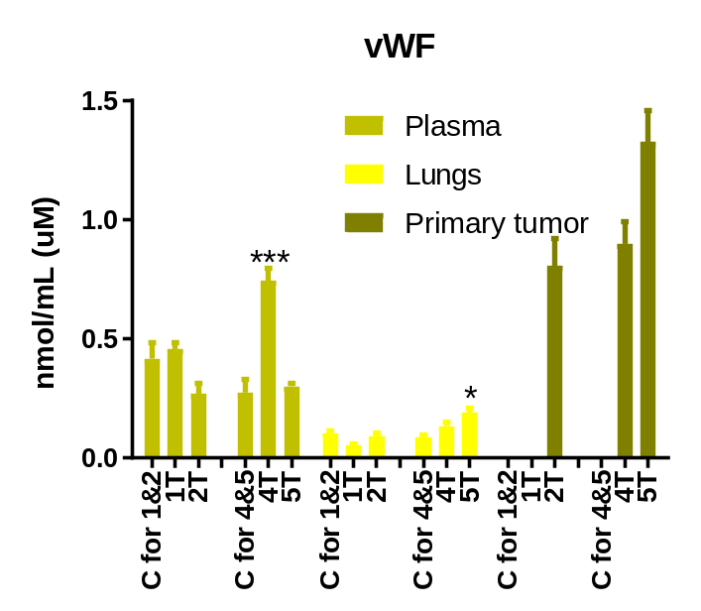
  Biomarkers of late metastasis

Slide 27
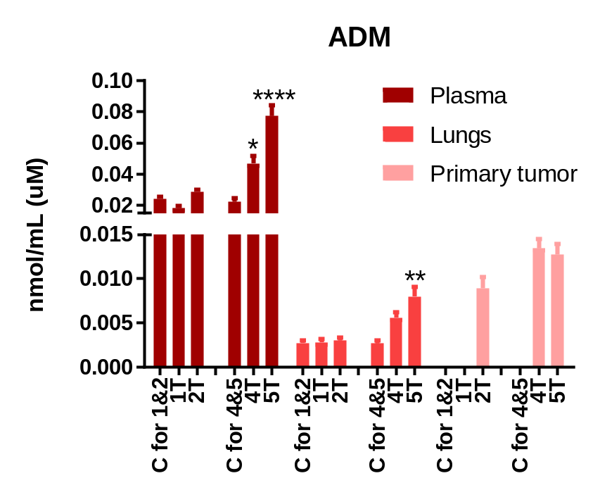
Biomarkers of late metastasis

Slide 28
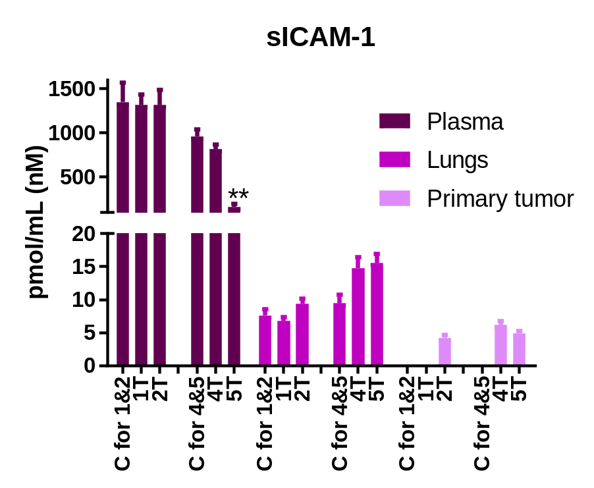
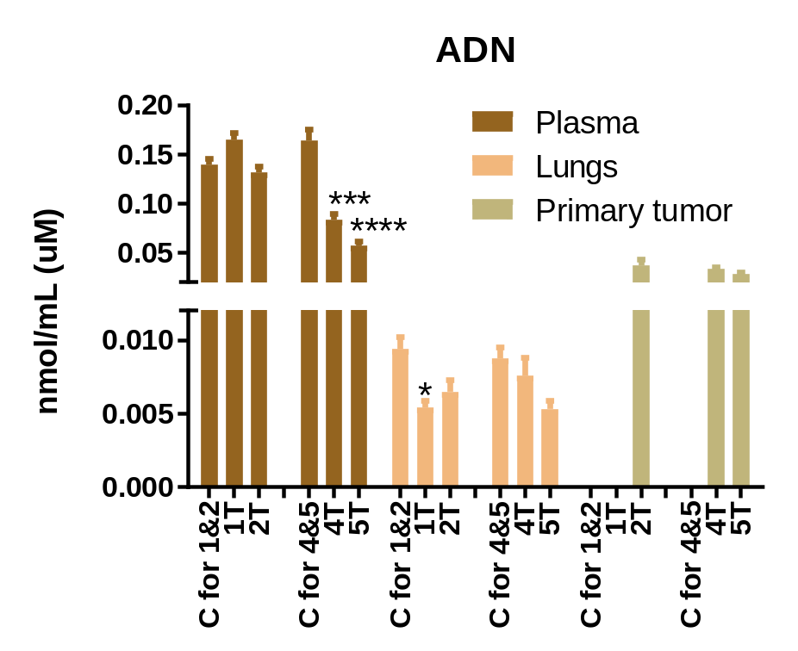
Biomarkers confirming gradual changes

Slide 29
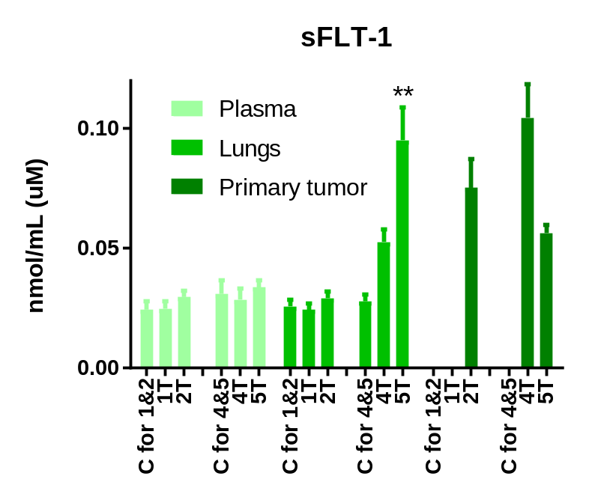
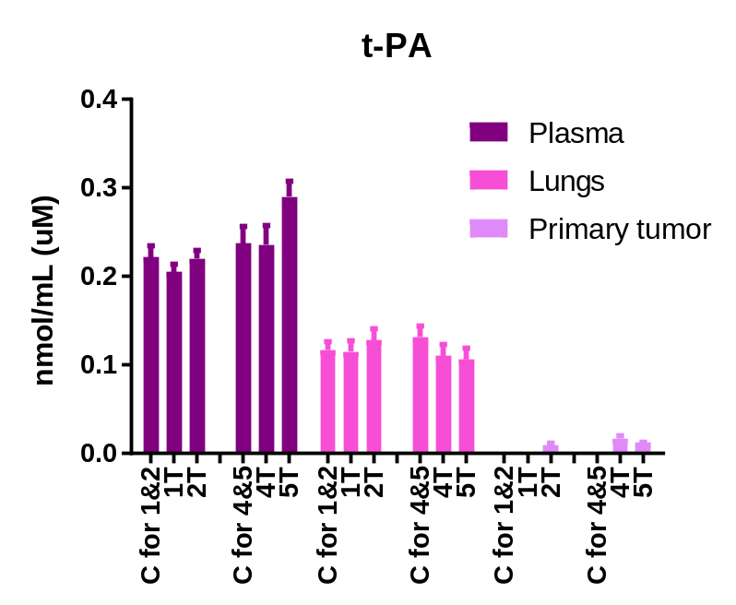
Biomarkers not specific
Legend: C-control group, 1T, 2T, 4T, 5T - groups of tumor-bearing mice in subsequent weeks after tumor cell inoculation; statistically significant changes are marked to respective control group: * p < 0.05, ** p < 0.01, *** p < 0.001, **** p < 0.0001.

Slide 30
Conclusions
The early visible biomarkers fluctuations in plasma confirm the hypothesis that dysfunction of vascular endothelium may be considered as the key step and the condition for further disease progression.
The conducted study revealed that the early metastatic processes start in the 2nd week after tumor cell inoculation.
SDC-1, ESM-1, VCAM-1 and Angp-2 seems to be the early biomarkers for breast cancer metastasis.
Decreased concentration of SDC-1, ESM-1, sVCAM-1, Angp-2, sICAM-1 and vWF in the 5th week of disease may result from the endothelial-mesenchymal transformation.
Due to the complexity of cancer metastasis, involving many mediators, more reasonable solution for disease diagnosis is to apply the multi-protein panel instead of one biomarker.

Slide 31

ACKNOWLEDGMENTS
Joanna Suraj, MSc
Agnieszka Kij, MSc
Agnieszka Zakrzewska, PhD
Kamil Kuś, PhD
Anna Kurpińska, PhD

