Slide 1



Effect of weather variation on Sarda sheep performances
International Conference on
Environmental Health & Safety
October 24-25. 2016 Valencia. Spain
Maria Sitzia
Mauro Decandia, Marco Acciaro, GianMarco Marrosu, Gianpaolo Epifani, Ilaria Peana e Carla Manca
Agris - Agenzia per la Ricerca in Agricoltura - Italy
Arpas –Agenzia Regionale per la Protezione dell’Ambiente della Sardegna
msitzia@agrisircerca.it

Slide 2
The increasing food demand due to the increasing population in the world is pushing the agriculture toward a more intensive production system.
This forces the farming system to intensive management of livestock and crops, which supplies feedstuffs.
Variation in meat, eggs and milk production (%; 2000-2010)
 | Meat |  |  | Eggs | Milk
 | Total | Red* | White**
Africa | 4.4 | 8.8 | 11.2 | 3.5 | 4.9
Asia | 3.2 | 5.6 | 7.5 | 2.8 | 5.1
America | 2.4 | 1.5 | 5.7 | 2.4 | 2.2
Latin America and the Caribbean | 3.7 | 3.2 | 8.2 | 3.6 | 3.4
Northern America | 1.1 | -2.5 | 3.5 | 0.9 | 1.3
Europa | 1.3 | -1.6 | 5.9 | 1.4 | 0.00
Australia and New Zealand | 0.6 | -1.6 | 2.9 | 2.2 | 1.6
Oceania | 0.7 | -0.8 | 3.3 | 2.0 | 1.6
World | 2.6 | 3.9 | 6.5 | 2.5 | 2.7
Read meat = beef and buffalo + sheep and goats;
White meat = pig + poultry
FAO Animal Production and Health Division
(www.fao.org/ag/portal/aga-index/en/)
Notes:
in developing countries of Asia, for example, the meat consumption has been growing by about 3% per annum and that of dairy products by 5% (Fao, Feeding the World,). the request of red meat is decreasing due to its unhealthy image forwarded to the consumers

Slide 3
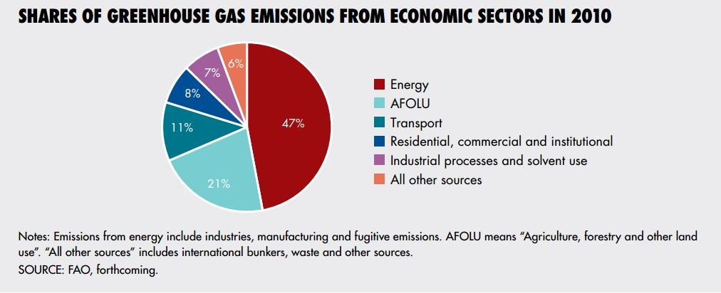
Livestock production is the largest user of agricultural land.
Intensive, large-scale livestock systems, mostly in developed countries but increasingly also in developing regions, are one of the main sources of environmental problems
https://twitter.com/FAOstatistics
GHG Emissions from agriculture are dominated by non-CO₂ gases: methane (CH₄) and nitrous oxide (N₂O) from crop and livestock production and management activities.
Total agricultural emissions are between 4,2 to 5,2 Gt CO₂/year ((Schadere et al., 2015)

Slide 4
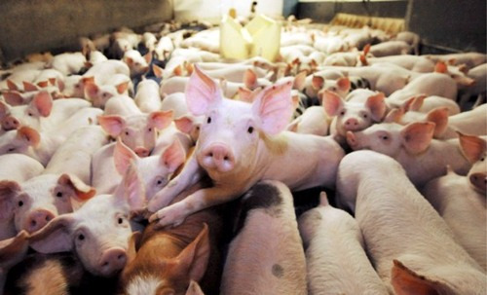
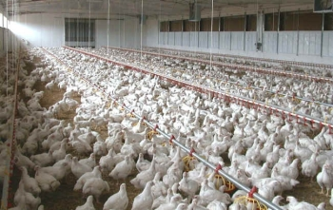
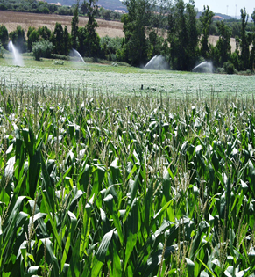
In intensive systems animals are fed with cereals and oil seeds, obtained by high-input cultivations
In particular in poultry or pig feeding systems that have a higher feed conversion per kg of cereal-based ration than ruminants.
In developing countries part of cereals are substitute by oil seeds, in particular by soybean oil and high-protein oil meal.
The inclusion of the cheaper imported soybean meal increase the dependence from the extra - Europe protein sources.
The area that is needed for the production of feed imported into the EU-27 corresponds to about 19 million ha (Von Witzke, Noleppa, S., 2010)

Slide 5
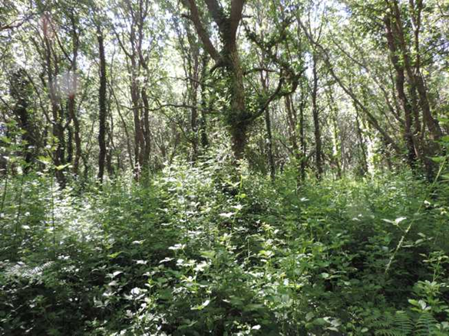
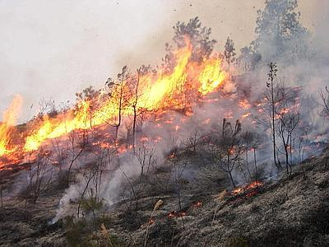
The intensification of the system bring about the simplification of the management
Grazing pasture and legume cultivation are left in favor of the housed system
In the last 50 years, the European Union (EU-15) has lost about the 20% of the total
grassland surface and has abandoned legumes cultivations (Pflimlin, 2013).
The abandonment of rural areas has severe consequences on the preservation of the
environment

Slide 6
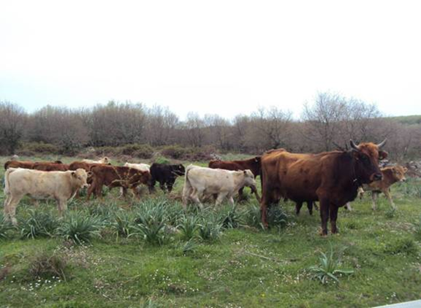
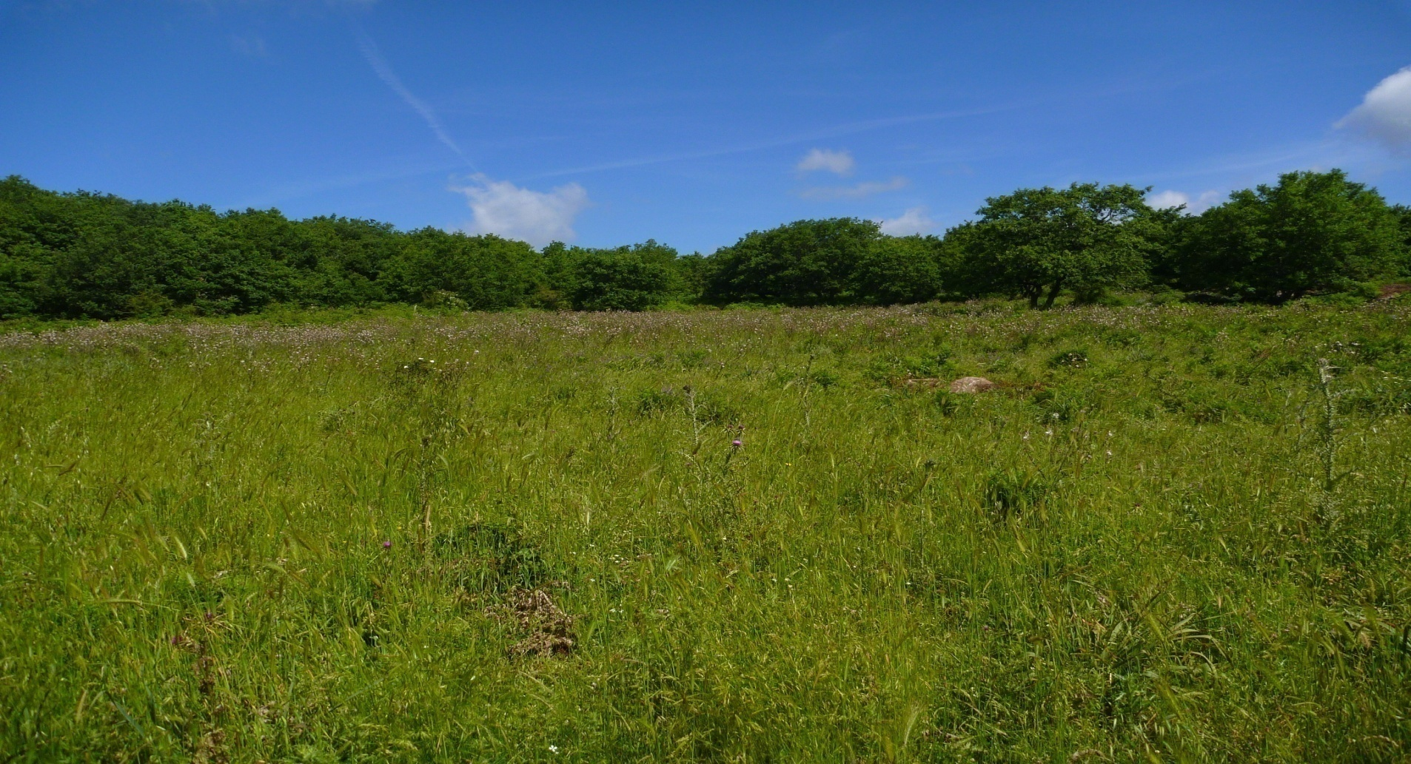
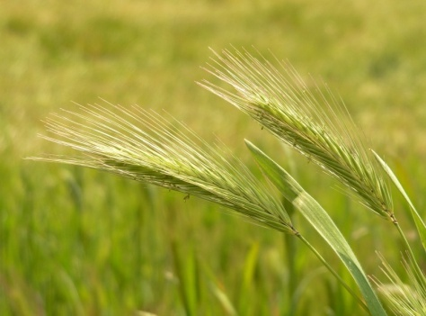

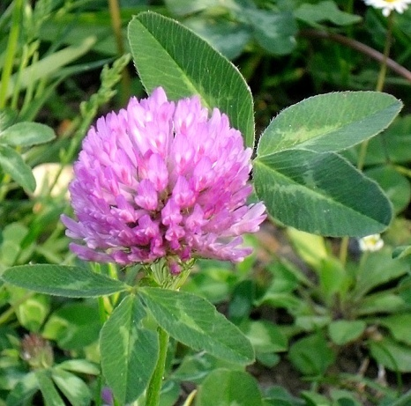
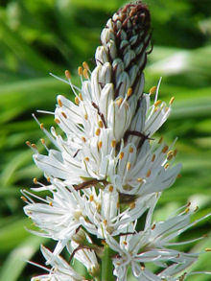
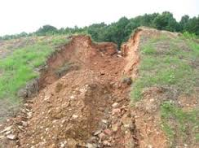
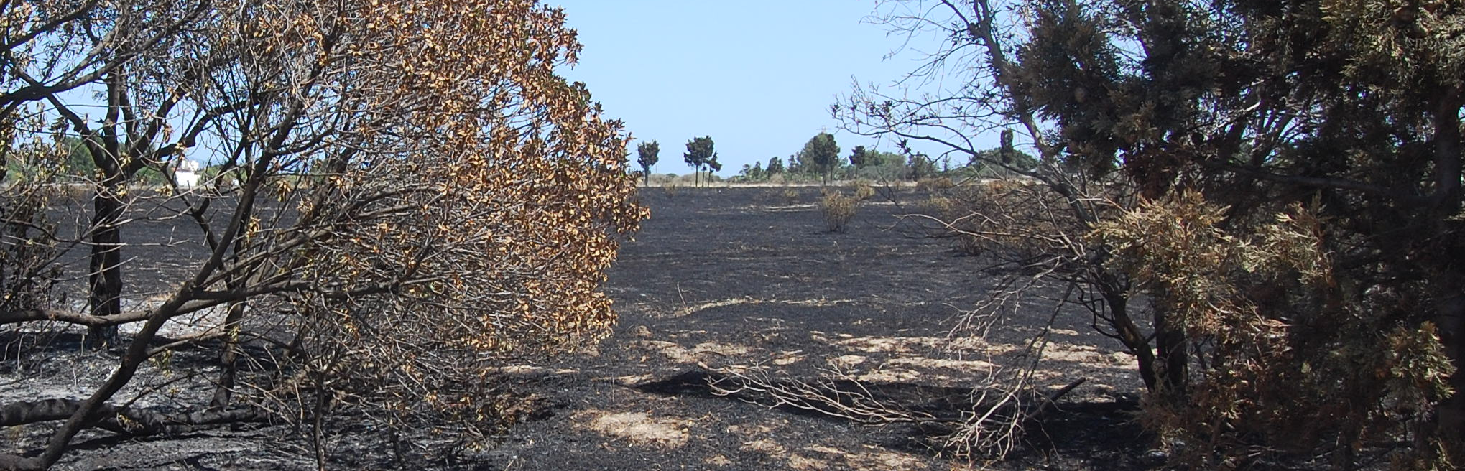
The natural ecosystems are recognized for their contribution to the conservation of botanical and faunal biodiversity, natural facilitation of soil fertility, production of quality water and landscape enrichment, which in turn has many social functions as areas of recreation.
Heterogeneous landscape
Biodiversity
conservation
Soil erosion prevention
Fire prevention

Slide 7
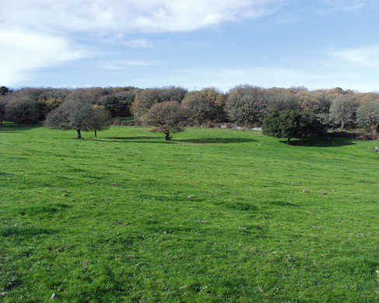
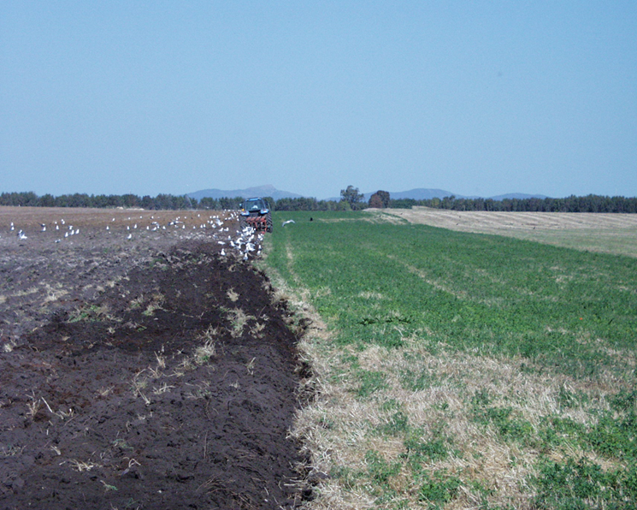
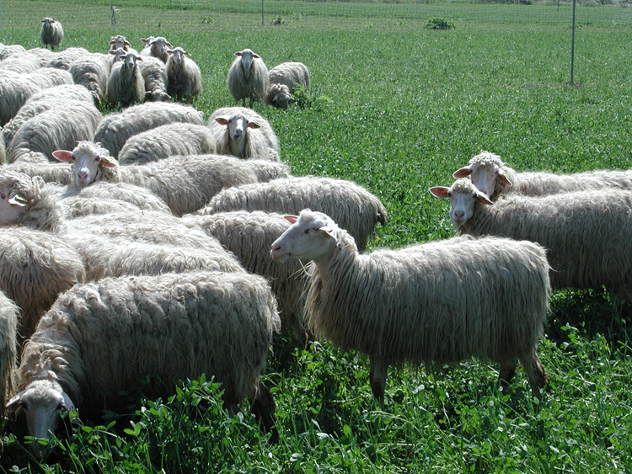
Agriculture can also help to mitigate the effects of climate change.
Through soil carbon sequestration, it has the potential to mitigate between
5.5 – 6 Gt of CO₂ per year, mainly
(Peeters, 2015)
CARBON STOCK
- 59%
+ 19%
It is estimated that CH₄ and N₂O emission from grazed grassland counterbalance 70% - 80% of the european grassland carbon sink
(Ciais et al., 2010; Pflimlin, 2013)

Slide 8
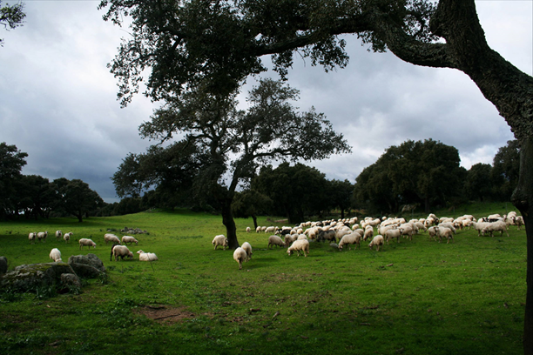
The new PAC reform (2014-2020) highlights the necessity to preserve the grassland-livestock systems recognizing to them positive externalities such as provision of environmental services.

Slide 9

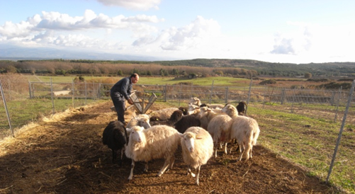
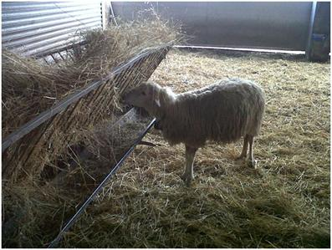
Aim
To understand which is the influence of meteorological conditions on welfare and performance of dairy sheep
Two homogeneous groups of ewes were subjected two different breeding conditions
PD - PADDOCK SYSTEM
ST - STALL SYSTEM

Slide 10
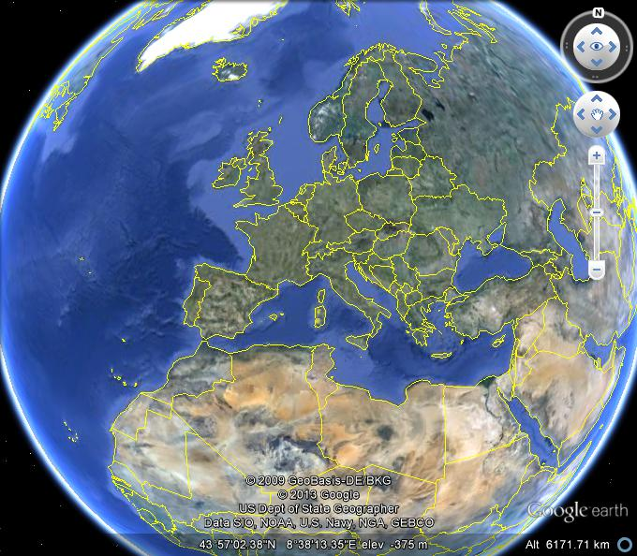
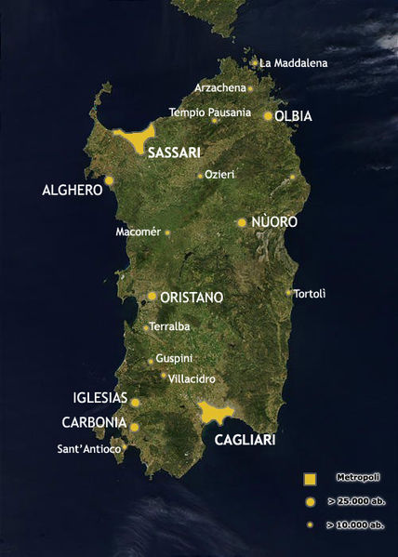
Where
N-W Sardinia
650 m a.s.l.
Annual rainfall: 1000mm
T Max: 28°C T min: 3°C
AGRIS Research Station

Slide 11
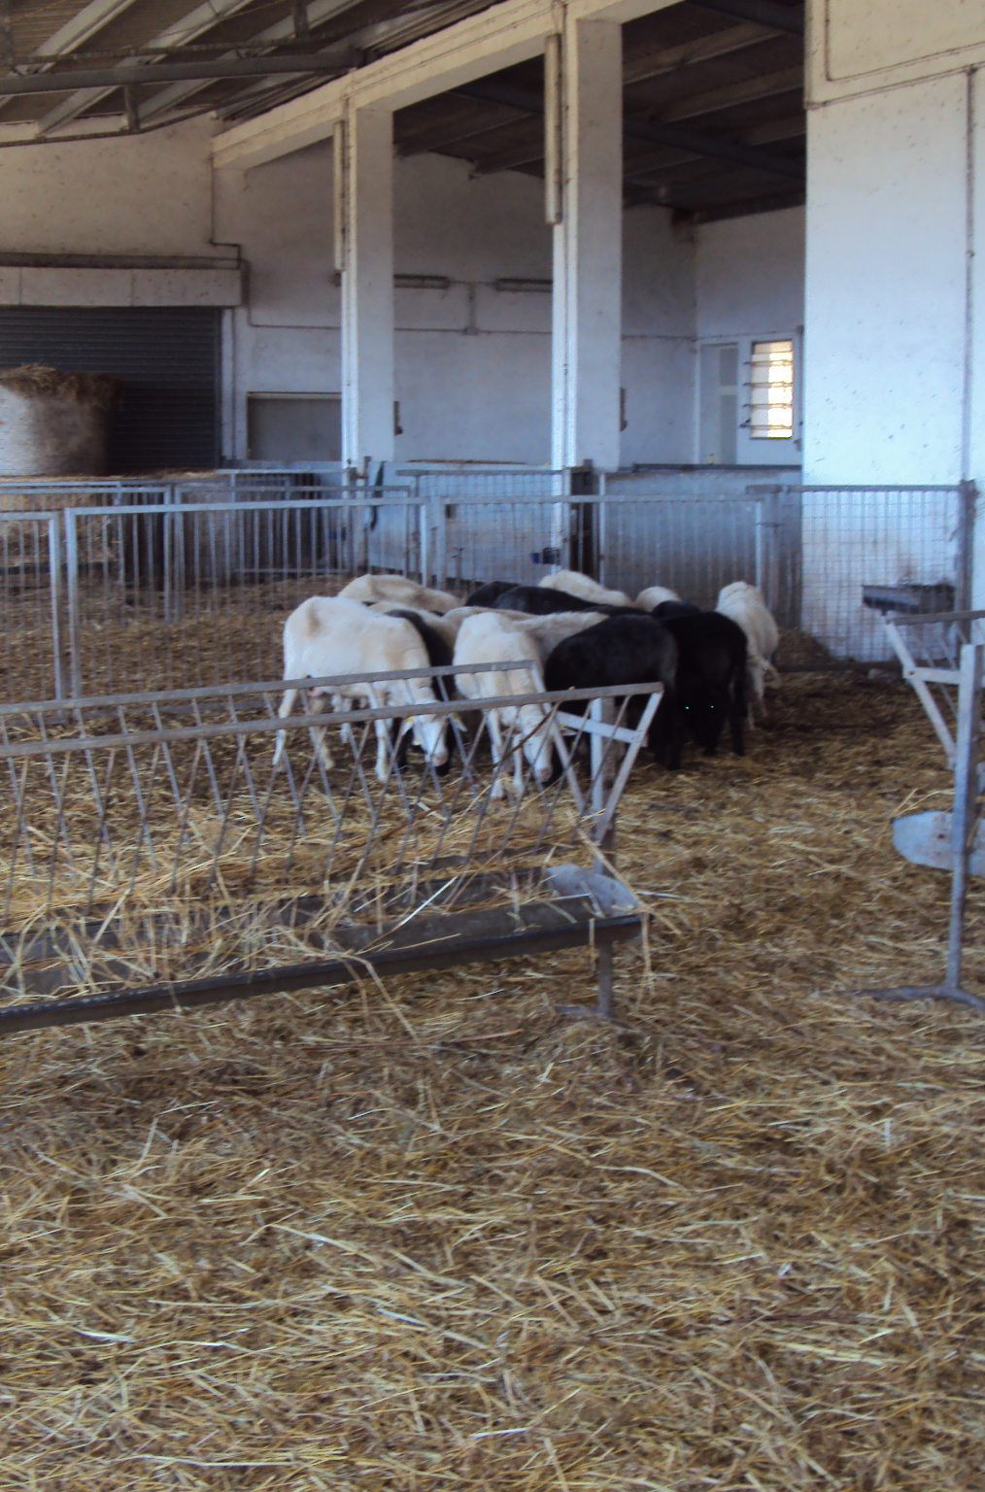
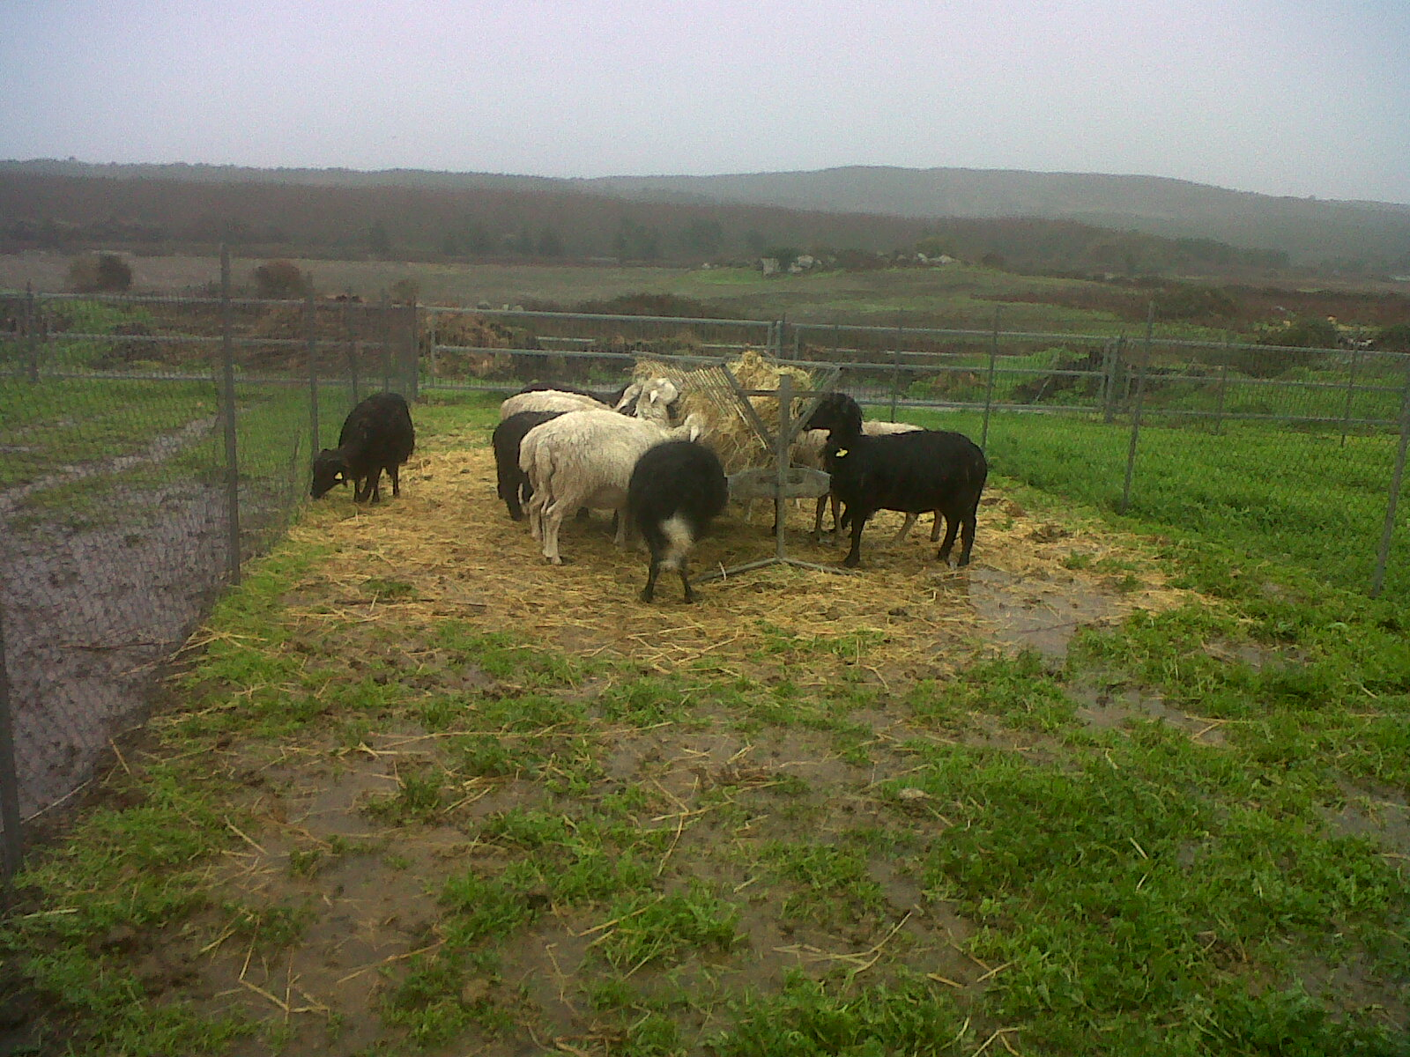
STALL
PADDOCK
16 ANIMALS PER GROUP
AUTOCHTHONOUS BREED OF SARDINIAN DAIRY EWES
between July 2011 and May 2013
In each season: 4 week measurement period
Season | Physiological phase
Summer | End lactation/ Mating period
Autumn | Lambing
Winter | Early lactaction
Spring | Mid Lataction

Slide 12
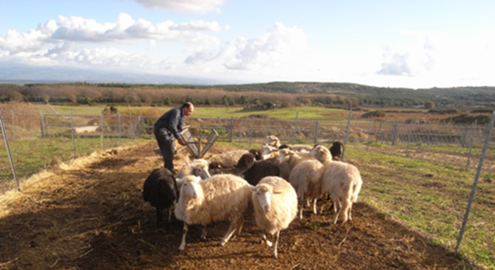
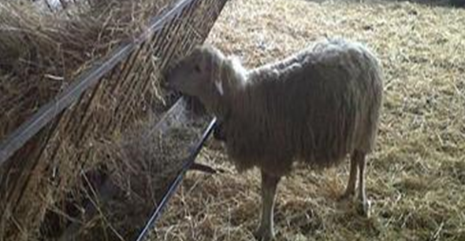
Diet offered to the experimental groups during the two year trial
 |  | A | W | S | Su
 |  |  | 1° year
Concentrate | kg head⁻¹die⁻¹ | 0.45 | 0.24 | 0.25 | 0.39
Hay | kg head⁻¹die⁻¹ | 1.34 | 2.22 | 1.89 | 1.58
Water consumption | l head⁻¹die⁻¹ | 3.3 | 5.1 | 4.4 | 3.5
 |  | 2° year
Concentrate | kg head⁻¹die⁻¹ | 0.21 | 0.43 | 0.40 | 0.22
Hay | kg head⁻¹die⁻¹ | 1.38 | 1.48 | 1.69 | 1.46
Water consumption | l head⁻¹die⁻¹ | 2.7 | 3.8 | 5.3 | 4.6
Each group were fed with the same amount of hay and concentrate

Slide 13
Energy animal requirement (UFLReq ) and energy offered with the diet (UFL tot)
First year
Second year

Slide 14
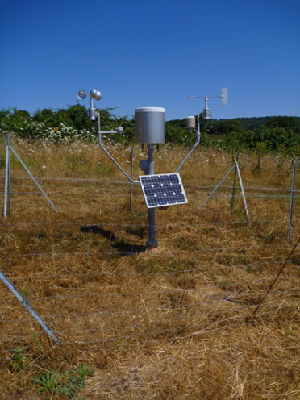
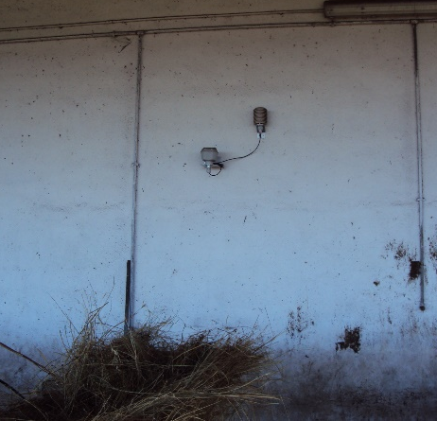
Materials and methods
DIET:
HAY AND CONCENTRATE OFFERED (according to animal requirement)
ANIMAL PERFORMANCE
BCS: weekly
MILK YIELD and MILK COMPOSITION: weekly on individual basis
BLOOD CORTISOL LEVEL: weekly on individual basis
ENVIRONMENTAL CONDITION
METEOROLOGICAL FACTORS, recorded continuously in ST and PD condition and analyzed hourly: T max, Tmed and T min; WCI (wind chill index) average and WCI in two discomfort classes; THI average and THI in two discomfort classes
Notes:
Feed diet were calculated according to animal requirement of their physiological state; Cortisol level was detected as stress marker
Because of the wide range of the basal cortisol value the variation of cortisol level was calculated
Tha data were analyzed with the GLM SAS procedure using Season (S) and Managemnt (M) and their interaction as fixed effects

Slide 15
Results

Slide 16
 |  | Winter |  |  |  |  | Spring |  |  |  |  | Summer |  |  |  |  | Autumn
 |  | PD | ST | T | Y | T*Y | PD | ST | T | Y | T*Y | PD | ST | T | Y | T*Y | PD | ST | T | Y | T*Y
T.avg | 1° Y | 9.87 | 10.64 | ns | * | ns | 14.74 | 15.99 | * | * | ns | 21.91 | 22.41 | ns | ns | ns | 11.50 | 12.13 | ns | ns | ns
 | 2° Y | 5.78 | 6.68 |  |  |  | 11.89 | 13.28 |  |  |  | 22.40 | 24.07 |  |  |  | 11.34 | 12.16
Tmax | 1° Y | 14.91 | 16.34 | ns | * | ns | 19.44 | 21.90 | * | ** | ns | 27.58 | 29.48 | * | * | ns | 15.17 | 15.59 | ns | ns | ns
 | 2° Y | 9.41 | 9.85 |  |  |  | 16.58 | 18.27 |  |  |  | 28.86 | 31.79 |  |  |  | 14.85 | 15.62
Tmin | 1° Y | 5.90 | 6.43 | ns | * | ns | 10.40 | 11.31 | * | ** | ns | 15.08 | 16.36 | ns | ** | ns | 9.00 | 9.47 | ns | ns | ns
 | 2° Y | 2.89 | 4.18 |  |  |  | 7.86 | 9.08 |  |  |  | 16.38 | 17.59 |  |  |  | 8.76 | 9.25
RHavg | 1° Y | 63.88 | 69.31 | * | ** | ns | 73.12 | 75.92 | ns | ** | ns | 63.10 | 63.51 | ns | * | ns | 85.47 | 93.16 | *** | * | ns
 | 2° Y | 91.52 | 96.23 |  |  |  | 84.48 | 87.25 |  |  |  | 55.53 | 54.57 |  |  |  | 89.50 | 93.10
RHmax | 1° Y | 85.04 | 91.88 | ns | ** | ns | 91.92 | 96.64 | * | ** | ns | 90.69 | 90.73 | ns | ns | ns | 96.48 | 100 | *** | * | *
 | 2° Y | 99.56 | 100 |  |  |  | 98.42 | 100 |  |  |  | 82.16 | 85.46 |  |  |  | 99.08 | 100
RHmin | 1° Y | 42.80 | 46.60 | * | ** | ns | 54.20 | 54.08 | ns | * | ns | 37.52 | 36.91 | ns | ns | ns | 66.34 | 74.10 | ns | ns | ns
 | 2° Y | 71.08 | 82.32 |  |  |  | 59.56 | 62.72 |  |  |  | 33.40 | 31.50 |  |  |  | 71.08 | 81.58
WCIavg | 1° Y | 6.28 | 9.19 | ** | ** | ns | 12.26 | 14.88 | ** | * | ns | 19.01 | 21.72 | ** | * | ns | 8.75 | 10.77 | *** | ns | ns
 | 2° Y | 1.39 | 4.97 |  |  |  | 8.81 | 12.00 |  |  |  | 20.98 | 23.49 |  |  |  | 8.88 | 10.44
WCImin | 1° Y | 1.67 | 4.85 | ** | ** | ns | 7.63 | 10.02 | ** | ** | ns | 12.50 | 15.39 | ** | ** | ns | 6.14 | 8.03 | * | ns | ns
 | 2° Y | -1.86 | 2.40 |  |  |  | 4.72 | 7.65 |  |  |  | 14.51 | 16.76 |  |  |  | 5.99 | 7.86
HWCI_{MD} | 1° Y | 15.96 | 15.32 | ns | ** | ns | 7.00 | 4.68 | * | ** | ns | 0.65 | 0 | * | ns | ns | 15.13 | 11.96 | * | ns | ns
 | 2° Y | 19.28 | 20.60 |  |  |  | 14.28 | 8.68 |  |  |  | 0.06 | 0 |  |  |  | 14.54 | 11.16
HWCI_{DL} | 1° Y | 1.64 | 0 | * | * | ns
 | 2° Y | 4.52 | 1.96
THIavg | 1° Y | 50.85 | 51.62 | ns | ** | ns | 57.92 | 59.70 | * | ** | ns | 65.97 | 68.16 | ** | ** | ns | 52.94 | 53.82 | ns | ns | ns
 | 2° Y | 43.09 | 44.27 |  |  |  | 53.40 | 55.52 |  |  |  | 67.95 | 69.92 |  |  |  | 52.58 | 53.89
THImax | 1° Y | 57.41 | 59.60 | ns | ** | ns | 63.94 | 67.40 | ** | ** | ns | 72.64 | 75.28 | *** | * | ns | 58.22 | 59.27 | ns | ns | ns
 | 2° Y | 49.17 | 50.15 |  |  |  | 59.95 | 63.05 |  |  |  | 74.13 | 77.28 |  |  |  | 57.87 | 59.56
THI_{MD} | 1° Y |  |  |  |  |  | 1.08 | 2.68 | ** | ** | * | 5.08 | 5.39 | ns | ns | ns
 | 2° Y |  |  |  |  |  | 0.00 | 0.68 |  |  |  | 5.23 | 5.60
ERaifall | 1° Y | 0.63 |  |  | ns |  | 8.86 |  |  | * |  | 1.04 |  |  | ns |  | 7.03 |  |  | ns
 | 2° Y | 2.02 |  |  |  |  | 0.92 |  |  |  |  | 0.08 |  |  |  |  | 6.91
WSavg | 1° Y | 1.79 |  |  | ns |  | 1.61 |  |  | ns |  | 2.61 |  |  | * |  | 1.47 |  |  | ns
 | 2° Y | 1.90 |  |  |  |  | 1.77 |  |  |  |  | 1.62 |  |  |  |  | 1.33
WSmax |  | 6.72 |  |  | ns |  | 6.12 |  |  | ns |  | 6.53 |  |  | ns |  | 5.45 |  |  | ns
 |  | 7.45 |  |  |  |  | 6.55 |  |  |  |  | 5.62 |  |  |  |  | 5.27

Slide 17
Weather
T max
T avg
T min
First year
Second year
THI max
THI avg
WCI avg
WCI min

Slide 18
Season |  | PD | ST | P
Winter | Rhavg % | 63.88-91,52 | 69.31-96.23 | ***
 | Rhmax % | 85.04-99.56 | 91.88-100 | ***
 | Rhmin % | 42.80-71.08 | 46.60-82.32 | ***
 | WCIavg | 6.28-1.39 | 9.19-4.97 | ***
 | WCImin | 1.67- -1.86 | 4.85-2.40 | *
 | WCI_{MD} n° h/day | 16-19 | 15-21 | *
Spring | T° avg °C | 14.74-11.89 | 15.99-13.28 | *
 | T° min °C | 10.40-7.86 | 11.31-9.08 | *
 | Rhmax % | 91.92-98.42 | 96.64-100 | *
 | WCIavg | 12.26-8.81 | 14.88-12.00 | **
 | WCImin | 7.63-4.72 | 10.02-7.65 | **
 | WCI_{MD} n° h/day | 7-14 | 5-9 | *
Summer | T max °C | 27.58-28.86 | 29.48-31.79 | *
 | RH avg | 63.10-55.53 | 63.51-54.57 | ns
 | THIavg | 65.97-67.95 | 68.16-69.92 | **
 | THImax | 72.64-74.13 | 75.28-77.28 | ***
 | THI_{MD} n° h/day | 5 | 5-6 | ns
Autumn | Rhavg % | 85.47-89.50 | 93.16-93.10 | ***
 | Rhmax % | 96.48-99.08 | 100 | ***
 | WCIavg | 8.75-8.88 | 10.77-10.44 | ***
 | WCImin | 6.14-5.99 | 8.03-7.86 | *
 | WCI_{MD} n° h/day | 15 | 12-11 | *
Weather

Slide 19
Body Condition Score
 |  | 1° Y | 2° Y | T | Y | T x Y
Winter | PD | 2.45 | 2.22 | ns | * | ns
 | ST | 2.46 | 2.27
Spring | PD | 2.69 | 2.61 | ns | * | ns
 | ST | 2.72 | 2.64
Summer | PD | 2.85 | 2.77 | ns | ns | ns
 | ST | 2.77 | 2.77
Autumn | PD | 2.79 | 2.83 | ns | * | ns
 | ST | 2.78 | 2.90

Slide 20
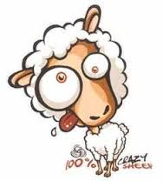
Cortisol level
Domestic animals react to stress by an alteration of behavioral and physiological responses, which are the results of individual emotional reactivity (Deiss et al.,2009).
 |  | PD | ST | T | Y | T*Y
Winter | 1° Y | 2.85±0.29 | 2.99±0.29 | ns | ns | ns
 | 2° Y | 2.24±0.29 | 2.78±0.29
Spring | 1° Y | 2.59±0.31 | 3.32±0.31 | ns | *** | ns
 | 2° Y | 4.07±0.31 | 3.52±0.31
Summer | 1° Y
 | 2° Y | 3.66±0.23 | 3.42±0.23 | ns
Autumn | 1° Y | 2.74±0.25 | 2.52±0.25 | ns | ns | ns
 | 2° Y | 2.80±0.26 | 3.11±0.26
Stress can induced hypercortisolemia

Slide 21
Milk yield and quality
 |  |  | Winter |  |  |  |  | Spring
 |  |  | PD | ST | T | Y | T*Y | PD | ST | T | Y | T*Y
Milk yield | g head ⁻¹ day⁻¹ | 1° Y | 654.4±36.7 | 664±37.1 | ns | ns | ns | 561.4±40.0 | 541.1±38.1 | ns | ns | ns
 |  | 2° Y | 623.8±37.2 | 674±36.8 |  |  |  | 565.0±35.3 | 598.8±35.4
Fat | % | 1° Y | 6.29±0.13 | 6.19±0.13 | ** | ** | * | 6.32±0.16 | 6.12±0.15 | * | ** | *
 |  | 2° Y | 6.90±0.11 | 6.30±0.11 |  |  |  | 7.35±0.14 | 6.82±0.14
Protein | % | 1° Y | 5.71±0.07 | 5.70±0.07 | ns | ns | ns | 5.68±0.10 | 5.76±0.10 | ns | ns | *
 |  | 2° Y | 5.66±0.06 | 5.54±0.06 |  |  |  | 5.81±0.10 | 5.66±0.1
Lactose | % | 1° Y | 4.80±0.03 | 4.80±0.03 | ns | ** | ns | 4.46±0.73 | 4.55±0.07 | ns | ns | ns
 |  | 2° Y | 4.59±0.06 | 4.60±0.03 |  |  |  | 4.55±0.07 | 4.60±0.07
Urea | % | 1° Y | 40.7±1.36 | 43.9±1.38 | ns | ns | ns | 36.7±1.38 | 36.8±1.35 | ns | * | ns
 |  | 2° Y | 43.5±1.17 | 41.1±1.20 |  |  |  | 40.6±1.30 | 42.0±1.26

Slide 22
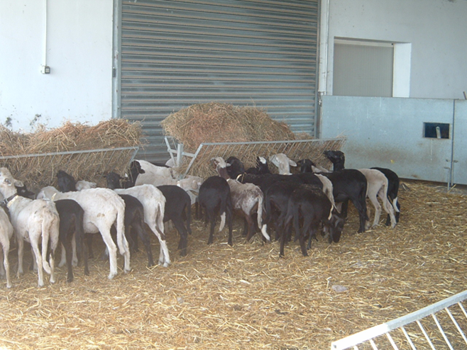
Milk production evolution during each observation period

Slide 23
Milk composition

Slide 24
Fat concentration pattern (%)

Slide 25
Milk fat concentration during winter of the second year
 | First year | WCI hours
 | Mid-disconfort | Disconfort | hight disconfort
STALL | 383 | 0 | 0
PADDOCK | 399 | 41 | 0
 | Second year WCI hours
 | Mid-disconfort | Disconfort | hight disconfort
STALL | 497 | 43 | 0
PADDOCK | 482 | 90 | 0

Slide 26
Milk fat concentration during spring in the second year
 | First year | WCI hours
 | Mid-disconfort | Disconfort | hight disconfort
STALL | 117 | 0 | 0
PADDOCK | 175 | 0 | 0
 | Second year WCI hours
 | Mid-disconfort | Disconfort | hight disconfort
STALL | 208 | 0 | 0
PADDOCK | 344 | 0 | 0

Slide 27
First remarks
Paddock conditions are more colder than Stall condition in winter and less hot in summer.
Any detrimental impact of meteorological conditions in animal performance and in wellfare are detected when the animals are raised outdoor or in stall system
As expected, the cold thermal stress determined an higher concentration of fat milk.
Paddok system had a higher cortisol content in second year late spring, probably due to sharply decreased of the temperature
Because of these colder condition we registered a low BCS in both Stall and Paddok system in the second year even if the energy requirement was completely coverd by the offered diet

Slide 28
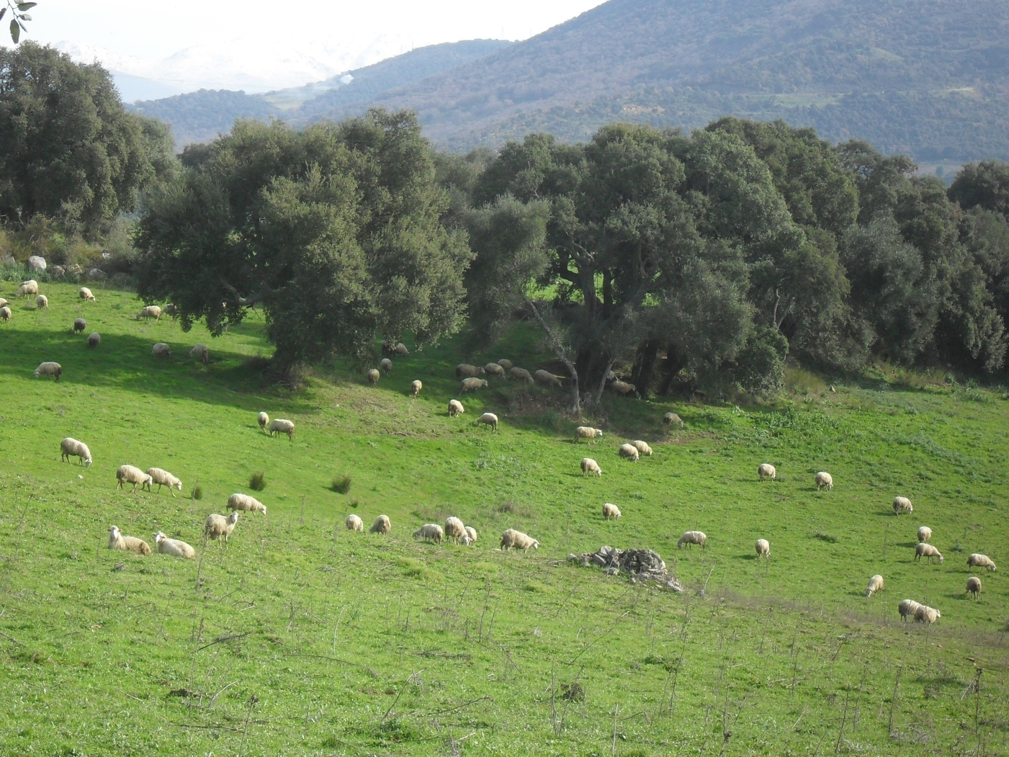
What happen if the animals are allowed to graze?
Sheep can have a diet based on fresh herbage and can select their diet
Sheep can seek a repair to the uncomfortable meteorological conditions

Slide 29
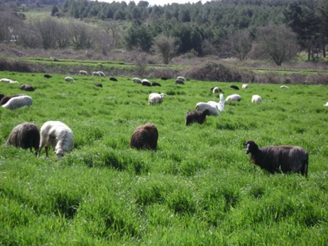
Milk yield
winter
spring
winter
spring

Slide 30
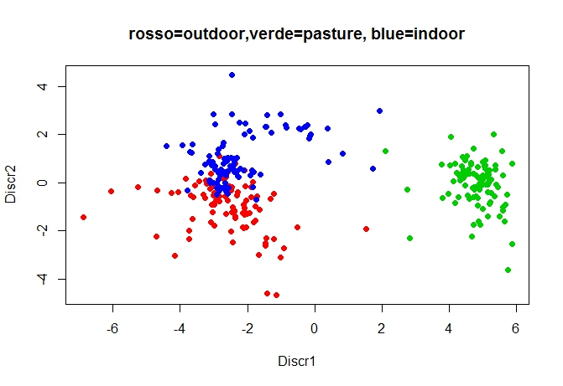
Pasture group

Slide 31

Conclusion
The study of relationships between production traits and climatic variables suggest us that adverse climatic conditions on farm profit is negligible
The Pasture system may lead to a greater farm profitability and environmental outcomes.
Animals has to be fed with food not competing with human food, with the aim to reduce crop-land derived feedstuffs;
contemporary ruminants, efficient converters of forage feed into animal proteins, are to be raised at pasture.

