Slide 1
Understanding Alzheimer’s Disease
María O. Longas
Purdue University Calumet
August 10, 2015

Slide 2
Alzheimer’s disease (AD) is a degenerative disorder of the central nervous system (CNS) that is characterized by the formation of amyloid plaques.

Slide 3
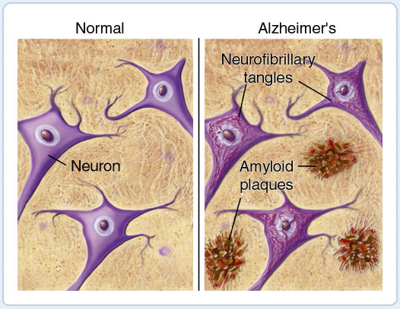

Slide 4
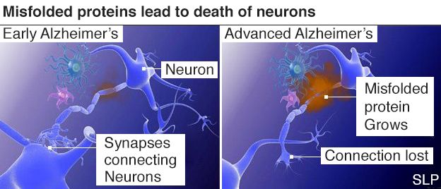

Slide 5
Amyloid was originally used to describe accumulation of carbohydrate-like material that reacted with iodine (3), and turned out to be amylose (4).

Slide 6
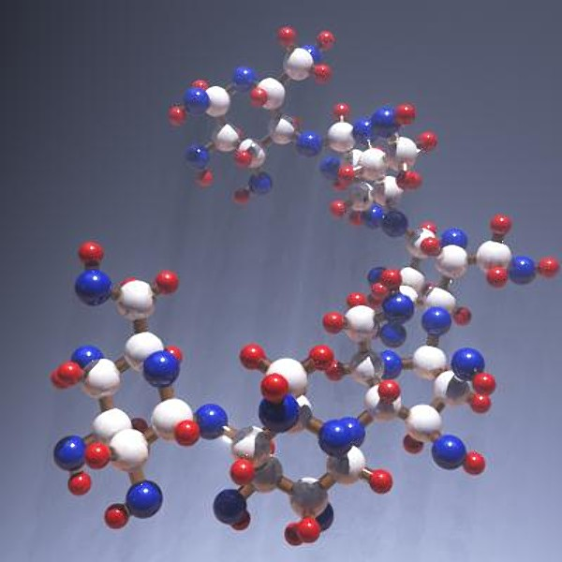
Amylose

Slide 7
The amyloid plaque contains D-GalNAc and amyloid (a polysaccharide of glucose), they slow glucose transport in the brain .

Slide 8
Astrocytes Release Cytokines
By Dr. Ananya Mandal, MD.
The term "cytokine" is derived from a combination of two Greek words - "cyto" meaning cell and "kinos" meaning movement. They stimulate the movement of cells towards sites of inflammation, infection and trauma.

Slide 9
Low glutamic acid (Glu) and aspartic acid (Asp) concentrations result in deficient glucose transport (7), and stimulate astrocytes to take action against the aberration and correct it. In normal people ß-amyloid fibrils that form in the astrocyte extracellular spaces are hydrolyzed, but in Alzheimer’s disease, this binding produces astrocyte immobility (9).

Slide 10
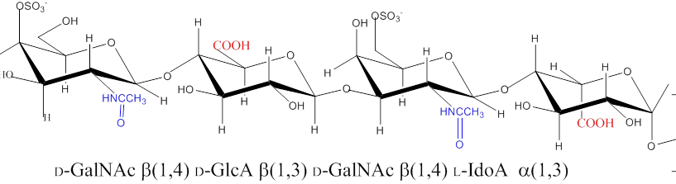
Astrocytes also have Glycosaminoglycan and Proteoglycans.
This is a tetramer of Dermatan Sulfate

Slide 11
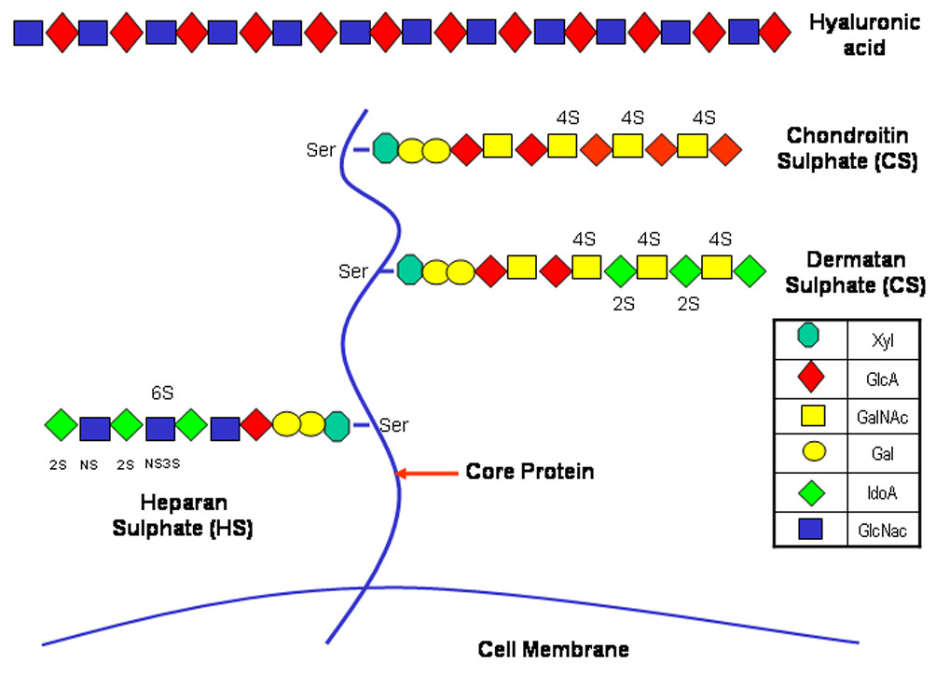
Heparan Sulfate Proteoglycan

Slide 12
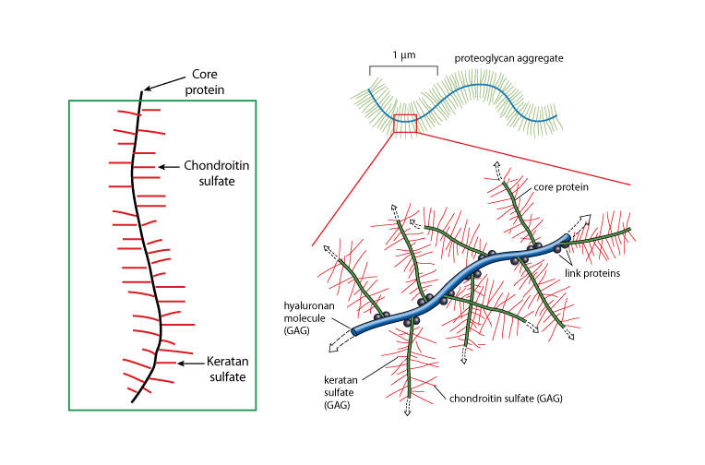
Proteoglycan

Slide 13
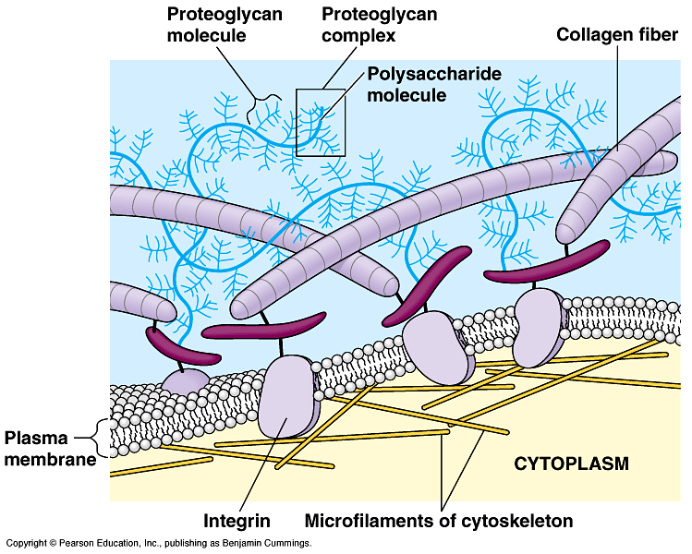

Slide 14
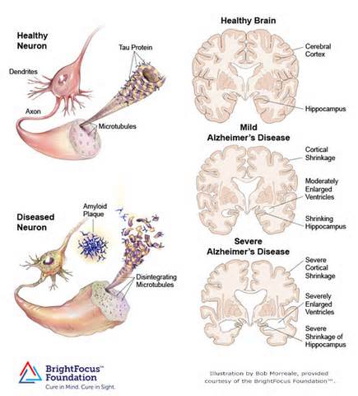

Slide 15
ASTROCYTES STOP THEIR MOBILITY UPON BINDING TO ß-AMYLOID FIBRIL

Slide 16
Tissue Culture
Cells were cultured in Astrocyte Basal Medium (ABM) obtained from Lonza and adjusted to 15% fetal bovine serum. This media was fortified with 5.0 ml L-Glutamine, 0.5 ml Ascorbic Acid, 1.25 ml Epidermal Growth Factors, 0.5 ml Insulin and 0.5 ml Gentamicin Sulfate Amphotencin-β.

Slide 17
NaH Conditions
NaH was prepared by Sigma Life Science. The name they gave was NaH, a heparin disaccharide 1-S sodium salt.

Slide 18
Cell Culture
Mid-frontal cerebral cortex, were the cells used in this study.
The cells were donated to us by Rush University Medical Center.

Slide 19
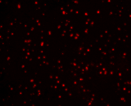
Fig. 2 - Mid Frontal Cerebral Cortex of Normal Astrocytes Stained with Congo red

Slide 20
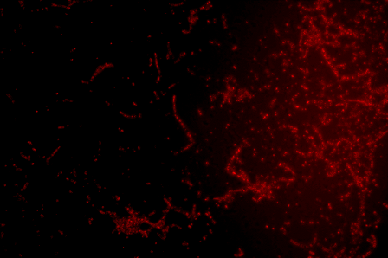
Fig. 3 - Mid-Frontal Cerebral Cortex of Astrocytes of Alzheimer’s Patients Stained with Congo red.

Slide 21
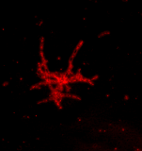
Fig. 4 - Mid-Frontal Cerebral Cortex of Astrocytes of Alzheimer’s Patients Stained with Congo red.

Slide 22
Cells were incubated at 37ºC, under 5% CO_{2.} Cultures lasted in this media for 15 days, with changes every 3rd day. After 15 days in this culture media was adjusted to NaH (Fig. 1). AD received 4 mg NaH/gram of body mass in 1 ml of sterilized phosphate buffer saline (SPBS). The controls received 1 ml SPBS/gram of body mass.

Slide 23
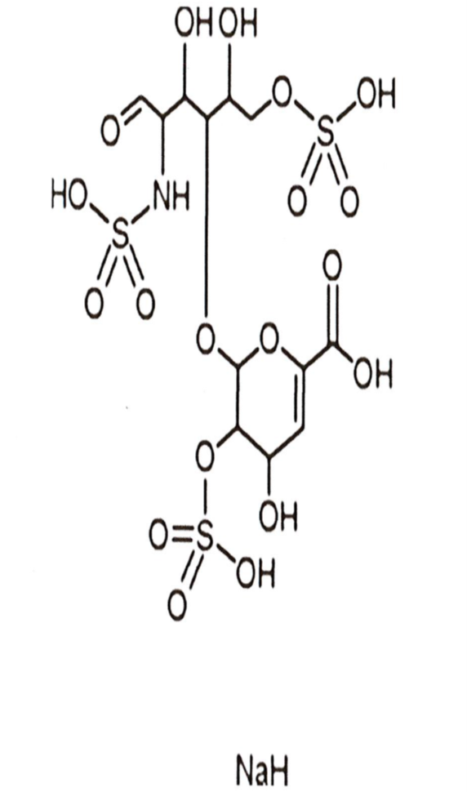
Figure 1

Slide 24
NaH Concentration Was Increased
The concentration was then increased to 5mg NaH/gram of body mass in 1 ml of sterilized (SPBS) for the AD patients. The controls continued receiving 1 ml of SPBS/gram of body mass.

Slide 25
The cultures were repeated using 6 AD samples and 6 of normal controls.

Slide 26
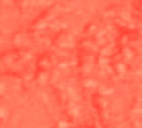
Figure 5 – Mid-Frontal Cerebral Cortex of Alzheimer’s Disease Tissue Stained with Congo red

Slide 27

Figure 6 – Mid-Frontal Cerebral Cortex of Alzheimer's Disease Tissue Stained with Congo red.

Slide 28
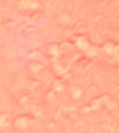
Figure 7-Mid-frontal Cerebral Cortex of Alzheimer’s Disease Tissue Stained with Congo red

Slide 29
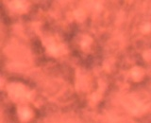
Figure 8 – Mid-Frontal Cerebral Cortex of Normal Control Tissue Stained with Congo red.

Slide 30
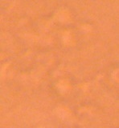
Figure 9 – Mid-Frontal Cerebral Cortex of Normal Control Tissue Stained with Congo red

Slide 31
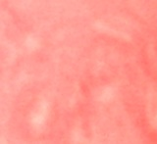
Figure 10- Mid-Frontal Cerebral Cortex of Normal Control Tissue Stained with Congo red

Slide 32
Rat Tissue Culture
Six Rats contracted Alzheimer's Disease at Taconic Bioscience, Inc. and 6 normal controls were obtained. They were all cultured using the normal conditions for the humans, except that a rat hippocampus was used to remove the cells for culture & no NaH.

Slide 33
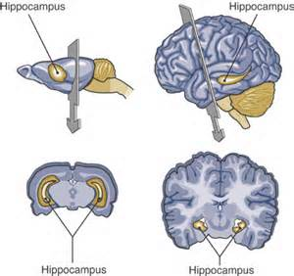
Figure 2- Rat hippocampus

Slide 34
Normal Rat Growth Rate
Rat growth was normal as indicated by Lonza Bioscience. The growth difference can be explained by comparing the body mass of the normal controls that increased from 263.3 g, 263.4 g, 239.8 g, 231.2 g, 220.6 g and 223.2 grams from the day when they arrived in the laboratory to 438.8 g, 473.7g, 449.7g, 436.6 g, 466.6 g, and 407.9 grams when they were guillotined.

Slide 35
Alzheimer’s Rat Growth rate
The weighs of the Alzheimer’s Disease Rats ranged from 240.2 g, 227.2 g, 257.1 g, 270.4 g, 247.3 g, and 240.0 g to 378.6 g to 415.1g, 480.4 g, 441.2 g, 437.4 g and 433.3 grams when they were guillotined. The masses were determined every other week, following the advised of a Purdue University Veterinarian.

Slide 36
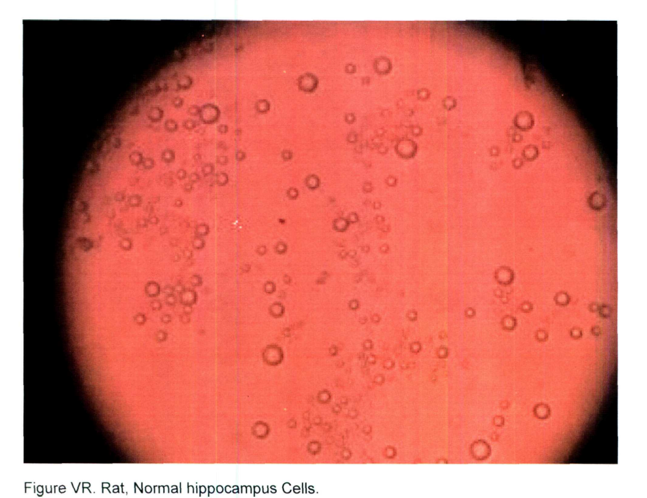
Figure 12 - Normal Rat Hippocampus Cells Stained with Congo red.

Slide 37
Fig. 13 – Rat Alzheimer’s Disease Hippocampus Cells Stained with Congo red.

Slide 38
NaH Was Added to Rat Culture
Cells were incubated at 37ºC, under 5% CO_{2.} Cultures lasted in this media for 15 days, with changes every 3rd day. After 15 days in this culture media was adjusted to NaH (Fig. 1). AD received 4 mg NaH/gram of body mass in 1 ml of sterilized phosphate buffer saline (SPBS). The controls received 1 ml SPBS/gram of body mass.

Slide 39
Figure 14. Rat Alzheimer's Disease Hippocampus Cells Stained with Congo red

Slide 40
Figure 15 – Rat Alzheimer’s Disease Hippocampus Cells Stained with Congo red.

Slide 41
Figure 16 – Normal Rat Hippocampus
Cells Stained with Congo red.

Slide 42
Figure 17 – Normal Rat Hippocampus Cells Stained with Congo red

Slide 43
Figure 1. NaH.

Slide 44
Figure 1 represents NaH. It is a heparin disaccharide or 1-S sodium salt (H9267) (C₁₂H₁₅N₁O₁₉S₃Na₄), formula weight 665.40 g/mol. H9267 was obtained from heparin upon digestion with heparinases 1 and 2. Sigma Life Science developed the product and called Na-S sodium sulfate salt. There are no sugars in such saccharide. The special groups includes: 1 carboxyl group and 3 OH’s. Of the 3 OH’s, one is bonded to cyclohexene and the other two are boned to carbons. There is only one N, which binds a sulfate and it is near the ketone group.

Slide 45
C O N C L U S I O N S
Alzheimer’s Disease Patients should be treated with a disaccharide that originates from anticoagulant heparin, like the one shown in this Figure.

Slide 46
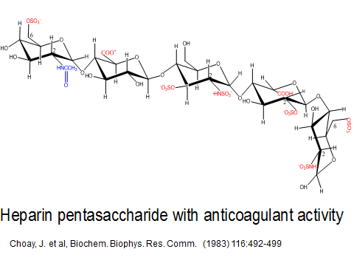

Slide 47
Fig. 18 – Alzheimer’s Disease Rat Hippocampus Cells.

Slide 48
The so called NaH (a heparin disaccharide) used in this study, has a very distorted structure to work like anticoagulant heparin.

Slide 49


GAG Sulfotransferase/Sulfatase Dance
Sulfates we give to the GAG’s
To help them do their jobs.
When we get tired or crippled
The GAG’s defects become tripled
They surely need our help
To do their functions well
With the GAG’s in disarray
The cells begin to decay
And the turmoil is such
That we cannot even DANCE.

Slide 51
Tissue culture hippocampus and media sere separated; the cultures were then washed with excess sterile NaCl; 100 μL of NaCl containing hippocampus tissue was placed in an electrophoresis plate to prepare for Congo red Staining ⁽⁶⁾.
NaCl (35.71 g) was dissolved in 100 ml of 80% w/w Ethanol; Congo red (0.8192 g) was added, and the solution was boiled with mixing for 5 min. This solution was allowed to stand at room temperature for 24 hr. Just before use, 9 parts of Congo red solution were combined with 1 part of 1% (W/V) NaOH; the solution was filtered, and used within 15 min⁶
Congo Red Staining

