Slide 1






The Role of Cardiac High-Energy Phosphate Metabolism in Cardiac Function and Performance: The Impact of Age
Maria Nathania; Kieren G. Hollingsworth; Guy A. MacGowan; Michael I. Trenell; Djordje G. Jakovljevic

Slide 2
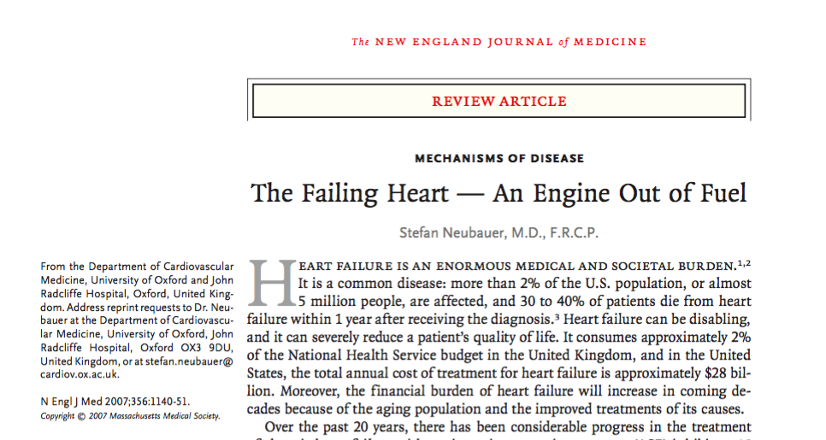
Background
Methods
Results
Conclusion
“The failing heart is an engine out of fuel — that is, altered energetics play an important role in the mechanisms of heart failure”
Notes:
Cardiac dysfunction and diminished performance are major characteristics of heart failure. A review article published in 2007 by Dr. Neubauer proposed that a failing heart is an engine out of fuel, in which, altered energetics play important role in mechanisms of heart failure

Slide 3

Background
Methods
Results
Conclusion
Cardiac metabolism
High-energy phosphates (i.e. ATP and PCr)
Contractile function, viability, and ionic homeostasis
Notes:
What we do know is that normal cardiac metabolism is essential to the heart as it utilises chemical energy stored in phosphoryl bonds of metabolites. The most important high-energy phosphates in the heart are adenosine triphosphate and phosphocreatine. In normal conditions, PCr is twice as abundant as ATP. Phosphocreatine is a source of ATP and is crucial during inadequate oxygenation where PCr will decrease rapidly to maintain high ATP and low adenosine diphosphate. Normal cardiac metabolism is essential to maintain the heart’s contractile function, viability and ionic homeostasis

Slide 4
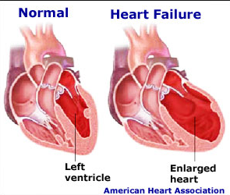
Background
Methods
Results
Conclusion
Cardiac metabolism
High-energy phosphates (i.e. ATP and PCr)
Cardiac dysfunction and heart failure
Notes:
Therefore, it is proposed that alterations in cardiac metabolism will lead to diminished high-energy phosphate which subsequently cause cardiac dysfunction and potentially heart failure

Slide 5
Background
Methods
Results
Conclusion
Aim
To define the relationship between cardiac high-energy phosphate metabolism and cardiac performance.

Slide 6
Study design
Background
Methods
Results
Conclusion
Volunteers
Inclusion criteria:
Exclusion criteria:
Female
No history of cardiovascular, pulmonary and other chronic diseases
No metabolic abnormalities
Able to perform exercise test
Current or past smokers
Medication affecting cardiovascular function
35 healthy women
Age
Young (≤50 years), n=20
Old (≥60 years), n=15
Notes:
Volunteers were screened according to inclusion and exclusion criteria. Participants had to be healthy females as defined by no history of cardiovascular, pulmonary and other chronic diseases, as well as no metabolic abnormalities and are able to perform an exercise test. Volunteers are excluded from the study if they are current or past smokers, or on medication affecting cardiovascular function. After screening, we had 35 healthy women, which were grouped based on age i.e. young less than 50 years old and old more than or equals to 60 years old. Within institute of ageing we have a group of 500 healthy volunteers associated with newcastle institue of ageing who help our research and also through university website.

Slide 7
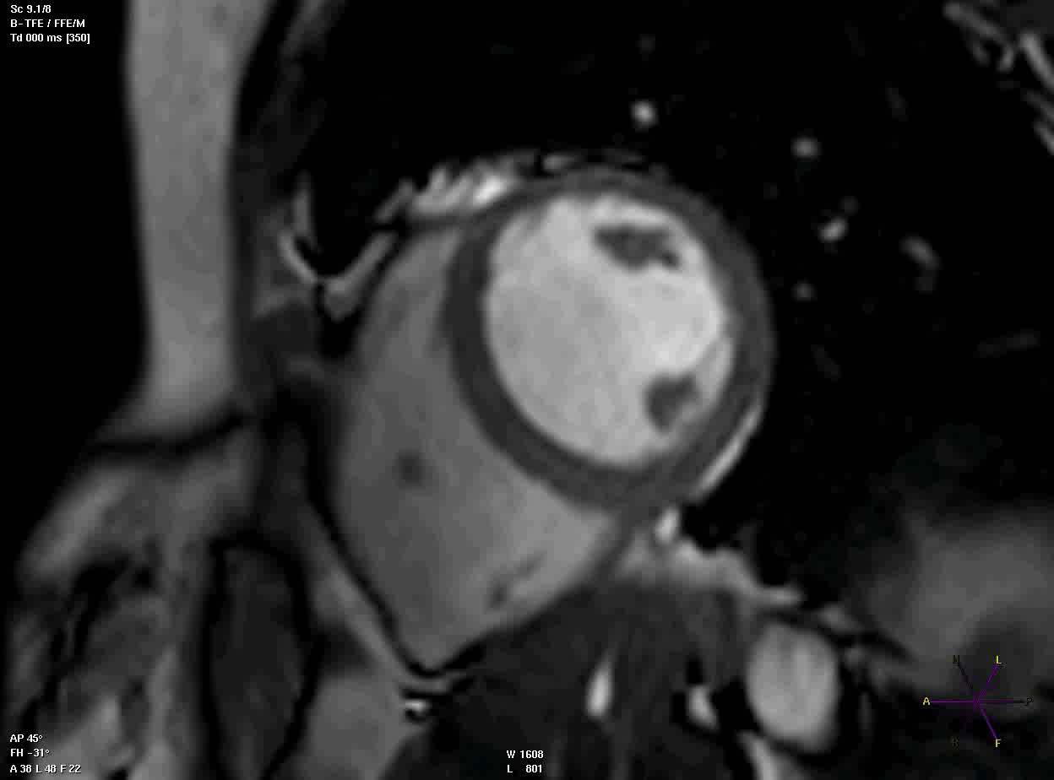
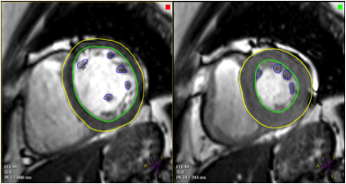
Cardiac Magnetic Resonance Imaging
Background
Methods
Results
Conclusion
Left ventricle
Right ventricle
Notes:
All participants underwent cardiac cine MRI to measure to measure cardiac parameters. This is an example of a still image from the procedure (MR short axis slice) – you can see the left and right ventricles. To calculate cardiac structure and function, endocardial borders, epicardial borders, and papillary muscles were traced at end systole and diastole.

Slide 8
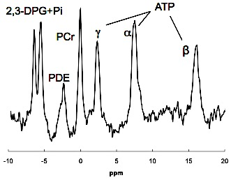
Cardiac spectroscopy
Background
Methods
Results
Conclusion
From previous human studies, PCr/ATP ratio of a healthy heart lies around 0.93 to 3.22
Esterhammer R, et al. (2014) PLoS ONE 9:e97368
Notes:
Participants also underwent 31Phosphorus-Magnetic resonance spectroscopy to assess PCr to ATP ratio as a measure of cardiac metabolism. Two particular peaks of interest are the PCr and gamma ATP peaks. Normal PCr/ATP ratio of a healthty heart ranges around 0.93 to 3.22. Low PCr/ATP ratio can indicate reduced phosphocreatine concentration that can be seen in pathologic conditions such as myocardial infarct.

Slide 9
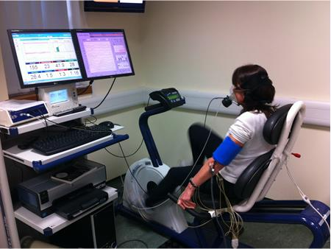
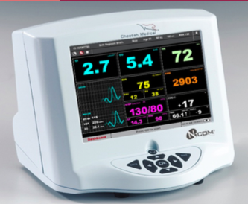
Maximal graded cardiopulmonary exercise test
Background
Methods
Results
Conclusion
Cardiac power output =
cardiac output x mean arterial blood pressure
Notes:
All participants performed maximal graded cardiopulmonary exercise testing with non-invasive central haemodynamic measurements using bioreactance method.
Cardiac power output was used as the best indicator of cardiac performance and was calculated as the product of peak exercise cardiac output and mean arterial blood pressure

Slide 10
Background
Methods
Results
Conclusion
Table 1. Demographic characteristics
 | Young | Old | P
Age, years | 44 ± 3 | 71±6 | 0.00
Weight, kg | 69±12 | 66±10 | 0.35
Height, cm | 166±5 | 159±5 | 0.00
BMI, kg/m² | 25±4 | 26±3 | 0.59
Notes:
Our findings reveal that the younger age group has a mean age of 44 years old while the older group has a mean age of 71 years old. There were no significant difference in anthropometric measures between the two age groups except for height.

Slide 11
Result
Background
Methods
Results
Conclusion
Table 2. The effect of age on cardiac function and performance
 | Young | Old | P
Cardiac variables
Left ventricular ejection fraction, % | 59±8 | 66±6 | 0.01
PCr/ATP ratio | 2.3±0.6 | 1.9±0.5 | 0.03
E/A ratio | 3±2 | 1±1 | 0.00
Cardiac performance
Peak cardiac output, L/min | 15±3 | 12±2 | 0.00
Peak heart rate, beats/min | 169±10 | 140± 15 | 0.00
Peak cardiac power output, W | 4.1±0.8 | 3.3±0.7 | 0.01
Peak O₂ uptake, mL/min | 1940± 434 | 1383± 255 | 0.00
Notes:
Major findings suggest cardiac function and metabolism significantly declines with age. If you see here, PCr/ATP ratio, as a measure of cardiac metabolism, was significantly lower in older age group. Early to late filling ratio as a measure of cardiac function, was also significantly lower in older age group. Peak cardiac output, peak heart rate, peak cardiac power output, as a measure of cardiac performance, and peak oxygen consumption, as a measure of cardiorespiratory fitness, were also significantly lower in older age group.
LVEF = 55-70%
V_{O2,peak} = 2.47 ± 0.7 l min⁻¹, Q_{Tpeak} = 18.3 ± 4.5 l min⁻¹, and CPO_{peak} = 4.7 ± 1.3 W (http://www.physoc.org/proceedings/abstract/J%20Physiol%20547PPC77)

Slide 12
Result
Background
Methods
Results
Conclusion
Fig 1. The effect of age on diastolic function
Fig 2. The effect of age on cardiac performance
*
*
67%
20%
Fig 3. The effect of age on cardiorespiratory fitness
*
29%
Diastolic function, cardiac power output, and peak oxygen consumption significantly declines with age
Notes:
As previously mentioned, diastolic function, cardiac power output, and peak oxygen consumption significantly declines with age. You can see here than there is a 67% decline in early to late filling ratio, as a measure of diastolic function with age. 20% decline in peak cardiac power output, and 29% decline in peak oxygen consumption, with age.

Slide 13
PCr/ATP ratio significantly declines with age and is correlated to ageing
Background
Methods
Results
Conclusion
Fig 1. The effect of age on PCr/ATP ratio
Fig 2. Relationship between PCr/ATP ratio and age
*
17%
r= -0.40, p<0.05
Notes:
Most importantly, we were able to confirm findings from previous studies that PCr/ATP ratio significanlty declines with age and that the decline in cardiac metabolism is significantly correlated to age. If you see here, PCr/ATP ratio shares a significant negative relationship with age.

Slide 14
PCr/ATP ratio significantly correlates with cardiac function
Background
Methods
Results
Conclusion
Fig 3. Relationship between diastolic function and PCr/ATP ratio
r= 0.42, p<0.05
Notes:
Moreover, our findings for the first time demonstrate a positive significant relationship between PCr/ATP ratio with measures of cardiac function, performance, and cardiorespiratory fitness. If you see the graph here, the blue dots represents subjects in young age group and the red dots represent subjects in old age group. We can also see that PCr/ATP ratio share a significant positive relationship with early to late filling ratio. Red and blue dots are spread around the x axis, meaning that the relationship between PCr/ATP ratio and diastolic function, is not attributable to the process of ageing.

Slide 15
PCr/ATP ratio significantly correlates with cardiorespiratory fitness
Background
Methods
Results
Conclusion
Fig 5. Relationship between peak O₂ consumption and PCr/ATP ratio
r= 0.50, p<0.01
Notes:
Last but not least, PCr/ATP ratio also significantly correlates with peak oxygen consumption, as a measure of cardiorespiratory fitness. If you look at the graph, we can see a positive relationship between peak oxygen consumption and PCr/ATP ratio.

Slide 16
PCr/ATP ratio significantly correlates with cardiac performance
Background
Methods
Results
Conclusion
Fig 4. Relationship between cardiac performance and PCr/ATP ratio
r= 0.40, p<0.05
Notes:
PCr/ATP ratio significantly correlates with cardiac performance and if you see in this graph here there is a significant positive relationship between PCr/ATP ratio and cardiac power output, as a measure of cardiac performance. Again we can see that the blue and red dots are distributed evenly around the chart suggesting that although there is a decrease in PCr/ATP ratio with age, the positive relationship between cardiac power output and PCr/ATP ratio is not affected by age.

Slide 17
Background
Methods
Results
Conclusion
Cardiac high-energy phosphate metabolism and performance decline with age.
Significant relationship between PCr/ATP ratio and cardiac power output suggests that cardiac-high energy phosphate metabolism plays an important role in cardiac function and performance.
Clinically, our results suggest that diminished cardiac metabolism may be responsible for the development of cardiac dysfunction and heart failure in older age
Notes:
In conclusion, we were able to confirm findings from previous studies that cardiac high-energy phosphate metabolism and performance decline with age. Our study for the first time demonstrate that cardiac high energy phosphate metabolism plays important role in cardiac function and performance as shown by significant relationship between PCr/ATP ratio and cardiac power output.
From clinical perspective this is important as it may suggest that diminished cardiac metabolism may be responsible for development of cardiac dysfunction and heart failure in older age.

Slide 18



Acknowledgements
….....Questions?
Notes:
I would like to thank Dr Djordje Jakovljevic and Professor Michael Trenell for giving me the opportunity to be a part of this project, to be a part of the Movelab and especially for guiding me patiently and supportively throughout the length of the project for the past few months
My role in this project involves organising and analysing data collected from the study

Slide 19
References
Neubauer S. The Failing Heart — An Engine Out of Fuel. New England Journal of Medicine. 2007 Mar 15;356(11):1140–51
Schocke MF., Metzler B, Wolf C, Steinboeck P, Kremser C, Pachinger O, et al. Impact of aging on cardiac high-energy phosphate metabolism determined by phosphorus-31 2-dimensional chemical shift imaging (31P 2D CSI). Magnetic Resonance Imaging. 2003 Jun;21(5):553–9 Weiss RG,
Bottomley PA, Hardy CJ, Gerstenblith G. Regional myocardial metabolism of high-energy phosphates during isometric exercise in patients with coronary artery disease. N Engl J Med 1990; 323:1593–1600
Yabe T, Mitsunami K, Okada M, Morikawa S, Inubushi T, Kinoshita M. Detection of myocardial ischemia by 31P magnetic resonance spectroscopy during handgrip exercise. Circulation 1994;89:1709– 16
Okada M, Mitsunami K, Inubushi T, Kinoshita M. Influence of aging or left ventricular hypertrophy on the human heart: contents of phosphorus metabolites measured by 31P MRS. Magn Reson Med 1998; 39:772– 82
Notes:
I would like to thank Dr Djordje Jakovljevic and Professor Michael Trenell for giving me the opportunity to be a part of this project, to be a part of the Movelab and especially for guiding me patiently and supportively throughout the length of the project for the past few months
My role in this project involves organising and analysing data collected from the study

