Slide 1
Faculty / Presenter Disclosure
Faculty: Maria Hernandez Fuentes
Relationships with commercial interests:
  Other: Employee of UCB Celltech, UK
  No off-label (or on-label) use of any product from UCB will be discussed in my presentation.

Slide 2
Biomarkers of tolerance in kidney transplantation: When predicting tolerance adjustment for confounding factors is imperative
Maria Hernandez-Fuentes

Slide 3
Current Challenges
Infections
Malignancy
Nephrotoxicity
Metabolic Disorder
Immunosuppression
Optimal Dose
Recipient
Rejection

Slide 4
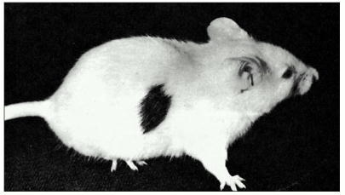
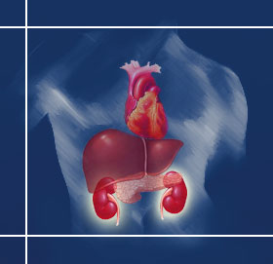
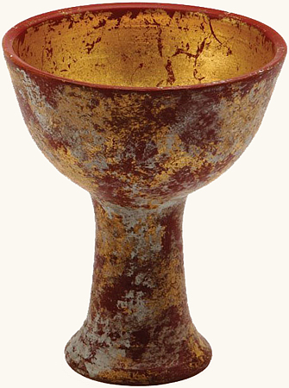
Why do we need biomarkers?...
Holy Grial in clinical Transplantation:
Tolerance
Donor-specific unresponsiveness in the context of otherwise normal immune responses
http://www.ncbi.nlm.nih.gov/books/NBK26921/
?
Notes:
Tolerance: in animal models, we define it as very long survival of organs or tissues placed into allogeneic individuals, in humans it cannot be very, very different, so a number of us embarked into the search of the Holy Grial

Slide 5
Outline
  The Indices Of Tolerance Study
  Other Biomarker of Tolerance studies
  The GAMBIT Study
    Immunosuppression Effects on IoT Signature
    New Signature of Tolerance: Validation (GAMBIT Fluidigm)

Slide 6
BioMarker-specific Challenges
  Description, validation, clinical application.
  Getting enough patients for sample collections
  Assessing and overcoming counfounders
  The challenges of academic collaborations

Slide 7
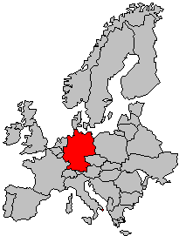
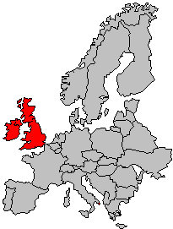
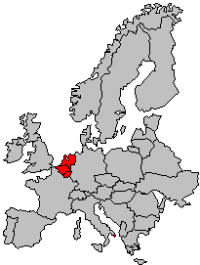
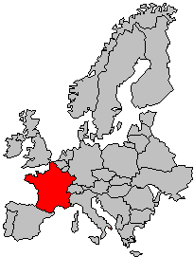
The Immune Tolerance Network
King’s College London, UK
Oxford University, UK
Miltenyi Memorec, Germany
Kathryn Wood
Uwe Janssen
Robert Lechler
Stephanie Chapman
Berlin
Maria Hernandez Fuentes
Piotr Trzonkowski
Bettina Peters
Berlin
Cologne
Stefan Tomiuk
Cologne
Pervinder Sagoo
London
Gregor Warnecke
Esperanza Perucha
London
Ian Roberts
Charité University
Medicine, Germany
Oxford
Elvira Jimenez
Oxford
Flavia Rovis
Imperial College
London, UK
Saskia Stevenson
Hans-Dieter Volk
Sharon Hughes
Anthony Warrens
Birgit Sawitzki
Immune Tolerance
Network
Amany Ballow
Guy’s Hospital, UK
Ruhena Sergeant
Rachel Hilton
Jan Waters
Robert Vaughn
Jackie and Katie
Fred Compton
McGill University Montreal, Canada
Liz, Ola and Diane
David Stephens
Institute for Medical Immunology,
ULB, Belgium
ITERT - INSERM, France
Vicki Seyfert
Larry Turka
Kenneth Newell
Kasia Bourcier
Ignacio Sanz
Wei Chungwen
James Roger
Michel Goldman
Brussels
Jean-Paul Soulillou
Ligia
Craciun
Sophie Brouard
Nantes
Cecile Braudeau
Nantes
Alain Le Moine
Myriam
Libin
Magali
Giral
Patrick Miqueu

Slide 8
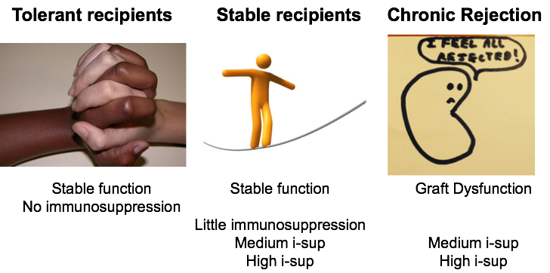
Biomarkers of Tolerance:
Patient groups
Index Group
Control Groups

Slide 9
Patient Cohorts
Training. EU | HC | Tol-DF | s-LP | s-nCNI | S-CNI | CR
n = 71 | 9 | 11 | 11 | 10 | 30 | 9
Mean Age | 44 | 54 | 44 | 49 | 42 | 52
% Female | 47 | 18 | 36 | 40 | 47 | 33
eGFR |  | 76 | 58 | 64 | 56 | 19
HLA-MM |  | 4 | 4 | 3.5 | 4 | 4
Test. USA | HC | Tol-DF | Mono |  | S-CNI | CAN
n = 89 | 31 | 24 | 11 |  | 34 | 20
Age | (18-55) | 51 | 57 |  | 44 | 51
% Female |  | 36 | 36 |  | 45 | 37
CRT mg/dL |  | 1.0 | 1.6 |  | 1.4 | 2.8
HLA-MM |  | 0.0 | 1.5 |  | 4.0 | 4.0
Notes:
An here is what we found, two cohorts of kidney transplant recipients, the index group a number of individuals that had stopped taking their immunosuppression for a number of years (range from 2 – 21) , and whose kidney function was very good.
As we are talking about biomarker discovery, the cohort that works for the search of the characteristics is called the training set, the EU cohort worked like this, and the cohort that works to validate the results is the test set, the USA cohort
HC Healthy Controls
Tol-DF Tolerant-Drug Free
s-LP Stable-Low Prednisone
s-nCNI Stable-Non Calcineurin-Inhibitor
s-CNI Stable-Calcineurin-Inhibitor
CR Chronic Rejection
Mono Monotherapy with steroids
CAN Chronic Allograft Nephropathy

Slide 10
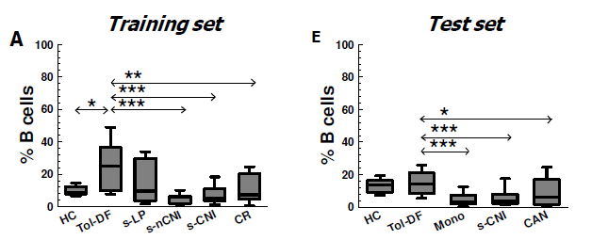
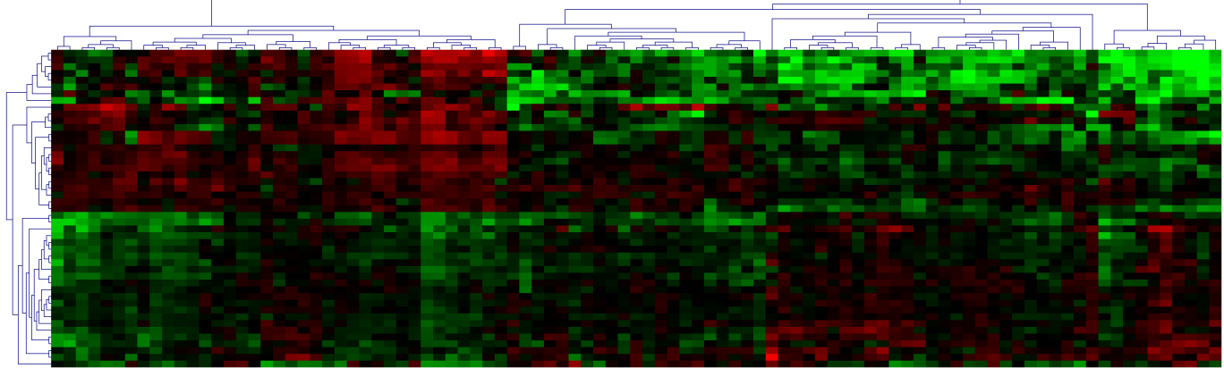
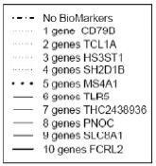
Detecting tolerance: The cross-platform signature
HC Healthy Controls
Tol-DF Tolerant-Drug Free
s-LP Stable-Low Prednisone
s-nCNI Stable-Non Calcineurin-Inhibitor
s-CNI Stable-Calcineurin-Inhibitor
CR Chronic Rejection
Mono Monotherapy with steroids
CAN Chronic Allograft Nephropathy
Sagoo P* and Perucha E*, www.transplant-tolerance.org.uk, et al. J CLIN INVEST (2010) 120 (6): 1848-1861
Notes:
Using flow cytometry we found that Tolerant kidney transplant recipients had an expansion of B lymphocytes in peripheral blood. A result that was confirmed in the USA cohort.
Using mRNA expression by microarray, we came up with a gene-singature developed in the training set and validated in the test set where 6 out of the 10 most differentially expressed genes were mainly expressed by B lymphocytes.
We also found that tolerant kidney transplant recipients had diminished anti-donor responses by IFNg ELISpot.

Slide 11
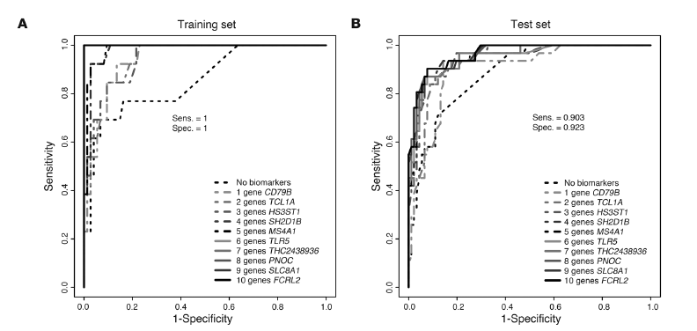
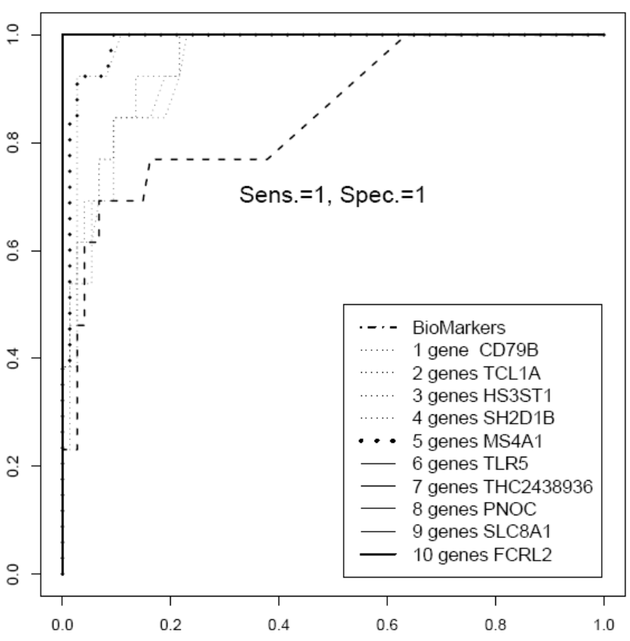
Predicted Probability of being tolerant
EU
USA
Sensibility = 0.903
Specificity = 0.923
Sensibility = 1
Specificity = 1
Sagoo P*, Perucha E*, www.transplant-tolerance.org.uk, et al. J CLIN INVEST (2010) 120 (6): 1848-1861

Slide 12
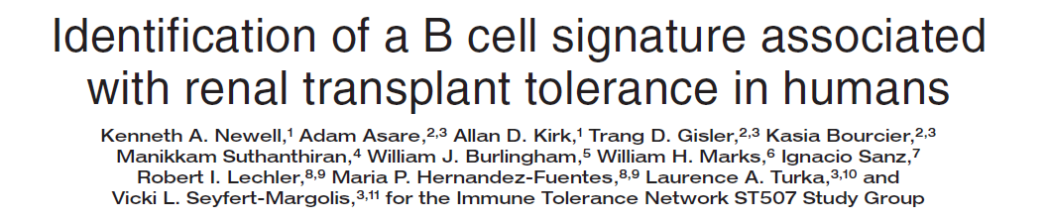
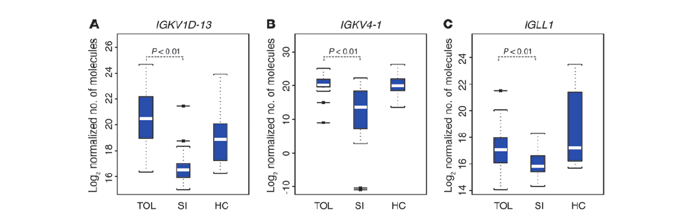
Tolerant subjects showed increased expression of multiple B cell differentiation genes.
A set of just 3 of these genes distinguished tolerant from non-tolerant recipients in a unique test set of samples.
Newell K, et al www.immunetolerance.org, et al. J CLIN INVEST (2010) 120 (6): 1836-47

Slide 13
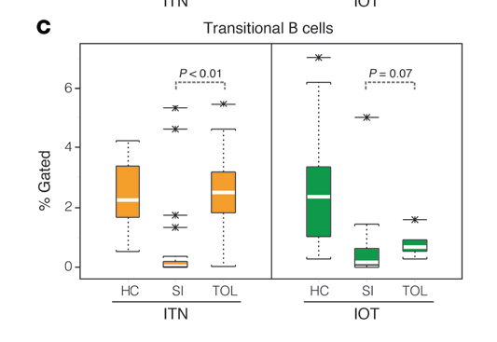
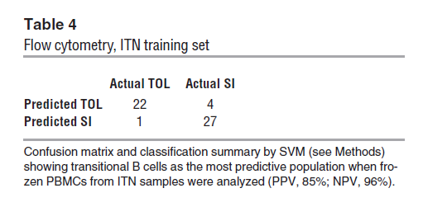
Transitional B cells in Tolerant recipients
Newell K, et al www.immunetolerance.org, et al. J CLIN INVEST (2010) 120 (6): 1836-47

Slide 14
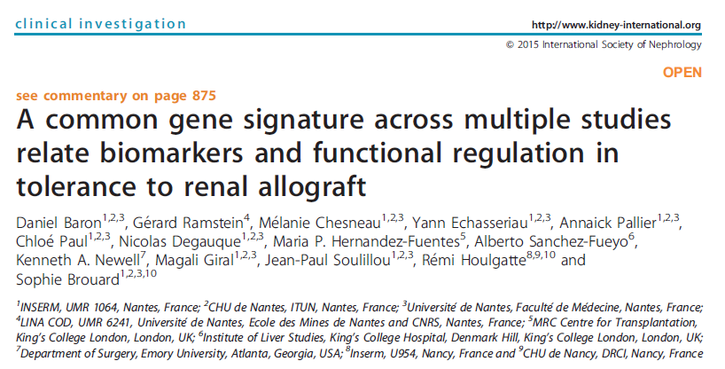
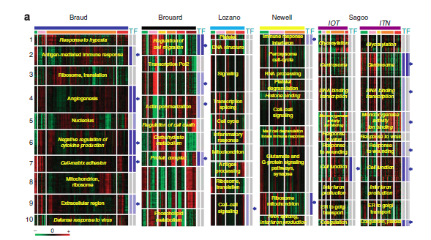

Slide 15
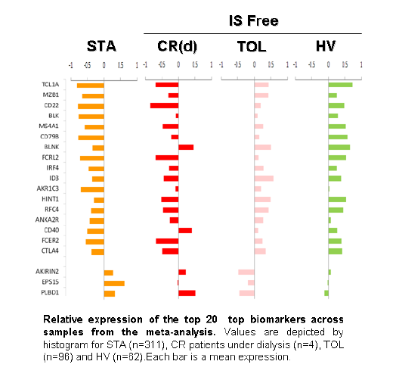

Slide 16
Conclusions 1
A number of gene signatures have been described and validated that identify patients that are operationally tolerant with high specificity and sensitivity
A general picture emerges whereby B-cell genes seemed to be differentially expressed and early B lymphocytes numbers / percentages are maintained
Initial “description” challenge ✓

Slide 17



Genetic Analysis & Monitoring of Biomarkers of Immunological Tolerance
GAMBIT study
Notes:
We have then set out to further validate these markers in what our imaginative Database Manager Florence Delaney has named the GAMBIT study.
Mike GAMBIT from The New Avengers. Or the X-Men Gambit Rémy Etienne LeBeau

Slide 18

The GAMBIT Consortium. NIHR CRN
King’s College London, UK
St Jame’s Hospital
Leeds
Hull Royal Infirmary
Maria Hernandez Fuentes
Cardiff and Vale University Health Board
Dr Sunil Bhandari
Sonia Norris
Estefania Nova-Lamperti
Paula Mobillo
Yogesh Kamra
Mano Runglall
Jonathan Lo
Tom Lewis
Florence Delany
Irene Rebollo-Mesa
Rosalynn Miller
Darlene Catalan
Jude Green
Robert Lechler
Graham Lord
Dr Richard Baker
Karen James
Tracy Cathcart
Dr Aravind Cherukuri
Shyama-Parbatee Rughooputh
Dr Sian Griffin
Leicester General Hospital
Royal Free Hospital
Dr Sue Carr
Dr Alan Salama
Rachel Westacott
Roy Marshall
King’s College Hospital
Manchester Royal
Infirmary
Dr Sui Phin Kon
Beatriz Tucker
Nicolene Atkinson
Queen Alexandra Hospital,
Postmouth
Dr Hany Riad
Dr Nick Simon
Kent and Canterbury
Dr Judith Stevens
Clare Griffin
Dr Chris Farmer
Lynn Watkins
Frances Williams
Hospital Universitari Vall d'Hebrón, Barcelona
Guy’s Hospital, UK
Gillian Eaglestone
Hazel Broad
Rachel Hilton
Dr Daniel Seron
Robert Vaughn
Northern General Hospital,
Sheffield
Maria Sarria
Evelina Children’s Hosp
Salford Royal
Dr Manish Sinha
Dr Phillip Kalra
Dr William McKane
INSELSPITAL, Universitätsspital Bern
Liz Reus, Joy & Paula
Lesley Haydock
Faith Okuhoya
Dr Markus Mohaupt
Petra Hribova
St George’s Hosp
Glasgow General Hospital
Dr Iain McPhee
Dr Joyce Popoola
Dr Patrick Mark
Transplantační laboratoř IKEM, Prague
Donna Kelly
Lorraine McGregor
Great Ormond Street
Upsala Hospital, Sweden
Raj Ramkhelawon
Dr Stephen Marks
Dr Ondrej Vickliky
Petra Hribova
Dr David Berglund

Slide 19
The GAMBIT Study
External Validation
in Independent Sample
Technical Validation
in different platform: RT-PCR
Stability of Signature:
Repeated Samples
Proof of Concept:
Steroid Withdrawal

Slide 20
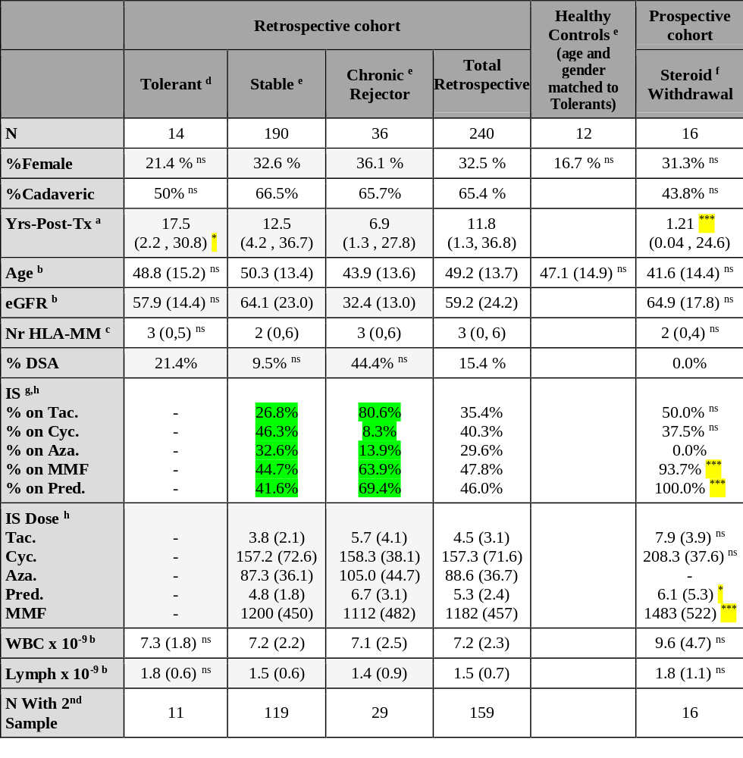

GAMBIT: Population data

Slide 21
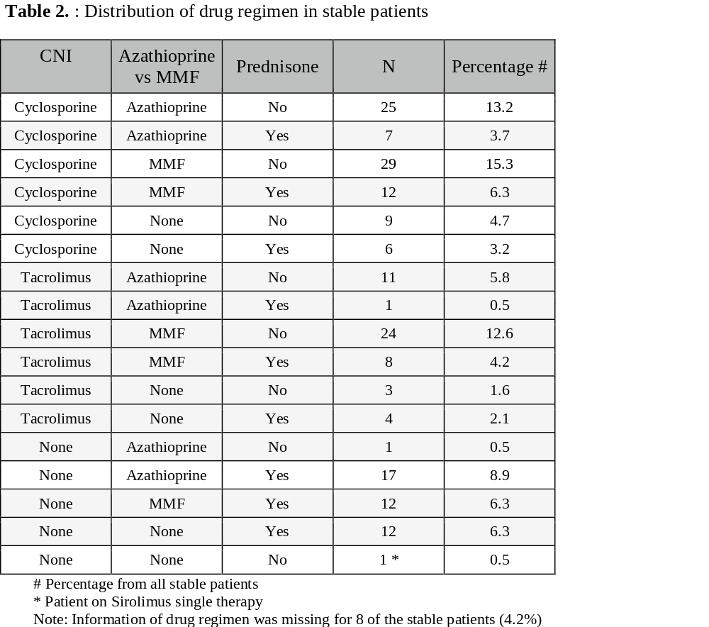
Immunosuppression in GAMBIT
Retrospective
collection!
17 groups

Slide 22
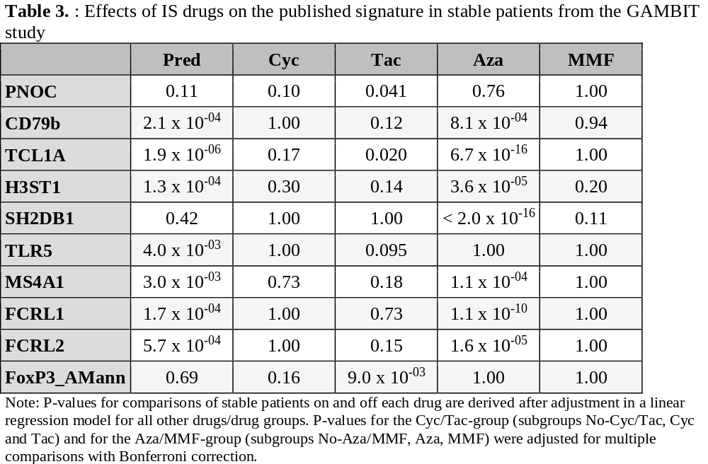
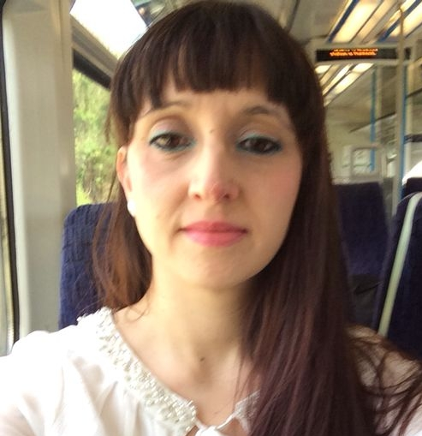
Effect of immunosuppression in gene expression
Rebollo-Mesa, et al AJTx 2016

Slide 23
BioMarker-specific Challenges
  Description, validation, clinical application.
  Getting enough patients for sample collections
  Assessing and overcoming counfounders
  The challenges of academic collaborations

Slide 24
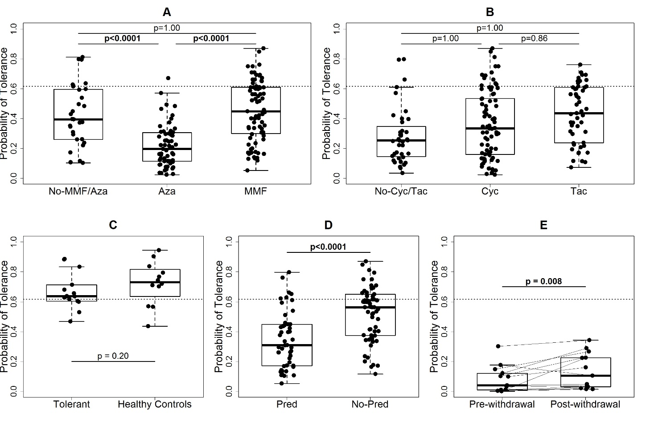
Immunosuppressants had a confounding effect on the expression of IoT gene set
Rebollo-Mesa, et al AJTx 2016

Slide 25
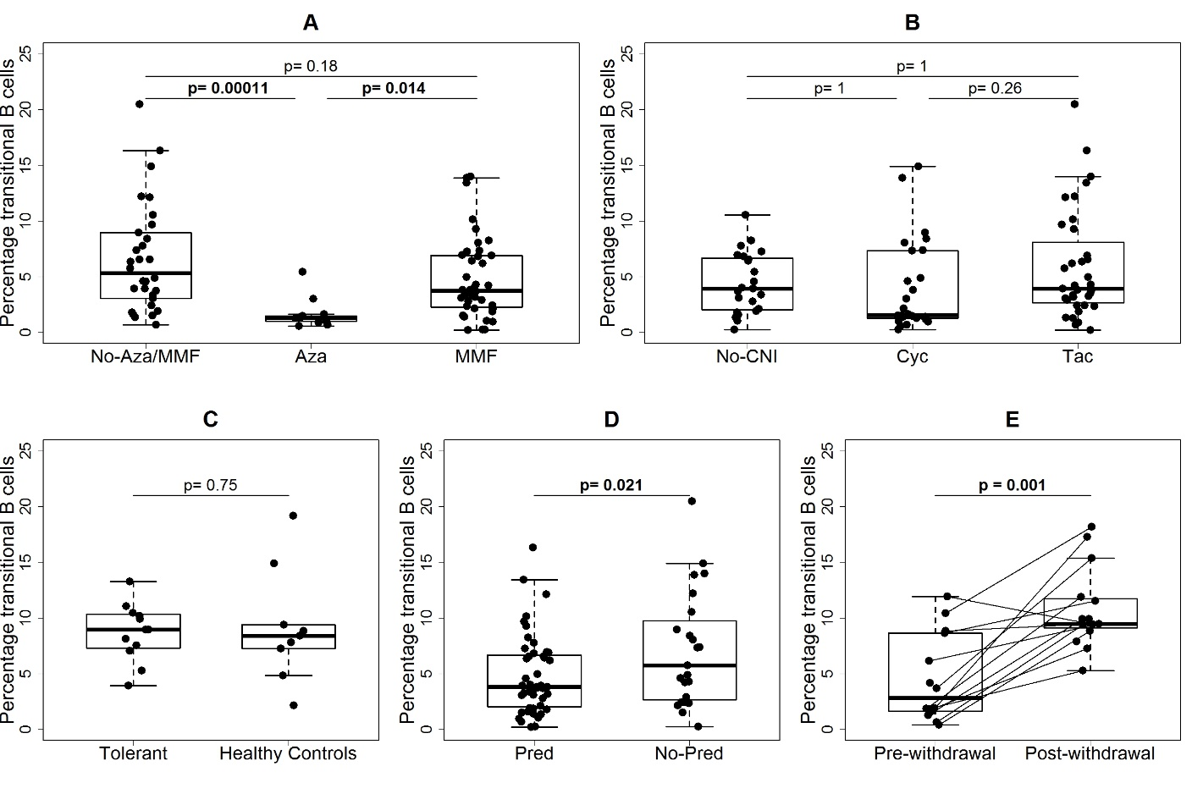
Immunosuppressants affected the transitional B cell subset size.
Rebollo-Mesa, et al AJTx 2016

Slide 26
Conclusions 2
RT-PCR = Diagnostic platform for gene expression
Immunosuppression drugs the patients are taking
    have a major effect on the expression of the chosen genes
    major effect on the percentage of lymphocyte subset specifically on Transitional B cells.

Slide 27

BioMarker-specific Challenges
  Description, validation, clinical application.
  Getting enough patients for sample collections
  Assessing and overcoming counfounders
  The challenges of academic collaborations

Slide 28
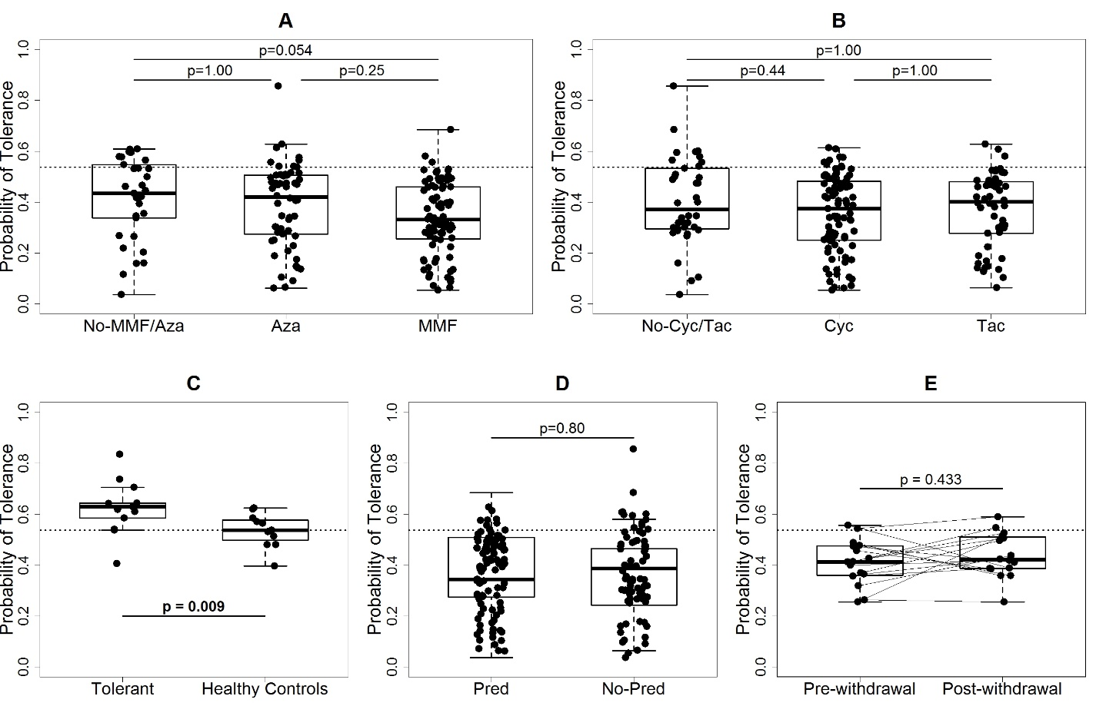
Validation : Novel Gene expression set.
Robust immunosuppression independence. Fluigdigm
Rebollo-Mesa, et al AJTx 2016

Slide 29
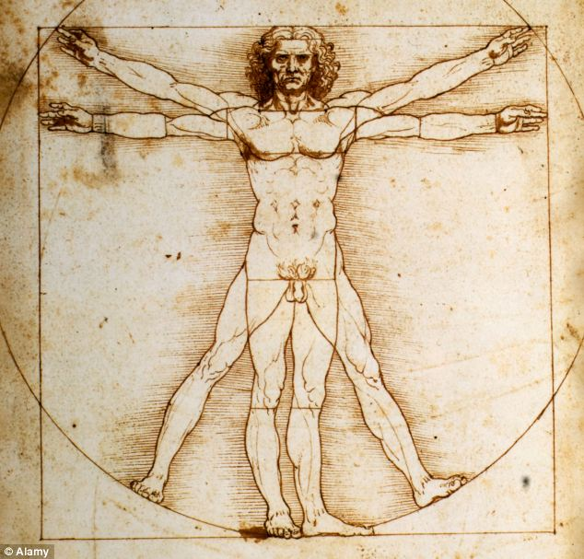
Retrospective Design Challenge
Gene Expression
in stable patients
“Biology due to IS
effects”
“Biology due to being tolerant”

Slide 30
BioMarker-specific Challenges
  Description, validation, clinical application.
  Getting enough patients for sample collections
  Assessing and overcoming counfounders
  The challenges of academic collaborations

Slide 31
International Consortia for Biomarkers of Tolerance in kidney transplantation
Acronym | Description | Year | Web page
ITN | Immune tolerance network | Since 2002 | www.immunetolerance.org
IOT | Indices of tolerance | 2003–2007 | www.nds.ox.ac.uk/riset/before-riset-the-indices-of-tolerance-project
RISET | Reprogramming the immune system for establishment of tolerance | 2005–2010 | www.nds.ox.ac.uk/riset
GAMBIT study | Genetic analysis and monitoring of biomarkers of immunological tolerance | 2010 | www.kcl.ac.uk/medicine/research/divisions/timb/research/tolerance/gambit/index.aspx
The One Study | A unified approach to evaluating cellular immunotherapy in solid organ transplantation | 2011 | www.onestudy.org
Bio-DRIM | Personalized minimization of immunosuppression after solid organ transplantation by biomarker-driven stratification of patients to improve the long-term outcome and health-economic data of transplantation | 2012 | www.biodrim.eu
BIOMARGIN | Biomarkers of renal graft injuries in kidney allograft recipients | 2013 | www.inserm.fr
Viklicky O, Hribova P, Brabcova I. Molecular markers of rejection and tolerance: lessons from clinical research.
Nephrol Dial Transplant. 2013 Nov;28(11):2701-8. doi: 10.1093/ndt/gft102. Epub 2013 Jun 5.

Slide 32
Conclusions 3
We NEED robust statistical methods that prevent false-positive results, and control confounding is essential prior to translation of clinical prediction models.
New-signature controls for the alterations of the immune effector pathways transiently activated or inhibited by IS drugs.
This signature highlights “biology due to tolerance”.

Slide 33

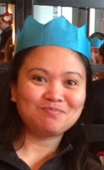
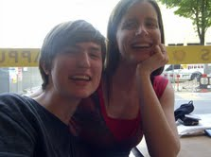
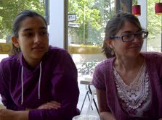


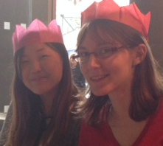
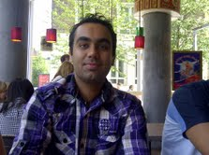
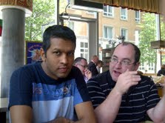

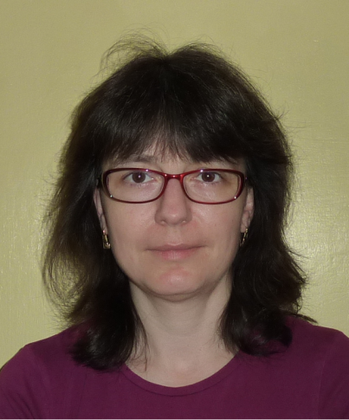



Guy’s and St Thomas’ NHS Foundation Trust and King’s College London’s
Comprehensive Biomedical Research Centre
Estefania
Nova-
Lamperti
Darlene J
Catalan
Florence
Delaney
Rosalynn
Miller
Paula
Mobillo
Jonathan Lo
Nicola Smallcombe
Jennifer Mullan
Sonia Norris
Akiko
Tsutsui
Claire
Duffy
Yogesh
Kamra
Mano
Runglall
Tom
Lewis
Dr Rachel Hilton
Dr David Game
Prof Steve Sacks
Prof Graham Lord
Prof Robert Lechler
Drs Irene Rebollo-Mesa
& Sofia Christakoudi
Dr Jean Harrington
Prof Myfanwy Morgan
Tissue typing at Guy’s Hospital:
Dr Robert Vaughn, Livvy Shaw & Team

