Slide 1

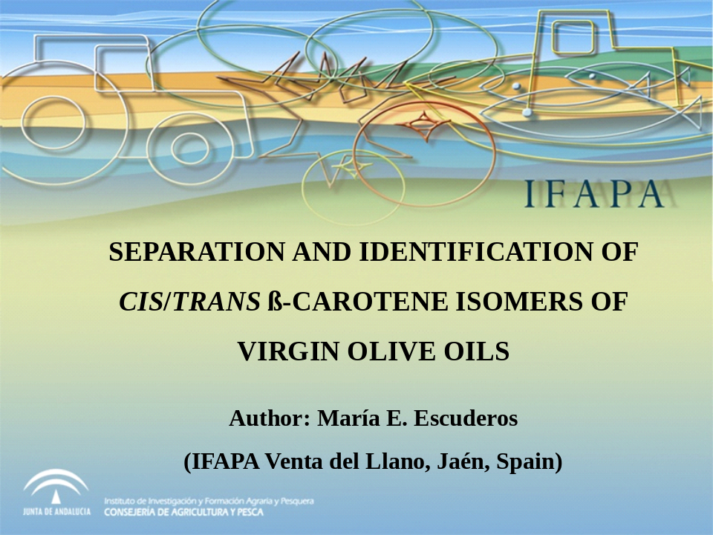
SEPARATION AND IDENTIFICATION OF CIS/TRANS β-CAROTENE ISOMERS OF VIRGIN OLIVE OILS
Author: María E. Escuderos
(IFAPA Venta del Llano, Jaén, Spain)

Slide 2

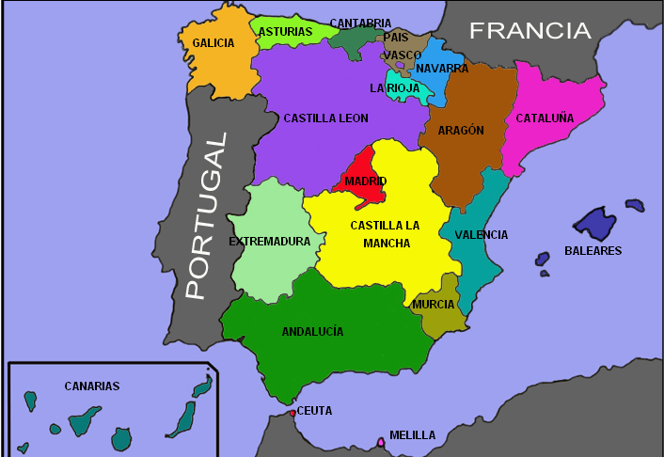
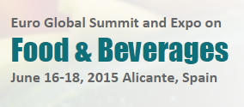
Where is IFAPA?
IFAPA

Slide 3
http://www.juntadeandalucia.es/agriculturaypesca/ifapa
IFAPA was born to help the demands of the Andalusian agricultural, fishing, aquaculture and agri-food sectors.
IFAPA programs are the tool to boost the agricultural and fishery sector to bring the knowledge and innovation as new ways of work aiming to create wealth, quality employment, and social welfare in Andalusia.

Slide 4
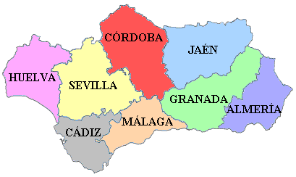



IFAPA NETWORK (18 centres)
http://www.juntadeandalucia.es/agriculturaypesca/ifapa

Slide 5
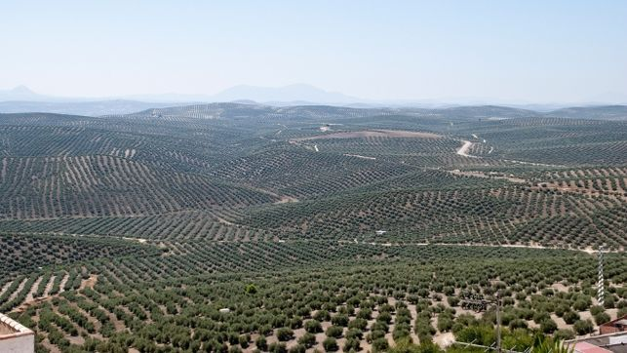
IFAPA VENTA DEL LLANO (JAÉN-SPAIN)
It was founded in 1902.
Specialized in:
  Olive oil technology and industrial process.
  Quality virgin olive oil.
  Olive cultivation.

Slide 6
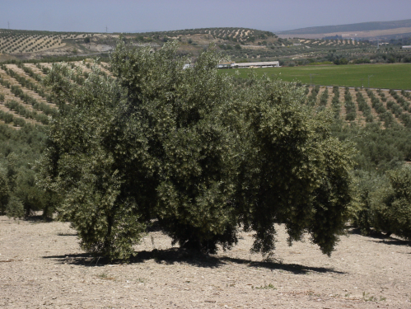
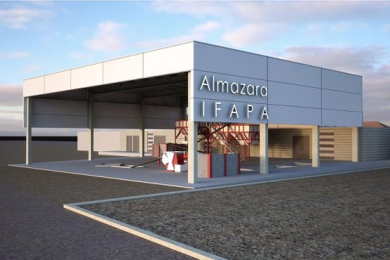
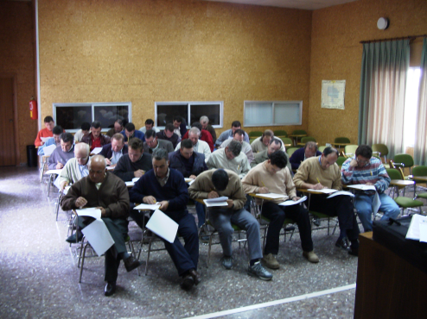
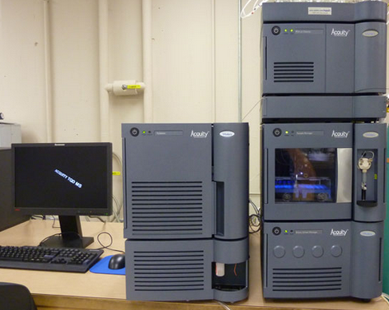
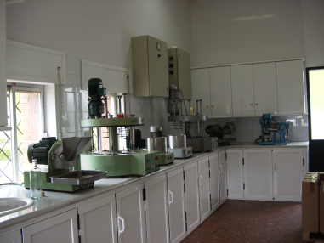
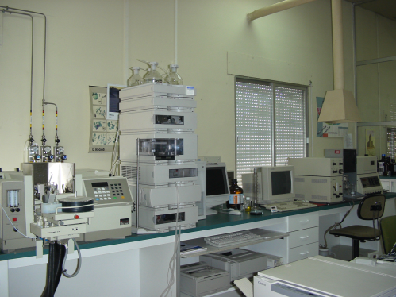
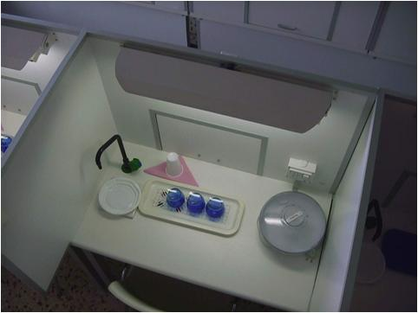
IFAPA VENTA DEL LLANO (JAÉN): Equipments
100 Ha olive farm
Experimental olive oil mill
Classroom
Laboratories
Olive oil tasting room (COI T 20 / Doc 15 / Rev 7)

Slide 7
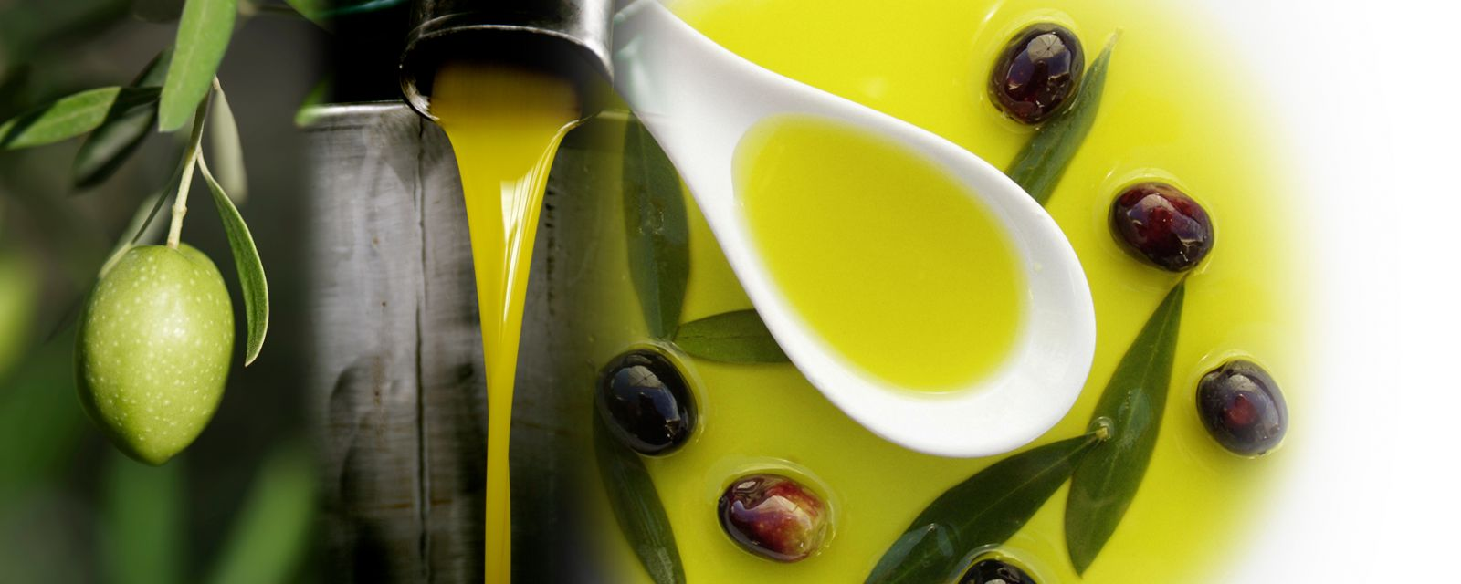
SEPARATION AND IDENTIFICATION OF CIS/TRANS β-CAROTENE ISOMERS OF VIRGIN OLIVE OILS
INTRODUCTION
β – carotene pigment

Slide 8
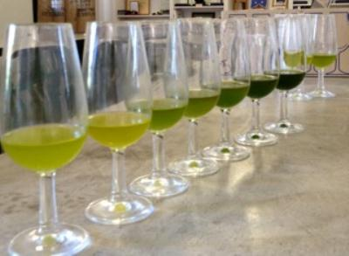
INTRODUCTION
Cultivars
The degree of ripeness of the olive fruit
Environmental conditions
Processing techniques
Storage conditions

Slide 9

INTRODUCTION
Commission Implementing Regulation (EU) No 1348/2013
Extra-Virgin Olive Oil
(trans β-carotene)
Virgin Olive Oil
(trans β-carotene)
Lampante Olive Oil
Refined process (↑Tª)
Bottled
Bottled
Refined olive oil
(stigmastadienes)
Market
Market
Virgin Olive Oil
The carotenoid profile of virgin olive oil can be used as a parameter of quality and authenticity for this product
Olive Oil
(cis β-carotene)
Bottled
Market

Slide 10
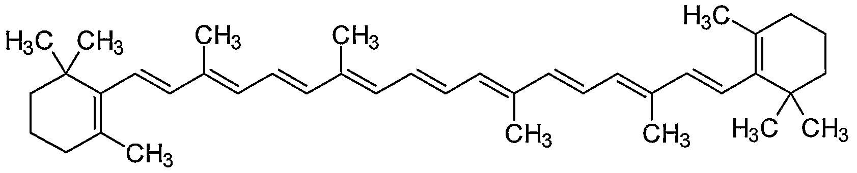
OBJECTIVE
Actually, chromatographic methods disadvantages:
β-carotene extract contains others components that can interfere in the subsequent identification and separation.
The oil amount used is very low, so some cis isomers are not detected.
A new, rapid and precise analytical method was developed for the quality and quantity determination of trans-β-carotene and cis-isomers to detect olive oils subjected to soft temperature process.

Slide 11
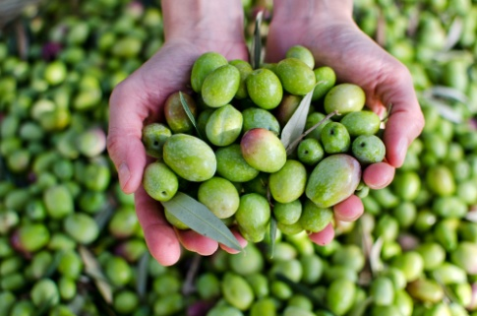
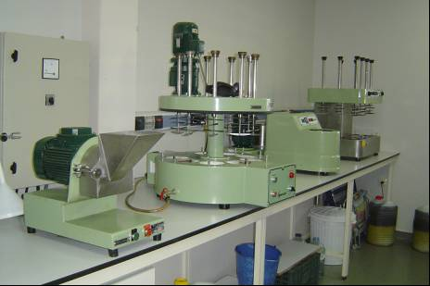
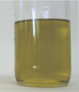
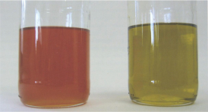
MATERIALS
Olives cv. Picual
Abencor system
Extra-Virgin Olive Oil cv. Picual
β – carotene standard
Extra-Virgin Olive Oil (blank sample)
Fortified Extra-Virgin Olive Oil

Slide 12

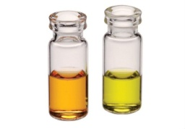
METHODS
Extraction of β-carotene
Cold-saponification
Liquid-phase distribution
Evaporation in rotavapor (30ºC)
Re-dissolution in 2.5 ml acetone
C30 colum (3 µm)
MetOH:TBME:H2O
λ 450 nm
HPLC (UV-Visible detector)

Slide 13
RESULTS AND DISCUSSION
Linearity and detection limit
Calibration line: y = 0.1745x + 0.0617
(R²: 0.9986)
Concentration range (µg/mL) | LOD (µg/mL) | LOQ (µg/mL) | Repeatability (%) | Recovery (%)
0.050 – 10.000 | 0.18 | 0.62 | 3.18 | 79.57
LOD: 3 × standard deviation of low concen/slope of the calibration line.
LOQ: 10 × standard deviation of low concen/slope of the calibration line

Slide 14
RESULTS AND DISCUSSION
Identification of β-carotene isomers (150ºC heating)
EVOO
OO heated 150ºC 20 min
1 | 13,15-di-cis
2 | 15-cis
3 | 13-cis
4 | 9,15-di-cis
5 | All-trans
6 | 9-cis
2
1
Bibliography: Strohschein et al., 1999; Qiu et al., 2009; Qiu et al., 2012; Achir et al., 2010.

Slide 15
RESULTS AND DISCUSSION
Changes (ppm) in the carotenoid profile in virgin olive oils (150ºC)
*Mean of three replicates
Bibliography: Chen et al., 1994; Achir et al., 2010; Qui et al., 2012.

Slide 16
RESULTS AND DISCUSSION
Changes (%) in the carotenoid profile in virgin olive oils (150ºC)
All-trans
All-cis

Slide 17
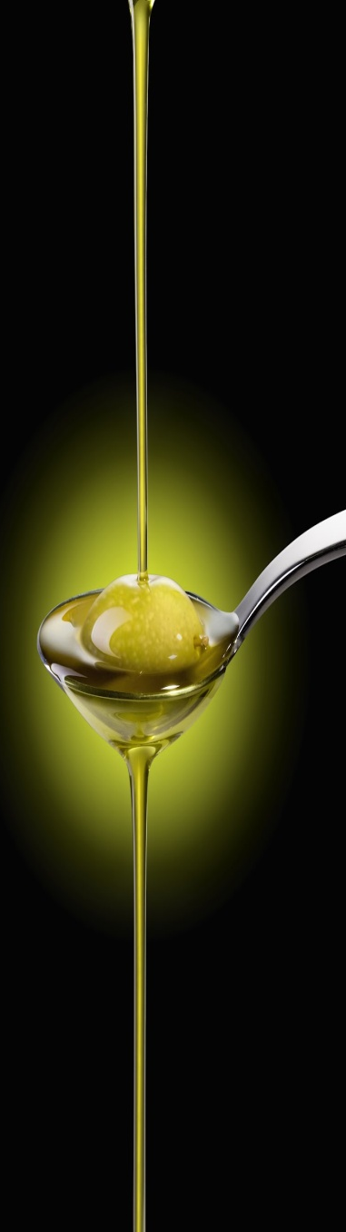
CONCLUSIONS
Conclusions
Carotenoids naturally exist in the all-trans forms in VOO.
Carotenoid profile of an olive oil can be used as parameter of quality and authenticity for this product ⇒ soft temperature process causes the isomerization of all-trans to cis forms.
The developed method, based on cold-saponification and liquid-phase extraction, is suitable for the isolation of β-carotene isomers in olive oils.
The use of C30 of 3μm column with HPLC technique for the separation of carotenoids leads to a good separation and short analysis times and results in sharp peaks which facilitate good detector response.

Slide 18
SEPARATION AND IDENTIFICATION OF CIS/TRANS β-CAROTENE ISOMERS OF VIRGIN OLIVE OILS
Author: María E. Escuderos mariae.escuderos@hotmail.com

