Slide 1
About OMICS Group
OMICS Group is an amalgamation of Open Access Publications and worldwide international science conferences and events. Established in the year 2007 with the sole aim of making the information on Sciences and technology ‘Open Access’, OMICS Group publishes 500 online open access scholarly journals in all aspects of Science, Engineering, Management and Technology journals. OMICS Group has been instrumental in taking the knowledge on Science & technology to the doorsteps of ordinary men and women. Research Scholars, Students, Libraries, Educational Institutions, Research centers and the industry are main stakeholders that benefitted greatly from this knowledge dissemination. OMICS Group also organizes 500 International conferences annually across the globe, where knowledge transfer takes place through debates, round table discussions, poster presentations, workshops, symposia and exhibitions.

Slide 2
OMICS International Conferences
OMICS International is a pioneer and leading science event organizer, which publishes around 500 open access journals and conducts over 500 Medical, Clinical, Engineering, Life Sciences, Pharma scientific conferences all over the globe annually with the support of more than 1000 scientific associations and 30,000 editorial board members and 3.5 million followers to its credit.
OMICS Group has organized 500 conferences, workshops and national symposiums across the major cities including San Francisco, Las Vegas, San Antonio, Omaha, Orlando, Raleigh, Santa Clara, Chicago, Philadelphia, Baltimore, United Kingdom, Valencia, Dubai, Beijing, Hyderabad, Bengaluru and Mumbai.

Slide 3

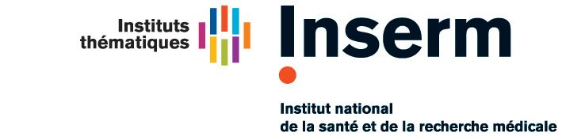


In silico screening to discover inhibitors of protein-protein interactions targeting angiogenesis
Maria A. Miteva
Molécules Thérapeutiques in silico (MTi)
Inserm U973 - University Paris Diderot
Team “VLS, PPI & ADMET in silico”
Valencia, August 25, 2015
Notes:
-------------
First of all I I would like to thank to the orgamnizers to inviting me to give this talk here for this meeting –
f the studies that I ve done with my team focusing on PPI & ADMET predictions, which is a part of the lab MTI - at Inserm , the Nat Health Res Instit in France

Slide 4
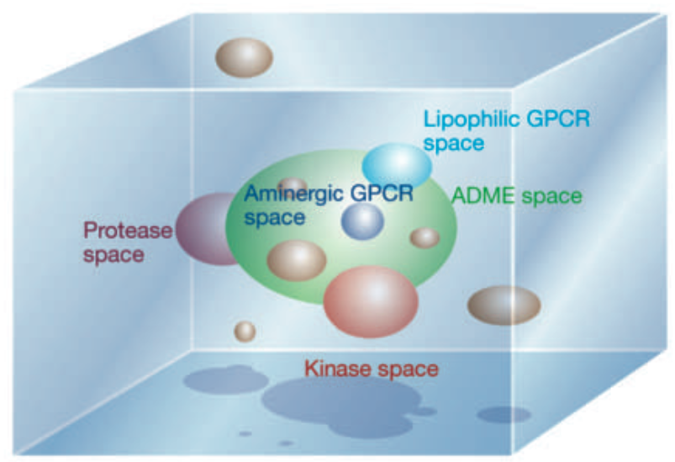
Modulate PPIs by low MW compounds
Estimated 150.000 to 650.000 PPIs insufficiently exploited
(Stumpf et al PNAS 2008)
Many PPI associated to specific diseases (Wells & McClendon Nature 2007)
  Growing interest of industry to low MW PPI modulators
20 LMW PPI cmpds are in phase I to III clinical trials;
Expected sales worldwide of over $800 million/year within 4 years
  (Mullard Nature Rev Drug Discov 2012)
It is difficult to modulate PPI with a small molecule:
  PPI interfaces: flat, large, flexible
  no sufficient data on chemical space to modulate PPI
no sufficient knowledge on key physico-chemical
  characteristics of low MW PPI modulators
  compared to other protein families !
Lipinski C. Nature. 2004
Notes:
Why we are interested in small maolecules PPI modulators
…
Chemical probes to investigate molecular mechanisms and establish proofs of concept
What are the chellenging and original points to focus on whem working on small mol PPI modulators
Growing interest of industry to low MW PPI modulators since
1st particularity is that PPI interfaces are different from the traditional proteins targets as enzymes or GPCR with binding pockets optimized by the nature ; the PPI interfaces are - large, flexible, with several small cavities
2nd point regarding the satte of the art – rarity of hits becuae our knowledge on on key physico-chemical characteristics to modulate PPI is not suffiicient , in contrary to other traditional prtotein targets as enzymens kinases, CGCP etc.
Rarity of hits: no sufficient knowledge on key physico-chemical characteristics of low MW PPI modulators in contrary to other families well-established protein target families
- PPI - small - all industy is intersted car many problem with peptides in humans ( pour ADMET - difficult for small organics but much more problems for peptides - the priority is stll orally administrable drugs for most of the disesae, also biologic agent - a lot of immunity problem;) - the paper in 20011 - for several industry on small PPI; we have the first DB with more than 1000 cmps opening the porte for much more seroirs analysis on chemical space - the internat interest demonstaretes that

Slide 5
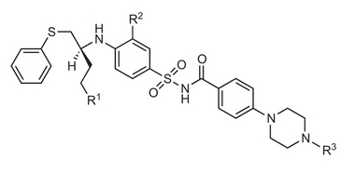


Modulation of PPIs
Examples of modulation
Orthosteric inhibition:
Allosteric inhibition: (conformation, dynamics)
Interfacial binders: the ligand binds to a pocket that is transiently formed and locks the complex in a nonproductive conformation
Stabilization of PPIs (here also different mechanisms)
Jin et al. Annual Rev Pharmaco Toxico, 2014
Ottmann et al. Angew. Chem. Int. Ed. 51, 2012
Zhang et al. Plos One 2014 9:e110884
Notes:
3 osnovi proncipa: …

Slide 6
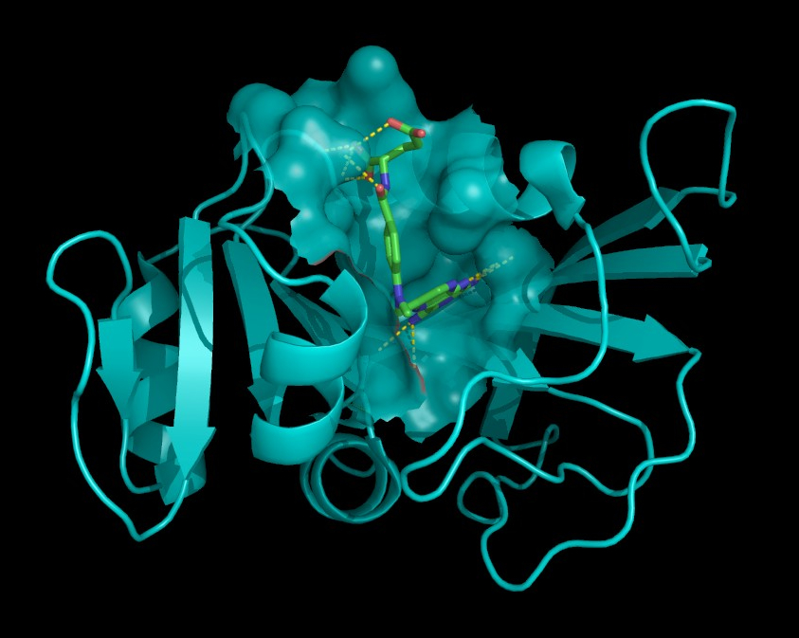
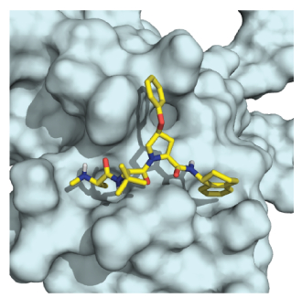
Small-molecule (LMW) binding pockets
Cmpds have been essentially developed for regular pockets
Depth:
7-11 Å
Dihydrofolate reductase
methotrexate
1TFT: Xiap-caspase 9
Enzyme pockets
“PPI pockets”
In general 3 to 5 subpockets, each ~ 50 Å³
Transient pockets
Interface regions likely to be ligandable are more predisposed to surface pocket formation
Hydrophobicity: 60 to 80 %
Surface area: 300-600Å²
Volume (smaller for allosteric): ~500 Å³
Perot et al. Drug Discov Today 2010
Li et al, J Mol Graphics & Model, 2013
Fuller et al., Jackson, DDT 2009
Eyrisch & Helms, 2007
Karanicolas et al, Plos Comput Biol, 2013
Gao & Skolnick, Plos Comput Biol, Oct 2013
Notes:
Major meaning for chemistry
For pockets at the interface, more exposed cmpds often translate to lower ligand efficiency. Yet, druggable pockets can form with little energetic cost, this preferencially at the interface

Slide 7
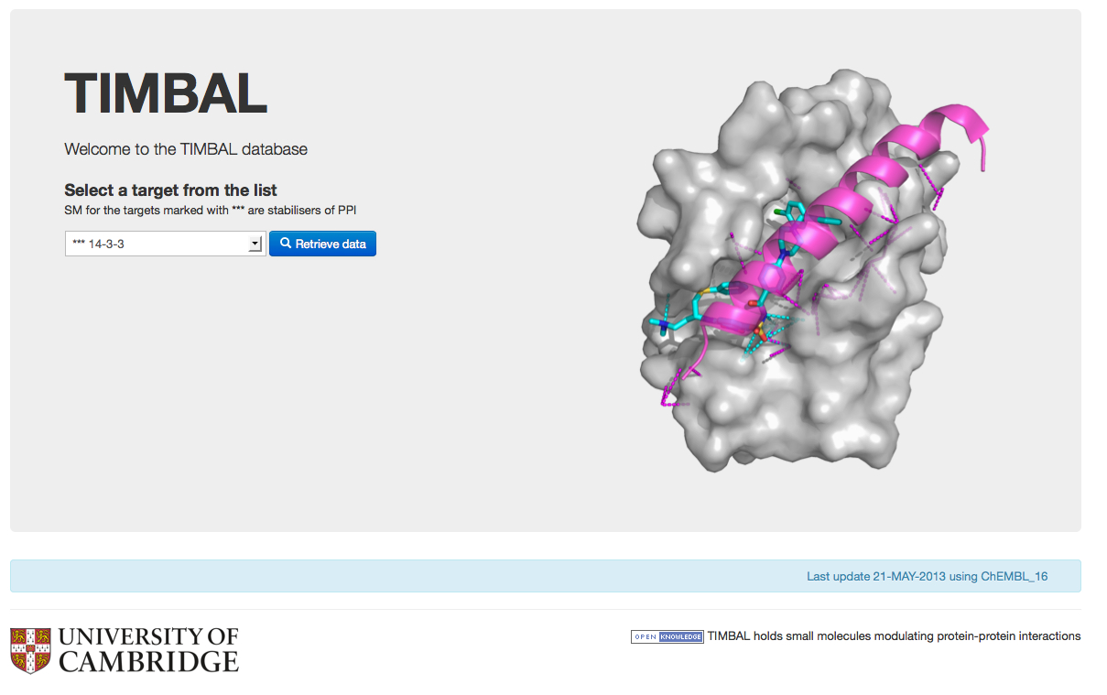

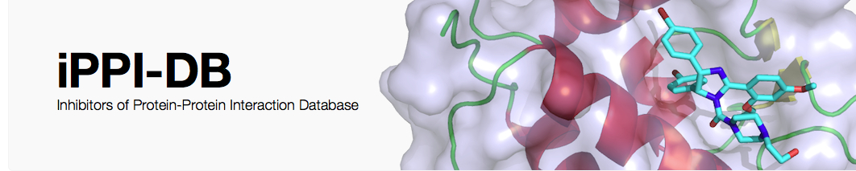
LMW Modulators of PPI :Databases
Need data to learn :
TIMBAL : small molecules that modulate PPI
created in 2008, by manually curating information;
Now automated searches on the ChEMBL database (about 8000 cmpds)
Higueruelo et al, 2009
Blundell Lab, Chem Biol & Drug Design
2P2I_{DB} : structures of PPI complexes with known small molecule inhibitors; ~200 small molecule inhibitors (hand-curated)
Basse et al, NAR, 2013
Bourgeas et al, PlosOne 2010, (Morelli's lab)
iPPI-DB : 1650 (soon ~2000) non-peptidic inhibitors across 13 families of PPI (hand-curated)
Labbé et al. Drug Discov Today 2013
Villoutreix et al. Mol Inform 2014

Slide 8
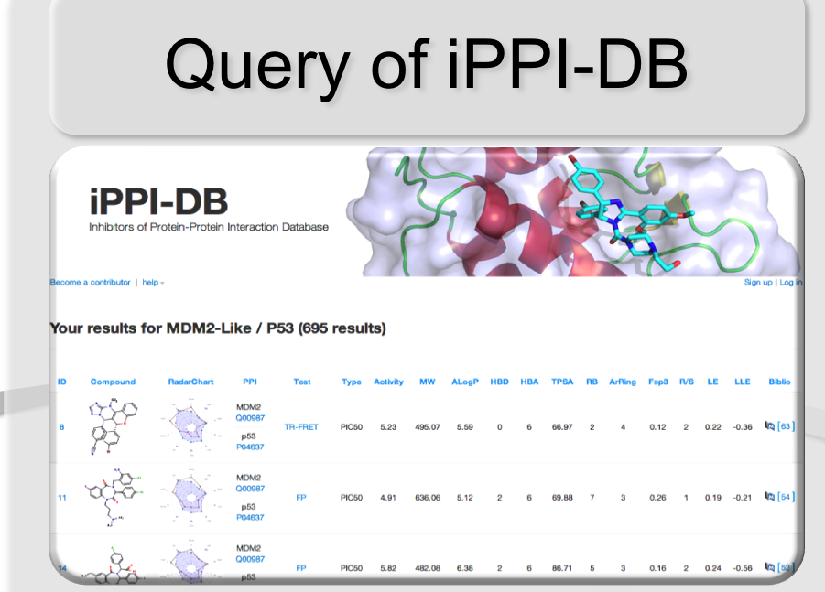
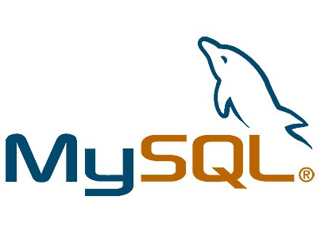
iPPI-DB: A Unique Database of small-molecule modulators of PPI
      Source
        Litterature (PubMed), world patents
        Manually curated by a medicinal chemist
      Criteria
        Activity : IC50, Ki, Kd, EC50 --> < 30 μM
        Absence of reactive or promiscuous groups
        Rule out peptides (Absence of 3 continuous peptide bonds) & macrocycles
Labbé et al. Drug Discov Today 2013
Nb of iPPI | Nb of assay data | Nb of PPI | Nb of References
1650 | 2435 | 31 | 117 | 84 articles
 |  |  |  | 33 world patents
http://www.ippidb.cdithem.fr
Notes:
Contributor mode access
access to all iPPI
Standard user access
access to a representative subset
Toxic groups - Avec medic. Chemist !!

Slide 9
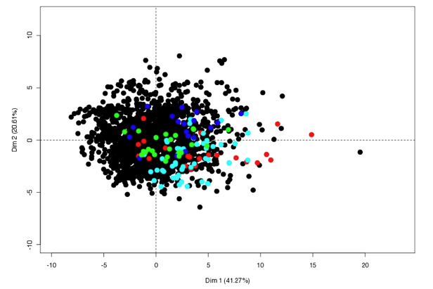
Chemical Space of i-PPI
Enzymes,
Bcl-2, MDM2,
LFA, Xiap
PPI modulators do not cover the chemical space of enzyme inhibitors:
? Need of new PPI modulators
Sperandio et al. Plos Comput Biol 2010
Villoutreix et al. Mol Informat 2014
Notes:
Problem with the chemical space !
Peparing the compound collection is critical
It is possible to navigate into this space with in silico tools
namely the p53/MDM2, Xiap/smac, Bcl-2 family/Bak, and ICAM-1/LFA-1 interactions
X-linked inhibitor of apoptosis protein (XIAP) is a potent inhibitor of caspases 3, 7 and 9, and mitochondrial Smac (second mitochondria-derived activator of caspase) release during apoptosis inhibits the activity of XIAP. In this study we show that cytosolic XIAP also feeds back to mitochondria to impair Smac release.
ICAM-1 is a ligand for LFA-1 (integrin), a receptor found on leukocytes.^{[5]} When activated, leukocytes bind to endothelial cells via ICAM-1/LFA-1 and then transmigrate into tissues.^{[6]}
Principal component analysis
a representative pool of 1730 chemically diverse inhibitors active on the most widely studied enzymes including some kinases, all taken from the binding database[25] (www.bindingDB.org)
46000 active compounds which was submitted to fingerprint-based sampling (ward clustering) to ensure chemical diversity. A series of 24 interpretable molecular descriptors (Table 1) such as molecular weight, AlogP, number of sp3 carbon, number of rings, etc…

Slide 10
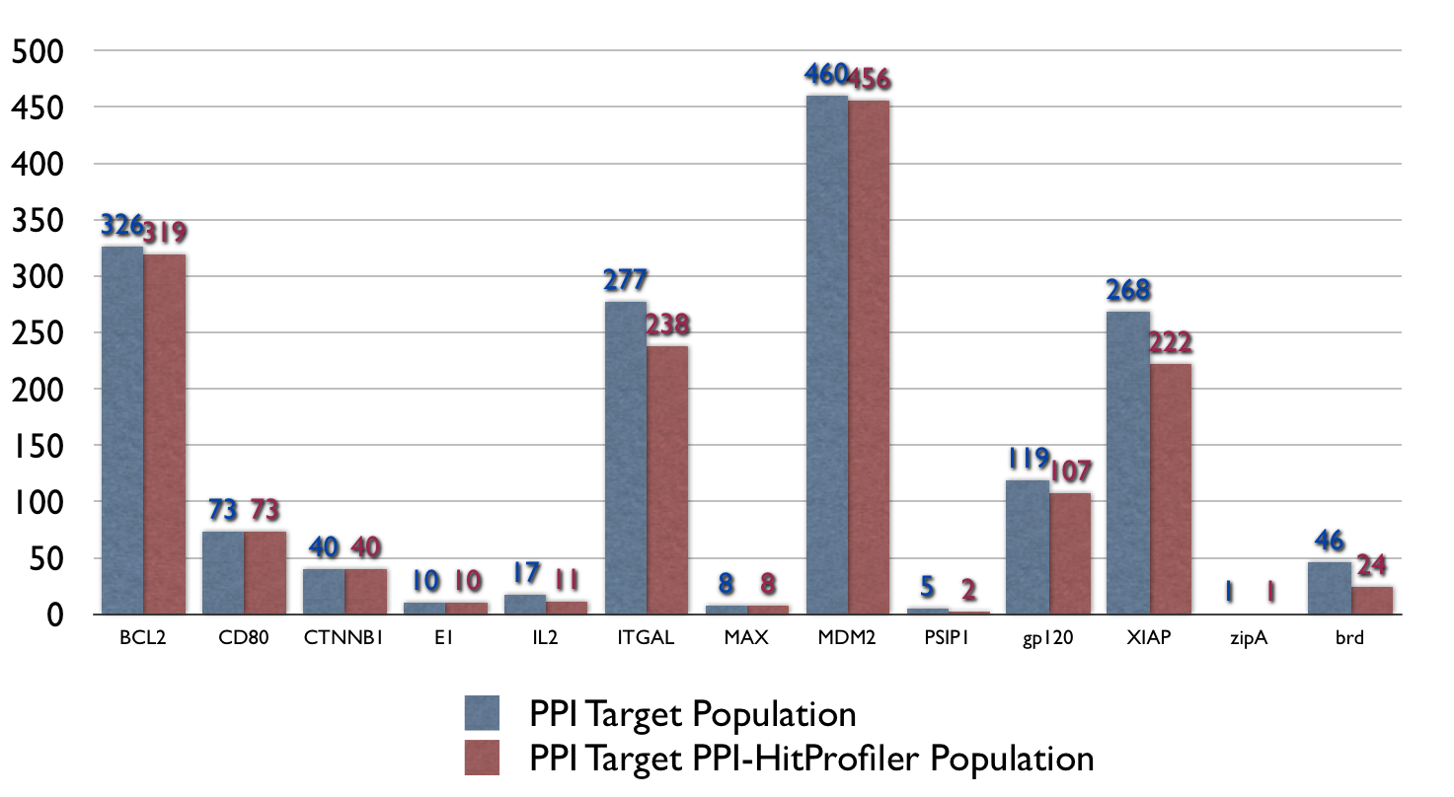
iPPI-Focused collections
Original Filter: PPI-HitProfiler
Specific molecular shape
Multiple bonds and aromatic rings
Validated on the experimental binding data of
500,000 cmpds from PubChem BioAssay and 11 PPI targets
iPPI-lib HitProfiler
http://www.cdithem.fr/getPPIHitProfiler.php or via FAFDrugs3
Sperandio et al. Plos Comput Biol 2010
iPPI-lib
3 mln PubChem cmps FAF-Drugs3 PPI-HitProfiler FCFP_4 Tanimoto 0.3
50,000 drug-like i-PPI like molecules
iPPI-lib & MTiOpenScreen web-server
http://bioserv.rpbs.univ-paris-diderot.fr/services/MTiOpenScreen/
Labbe et al. NAR 2015
Notes:
General trends: Higher MW, higher log P, more aromatic, more three-dimensional…compared to oral drugs or other datasets… A snapshot of our present knowledge
A critical number of 15 multiple bonds matches 80% of iPPI
92% of the iPPI-DB compounds were correctly predicted by th new PPI-HitProfiler

Slide 11
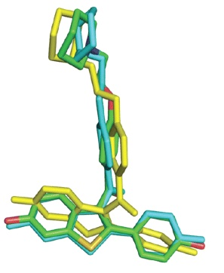

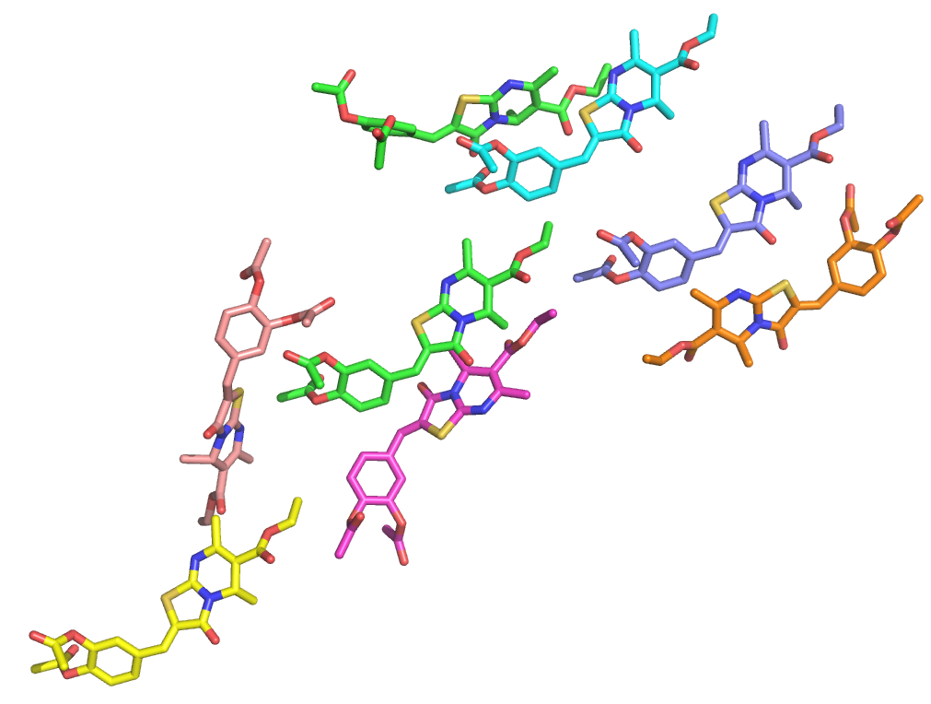
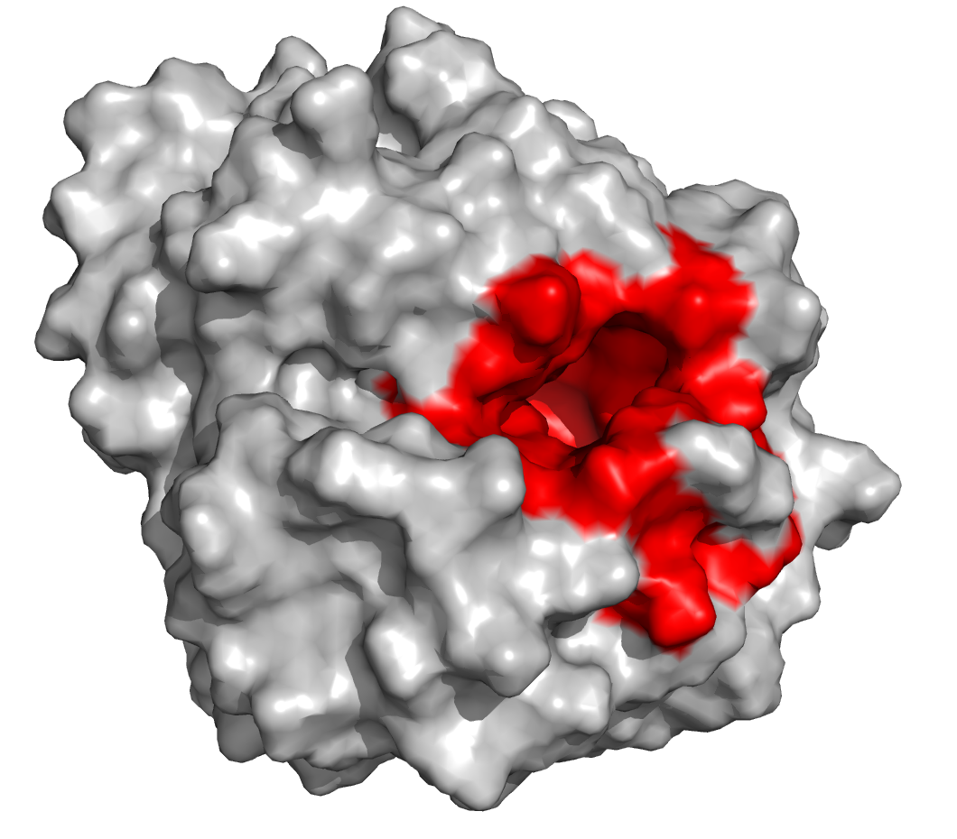
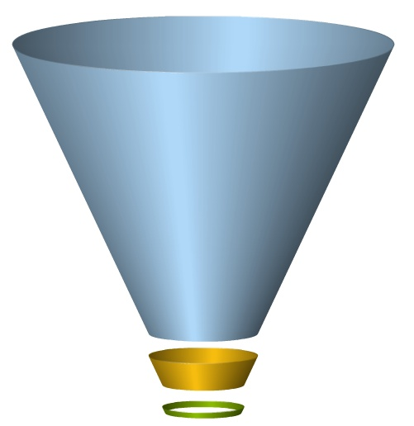
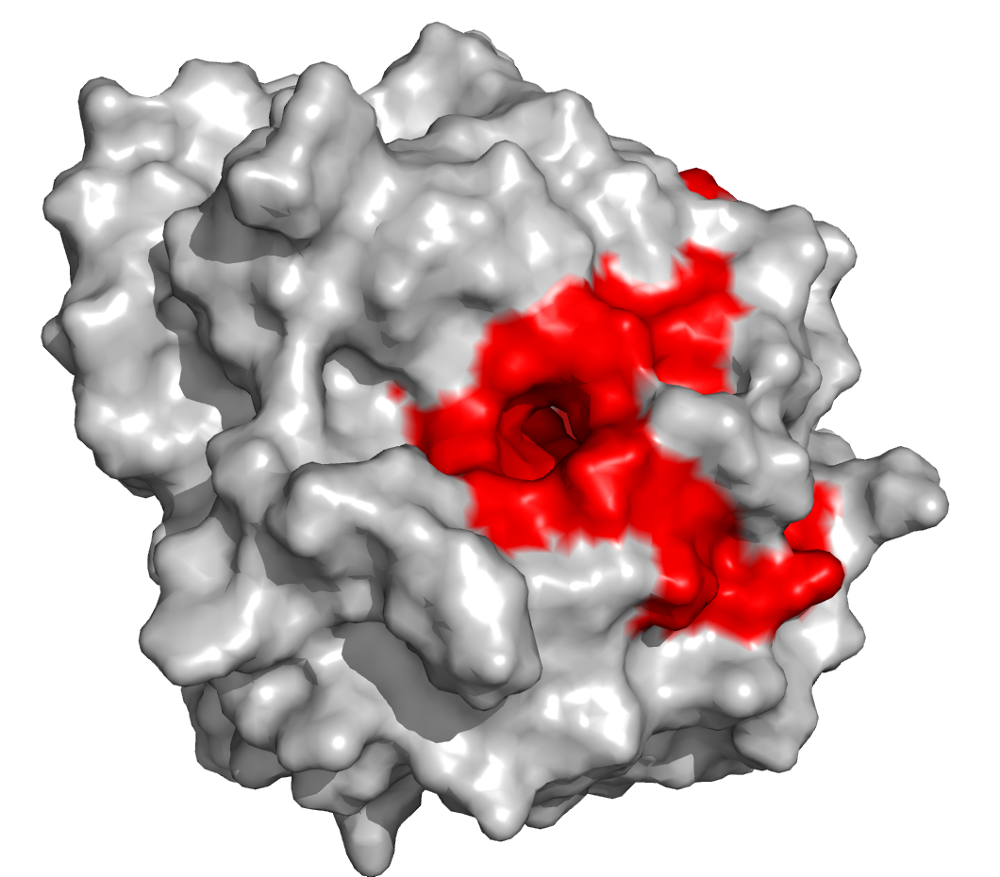
Our Structure-based VS approach
Virtual Screening
Protein receptor flexibility
ADME-Tox filtering
Focused i-PPI compound collections
.
Docking – Scoring
MM refinement
MD Refinement
ΔGbind
Compound collection
i-PPI filters, ADME-Tox:
FAFDrugs3
Multiple Protein
Conformations
Zhe et al. Plos One 2014 , 9:e11088421
http://fafdrugs3.mti.univ-paris-diderot.fr
Lagorce et al. NAR 2015
100-500 molecules
for assays

Slide 12
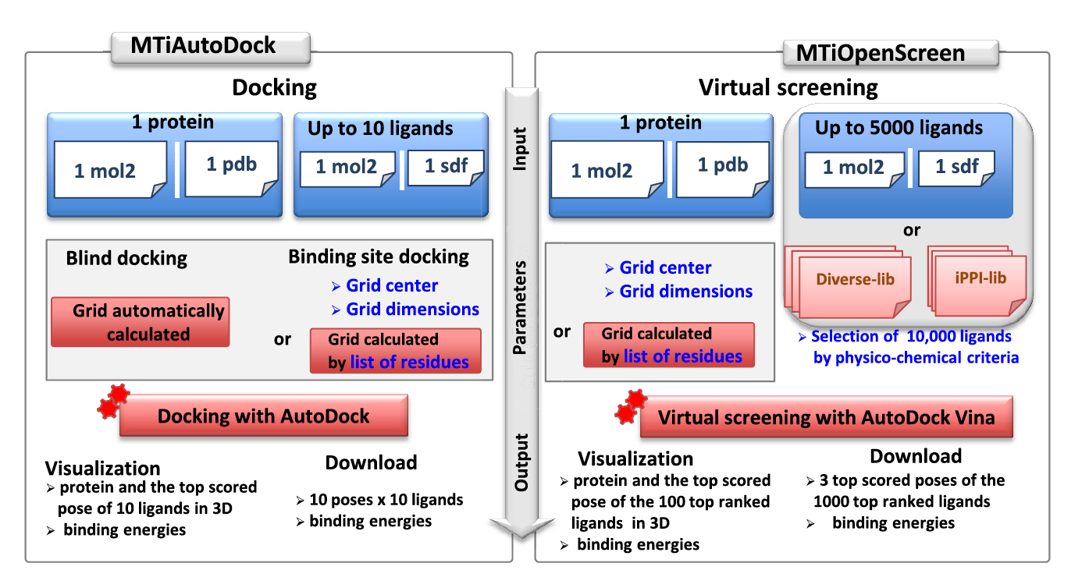
MTiOpenScreen web-server
Virtual Screening
http://bioserv.rpbs.univ-paris-diderot.fr/services/MTiOpenScreen/
Labbe et al. NAR 2015
Notes:
Eto na pratktik aplanija protocok la virt screening -
1stly- We developed tools for ptreparation of electronic small mols chemical libraries. And secondly, we have developed a multistep docking protocol incl;uding several steops to propose a list of cmp to be experimentally tested .
For the docking & screning – for the fional stage we are working on a new protocol for DG calculation by Mdsimulation, we call it - a simplified free energy calculation approach. That will permit to decrease considerably th enumber of molecules tobe tesrted experimenaltlly. This is an important step since small modifications in a ligand may lead to drastic changes in the observed binding energy landscape.
-----------------------------------------------------------------------------------------------------
DOCK, AUTODOCK, VINA, Molegro, Surflex, Ligandfit, CDocker, MOE-Dock – Cerius -
Our DG I so=mainly enthaplic – DS is taken inderectly from the R-L movements; for ex. Tropsha suggest to take into accounr DS for pose selection indereclt by MD – only by considering the time th eligands remain in the evaluaiet pose – in 2 A mas RMSD;
- quand on parle de flex problem - on va noter vite que les solution in silico prot-small ligands much more success than la flex de prot-prot docking et prot- peptide, much more challenging than prot-small lig vue number f o degree of freedem ( during ithe oral pres); any gropus wormikhg Abagyan, McCammon - our aprich ais higly ctes – so we siggest ortiginal & valuable solutions
For Flex-+docking – some use Hagler de Shrodinger – use replica excahne MD = in paralel different temp; we different velocities

Slide 13
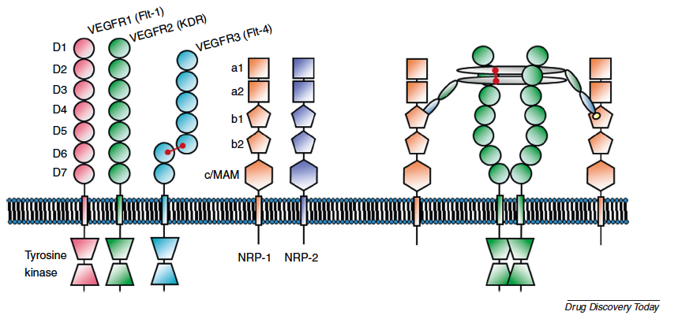
Inhibiting protein-protein interactions in angiogenesis
Targeting angiogenesis could be of interest to complement chemotherapeutic approaches to treat cancer
A pivotal pro-angiogenic signalling molecule is VEGF-A, which promotes proliferation, survival, migration…
Drugs acting here are essentially mAb (eg, Avastin…) and kinase inhibitors: sorafenib, sunitinib…
VEGF
VEGF-A₁₆₅
VEGFR co-receptors:
NRPs
NRP
VEGFR
Djordjevic and Driscoll, DDT 2013

Slide 14
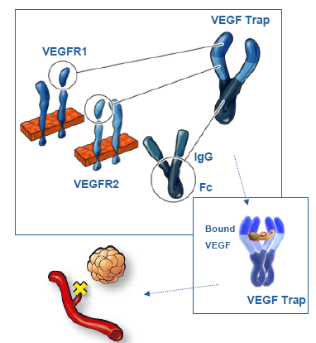
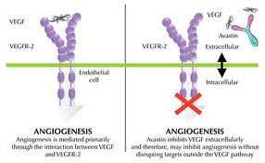
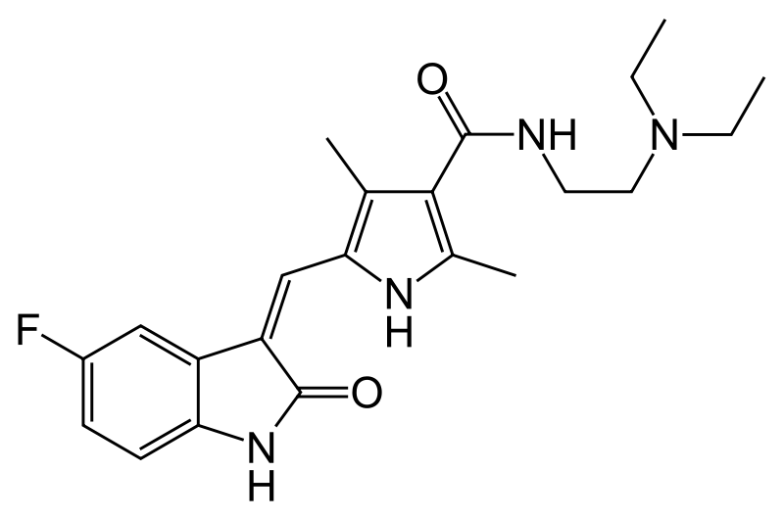


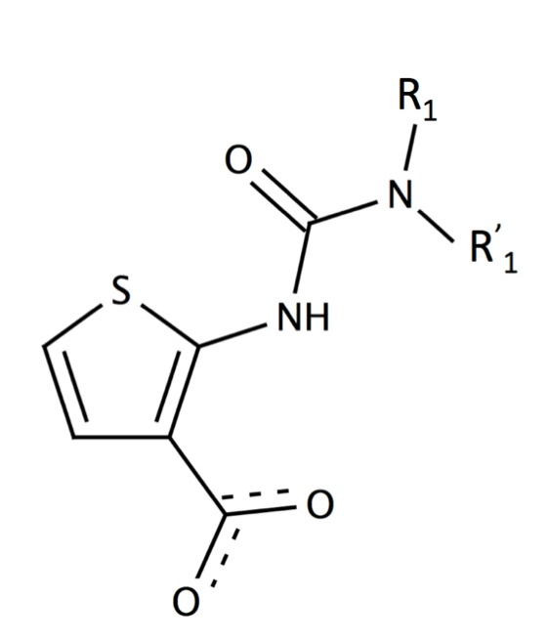
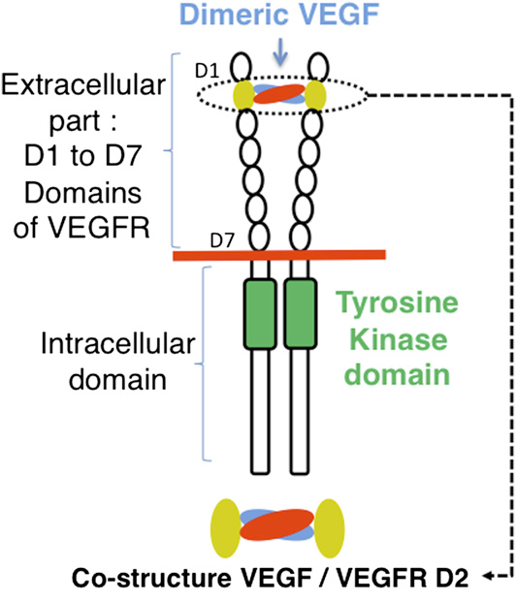
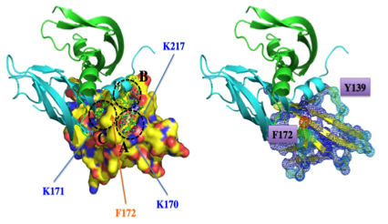
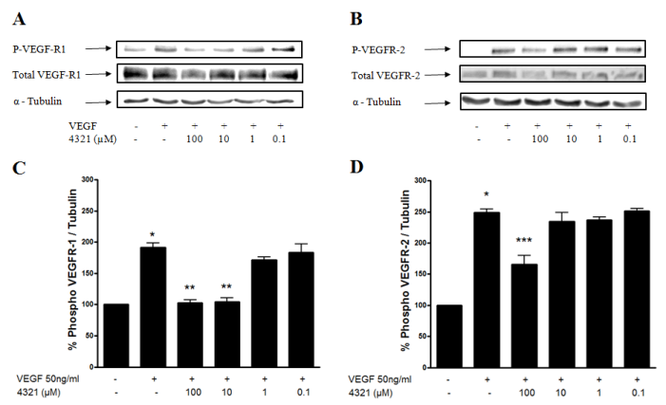
Anti-angiogenic drug-like molecules blocking VEGF-VEGFR
?
Regeneron/
Sanofi-Aventis
VEGF
Smal « drug-like » inhibitors of IPP
VEGF
VEGFR
Avastin
VEGFR
Endothelial
cell
Intracellular – TK
Inhibition TK and
angiogenesis
activation TK and
angiogenesis
Inhibition TK and
angiogenesis
Sunitinib
20 molecules
10-100 υM
VEGF
in silico
8,000 cmp
% Phospho VEGFR
4321:
R1 ethyl
R1’ benzyl
in vitro
206 cmp
VEGF - + + + + +
4321 - - 100 10 1 0.1
VEGFR-D2
4321 inhibits VEGF-induced phosphorylation of VEGFR
NMR:
4321 – D2
Gautier et al. Chem Biol 2011
Notes:
Obhctopreita klinichna praktika e da se atakuva VEGF s antitela kato avistan , tov akapttir aVEGDF I ne pozvoljat aaktiviraneto na negovija receptorr VEGFm, krto blokira po-naratak predavaneto na sognla neobdof=din za angioganezata.
….
HUVEC,WT blot
They are sevral different current therapeutioc strategus to inhibit VEGF-andf its receptor pathways.
VEGF, can be blocked by Avastin ( Bevacizumab), a monoclonal antibody, or by a "fusion protein", VEGF Trap,
VEGF Trap is in clinical trials for cancer and approved for neovascular disorder of the eyes ( AMD. (Age-Related Macular Degeneration). AMD is a disorder of the retina in the eye that causes blurred vision or blindness. Aflibercept works by changing the amount of blood that gets to the retina.)
(, and bevacizumab is arguably the most well-known and widely-used of these drugs. Bevacizumab is a monoclonal antibody that binds to and sequesters VEGF-A in patients. By sequestering VEGF-A, bevacizumab inhibits the ability of VEGF-A to activate VEGFR2 on endothelial cells, and there is an overall decrease in angiogenesis.)
(Bevacizumab therapy has shown promise in certain kinds of cancers, but response to the drug is unpredictable. Some patients will show an initial improvement after bevacizumab treatment and then stop responding to the drug. Other patients will not respond to the drug at all. The ineffectiveness of bevacizumab for these patients is not completely understood, but most likely stems from the activation of endothelial cell signaling pathways that compensate for a decrease in VEGFR2 signaling pathways.)
(The antiangiogenic agent vascular endothelial growth factor-Trap (VEGF-Trap) (aflibercept), which is a composite decoy receptor based on VEGF receptor-1 and VEGF receptor-2 fused to an Fc segment of immunoglobulin G1 that binds specifically to VEGF, has demonstrated preclinical efficacy in a range of different tumor types. VEGF-Trap exerts its antiangiogenic effects through regression of tumor vasculature, remolding or normalization of surviving vascu- lature, and inhibition of new tumor vessel growth.
By sequestering VEGF-A these 2 ahgents inhibits the ability of VEGF-A to activate VEGFR2 on endothelial cells, and there is an overall decrease in angiogenesis.)
The thirs iused approach is ..inh RTK
Sunitinib (Sutent™) est une petite molécule qui inhibe les tyrosine kinases de récepteurs variés : VEGF-R 1 et 2 impliqués dans l'angiogenèse, récepteurs des facteurs de croissance dérivés des plaquettes (PDGF-R β), les récepteurs pour c-KIT, FLT3 et RET. L'inhibition de ces kinases entraîne un blocage de la transduction, et de nombreux processus intra-cellulaires comme la croissance cellulaire, la progression tumorale, le développement des métastases et l'angiogenèse.
We … Our goal was to Identifier by SBVS des hits preventing VEGF-VEGFR interaction
For that we used SBVS based on the X0raystr of VEGF- an d its rec namely domain 2 – than test flex on the bi ding are ,a nd we defined rigid zoen to tbe targetecd by dokcing . We docekd ..
We have obtained bioactives on a very difficult target and performed preliminary in silico ADMET profiling for VEGF-VEGFR (ChemBiol 2011)
hit rate VLS VEGFR: 9
----------------
The assay was performed as previously described (Goncalves et al., 2008). Briefly, a fixed amount of biotinylated human VEGF165 (131 pM) was incubated with the screened compounds in a 96-well microplate coated with a human VEGFR-1 ECD/Fc chimera or a VEGFR-1 D1–D3 domains/Fc chimera. The residual btVEGF165 present after washing was detected by chemiluminescent with horseradish peroxidase-conjugated streptavidin.
NMR: 43121 + or - with the vegrf1-D2
-----

Slide 15
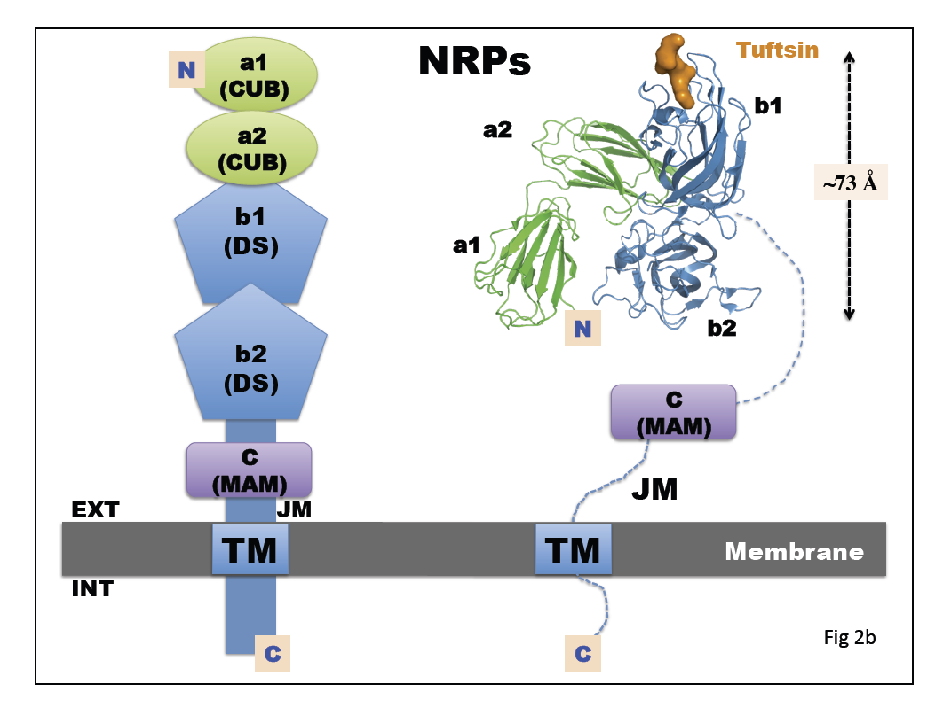
Anti-angiogenic drug-like molecules blocking VEGF-NRP

Slide 16
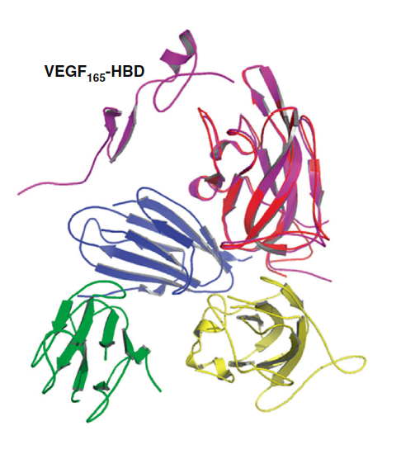
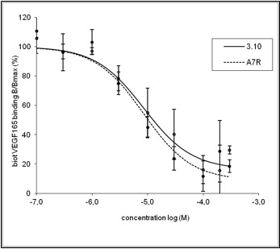
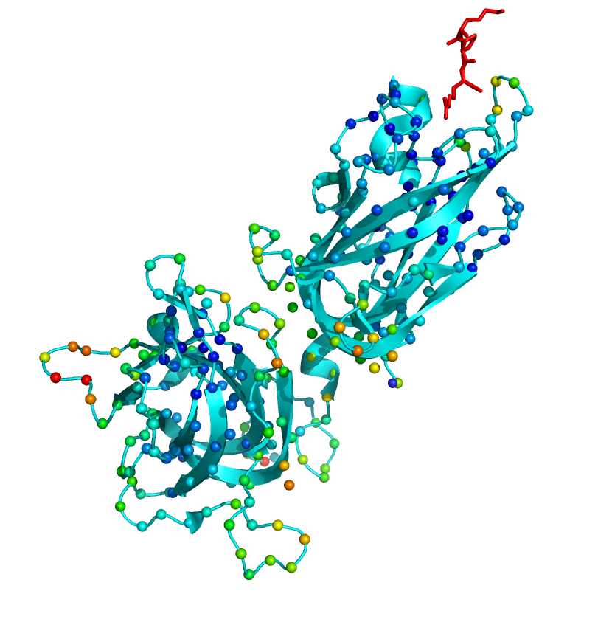
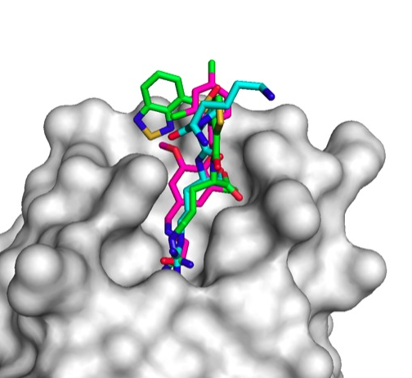
Anti-angiogenic drug-like molecules blocking VEGF-NRP
X-ray
VEGF
?
VEGF
NRP
Smal « drug-like » inhibitors of IPP
b1
VEGFR
Endothelial
cell
a2
?
b2
Intracellular – TK
Inhibition of VEGFR dimerization
and angiogenesis
a1
NRP
EG00229 (X-ray)
Tuftsin
SBVS
MS-DOCK, SF
500,000 cmp
3.10
Tuftsin (X-ray)
A7R
Our cmp 3.10 (docking)
NRP
b1
in vitro
508 cmp
Ligand Info
70 cmp
in vitro
133 cmp
NRP
b1
b2
New scaffold: 4 cmpds with <4 microM affinity to NRP
Starzec et al. Bioorg Med Chem. 2014
Notes:
Deformability of neuropilin (NRP-1, PDB ID 2ORZ after removal of tuftsin). Colored spheres (deformability scores computed with iMODS) represent the Calpha atoms, color code range from high deformability in red, medium deformability in orange, yellow and green, and more rigid regions in cyan, blue and dark blue
Deformability scores computed with the iMODS server
(NMA in internal coordinates)
HUVEC,WT blot
They are sevral different current therapeutioc strategus to inhibit VEGF-andf its receptor pathways.
VEGF, can be blocked by Avastin ( Bevacizumab), a monoclonal antibody, or by a "fusion protein", VEGF Trap,
VEGF Trap is in clinical trials for cancer and approved for neovascular disorder of the eyes ( AMD. (Age-Related Macular Degeneration). AMD is a disorder of the retina in the eye that causes blurred vision or blindness. Aflibercept works by changing the amount of blood that gets to the retina.)
(, and bevacizumab is arguably the most well-known and widely-used of these drugs. Bevacizumab is a monoclonal antibody that binds to and sequesters VEGF-A in patients. By sequestering VEGF-A, bevacizumab inhibits the ability of VEGF-A to activate VEGFR2 on endothelial cells, and there is an overall decrease in angiogenesis.)
(Bevacizumab therapy has shown promise in certain kinds of cancers, but response to the drug is unpredictable. Some patients will show an initial improvement after bevacizumab treatment and then stop responding to the drug. Other patients will not respond to the drug at all. The ineffectiveness of bevacizumab for these patients is not completely understood, but most likely stems from the activation of endothelial cell signaling pathways that compensate for a decrease in VEGFR2 signaling pathways.)
(The antiangiogenic agent vascular endothelial growth factor-Trap (VEGF-Trap) (aflibercept), which is a composite decoy receptor based on VEGF receptor-1 and VEGF receptor-2 fused to an Fc segment of immunoglobulin G1 that binds specifically to VEGF, has demonstrated preclinical efficacy in a range of different tumor types. VEGF-Trap exerts its antiangiogenic effects through regression of tumor vasculature, remolding or normalization of surviving vascu- lature, and inhibition of new tumor vessel growth.
By sequestering VEGF-A these 2 ahgents inhibits the ability of VEGF-A to activate VEGFR2 on endothelial cells, and there is an overall decrease in angiogenesis.)
The thirs iused approach is ..inh RTK
Sunitinib (Sutent™) est une petite molécule qui inhibe les tyrosine kinases de récepteurs variés : VEGF-R 1 et 2 impliqués dans l'angiogenèse, récepteurs des facteurs de croissance dérivés des plaquettes (PDGF-R β), les récepteurs pour c-KIT, FLT3 et RET. L'inhibition de ces kinases entraîne un blocage de la transduction, et de nombreux processus intra-cellulaires comme la croissance cellulaire, la progression tumorale, le développement des métastases et l'angiogenèse.
We … Our goal was to Identifier by SBVS des hits preventing VEGF-VEGFR interaction
For that we used SBVS based on the X0raystr of VEGF- an d its rec namely domain 2 – than test flex on the bi ding are ,a nd we defined rigid zoen to tbe targetecd by dokcing . We docekd ..
We have obtained bioactives on a very difficult target and performed preliminary in silico ADMET profiling for VEGF-VEGFR (ChemBiol 2011)
hit rate VLS VEGFR: 9
----------------
The assay was performed as previously described (Goncalves et al., 2008). Briefly, a fixed amount of biotinylated human VEGF165 (131 pM) was incubated with the screened compounds in a 96-well microplate coated with a human VEGFR-1 ECD/Fc chimera or a VEGFR-1 D1–D3 domains/Fc chimera. The residual btVEGF165 present after washing was detected by chemiluminescent with horseradish peroxidase-conjugated streptavidin.
NMR: 43121 + or - with the vegrf1-D2
-----
For that we used SBVS based on the X0raystr of VEGF- an d its rec namely domain 2 – than test flex on the bi ding are ,a nd we defined rigid zoen to tbe targetecd by dokcing . We docekd ..
We have obtained bioactives on a very difficult target and performed preliminary in silico ADMET profiling for VEGF-VEGFR (ChemBiol 2011)
hit rate VLS VEGFR: 9
----------------
The assay was performed as previously described (Goncalves et al., 2008). Briefly, a fixed amount of biotinylated human VEGF165 (131 pM) was incubated with the screened compounds in a 96-well microplate coated with a human VEGFR-1 ECD/Fc chimera or a VEGFR-1 D1–D3 domains/Fc chimera. The residual btVEGF165 present after washing was detected by chemiluminescent with horseradish peroxidase-conjugated streptavidin.
NMR: 43121 + or - with the vegrf1-D2

Slide 17
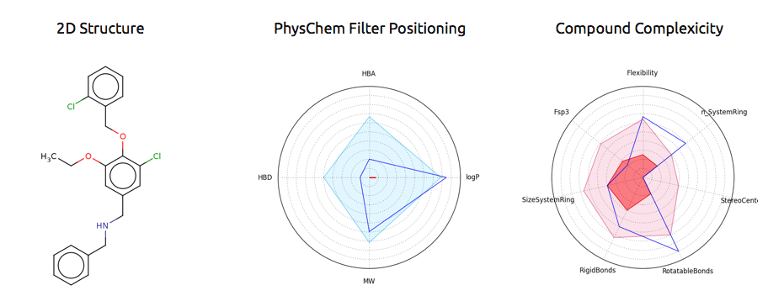
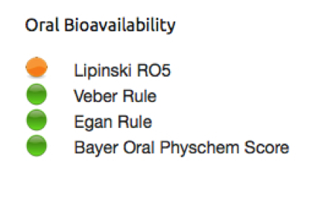
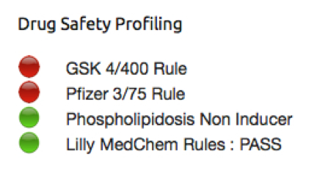
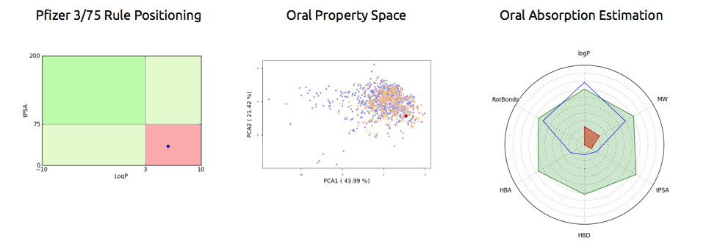
Anti-angiogenic drug-like molecules blocking VEGF-NRP
K_{i}: 11 micro-M; log P: 5.9; MW: 453; LE: 0.2, PPI-hit-Profiler: yes (FAF-Drugs3 server)
Some other cmpds have better physchem properties…For the time being, proof of concept studies
http://fafdrugs3.mti.univ-paris-diderot.fr

Slide 18
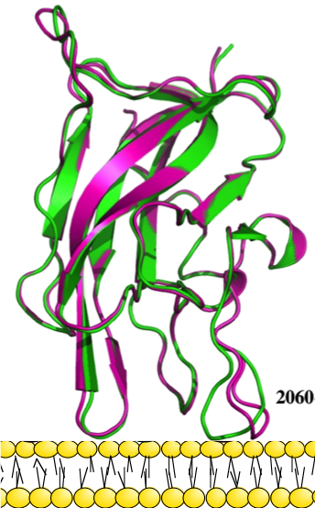
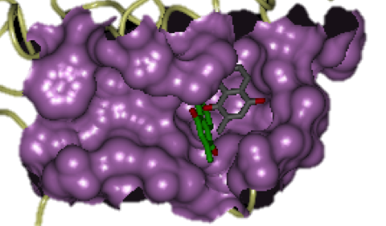
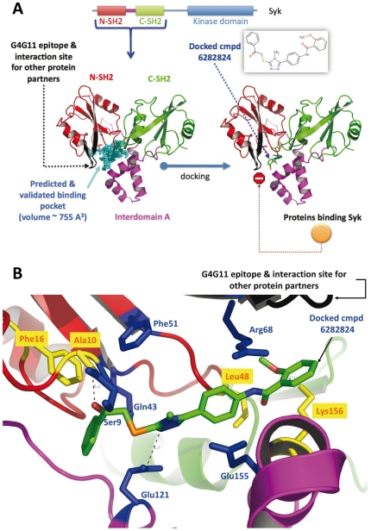
Successful SBVS
Success stories are growing rapidly !
Drug Target | Diseases | Docking software | Drugs / hits
HIV integrase McCammon group, J Med Chem, 2004 | AIDS | AutoDock MRC Relaxed scheme | Isentres (Merck)
Mycobacterium tuberculosis HisG ATP transferase Cho et al. J Med Chem 2008 | tuberculosis | GOLD, FlexX | IC50=4 uM
Insulin-like Growth Factor-1 Receptor (RTK) Liu et al. J Med Chem 2010 | cancer | Receptor-based pharmacophore, Glide XP | IC50=0.05 uM
Factor V/VIII – membrane interactions Segers et al. PNAS 2007 | coagulation system, thrombosis | FRED, Surflex, LigandFit | IC50=3.5 uM
Enzymes: CDC25, proteasome,.. Montes et al. J Chem Inf Model 2008 Maréchal et al. Curr Med Chem 2013 … | cancer | FRED, Surflex, LigandFit | IC50=13 uM
PPI: SYK kinase, VEGFR, NRP, SMS … Starzec et al. Bioorg Med Chem. 2014 Zhang et al. Plos One 2014 … | allergies, cancer, rare diseases | MS-DOCK, MD Surflex, Vina | IC50= 4 uM
Notes:
… We develoepd SM inhibitords of catalyistic sites, PPI , anf protein-membrane ointeractions.
I should note that blocking Iip & P-membrane interactions, even challenging, we achivend very good hit rates competared to similar experimental HTP screenng.
hit rate: our VLS FV HTS FVIII
1.2 0.1

Slide 19
Conclusions
Structure-based VS methods are well established to identify new hits
Importance of ADME-Tox filtering of compound collections
PPI modulators focused compound collections
Protein flexibility consideration
Notes:
SBVS are ..
yet some critoical p[oints: …
Scorinfg- e.g. entropy

Slide 20




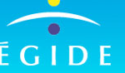
Acknowledgements
Collaborations
Dr. P. Vayer (Lab. Servier, Orléans)
Pr. M. Vidal (Univ. Paris Descartes)
Pr. C. Garbay (Univ. Paris Descartes)
Dr. A. Starzec (Univ. Paris 13)
Pr. G. Perret (Univ. Paris 13)
Dr. D. Perahia (ENS Cachan)
Pr. E. Alexov (Univ. Clemson, US)
Dr. Ikeguchi (Josay Univ., Japon)
Pr. P. Carbonell (Univ. Manchester)
Pr. J. Baell (Univ. Melbourne)
Dr. T. Pencheva (Bulg Acad Sci )
Pr. I. Pajeva (Bulg Acad Sci )
Pr. A. Isvoran (West Univ. Timisoara)
Team “Virtual screening,
PPI modulators – ADMET”
Dr. Olivier Sperandio
Dr. David Lagorce
Céline Labbé (Engineer)
Isabella Guedes (PhD student)
Mélaine Kuenemann (PhD student)
Dr. Zhe Zhang (former PhD student)
Dr. Virginie Martiny (former PhD student)
Dr. Pierre Tuffery (team Peptide design)
Dr. Bruno Villoutreix (Dir. MTi)

Slide 21
Thank you

Slide 22
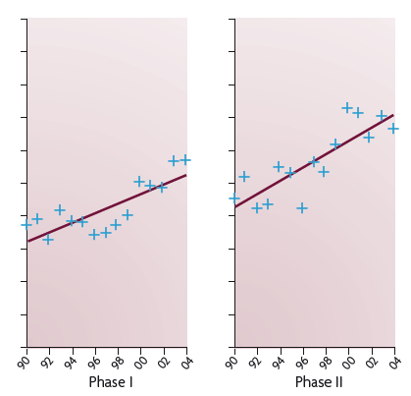
Conclusions
Today about 20 LMW PPI cmpds are in phase I to III clinical trials. Expected sales worldwide (to start with) of over $800 million/each year within 4 years
In phase I, latest generation of PPI modulators (developed between 2005-2012) seem to have 82% probability of making it to the next phase compared to 54% for all NMEs, and for phase II, the probability of success seems to be 57% for PPI modulators compared to 34% for all NMEs (Phase III can not be evaluated at present due to small sample size)
Trends in attrition rates of drug development projects. Data are for projects started between 1990 and 2004 in the United States, Europe and Japan
Some hope with PPI modulators ? Some PPI targets seem much more promising than some of the ~500 regular targets currently investigated…with over 300,000 PPIs in human, there is a lot to do !
Meier et al DDT 2013
Nat Rev Drug Discovery, June 2011, Vol 10

Slide 23
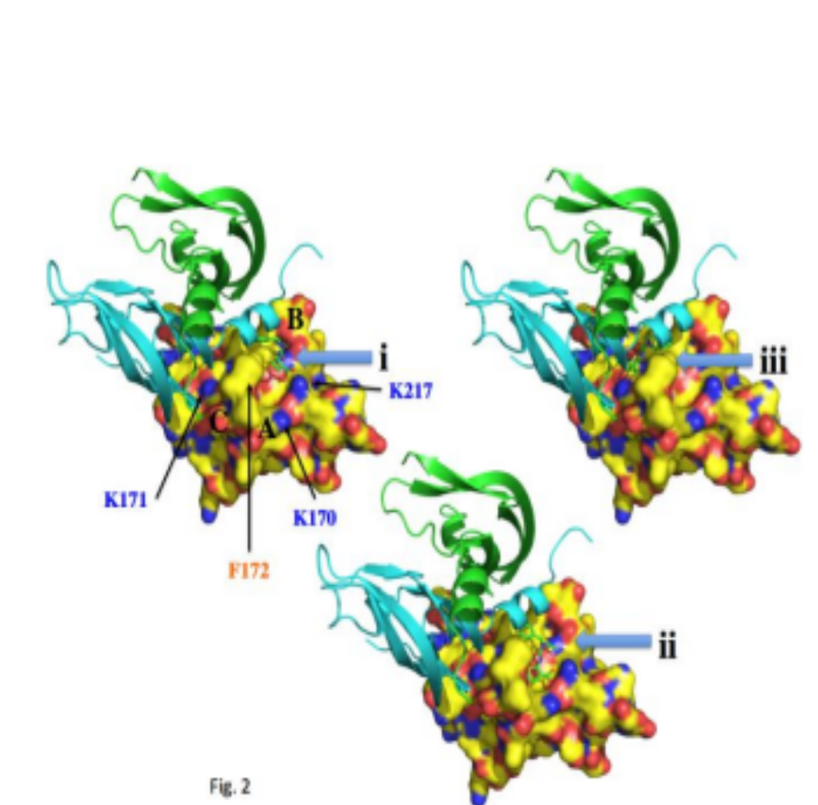
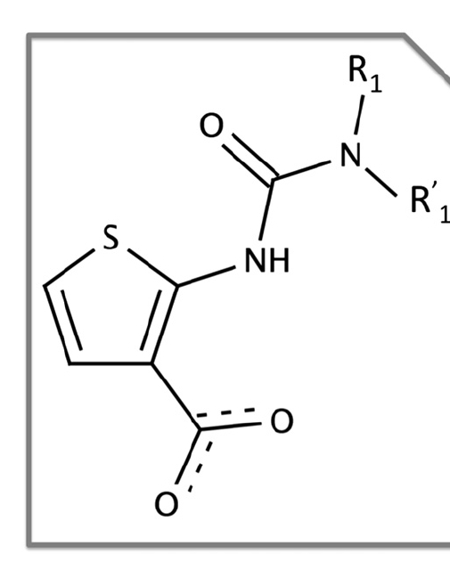
We discovered the first anti-angiogenic drug-like molecules blocking VEGF-VEGFR
206 mols in vitro
displacement of
VEGFR
20 actives IC50 < 100 μM
10 actives IC50 ~10-20 μM
8,000 mols National Chemical library CERMN
docking Surflex
VEGF
NMA: flexible zone
VEGFR1-D2
R
L1
L2
4321:
R1 ethyl
R1’ benzyl
VEGFR1
Binding of 4231 into D2 domain was validated by NMR experiments
% Phospho VEGFR
4321 inhibits VEGF-induced phosphorylation of VEGFR HUVEC,WT blot
Gautier, Miteva et al.
Chem Biol 2011
VEGF - + + + + +
4321 - - 100 10 1 0.1
Notes:
For that we used SBVS based on the X0raystr of VEGF- an d its rec namely domain 2 – than test flex on the bi ding are ,a nd we defined rigid zoen to tbe targetecd by dokcing . We docekd ..
We have obtained bioactives on a very difficult target and performed preliminary in silico ADMET profiling for VEGF-VEGFR (ChemBiol 2011)
hit rate VLS VEGFR: 9
----------------
The assay was performed as previously described (Goncalves et al., 2008). Briefly, a fixed amount of biotinylated human VEGF165 (131 pM) was incubated with the screened compounds in a 96-well microplate coated with a human VEGFR-1 ECD/Fc chimera or a VEGFR-1 D1–D3 domains/Fc chimera. The residual btVEGF165 present after washing was detected by chemiluminescent with horseradish peroxidase-conjugated streptavidin.
NMR: 43121 + or - with the vegrf1-D2

Slide 24
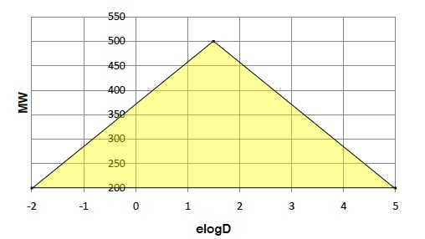
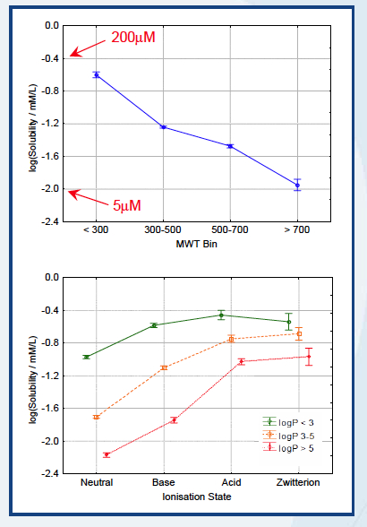
ADME-Tox Prediction
Lipinski’s rule of 5 for oral absorption (1997), but new rules are also for toxicity
Veber’s rule (2002) for oral absorption: nb of rotatable bonds, TPSA, …
GSK rule of 4 (2009): MW < 400 and clog P < 4 to reduce ADMET problems
Pfizer 3/75 (2008): significant reduction of toxicity in vivo when clogP <3 and TPSA >75 Å² (toxicity, off-target, CYP, hERG)
Golden triangle (Pfizer 2009):
the yellow region is found to have a higher
chance for permeability and metabolic stability
Solubility
with size and clogP
with ionisation
data from GSK

Slide 25
Filtering and Substructure Detection in FAFDrugs2
PhysChem Properties
User’s defined
physchem ranges
Predefined filters
In house drug-like « soft »
In house lead-like
R-O-5 (Lipinski, Adv Drug Deliv Rev 1997)
R-O-3
(Congreve et al. Drug Discov Today 2003)
REOS (Walters & Namchuk, Nature Rev Drug Discov 2003)
« ZINC »
(Irwin & Shoichet, J Chem Inf Model 2005)
CNS (Jeffrey & Summerfield, Neurobiol Dis 2010)
Substructure Detection
Aggregators
311
Toxicophores
~ 150
(McGovern et al. J Med Chem 2002)
Frequents Hitters
(Roch et al. J Med Chem 2002)
15
492
PAINS
Pan Assay Interference Compounds
(Baell & Holloway, J Med Chem 2010)
Notes:
lead-like ranges combined drug-like ranges and lead-like filtering established values
in order to have good starting point molecules (Oprea 2001, Baell 2013, Brenk 2008)
Central nervous system
REOS Rapid Elimination of Swill – is a hybrid method ( a program) that combines a set of functional groups filter with simple counting similar to RO5 – Vertezx
Aggregators : a list form Shoichet paper
Frquent hitters: the paper - of Roche et al. Shneider group
Additional validations can be done ver e.g. ~2K cmps od Cerep BioPrint DB - tested in an in vitro panel of more than 200 receptors, enz and metabolic screens – that the promiscuity ogf cmp can be assessed

Slide 26
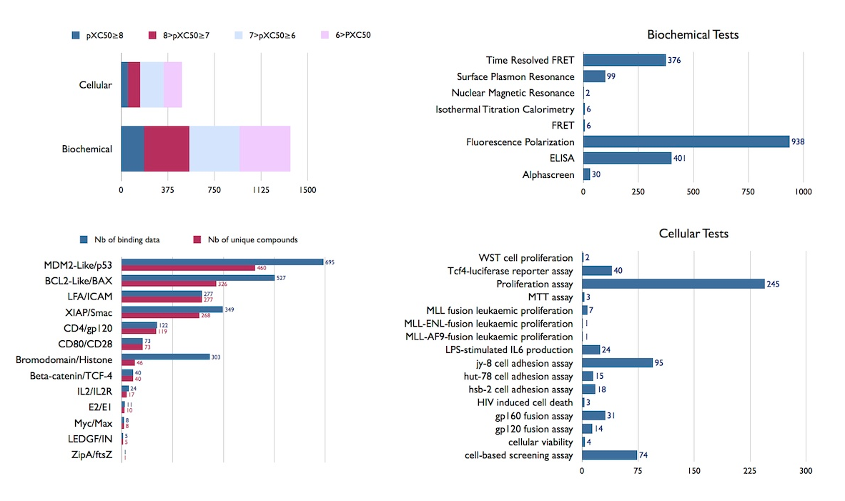
iPPI-DB Stats

Slide 27
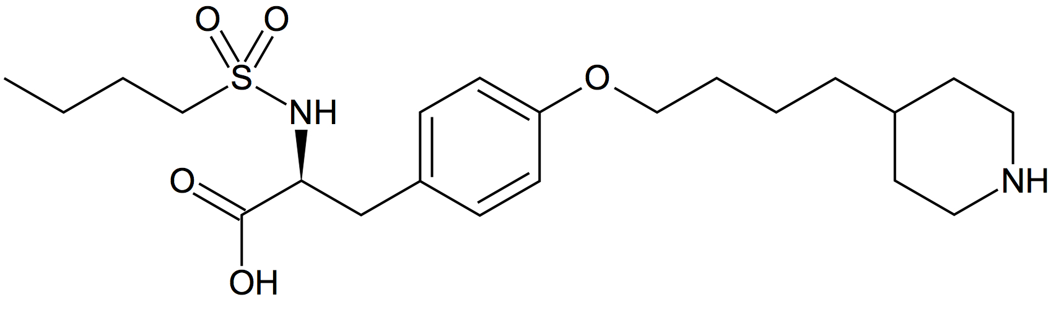
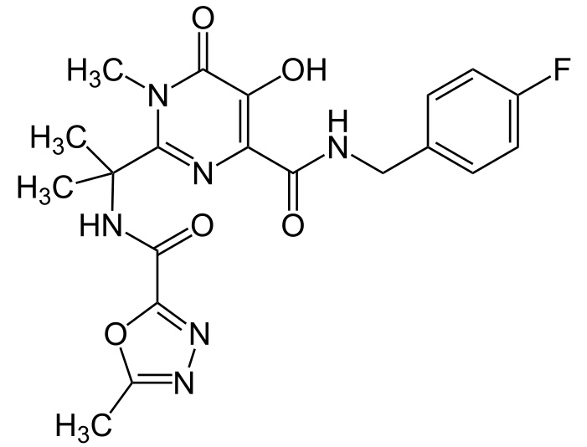
Drugs discovered using VS
Aggrastat : fibrinogen receptor antagonist (Merck) (optimized by LBVS)
anticoagulant and platelet aggregation inhibitor
modulates a protein-protein interaction (between Integrin glycoprotein Alpha IIb
and Beta II and Fibrinogen receptors on platelets)
  PRX-00023 (Phase IIb) antidepressant, 5-HT 1A receptor agonist (SBVS)
  SC12267 (Phase IIa) immunosuppressant, inhibitor of dihydroorotate dehydrogenase (SBVS)
  Isentres : AIDS, HIV integrase inhibitor (Merck), SBVS
DE Clark. Expert Opinion on Drug Discovery 2008
docking - AutoDock
Flexibility receptor by MD – MRC Relaxed Complex Method
McCammon group, J Med Chem, 2004

Slide 28
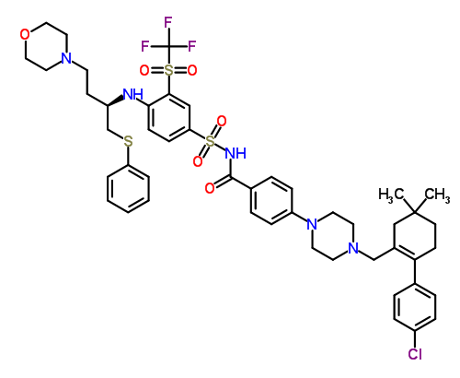
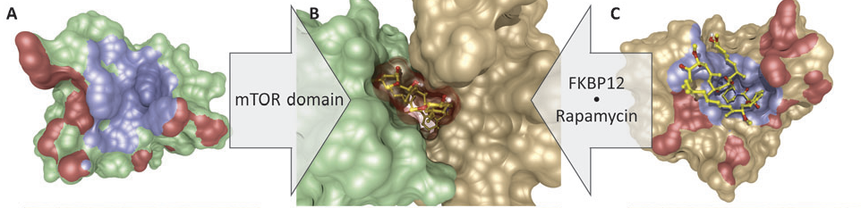
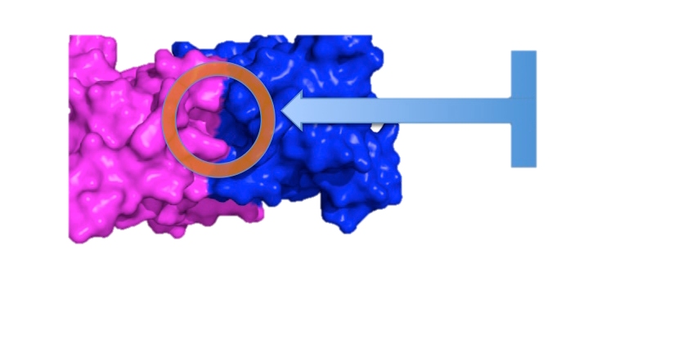
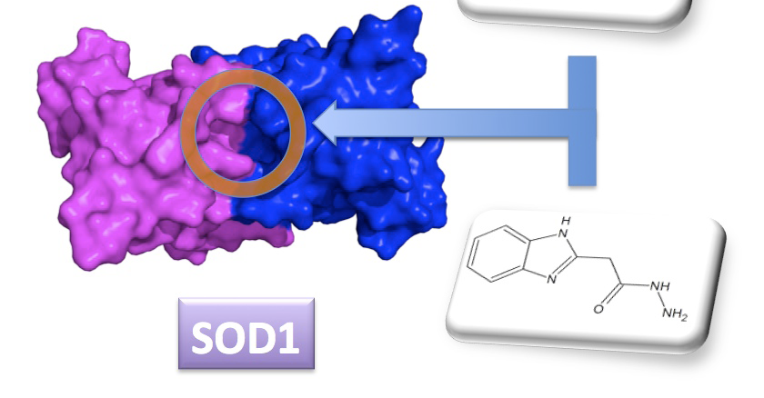

PPI modulators
PPI inhibitors
Drugs: Navitoclax (ABT-263), Phase II
(Bcl-2 ,cancer, Abbott)
RG7112 (Phase Ib)
(MDM2, cancer, Roche)
Lead
BRD4 epigenetic reader recognizing
acetyl-histones ; cancer
Tensha Therapeut, GSK interested;
Bradner et al. Nature 2010
PPI stabilizers
Drugs: Rapamycin,
Paclitaxel
Lead
immunosuppressant
^{the protein kinase mTOR}
^{immunosuppressant FK506}
cell-cycle arrest by modulating microtubules structures, cancer
Mullard A. Nature Rev Drug Discov. 2012
Thiel et al. Angew. Chem.Int.Ed 2012, 51:2
amyotrophic lateral sclerosis
SBVS: Ray et al. PNAS 2005, 102: 3639
H2L: Chen et al. J Med Chem 2012,55: 515

Slide 29


Compounds collections
FAFDrugs3 : Free ADME-Tox Filtering
of chemical compounds
Oral Bioavailability
Simple PhysChem
Simple PhysChem rules for
oral bioavailability
drug/lead/fragment–like
cmps filters
    Lipinski rules: HBD, HBA, MW, log P
    Oprea rules: number of rings, rotatable bonds
Toxic atoms/groups ~150
Frequent hitters & Pan Assay Interference Compounds (PAINS) ~500
Lagorce et al. NAR 2015
FAFDrugs3 web-server:
http://fafdrugs3.mti.univ-paris-diderot.fr
Notes:
Za tzo cel nashokiah ekip razrabotba ot najkolko gonin nasma softaera kojto e docplanet online I kojto pozvoljava da se filtirata koliencii s goljam broj him molekuli . Parmetrite koite se ischislajvat sa – na pravo mjasto filtera predlojen of Lipinski ot Pfieer 90-godini, kojot e bazipran na statictoicjeski analiz na lekarstna administrani po oralen pat – I koljto pokazba che physchem pram katos ….donpori na Vod vr, Aceptori na Bodor. Vrazki, mol teglo I lipofiliciy ili hidriphobnost pozvoljata va se peedskaje sposobnosttsa na 1 him mol de bade administraina po oralen pak, bez da se nalaganejnoto injektoirane.
VC kolab s Prol Baell razprabotane tarcesme ma toksichni grupi I tdrugopodo=bnikoito nariocajen PAINS za …. Chojto prosastvie e nejelano za kandiaka lasteni kanifdatti.
---------------------------------------------------
Maria
le papier que tu as envoye est tres important indeed
How drug-like are 'ugly' drugs: do drug-likeness metrics predict ADME behaviour in humans?
Ritchie TJ, Macdonald SJ.
Drug Discov Today. 2014 Jan 21. pii: S1359-6446(14)00009-9. doi: 10.1016/j.drudis.2014.01.007.
il revient à 200% sur la pertinence de comparer des molecules avec tout le FDA oral et globalement dit que cela n a pas bcp de sens au moins pour l ADMET, c est une sorte de averaged noise qui dit tout et rien, cela donne une idee mais pas grand chose... Il y a eu plusieurs critiques sur ce type d analyse fait par Leeson et Overingthon etc a chembl, les chimistes disent on peut pas melanger ugly drug with good drug et tirer des conclusions.. d ou aussi nos discussions ou plusieurs fois on a dit, il nous faudrait dans l ideal un data set clean drug pour au moins comparer, je pense que c est un message important... maintenant pour faire ce dataset clean, c est pas simple... sinon il serait deja la publie... Les warning de Ritchie dans son intro sur adme etc, je pense certains points sont vraiment bien explique, sur le + et le - de ces concepts
autre mini point sur l ADMET, c est que la derniere version de drug bank injecte bcp sur metabolisme, du moins vu dans l abstract de drug bank in the last NAR database issue de Jan 2014
dans ce context ADME et related, sur mon site vls3d, j ai ajoute 2 trucs dans off target, je ne sais pas si useful pour ton talk:
CTD illuminates how environmental chemicals affect human health. Manual curation of 88,000 scientific articles text mined for drug-disease and drug-phenotype interactions
et
The International Union of Basic and Clinical Pharmacology/British Pharmacological Society (IUPHAR/BPS) Guide to PHARMACOLOGY is an expert-driven knowledgebase of drug targets and their ligands
dans ADMET datasets, maybe of interest if you need to mention some new databases in the conclusion that could help to understand better things..
Plasma Proteome Database. This database contains information on 10 546 proteins detected in serum/plasma of which 3784 have been reported in two or more studies

Slide 30

VEGF – VEGFR
Angiogenesis - Cancer
VEGFR1, VEGFR2
endothelial cell
VEGFR1 –migration (Ziche 1997; Kanno 2000 )
VEGFR2 – signaling (Olsson 2006 )
Notes:
First of all what is the relation between the angiogenegis and the cancer ? Tha angiogenesis is the process of creation of neovasculrar network
in 1971, it has been proposed a hypothesis that solid tumors, which were known to have a high number of new blood vessels, require angiogenesis to continue to grow
Thus the tumor-associated angiogenesis could be a therapeutic target for the inhibition of tumor growth and progression. Actually inhibiting angiogenesis is an establed a[proach for an anti-cancer strategy.
Consequently, many therapies now aim to inhibit angiogenesis by targeting the VEGF-A / VEGFR pathway which is involved in Endothelial celles migariin and angiogenesis signaling.
Binding of VEGF kled to dimeraization of R t=whixch leads i=to ots autophoslorolaryion an dthus activation. activaes its receptoprs R1 et R2 and then …
======
In a letter to the New England Journal of Medicine in 1971, Dr. Judah Folkman proposed a hypothesis that solid tumors, which were known to have a high number of new blood vessels, actually require angiogenesis to continue to grow. If this were true, Folkman speculated, then the tumor-associated angiogenesis could be a therapeutic target for the inhibition of tumor growth and progression. This letter was the first time that a researcher actually proposed inhibiting angiogenesis as an anti-cancer strategy.
Consequently, many therapies now aim to inhibit angiogenesis by targeting the VEGF-A / VEGFR2 pathway, and bevacizumab is arguably the most well-known and widely-used of these drugs. Bevacizumab is a monoclonal antibody that binds to and sequesters VEGF-A in patients. By sequestering VEGF-A, bevacizumab inhibits the ability of VEGF-A to activate VEGFR2 on endothelial cells, and there is an overall decrease in angiogenesis.
By sequestering VEGF-A, bevacizumab inhibits the ability of VEGF-A to activate VEGFR2 on endothelial cells, and there is an overall decrease in angiogenesis.
Bevacizumab therapy has shown promise in certain kinds of cancers, but response to the drug is unpredictable. Some patients will show an initial improvement after bevacizumab treatment and then stop responding to the drug. Other patients will not respond to the drug at all. The ineffectiveness of bevacizumab for these patients is not completely understood, but most likely stems from the activation of endothelial cell signaling pathways that compensate for a decrease in VEGFR2 signaling pathways.
bevacizumab is arguably the most well-known and widely-used of these drugs. Bevacizumab is a monoclonal antibody that binds to and sequesters VEGF-A in patients. By sequestering VEGF-A, bevacizumab inhibits the ability of VEGF-A to activate VEGFR2 on endothelial cells, and there is an overall decrease in angiogenesis.

Slide 31
Let us meet again..
We welcome you all to our future conferences of OMICS International
4th Annual Conference on European Pharma Congress
June 18-20,2016, Berlin, Germany.
http://europe.pharmaceuticalconferences.com/

