Slide 1
The bright side of life
Emotional support in elderly care
Margaretha Norell Pejner
PhD, Health and care sciences
margaretha.pejner@hh.se

Slide 2
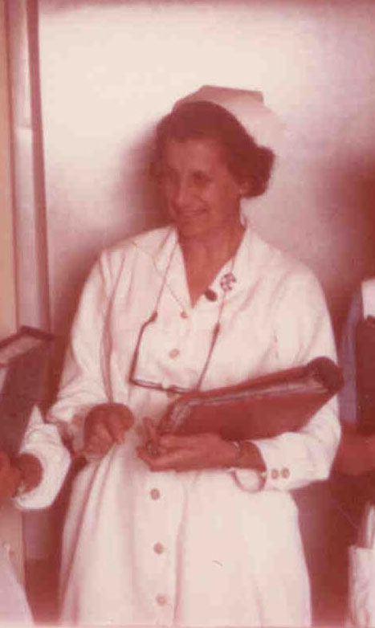
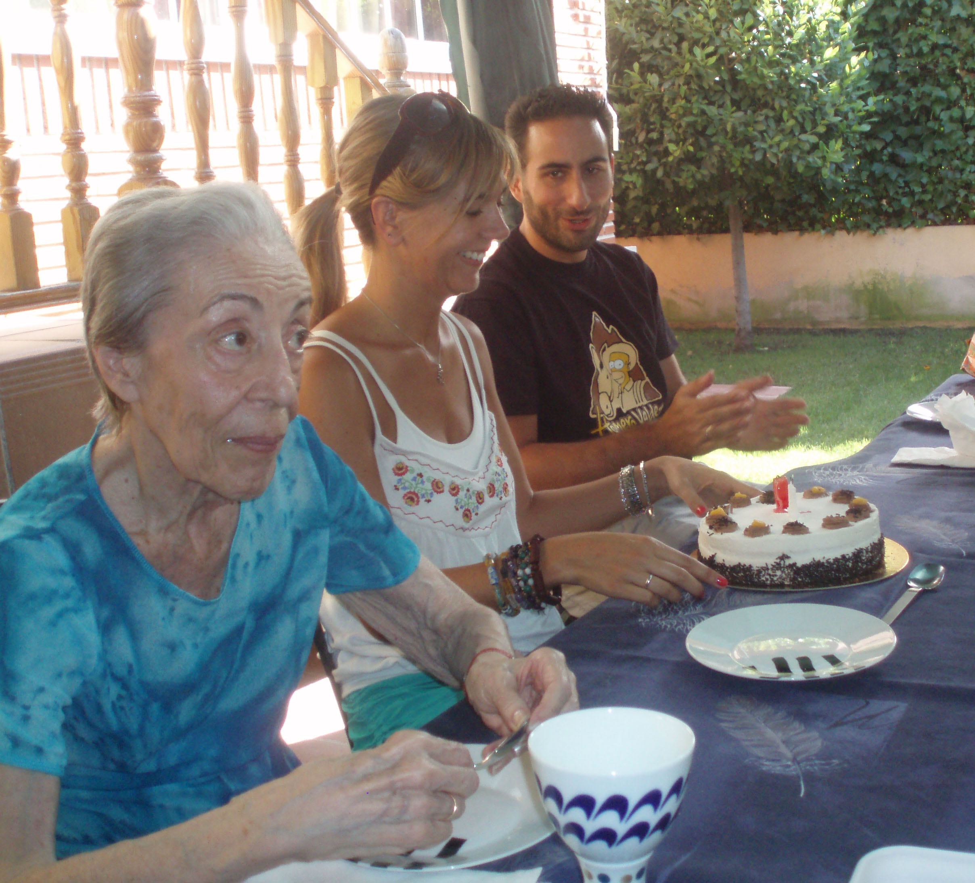

Support as nursing intervention

Slide 3
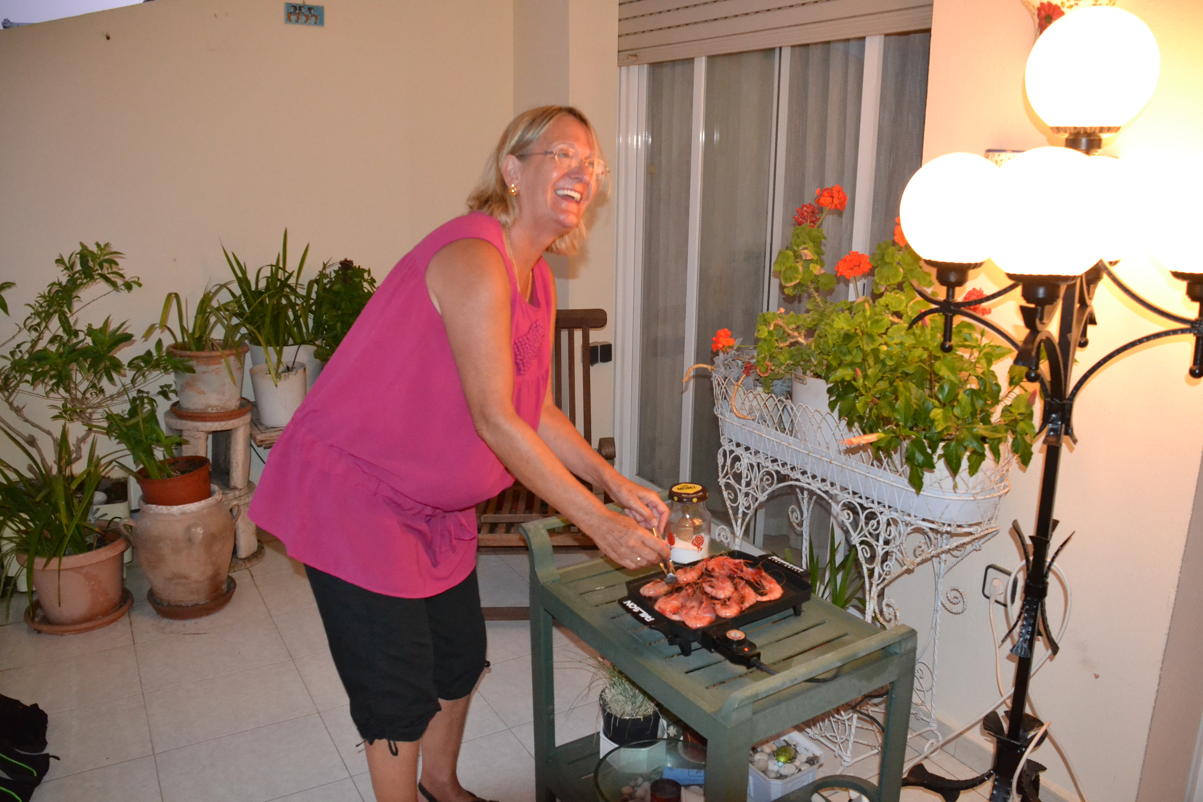
Instrumental support

Slide 4

Instrumental support

Slide 5
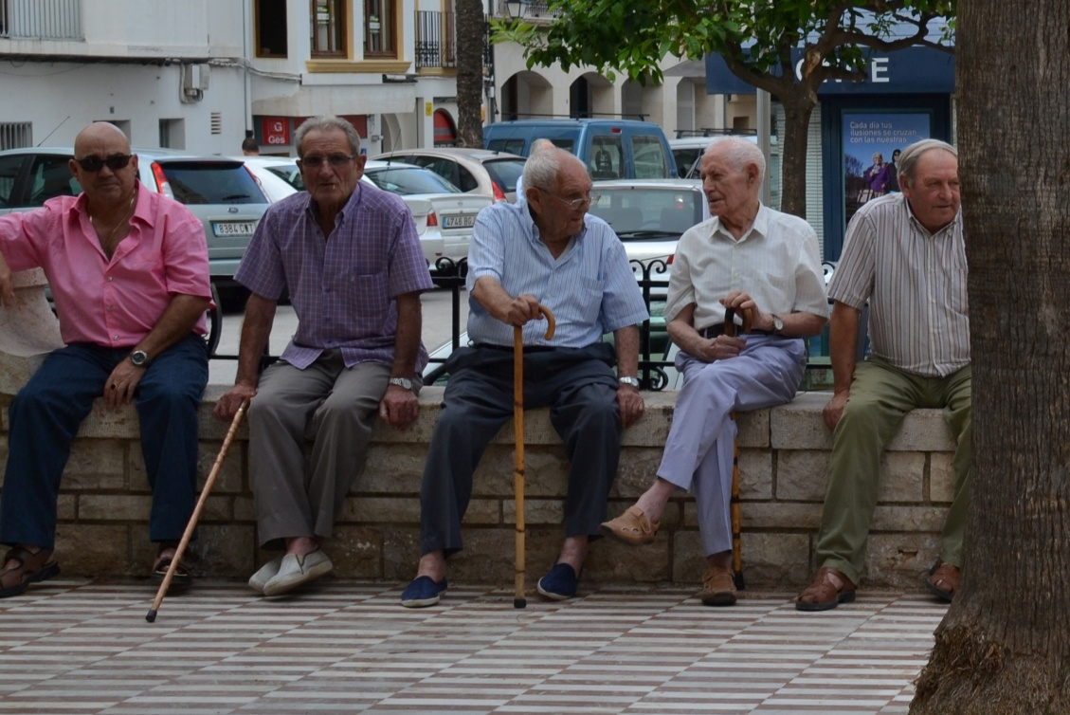
Social support

Slide 6
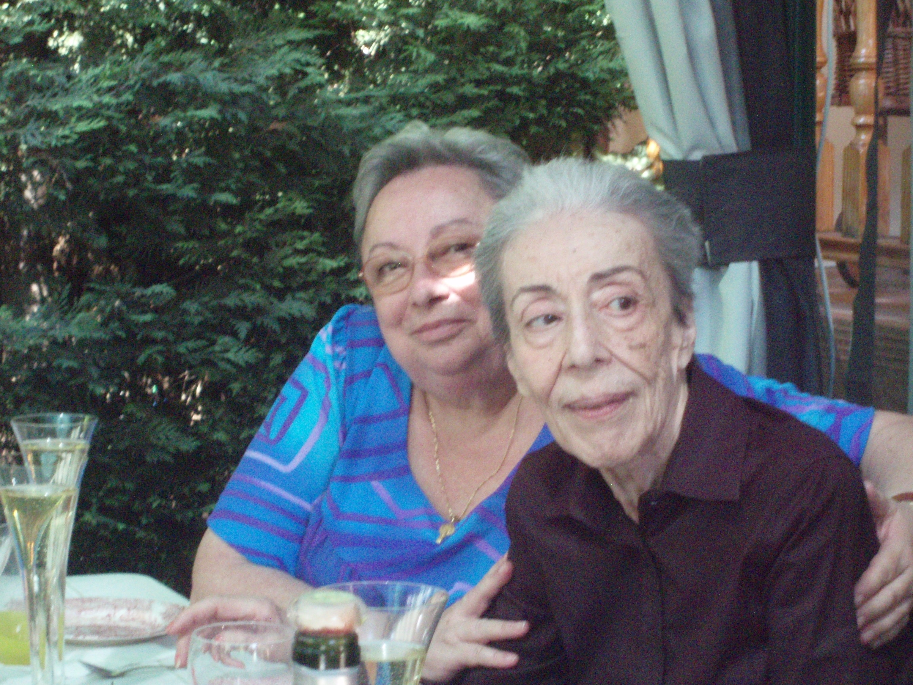
Emotional support

Slide 7
Instrumental support
Social support
Emotional support
Support

Slide 8
Emotional support
Grounded theory
Observation of 12 RNs supportive interventions to 36 patients 80- 102 years
Grounded theory
Interviews of 16 RNs
Descriptive statistic
7053 interventions given to
patients 80 years or older
Grounded theory
Interviews of 18 patients 80- 96 years

Slide 9
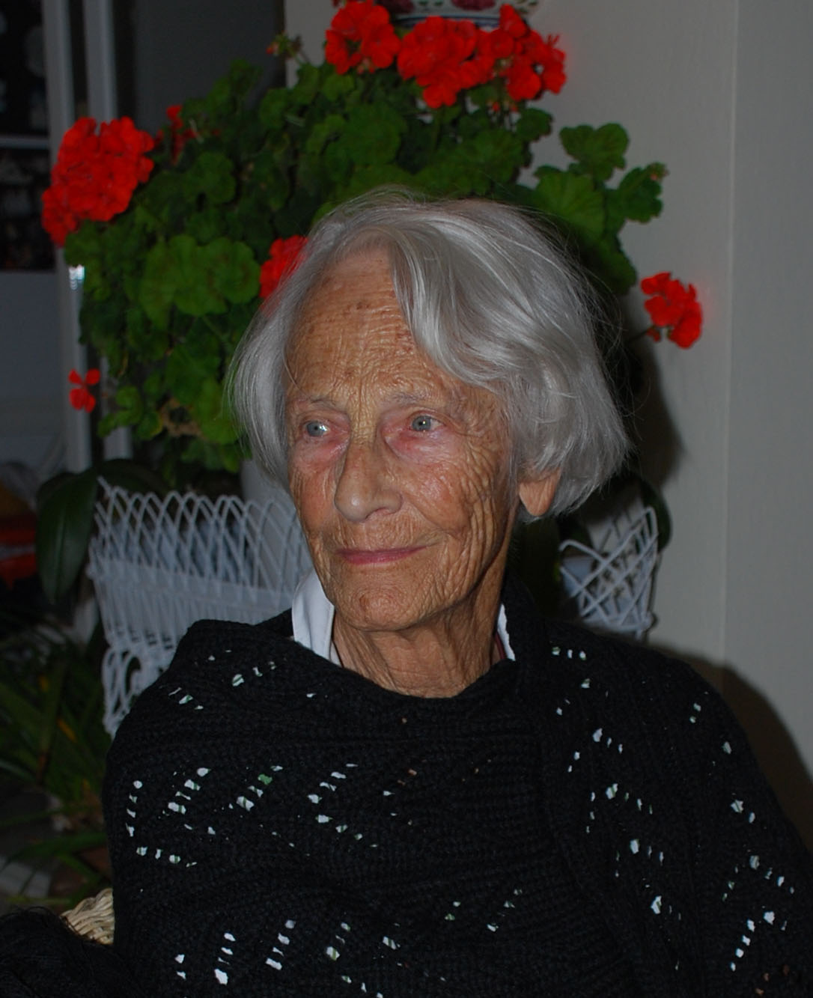
Vulnerability
Irresolution
Loneliness
Emotional support

Slide 10
The RN meet my needs
when I am;
Irresolute
By giving me advice
Vulnerable
By confirming me
Loneliness
By act as my social network

Slide 11
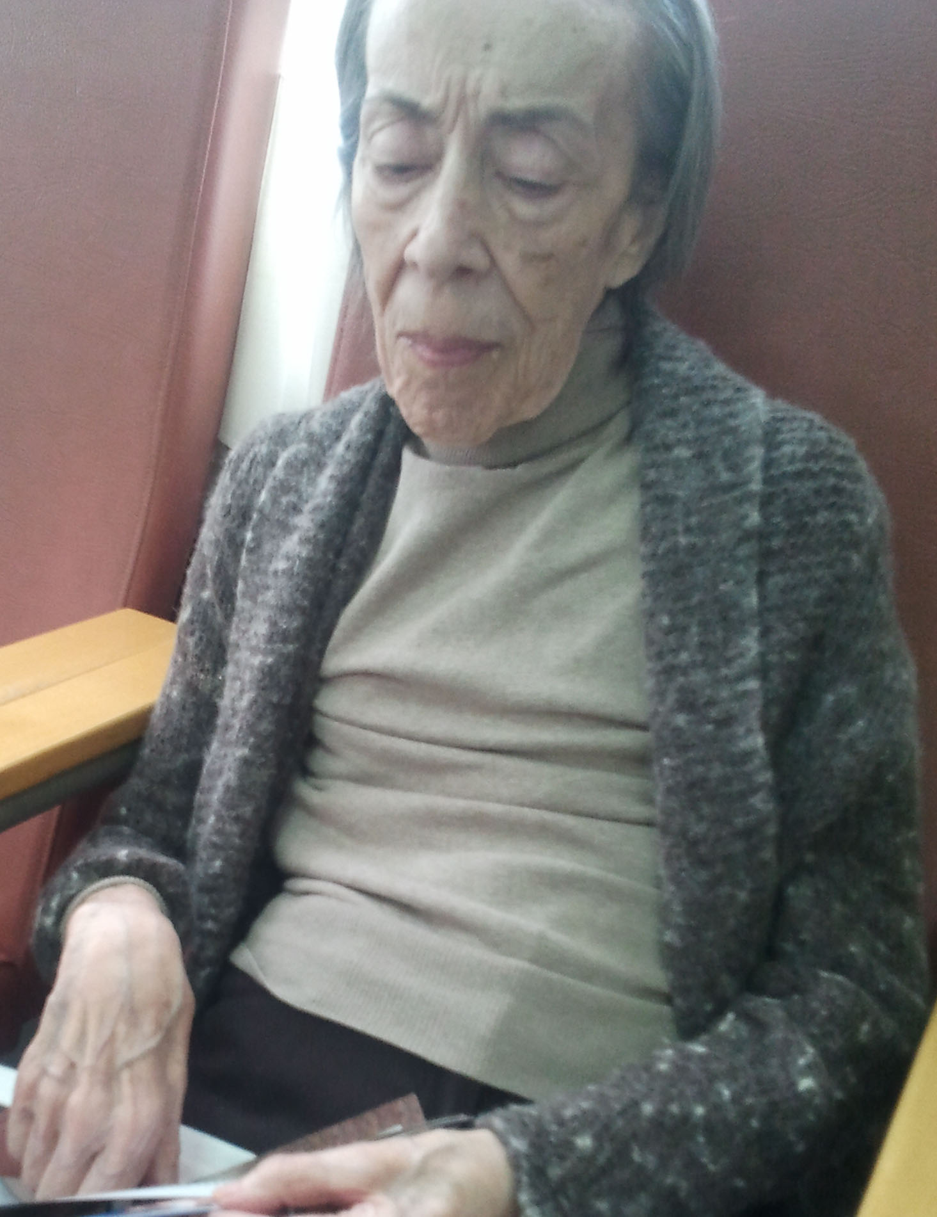
Trapped in an emotional state
Trying to help the patient dealing with their emotions

Slide 12
RNs strategies
Encouraging the situation
Using the patient's own strength
Reducing patient’s limitation
Replace the patient’s lost or reduced ability
Gap of support
Difficulty in identifying the patient’s needs

Slide 13
Vulnerability
Reducing patient’s limitation
Encouraging the situation
Emotional support
Serenity
Irresolution
Loneliness

Slide 14
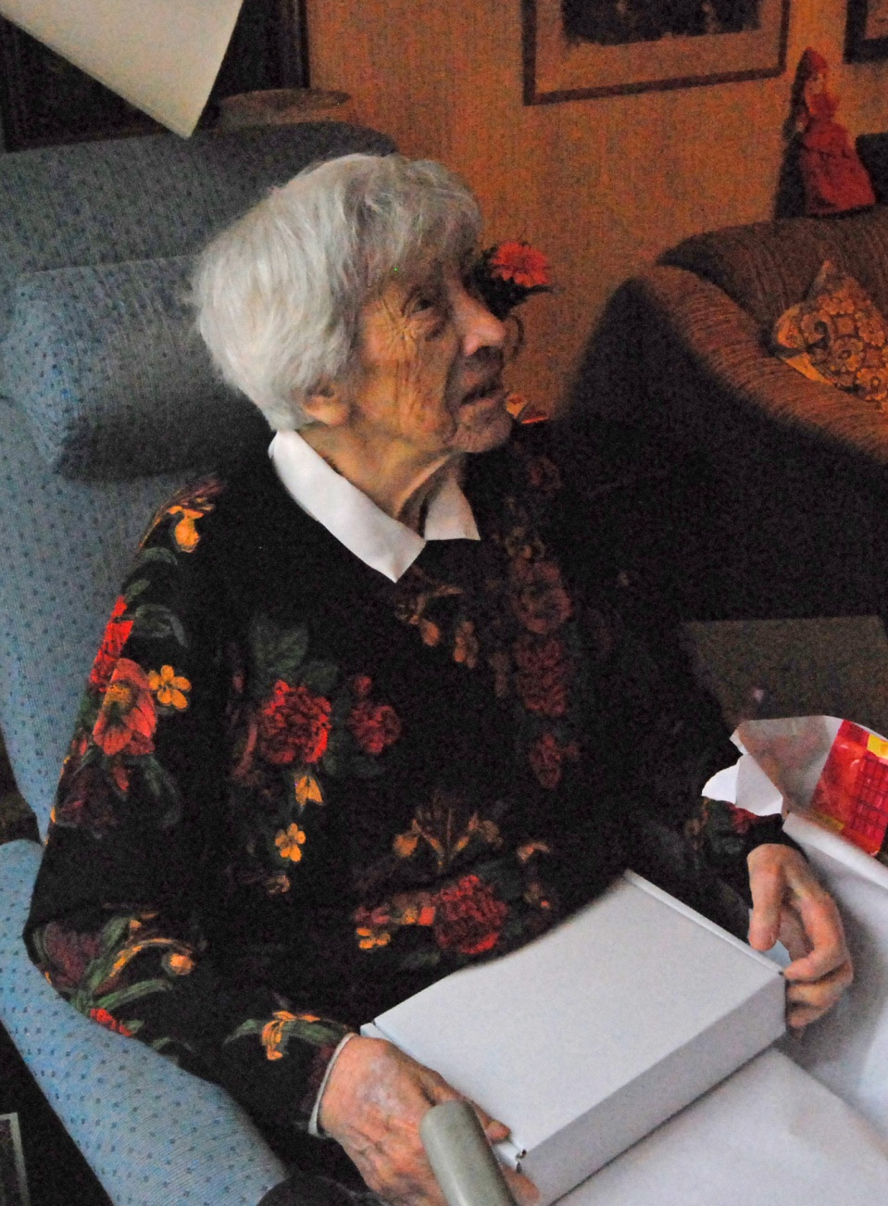

Slide 15
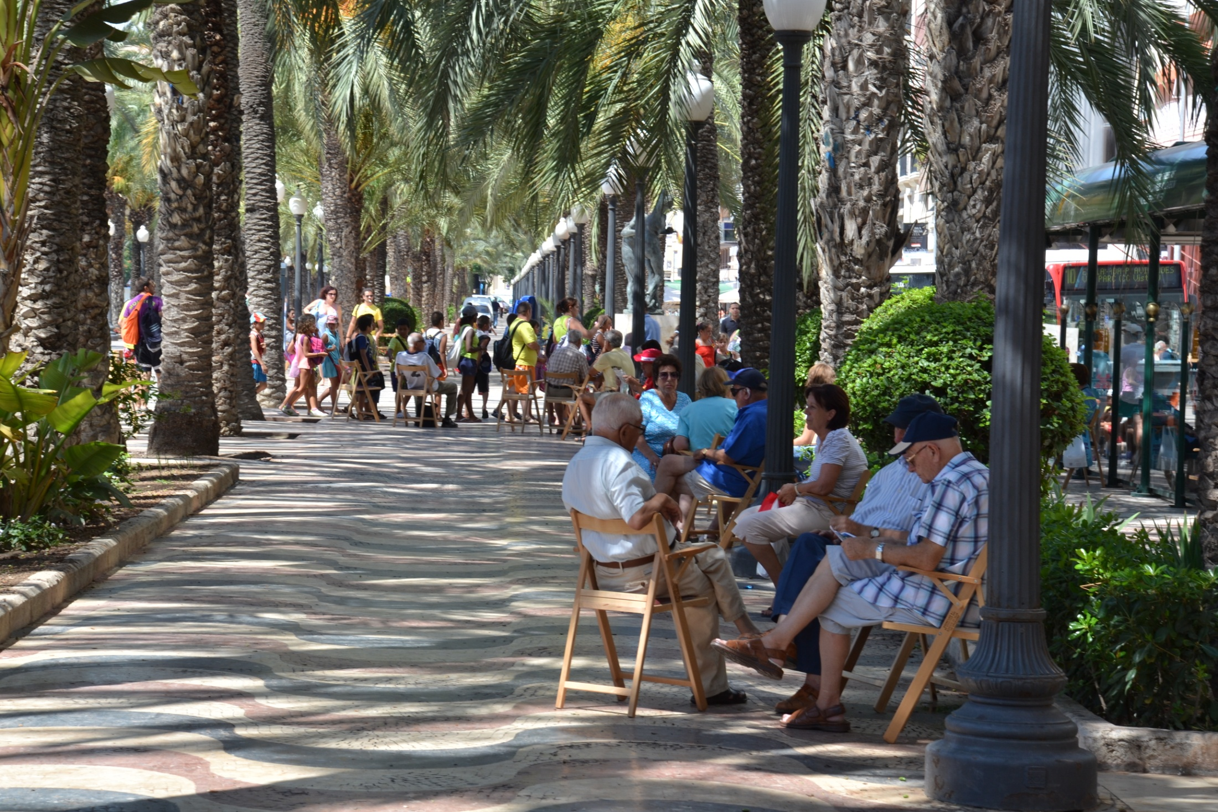
Thank you

