Slide 1


MASS SPECTROMETRY AIMED AT SEQUENCE ANALYSIS OF NATURAL
AND SYNTHETIC BIODEGRADABLE MACROMOLECULES
Marek M. Kowalczuk
School of Biology, Chemistry
and Forensic Science
Faculty of Science and Engineering
University of Wolverhampton
Polish Academy of Sciences
Centre of Polymer and Carbon Materials

Slide 2
OUTLINE
Introduction – natural and synthetic biodegradable macromolecules
Molecular level structure of natural PHA
MS for synthetic analogues of PHA
Conclusions
Mass Spectrometry Reviews, DOI: 10.1002/mas.21474

Slide 3
Biopolymers
Monomers | Oligomers | Polymers
3-HB (3-hydroxy-butyric acids) | cP(3-HB) (channel component) | sP(3-HB) (cf. storage)
Amino acids | Oligopeptides | Polypeptides (enzymes, silk)
Monosacharides | Oligosacharides | Polysacharides (cf. cellulose, starch)
Nucleotides | Oligonucleotides | Polynucleotides (cf. DNA, RNA)
D. Seebach, M. G. Fritz,
International Journal of Biological Macromolecules, 25 (1999) 217-236
Notes:
Czy tak ma być zrobiona ta druga linijka?

Slide 4
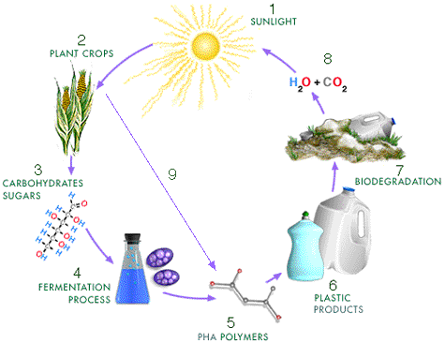
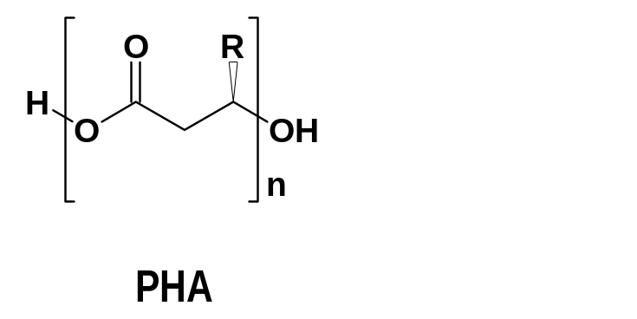
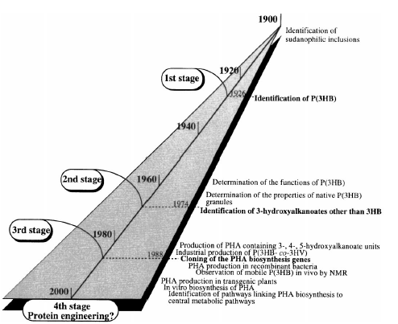
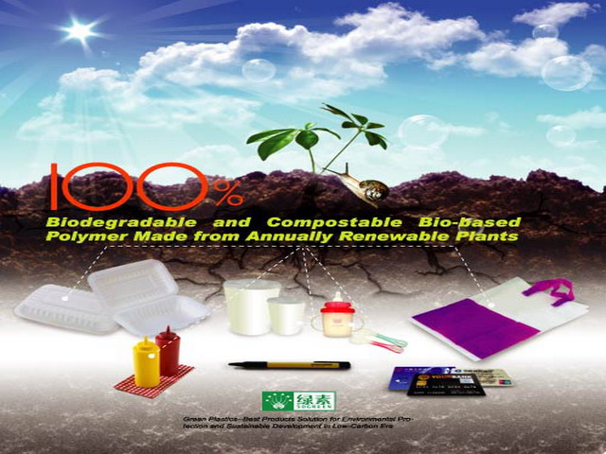
History of PHA
Production of PHA from renewable
resources by fermentation
PHA production by genetically
modified plants
In-vitro production of PHAs
Identification of sudanophilic inclusions
1st stage
Identification of P(3HB)
Price: 2GBP/kg
Determination of the functions of P(3HB)
2nd stage
Determination of the properties of native P(3HB) granules
Identification of 3-hydroxyalkanoates other than 3HB
3rdstage
Production of PHA containing 3-, 4-, 5-hydroxyalkanoate units
Industrial production of P(3HB- co-3HV)
Cloning of the PHA biosynthesis genes
PHA production in recombinant bacteria
Observation of mobile P(3HB) in vivo by NMR
PHA production in transgenic plants
In vivo biosynthesis of PHA
Identification of pathways linking PHA biosynthesis to
central metabolic pathways
4th stage
Protein engineering?

Slide 5
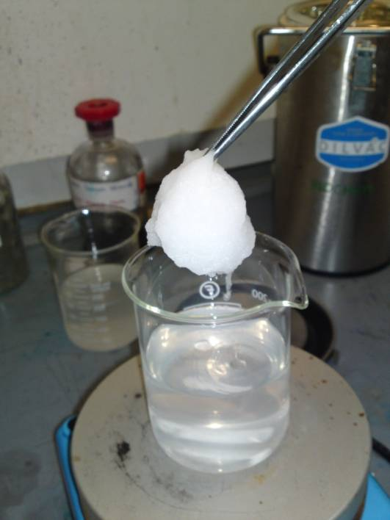
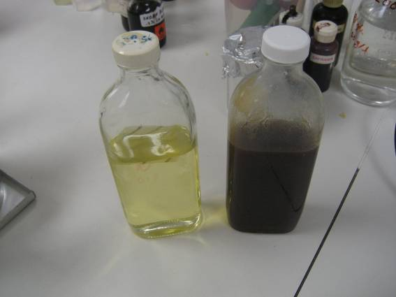
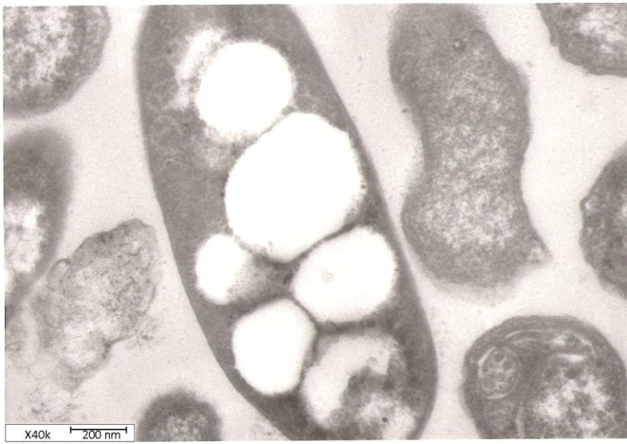

Bacterial bioplastics
from vegetable frying oil
Work by a research team at the University of Wolverhampton, UK suggests that using waste cooking oil as a starting material for the production of bioplastic can reduce production costs significantly
Waste cooking oil
Bacteria with PHA granules
Bioplastics!

Slide 6
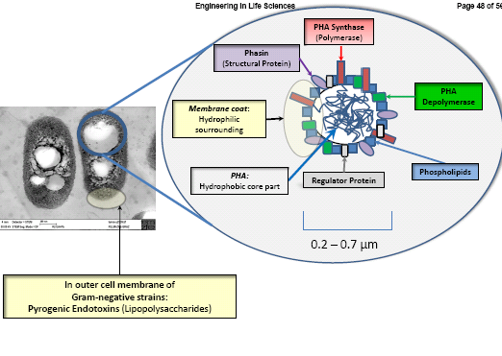
Recovery and purification of PHA
PHA Synthase (Polymerase)
Phasin
(Structural Protein)
PHA Depolymerase
Membrane coat:
Hydrophilic sourrounding
PHA:
Hydrophobic core part
Phospholipids
Regulator Protein
In outer cell membrane of
Gram-negative strains:
Pyrogenic Endotoxins (Lipopolysaccharides)
M. Koller, H. Niebelschütz, G. Braunegg,
Engineering in Life Sciences,
13 (2013) 549–562

Slide 7
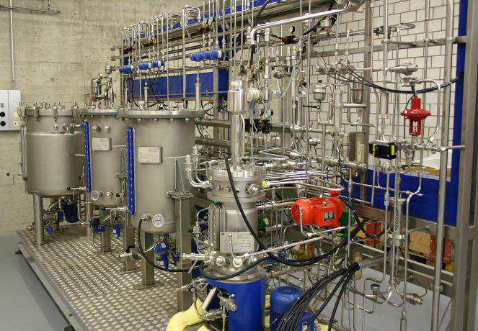
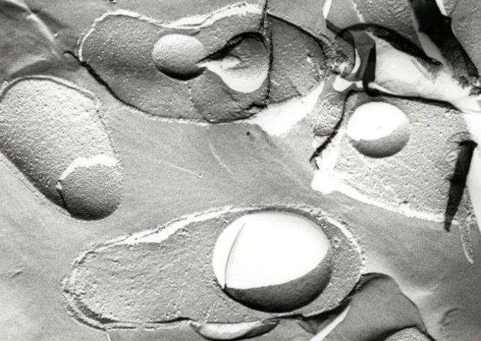
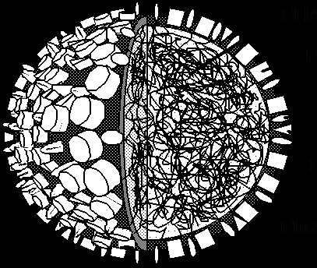
Bacterial synthesis of
poly(3-hydroxyalkanoate)
Short-chain-length PHA
Medium-chain-length PHA
Thermoplasts (T_{m} 120-180°C)
High crystallinity (40-80%)
Density >1.2 g cm⁻³
Elongation at break 6-10%
Industrial production: +
Elastomeric, thermoplastic, duroplastics or fluidoplastic properties (T_{m} n.d.-80°C)
Low crystallinity (0-40%)
Density: ca. 1.05 g cm⁻³
Elongation at break: adjustable (>100%)

Slide 8
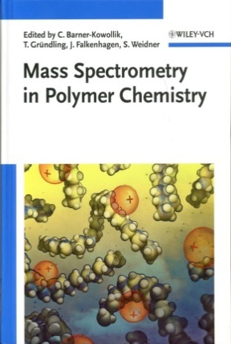
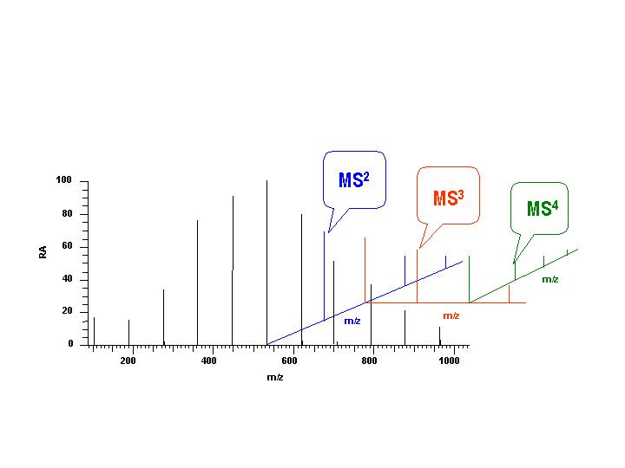

Polymer MS
molecular level structure evaluation
• Ion trapping ESI mass spectrometers can trap ions of a selected mass and analyze fragments derived from these precursors
• Multistage ESI MS (MS^{n}) allows all relationships between precursor ions and products to be established
Artist: Nils G. Stenqvist

Slide 9
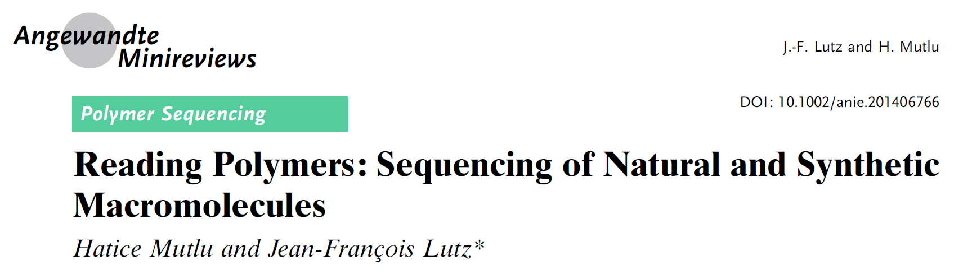
„Indeed, modern chemical methods for sequence analysis allow reading and understanding the codes of life. Thus, sequencing methods currently play a major role in applications as diverse as genomics, gene therapy, biotechnology, and data storage. However, in terms of fundamental science, sequencing is not really a question of molecular biology but rather a more general topic in macromolecular chemistry. Broadly speaking, it can be defined as the analysis of comonomer sequences in copolymers”
Angewandte Chemie International Edition, 53 (2014) 13010 -13019

Slide 10
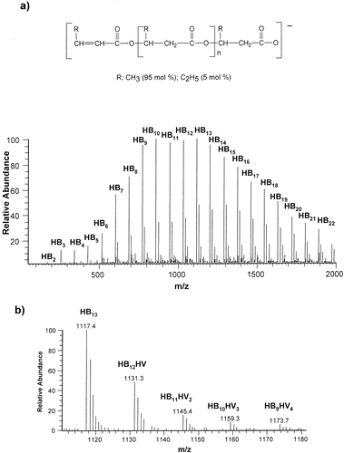
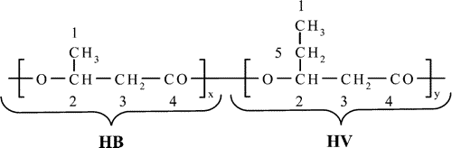
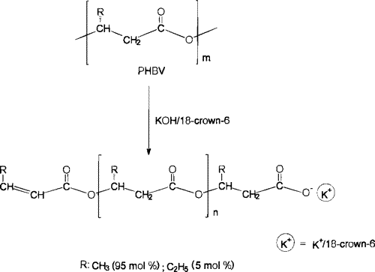

Characterization of PHBV macroinitiator
ESI MS (‒)
PHBV
Macromolecules, 33 (2000) 5797-5802

Slide 11
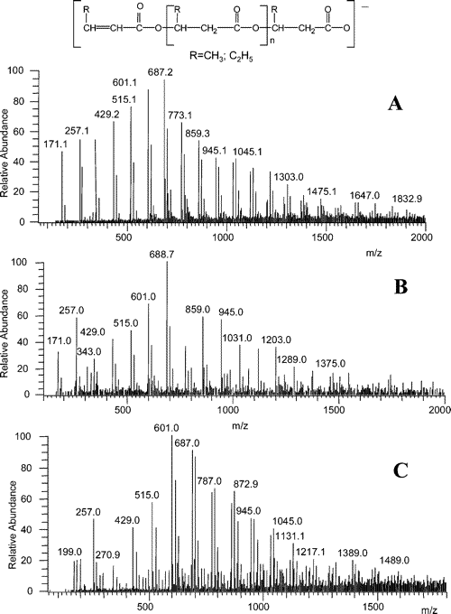
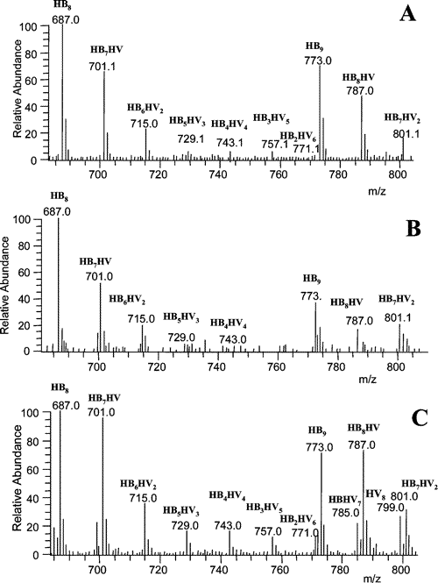
ESI MS(‒) spectra of partially depolymerized PHBV
12.0 mol %
12.9 mol %
Depolymerization
27.1 mol %
Biomacromolecules, 7 (2006) 2210–2216

Slide 12
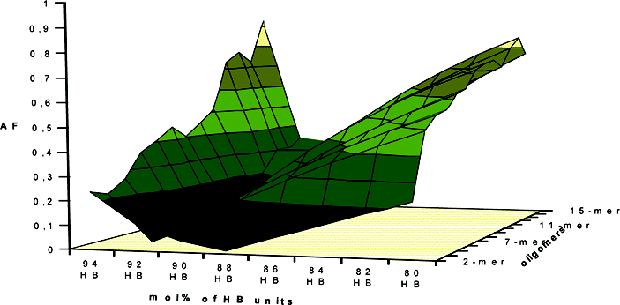
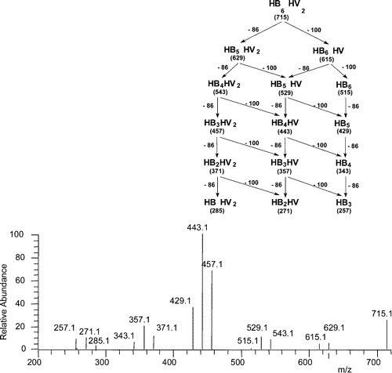
Sequential fragmentation spectrum (MS²)
Calculated agreement factors (AF)
as a function of copolymer composition for PHBV oligomers of 12.0 mol % depolimerization
HB₆HV₂ selected from 8-mer oligomer cluster of a 12.0 mol % PHBV
ESI MS² (‒)
[HB₆HV₂-H]⁻
715  **
Biomacromolecules, 7 (2006) 2210–2216

Slide 13
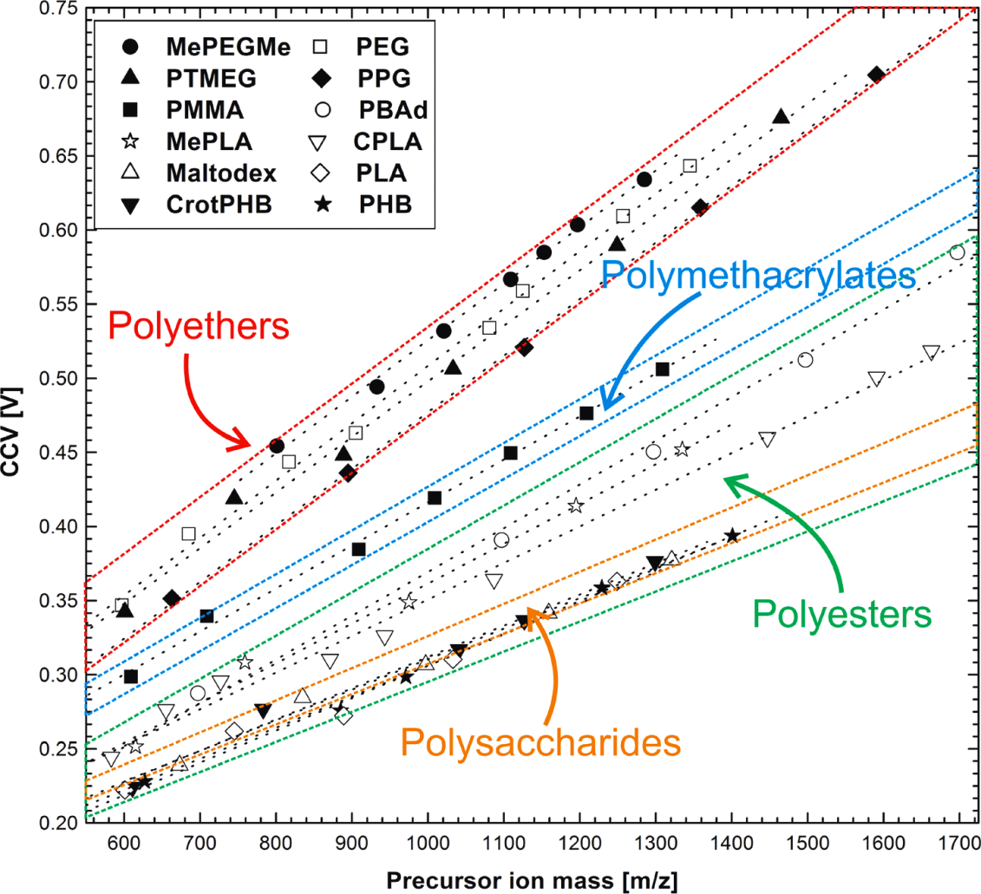
Discrimination of polymers by using their characteristic collision energy
Characteristic collision voltage (CCV) versus the precursor ion masses of the studied singly lithium cationized polymers. The data points per polymer were linear fitted and grouped into four groups:
polyethers (red), polymethacrylates (blue), polyesters (green), polysaccharides (orange)
K. Vékey et al., Analytical Chemistry, 82 (2010) 9350-9356

Slide 14
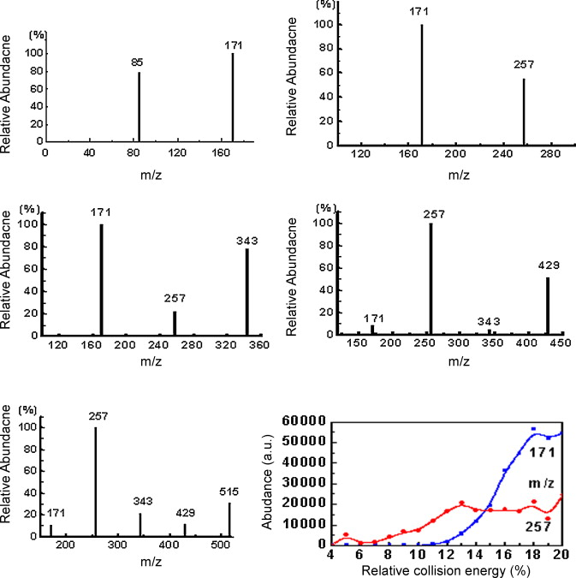
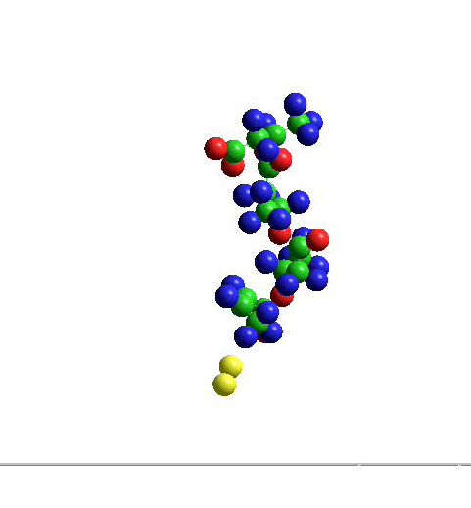
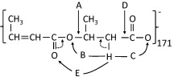
Mechanism of fragmentation active
for PHB oligomers
ESI MS/MS(‒)
[PHB_{n}-H]⁻
n = 2 dimer
n = 3 trimer
n = 4
tetramer
n = 4
tetramer
n = 5 pentamer
n = 6 hexamer
International Journal of Mass Spectrometry, 304 (2011) 15-24

Slide 15
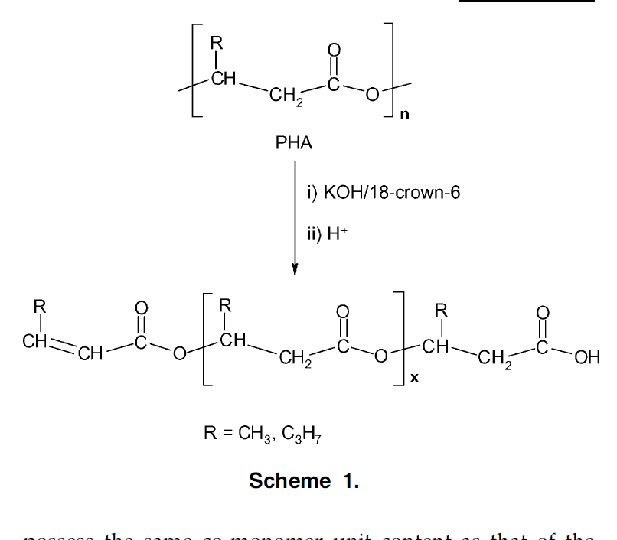
Bacterial poly(3-hydroxybutyrate-
-co-3-hydroxyhexanoate)
NODAX TM
HB₇HH₂ selected from the 9-mer cluster of PHBH oligomers
ESI MS/MS (+)
[HB₇HH₂ +Na]⁺
853  **
Rapid Communications in Mass Spectrometry, 17 (2003) 2260–2266

Slide 16
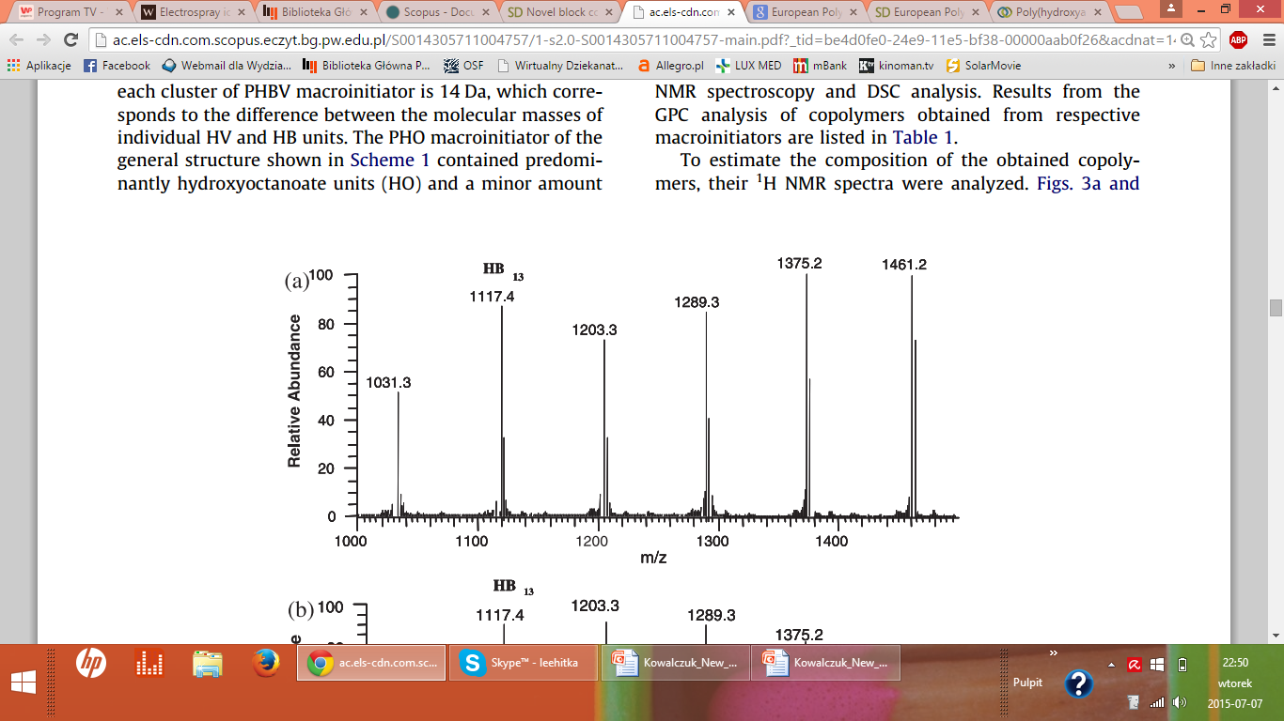
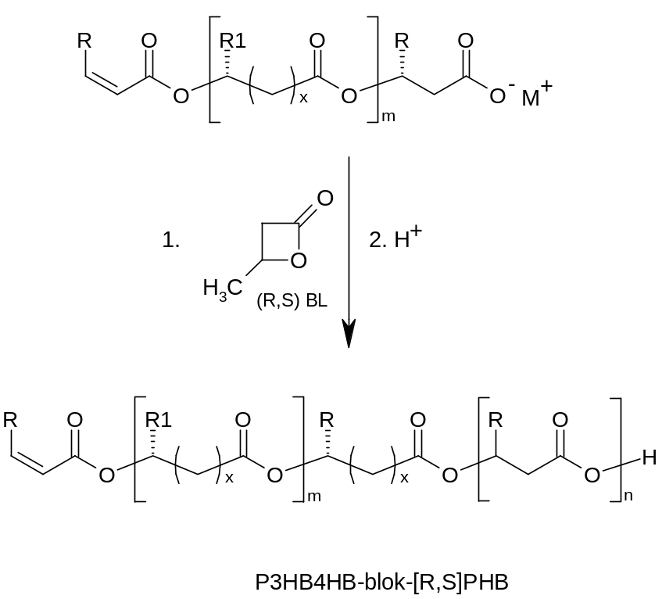
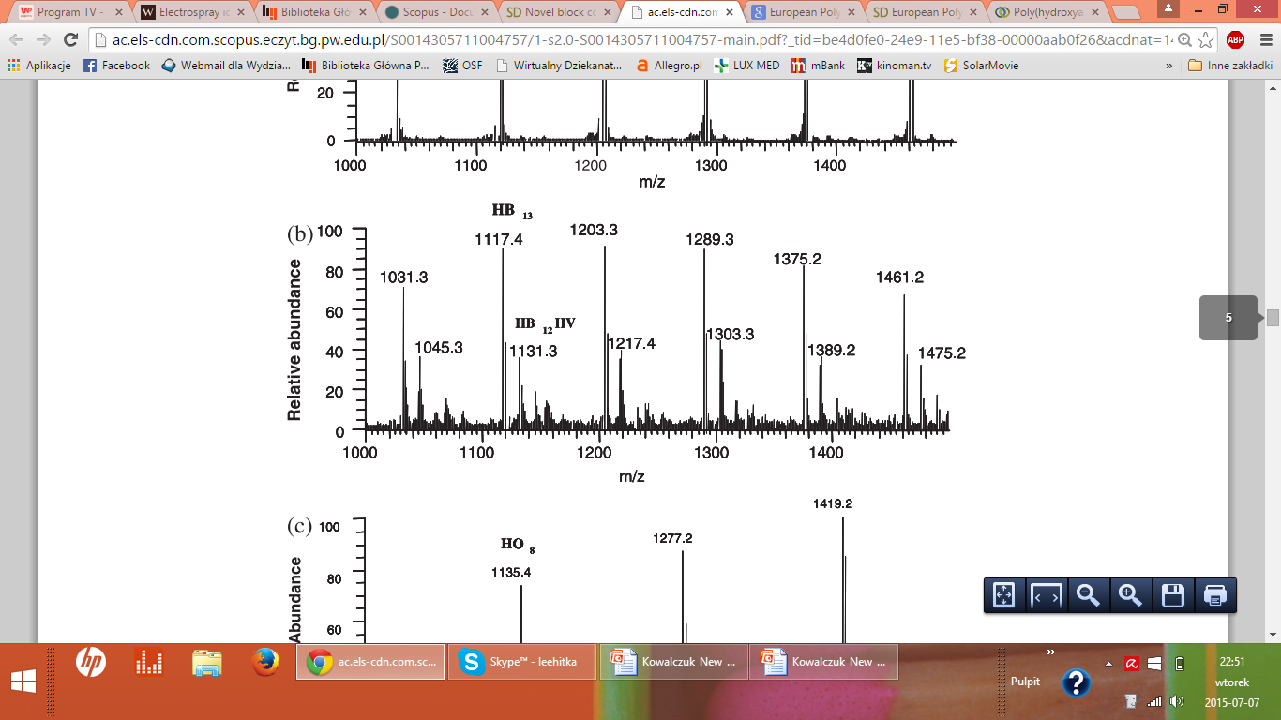
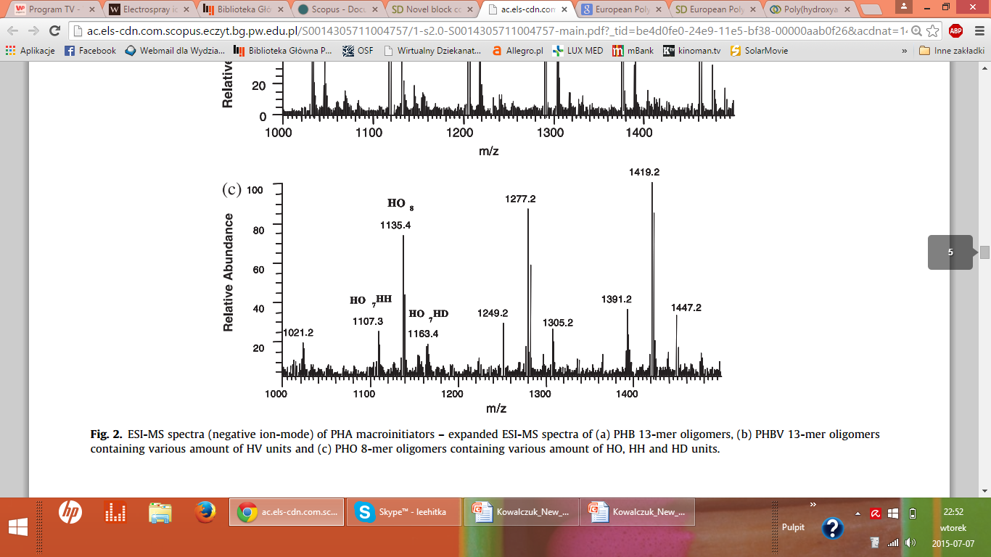
PHA block copolymers
ESI MS(‒)
PHB 13-mer oligomers
PHBV 13-mer oligomers
PHO 8-mer oligomers
European Polymer Journal, 48 (2012) 621-631

Slide 17
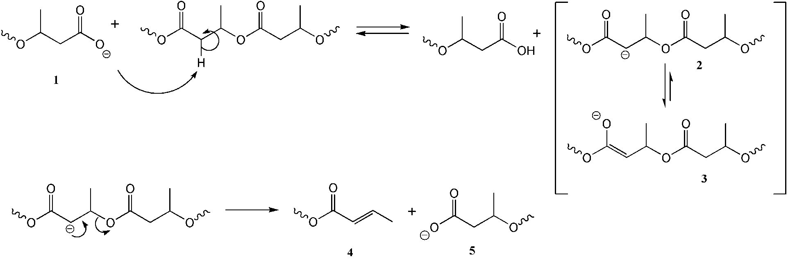
E1cB degradation mechanism of PHB
M. Kawalec, G. Adamus, P. Kurcok, M. Kowalczuk,
I. Foltran, L. Focarete, M. Scandola,
Carboxylate induced degradation of poly(3-hydroxybutyrate)s,
Biomacromolecules, 8 (2007) 1053-1058

Slide 18
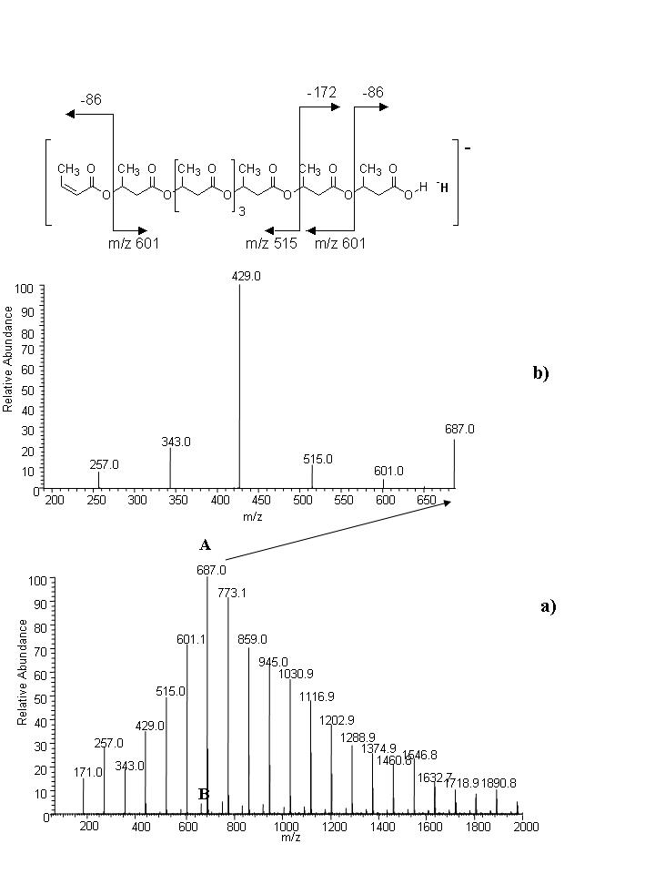
E1cB degradation mechanism of PHB
ESI MS² (‒)
687  **
a-PHB oligomer with crotonate end group
ESI MS (‒)
Mass spectrum of a-PHB sample after 4h of the isothermal treatment at 120°C

Slide 19
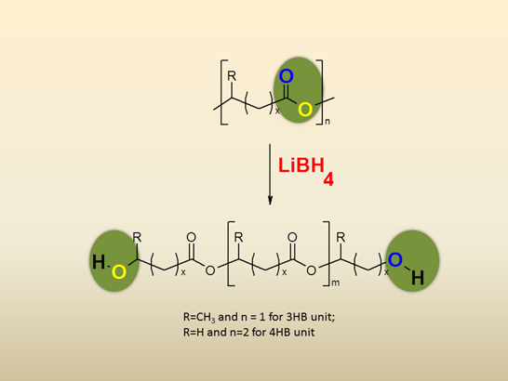
Reduction of PHA biopolyesters
LiBH₄
Biomacromolecules, 14 (2013) 1181-1188

Slide 20
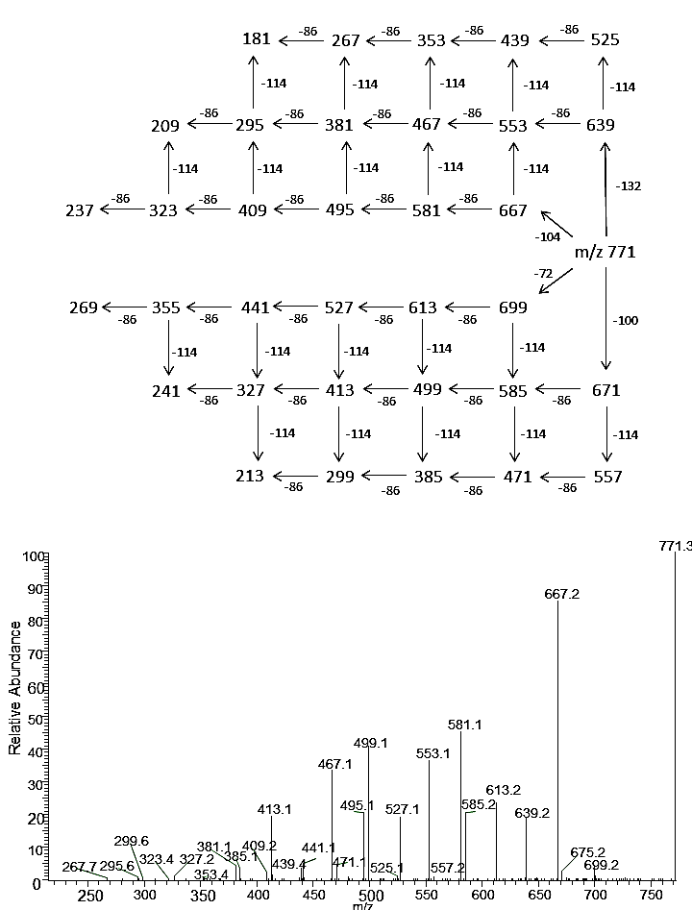
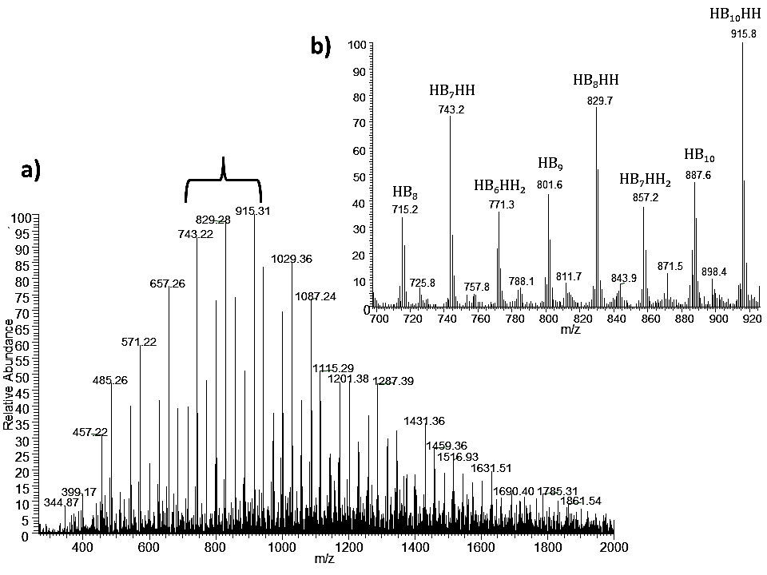
Reduction of PHBH with LiBH₄
ESI MS/MS(+)
771  **
[HB₆HH₂+Na]⁺
ESI MS(+)

Slide 21
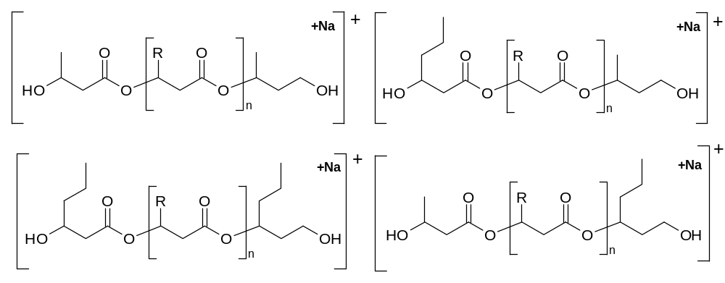
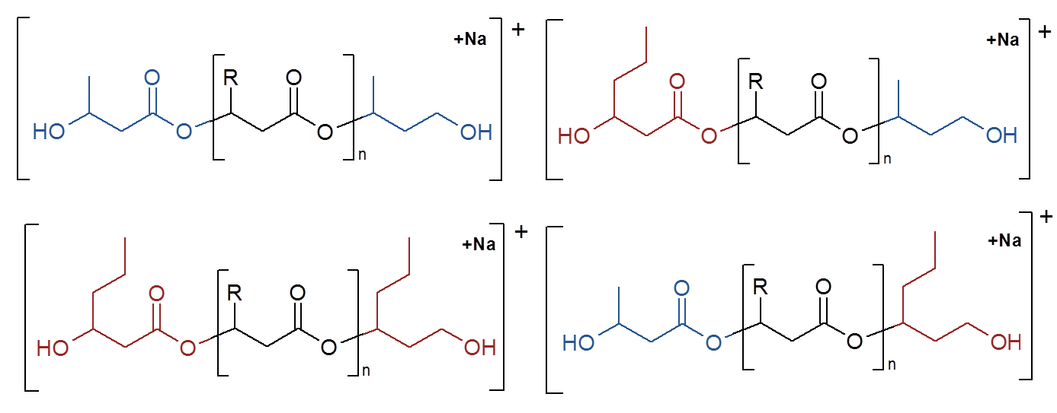
Reduction of PHBH with LiBH₄

Slide 22
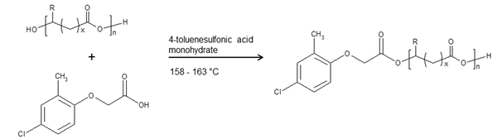
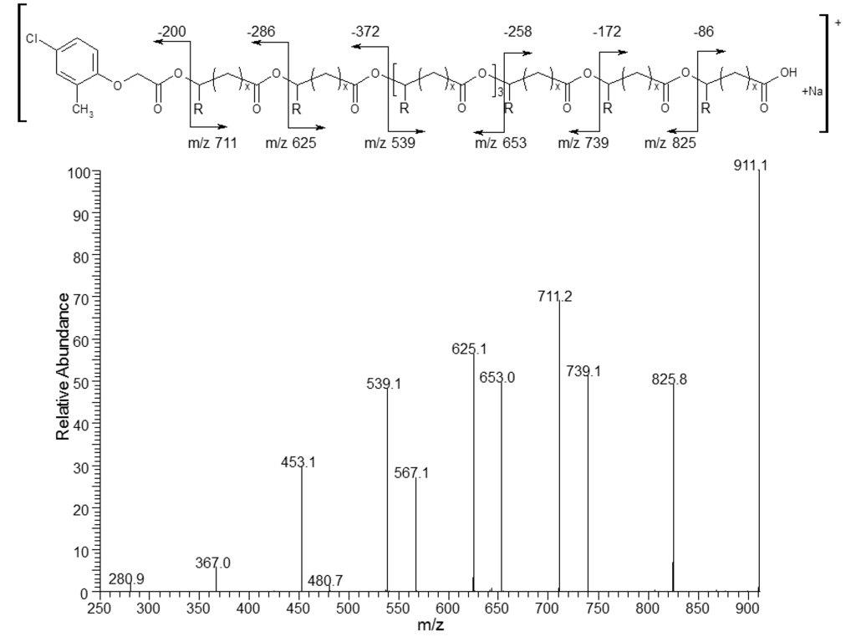
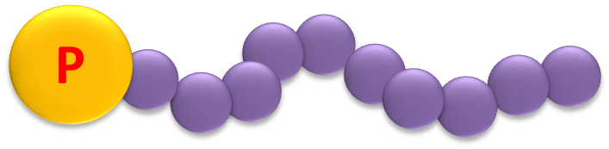
Bioactive conjugates from natural PHA
Transesterification reaction of P(3HB-co-4HB)
by (4-chloro-2-methylphenoxy)acetic acid (MCPA)
mediated by TSA∙H₂O
R=CH₃, x=3HB units
or
R=H, x=4HB units
ESI- MS²
[MCPA–(OHB)₈+Na]⁺
911  **
New forms of pesticides containing
carboxyl
functionalities
PLoS One. 2015; 10(3): e0120149.

Slide 23
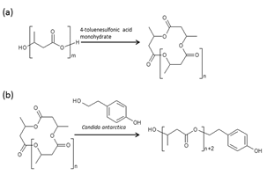
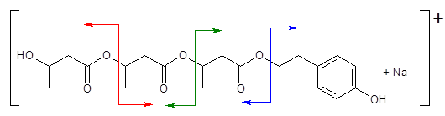
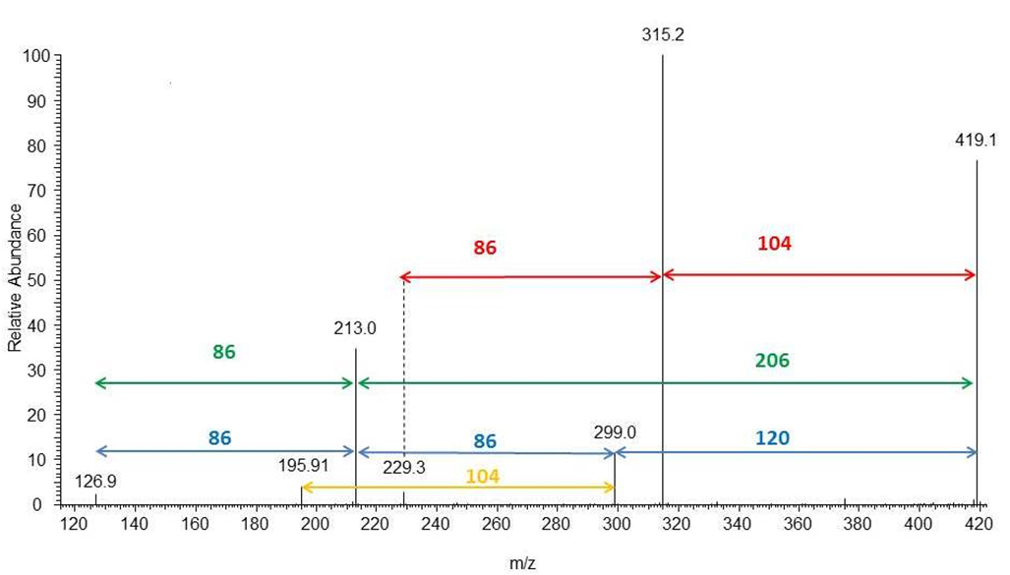
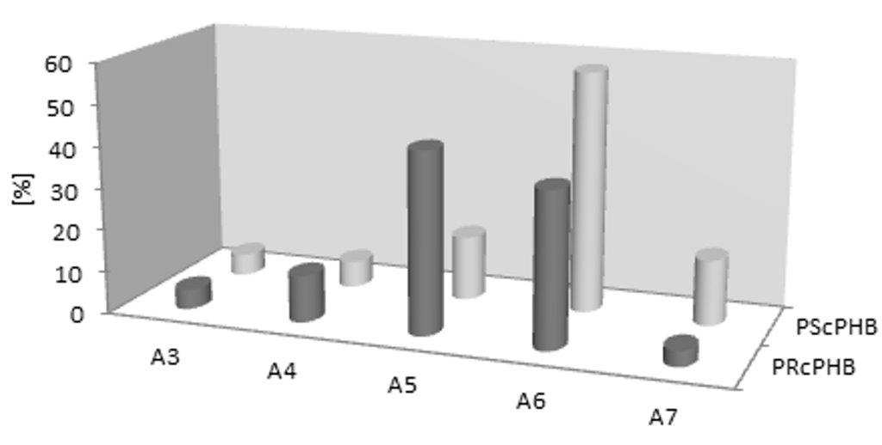
Bioactive conjugates from natural PHA
Synthesis of oligo(3HB)-tyrosol conjugates using the two-step method
-120
299
ESI MS/MS(+)
[Tyrosol–(OHB)₃+Na]⁺
419  **
New forms of pesticides containing
hydroxyl
functionalities
PLoS One. 2015; 10(3): e0120149.

Slide 24
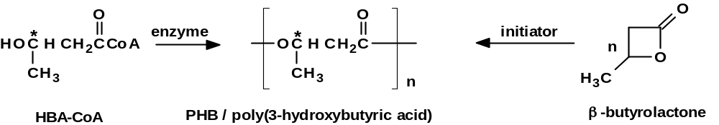
BIOCOP ®
structure
properties

Slide 25
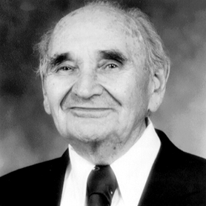
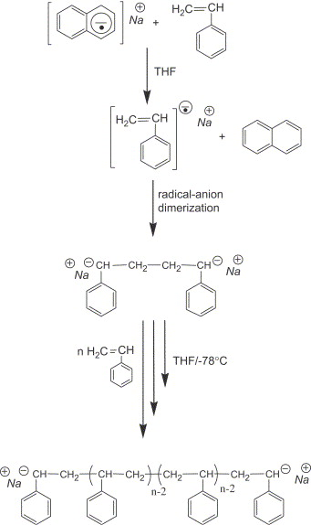
Anionic living polymerization
Michael Szwarc (June 9, 1909, Będzin, Poland – August 4, 2000, United States) was a British (University of Manchester) and American (State University of New York) polymer chemist who discovered and studied ionic living polymerization
Kyoto Prize in 1991
http://www.inamori-f.or.jp/laureates/k07_a_michael/prf_e.html
Living Polymers, Nature, 178 (1956) 1168–1169

Slide 26
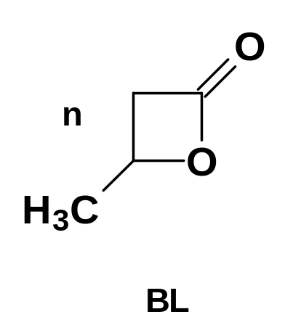
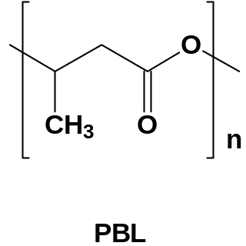
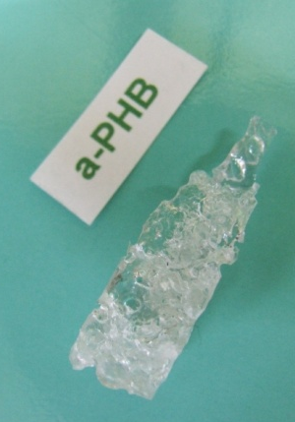
Anionic ROP
anionic catalyst
no polymerization
supramolecular catalyst
activated by e.g.,
18-crown-6
BL
PBL
Activation of anionic species
Regioselectivity
Stereoselectivity
Propagation on carboxylate active centers
Z. Jedliński, M. Kowalczuk, W. Główkowski, J. Grobelny, M. Szwarc,
Macromolecules, 24 (1991) 349-352

Slide 27

Biodegradable polymers synthesis
based on clean coal technologies and biomass
John W. Kramer, Emil B. Lobkovsky, Geoffrey W. Coates
Organic Letters, 8 (2006) 3709-3712
Tomasz Bałakier, Wojciech Chaładaj , Janusz Jurczak, Grażyna Adamus, Marek Kowalczuk
Tetrahedron, 69 (2013) 4990-4993

Slide 28


Copolyesters of β-butyrolactone with
β-etoksymethyl-β-propiolactone
Random Copolyester
Diblock Copolyester
Macromolecules, 42 (2009) 4547-4557

Slide 29



Copolyesters of β-butyrolactone with
β-etoksymethyl-β-propiolactone
Diblock Copolyester
Random Copolyester
A
A
1075,8
A
1075,8
A
100
A
100
1033,9
90
1033,9
90
A
A
A
80
80
989,8
989,8
1077,9
1077,9
A
A
70
A
70
B
B
947,8
B
A
947,8
A
A
B
B
Relative Abundance
B
Relative Abundance
60
60
B
B
B
B
B
991,8
B
991,8
1061,8
903,9
1061,8
903,9
975,8
50
B
975,8
50
1017,7
1017,7
1105,9
1035,9
1105,9
931,7
1035,9
40
931,7
40
949,8
949,8
973,8
973,8
1059,9
30
1059,9
30
905,8
905,8
20
20
993,9
993,9
907,8
10
907,8
10
0
0
m/z
900
m/z
900
950
950
1000
1000
1050
1050
1100
1100
ESI MS(+)
3-HB/EMPL
ESI MS(+)
3-HB/EMPL

Slide 30

ESI MS/MS spectrum
of 3-HB/EMPL
100
973,2
90
ES MS/MS(+)
[3-HB₅/EMPL₄+Na]⁺
1033  **
80
70
887,2
60
715,2
801,2
Relative Abundance
50
40
1033,3
Diblock Copolyester
773,2
903,3
30
629,2
643,2
20
10
427,1
513,1
557,1
671,1
757,2
987,1
0
368,8
300
400
500
600
700
800
900
1000
m/z

Slide 31


ESI MS/MS spectrum
of 3-HB/EMPL
Random Copolyester
ES MS/MS(+)
[3-HB₅/EMPL₄+Na]⁺
1033  **

Slide 32
ESI MS/MS mass spectra of selected parent ions
ES MS/MS(+)
[3-HB₅/EMPL₄+Na]⁺
1033  **
973,2
100
90
80
887,2
70
715,2
60
801,2
50
Diblock Copolyester
Relative Abundance
903,3
1033,3
40
629,2
773,2
30
643,2
20
10
368,8
427,1
513,1
557,1
671,1
757,2
987,1
0
300
400
500
600
700
800
900
1000
m/z
100
ES MS/MS(+)
[3-HB₅/EMPL₄+Na]⁺
1033  **
973,2
100
90
90
80
80
Random Copolyester
70
70
843,2
60
60
903,3
947,3
Relative Abundance
757,2
50
50
887,2
1033,2
40
817,2
40
671,2
687,2
801,2
30
30
601,2
773,2
20
713,2
Mass Spectrometry Reviews,
DOI: 10.1002/mas.21474
20
541,1
497,1
541,1
861,2
455,2
497,1
10
455,2
10
325,0
411,0
0
0
300
300
400
400
500
500
600
600
700
700
800
800
900
900
1000
m/z
1000
m/z

Slide 33


Synthetic analogues of PHA
R₁= | —CH₃ |  | R = R₁= | —CH₃
 |  |  | or
R₂= | —CH₂OC₄H₉ |  | R = R₂= | —CH₂OC₄H₉
 | or |  |  | or
 | —CH₂OPh |  |  | —CH₂OPh
 | or |  |  | or
 | —CH₂OBn |  |  | —CH₂OBn
Analytica Chimica Acta, Special Issue: Polymer Mass Spectrometry, 808 (2014) 104-114

Slide 34


Structure at the molecular level
ES MS/MS(+)
[HB₈/BnOHB+Na]⁺
963  **
ES MS(+)
Analytica Chimica Acta, Special Issue: Polymer Mass Spectrometry, 808 (2014) 104-114

Slide 35
CONCLUSIONS

Slide 36
ESI MS^{n} for natural and synthatic biodegradable macromolecules characterization at the molecular level
macromolecular topology
verification of chemical homogeneity and end group analysis
location of functional groups
structural analysis of copolymers including composition and sequence distribution of individual structural units

Slide 37


The University of Wolverhampton has a long and cherished history dating back to Wolverhampton's Mechanics' Institute and College of Art in the mid-1800s

Slide 38


Centre of Polymer and Carbon Materials
Polisch Academy of Sciences
PL 41-819 Zabrze, M. Curie-Skłodowskiej 34
PL 44-121 Gliwice, Sowińskiego 5

Slide 39


RESEARCH SUPPORTED BY
NCN DEC-2012/07/B/ST5/00627

Slide 40



THANK YOU
FOR YOUR KIND ATTENTION
Artist: Agnieszka Bieniek – Wydrzyńska, Rybotycze, 2012

