Slide 1
The Relation of Mini Nutritional Screening Score, Subjective Global Assessment of Nutrition, and Pneumonia Severity Index in elderly patients diagnosed with Community Acquired
Pneumonia admitted at
Cardinal Santos Medical Center:
An Obervational, Analytical, Cross Sectional Study
Marco Angelo D. Tongo, MD
Rosa Allyn Sy, MD

Slide 2
introduction
Community Acquired Pneumonia remains among the leading causes of mortality worldwide.
According to Mandell et al in 2007, one estimate shows that 915,900 episodes of Community Acquired Pneumonia in the United States occurred in adults >65 years.

Slide 3
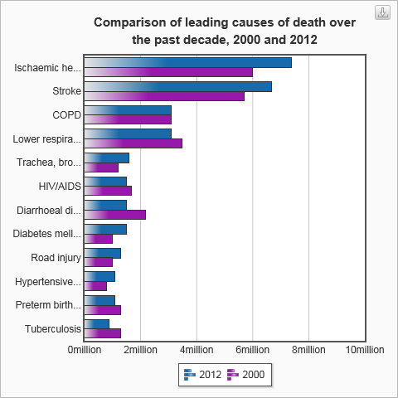
Source: http://www.who.int/mediacentre/factsheets/fs310/en. Accessed 06 December 2016.

Slide 4
Introduction
Community Acquired Pneumonia is among the leading causes of morbidity and mortality among the Filipino community.
Among the elderly population, pneumonia remains to be the leading infectious cause of mortality. Identified risk factors for pneumonia include advanced age and poor nutrition status.
In the evaluation of patients with the disease, the Pneumonia Severity Index is a scoring system developed to calculate the probability of mortality and morbidity of a patient with pneumonia.

Slide 5
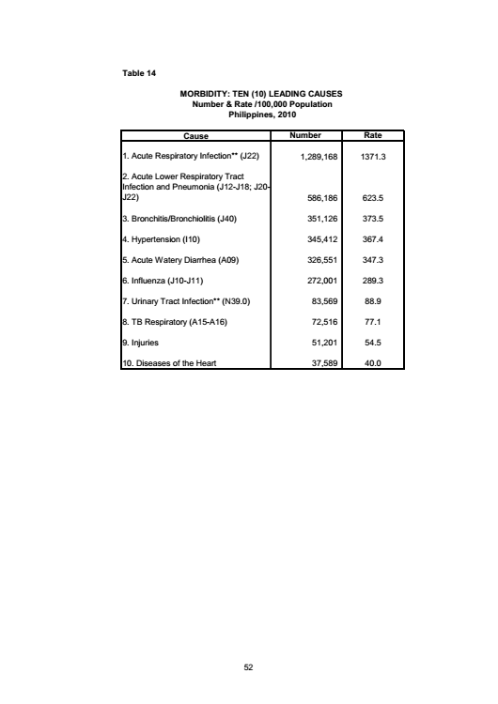
Source: http://www.doh.gov.ph. Accessed 06 December 2016.

Slide 6
Introduction
Nutrition is a significant determinant of the health status of an elderly individual.
Nutrition assessment has been understated in most clinical settings.
Malnutrition has been recognized to decrease quality of life, increase fatality rate, and decrease survival rate among elderly patients with pulmonary pathology.

Slide 7
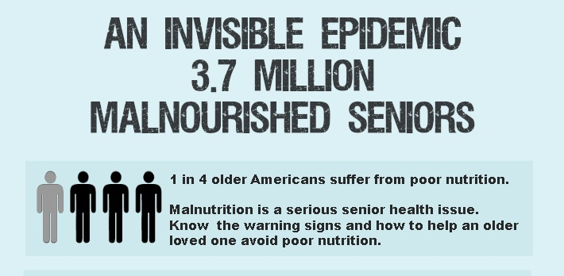
Source: http://www.aplaceformom.com/media/3ql9n5l/0/senior-malnutrition.jpg.
Accessed 06 December 2016.

Slide 8
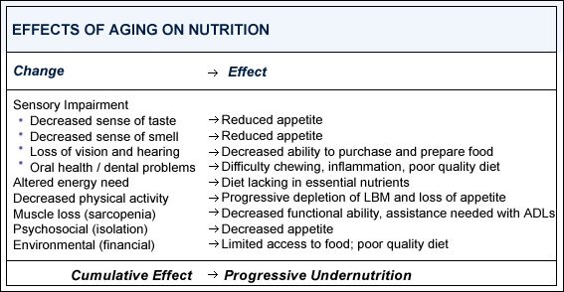
Source: http://www.mna-elderly.com/images/table2.jpg. Accessed 06 December 2016.

Slide 9
Objectives
Primary Objectives
To determine the relation of the mini nutritional screening score and the pneumonia severity index among elderly individuals with community acquired pneumonia admitted in Cardinal Santos Medical Center
To determine the relation of the subjective global assessment of nutrition status and the pneumonia severity index among individuals with community acquired pneumonia admitted in Cardinal Santos Medical Center

Slide 10
Objectives
Secondary Objectives
To determine the relation of the body mass index and the pneumonia severity index among elderly individuals with community acquired pneumonia admitted in Cardinal Santos Medical Center
To determine the relation of calf circumference and the pneumonia severity index among elderly individuals with community acquired pneumonia admitted in Cardinal Santos Medical Center

Slide 11
Methods
Community Acquired Pneumonia, at least 60 years old, admitted in CSMC
Pneumonia Severity Index
Nutritional Assessment
Subjective Global Assessment of Nutrition
Mini Nutritional Screening
Statistical Analysis
Excluded if in congestive heart failure, with other indication for admission (eg. GI bleed, loss of consciousness), undergoing hemodialysis, resident of hospice care, with recent previous hospitalization

Slide 12
Inclusion Criteria
At least 60 years old
Diagnosed with Community Acquired Pneumonia on admission
Admitted in Cardinal Santos Medical Center
Exclusion Criteria
Must not be in congestive heart failure
Must not have other indications for admission not related to community acquired pneumonia such as bleeding, loss of consciousness, abdominal pain
Must not be undergoing hemodialysis
Must not be a resident of a nursing home or hospice care

Slide 13
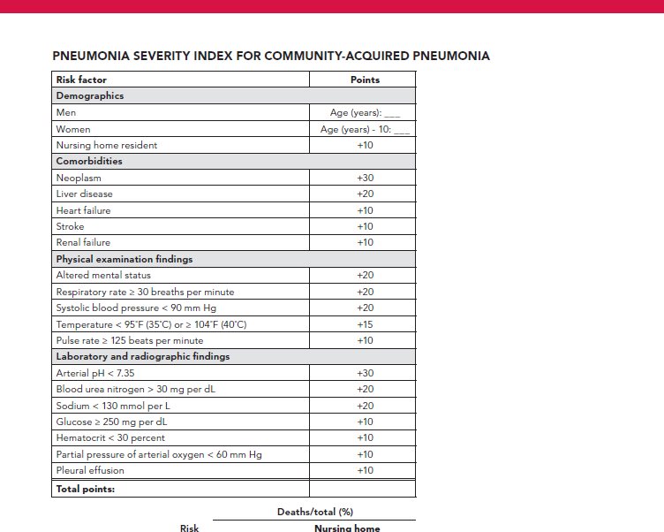
Pneumonia Severity Index
Demographics
Comorbidities
Physical Examination Findings
Laboratory and Radiographic Findings

Slide 14
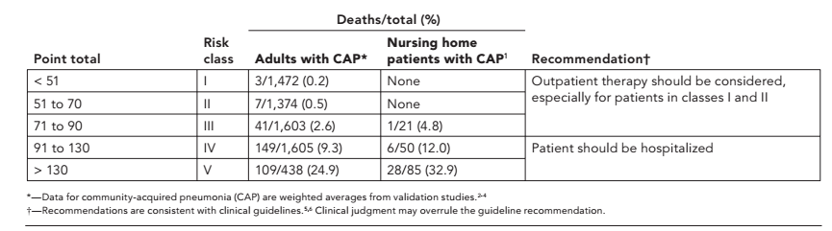
PNEUMONIA SEVERITY INDEX

Slide 15
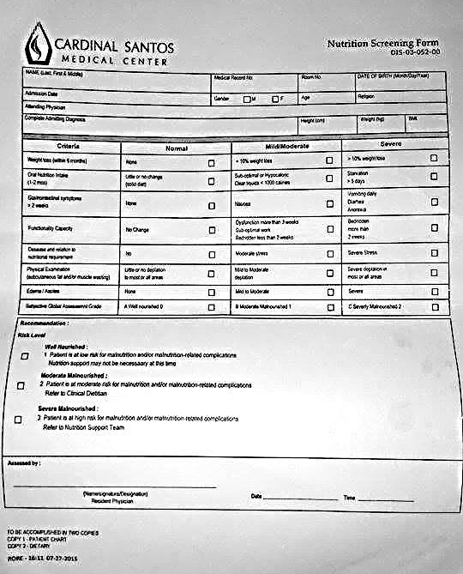
Subjective Global Assessment of Nutrition
Weight loss in past 6 mos
Oral Nutrition Intake
Gastrointestinal Symptoms >2wks
Functional Capacity
Stress in relation to nutritional requirement
Physical exam (subcutaneous fat/muscle wasting)
Edema/ascites

Slide 16
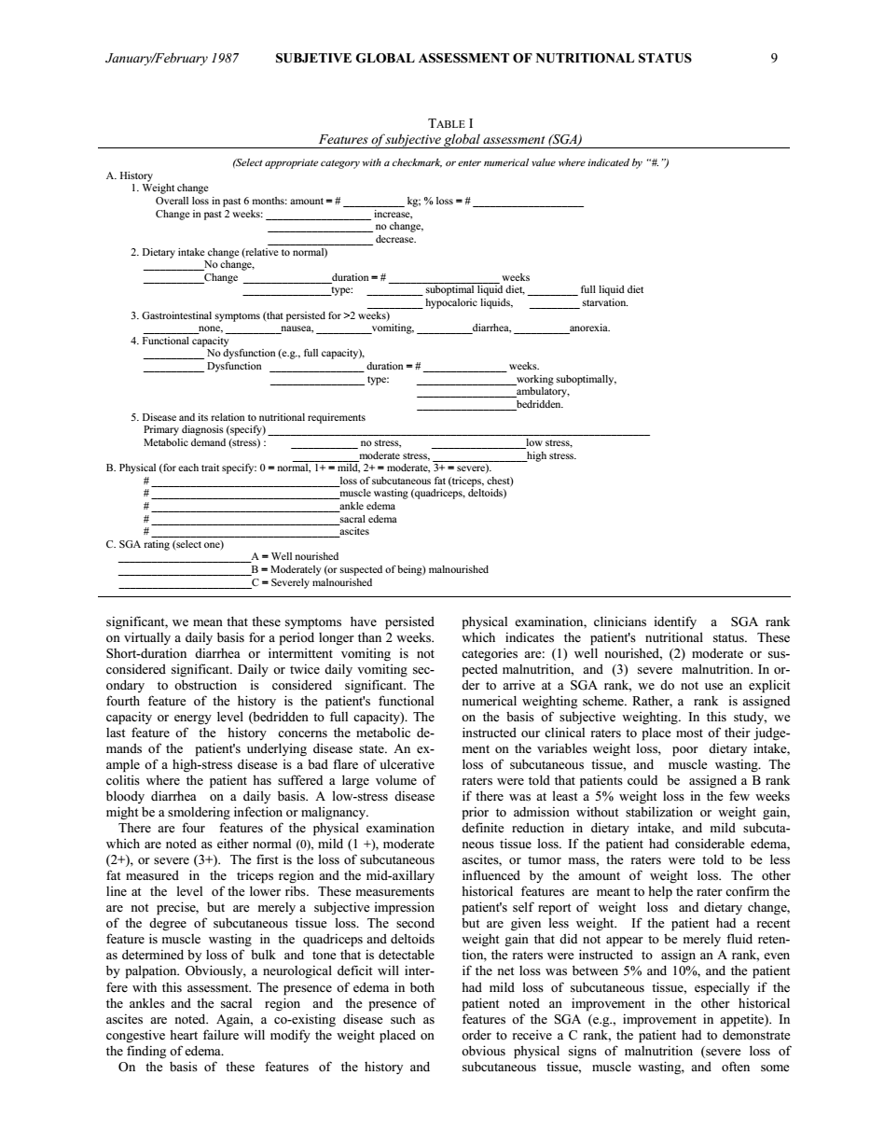

Slide 17
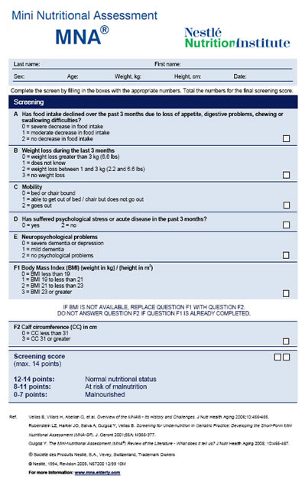
Mini Nutritional ASSESSMENT –
SHORT FORM (mna-sf)
Food intake for past 3 months
Weight loss during last 3 months
Mobility
Psychological stress/Acute disease
Neuropsychological problems
Body mass index
Calf circumference

Slide 18
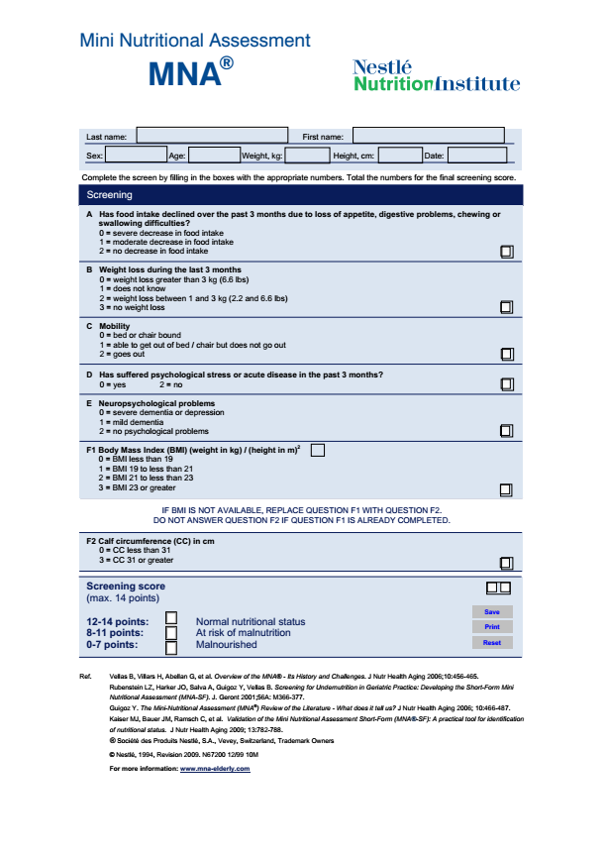

Slide 19
Table 1. Demographic Characteristics of Study Participants stratified according to Pneumonia
 | PSI I-II (n=17) | PSI III (n=43) | PSI IV-V (n=46)
Age, mean (yrs) | 65.76 + 5.0932 | 75.95 + 7.5654 | 84.65 + 7.2149
Sex Males | 47% (n=8) | 46.5% (n=20) | 34.8% (n=16)
Females | 53% (n=9) | 53.5% (n=23) | 65.2% (n=30)

Slide 20
Table 2. Odds ratio in developing intermediate risk (PSI III) pneumonia of patients who underwent Subjective Global Assessment, Mini Nutrition Screening, determination of Body Mass Index, and Calf Circumference
Nutrition Evaluation |  | PSI I-II (n=17) | PSI III (n=43) | Odds Ratio (95% CI) | P value
Subjective Global Assessment of Nutrition | Well nourished | 9.43% | 2.83% | 19.0476 (4.1671,87.0652) | 0.000052316
 | Moderately to Severely malnourished | 6.6% | 37.74%
Mini Nutritional Screening Score | Normal Nutrition status | 11.32% | 7.5% | 10.500 (2.8744, 38.356) | 0.00039232
 | At risk for malnutrition & Malnourished | 4.72% | 33.02%
Body Mass Index (kg/m2) | <18.5 | 0.94% | 0.94% | 0.5455 (0.0312,9.521) | 0.736397
 | 18.5-24.9 | 11.32% | 20.75%
Calf Circ (cm) | <31 | 2.8% | 17.92% | 3.6944 (0.9252,14.75) | 0.104159
 | > 31 | 13.2% | 22.6%

Slide 21
Table 3. Odds ratio in developing high risk pneumonia (PSI IV-V) of patients who underwent Subjective Global Assessment, Mini Nutrition Screening, determination of Body Mass Index, and Calf Circumference
Nutrition Evaluation |  | PSI I-II (n=17) | PSI IV-V (n=46) | Odds Ratio (95% CI) | P value
Subjective Global Assessment of Nutrition | Well nourished | 9.43% | 0.94% | 64.2857 (7.0909, 582.81) | 0.0000010417
 | Moderately to Severely malnourished | 6.6% | 42.45%
Mini Nutritional Screening Score | Normal Nutrition status | 11.32% | 0.94% | 108 (11.503, 1013.98) | 0.000000027
 | At risk for malnutrition & Malnourished | 4.72% | 42.45%
Body Mass Index (kg/m2) | <18.5 | 0.94% | 9.43% | 4.2857 (0.4923,37.312) | 0.30837
 | 18.5-24.9 | 11.32% | 26.42%
Calf Circ (cm) | <31 | 2.8% | 29.25% | 9.644 (2.3997,38.760) | 0.0012314
 | > 31 | 13.2% | 14.15%

Slide 22
Conclusion
Elderly patients, of at least 60 years of age, diagnosed with Community Acquired Pneumonia, have a higher risk for malnutrition as the disease becomes more severe.
Nutrition assessment tools, including the Subjective Global Assessment of Nutrition and the Mini Nutrition Screening Scores can be used in determining clinical outcome of elderly patients.
The use of body mass index, may aid in predicting morbidity and mortality if correlated with other components of nutrition assessment tools.
Calf circumference, on the other hand, was able to yield statistically significant odds in determining high risk pneumonia.

Slide 23
References
Detsky, et al. (1987). What is Subjective Global Assessment of Nutrition Status. Journal of Enternal and Parenteral Nutrition. Vol.11 No. 1.
Ebell, MH.2006. Outpatient vs Inpatient Treatment of Community Acquired Pneumonia. Family Practice Management. April 2006: 41-44.
Flanders, W.D., Tucker, G., Krishnadasan, A., Martin, D., Honig, E., McClellan, W. (1999). Validation of the Pneumonia Severity Index. Journal of General Internal Medicine. Vol. 14: 333-340.
Mandell, L.A. et al. (2007). Infectious Diseases Society of America/American Thoracic Society Concensus Guidelines on the Management of Community Acquired Pneumonia in Adults. Clinical Infectious Diseases. Vol. 44. S27-72.
Neo, H.Y., Chan, M. Tan, T.L. (2013). Comorbidity measures and mortality in institutionalised elderly. Journal of Aging Research and Clinical Practice. Vol.2 No.1.
Nestle Nutrition Institute. (2009). Mini Nutritional Assessment. www.mna-elderly.com accessed 30 May 2015.
Oliveira, M., Fogaca, K., Leandro-Merhi. (2009). Nutritional status and functional capacity of hospitalized elderly. Nutrition Journal. Vol.8 No. 54.
Shah, BA., Ahmed, W., dhobi, GN, Shah, NN, Khursheed, SQ., Haq, I. (2010). Validity of pneumonia severity index and CURB-65 severity scoring systems in community acquired pneumonia in an Indian setting. Indian Journal of Chest Diabilities and Allied Sciences. Vol. 52:9-17.
Stupka, J., Mortensen, EM., Anzueto, A., Restrepo, M. (2009). Aging Health. Vol. 9 No. 6.
Vellas, B., Guigoz, Y., Nourhashemi, F., Bennahum, D., Laugue, S., Albarede, JL. (1999). The mini nutritional assessment and its use in grading the nutritional state of elderly patients. Nutrition. Vol. 15 No. 2.
Wells, J., Dumbrell, A. (2006). Nutrition and aging: assessment and treatment of compromised nutritional status in frail elderly patients. Clinical Interventions in Aging. Dovepress: Vol. I 67-79.
Zhang, L., Su, Y., Wang, C., Sha, Y., Zhu, H. Xie, S. Kwaus, S., Zhang, J., Lin, Y., Wang, C. (2013). Assessing the nutritional status of elderly Chinese lung cancer patients using the Mini Nutritional Assessment tool. Clinical Interventions in Aging. Dovepress: March 2013.

Slide 24

Thank you

