Slide 1
Glycans and miRNAs
Recent Advances in Nutritional Sciences
Dr. Marcello Menapace

Slide 2
Glycans and miRNAs
What they are
Where are they found
Why are they important
How do they interact with the human body
The triad relationship
Future research

Slide 3
Disclaimer
A review
New information from recent literature
An extra layer of complexity

Slide 4
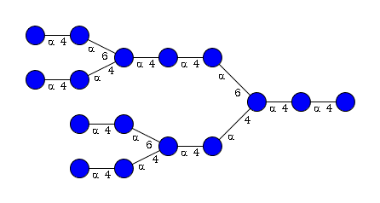

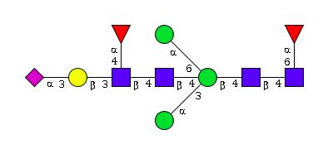
What are Glycans
Special types of carbohydrates

Slide 5
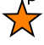
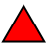
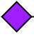
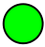
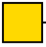
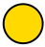
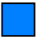
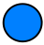
What are Glycans (II)
Xylose (Xyl)
Fucose (Fuc)
N-Acetilneuramic acid (NAc5Neu)
Mannose (Man)
N-Acetil Galactosamine (GalNAc)
Galactose (Gal)
N-Acetil Glucosamine (GlcNAc)
Glucose (Glc)

Slide 6
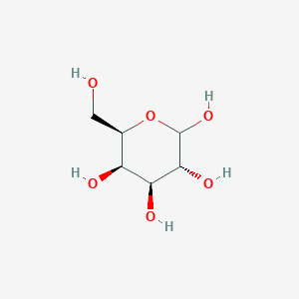
What are Glycans (III)
Link to other sugar: α/β 1
Link to other sugar: α/β 6
6
5
1
4
2
3
Link to other sugar: α/β 2
Link to other sugar: α/β 4
Link to other sugar: α/β 3

Slide 7
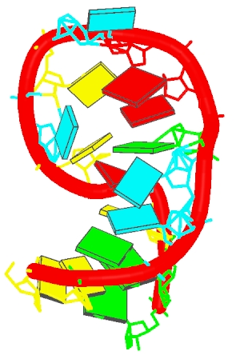

What are miRNAs
Small single stranded RNA molecules
ncRNAs of 18-22 bp nucleotides

Slide 8
Where are glycans found
Free forms
  Milk
Bound
  Proteins (glycoproteins or proteoglycans)
  Lipids (glycolipids or lipopolysaccharides [LPS])

Slide 9
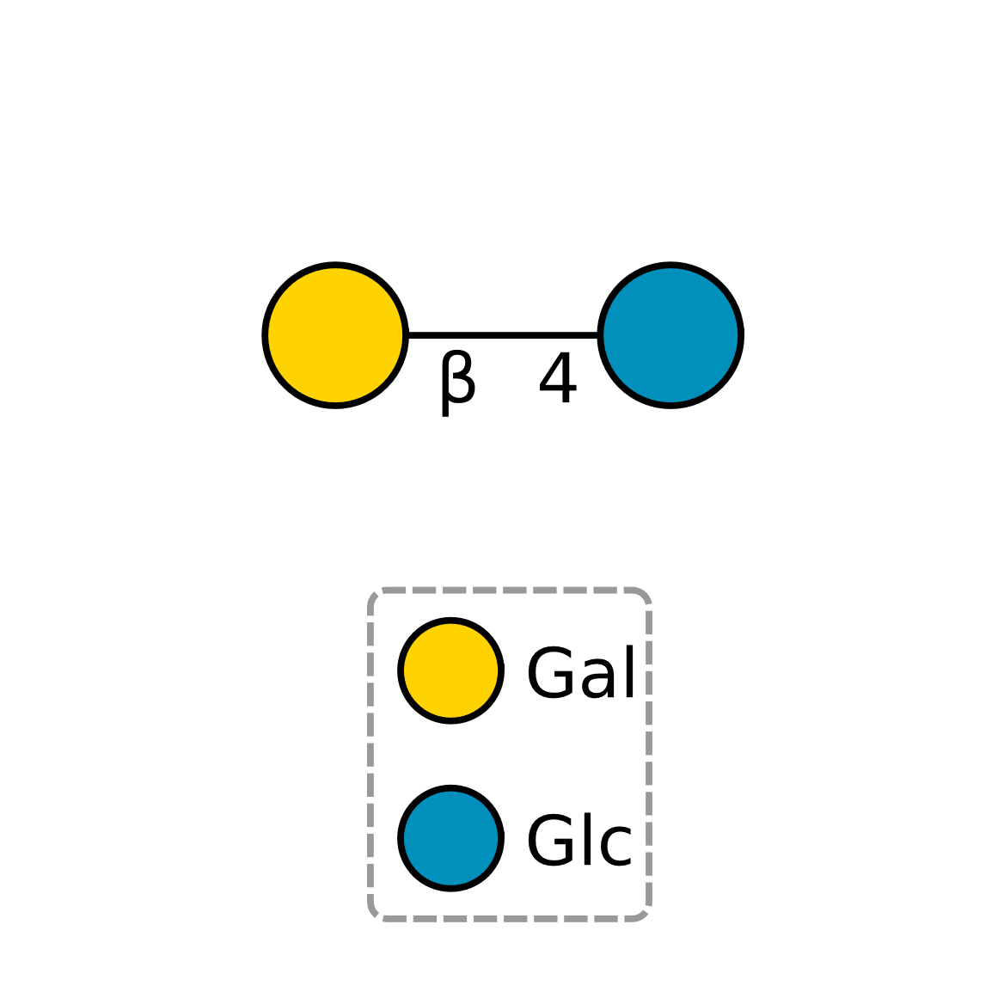
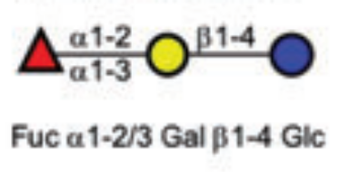
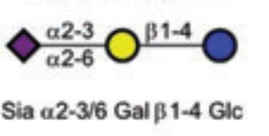
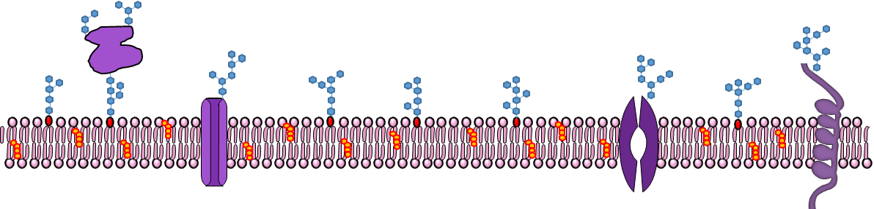
Where are glycans found

Slide 10
Where are MIRs found
20 -
ggaauguugucuggcucgagg
- 40
xla-mir-181a MI0038269
44 - aucgaucguugacuguaca - 62
Xenopus Laevis
Inside and Outside Cells
Plant and Animal foods
Found in blood after a meal
Expressed differentially in the intestines
aly-mir-166a MI0014532
20 - ggaauguugucuggcucgagg - 40
Arabidopsis lyrata

Slide 11
Why are glycans important
Ubiquity
  Complementarity with Lectins
Reactivity
  Lectins
  Almost limitless interactivity
  Not just PCI

Slide 12
Why are glycans important (II)
Lectins
  Plant lectins (beans, haemoglutinins)
  Animal lectins (Pattern recognition receptors: PRR)
    CTL (C-type Lectins)
    TLR (some Toll-like receptors)
    ITL (I-type lectins, belonging to the Ig superfamily)
    Galectins
    Selectins and Siglecs

Slide 13
Why are glycans important (III)
Third alphabet of life
Glycans are involved in all biological processes
  Immune modulatory
  Self/non-self recognition
  Regulation of signalling
  Cell to cell communication
  Protein folding
  Homeostasis
  Cross-communication with ECM

Slide 14
Why are miRNA important
This is a very young field of study
Size factor
Exosomes
Studies on siRNA
Studies on Epigenetics
  Immune function
  Intestinal barrier regulation

Slide 15
Microbiota
Trillions of microbes
Holobionts (commensal bacteria + pathogens)
Several functions
  CAZy
  SCFA
  Pathogen control
  miRNA regulation
Normobiosis/Dysbiosis
Molecular mimicry

Slide 16


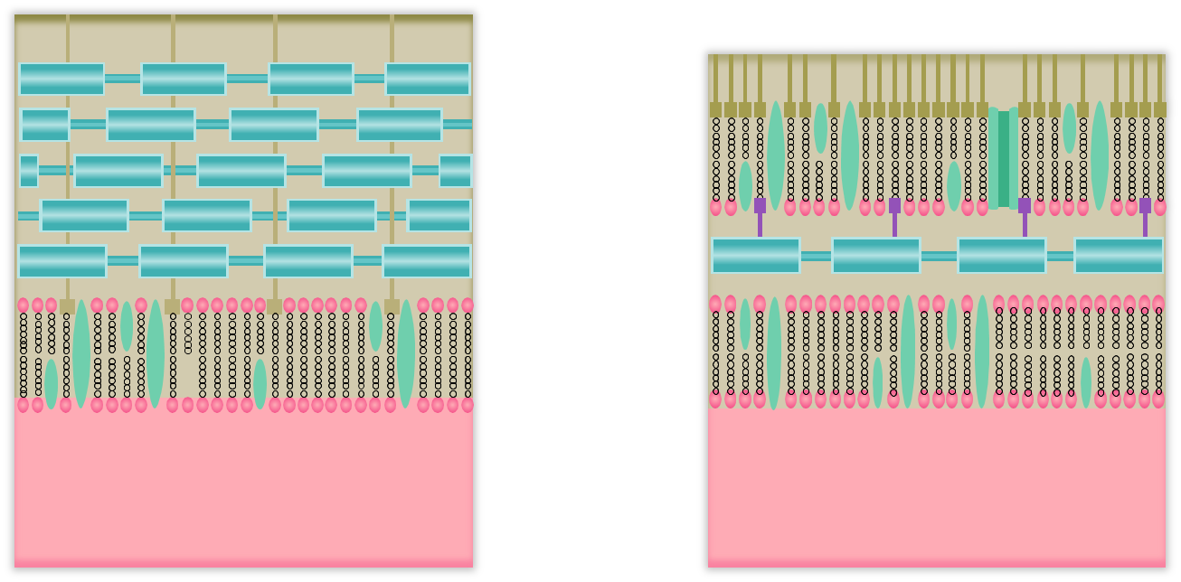
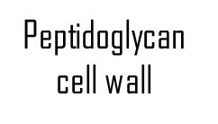
Microbiota (II)
Gram-positive Gram-negative

Slide 17
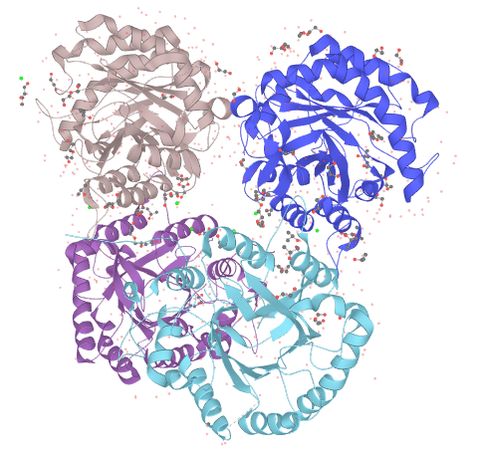
Microbiota (III)
CAZy: Cellulase CleDZ1a
UniProtKB - A0A0U4EBH5

Slide 18
The GUT
IEC (intestinal epithelial cells)
Goblet cells (mucus)
GALT (Gut-associated lymphoid tissue)
Other cells
PRRs
  Complex biochemical cascades
  Interaction with cytokines
  Inflammation and autoimmune diseases

Slide 19
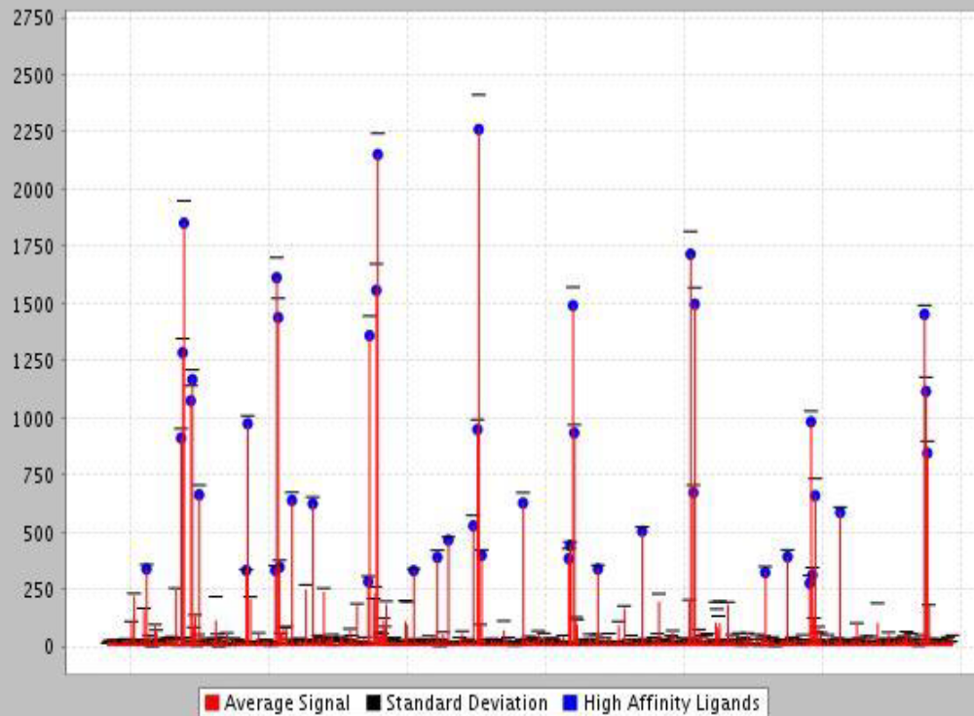
The GUT (II)
IEC express special glycans
Galectins
  lectin-glycan binding test
  using a glycan array (PA_v5)
  from CFG.

Slide 20
The triple relationship
Food
miRNA
Microbiome
Glycans
Glycans
miRNA
Glycans
Glycans
miRNA
GUT
Glycans
miRNA
Immune
Response

Slide 21
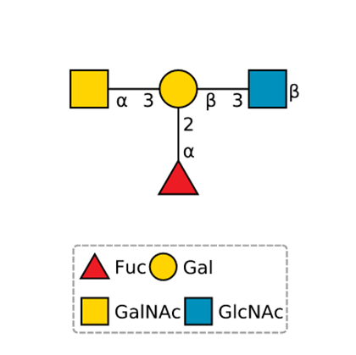
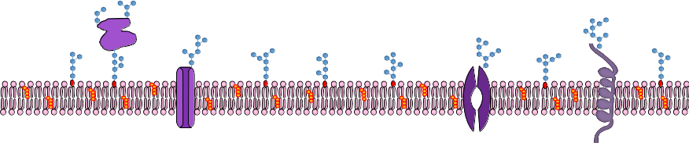
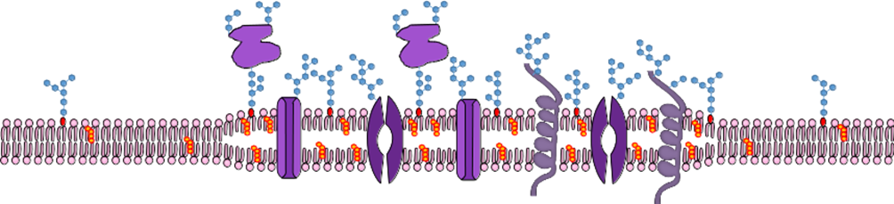
A Curiosity: HBGA

Slide 22
Conclusions and Future Research
Microbiota is highly individual
Nutritional epigenomics
Glycan and MIR profiling
Glyco-kinetics
  Absorption
  Distribution
  Metabolism
  Elimination
Pharmacological applications of glycans and miRNAs

Slide 23
Thank YOU

