Slide 1
Method for Hot Real-Time Sampling of Gasification Products
Bioenergy 2016 – Rome, Italy
Marc Pomeroy
June 14, 2016

Slide 2
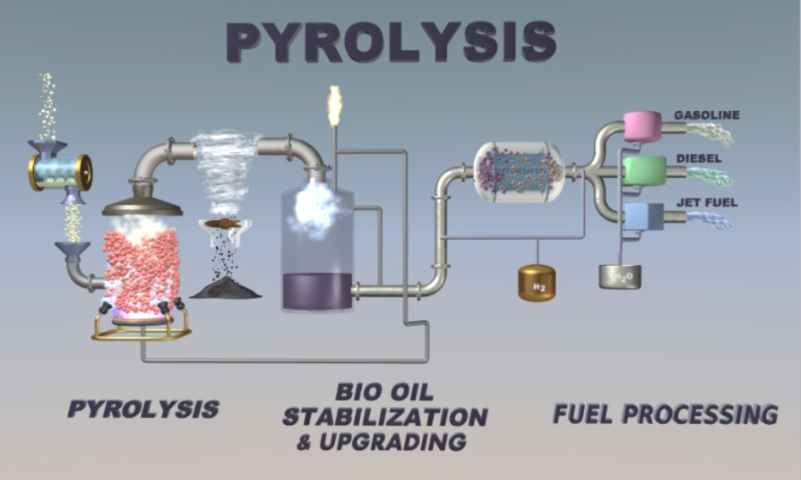
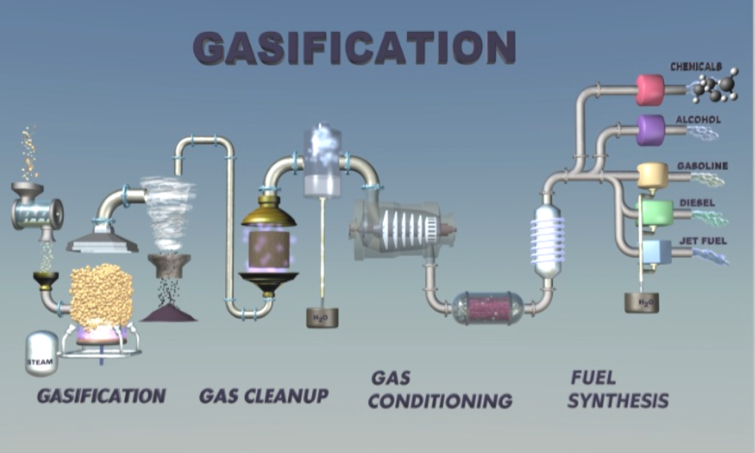
Thermochemical Biomass Conversions
Rapid heating of biomass to around 500°C in absence of oxygen
  Primary product is complex bio-oil
    Over 400 compounds
    Chemistry changes when condensing from vapor to oil
    Acidic
    High oxygen content
    Up to 60% of material does not re-volatilize making analysis challenging
Rapid heating of biomass to around 825°C in presence of controlled oxygen or steam
  Primary product Syngas (H₂ + CO) for liquid fuel synthesis
    Still a complex mixture with tars and inorganic contaminants
    Up to 70% steam content
    Formation of catalytic poisons such as hydrogen sulfide

Slide 3
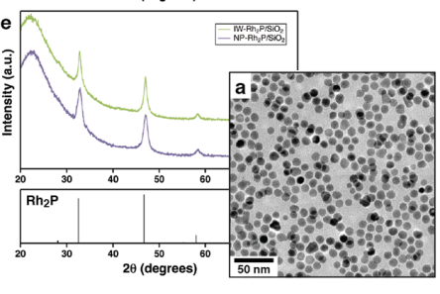
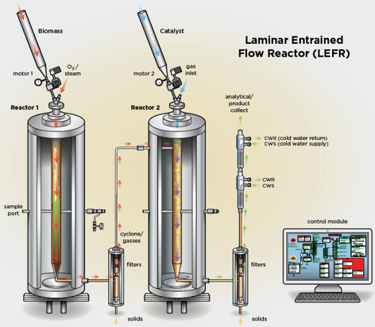
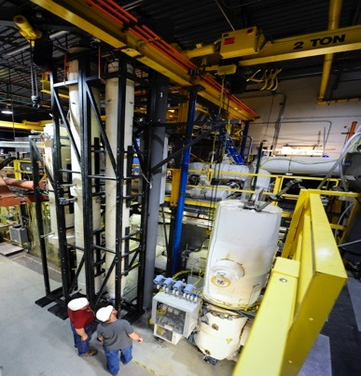
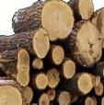
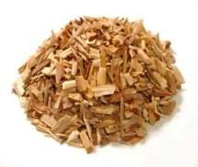
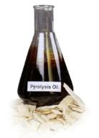
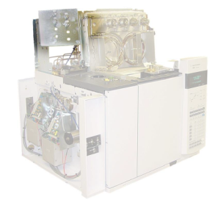
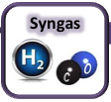
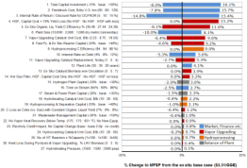
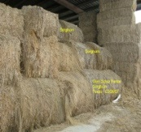
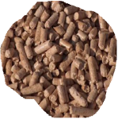
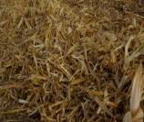
Finding Solutions for Biomass Conversion at NREL
Research at multiple scales from fundamental, to bench, to pilot plant.
Fundamental Science
mg-g
Catalyst Development & Testing
g-kg
Scale-up & Demonstration
100’s kg
Overarching research necessary to support lab and industrial deployment.
Feedstocks
Bio-Oil Characterization
Gasification Products
Technoeconomic Analysis

Slide 4
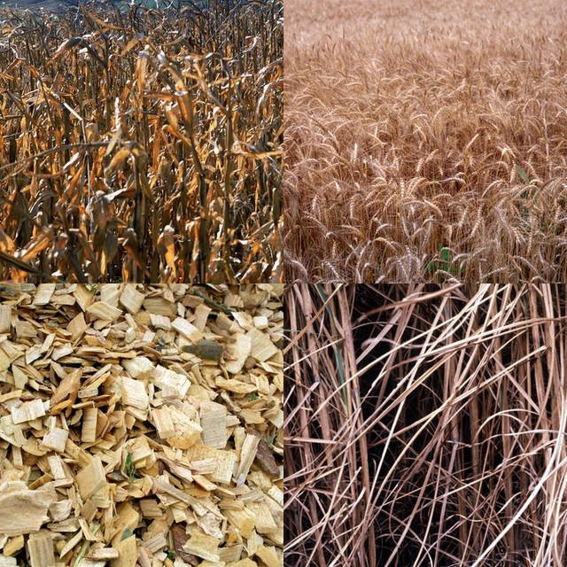
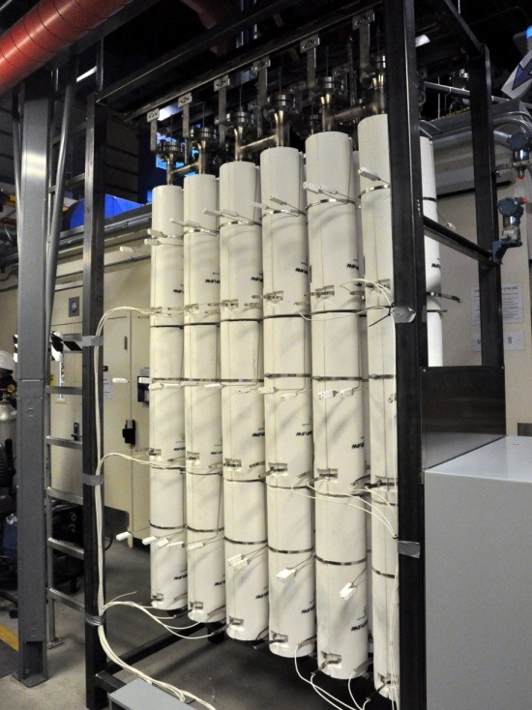
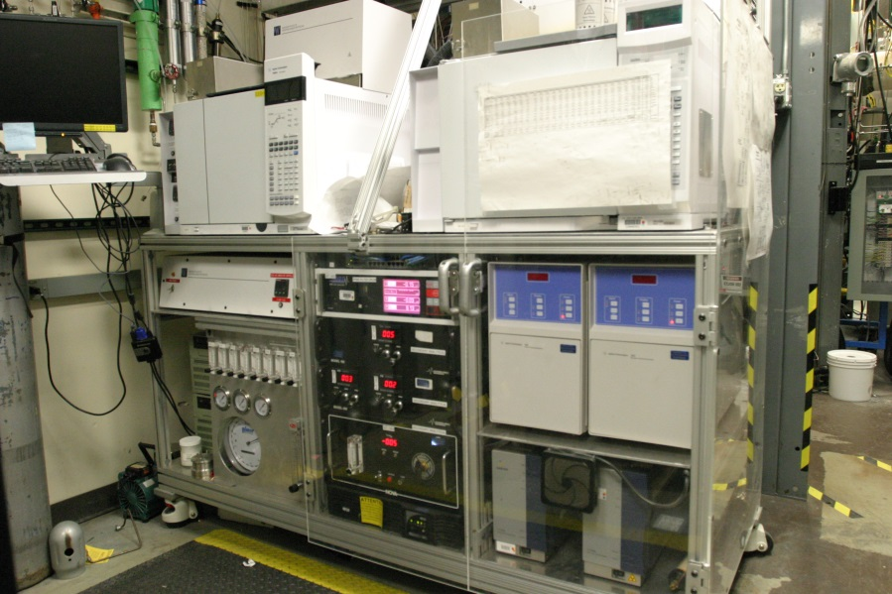
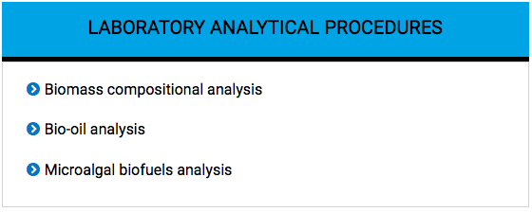
Analytical Procedures – Validated Methods
WWW.NREL.GOV/BIOENERGY

Slide 5
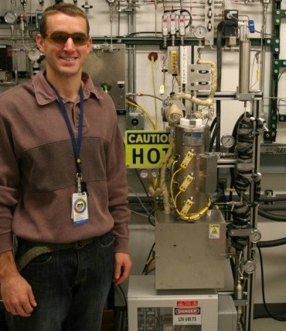
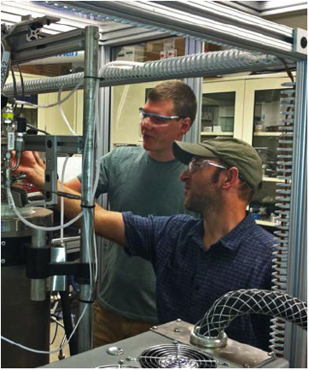
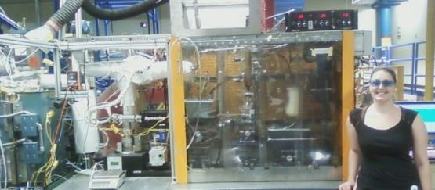
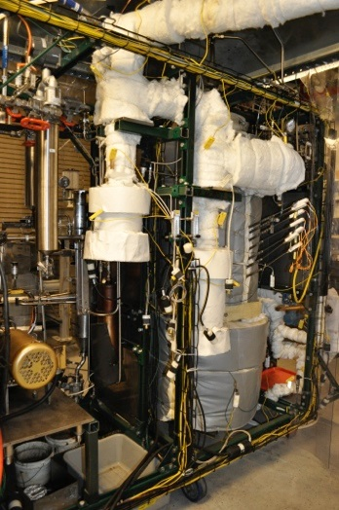
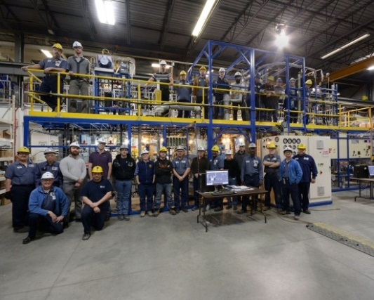
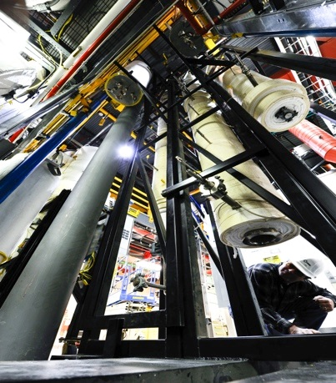
Thermochemical platform at NREL has multiple systems from mg to 450kg/day scales and operating in a variety of configurations
Small Scale Reactors: Catalyst Development
Catalyst use per test: 0-2g
Laminar Entrained Flow Reactor: In-Situ Pyrolysis
Biomass rate: <5 g/hr
2” Fluidized Bed Reactor:
Fast, Ex-situ, & In-Situ Pyrolysis
Biomass rate: <0.5 kg/hr
4” Fluidized Bed Reactor: Gasification
Biomass rate: <2 kg/hr
Davison Circulating Riser: Ex-Situ Pyrolysis
Biomass rate: <5 kg/hr
Thermochemical Process Development Unit: All Pathways
Biomass rate: <30 kg/hr

Slide 6
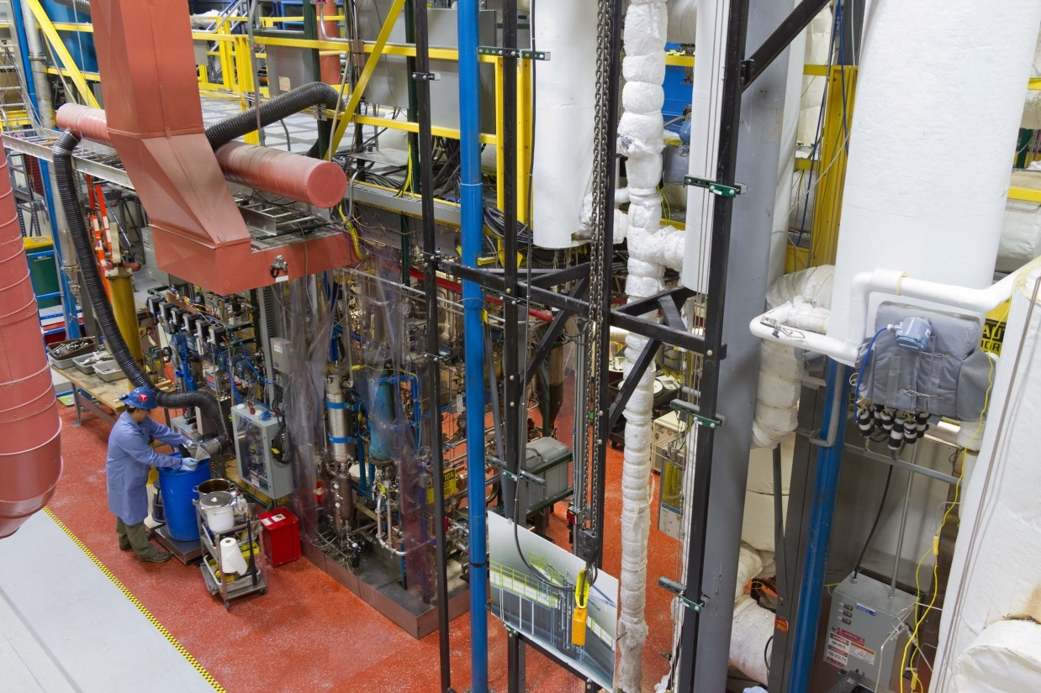
Pilot Scale Research Configurations
The Thermochemical Process Development Unit (TCPDU) is designed to be flexible and operate in three primary configurations:
  Fast Pyrolysis
    Production of condensed Bio-Oils
  Ex-Situ Catalytic Fast Pyrolysis
    Catalytic upgrading of Pyrolysis vapors prior to condensation
  Gasification
    Production and upgrading of Syngas

Slide 7
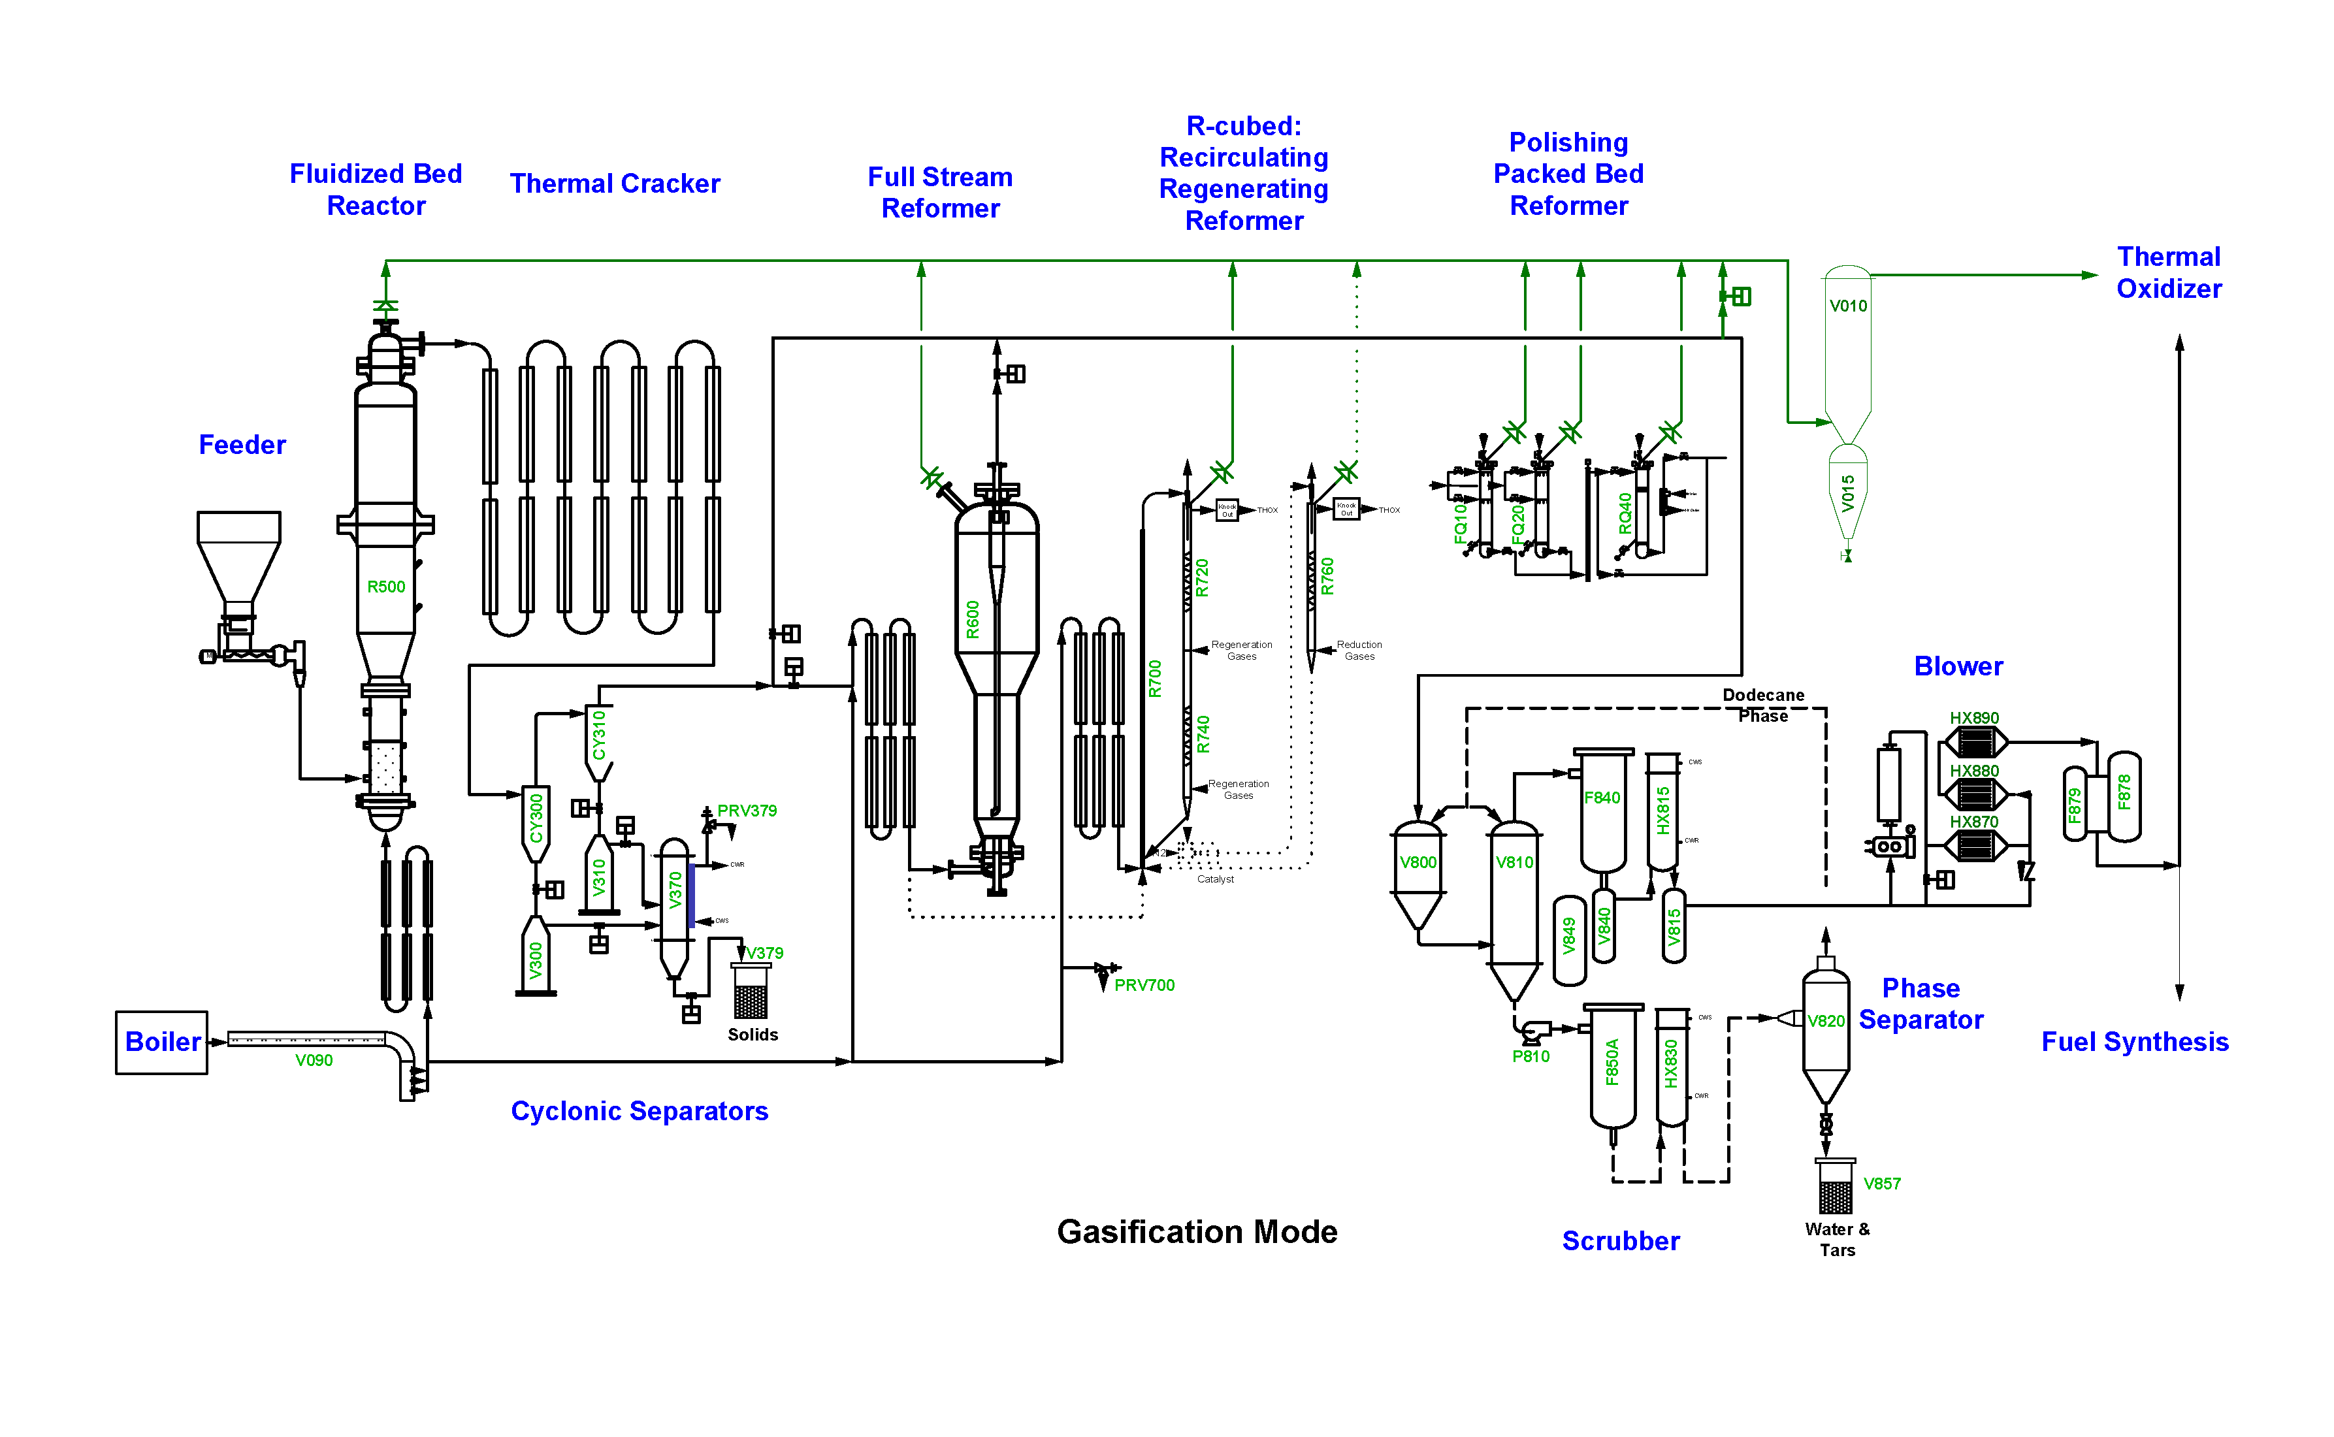
Process Flow Diagram – TCPDU
Hot Sample Port
Condensed
Sample
Hot Sample Port

Slide 8
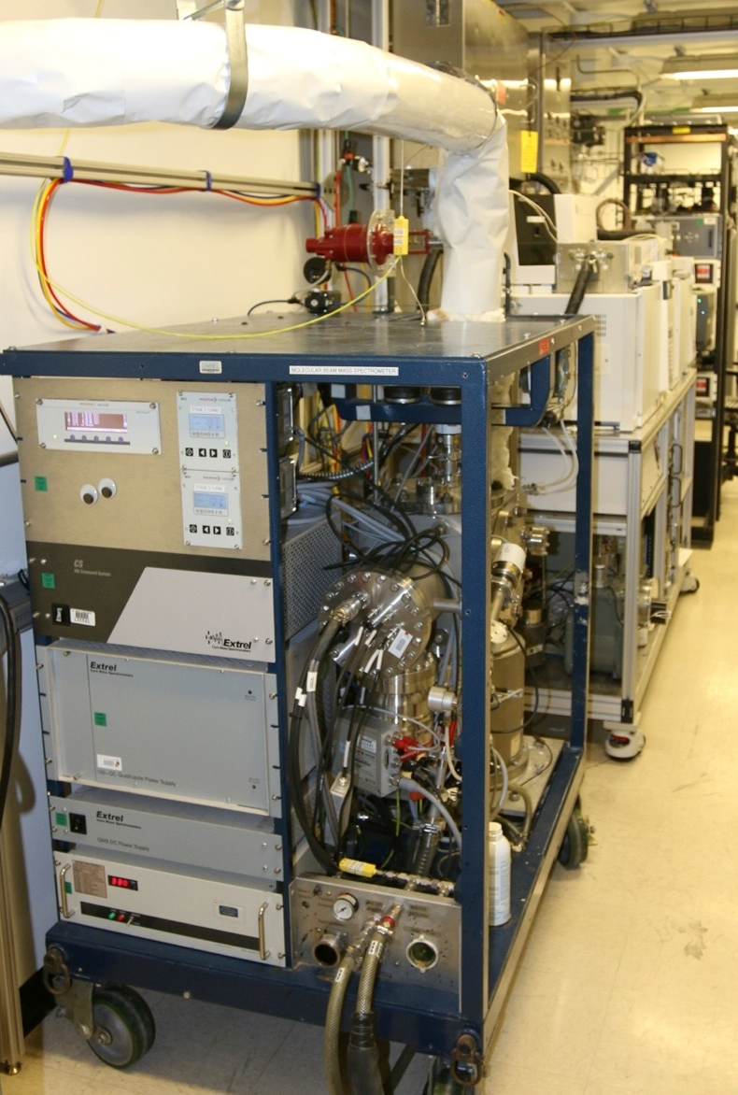
All systems are capable of hot real-time sampling
Molecular Beam Mass Spectrometer (MBMS)
  Sampling up to 500° C
  Supersonic expansion, rapid cooling/rarefaction preserves sample without condensation or reaction
  Mass analysis provides instantaneous chemical fingerprint of on-line sample

Slide 9
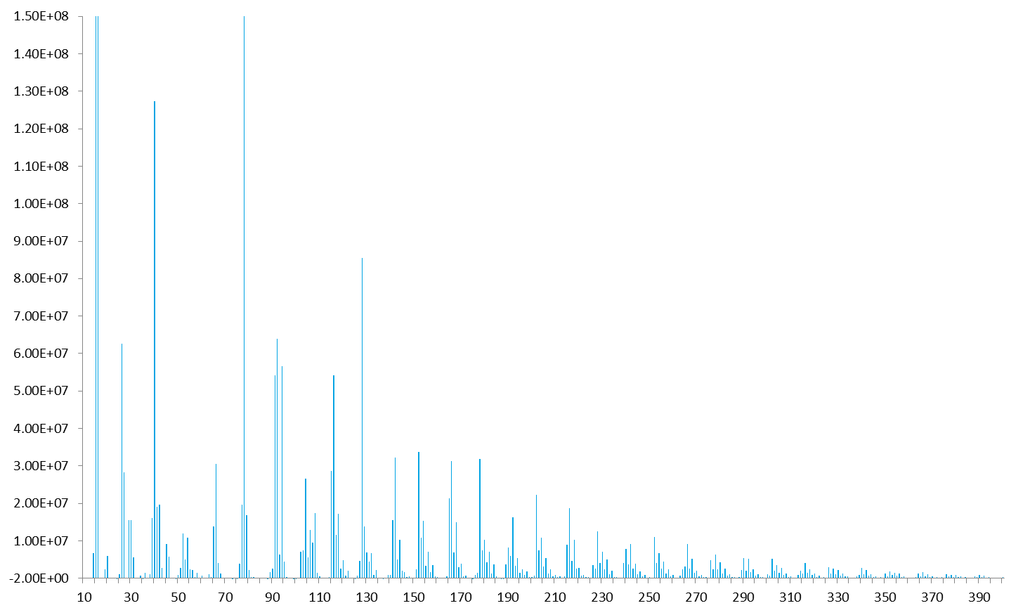
MBMS Representative Tar Spectrum
m/z

Slide 10
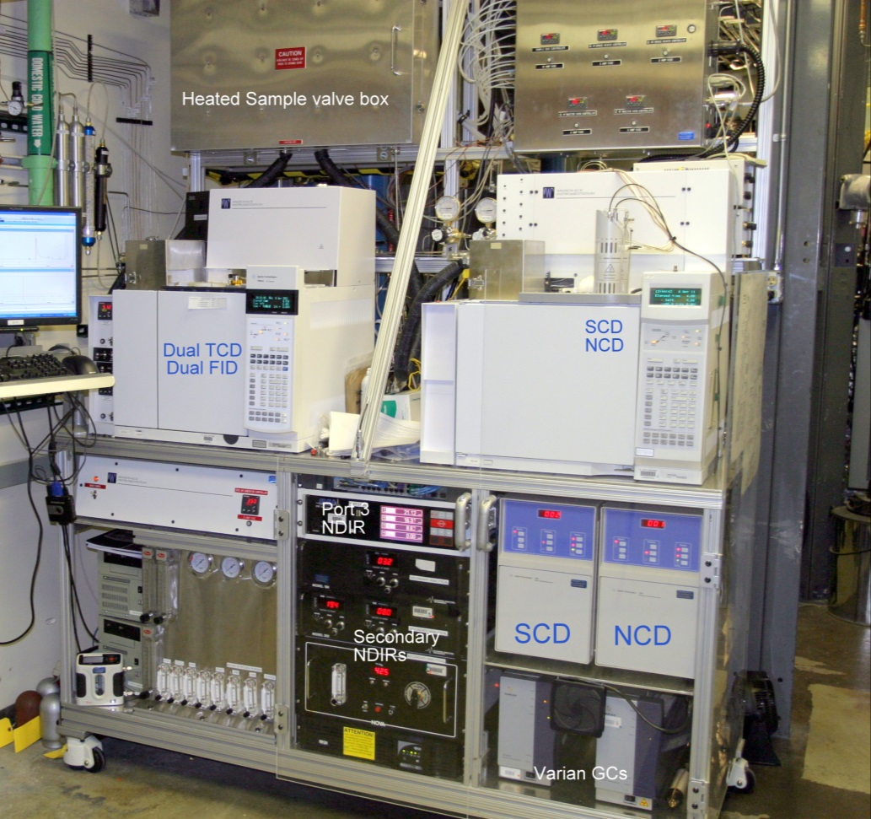
TCPDU – Modified Agilent GCs
Hot sampling Gas Chromatographs (GC)
  Valve material limited to 325°C
  Sulfur Chemiluminescent Detector (SCD)
    Trace Measurements to 0.05 ppm
  Nitrogen Chemiluminescent Detector (NCD)
    Trace Measurements to 0.01 ppm

Slide 11
Challenges of Sampling at the Pilot Scale
Operational Constraints
Representative Sample
Analytical equipment adversely affected by high ambient temperatures/dust
Space around reactors required for plant maintenance and operation
Multiple sampling points
  Pre- and Post-catalytic Reactors
Plugging and flow issues
Residence time
  Thermal changes
    Cracking, further reaction chemistries
Catalytic effects
  Ash, char, anti-seize
Material Selection
  Sulfur interactions with steel

Slide 12

Guide to Successful Sampling – Sample Ports
Position orthogonal prior to bends
  Avoid in-line placement
Place on upper half of pipe to prevent accumulated condensates from entering sample lines
Process Stream

Slide 13
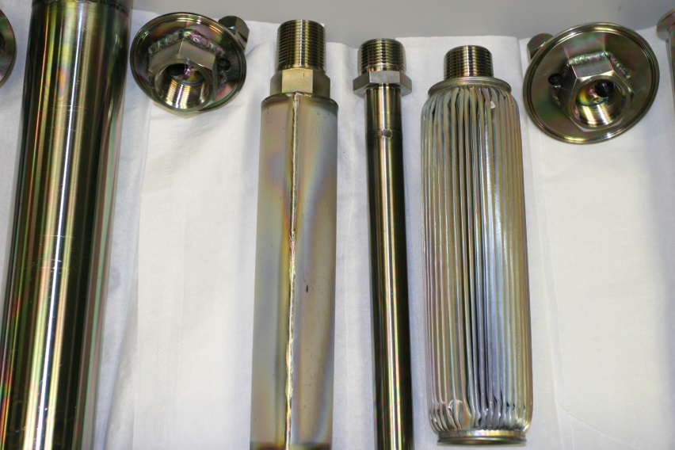
Guide to Successful Sampling - Filtration
Filter as close to process as possible
  Filter volume large enough to prevent particulate plugging
  Sample volume small enough to prevent dilution or long residence times
    Cracking of samples or catalytic changes due to particulate interaction
  Appropriate filtration size for sampling equipment and tubing
    TCPDU uses 10-15 μm elements
  Materials/coatings selection
    Sulfur interactions

Slide 14
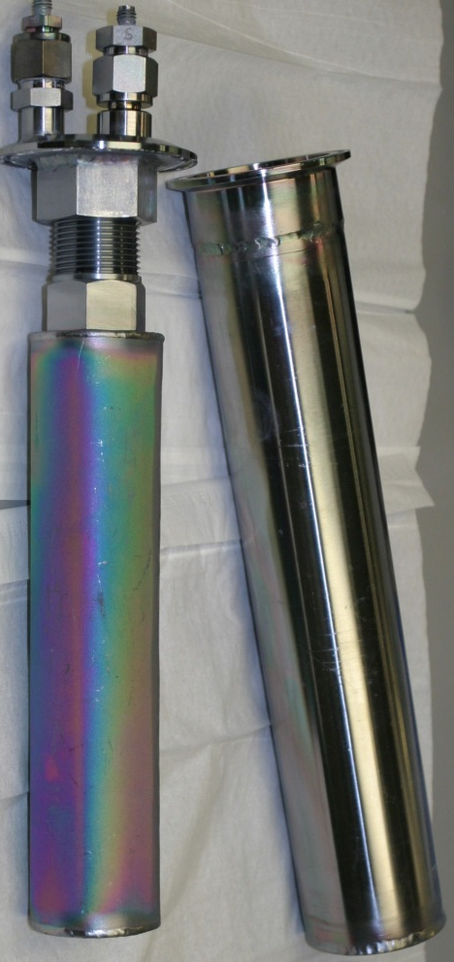
Guide to Successful Sampling – Materials Selection
Sulfur species tend to be Catalyst Poisons
  Higher concentrations from Herbaceous Feedstocks – Primarily Hydrogen Sulfide (H₂S) in Syngas
    400 ppm to 800 ppm H₂S from Corn Stover
    5 ppm to 50 ppm H₂S from Oak
Hydrogen Sulfide binds to steel surfaces at temperature and can take significant time to reach steady state at low concentrations
  Use Stainless Steels (316L)
  Coat with commercially available coatings
    Keep Below 500°C
    Do NOT “Burn out” lines or allow oxygen at temperature

Slide 15
Effect of Gasket Material - Change of Sulfur Species
3" coated Housing, coated Pleated Filter, Graph-Lock Gasket
Notes:
With all coatings combinations and the use of a Graph-Lock Graphoil gasket, conversion of H₂S (Hydrogen Sulfide) to COS (Carbonyl Sulfide) was observed in significant amounts. Use of a ceramic fiber gasket did not show the same COS formation, but was very difficult to achieve a gastight seal.

Slide 16
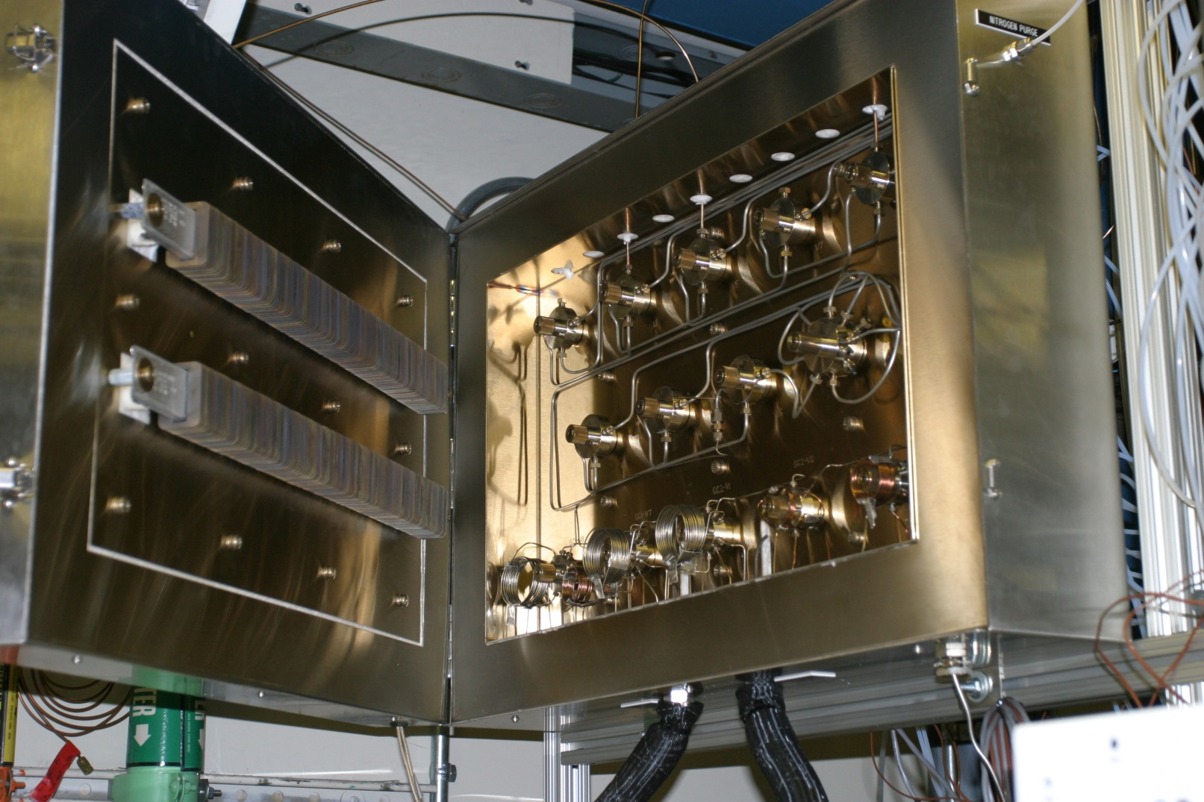
Materials Limitations - Valves
High Temperature multi-position valves limited to 325°C

Slide 17
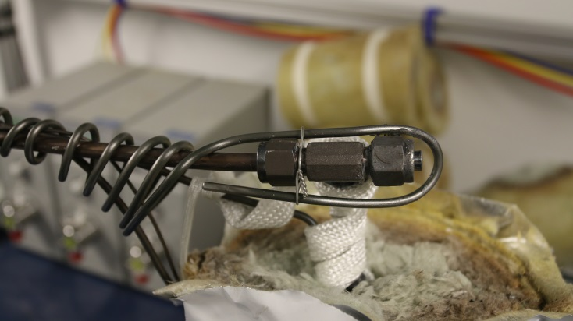
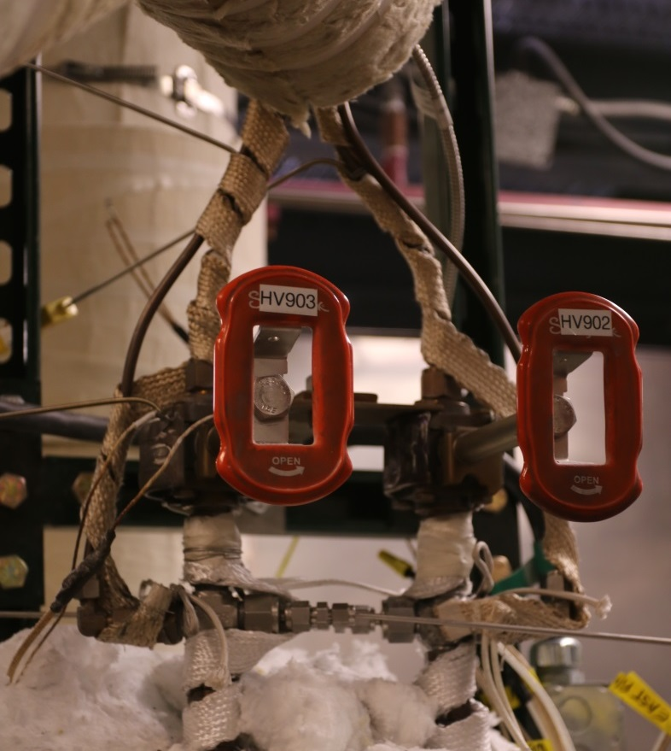
Guide to Successful Sampling – Even Heating
Sample line temperatures must not change composition of Gas Stream
  Gasification much more forgiving than pyrolysis
    Stay between 425°C – 500°C
  Be careful of heat sinks like fittings
    Can partially or fully condensate a sample and promote plugging

Slide 18
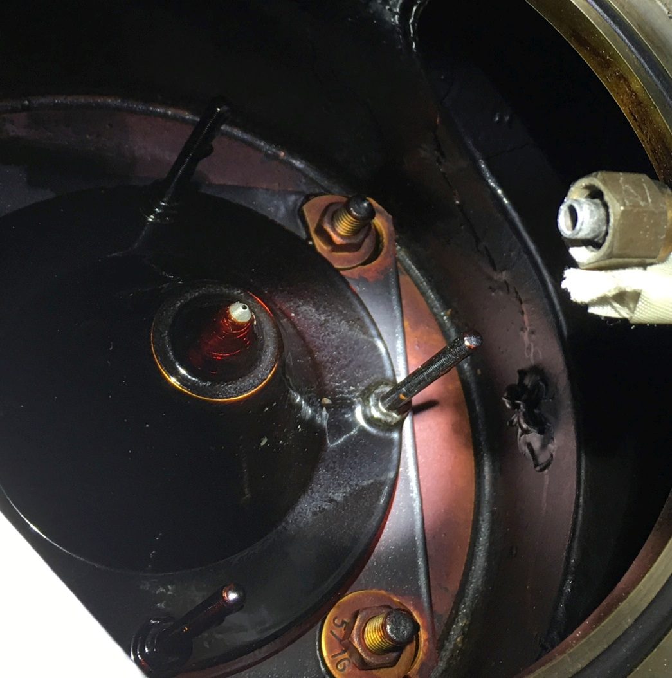
Gasification products are hard on analytical equipment
Robust pumping systems required
Coatings limited to <500°C
Cannot “Burn Out” coated components
Heated nitrogen purge when not actively sampling
Redundant sample lines
Material compatibility
  Valve packing materials my pyrolize at temperature

Slide 19
Robust Sampling System - Summary
Leave time for commissioning of sampling system
  May need to optimize for an individual feedstock
Place your sample ports effectively
Filter close to the process
Carefully select materials and coatings
  Do not oxidize or exceed 500°C
Even heating of sample components is critical
Solvent cleaning of residual tars may be required
Analytical equipment must be designed for high temperatures and condensable components
Adequate sample flow for as short a sample time as reasonable

Slide 20

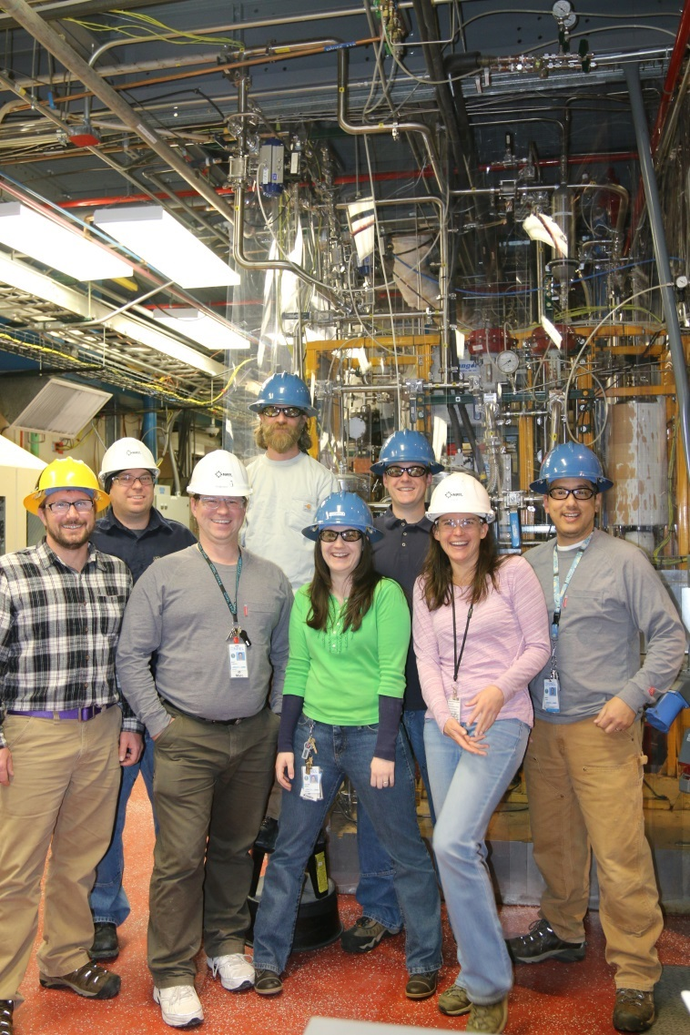
Acknowledgements
US Department of Energy
Bioenergy Technologies Office
TCPDU Team
Dr. Esther Wilcox - PI
Daniel Dupuis
Tim Dunning
Katherine Gaston
Chris Golubieski
Raymond Hansen
Matthew Oliver
Kristin Smith
Other Contributors
Daniel Carpenter
Steve Deutch
Tina Fehringer
Calvin Feik
Dr. Mark Jarvis
Marc Oddo
Jack Ferrell

Slide 21
Questions?

