Slide 1

Luminescent Properties of ZnO and ZnO:Ce Thin-Films
Manuel García-Méndez
mgarcia@fcfm.uanl.mx

Slide 2




UNIVERSIDAD AUTÓNOMA DE NUEVO LEÓN, MÉXICO
www.uanl.mx

Slide 3
INTRODUCTION
I.1. Objective
II. Experimental
II.1 Growth procedure
III. Results
IV. Conclusions

Slide 4
I. INTRODUCTION
Zinc oxide (ZnO) is a binary transparent conducting oxide (TCO). Synthesized as thin film, this material has been garnered a great interest due to its importance in basic scientific research and potential technological applications
Some of its numerous advantages include the tuning of its physical properties, the low cost, abundance in earth, non-toxicity, compatibility with large-scale processes and its relative easy fabrication
Additionally, doping ZnO films with selective elements can induce changes in its structural, electrical, optical and electronic properties
From elements available for doping, Ce has been a subject of interest over the last years, due to the potential of Ce-doped ZnO films in optoelectronic applications, like electroluminescent displays

Slide 5
I.1. Objective
In this work, undoped (ZnO) and cerium-doped zinc oxide (ZnO:Ce) films were fabricated by RF magnetron sputtering followed by a post thermal annealing at 300°C, in an oxygen atmosphere
With the usage of X-ray diffraction, UV-Vis spectroscopy, PL spectroscopy and XPS techniques, we investigated the effects of Ce and temperature on the film´s luminescent properties

Slide 6
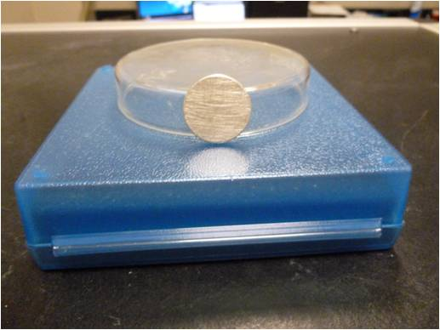
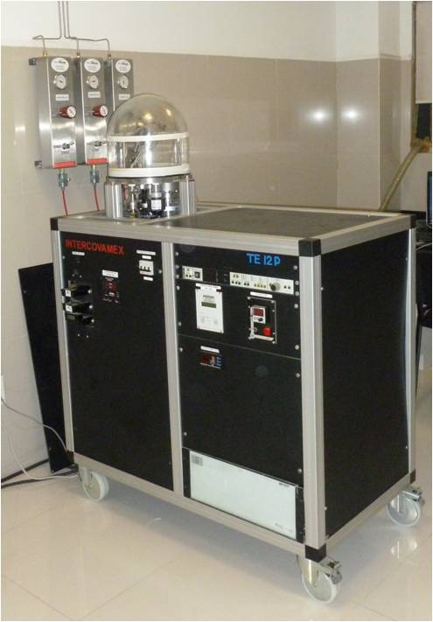
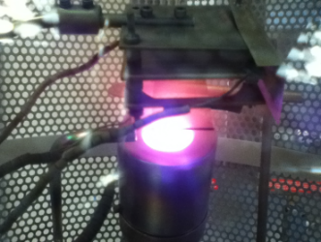
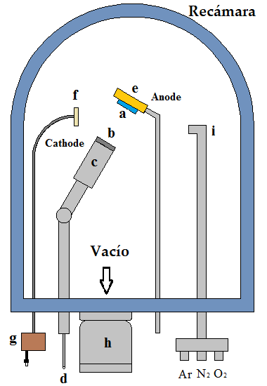

II. Experimental
Zn target, 1” diam, 1/8” thick
Zn:Ce target (95:5 at%)
Deposition chamber
Glass substrates
The thickness and deposition rate are monitored by a quartz crystal oscillator
ZnO and ZnO:Ce samples. Heated at 100°C, 200°C and 300°C under an Ar:O₂ (90%:10%) atm at 22 mTorr, for 1 hr.
RF Sputtering set-up

Slide 7
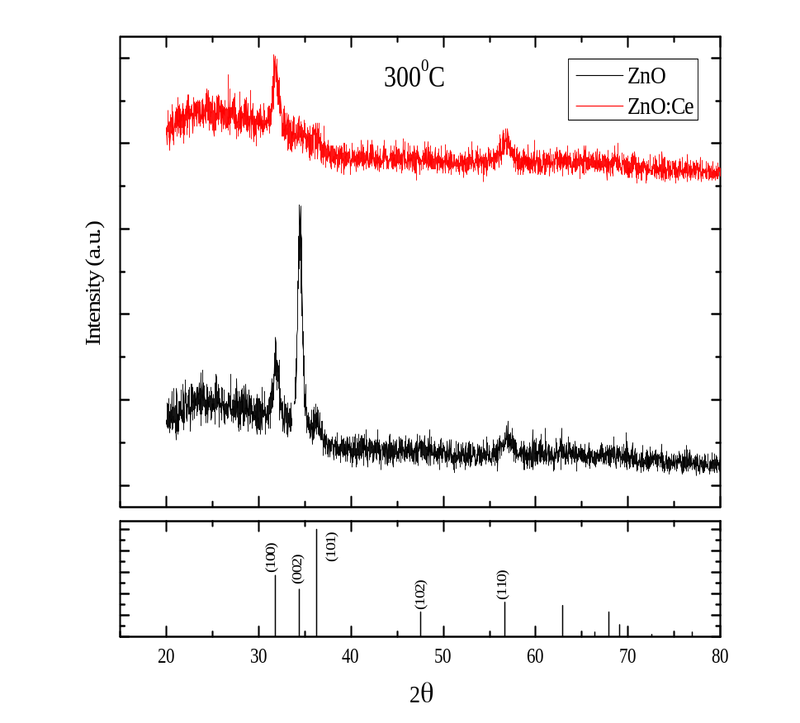
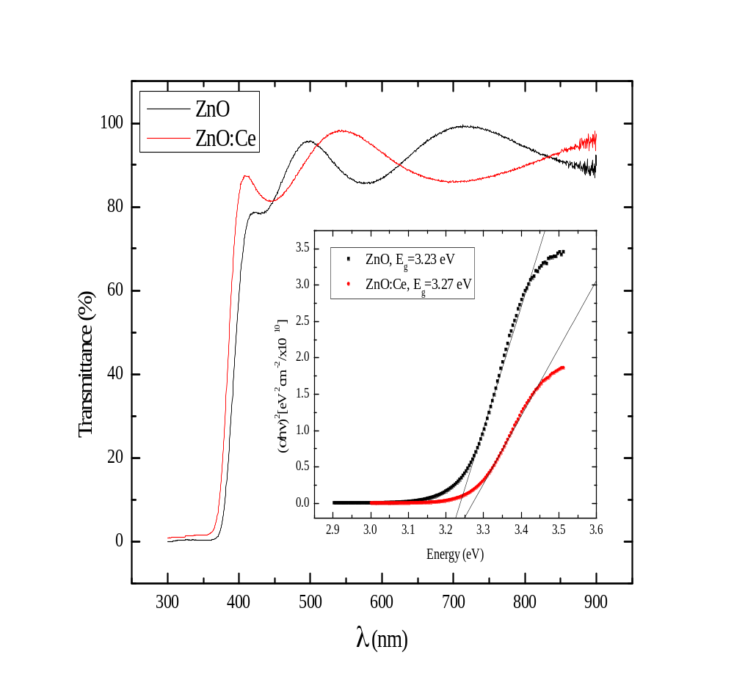
III. Results
XRD
UV-Vis

Slide 8
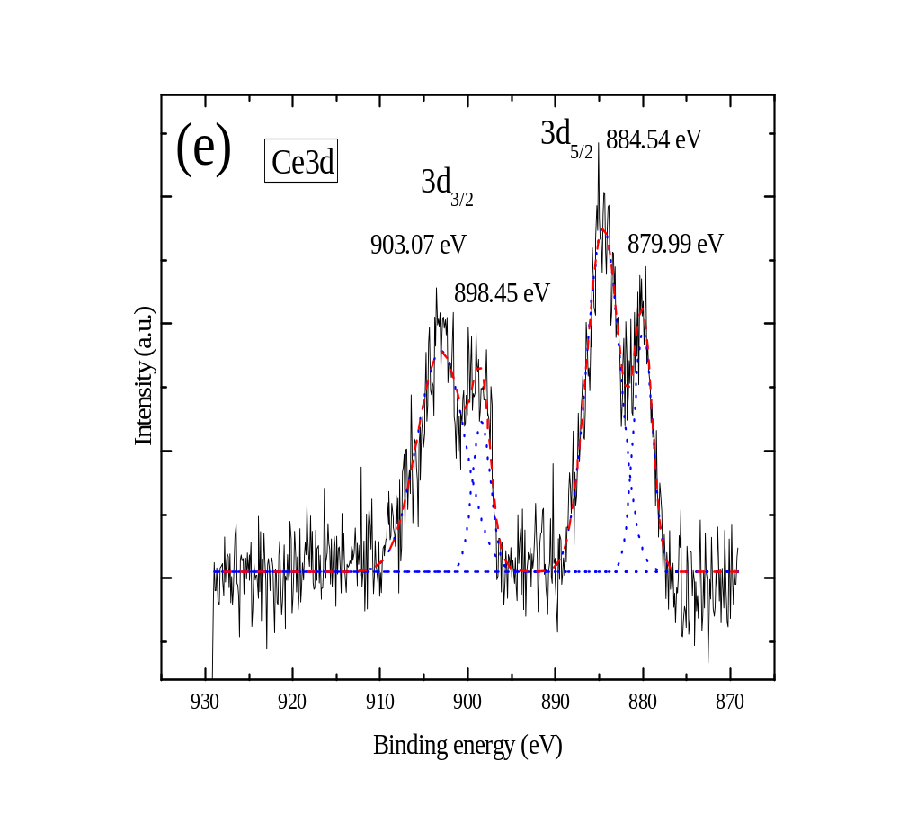
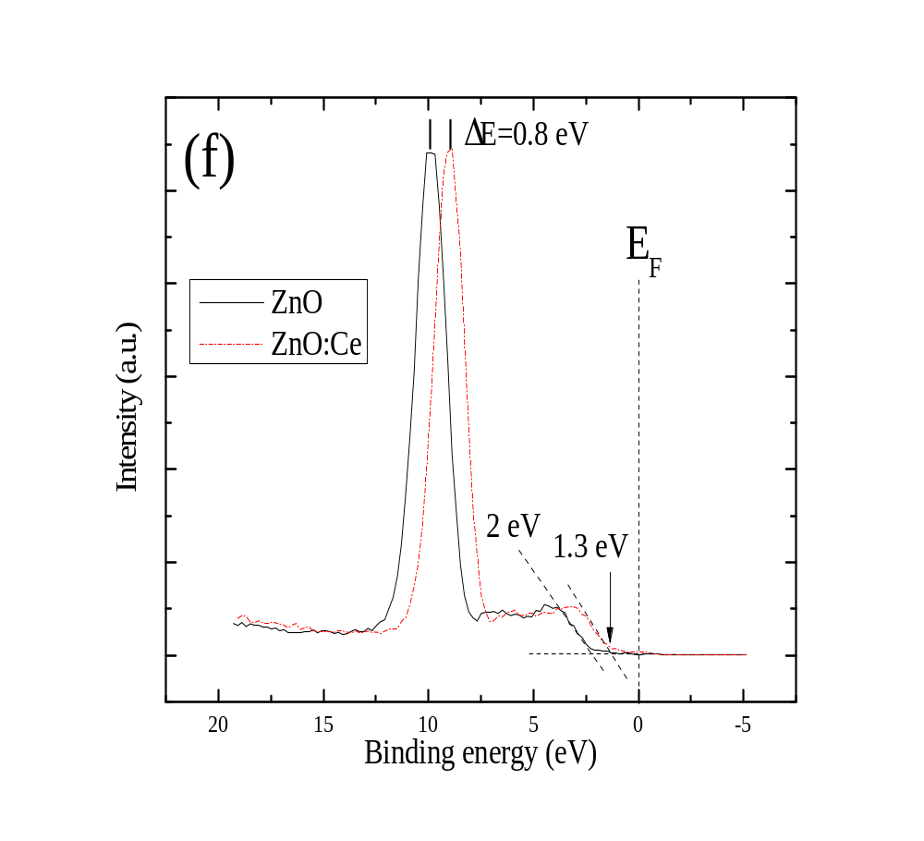
Ce³⁺
Ce⁴⁺
Ce3d_{5/2}: ∼71.8% Ce³⁺, ∼28.1% Ce⁴⁺
XPS

Slide 9
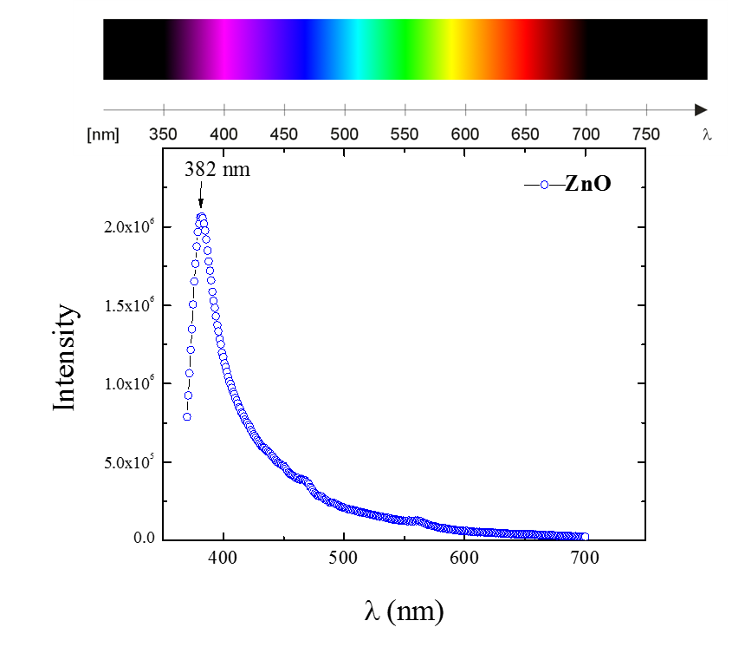
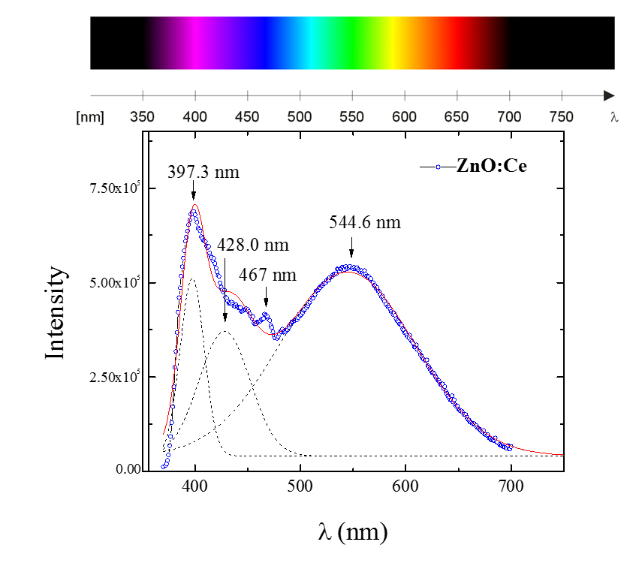
PL

Slide 10
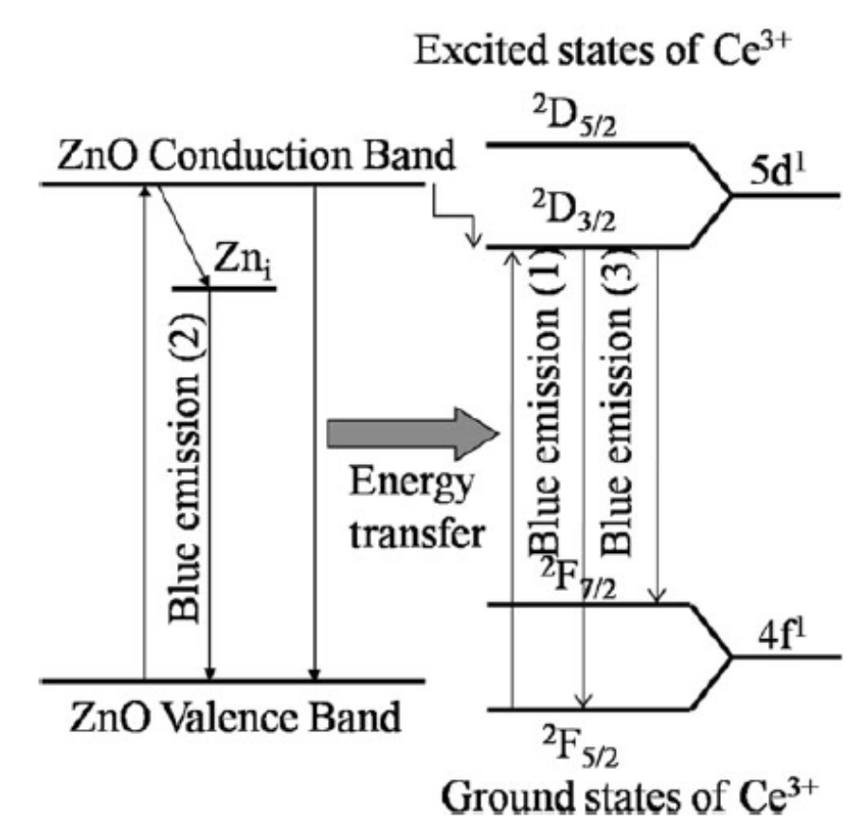
Q. Luo et al, Appl Phys A (2012) 108: 239-245

Slide 11
IV. Conclusions
Both films crystalized in wurzite structure with lattice parameters very similar in value to the stress-free standard
ZnO grew preferentially oriented at the [0002] direction, while ZnO:Ce grew preferentially oriented at the [10$\overline{1}$0] direction
Transmittance of both films was high, of about 90% at ∼400-750 nm, where E_{g}=3.23 eV and E_{g}=3.27 eV for ZnO and ZnO:Ce, respectively. The absorption edge of the doped film was shifted to the blue because the Burstein-Moss effect
XPS spectra showed the coexistence of Ce³⁺ and Ce⁴⁺ ions in a proportion of about 70%:30% into the host ZnO lattice. Both type of ions induce extra electron states that allows multi-emission peaks at the blue-green region and a shift of the red to the UV emission
From calculations of elemental concentration, the stoichiometric proportion of ZnO sample was found to be Zn_{0.5}O_{0.49} whereas to ZnO:Ce was Zn_{0.45}O_{0.46}:Ce_{0.078}, i.e. the growth of both films were non-stoichometric, slightly away from ideal ZnO

Slide 12
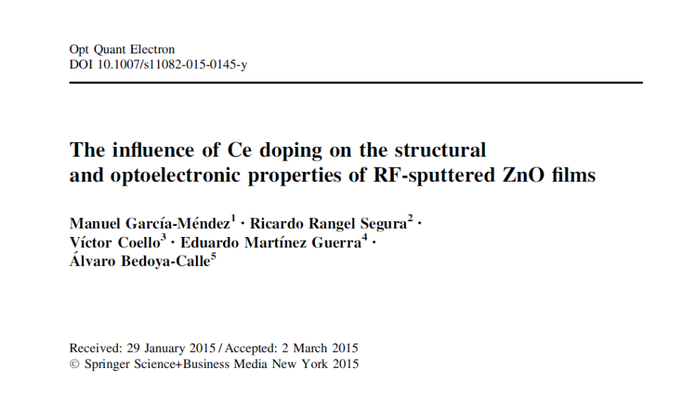
knowledgements
This work was financed by CONACyT (project 168234) and PAICyT-UANL (project CE671-11).

Slide 13

Thank you………...

