Slide 1



Burning oil layer on the surface water
Mansurov Z.A.
Director
Institute of Combustion Problems, Almaty, Kazakhstan
E-mail: zmansurov@kaznu.kz
5 December, Phoenix

Slide 2
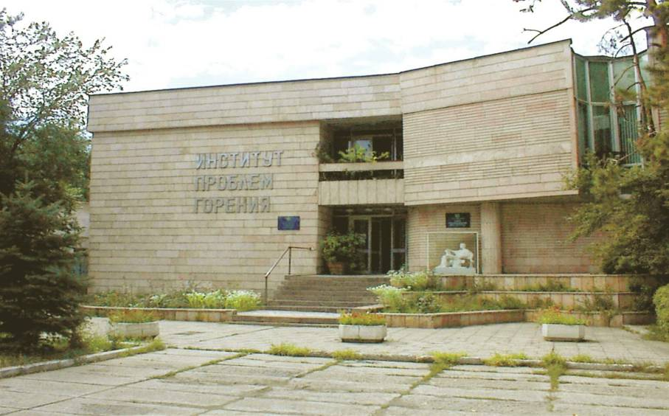
Institute of Combustion Problems

Slide 3
The Institute of Combustion Problems was founded in 1987 on the basis of Kazakh Interdisciplinary Science and Technology Center of self-propagating high-temperature synthesis (SHS). In 1991 the Institute gained its modern name “Institute of Combustion Problems” by the decision of the Government of the Republic of Kazakhstan.
The first Director of the Scientific Institution became Academician of the Russian Academy of Technical Sciences, Professor Georgiy Ksandopulo. At the time, the scientific results gained by our staff members, attracted the attention of Nobel Prize Laureate, Academician Nikolay Semenov as well as Academicians Yakov Zel’dovich, Viktor Kondratyev, Nikolay Emanuel and other world-famous scientists.
The results, which were the outcome of fundamental and applied researches of the Institute of Combustion Problems along with the Department of Chemical Physics and Chemistry of High-Molecular Compounds of the Al-Farabi Kazakh National University, contributed significantly to the development of a number of scientific fields. On this occasion, Academician Nikolay Semenov said: "We can assume that proceedings of scientists working at the Department and Institute of Combustion Problems established the basis of new original Kazakhstani School in the field of Chemical Physics."
Institute of Combustion Problems

Slide 4
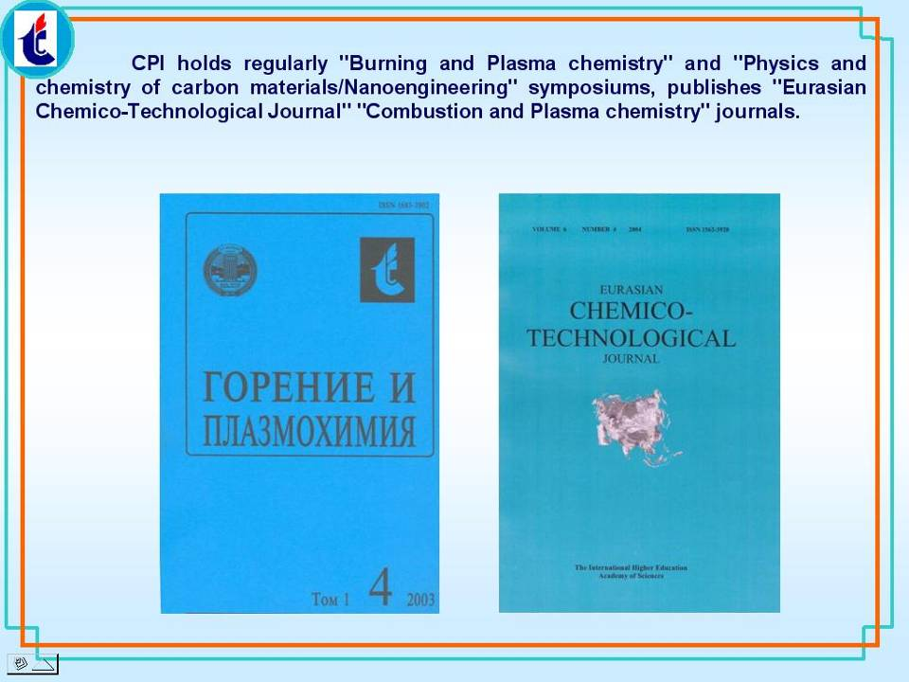

Slide 5
BURNING OIL LAYER ON THE SURFACE OF WATER

Slide 6
Introduction
Emergency oil spills during transportation of them by water way, from offshore oil drilling rigs and other sources can rapidly result in harm to the ecosystem and leads to negative and social impact. Apart from the category of oil spill, the first elimination measures should be directed to the rapid localization for the avoidance of further contamination of new sites. Oil, which falls on the water surface, prevents the penetration of sufficient sun lights and reduces the level of oxygen dissolved in water and it is make a great harm to the flora and fauna of water area. Therefore the development of effective methods on oil spill elimination is a task of singular importance.

Slide 7
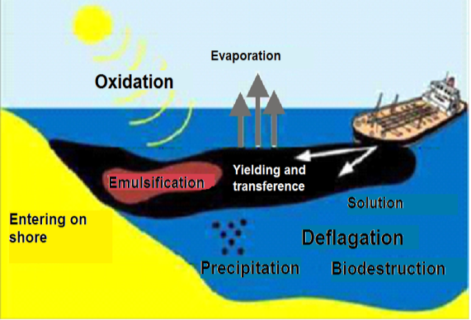
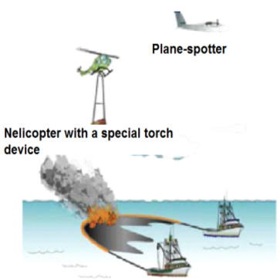
Behavior of oil spill in clean water
Typical combustion system surfaced situ oil spill

Slide 8
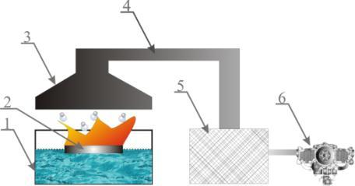
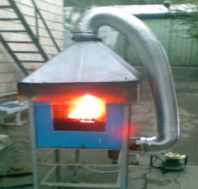
Experimental
The research on combustion of Karazhanbas oil on water surface were carried out. Experiments with oil combustion on water surface were conducted with the help of apparatus pictured in Fig.1.
a b
Fig. The scheme of experimental apparatus for oil combustion on water surface : а – installation diagram: 1 – water vessel; 2 – the bounding box for oil; 3 – exhaust hood; 4 –pipe-line; 5 –soot collector; 6 –air exhauster; b – photo of apparatus

Slide 9
Experimental apparatus includes 1 vessel with the volume of 50 liters with fixed watch window at the middle of vessel. For localization of oil sample on water surface and production of a layer with required thickness we used a bounding box 2 with the size of 15х15 cm and with high of 6 cm, from band-iron. For prevention of soot emission to the atmosphere the apparatus is equipped with exhaust hood 3 adjacent pipe-line 4 through soot collector 5 and air exhauster 6.

Slide 10
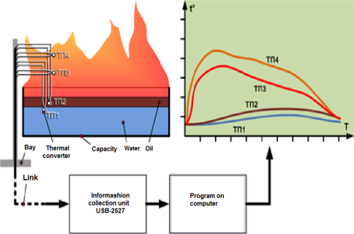
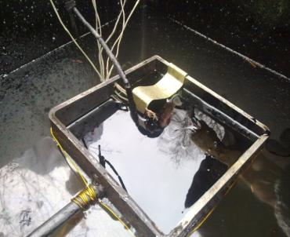
Zonal temperature measurement system (ZTMS)
а
b
a – photo bounding box with built-in thermocouples;
b – block diagram of the measuring system.

Slide 11
Characteristics and parameters measurement (ZTMS)
Parameter name | The value parameter
Number of serviced areas (defined by the possible applications of information collection module USB-2527) | 4
Positioning accuracy of the temperature sensor in the measurement zone | ± 0,5 mm
Type of thermocouple used | K (chrome-aluminum)
Temperature measurement range | −200 °C ... +1200 °C
The number of measurements per second per sensor | 1 ... 10000
Time of continuous monitoring | Restricted by the capacity of the recorder
Language software | LabView
Output type | Graphs, tables

Slide 12
The temperature dependence of the viscosity and density of oil
Temperature, ^{о}С | Coefficient of kinematic viscosity, mm²/s | Density, ρ, kg/cm³
0 | - | 0,9488
10 | - | 0,9413
20 | 612,9 | 0,9339
30 | 320,8 | 0,9279
40 | 164,0 | 0,9228
50 | 104,5 | 0,9165
60 | 57,7 | 0,9069
70 | - | 0,9039
80 | 26,3 | 0,8948

Slide 13
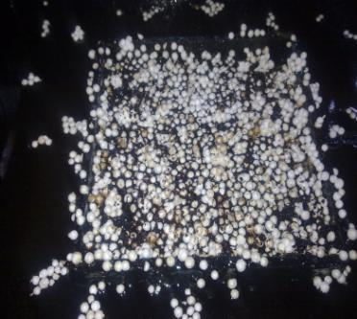
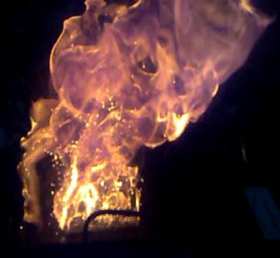
The general appearance of synthetic sorbent and combustion process
a b
Fig.2. The general appearance of synthetic sorbent (а) and photo of the combustion process of oil with synthetic sorbent (b)

Slide 14
The results on oil sorption by synthetic sorbent
The form of a sorbent | The weight of pure sorbent, | Time of sorption, minute | The weight of a sorbent with oil, г | Increase in weight, %
Holistic peace | 3,7 | 10 | 25,4 | 686
In the form of chip | 1,7 | 10 | 33,8 | 1988

Slide 15
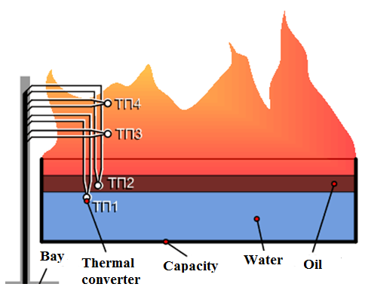
Scheme of arrangement block thermocouples for temperature control of the combustion process
Temperature of the combustion process in the application of synthetic porous sorbent with initiating pyrotechnic composition with probing height.

Slide 16
Table 2. Temperature profile of the flame according the height with using of synthetic sorbent
№ thermocouples | Temperature ^{о}С during the time has elapsed since the beginning of combustion, min
 | 1 | 3 | 6 | 7
ТП1 (in a layer of oil-water emulsion) | 130 | 180 | 230 | 50
ТП2 (in a layer of oil at the depth of 0, 5 cm) | 180 | 320 | 465 | 440
ТП3 (in flame at a height of10 cm) | 730 | 920 | 850 | 680
ТП4 (in flame at a height of 15 см) | 790 | 1070 | 1020 | 820

Slide 17
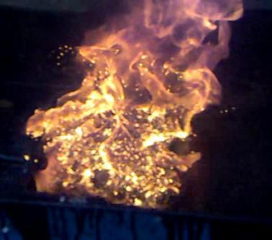
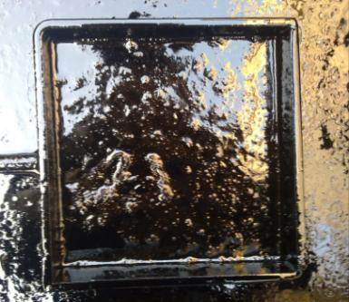
a b
Fig. The photo of intensive combustion process with emission of vapor to the flame (а) and swelling process of oil mass after burning completing due to continued boiling of water sublayer (b)

Slide 18
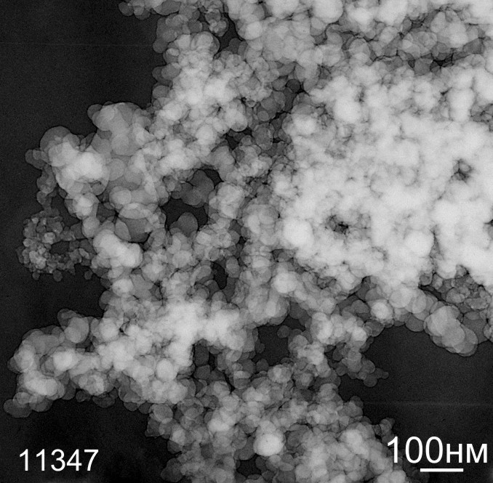
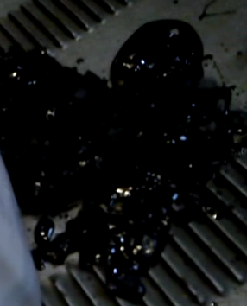
Residual products of the combustion of oil on the water surface
Electronic microscopy photo sample soot
Bituminous mass after burning

Slide 19
Conditions and results of the evaluation waterproof incendiary for ignition of the main
Weight incendiary, g | Weight of melted paraffin, g | Time Spent incendiary mixture in water, days. | Number of experiments | Ignition and combustion
100 | 3 | 1 | 10 | Complete combustion
100 | 3 | 1 | 10 | Complete combustion
100 | 5 | 1 | 10 | Complete combustion
100 | 5 | 1 | 10 | Complete combustion
100 | 10 | 1 | 10 | Complete combustion
100 | 10 | 1 | 10 | Complete combustion

Slide 20
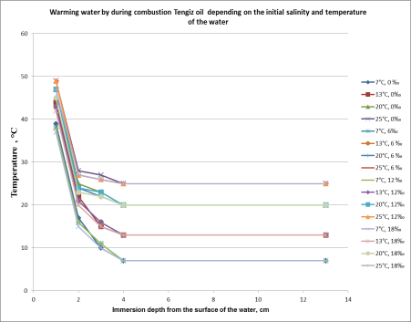
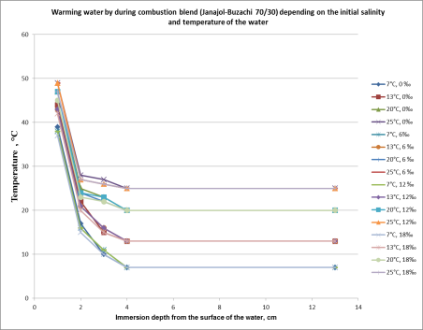
When carrying out experiments on burning, water temperature change on height (1,2,3,4,13 cm from border oil-water). The general water temperature was measured after the burning termination. These researches showed that the combustion of oil increases in water temperature on height (from border oil-water) is not evenly. Thus the top layer of water adjacent to oil begins to boil. Changing the temperature of the water depth (from the surface) during combustion Tengiz oil averaged: at a depth of 1 cm-an increase of 20-30ºC, at a depth of 2 cm - 3-10ºC, at a depth of 3 cm - 2-5ºC above the initial temperature. Changing the temperature of the water depth (from the surface) in the combustion hood (Zhanazhol - Buzachi, 70/30) the average was as follows: at a depth of 1 cm - an increase of 20-30ºC, at a depth of 2 cm - 2-10ºC, at a depth of 3 cm - 1-4ºC above the initial temperature. Regardless of the brand of the investigated oils warm water column terminated at a depth of 4 cm 4 cm below the temperature does not change and is equal to the initial water temperature. The overall temperature of the water (48 liters volume) increased by an average of 2-6°C. Given the weight of water and its specific heat and by changes in water temperature burning oil on the surface was calculated approximate value of the energy released by combustion of oil, it is about 4000 kJ. Thus estimated that when burning crude oil in the amount of water transferred heat for about 2 kJ per 1 cm² of surface. At a certain stage of burning oil, due to the small thickness of the layer of oil and a large cooling effect of water, the energy transferred to the film of oil is insufficient to maintain its evaporation and combustion.

Slide 21
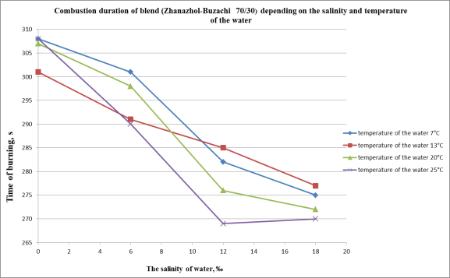
The graph shows the dependence of the burning blend (Zhanazhol-Buzachi, 70/30) of the temperature and salinity of the water. Duration of the combustion process depends on salinity, water temperature and on the brand of oil. The uneven length of the combustion due to the intensification of the combustion process in the last 30-40 seconds, which comes at a time when the oil layer becomes thinner and the energy released by burning oil leads to boil the surface layer of water. Evaporating surface of the water layer increases the oil evaporation and accelerates the combustion process, but there is intensive spraying water droplets and enhancing vaporization process and subject to intense heat outflow volume of water all together result in an unexpected and premature extinction of the flame, particularly the influence of a strong effect low oil density. When burning blend because of its denser composition (Zhanazhol - Buzachi 70/30) was observed overall pattern of change of the length of time the combustion temperature and salinity of the water, the higher the salinity of the less burning.

Slide 22
The influence salinity of the water at the time of burning oil slick

Slide 23
BURNING OIL LAYER ON THE SURFACE
OF ICE

Slide 24
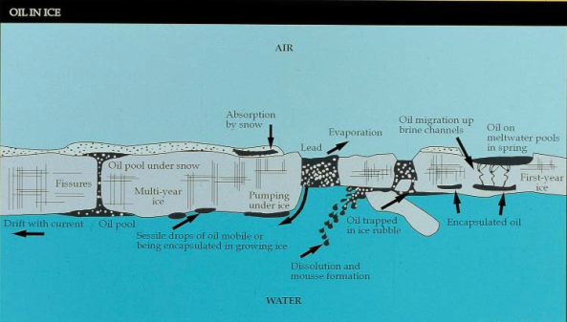
Our work is devoted to the studyresearch and development will improve the ability of responders to deal with an accidental oil spill in a fresh or salt-water marine environment in the presence of ice. Such an event could include spills of oil on top of or underneath solid, stable ice extending out from shore, into an area of drifting ice floes (pack ice), or onto an ice-covered shoreline. Figure shows a schematic composite displaying a number of possible configurations of oil in ice.
Spill response operations in ice and open water are fundamentally different. These variances must be recognized when determining the most appropriate strategy for dealing with oil in specific ice conditions and seasons, including freeze-up, winter, and break-up. Because of the vastly different ice environments and oil-in-ice situations, over-reliance on a single type of response will likely result in inefficient, ineffective cleanup after an actual spill.
In terms of ice type, the greatest need in most areas worldwide is to develop a credible, effective response to oil spilled in moving, broken, pack ice in oceans, lakes and rivers. Practical response strategies are available to deal with spills in a stable, fast-ice situation.
Successful spill response hinges on more than the immediate availability of the best technology.
Schematic view of possible oil configurations in ice

Slide 25
Restrictions response to oil spills in ice
Terms | Limiting the use of technology spill on the ice
 | General Restrictions | Localization / mechanical cleaning | In-situ burning
Sea ​​ice | May prevent access to the area of ​​the spill, spill impede detection and monitoring. Ice may limit the maneuverability of vessels and the deployment of devices for the collection of oil and oil booms. In the face of severe ice conditions should not be operated vessels for which there is no special ice-resistant housing | Boom can be moved or broken ice. Ice chips may clog the pump unit and reduce the efficiency of the skimmer | Ice can reduce the effectiveness of burning oil or impair its inflammation. Deploying a fire barrier can be difficult or impossible
Wind/sea state | Strong winds and waves can impede the effective deployment of the crew, the ship, the equipment needed for the oil spill. The winds of high speeds can impede the operation from the air, or make them unsafe | Strong winds and waves can displace or disrupt the boom anchor. A common limitation for the boom is the wave height of 2-3 meters | Burning of spilled oil on the spot at high speed winds and rough seas is generally unsafe and unfeasible
Temperature | Prolonged periods of extreme low temperatures affect the safety of personnel and require more frequent changing of watches | It may be the icing booms and equipment for oil spill response. The increased viscosity of the oil makes it difficult to extract and pumping | Extremely low temperatures can make it difficult to fire or make it ineffective and lead to slow decay or burning of oil

Slide 26
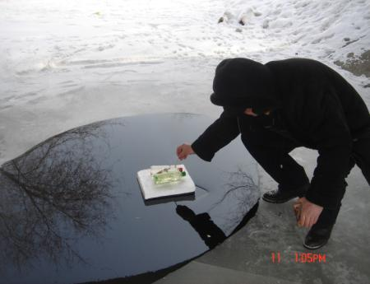
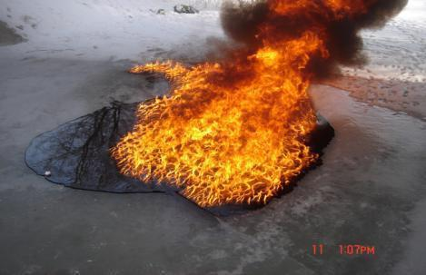

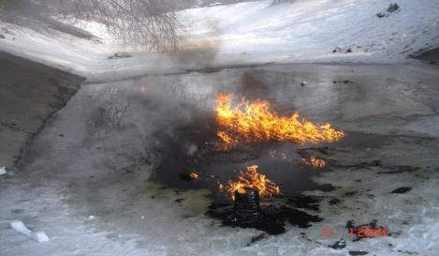
а - Initiation of oil burning pyrotechnic composition on the ice with a temperature of
2000 ºC burning b -The process of burning oil slick on the surface of ice. с -By incineration was eliminated 90% of the spilled oil on the surface of ice.
Examples of recent tests in-situ burning oil layer on ice

Slide 27
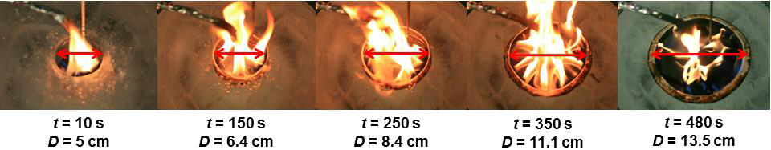
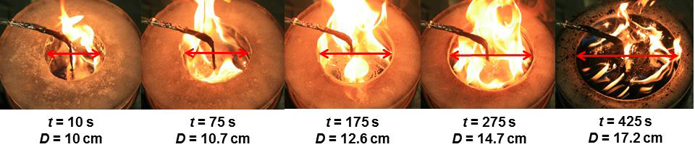
Figure 1. Showcasing cavity expansion for a) 5 cm and b) 10 cm trials.
Hamed Farmahini Farahani. Thesis Degree of Master of Science in Fire Protection Engineering.
“A Study on Burning of Crude Oil in Ice Cavities”

Slide 28
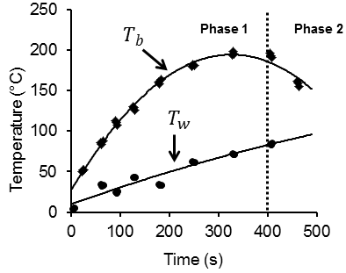
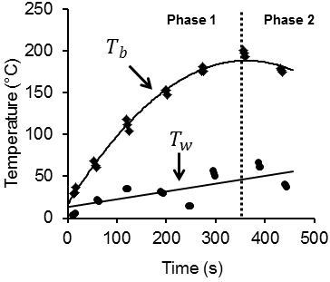
a) b)
Figure 2. a) 5 cm and b) 10 cm temperature distributions corresponding to the top and bottom of the fuel layer.
Hamed Farmahini Farahani. Thesis Degree of Master of Science in Fire Protection Engineering.
“A Study on Burning of Crude Oil in Ice Cavities”

Slide 29
A series of experiments were conducted to develop an understanding of the burning of crude oil in circular ice cavities. The burning rate of a fuel layer within ice cavities of varying diameters was studied to understand how the cavity expansion affects it. The mass loss rate is primarily enhanced by the cavity diameter and is limited by the fuel layer thickness. Ice melting over the course of the trial created a highly dynamic burning environment. It decreased ullage and increased the fuel surface area, enhancing the thinning of the fuel layer. Due to strong heat losses any benefits created by the high burning rates were quickly overcome. However, the rapid decrease in fuel layer thickness is the more prominent factor in reducing mass loss rates. The temperature profiles along the centerline of the oil layer were used to estimate heat losses of the fuel layer to the water sub-layer and icy walls. An energy balance for the fuel layer was used to estimate the mass loss rate. The model was relatively successful but further developments are necessary. Modeling and understanding such complex burning conditions requires describing other phenomena, such as the ullage and lip creation.
Hamed Farmahini Farahani. Thesis Degree of Master of Science in Fire Protection Engineering.
“A Study on Burning of Crude Oil in Ice Cavities”

Slide 30
Features of burning sulphuretted oil on the surface of water

Slide 31
About toxicity of sulfide hydrogen for human well known for centuries. Currently, the gas occupies the first place in the list of toxic substances in the extraction, pumping and refining oil and gas. We begin to feel the smell in the air at a concentration equal to 0.0047 ppm. At a concentration of 500 ppm hydrogen sulfide causes respiratory disorders, and the concentration of 800 ppm for five minutes, leading to death. The burning method of oil spills does not require the direct involvement of people on the ground, and it refers to another advantage incineration as a method of oil spills containing hydrogen sulphide. Based on the foregoing, in the present paper we studied the processes of evaporation of sulfide hydrogen from sulphuretted oil. It was studied the processes of burning oil containing hydrogen sulphide, on the water surface at its various salinities.

Slide 32
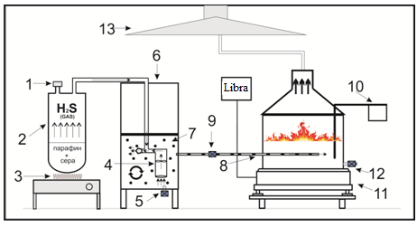
The experimental setup for the study of combustion characteristics of sulphuretted oil on the surface of water
Gaseous hydrogen sulfide was obtained by standard methods: 100 grams of wax mixed with crushed sulfur weighing 60 grams was heated to wax melting and mixing to produce a homogeneous mass. The resulting mass is poured into an iron pot and heated for producing a temperature in excess of 170 °C and while the intensive isolation of hydrogen sulfide. For saturation of oil with hydrogen sulfide in a sealed container with oil (6) placed Aerator (4), which is the principle of operation lies in the fact that through the compressor outlet is run oil in an amount of 600 l / h, which is due to release a large oil flow rate from the nozzle grips sulfide volume of about 300 cm³ / min. The mixture of oil and hydrogen sulphide expelled through the spray cone and thus the oil is saturated with hydrogen sulphide in the form of small bubbles (7).
1 - pipe, 2 - hermetic container, 3 - heater 4 - aerator, 5, 9, 12 - valves, 6 - a sealed vessel with oil, 7 - diffuser spray, 8 - the tube for supplying the oil 10 - temperature sensor 11 - scales.

Slide 33
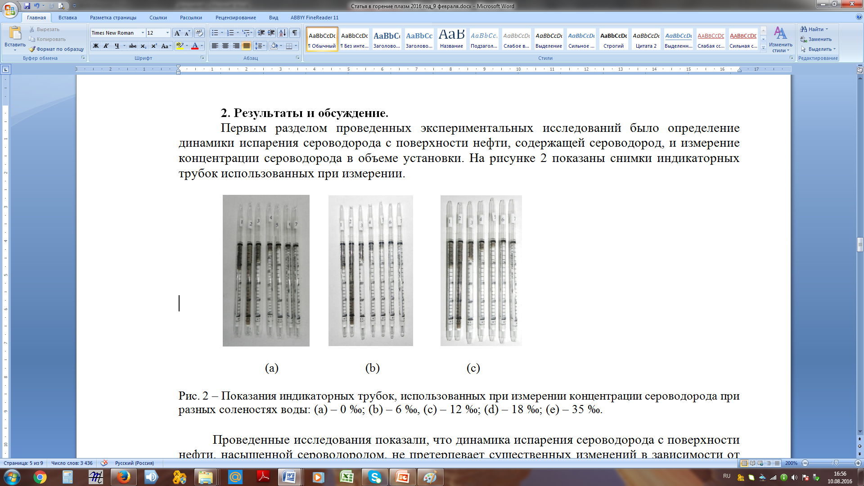
Studies have been conducted to study the dynamics of process of evaporation hydrogen sulfide from oil, depending on the time spent on the water surface. The percentage of vaporized hydrogen sulfide in the amount of the installation was made using a standard linear colorimetric rapid method of analysis. Line-colorimetric method is based on pulling the investigated gas mixture through a glass display tubes and measuring the length of a column of colored powder from the concentration of hydrogen sulfide. When measuring the concentration of hydrogen sulfide were used indicator tubes for hydrogen sulfide TU - RyU - 415522505. AF measurement is carried out in the following order:
- Measurement was carried out at oil startup at the expiration of 15-30 seconds.
- Measurement was carried out at the expiration of 15 minutes after the start of the oil
- Pumped exhaust system accumulated hydrogen sulphide and the next measurement is made after 15 minutes of stretching. Measurements were made to reduce the hydrogen sulfide concentration to a minimum.
The figure shows the images of test tubes used in the measurement. Water temperature was maintained in the range 18-20 °C. Average time of evaporation of hydrogen sulfide to the minimum value was 1 hour 30 minutes.
Indications of test tubes used in the measurement of hydrogen sulfide concentration at different salinities of water: (a) - 0 ‰; (B) - 12 ‰, (c) - 35 ‰.

Slide 34
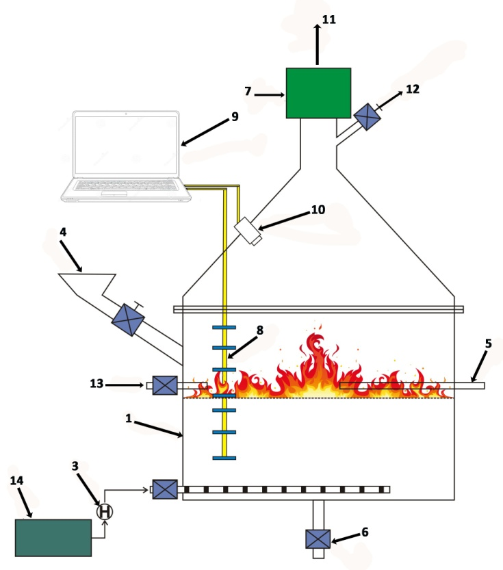
The second section of the research was to study the process of burning oil containing hydrogen sulphide in a sealed apparatus at a constant draw-products of combustion. The essence of the study was to investigate the temperature regimes of burning oil and the degree of burn-up, depending on the salinity of the water. flame temperature measurements were carried out permanently installed six chromel-alumel thermocouples located at the height of the flame every 4 cm, the first thermocouple is also located at the level of 4 cm from the surface of the oil slick. Measurement was carried out with special water temperature sensor, representing the resistive elements that are arranged 2 cm from the bottom of the oil film at or below 4 cm and 12 cm. results of measurements in real time every 600 msec were recorded on a computer automatic control system. The figure shows the installation diagram that conducted research process of burning oil containing hydrogen sulphide.
1 - working chamber, 2 - sealed container for raw material, 3 - the pump for pumping oil, 4 - funnel for pouring water, 5 - burner for arson, 6 - valve, 7 - filter, 8 - temperature sensors, 9 - PC 10 - a video camera, 11- hood, 12 - sampling, 13 - air flow, 14 - container with oil.

Slide 35
The main goal of the research was to study the degree of burn-out oil film containing hydrogen sulfide with the maximum saturation and at least its evaporation, and a study of oil residues from burning on the sulfur content. The first was made of the initial burning of the control of the Tengiz oil that is not saturated with hydrogen sulfide at 0 ‰ salinity. The residue oil after burning was 70 ml, burning time 4 minutes 17 seconds, the temperature in the flame volume fluctuated in the interval of temperatures of 300-900 ° C.
The following table presents the results of research on the combustion of Tengiz oil saturated with hydrogen sulfide. Ignition was made 1 hour 30 minutes after the pouring of oil.
Salinity | The volume of oil spilled, ml. | The volume of oil residues, ml. | The temperature gradient in the volume of the flame height, ° C | The burning time of oil
0 ‰ | 360 | 70 | 300-920 | 4 мин 15 sec
6 ‰ | 360 | 80 | 300-920 | 4 мин 27 sec
12 ‰ | 360 | 100 | 300-920 | 4 мин 32 sec
18 ‰ | 360 | 110 | 300-920 | 4 мин 24 sec
35 ‰ | 360 | 130 | 300-920 | 4 мин 40 sec
In these experiments, there is the effect of salinity of water on the process of burning the oil slick. With an increase in water salinity is increasing the amount of unburned oil residues. This phenomenon explains the inhibitory effects of salt water in the composition to the combustion process. We can distinguish two mechanisms of the effect of salinity on the combustion process. First, the formation of a powdery salt by evaporation of water droplets that rise in the flame due to the boiling water. The powdered salt has an inhibitory effect mainly due to the heat removal from the combustion zone and the insulating effect on the fuel. Second, the salt acts as a flame retardant and the catalyst is a negative retarding the reaction at a constant temperature combustion.

Slide 36
The third section of the study was to analyze the total percentage of sulfur in the oil residues after combustion. Studies were conducted on the analyzer sulfur content in petroleum and petroleum products "Spectroscan S». The following table shows the results of the research.
№ Sample | Sample | Sulfur content
Sample №1 | Initial Tengiz oil | 0,565 %
Sample №2 | Initial Tengiz oil after burning | 0,979 %
Sample №3 | Initial Tengiz oil saturated with hydrogen sulfide | 0,632 %
Sample №4 | Oil saturated with hydrogen sulfide and burned immediately after casting | 1,176 %
Sample №5 | Oil saturated with hydrogen sulfide and burnt in 1 hour 30 minutes | 1,151 %
Sample №6 | Oil saturated with hydrogen sulfide and burned immediately after filling with water salinity 6 ‰ | 1,183 %
Sample №7 | Oil saturated with hydrogen sulfide and burned immediately after filling with water salinity 35 ‰ | 1,086 %
The combustion process of oil containing hydrogen sulphide leads to an increase in the concentration of sulfur composition unburned oil residues. Additional improvement can be explained by the formation of sulfur-coupled stably sulfur compounds which are formed in the reaction of hydrogen sulfide and hydrocarbon oil compounds. These processes are possible because of the high combustion temperature. Relatively minimal sulfur content of the sample due to the large volume №7 (130 ml) of oil residues after combustion.

Slide 37
Thus conducted studies to determine the operational capability of using in-situ burning as a method of oil spill with a high content of sulfur compounds, hydrogen sulfide was studied in the process of evaporation of sulphuretted oil from the Tengiz field and the characteristics of its combustion on the water surface. The analysis of changes in the percentage of sulfur in the oil residues after combustion. Studies have shown that the overall combustion process of a sulfur containing oil has no significant differences in stability of flame propagation, to change the combustion temperature of the combustion process of oil containing no hydrogen sulfide. The main difference is that the process of burning oil containing hydrogen sulphide leads to an increase in the concentration of sulfur in crude oil residue after combustion. Increasing the concentration of sulfur due to the formation stably-bound sulfur compounds formed in the reaction of hydrogen sulfide and hydrocarbon compounds of oil at high combustion temperatures.

Slide 38
Conclusions
as an example of Karazhanbas oil it was established that minimum thickness of oil layer, allowing to initiate and maintain the combustion process, is in in the range of 3-5 mm.
the proposed synthetic sorbent accelerates the combustion process of oil on the water surface tree-fold, compared with the combustion process of oil without sorbent, that is explained by significant sorption of light fractions an their involvement in combustion process.
- it is shown that remaining mass of oil on the water surface after combustion process ending, is a bitumen mass, which has good adherence and strong adhesion, that allows to take it by mechanical way from water surface.
asphaltenes and resins contained in the oil from the field Janajol are natural emulsifiers and dispersants in the process of dispersion and emulsion formation. Emulsification of oil film is saturated with water and its ability to fire is greatly reduced;
the combustion of oil increases in water temperature adjustment (of the oil-water boundary) is not uniform. The upper oil layer adjacent to the water boils. Changing the temperature of the water depth (from the surface) during combustion averages: at a depth of 1 cm - an increase of 20 - 30 º C, at a depth of 2 cm - 2 - 10 º C, at a depth of 3 cm - 1 - 5 º C above the initial temperature. Regardless of the brand of the investigated oils warm water column terminated at a depth of 4 cm 4 cm below the temperature does not change and is equal to the initial water temperature;
burning blend (Janajol - Buzachi, 70/30) there is a general pattern of influence of salinity on the process of burning the oil layer. This pattern is most clearly expressed in relation to the burning time of the oil layer. Thus, with increasing salt concentration and temperature of water decreases the amount of time combustion and burnt oil. In fresh water, the influence of water temperature on the combustion process is not observed.

Slide 39
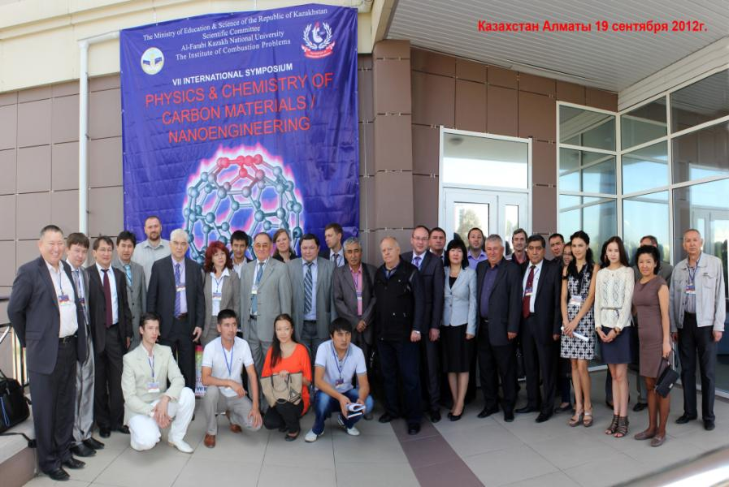

Slide 40

Thank You for attention!

