Slide 1




FDA Approved Recombinant Hemagglutinin Influenza Vaccine Protects Against Drift Influenza Viruses
2nd International conference on Flu
October 31- November 02, 2016
San Francisco, California, USA

Slide 2


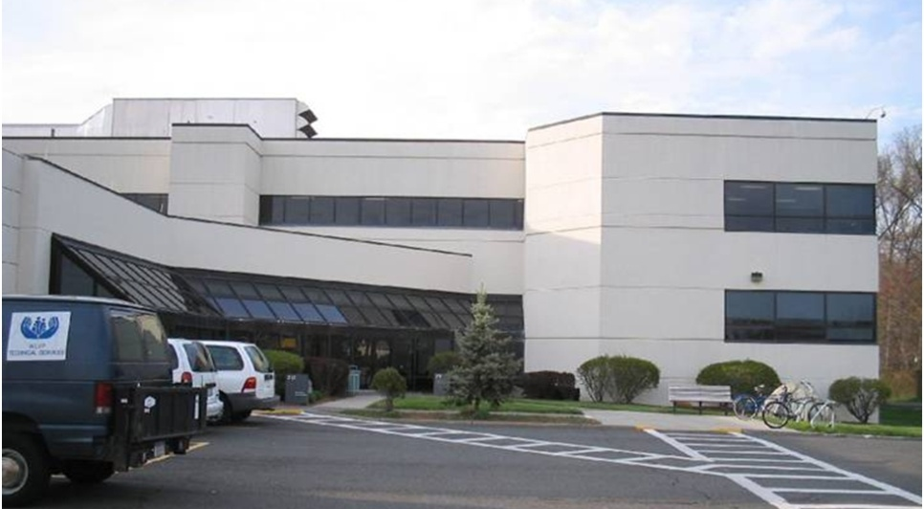
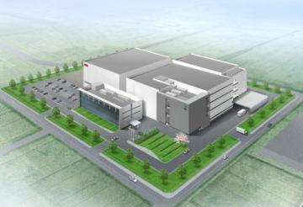

Protein Sciences
Manufacturing Vaccines
More, Faster, and Better ….
Meriden, CT
Pearl River, NY
Gifu, Japan (UNIGEN)
cGMP facility: 2x21,000L; adding 2 more

Slide 3
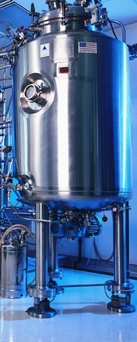
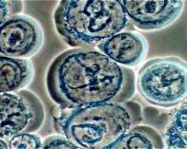
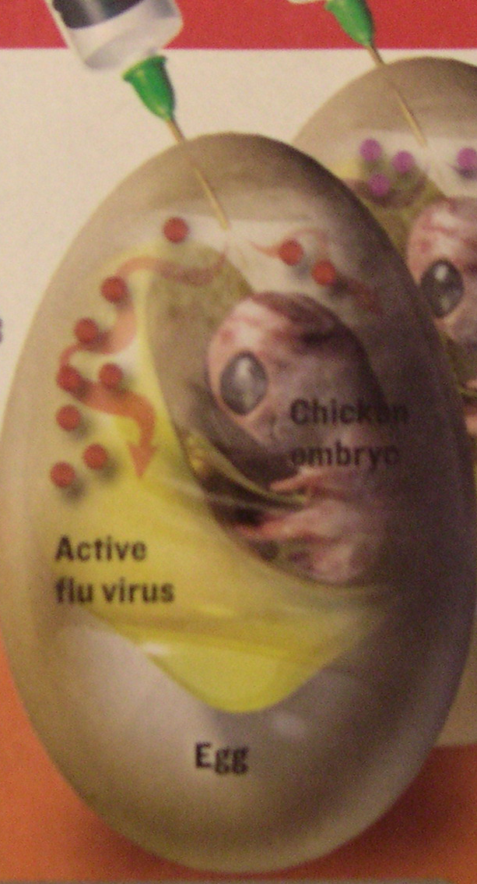
A New Approach to Vaccine Manufacture
Traditional
BEVS
Grow pathogen (in eggs)
Inactivate pathogen
Purify antigen (i.e., the active ingredient)
Formulate vaccine
Produce antigen (in cell culture)
Purify antigen
Formulate vaccine
Fast Pure Egg-free
TRADITIONAL
METHOD
MODERN VACCINE

Slide 4
Baculovirus Technology Platform (BEVS)
4

Slide 5
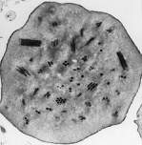
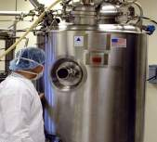
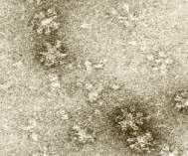
BEVS Technology
“Enabling products where speed, cost and safety matter”
Baculovirus Expression Vector System (BEVS)
Engineer baculovirus with the gene of interest (e.g. Hemagglutinin)
Baculoviruses highly specific to insect cells
Powerful promoter generates high yield of protein of interest
Culture expression of insect cells in a
fermenter
Infect cells with engineered virus
Incubate infection for ~48 - 72 hours
Protein forms rosettes
Purify protein to > 90% into final product
Formulate with PBS into vaccine
Flublok Approval → Validation

Slide 6
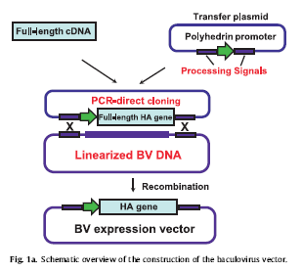
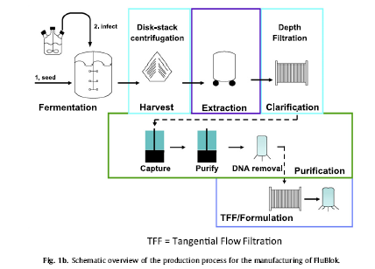
Universal Plug and Play Process
From Gene to Production in 22 Days
From gene to production in 22 days

Slide 7
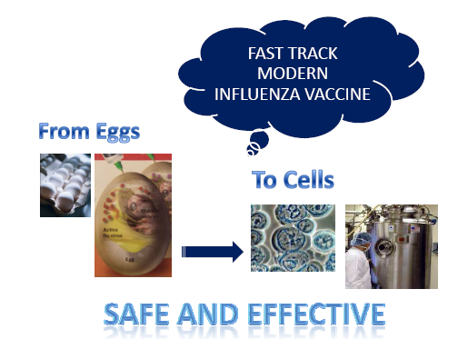
Flublok®
  First recombinant influenza vaccine
  FDA licensed for 18 years and above
  Pediatric age expansion underway
  Panblok: The pandemic solution
    Only pandemic vaccine that can be
    quickly manufactured and/or transferred
    to and manufactured in other countries

Slide 8

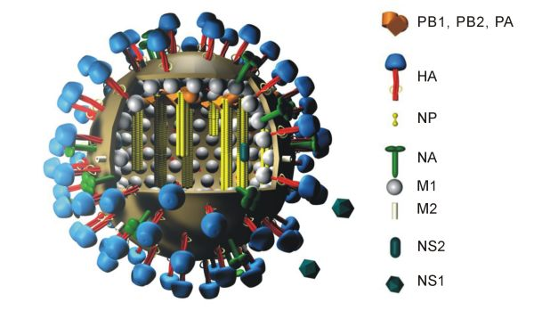
Influenza Vaccine:
HA = Major Surface Protein
HA (Hemagglutinin):
  Coat of the influenza virus
  Antibodies against HA protect against influenza
  Changes in HA require annual update of vaccine
Notes:
Mention both HA and NA then go into details.
The flu shot is the best way to prevent the flu!
Anti-viral drugs are other tools that can help prevent and treat influenza.
The four antiviral drugs all target NA.
All require prescription and must be taken during first 2 days of illness.
Most only good for type A influenza
Anti-viral drugs cause many side effects such as nausea and other gastrointestinal problems.

Slide 9
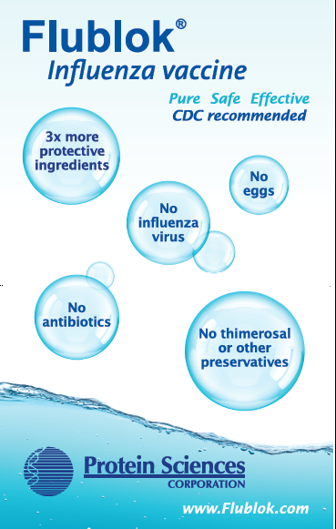
Flublok Features
Pure protein vaccine – unique
Matches circulating flu virus
3X more protein than conventional flu vaccines
No
  egg protein
  influenza virus
  thimerosal (mercury)
  antibiotics
  formaldehyde
  latex
  gelatin
  gluten
  endotoxins

Slide 10
Vaccine Characteristics - Purity
 | EXACT MATCH | EGG | GELATIN | ANTIBIOTICS | LATEX | THIMEROSAL | FORMALDEHYDE | LIVE VIRUS
FLUBLOK | X
AFLURIA |  | X |  | X |  | X
FLUARIX |  | X |  | X | X |  | X
FLUMIST |  | X | X | X |  |  |  | X
FLUVIRIN |  | X |  | X | X | X
FLUZONE |  | X | X |  |  | X | X (INTRADERMAL)
FLUCELVAX |  | X |  |  | X
FLULAVAL |  | X |  |  |  | X | X
AGRIFLU |  | X |  | X | X
Flublok can “de-risk”

Slide 11
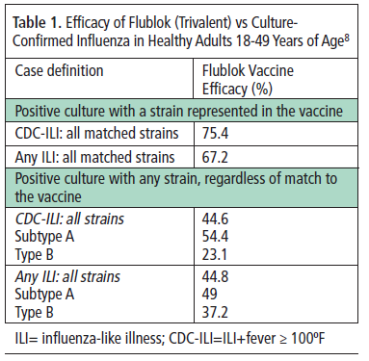
Flublok Protects Against Matched and Drifted Influenza Strains
75% protection against matched strains
45% protection against all strains (including drifted)
And shows improved immunogenicity against the A strains and comparable responses to the B strains in adults ≥50 yr old

Slide 12
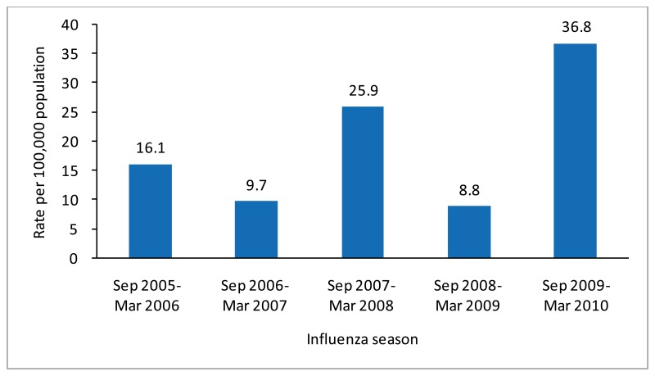
Influenza 2014-2015:
The Longest Flu Season on Record
  Predominant circulating virus was H3N2
    Causes worse disease and more complications than other influenza subtypes and can have mortality rates as high as 50,000
    Highest hospitalization rate ever for people >65 (322/100,000) and 65.5/100,000 in all age groups
  Poor vaccine performance –
    Approx. 35% effective in people over 65 years old (ACIP, June’15)
    Some vaccines were associated with increased disease rates
  Why?
  2 reasons for poor performance:
    Egg drift
    Seasonal drift
Notes:
VE ref: http://www.cdc.gov/flu/professionals/vaccination/effectiveness-studies.htm

Slide 13
Immunogenicity Data
- Clinical -
Effectiveness: Non Inferiority Comparison
Flublok vs. Fluzone®
 |  | H1 | H3 | B
GMT | 06 | FB>Fz | FB>Fz
 | 03 | FB>Fz | FB>Fz
% SCR | 06 |  | FB>Fz
 | 03 | FB>Fz | FB>Fz | Fz>FB
NI |  | Not NI

Slide 14
Topline Results
Quadrivalent Flublok [RIV4] vs. IIV
Efficacy of Flublok vs. PCR-confirmed Influenza in Adults 50 years and older in comparison to IIV
 | Flublok (n= 4303) | IIV (n=4302)
Overall RT-PCR Confirmed influenza | 96 | 138
Attack rate | 0.022 | 0.032
Conclusion: Relative Vaccine Efficacy = 0.31 (0.10, 0.47)
Flublok meets the exploratory superiority endpoint

Slide 15
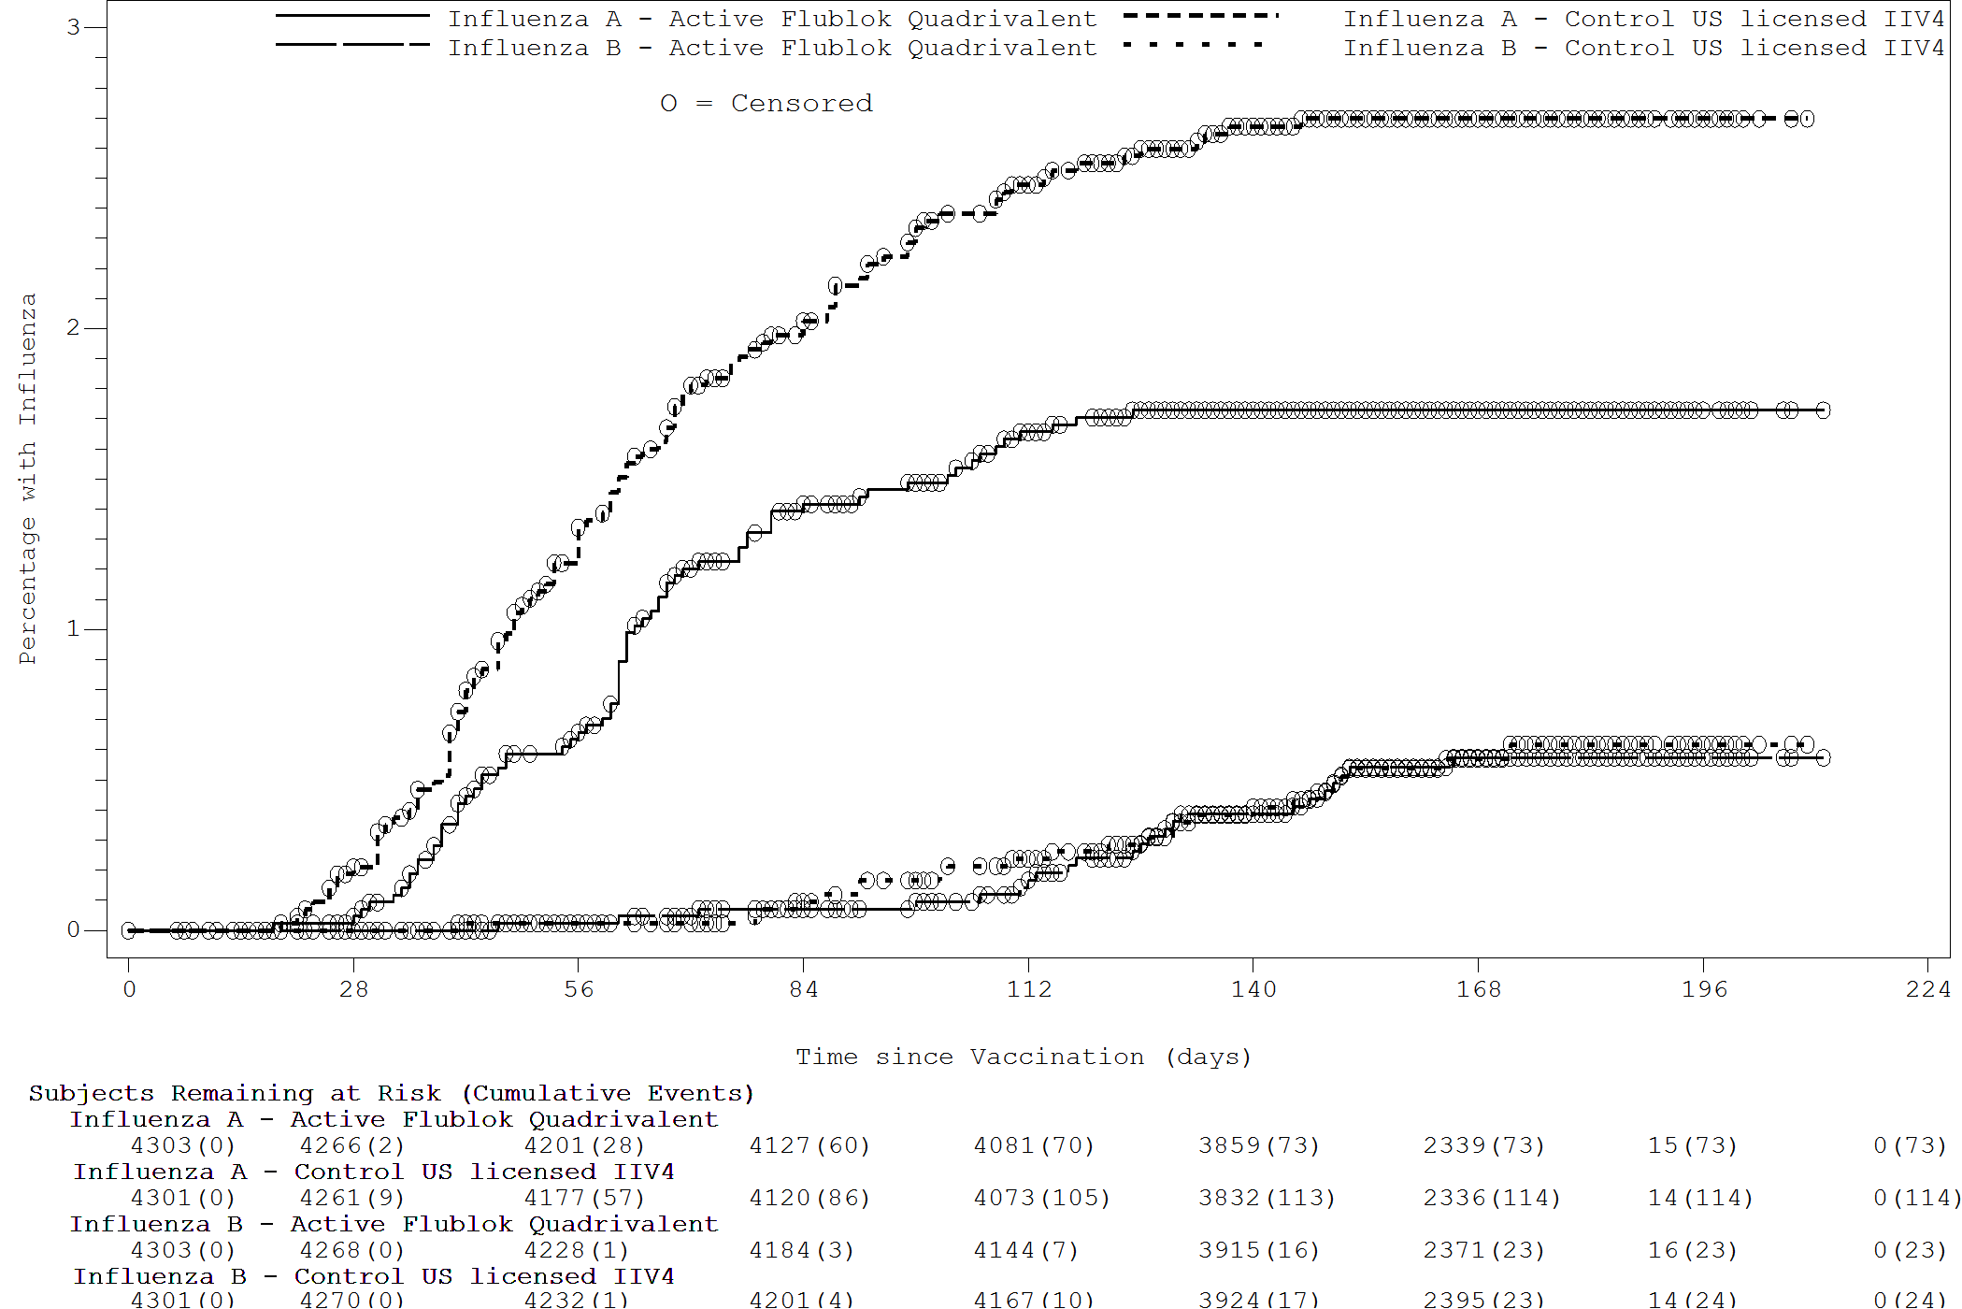
Influenza Isolates by RT-PCR
Flu A
Flu B

Slide 16
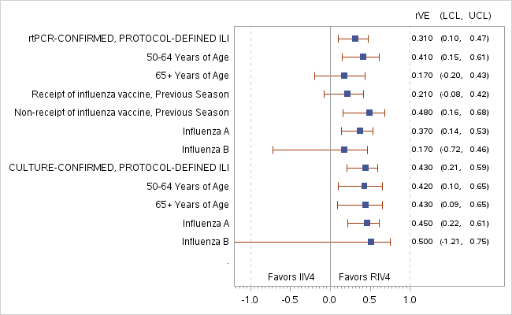
Flublok Clinical Efficacy in Adults 50+
(protocol defined ILI)

Slide 17
ILI Related MAEs/ SAEs
During 6 months after vaccination
Medical attended ILI
  RIV4 = 6; IIV4 = 13
Hospitalization for influenza
  RIV4 = 1; IIV4 = 3

Slide 18
Most Common AEs (≥2%)
Preferred Term | Flublok [RIV4] N=4328 | IIV4 N=4344
 | N (%) | N (%)
Cough | 226 (5.2) | 253 (5.8)
Influenza like illness | 186 (4.3) | 199 (4.6)
Oropharyngeal pain | 178 (4.1) | 177 (4.1)
Headache | 143 (3.3) | 145 (3.3)
Upper respiratory tract infection | 129 (3.0) | 156 (3.6)
Fatigue | 106 (2.4) | 100 (2.3)
Myalgia | 95 (2.2) | 79 (1.8)
Productive cough | 59 (1.4) | 97 (2.2)

Slide 19
Most Common AEs (≥2%)
Preferred Term | Flublok [RIV4] N=4328 | IIV4 N=4344
 | N (%) | N (%)
Cough | 226 (5.2) | 253 (5.8)
Influenza like illness | 186 (4.3) | 199 (4.6)
Oropharyngeal pain | 178 (4.1) | 177 (4.1)
Headache | 143 (3.3) | 145 (3.3)
Upper respiratory tract infection | 129 (3.0) | 156 (3.6)
Fatigue | 106 (2.4) | 100 (2.3)
Myalgia | 95 (2.2) | 79 (1.8)
Productive cough | 59 (1.4) | 97 (2.2)

Slide 20
Reactogenicity (%)
 | RIV4 (Flublok Quadrivalent) N=4307 |  |  | IIV4 N=4319
 | Any | Grade 3 | Grade 4 | Any | Grade 3 | Grade 4 | P-value
≥1 event | 48 | 1 | <1 | 51 | 1 | <1 | 0.006
≥1 local reaction | 38 | <1 | 0 | 40 | <1 | 0 | 0.009
Local Pain | 19 | <1 | 0 | 22 | <1 | <1 | <0.001
Local Tenderness | 34 | <1 | <1 | 37 | <1 | <1 | 0.007
Erythema | 3 | <1 | 0 | 2 | <1 | 0 | 0.014*
Induration | 3 | <1 | 0 | 3 | <1 | 0 | 0.09
* Not significant after adjustment for four comparisons

Slide 21
PSC12 - Conclusions
Flublok RIV4 met non-inferior clinical efficacy compared with IIV4
Flublok RIV4 met pre-specified criterion for superiority over IIV4 clinical efficacy
  Primary endpoint (non-inferiority) met for subgroups aged 50-64 and ≥65 years, despite smaller sample sizes
  Efficacy most marked in subjects unvaccinated in 2013
HAI responses to B/Brisbane were suboptimal for both vaccines
Flublok RIV4 caused significantly less injection site pain and tenderness than IIV4
No notable differences in SAEs or MAEs

Slide 22

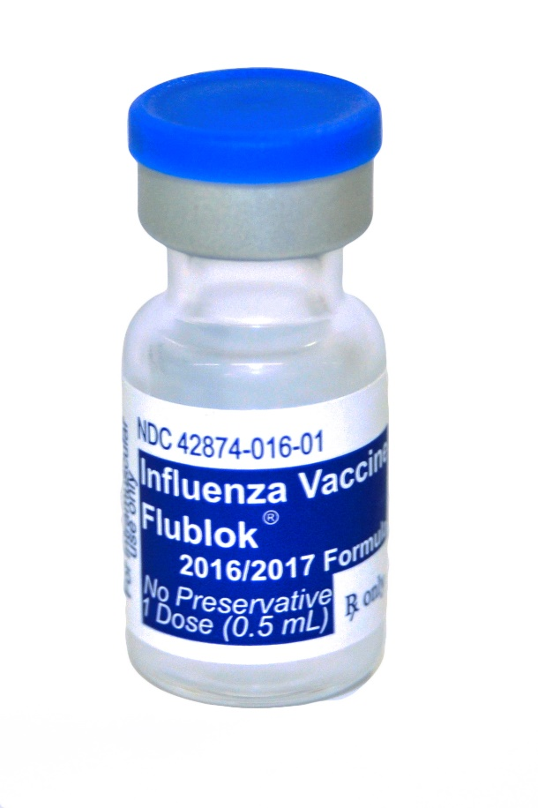
Acknowledgement
Flublok is a reality thanks to support of BARDA contract HHSO100200900106C and the perseverance of the Protein Sciences team!

