Slide 1


East Indian Sandalwood Oil (EISO) Alleviates Inflammatory and Proliferative Pathologies of Psoriasis
Manju Sharma

Slide 2
Conflict of Interest Statement
Cox and Sharma have received funds through a collaborative research agreement with Santalis Pharmaceuticals. Inc. that supported this project

Slide 3
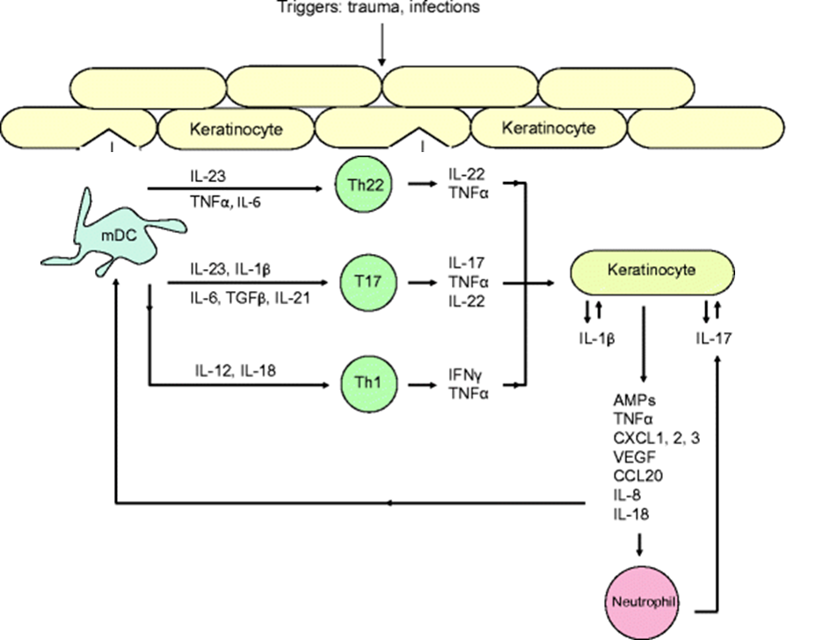
Immunopathogenesis of Psoriasis
Mahil, Sem. Immunopathol. 2016

Slide 4
Medicinal Properties of East Indian Sandalwood Oil (EISO)
Conventional treatments for psoriasis are usually associated with severe side effects. Natural products may provide effective alternatives while offering less severe side effect profiles.
Santalum album L. (Santalaceae), known as EISO, is used in aromatherapy, as an antidepressant, anti-inflammatory, antifungal, astringent, sedative, insecticide, and antiseptic.
Antiseptic, anti-inflammatory and anti-proliferative properties of EISO make it an effective remedy for various skin ailments.
However, much debate still exists concerning the therapeutic efficacy of this plant as a consequence of inadequate standardization and characterization of most preparations used in clinical trials and so much of the information available in this context is anecdotal

Slide 5
Santalis East Indian Sandalwood Oil Characterization
Parameters | EISO
(Z)-α-Sanatalol | 46.2-59.9%
(Z)-β-Santalol | 20.5-29.0%
(Z)-Nuciferol | 1.1-5.5%
epi-β-Sanatlol | 4.1-4.3%
(Z)-α-trans-Bergamotol | <3.9%
α-Santalal | 0.5-2.9%
β-Santalal | 0.6-1.9%
(Z)-lanceol | 1.5-1.7%
(E)-β-Santalol | 1.5-1.6%
β-Santalene | 0.6-1.4%
Spirosantalol | <1.2%
α-Santalene | 0.8-1.1%

Slide 6
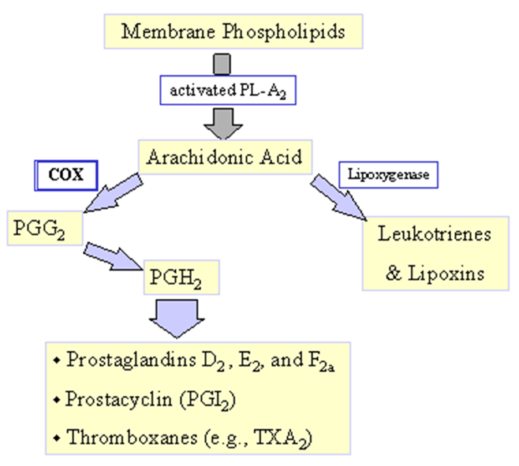
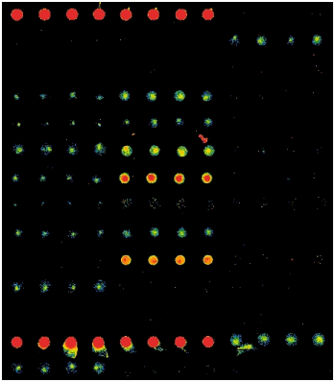
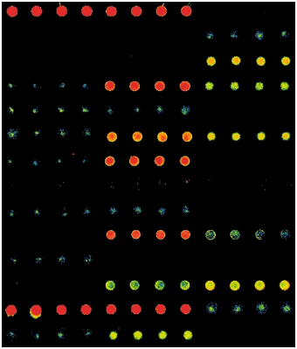
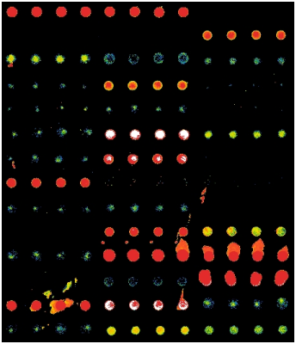
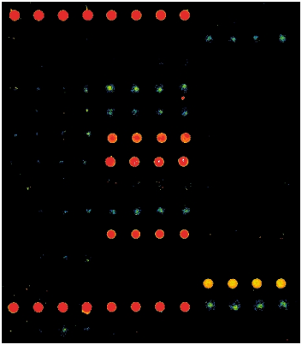
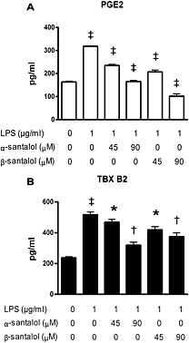
EISO and α- & β-Santalols Suppress Proinflammatory Response of Skin to LPS
POS1
POS2
POS1
POS2
G-CSF
G-CSF
GM-CSF
GM-CSF
I-309
ICAM-1
IFN γ
IL-1α
IFN γ
IL-1α
IL_1 r a
IL-2
IL-1β
IL-5
IL-6
IL-6 sR
IL_1 r a
IL-2
IL-5
IL-6
IL-6 sR
Control
IL-7
IL-8
LPS+EISO: 90 µM
IL-8
IL-11
IL-7
IL-13
IL-15
IL-11
IL-13
IL-15
MCP-1
MCSF
MCP-1
MCSF
MIG
MIP-1 α
MIP-1 β
MIG
MIP-1 α
MIP-1 β
PDGF-BB
RANTES
PDGF-BB
RANTES
TIMP-1
TIMP-2
TNF α
TIMP-1
TIMP-2
TNF α
TNF β
TNF RI
TNF RII
TNF β
TNF RI
TNF RII
POS1
POS2
POS1
POS2
G-CSF
G-CSF
G-CSF
GM-CSF
I-309
GM-CSF
I-309
ICAM-1
GM-CSF
I-309
ICAM-1
IL-1α
ICAM-1
PGE2
TBX B2
IFN γ
IL-1α
IL-1β
IFN γ
IFN γ
IL-1α
IL-1β
IL_1 r a
IL-2
IL_1 r a
IL-2
IL_1 r a
IL-2
IL-5
IL-6
IL-6 sR
IL-5
IL-5
IL-6
IL-6
IL-6 sR
IL-8
IL-6 sR
LPS: 1µg/ml, 24 h
IL-8
IL-7
IL-7
IL-7
LPS+ Ibuprofen 90 µM
IL-8
IL-11
IL-11
IL-11
IL-13
IL-15
IL-13
IL-15
MCSF
IL-13
IL-15
MCSF
MCP-1
MCP-1
MCP-1
MCSF
MIG
MIP-1 α
MIP-1β
MIG
MIG
MIP-1 α
MIP-1 β
MIP-1 α
MIP-1β
RANTES
PDGF-BB
RANTES
RANTES
PDGF-BB
PDGF-BB
TIMP-1
TIMP-2
TIMP-1
TIMP-2
TNF α
TIMP-1
TIMP-2
TNF α
TNF α
TNF RI
TNF RII
TNF β
TNF RI
TNF RI
TNF RII
TNF β
TNF β
TNF RII
Sharma, Phytother. Res.2014

Slide 7
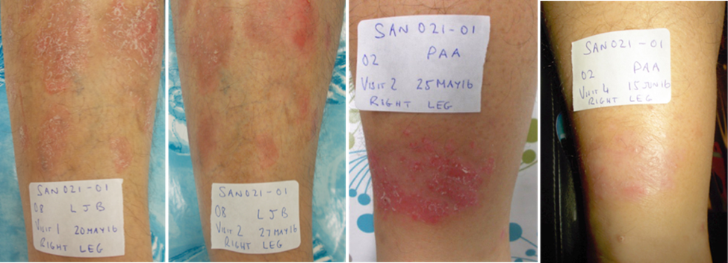
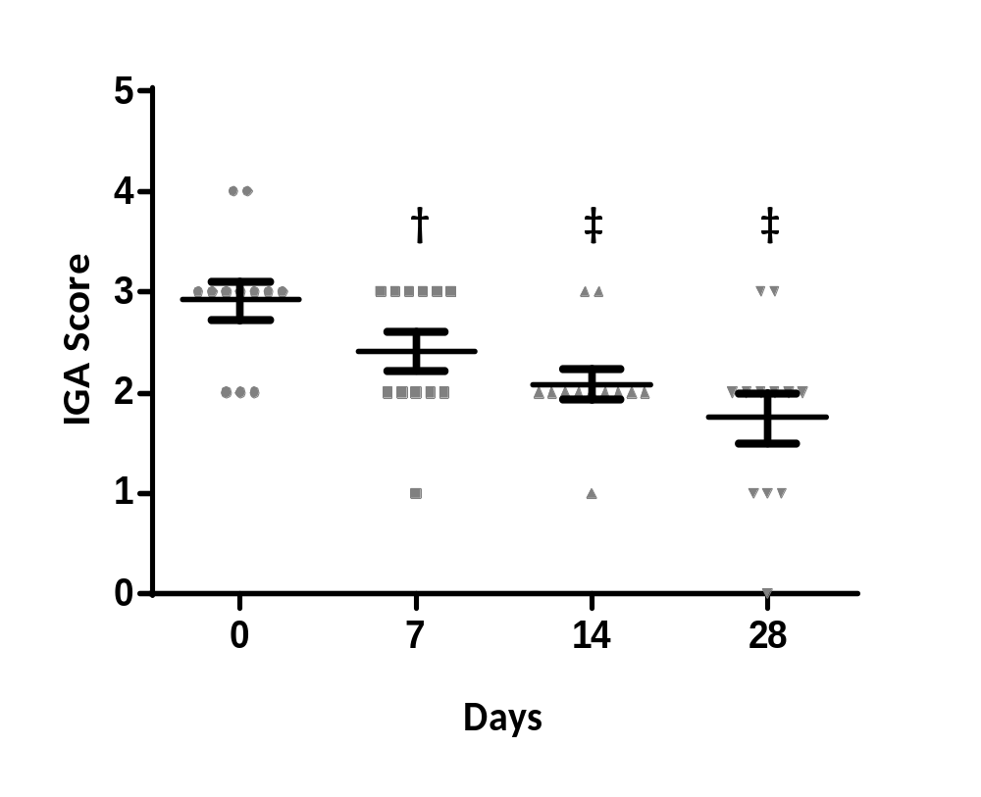
EISO Improves Psoriasis Lesion Severity
Patient A
Week 0
Week 1
Patient B
Week 0
Week 3

Slide 8
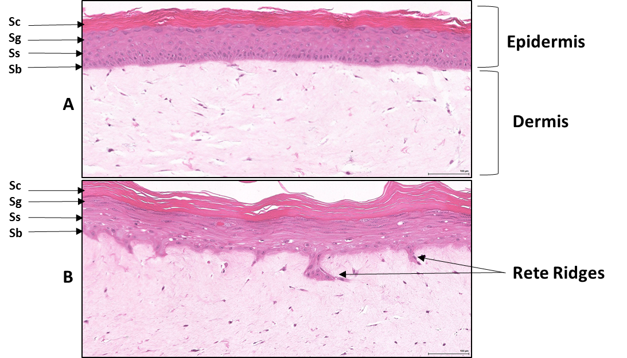
Reconstituted Normal Epidermal Tissue vs. Reconstituted Psoriatic Tissue
normal
psoriatic

Slide 9
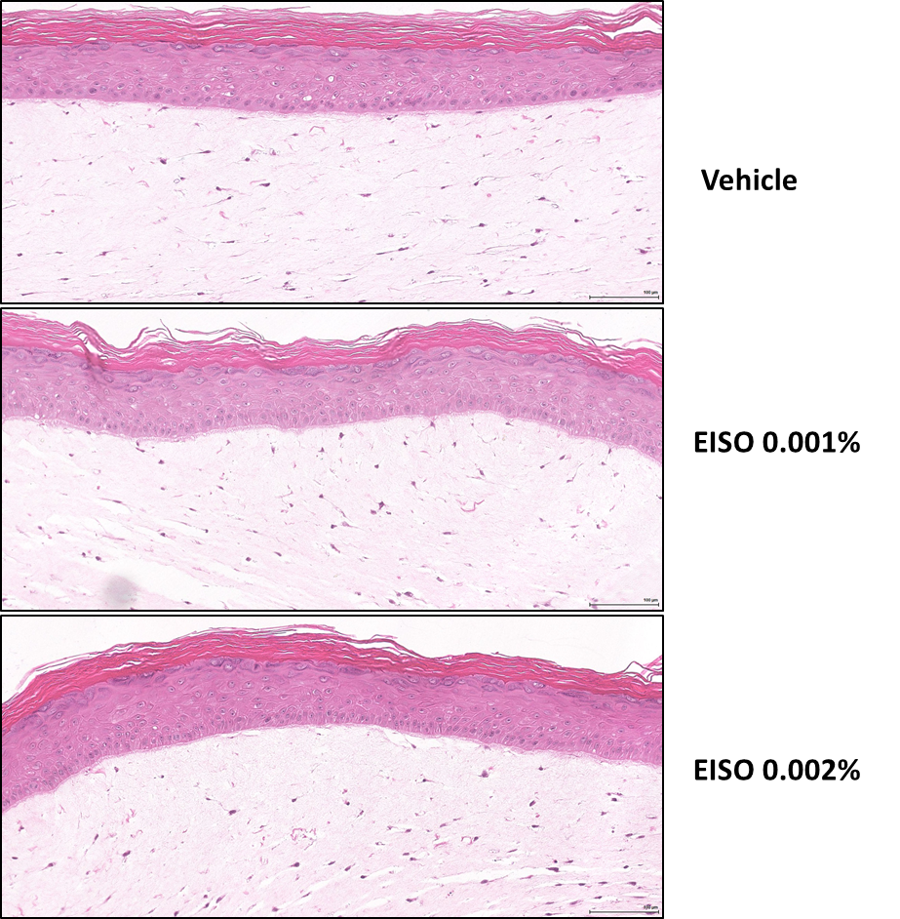
EISO Does Not Affect Normal Epidermal Tissue Morphology

Slide 10
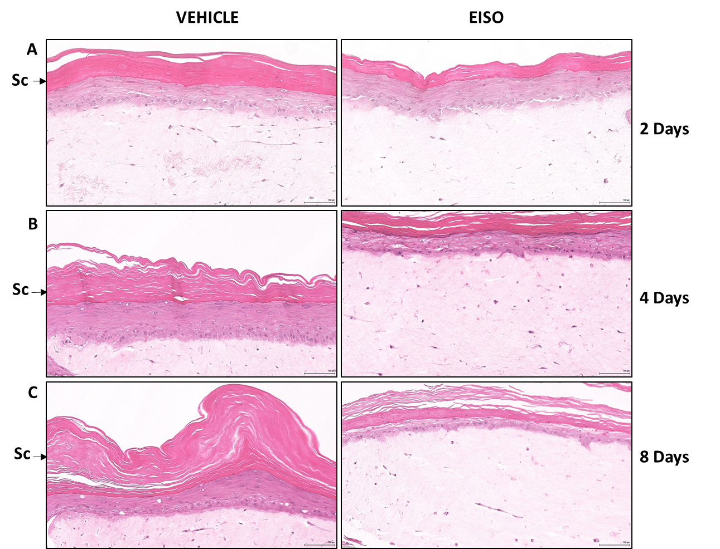
EISO Restores Normal Architecture of Psoriatic Tissue

Slide 11
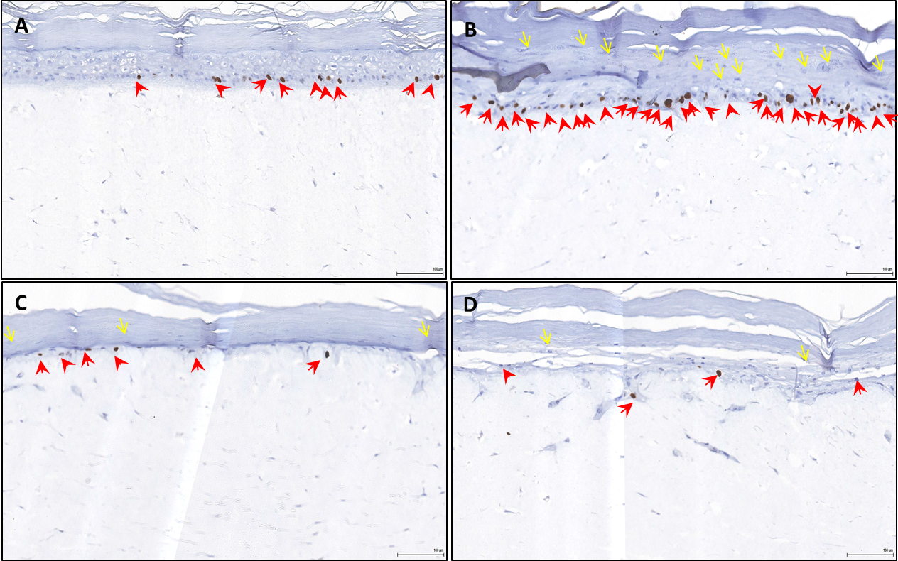
EISO Suppresses Hyperproliferation of Psoriatic Tissue
Normal, Control
Psoriasis, Control
Psoriasis, EISO 0.001%
Psoriasis, EISO 0.002%

Slide 12
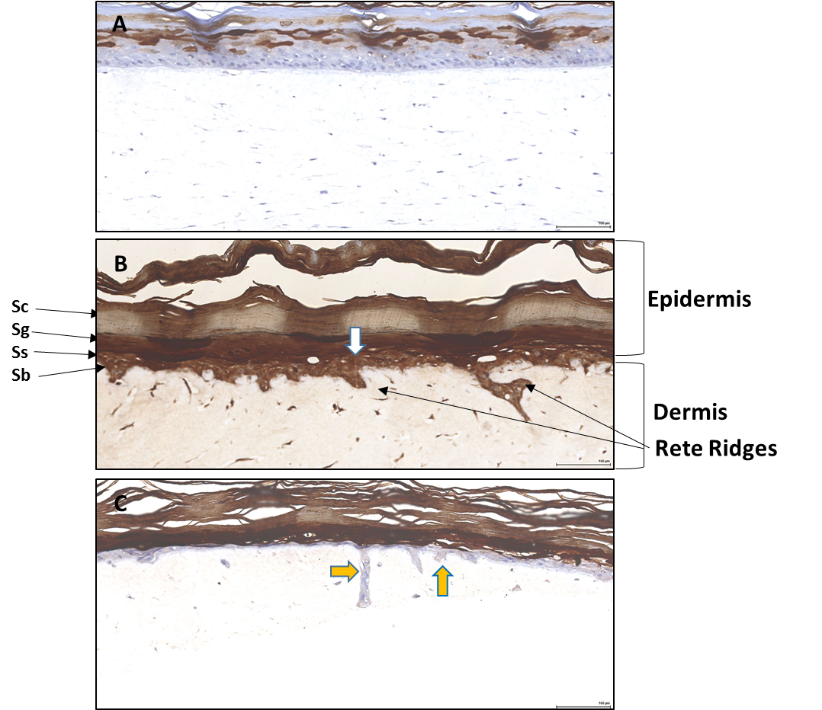
EISO Suppresses Psoriasin Expression Psoriatic Tissue
Normal, Control
Psoriasis, Control
Psoriasis, EISO 0.002%

Slide 13
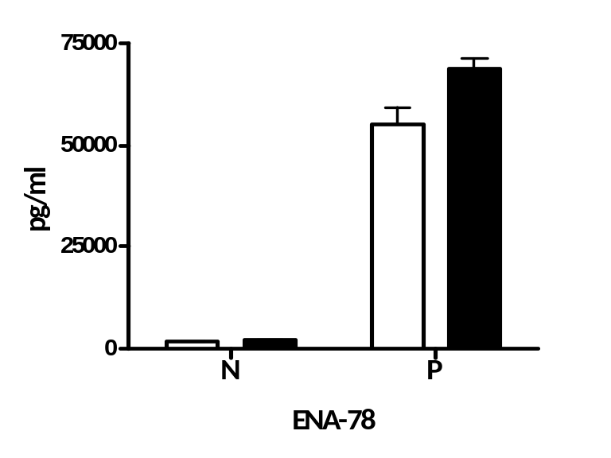
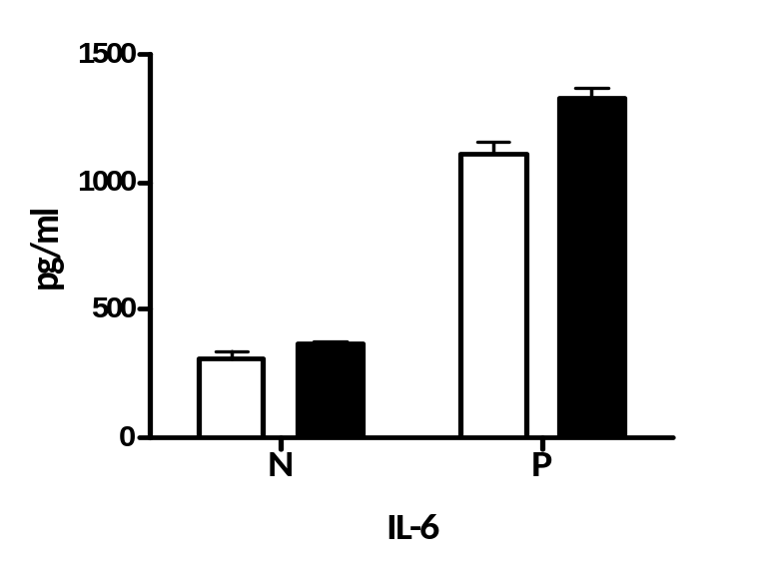
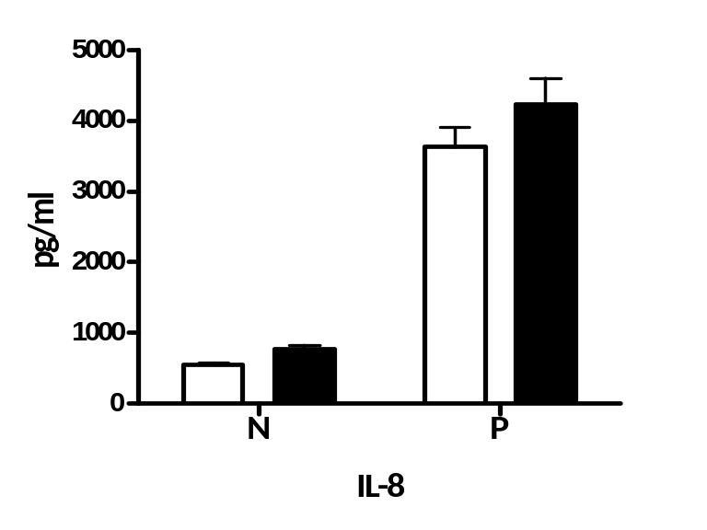
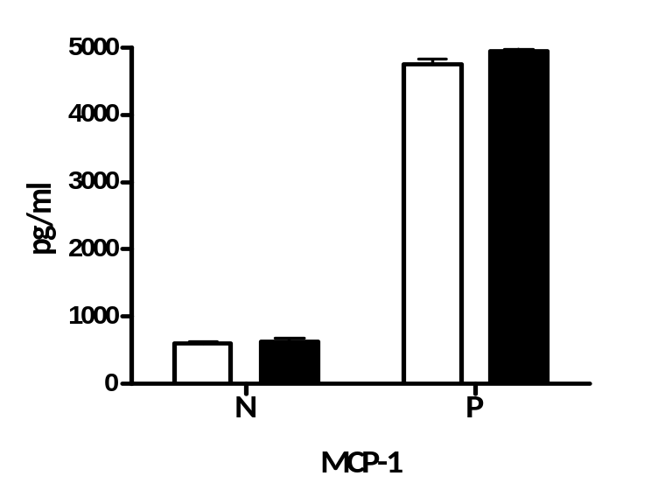

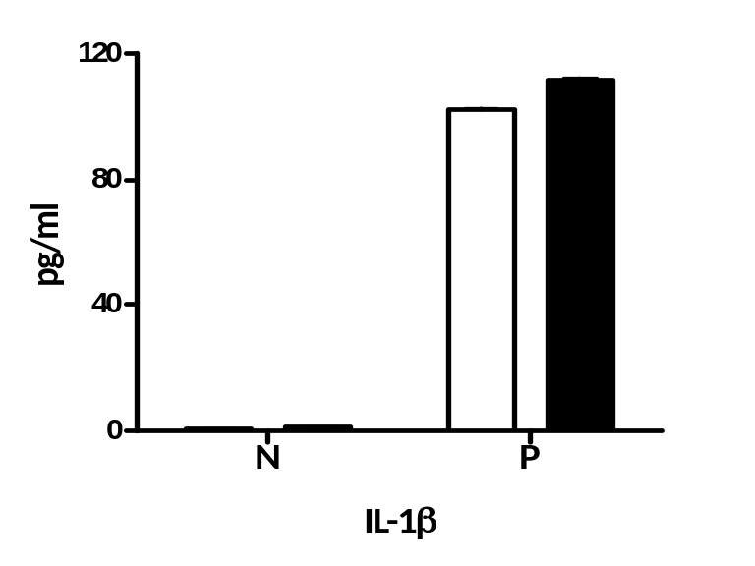
Cytokine/Chemokine Expression is Elevated in Psoriatic Tissue
ENA-78
IL-6
IL-8
1 day
2 day
MCP-1
GM-CSF
IL-1β

Slide 14
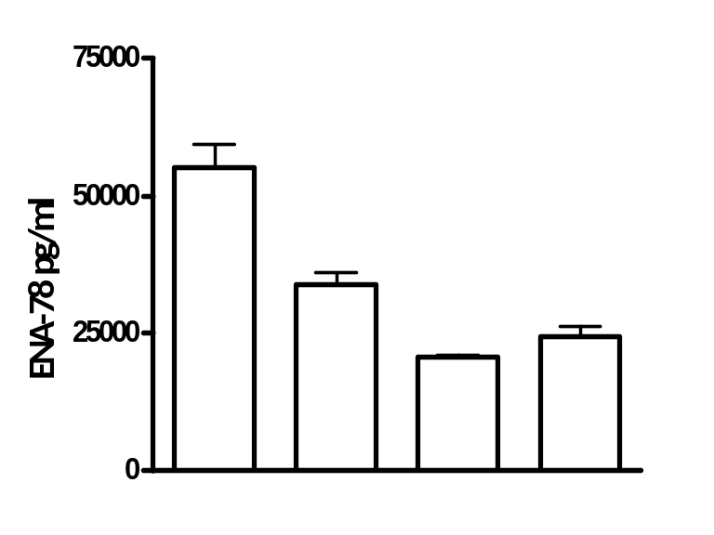
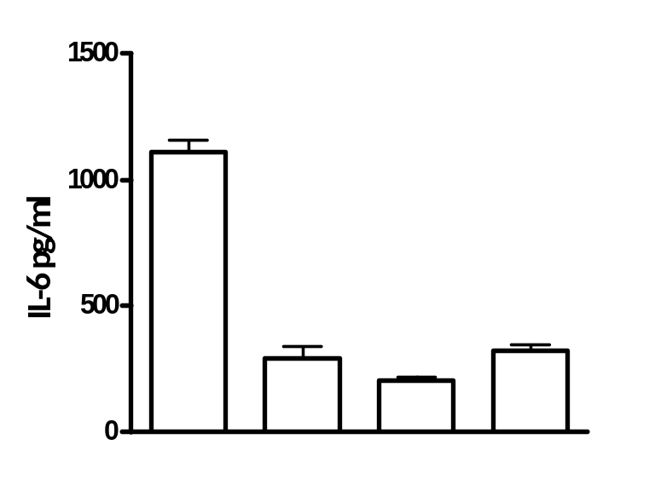
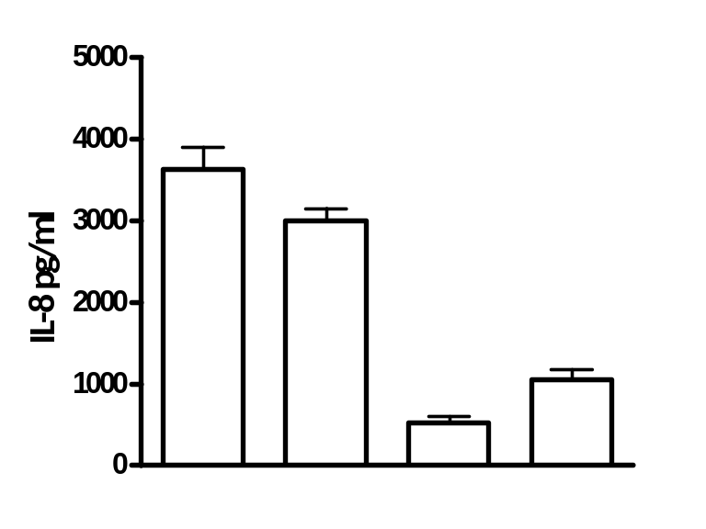
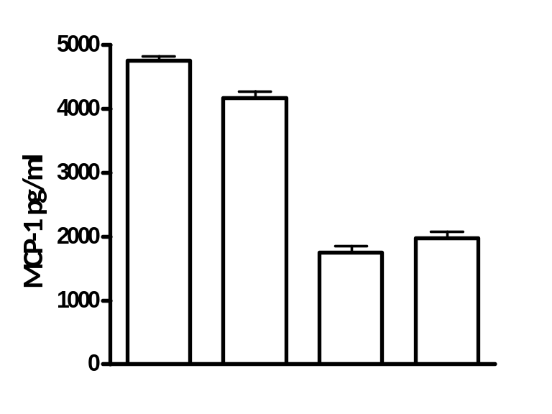
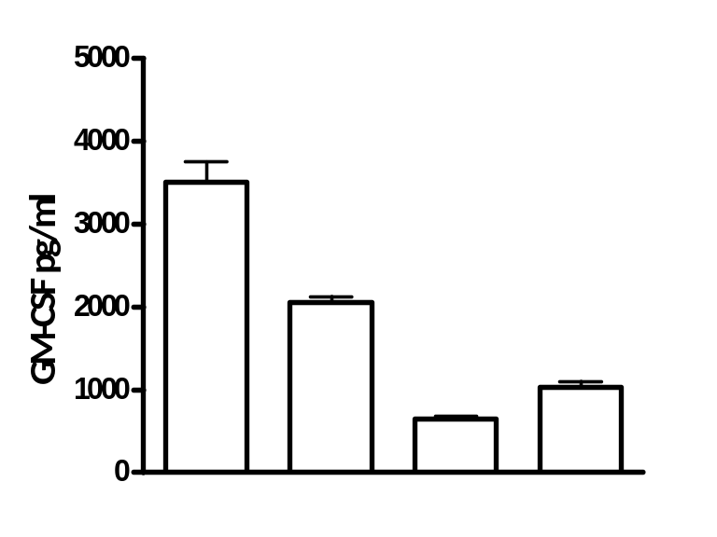
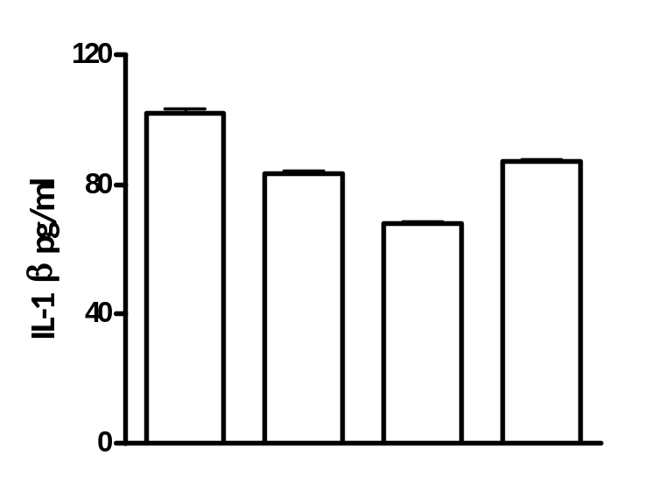
EISO Suppresses Cytokine/Chemokine Expression in Psoriatic Tissue
EISO (%) | 0 | 0 | 0.002 | 0
IB (µM) | 0 | 0 | 0 | 45
EISO (%) | 0 | 0 | 0.002 | 0
IB (µM) | 0 | 0 | 0 | 45
EISO (%) | 0 | 0 | 0.002 | 0
IB (µM) | 0 | 0 | 0 | 45

Slide 15
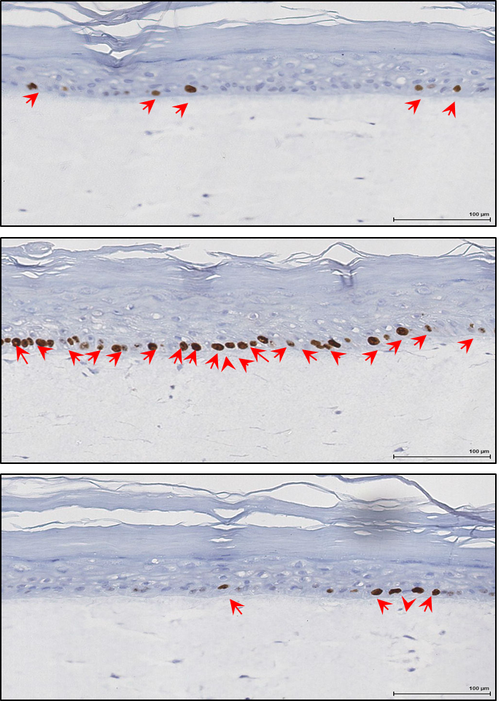
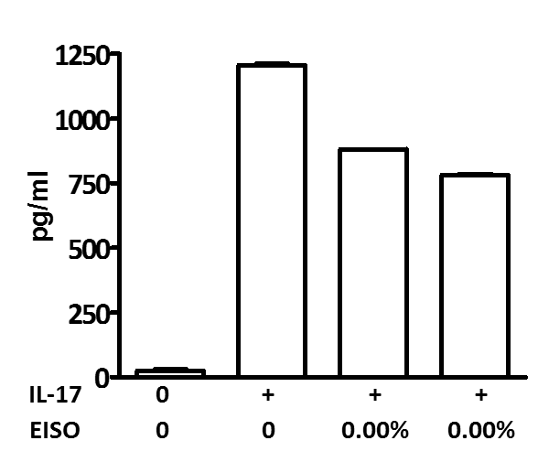
IL-17 Promotes, & EISO Suppresses Proliferation and MIP-3α Expression in Normal Tissue
MIP-3α
Control
IL-17
IL-17 + EISO

Slide 16
Conclusions
EISO administered topically, is well-tolerated and reduces psoriatic lesion severity
MatTek reconstituted organotypic epidermal and psoriasis tissue models morphology parallel normal and psoriatic skin
EISO treatment improves pathology of psoriatic model:
- epidermal stratification
- number, and size of, Rete ridges
- Ki67 and psoriasin expression
Proinflammatory cytokine/chemokine expression is elevated in psoriatic vs. normal epidermal models
EISO suppresses cytokine/chemokine levels in psoriatic model
IL-17 promotes proliferation and MIP-3α expression in normal epidermal tissue model
EISO suppresses proinflammatory response of normal epidermal tissue to IL-17
These clinical and supporting in vitro studies suggest that psoriatic lesion severity is improved due to anti-inflammatory properties of EISO

Slide 17

Acknowledgements
Vancouver Prostate Centre
Michael E Cox: Basic Research Director
Santalis Pharmaceuticals
Paul Castella : CEO
Corey Levenson : Chief scientific officer
Ian Clements : Chief operating officer
Fremantle Dermatology
Kurt Gebauer: Clinical Collaborator
Thank You !

