Slide 1
Newer α-acyl β-phenylpropanoic acid Derivative as PPAR-α Based Hypolipidemic Agent
Presented By:
Dr. Manish Sharma
School of Pharmaceutical Sciences
Bahra University-Shimla Hills
HP, India
Email: manishsharma@bahrauniversity.edu.in
smanishbits@gmail.com

Slide 2
Outline
Introduction
Experimental
Results and Discussion
References
Conclusion

Slide 3
Introduction
Peroxisome Proliferator–Activated Receptors (PPARs) are ligand-activated transcription factors which are members of the nuclear hormone receptor super family.
Three types: PPAR α, δ, and γ.
PPAR α is present in mitochondria, microsomes and peroxisomes in the liver.
PPAR α acts on transcription and the protein levels of critical enzymes in ω- oxidation and β- oxidation pathways.

Slide 4
Such enzymes include mitochondrial hydroxymethylglutaryl-CoA synthase, carnitine palmitoyl transferase I, cytochrome P450 (CYP 3A4) and acyl CoA oxidase.
PPAR α on activation increases liver fatty acid oxidation, whereas inactivation leads to increased accumulation of lipids in liver and increased plasma free fatty acid levels.

Slide 5
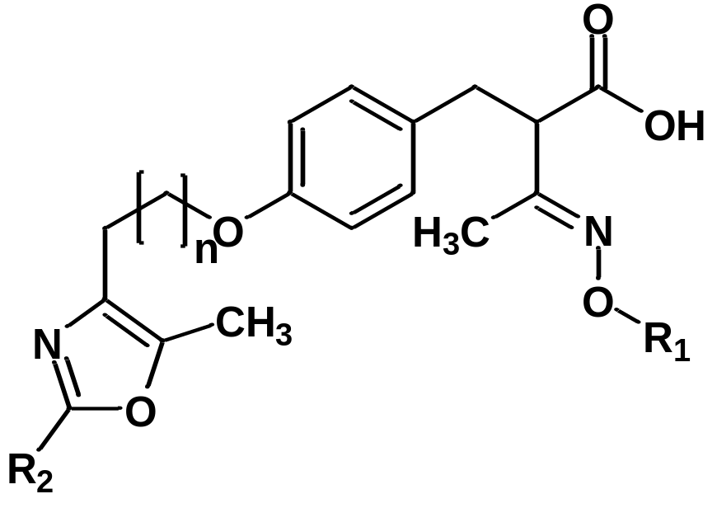
On the basis of previous comparative 2D-QSAR studies, molar refractivity value of 143 was found to be optimal for maximum agonistic activity.
New substitutions were proposed in oxime ethers of α-acyl-β-phenylpropanoic acid in this range and RM-KT-01 (MR=145) was proposed which also passes the Lipinski’s rule of 5 for drug likeness.

Slide 6
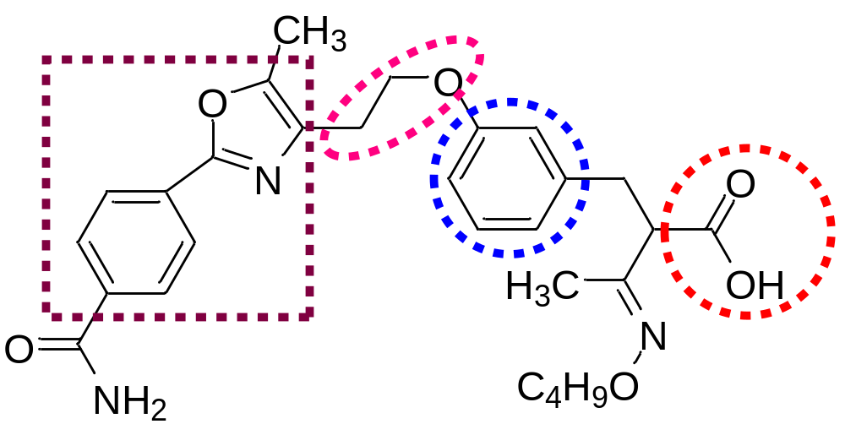
Structure of RM-KT-01
(E)-2-(3-(2-(2-(4-carbamoylphenyl)-5-methyloxazol-4-yl)ethoxy)benzyl)-3-(butoxyimino) butanoic acid
Structure of phenylpropanoic acid derivatives as PPAR α agonists comprises of four key regions- these are a carboxylic acid head group, a central phenyl ring, a linker and a lipophilic tail.

Slide 7
Experimental
1. Molecular Docking Simulations:
on propanoic acid derivatives using AutoGrid 4 and AutoDock 4 softwares.
Ligand Preparation:
2-D chemical structures in ChemDraw™ Ultra 8.0 and converted into 3D by Chem3D™ Ultra 8.0
Were geometrically minimized through MM2 method (default dynamics parameters and electrostatic charges assigned by Gastgeiger-Hückel method.
Were then utilized as starting conformation to perform molecular docking.

Slide 8
Receptor Preparation:
The X-ray crystal structure of PPAR α (PDB ID: 3ET1) was obtained from Brookhaven Protein Data Bank (http://www.rcsb.org/pdb).
Hydrogens were added and extra charges were diffused wherever necessary.
Grid Box Formation:
Binding pocket in receptor was defined by a grid box (no. of grid points: 42x, 48y, 40z; spacing: 0.375; grid center: 6.86x, 32.614y, -7.929z).
All extended conformations of ligand fit in the box.

Slide 10
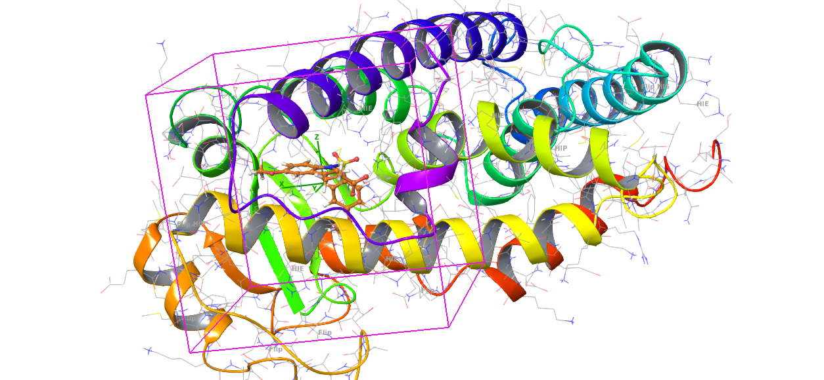
Chain A of PPAR α Receptor PDB:ID 3ET1

Slide 11
Docking Method Validation:
By redocking the crystallized ET1 (3-[5-methoxy-1-(4-methoxy-benzenesulfonyl)-1H-indol-3-yl]-propanoic acid) and overlaying the docked and crystallized ET1 to calculate rms.
Grid Maps Preparation:
Autogrid 4 was run to prepare map files for different atom types in ligands and receptor viz. A, C, OA, N, NA, SA. These map files are in turn taken up by AutoDock for carrying docking simulations.

Slide 12
Docking Parameters:
Primary approach for conformational searching in AutoDock is a Lamarckian genetic algorithm (LGA).
Result Analysis of Docking Simulation:
By evaluating hydrophobic and polar interactions between ligand and receptor active site residues.
Calculation of binding energy (empirical range -5 to -15 kcal/mol).
Calculation of rms between crystallized and docked ET1.

Slide 13
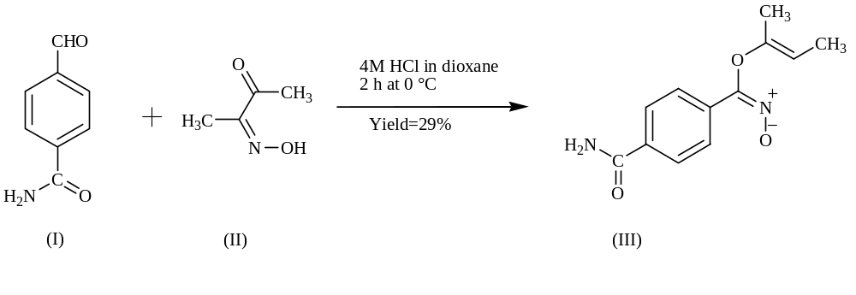
2 SCHEME
Step-1
4-Formyl benzamide (I)
Butane-2,3-dione monooxime (II)
Oxazole N-oxide (III)
FTIR (cm⁻¹) : 1151 (C-O-C Asymmetric Stretch)

Slide 14
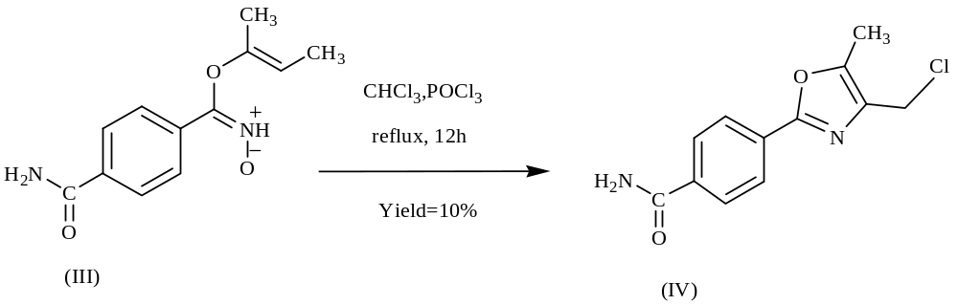
Step 2
Oxazole N-oxide (III)
FTIR- 770.4 (C-Cl Stretch )
(cm⁻¹)
FTIR (cm⁻¹) : 1151 (C-O-C Asymmetric Stretch)

Slide 15
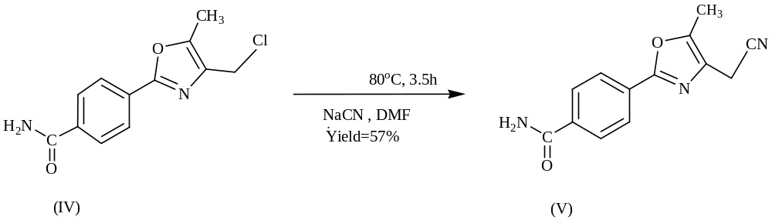
Step 3
FTIR- 770.4 (C-Cl Stretch )
(cm⁻¹)
FTIR- 2240.3 (CN Stretch of nitrile)
(cm⁻¹)
¹HNMR- δ 7.98 (dd, 2H Ar, J_{o} = 8.2 Hz, J_{m} = 2.36 Hz)
(ppm) δ 7.97 (dd, 2H Ar, J_{o} = 8.12 Hz, J_{m} = 2.34 Hz)
δ 6.17 (s,2H), δ 3.67 (s,2H), δ 2.43 (s,3H).

Slide 16
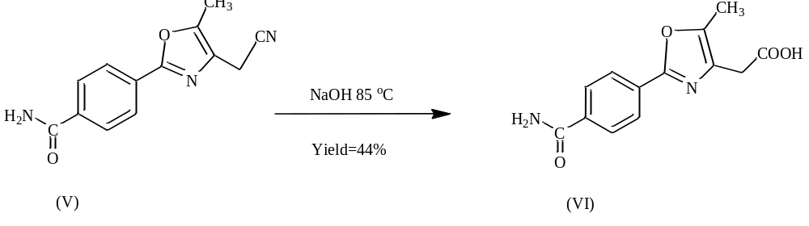
Step 4
FTIR- 2240.3 (CN Stretch of nitrile)
(cm⁻¹)
¹HNMR- δ 7.98 (dd, 2H Ar, J_{o} = 8.2 Hz, J_{m} = 2.36 Hz)
(ppm) δ7.97 (dd, 2H Ar, J_{o} = 8.12 Hz, J_{m} = 2.34 Hz)
δ 6.17 (s,2H), δ 3.67 (s,2H), δ 2.43 (s,3H).
¹HNMR- δ 11.59 (s, 1H , COOH
(ppm)

Slide 17
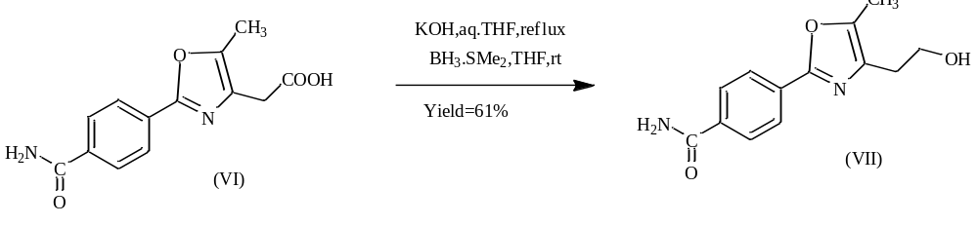
Step 5
¹HNMR- δ 11.59 (s, 1H , COOH)
(ppm)
¹HNMR- δ 2.14 (s, 1H , OH)
(ppm)

Slide 18
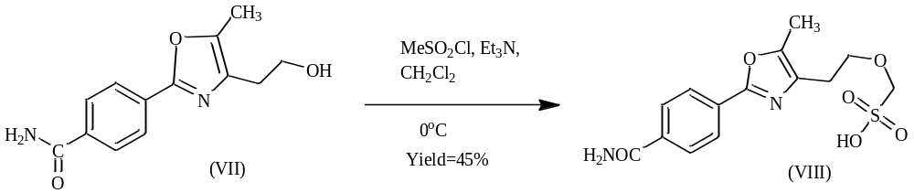
Step 6
Mesylate (VIII)
FTIR- 1340.3 (Asymmetric Stretch of S=O)
(cm⁻¹) 1151.6 (Symmetric Stretch of S=O)
654.8 ( S-O Stretch of sulfonic acid)
¹HNMR- δ 11.80 (s, 1H, COOH)
(ppm)
¹HNMR- δ 2.14 (s, 1H , OH)
(ppm)

Slide 19
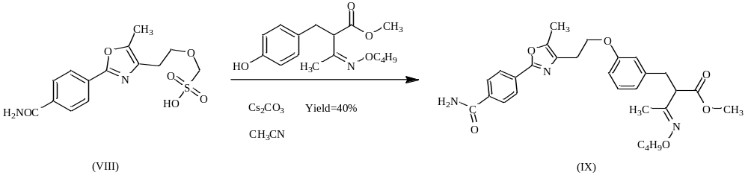
Step 7
Ester (IX)
FTIR- 1340.3 (Asymmetric Stretch of S=O)
(cm⁻¹) 1151.6 (Symmetric Stretch of S=O)
654.8 ( S-O Stretch of sulfonic acid)
¹HNMR- δ 11.80 (s, 1H, COOH)
(ppm)
FTIR- 1257.4 (Asymmetric Stretch of Ar-O-R)
(cm⁻¹) 1022.5(Symmetric Stretch of Ar-O-R)

Slide 20
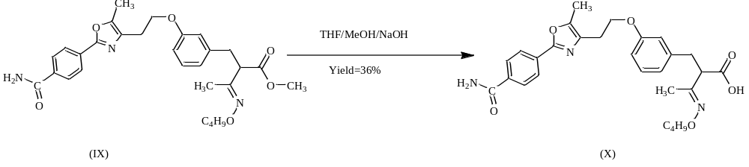
Step 8
FTIR- 1257.4 (Asymmetric Stretch of Ar-O-R)
(cm⁻¹) 1022.5(Symmetric Stretch of Ar-O-R)
FTIR- 1690.1 (C=O Stretch of acid)
(cm⁻¹) 1218.4 (C-O Stretch of acid)
¹HNMR- δ 11.10 (s, 1H, COOH)
(ppm)

Slide 21
3. In vitro PPAR-α transactivation assay:
The in vitro transactivation assay was determined spectrophotometrically in a 24 well plate in ELISA reader.
Cell culture: HepG2 cells (ATCC, USA) were maintained in growth medium composed of MEM (Sigma) supplemented with 10% FBS (Hyclone), 1 × MEM non essential amino acid (Sigma) and 1 mM sodium pyruvate and 1% penicillin/streptomycin (Sigma).

Slide 22
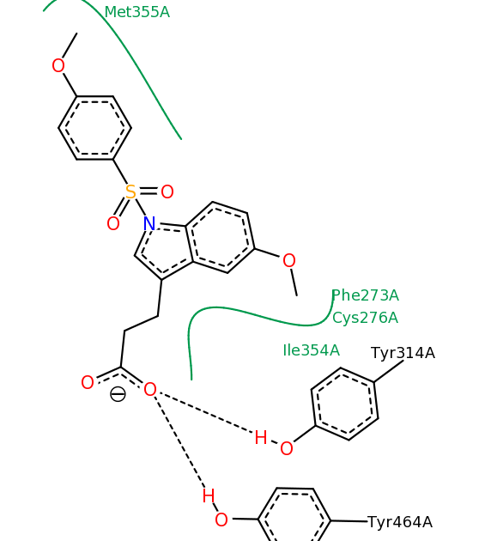
2-D picture of binding interactions of propanoic acid derivative ET1 with residues of PPAR α receptor PDB ID 3ET1.
Results and Discussion

Slide 23
1. Controlled docking of reference ligand on macromolecule.
Binding energy of proposed molecules was within the empirical range of –5 to –15 kcal/mol.
A low rms value of 0.51 between crystallized and docked ET1.

Slide 24
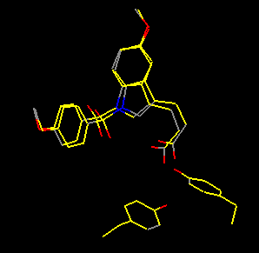
Overlay of crystal and docked bioactive conformations of propanoic acid derivative ET1 with rms value 0.51

Slide 25
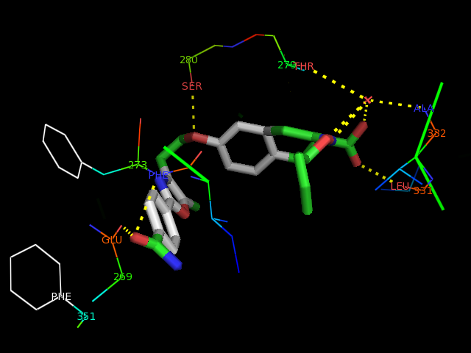
Bioactive conformation of RM-KT-01 with interactions (dotted lines) to residues of PPAR α site.

Slide 26
Molecular docking results for some PPAR α receptor agonists.
C. N. | Obs. K_{i} (µM) | Pred. K_{i} (µM) | Binding energy (kcal/mole) | Residues involved in molecular interactions | Hydrophobic Pocket
Propanoic acid derivative (ET1) | 1.0 | 1.17 | -8.09 | SER280, CYS276, TYR314, TYR464 | PHE273, ILE354, MET355
AZ242 | 1 | 16.57 | -6.52 | ILE317, PHE273 | PHE273
GW735 | 0.02 | 0.693 | -8.4 | SER280, HIS440, TYR464, THR279 | PHE273, PHE351
Gemfibrozil | 230 | 44.28 | -5.94 | SER280 | PHE273, PHE351
Clofibrate | 700 | 46.08 | -5.92 | PHE273, GLN277 | PHE273
Benzafibrate | 1000 | 99.26 | -5.46 | SER280, PHE351, CYS276 | PHE273
RM-KT-01 | NA | 0.20 | -9.15 | SER280, GLU269, LEU331, VAL332, THR279 | PHE273

Slide 27
2. PASS (Prediction of Activity Spectra for Substances)
RM-KT-01 molecule did not show any undesirable effects like carcinogenicity, mutagenicity, embryotoxicity and teratogenicity when passed through PASS.

Slide 28
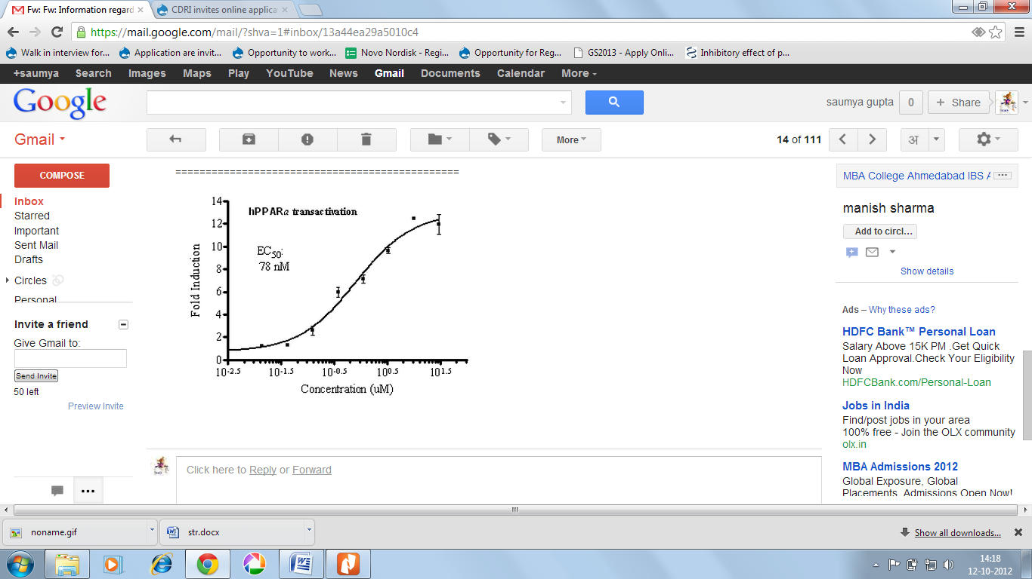
3. In vitro PPAR α transactivation assay
The synthesized compound RM-KT-01 was screened for human PPAR (hPPAR) α agonistic activity on full length PPAR α receptor transfected in HepG2 cells. PPAR α agonistic activity calculated as EC₅₀ was 78 nM.

Slide 29
The in vitro activity suggests relevancy of presence of phenyl carboxamide group at one end and n-butyl group attached with phenylpropanoic acid chain of oxime ether of α-acyl-β phenylpropanoic acid.
The result of in vitro transactivation assay also suggests that RM-KT-01 is PPAR α selective and shows no activity on PPAR γ and PPAR δ.

Slide 30
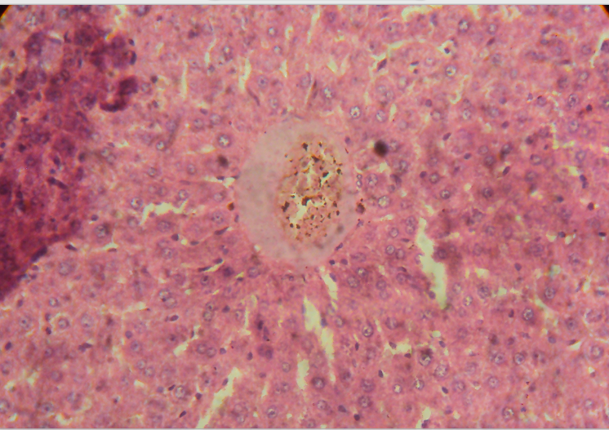
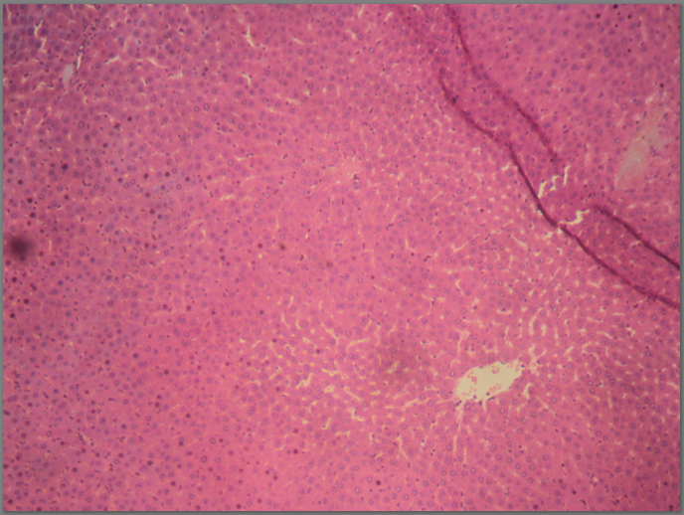
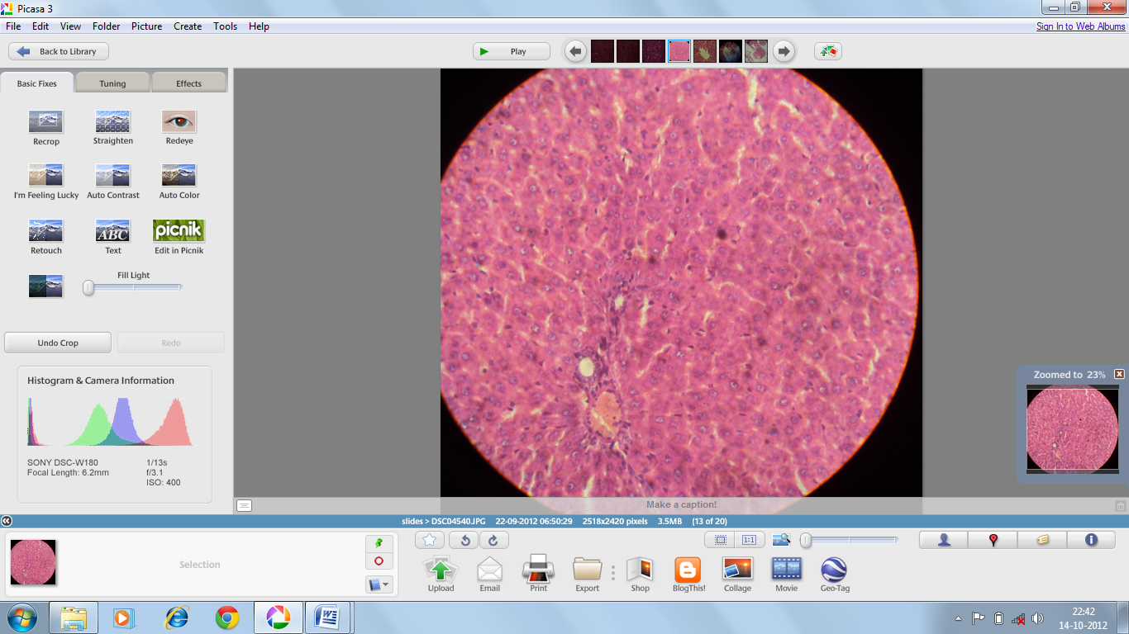
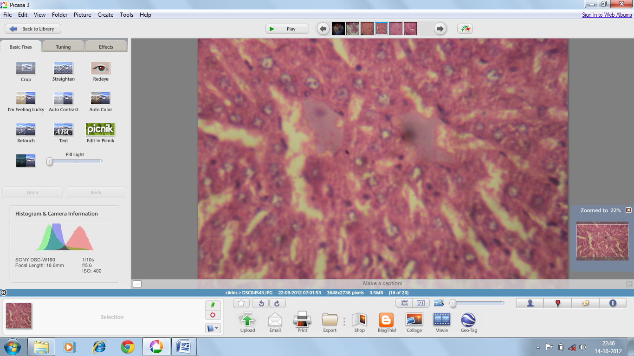
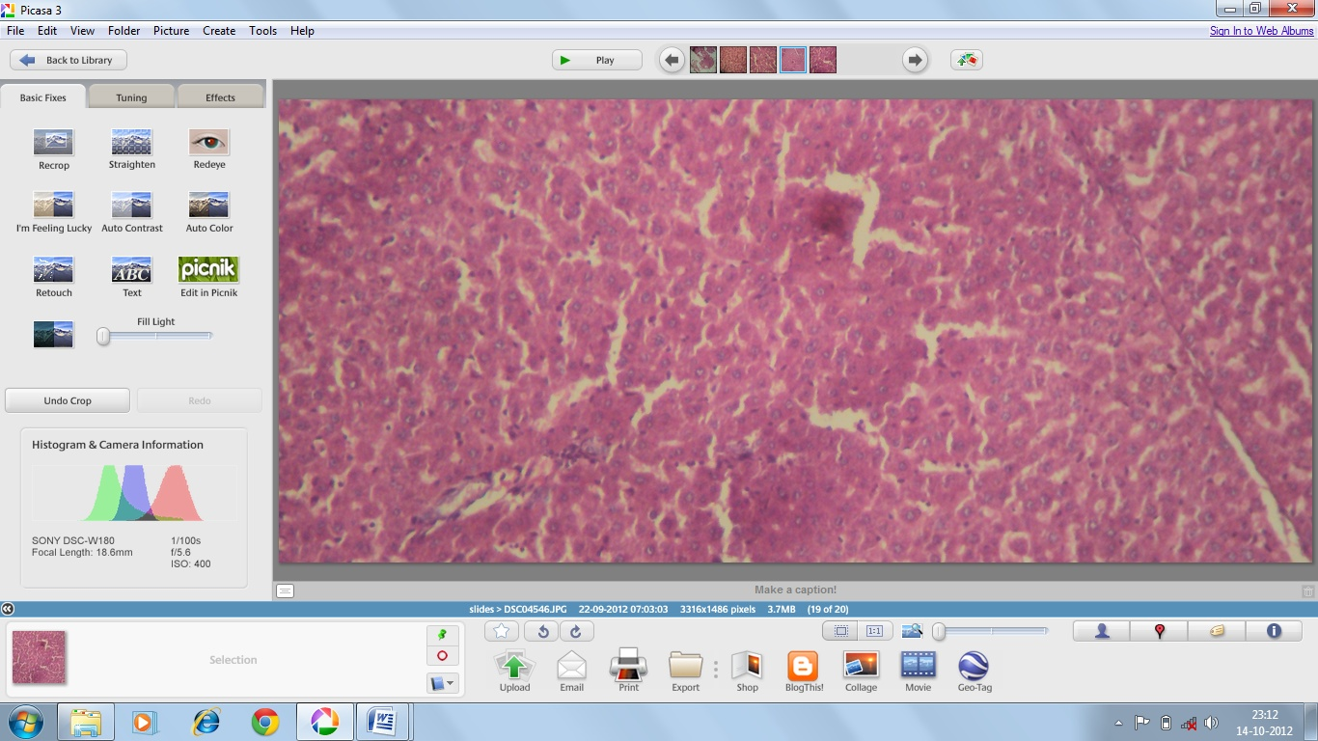
4. Histopathology
A
B
C
Group I (A) shows a
normal liver from control group
Group II (B) shows inflammation and cytoplasmic vacuolization (arrows) caused by alloxan
Group III (C) treated with alloxan and standard drug glibenclamide (5 mg/kg) shows ground glass appearance (arrow) and thus shows signs of recovery
D
E
Group V (E) treated with test drug (10 mg/kg) shows sign of partial improvement by showing binucleated cells and ground glass appearance.
Group IV (D) treated with test drug (5 mg/kg)
Evaluation of rat liver after alloxan administration and treatment with respective drugs.
Notes:
Additionally histopathology of treated rats liver was done as density of PPAR α is most in rat liver (Escher P et al., 2001). Figure no. Shows a clear demarcation between control (A) and alloxan treated liver (B) as alloxan treated liver shows marked inflammation and vacuolization. This inflammation ( Cindoruk M et al., 2007) and vacuolization are signs of cell injury. They occurred due to increased permeability of cell membranes leading to an increase of intercellular water. As water sufficiently accumulates within the cell, it produces cytoplasmic vacuolization. (Hussein WF et al., 2011)

Slide 31
Conclusion
A mechanistic molecular docking model for prediction of derivatives of lead molecule “oxime ether of α-acyl-β phenylpropanoic acid” is proposed.
Structural modification in the lead molecule for a newer derivative RM-KT-01 accounts for good in vitro PPARα agonistic activity with better in vitro liver safety profile and lacks virtually predicted toxicity.
Further in vivo studies for RM-KT-01 is suggested for establishment of RM-KT-01 as a potent hypolipidemic.

Slide 32
References
1. Guan, Y. Peroxisome proliferator – activated receptor family and its relationship to renal complications of the metabolic syndrome. J. Am. Soc. Nephrol., 2004, 15, 2801-2815.
2. Tripathi, R.B.; Sharma, M. Understanding allosteric modulation in PPARγ receptors by comparative QSAR analysis. Der. Pharma. Chemica., 2010, 2(2), 303-311.
3. Fiévet, C.; Fruchart, J.C.; Staels B. PPARα and PPARγ dual agonists for the treatment of type 2 diabetes and the metabolic syndrome. Curr. Opin. Pharm., 2006, 6(6), 606-614.
4. Henry J.R., Li Y., Scheryantz J.M. and Warshawsky A.M. Heterocyclic compounds as modulators of peroxisome proliferator activated receptors, useful for the treatment and/or prevention of disorders modulated by a ppar. US Patent 20080207685, August 08, 2008.
5. Makadia, P., Shah, S.R.; Pingali, H.K.; Zaware, P.; Patel, D.; Pola, S.; Thube, B.; Priyadarshini, P.; Suthar, D.; Shah, M.; Giri. S.; Trivedi, C.; Jain, M.; Patel, P.; Bahekar, R. Effect of structurally constrained oxime-ether linker on PPAR subtype selectivity: Discovery of a novel and potent series of PPAR-pan agonists. Bioorg. Med. Chem., 2011, 19, 771-782.
6. Oon Han H., Kim S.H., Kim K.H., Hur G.C., Joo Yim H., Chung H.K., Ho Woo S., Dong Koo K., Lee C.S., Sung Koh J., Kim G.T., Design and synthesis of oxime ethers of alpha-acyl-beta-phenylpropanoic acids as PPAR dual agonists., Bioorg Med Chem Lett. , 2007,17(4), 937-41
7. Cronet, P.; Petersen, J.F.; Folmer, R.; Blomberg, N.; Sjoblom, K.; Karlsson, U.; Lindstedt, E.L.; Bamberg, K.. Structure of the PPAR alpha and gamma ligand binding domain in complex with AZ 242; ligand selectivity and agonist activation in the PPAR family. Structure, 2001, 9, 699-706.
8. Filimonov DA, Poroikov VV, Karaicheva EI. Computer Aided Prediction of Biological Activity Spectra of Chemical Substances on the Basis of Their Structural Formulae: Computerized System PASS. Experimental & Clinical Pharmacology (Rus), 1995, 58,56-62.
9. Binggeli A., Boehringer M., Grether U, Hilpert H., Maerki H.P., Meyer M., Mohr P., Ricklin F. Carboxylic acid substituted oxazole derivatives for use as ppar-alpha and -gamma activators in the treatment of diabetes. US Patent WO 2002092084 A1, November 21, 2002.

Slide 33



Acknowledgements
Dr. Rajesh Bahekar- GM, Medicinal Chemistry,
Zydus Cadila, India for in vitro analysis.
Dr. Harsh Mishra, MD,MBBS, India for pathological examinations.
Dr. Ruchi Malik, Asst. Prof., Dept. of Pharmacy, CURAJ, India
for her critical suggestions in organic synthesis.
Mr. Kamlesh Thakur, Mr. Ritesh Mathure, Ms. Monika Shringi and Ms. Saumya Gupta for their experimental assistance.

Slide 34
Thank You

