Slide 1


Prevalence of otological disorders in diabetic patients with hearing loss
Manche Santoshi Kumari†*, Jangala Madhavi†*, Koralla Raja Meganadh*, Akka Jyothy†
†Institute of Genetics and Hospital for Genetic Diseases, OU, Telangana State, India
*MAA Research Foundation, Hyderabad, Telangana State, India

Slide 2
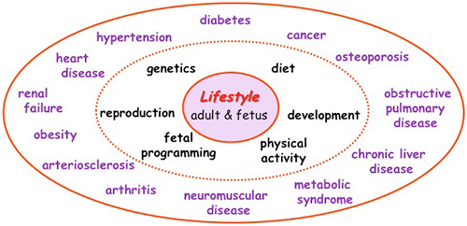
Diabetes mellitus
Prevalence all over the globe is increasing at an alarming rate.
India is the ʽʽDiabetes capital of the world”.
Increased propensity for developing a broad spectrum of irreversible complications.

Slide 3
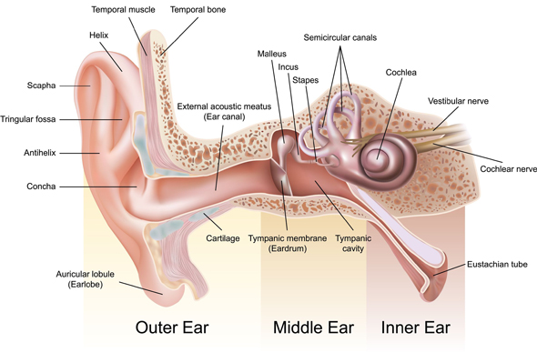
Diabetes with hearing loss
Alterations in glucose levels affect nearly every organ system in the body.
Affects the auditory system - leads to the onset of hearing loss.
Prevalence of hearing loss in diabetic patients is increasing (Mitchell et al., 2009).
Adapted from http://www.audiologyspecialists.com/anatomy-of-the-ear

Slide 4
Otological disorders
Diseases of Ear
External Ear
Cerumen impaction
Congenital ear anamolies
Otitis externa
Otomycosis
Referred otalgia
Middle Ear
Acute suppurative otitis media
Chronic suppurative otitis media
Otitis media with effusion
Otosclerosis
Inner Ear
Cervical vertigo
Congential hearing loss
Meniereʹs disease
Presbycusis
Sudden sensorineural hearing loss
Traumatic lesions
Ototoxicity

Slide 5
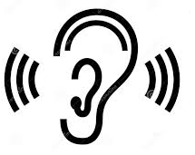
Sound transmission pathway
External ear
Pinna
Sound
Auditory canal
Middle ear
Tympanic membrane
Mechanical energy
Ossicles
Oval window
Inner ear
Cochlea
Hair cells
Electrochemical energy
Auditory nerve
Brain
Adapted from http://hsc.csu.edu.au/biology/options/communication/2954/CommPart6.html

Slide 6
Pathological changes caused by diabetes in the auditory system
Structures of the cochlea
Auditory nerve
Blood supply to cochlea
Central auditory processing
Microvascular and neuropathic Nerve damage associated with
changes in the cochlea auditory system

Slide 7
Hearing impairment
Hearing impairment is a common sensory disability to comprehend sound in auditory pathway of one or both ears.
Patterns of hearing loss:
Conductive (outer and/or middle ear)
Sensorineural (inner ear)
Mixed (outer/ middle/inner ear)
Central (brain stem lesions)

Slide 8
Degree of hearing loss
Degree of hearing loss | Hearing loss range(dB HL)
Normal | -10 to 15
Minimal | 16 to 25
Mild | 26 to 40
Moderate | 41 to 55
Moderately severe | 56 to 70
Severe | 71 to 90
Profound | 91+
Source: Clark, J. G. (1981). Uses and abuses of hearing loss classification. Asha, 23, 493–500.

Slide 9
Importance of the study
Hearing loss and diabetes (DM2) are significant health issues in the elderly population.
Studies on hearing loss in diabetes have not received attention in South Indian population.
For determining the magnitude and onset of hearing loss in diabetic population of South India.

Slide 10
Objectives
To determine the demographic and otological parameters in diabetic subjects affected with hearing loss.
To investigate the prevalence of otological diseases and hearing loss patterns in adults suffering from diabetes in South Indian population.

Slide 11
Subjects
174 diabetic cases affected with hearing loss and 420 non-diabetic constituted the study subjects
MAA ENT Hospitals, Hyderabad, Telangana State, India
Age >=40 years were included in the study.
Confirmatory diagnosis was done by the general physician and ENT specialist.
Otological examinations were carried out to diagnose the disorders.
Hearing loss was evaluated using pure tone audiometry and average for the frequencies at 0.5,1,2,4 and 8 kHz was recorded.

Slide 12
Statistical Analysis
The data obtained was coded for statistical evaluations.
Analysis was performed using the Statistical Package for Social Sciences PASW STATISTICS 18.0 software (SPSS Inc., Chicago, IL, USA).
Continuous data is represented as means and standard deviations.
Categorical data as proportions and percentages for illustrations.
Chi-square test and binary logistic regression analysis was used for evaluating the association of various parameters.

Slide 13
Table 1. Distribution of gender, age and otological parameters in diabetic and non diabetic study subjects
Parameters | Diabetic (n=174) | Non-diabetic(n=420) | OR(95% CI)††
Gender
Female | 60(34.5) | 182(43.3) | 1.00(Reference)
Male | 114(65.5) | 238 (56.7) | 1.45(1.03-2.04)*
Age(years)† | 58.3±11.36 | 55.5±11.47 | NC
Age of onset(years)† | 56.2±11.31 | 54.4±10.62 | NC
40-60 | 108(62.1) | 307 (73.0) | 1.00(Reference)
>60 | 66(37.9) | 113(26.9) | 1.65(1.17-2.32)**
Laterality
Unilateral | 62(35.6) | 191(45.5) | 1.00(Reference)
Bilateral | 112(64.4) | 229(54.5) | 1.51(1.07-2.11)*
Mean PTA(dBHL) | 50.5±17.34 | 49.4±17.54 | NC
<40dB | 71(40.8) | 167(39.7) | 1.00(Reference)
>40dB | 103(59.2) | 253(60.3) | 0.95(0.68-1.33)
Associated symptoms
Tinnitus | 56(32.2) | 161(36.0) | 0.83(0.59-1.17)
Vertigo | 24(13.8) | 69(15.3) | 0.97(0.60-1.56)
a.† -Independent sample t test(mean ± standard deviation);
b. Values in paranthesis are percent frequency; NC-Not calculated.
c. †† - Chi-square test

Slide 14
Table 2. Association of gender and otological parameters with age of onset in diabetic subjects affected with hearing loss
Parameters | Total | 40-60 years |  | >60 years | P-value | OR(95% CI)
Gender†
Male | 114(65.5) | 59(51.8) | 55(48.2) |  | 0.036 | 1.00(Reference)
Female | 60(34.5) | 41(68.3) | 19(31.7) |  |  | 0.49(0.26-0.96)*
Laterality†
Unilateral | 2(35.6) | 43(44.3) | 19(24.7) |  | 0.007 | 1.00(Reference)
Bilateral | 112(64.4) | 54(55.7) | 58(75.3) |  |  | 2.43(1.26-4.67)**
Degree of hearing loss(Decibels-dB)†
<40 dB | 26(14.9) | 10(13.0) | 16(61.5) |  | 0.519 | 1.00(Reference)
>40dB | 148(85.1) | 67(87.0) | 81(83.5) |  |  | 1.32(0.56-3.11)
Types of hearing loss††
Conductive hearing loss | 77(44.3) | 24(31.2) | 53(54.6) |  | <0.001 | 1.00(Reference)
Sensorineural hearing loss | 67(38.5) | 23(23.7) | 44(57.1) |  |  | 4.23(2.10-8.48)***
Mixed hearing loss | 30(17.2) | 9(11.7) | 21(21.6) |  |  | 0.95(0.38-2.37)
a. Values in paranthesis are percent frequency
b.†-Chi-square test, ,††-binary logistic regression analysis
Table 2. Association of otological parameters with age of onset in subjects with diabetes
Table 2. Association of otological parameters with age of onset in subjects with diabetes

Slide 15
Figure 1. Prevalence of otological disorders in diabetic and non diabetic study subjects

Slide 16
Figure 2. Distribution of otological diseases at different age groups in diabetic and non diabetic study subjects

Slide 17
Figure 3. Prevalence of otological diseases in the study subjects with laterality in diabetic and non diabetic study subjects
Unilateral Bilateral

Slide 18
Figure 4. Distribution of hearing loss patterns in otological diseases of diabetic and non diabetic study subjects
Conductive hearing loss Sensorineural hearing loss Mixed hearing loss

Slide 19
Figure 5. Prevalence of hearing loss at lower(<40dB) and higher frequency (>40dB) in otological diseases of diabetic and non diabetic study subjects

Slide 20
Results
Male preponderance(1.9) was observed.
Prevalence of hearing loss was more in subjects >60 years of age (55.7%).
Prevalence of bilateral hearing loss was more in diabetic subjects.
85.1% of study subjects showed hearing loss at higher frequency (>40 dBHL).
Hearing loss was more prevalent in presbycusis (61.3%) and acute suppurative otitis media (27%)among diabetic cases.
32.2% of the diabetic subjects showed tinnitus.
44.3% of the diabetic subjects showed conductive type followed

Slide 21
by 38.5 % of sensorineural and 17.2% of mixed hearing loss.
Association of hearing loss with age of onset of diabetes
Bilateral form of hearing loss was observed to be more in subjects >60 years of age group.
Sensorineural hearing loss was significantly associated with increase in age.
Otological disorders
Prevalence of presbycusis was predominant at higher age group.
Bilateral form of hearing loss was noticed in Meniere’s disease and presbycusis.
Otitis media, otosclerosis and sudden sensorineural form of hearing loss showed unilaterality.

Slide 22
Sensorineural form of hearing loss was noticed to be high in Meniere’s disease, OME and otosclerosis.
Conductive hearing loss was noticed more in ASOM.
Presbycusis, CSOM and OME were observed to have hearing loss at >40dBHL.
Hearing loss at lower frequency (<40dBHL) was noticed at ASOM, otosclerosis and Meniere’s disease.

Slide 23
Conclusion
Presbycusis and otitis media were the predominant otological disorders found in diabetes patients with hearing loss.
Sensorineural form of hearing loss was found to significantly associated with the elderly age group (>60 years).
Conductive form of hearing loss was more prevalent in subjects suffering from ASOM.
Sensorineural form of hearing loss was high in Meniere’s disease, OME and otosclerosis.
Hearing disability (>40dB) was more in otological disorders of otosclerosis, Meniere’s disease and presbycusis
ASOM and sudden sensorineural hearing loss showed prevalence even at lower decibel range(<40dB).

Slide 24
Significance of the study
The study helped to establish the prevalence otological disorders to be more prevalent in diabetic subjects is caused by the dysfunction of middle and inner ear.
Diabetes is associated with hearing disorders in above 60 years age group than between 40-60 years.
Effective control of diabetes is to be considered to reduce the incidence of deafness in above 60 years.

Slide 25
Acknowledgement
I would like to thank MAA Research foundation for the funding and Ms. B. Sunita G Kumar, CMD, MAA ENT Hospitals for her support and cooperation in carrying out the work.
I would also thank J.V. Ramakrishna, D. Dinesh Babu and P. Padmavathi in providing valuable support in carrying out the work.

Slide 26
References
Kakarlapudi V, Sawyer R, Staecker H. The effect of diabetes on sensorineural hearing loss. Otol Neurotol. 2003 May;24(3):382-6. Review. PubMed PMID: 12806288.
Hong O, Buss J, Thomas E. Type 2 diabetes and hearing loss. Dis Mon 2013; 59: 139-46.
Mitchell P, Gopinath B, McMahon CM, Rochtchina E, Wang JJ, Boyages SC, et al. Relationship of Type 2 diabetes to the prevalence, incidence and progression of age-related hearing loss. Diabet Med 2009; 26: 483-8.
Malucelli DA, Malucelli FJ, Fonseca VR, Zeigeboim B, Ribas A, Trotta Fd, Silva TP. Hearing loss prevalence in patients with diabetes mellitus type 1. Braz J Otorhinolaryngol. 2012 Jun;78(3):105-15. English, Portuguese. PubMed PMID: 22714855.
Taylor,I.G.,Irwin,J. Some audiological aspects of diabetes mellitus. J Laryngol Otol.1978;92:99-113.
Cullen JR, Cinnamond MJ. Hearing loss in diabetics. J Laryngol Otol.1993;107(3):179-82.

Slide 27
Thank you

