Slide 1
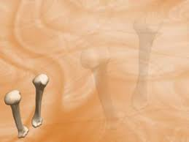

Evaluation of Sclerostin Serum Level and Bone Density Status in Children on Regular Haemodialysis
By
Manal Abd El-Salam
Prof. of Pediatrics and Pediatric Nephrology
Al-Azhar University
Cairo, Egypt

Slide 2
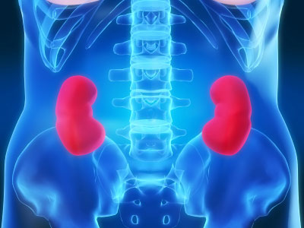
1
Introduction
2
Aim of the work
KEY POINTS IN:
3
Subjects and Methods
4
Results
Summery and conclusions
5

Slide 3

Introduction

Slide 4

Introduction
Chronic kidney disease (CKD) contributes significantly to the global health burden; it has an estimated prevalence of 8‑16% worldwide and results in millions of mortalities annually, due to poor access to affordable treatment in resource limited settings.

Slide 5
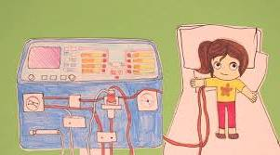

Introduction
The number of patients with end-stage renal disease (ESRD) is increasing in both developed and developing countries, greatly expanding the need for chronic dialysis and renal transplantation.

Slide 6
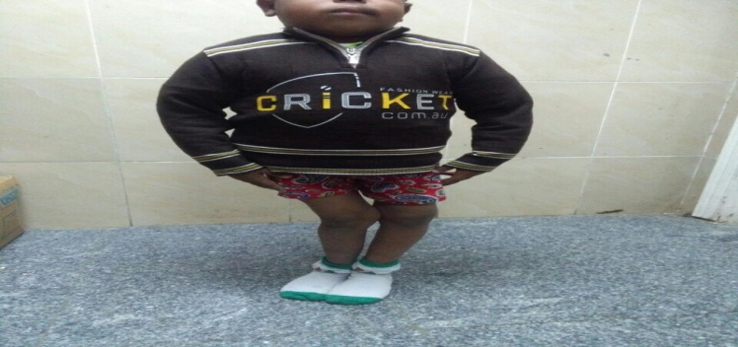
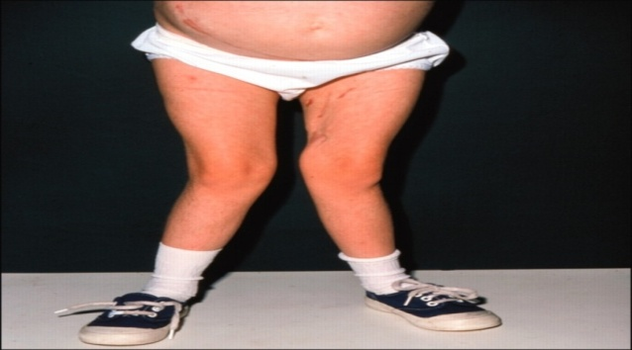
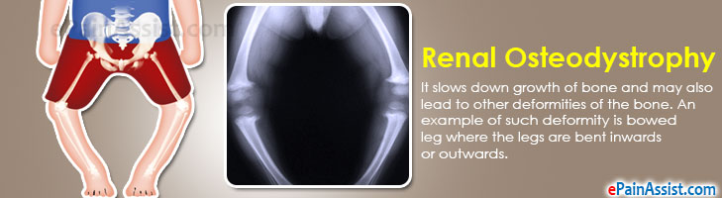
Introduction
Bone disease is frequently observed in chronic kidney disease (CKD) and increases a patient’s risk for fracture, cardiovascular (CV) calcification and mortality. The Kidney Disease Improving Global Outcomes foundation defined a new syndrome incorporating the bone, mineral and CV disorders, such as chronic kidney disease–mineral and bone disorders (CKD– MBDs) (Jean and Chazot, 2013).

Slide 7
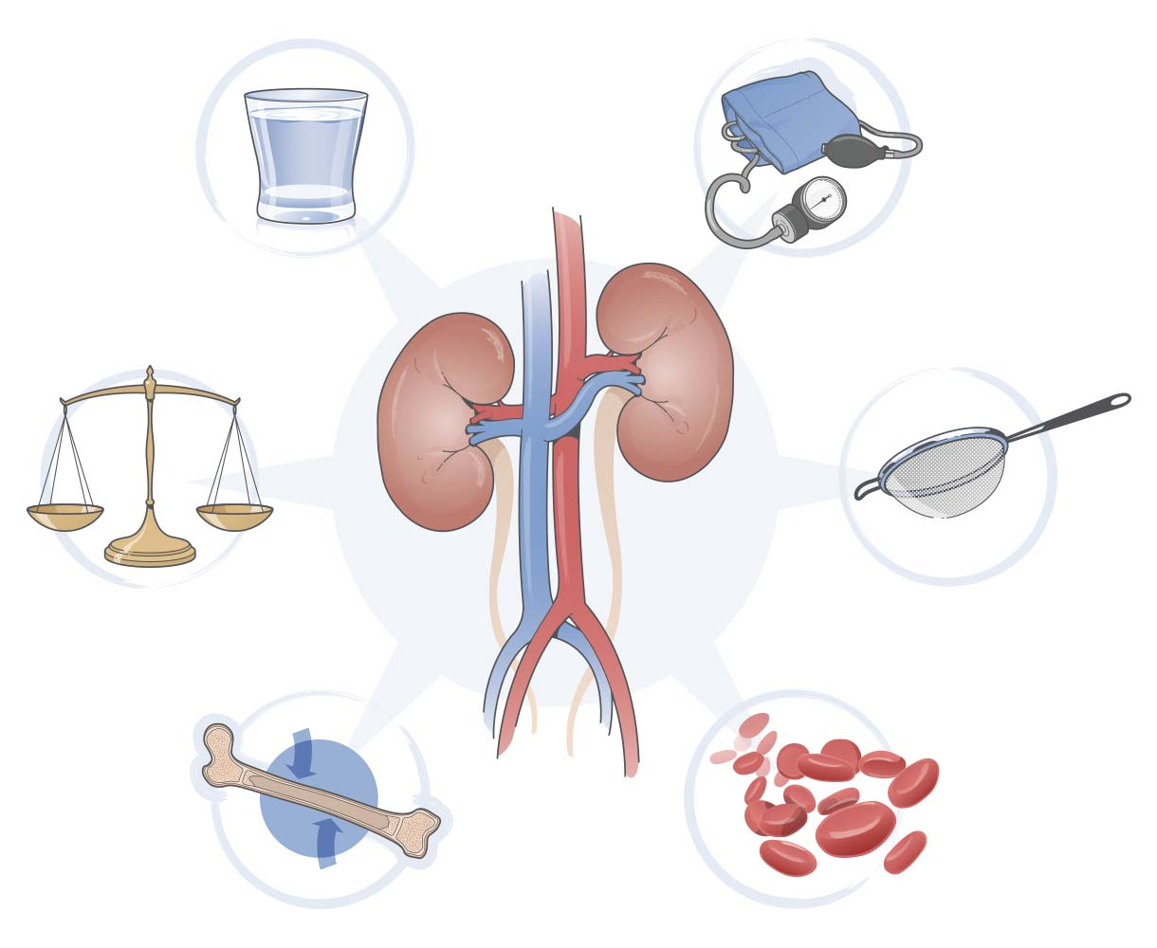
Introduction
7

Slide 8
Introduction
Chronic kidney disease
Low levels 1.25(OH)2 D3
Phosphate retention
Hypocalcemia
Resistance of bone to PTH
hyperparathyroidism
Decreased Ca Sensor
Decreased 1.25(OH)2 D3
These markers have been established as crucial risk factors and represent chronic kidney disease - mineral and bone disorder syndrome
8

Slide 9
Introduction
Loss of
nephron mass
↓Renal biosynthetic capacity
↓Renal excretory function
↓ Renal production of 1.25 (OH)2 D3
Retention of toxic metabolites
Metabolic acidosis
Hyper-
phosphatemia
Calcium× phosphate product> 60
↓ circulating
1.25(OH)2 D3
Hypocalcemia
Gut absorption
of calcium
Protein-caloriemalnutrition
↓ Responsiveness of bone to 1.25(OH)2 D3
Dissolution of bone buffers
↑PTH secretion
Remodeling and redistribution of bone (osteosclerosis)
Osteities
fibrosa
Aluminum
and/or iron toxicity
Impaired bone
growth in children (CKD,MBD)
Osteomalacia
Bone decalcification
and osteoporosis
Metastatic calcification
9

Slide 10


Introduction
The quest for a modifiable reliable biomarker of bone disease in CKD–MBD remains the nephrologist’s Holy Grail. Numerous bone proteins have been associated with the outcome in patients with CKD, such as osteoprotegerin (OPG) (Sigrist et al., 2009), fibroblast growth factor (FGF)-23 (bone-specific alkaline phosphatase (Jean et al., 2009; Kovesdy et al., 2010).
10

Slide 11


Introduction
A deeper understanding of the complex mechanisms that mediate the control of osteoblast and osteoclast function by osteocytes may identify new osteocyte-derived molecules as potential pharmacological targets for treating osteoporosis and other skeletal diseases and develop better treatments.
11

Slide 12
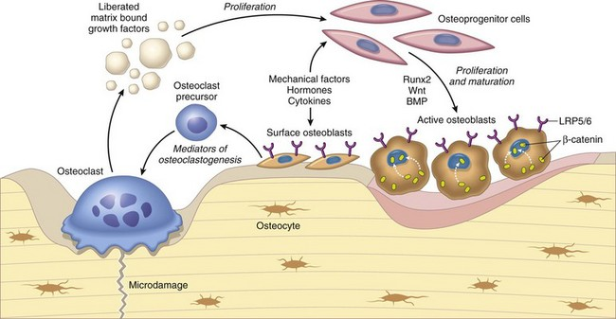
Introduction
Bone formation and resorption are strictly regulated by two types of cells, osteoblasts and osteoclasts.
12

Slide 13
Introduction
Osteoblasts are specialized bone-matrix producing cells originating from undifferentiated mesenchymal cells. By regulating proliferation, differentiation and maintenance of osteoblasts, various bone-seeking inter- and intracellular signals and hormones, cytokines, enzymes, minerals, and transcription factors are known to modulate bone mass.
13

Slide 14
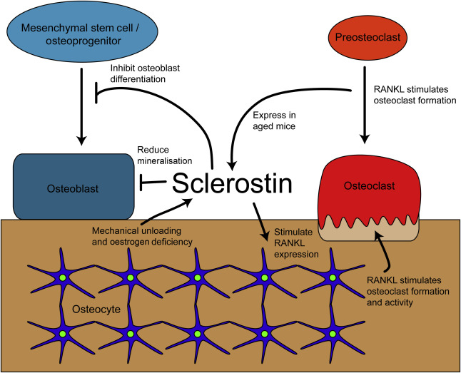
Introduction
Current, therapeutic approaches harness this accumulating knowledge by targeting osteocytic signalling pathways and messengers to improve skeletal health.
14

Slide 15
Introduction
Osteocytes can secrete several molecules, including sclerostin, receptor activator of nuclear factor κB ligand and fibroblast growth factor 23 to regulate osteoblastic bone formation, osteoclastic bone resorption and mineral homeostasis.
15

Slide 16
Introduction
1
What is the Sclerostin
2
Functions
Sclerostin
3
PTH
4
Calcitonin
5
Glucocorticoid
6
Hormonal regulation
7
Anti-sclerostin antibodies

Slide 17
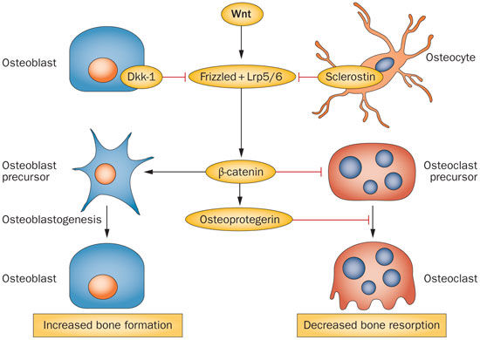
Introduction
What is the Sclerostin
Sclerostin is an important player in the well-known bone–vascular axis in chronic kidney disease (CKD) and end-stage renal disease.
17

Slide 18
Introduction
What is the Sclerostin
It is secreted by osteocytes. As a circulating inhibitor of the Wnt-signaling pathway it inhibits bone formation and contributes to the development of osteoporosis.
18

Slide 19
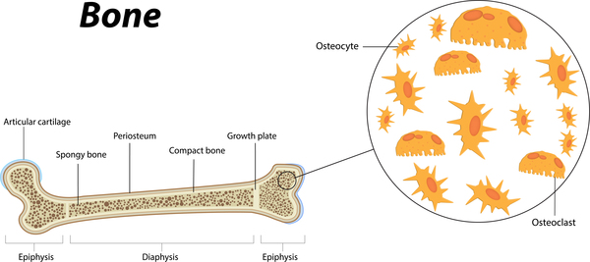
Introduction
What is the Sclerostin
Only osteocytes express sclerostin, which acts in a paracrine fashion to inhibit bone formation. Sclerostin is inhibited by parathyroid hormone (PTH) and mechanical loading. Sclerostin antagonizes the activity of BMP (bone morphogenetic protein), a cytokine that induces bone and cartilage formation.
19

Slide 20
Introduction
What is the Sclerostin
Osteocytes synthesize sclerostin, a secreted protein that inhibits bone formation by binding to LRP5/LRP6 coreceptors and blunting Wnt signaling] Sclerostin, the product of the SOST gene, is the first mediator of communication between osteocytes, bone forming osteoblasts and bone resorbing osteoclasts, critical for bone remodeling
Osteocyte
Scleroxtin antibody
Wnt
Sclerostin
Osteoblast cell membrane
LRP5/5
Frizzled
Cytoplasm
B- catenin
Gene transcription
Bone Formation
20

Slide 21
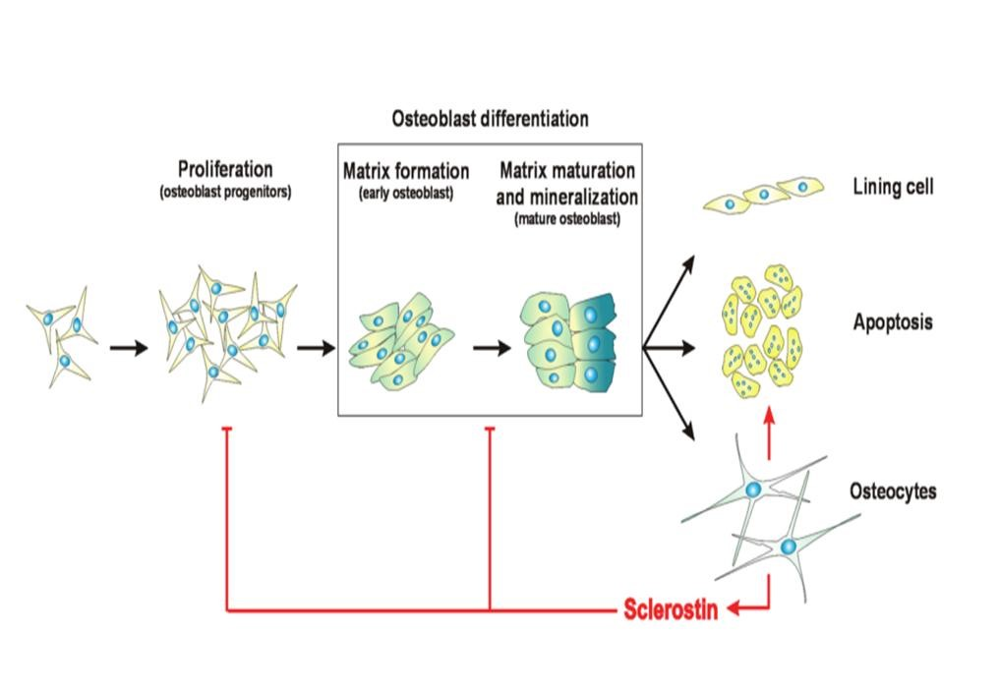
Introduction
Functions of Sclerostin
On osteoblast:
It inhibit osteoblast proliferation and differentiation and suppress mineralization of osteoblastic cells and stimulate osteoblast apoptosis.
21

Slide 22
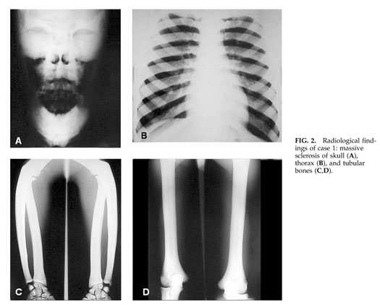
Introduction
Functions of Sclerostin
Balemans and his colleagues in 2001 identified mutations in the gene they named SOST gene, that encoding sclerostin, as the cause of sclerosteosis.
22

Slide 23
Introduction
Functions of Sclerostin
Sclerosteosis and Van Buchem disease, two highly clinically related, rare skeletal dysplasias with an autosomal recessive inheritance. In both diseases, a progressive bone thickening due to increased bone formation leads to sclerosis of the skeleton.
23

Slide 24
Introduction
Functions of Sclerostin
Both these disorders are caused by deficient synthesis of sclerostin, resulting in unrestrained bone formation and progressive generalized hyperostosis.
24

Slide 25
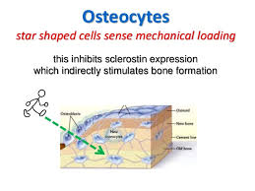
Introduction
Functions of Sclerostin
Osteocytes effectively act as mechanoreceptors for bone formation, and sclerostin was shown to play a key role in the development of osteoporosis associated with lack of mechanical stimulation, as observed in weightless astronauts or in patients confined to bed for a long period of time (Robling et al., 2008).
25

Slide 26
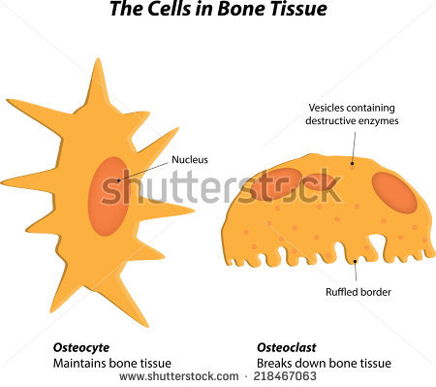
Introduction
Functions of Sclerostin
On osteoclast:
It stimulates osteoclast maturation and function thus increases bone resorption.
26

Slide 27
Introduction
Functions of Sclerostin
On osteoclast:
Osteocytic expression of sclerostin is regulated by systemic hormones that are known to influence the skeleton including parathyroid hormone and calcitonin.
27

Slide 28
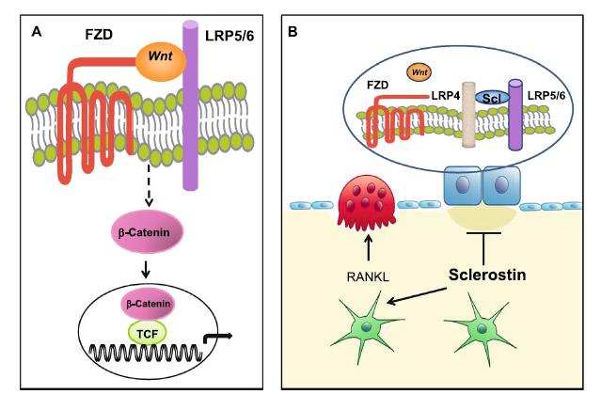
Introduction
Schematic presentation of the canonical Wnt-signaling pathway and the effect of sclerostin on bone cells.
28
Notes:
A- Wnt bind to the receptor complex of frizzled (FZD) and LRP5/6, prevent the degradation of beta-catenin, and increase its accumulation in the cytoplasm; beta-catenin is translocated to the nucleus where it associates with transcription factors to control transcription of target genes in osteoblasts.
B- Osteocyte-produced sclerostin is transported to the bone surface and acts on osteoblast to reduce bone formation by disabling the association of Wnts with their co-receptors and inhibiting the Wnt pathway in osteoblasts, an action facilitated by LRP4; Sclerostin also stimulates the production of RANKL by neighboring osteocytes and osteoclastic bone resorption.

Slide 29
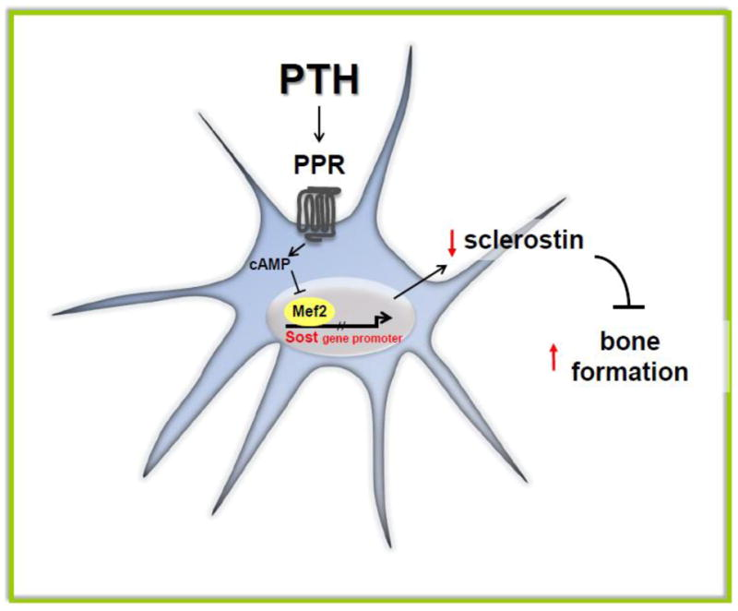
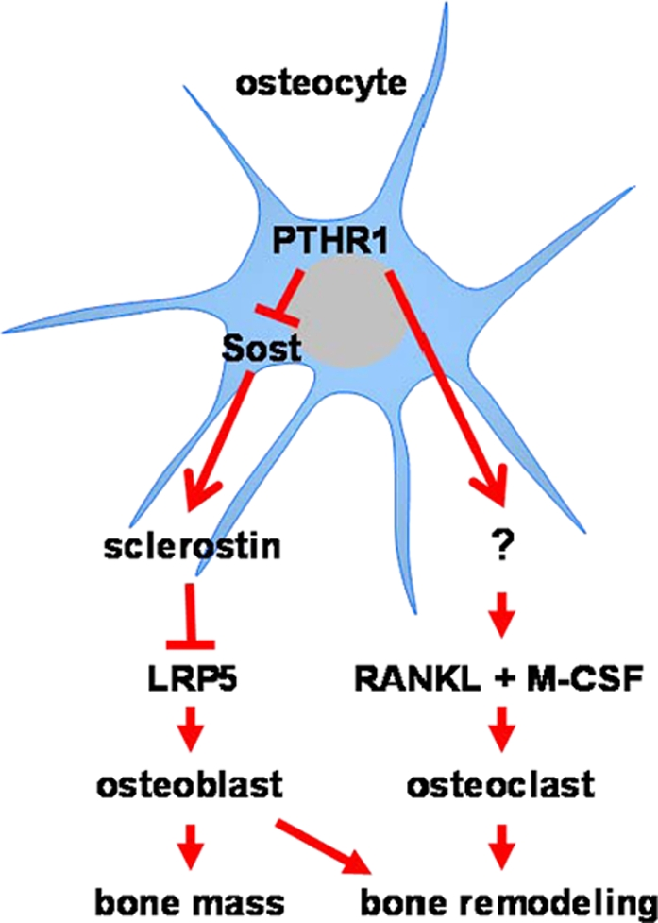
Introduction
PTH and Sclerostin
PTH plays a central role in the maintenance of calcium homeostasis.
Chronic elevation of PTH increases osteoclast formation.
PTH stimulates bone formation by suppressing Sclerostin expression.
29

Slide 30
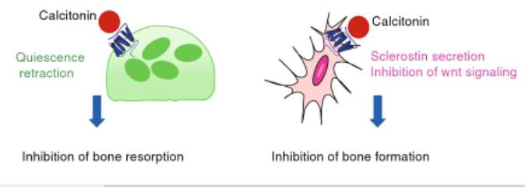
Introduction
Calcitonin (CT)
Calcitonin receptors are present on osteoclast cells, inhibiting osteoclast resorption.
Sclerostin production is increased by calcitonin.
Significantly inhibits PTH anabolic effects, increasing sclerostin levels.
30

Slide 31
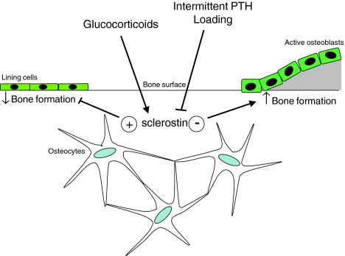
Introduction
Glucocorticoid and slerostin
Bone cells have receptors for glucocorticoid, and it inhibits bone formation therefore increases bone resorption. Glucocorticoid depresses bone formation through the effect on Wnt/beta-catenin pathway
31

Slide 32
Introduction
Glucocorticoid and slerostin
Some data has shown that patients treated with high doses of glucocorticoids have increased levels of sclerostin and decreased levels of Dkk-1.
32

Slide 33
Introduction
Hormonal regulation of sclerostin
Parathyroid hormone
Cytokines
Calcitonin
Prostaglandin E2 and hypoxia
Different types of hormones that regulate Scleorstin
Oestrogen
Osterix
Glucacorticoids
Zfp467
Ephrin B2
33

Slide 34
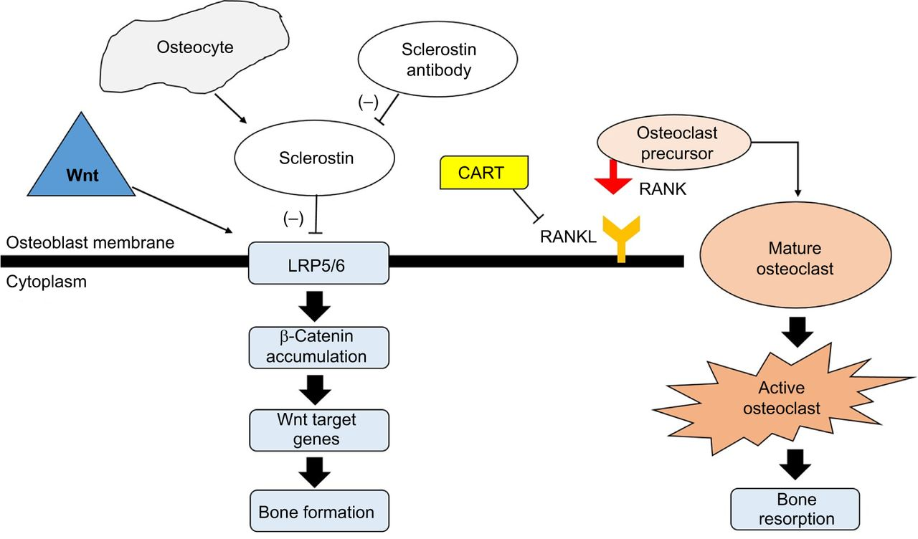
Introduction
Anti-sclerostin antibodies
An anti-sclerostin antibody increases BMD in hip and the spine in healthy men and postmenopausal women.
34

Slide 35
Introduction
Anti-sclerostin antibodies
Phase II studies with the anti-sclerostin antibody have been carried out in postmenopausal women and increased BMD, increased bone formation and inhibition of bone resorption.
35

Slide 36
Introduction
Anti-sclerostin antibodies
Sclerostin is, therefore, an excellent target to improve bone health without affecting other tissues. Preclinical studies have shown that inhibition of sclerostin using the antibody prevents the decrease in bone mass induced by ovariectomy, excess glucocorticoid administration, ulcerative colitis, immobilization and ageing.
36

Slide 37
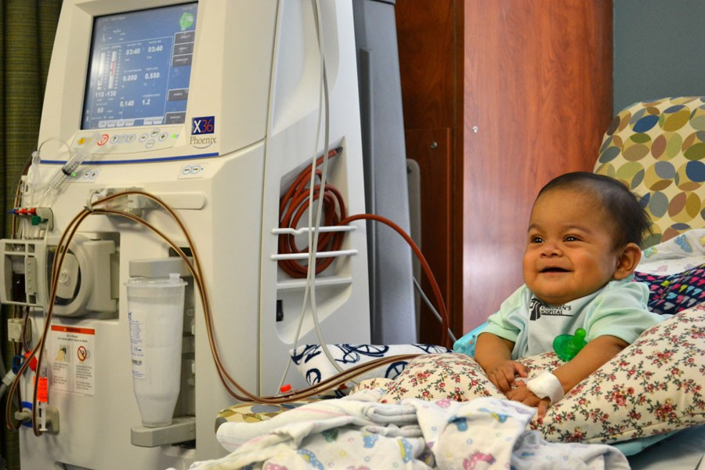
Introduction
Our research is turn into hidden assassins inflicting bone health particularly in children with CKD.
37

Slide 38
Introduction
The available data
Cejka D, Jäger-Lansky A, Kieweg H, Weber M, Bieglmayer C, Haider DG, Diarra D, Patsch JM, Kainberger F, Bohle B, Haas M. Sclerostin serum levels correlate positively with bone mineral density and microarchitecture in haemodialysis patients. Nephrology Dialysis Transplantation. 2011; 27(1):226-30.
Ishimura E, Okuno S, Ichii M, Norimine K, Yamakawa T, Shoji S, Nishizawa Y, Inaba M. Relationship between serum sclerostin, bone metabolism markers, and bone mineral density in maintenance hemodialysis patients. The Journal of Clinical Endocrinology & Metabolism. 2014; 99(11):4315-20.
Bruzzese A, Lacquaniti A, Cernaro V, Ricciardi CA, Loddo S, Romeo A, Montalto G, Costantino G, Torre F, Pettinato G, Salamone I. Sclerostin levels in uremic patients: a link between bone and vascular disease. Renal failure. 2016;38(5):759-64.
Almroth G, Lönn J, Uhlin F, Brudin L, Andersson B, Hahn‐Zoric M. Sclerostin, TNF‐alpha and Interleukin‐18 Correlate and are Together with Klotho Related to Other Growth Factors and Cytokines in Haemodialysis Patients. Scandinavian journal of immunology. 2016;83(1):58-63.
Pelletier S, Dubourg L, Carlier MC, Hadj-Aissa A, Fouque D. The relation between renal function and serum sclerostin in adult patients with CKD. Clinical Journal of the American Society of Nephrology. 2013; CJN-07670712.
Jean G, Chazot C, Bresson E, Zaoui E, Cavalier E. High serum sclerostin levels are associated with a better outcome in haemodialysis patients. Nephron. 2016;132(3):181-90.
38

Slide 39
Aim of the work
39

Slide 40
Aim of the work
The hypothesis of (CKD-MBD) is a complex disease that is not completely understood.
1
To assess sclerostin serum level as a one of the factor secreted by the osteocytes that may facilitate the understanding and management.
2
Correlate with bone density status.
40

Slide 41
Patients and Methods
Subjects and Methods
41

Slide 42
Patients and Methods
Study design
Study setting
Study timing
A cross sectional comparative study.
Samples were selected from the pediatric hemodialysis unit of Al-Zahraa University hospital
The study was conducted in the period from April 2016 to January 2017.

Slide 43
Patients and Methods
The study children were divided into
Group I (dialysis group) :
Included 25 children with ESRD (eGFR < 15 mL/min/1.73 m²) (KIDIGO, 2012), on regular hemodialysis more than 3 months. They were on regular hemodialysis for 4 hours, 3 times weekly, with polysulfone low flux membrane dialyzer by 4008 Fresenius and 5008 S-classic machines.
Group II (control group)::
Included 25 healthy children matched age and sex with group I

Slide 44

Subjects and Methods
Exclusion criteria
Inclusion criteria
Children on: Steroid therapy
Children with ESRD on regular hemodialysis for ≥3 months at the time of the study (KDIGO, 2012), their ages ranged from (5-17) years.
Children with congenital bone deformity.
Children with other chronic illness.
Children with recent fracture.

Slide 45

Subjects and Methods
Laboratory investigation
Complete Blood Picture (CBC).
Serum Urea, Creatinine, Cholesterol, Triglyceride
Ca, Ph, PTH. ALP
Serum Sclerostin

Slide 46
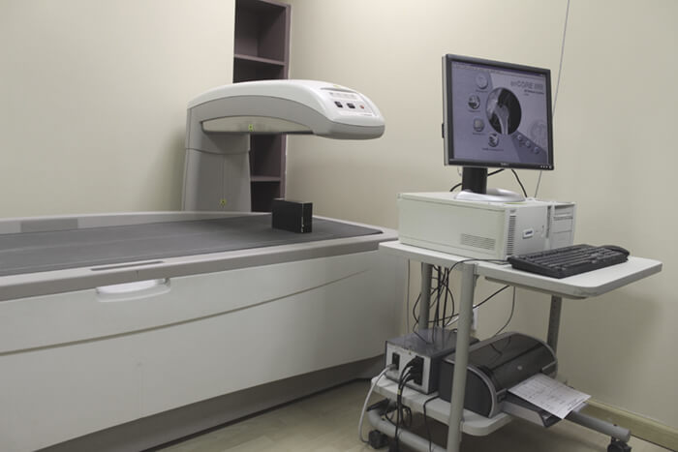
Patients and Methods
Dual-energy X-ray absorptiometry:
Measurement at the two sites (hip, spine).
AP images of L1–L4 were used for spine BMD measurement.
Proximal left neck of femur was used for the hip.
A reference database was consulted, and values and curves were obtained.
Affinitymri.com

Slide 47
subjects and Methods
DXA Report:
A DXA scan report compares the patient's bone mineral density values with age matched normal patient (Z-score). By comparing a patient's bone density against their peers, a low score indicates there may be a reason for bone loss.
Z-score less than –2 indicates the diagnosis is below the expected range for age (Lewiecki et al., 2008).
Affinitymri.com

Slide 48
Results
Results

Slide 49
Results
Comparison Between Patients group and Control group regarding Age, Sex and anthropometric measures
Variable |  | Control group No. = 25 | Patients group No. = 25 | Independent t-test
 |  | Mean±SD | Mean±SD | t | p-value
Age (years) |  | 10.72 ± 2.88 | 12.16 ± 3.57 | 1.565 | 0.124
Sex | Females | 12 (48%) | 14 (56%) | 0.321 | 0.571
 | Males | 13 (52%) | 11 (44%)
Z-weight |  | 0.53 ± 1.02 | -0.85 ± 0.37 | 6.359 | 0.001
Z-height |  | 0.36 ± 0.91 | -0.74 ± 0.66 | 4.893 | 0.001
Z-BMI |  | 0.51 ± 0.88 | -0.64 ± 0.93 | 4.491 | 0.001
Systolic BP (mmHg) |  | 102.20 ± 8.30 | 132.80 ± 15.42 | 8.739 | <0.001

Slide 50
Results
Comparison between dialysis and control group regarding CBC and laboratory data
Variable | Control group No. = 25 | Patients group No. = 25 | Independent t-test
 | Mean±SD | Mean±SD | t | p-value
TLC (cmm)³ | 7.89 ± 1.41 | 5.94 ± 1.96 | 4.038 | 0.001
RBCs (cmm)³ | 4.77 ± 0.40 | 3.40 ± 0.89 | 7.020 | 0.000
Hb (gm/dl) | 12.00 ± 0.88 | 9.30 ± 2.01 | 6.153 | 0.000
Hct (%) | 36.37 ± 2.55 | 27.24 ± 6.10 | 6.905 | 0.000
Platelet(cmm)³ | 292.24 ± 52.92 | 154.16 ± 33.48 | 11.025 | 0.000
Creat (mg/dl) | 0.39 ± 0.14 | 9.25 ± 2.02 | 21.878 | 0.000
Ca (mg/dl) | 9.13 ± 0.41 | 9.26 ± 1.66 | 0.380 | 0.706
Phosphate (mg/dl) | 4.34 ± 0.30 | 8.21 ± 3.55 | 5.431 | 0.000
PTH (Pg/ml) | 33.60 ± 12.10 | 786.50 ± 376.20 | 10.001 | 0.000
Alk.phosphatase (U/l) | 187.83 ± 30.25 | 418.08 ± 166.69 | 6.796 | 0.000
BUN(mg/dl) | 12.60 ± 5.83 | 185.08 ± 36.49 | 23.338 | 0.000

Slide 51
Results
Comparison between dialysis group and control group regarding Sclerostin serum level
Sclerostin serum level (ng/ml) | Mean±SD | Independent t-test
 |  | t | p-value
Control group | 0.290 ± 0.074 | 5.76 | 0.001
Patients group | 1.754 ± 1.311
Female | 1.28 ± 0.62 | 2.196 | 0.038
Male | 2.36 ± 1.70

Slide 52
Results
Classification of hemodialysis patients according to DEXA findings
Patients with normal BMD 16(64%)1 | Patients with low BMD 9 (36%)
 | Patients with low BMD in both femur neck and lumber spines | Patients with low BMD in lumber spines only | Patients with low BMD in femur neck only
 | 8(32%) | 1(4%) | 0(0%)

Slide 53
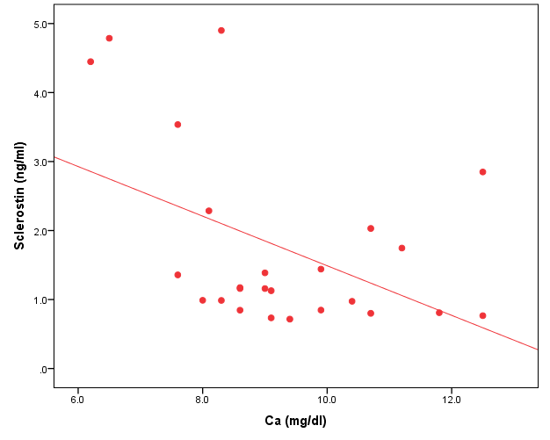
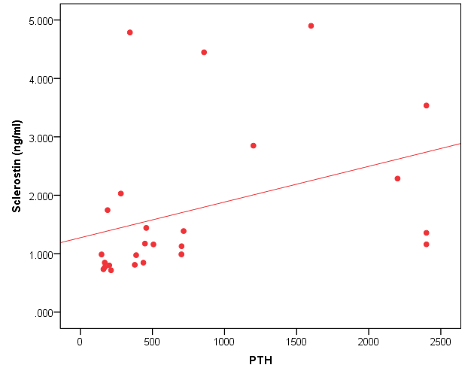
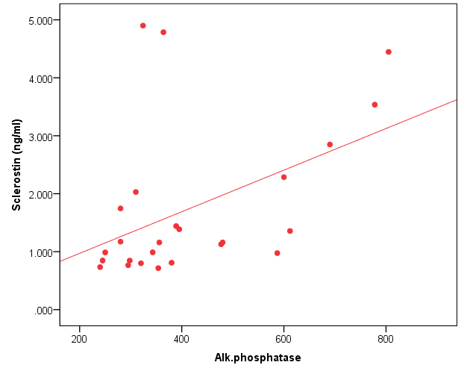
Results
Correlation between Sclerostin serum level and PTH, Ca and Alk. phosphates
r=-.441-*
P-=0.02
p-=0.002
r=.598**
Ca
PTH
r=.488*
p-=0.013
Alk. ph

Slide 54
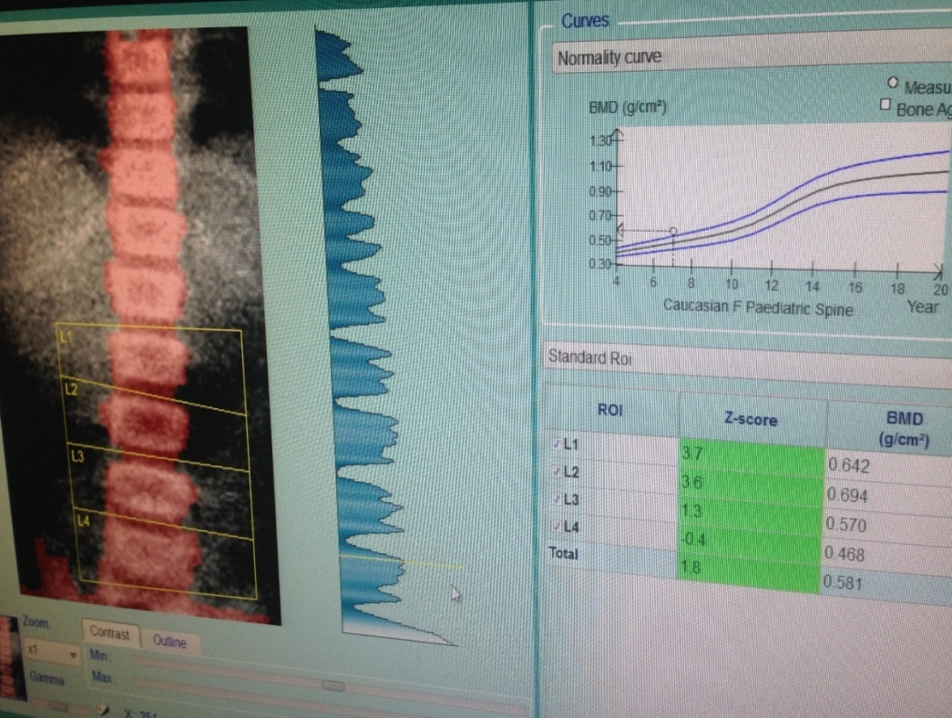
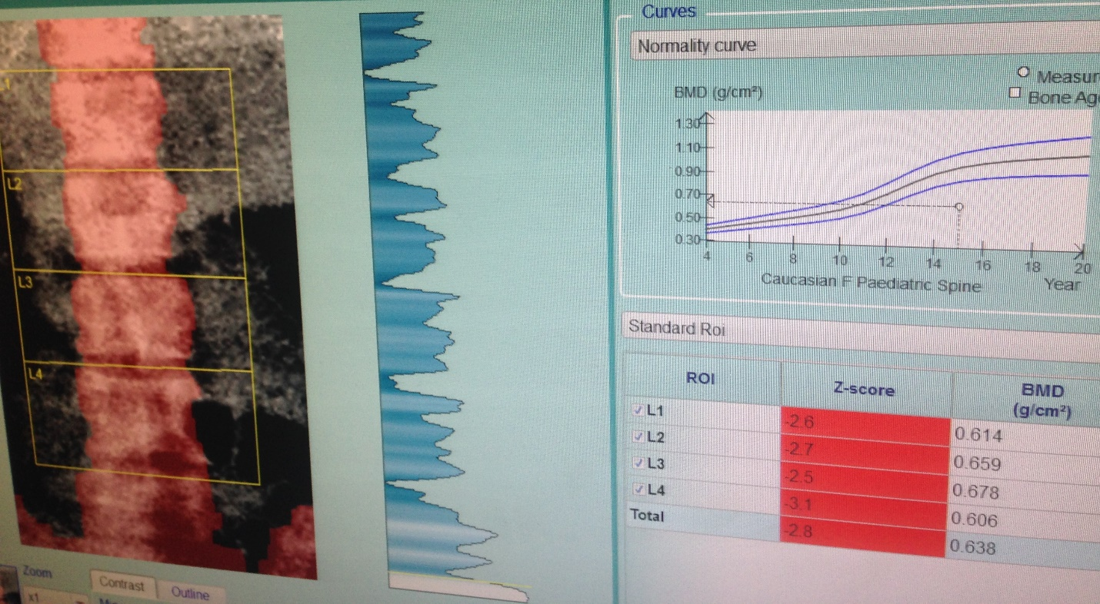
Results

Slide 55
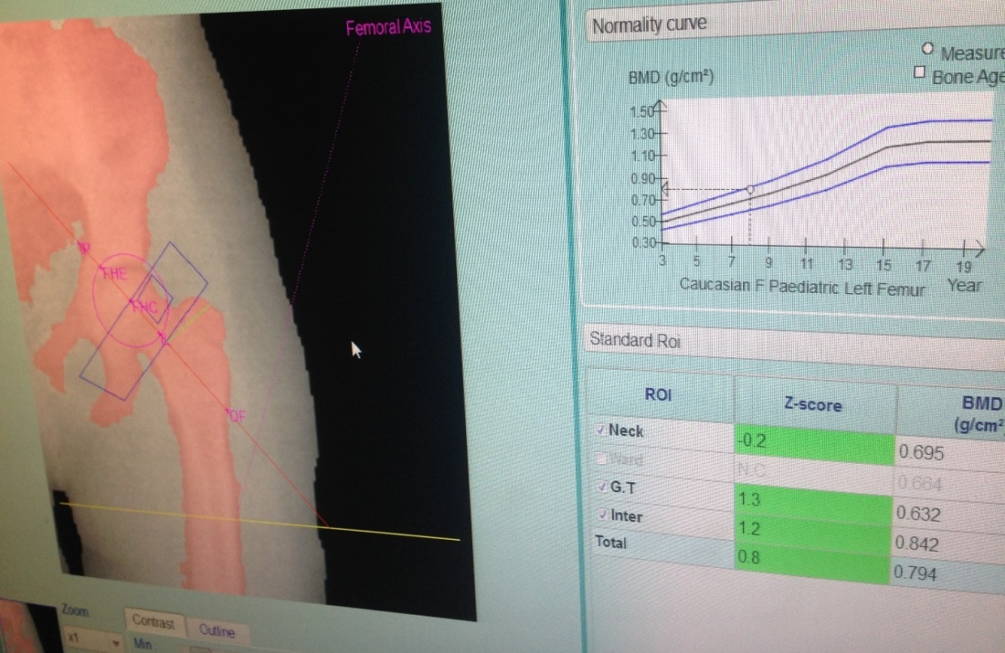
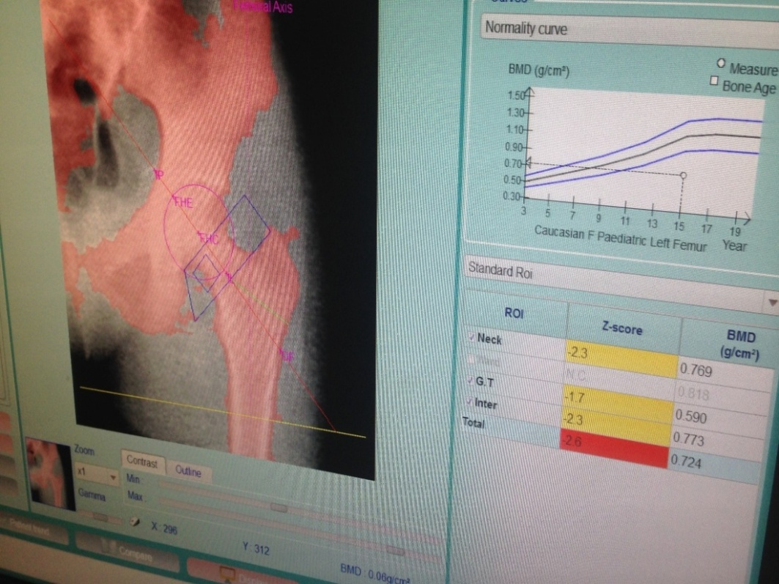
Results

Slide 56
Results
Comparison between patients with normal and those with low bone mineral density regarding Sclerostin level
Sclerostin (ng/ml) | Mean±SD | Independent t-test
 |  | t | p-value
Patients with normal bone mineral density | 1.4 ± 0.98 | 2.426 | 0.023
Patients with low bone mineral density | 2.38 ± 0.85
Comparison between patients with normal and those with low BMD regarding serum Ca, Phosphate, PTH and Alk. phosphatase levels
Variable | Patients with normal bone mineral density (no =16) | Patients with low bone mineral density (no =9) | Independent t-test
 | Mean±SD | Mean±SD | t | p-value
Ca (mg/dl) | 9.65 ± 1.67 | 8.58 ± 1.50 | 1.598 | 0.124
Phosphate (mg/dl) | 9.68 ± 10.45 | 5.60 ± 1.64 | 1.152 | 0.261
PTH(pg/ml) | 590.29 ± 568.32 | 1135.33 ± 994.05 | -1.757 | 0.092
Alk.phosphatase (u/l) | 412.25 ± 161.68 | 428.44 ± 184.81 | -0.229 | 0.821

Slide 57
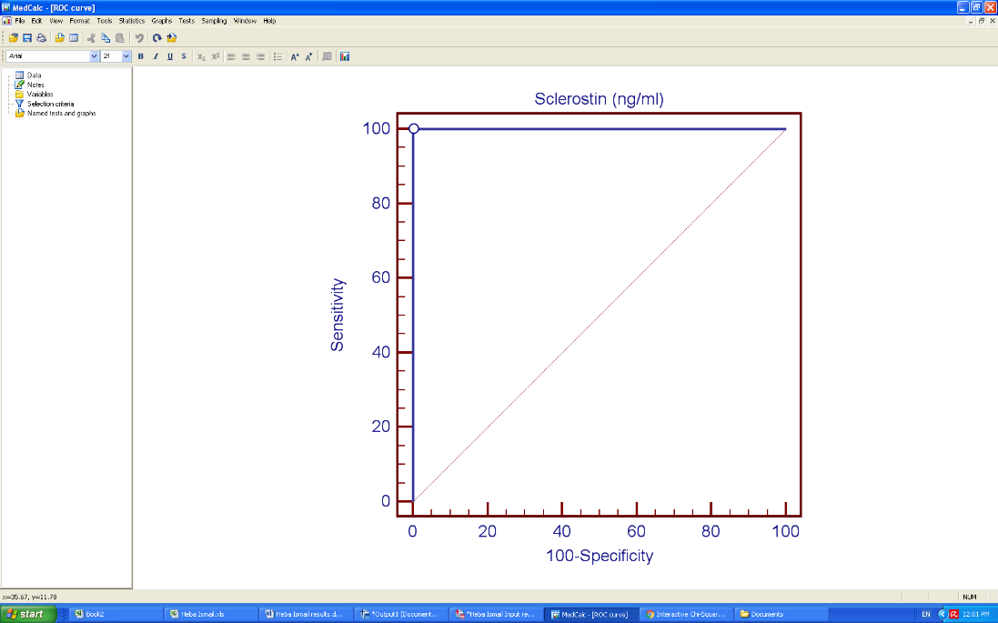
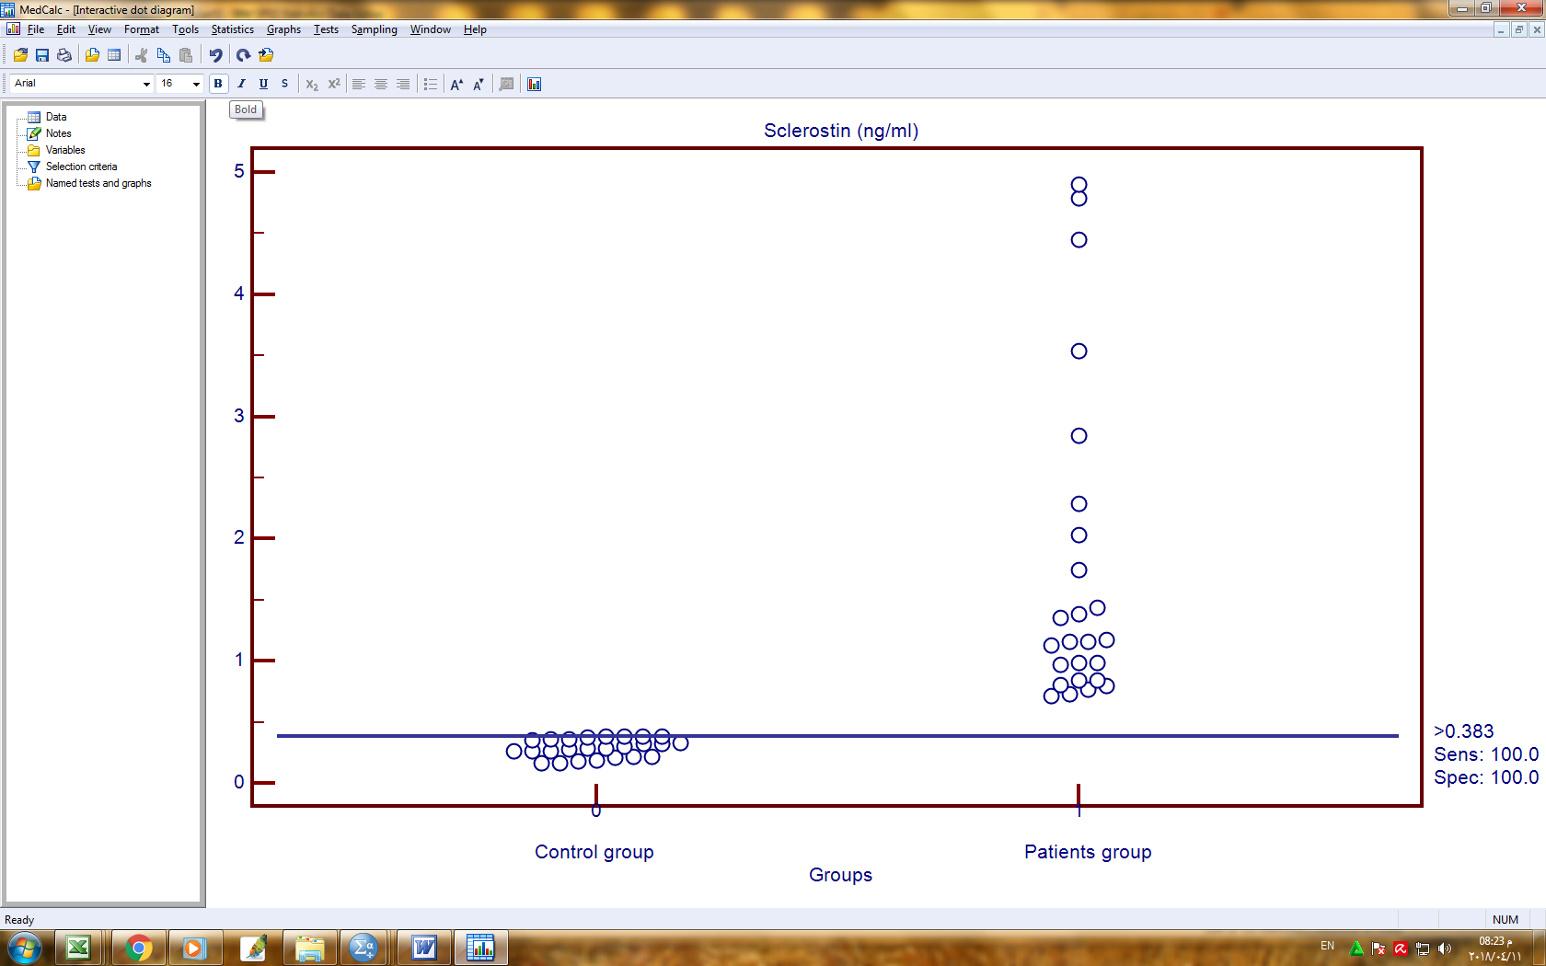
Results
Cut-off point, sensitivity and specificity of sclerostin serum level in predicting (CKD-MBD) in hemodialysis children
Cut off point | Sensitivity (95% CI) | Specificity (95% CI) | +PV (95% CI) | -PV (95% CI)
>0.383 (ng/ml) | 100.00 (86.3 - 100.0) | 100.00 (78.2 - 100.0) | 100.0 (86.3 - 100.0) | 100.0 (78.2 - 100.0)

Slide 58
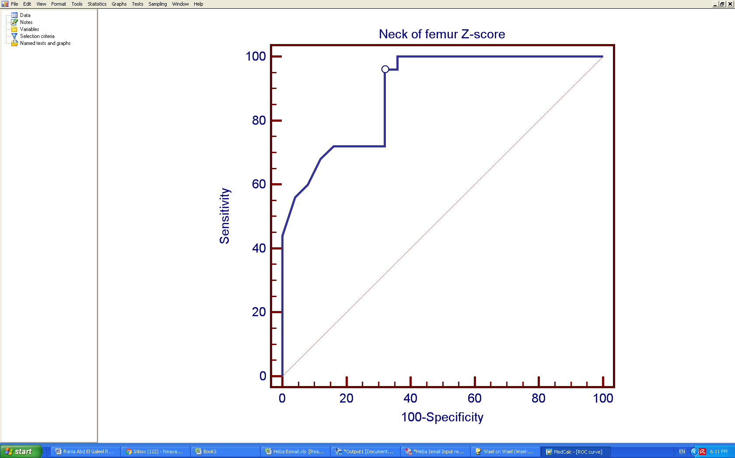
Results
Cut-off point, sensitivity and specificity of femur neck BMD in predicting (CKD-MBD) in hemodialysis children
Cut off point | AUC | Sensitivity | Specificity | +PV | -PV
≤ 0.3 | 0.89 | 96.00 | 68.00 | 75.0 | 94.4

Slide 59
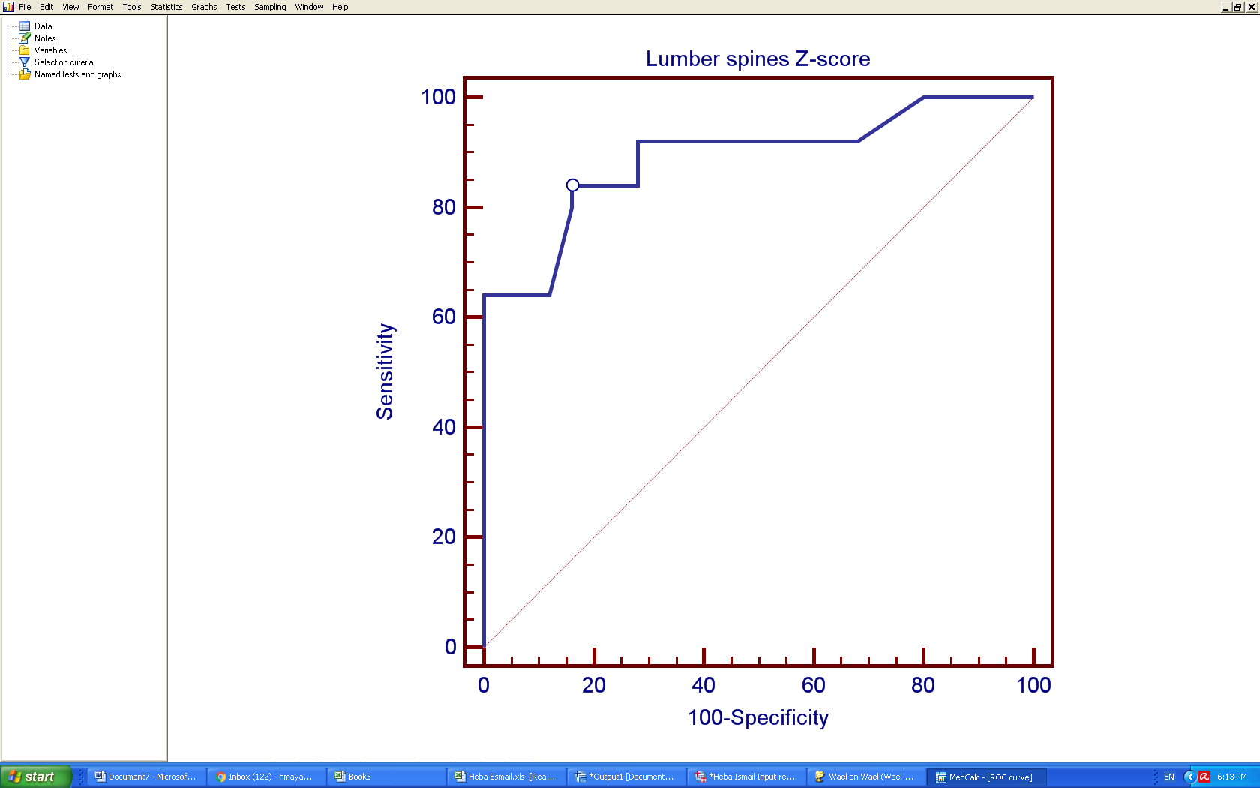
Results
Cut-off point, sensitivity and specificity of lumber spines BMD in predicting (CKD-MBD) in hemodialysis children
Cut off point | AUC | Sensitivity | Specificity | +PV | -PV
≤ -0.4 | 0.890 | 84.00 | 85.00 | 83.0 | 86.0

Slide 60

Study limitation
Some limitations of the study include: We could not obtained information related to this issue, no data were published on sclerostin in pediatric population on hemodialysis and the relatively low number of participants.

Slide 61
Summery and conclusion
Summery and conclusion

Slide 62

Summery and conclusion
Over the past two decades, understanding of the function of osteocytes both as regulators of the activity of bone forming and resorbing cells, and as modulators in other tissues, has markedly increased.
Excess sclerostin in children on hemodialysis leads to bone loss and bone strength is reduced.
Significant negative correlation between sclerostin and serum Ca level and positive correlation with Alk. Phosphatase and PTH serum level in hemodialysis patients.

Slide 63
Summery and conclusion
Significant relation between sclerostin serum level and low bone density.
Sclerostin is highly specific and sensitive for early diagnosis of CKD-MBD in children on regular hemodialysis.
Sclerostin made its strong way as a novel mediator of CKD-MBD. sclerostin may be considered as one of the driving forces in the bone-axis of patients with CKD.

Slide 64
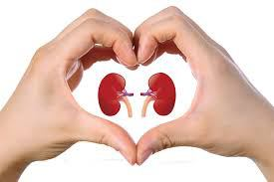
Summery and conclusion
Our study provides a base for further research of the role of sclerostin in children on regular hemodialysis for preservation of bone health.
Much work remains to be done
The future is bright
Even with CKD-MBD

Slide 65


Slide 66




Slide 67


