Slide 1
Arbovax ®
Advanced technology for insect-borne virus vaccines
Vaccines and Vaccination
Valencia, Spain
September 2014
Notes:
1

Slide 2
Arbovirus Structure
These are unique in that they derive their membrane from phylogenetically different hosts – insects and mammals
Insect cells differ from mammalian cells in that they have no cholesterol in the membrane – this affects chemical and physical properties
Surface glycoproteins of the virus are folded into high energy metastable structures – this is seen as important in cellular infection
Protocols to release these proteins result in collapse to non-native low energy configurations

Slide 3
Arbovax Unique Approach
Modify transmembrane domain of target virus
  Resulting virus incapable of complete replication in mammalian cells – “host-range mutation”
  Replicates normally in insect cells
  Retains native conformation of wild type
  Changes hidden from immune system
  Immune response same as with wild-type
  Strong immune response in absence of disease

Slide 4

Dengue Virus
E1 transmembrane domain
Envelope
Capsid
ET-2
ET-1
MT-1
MT-2
RNA
RNA
Figure 1: TM domains of envelope proteins transverse the lipid bilayer.

Slide 5
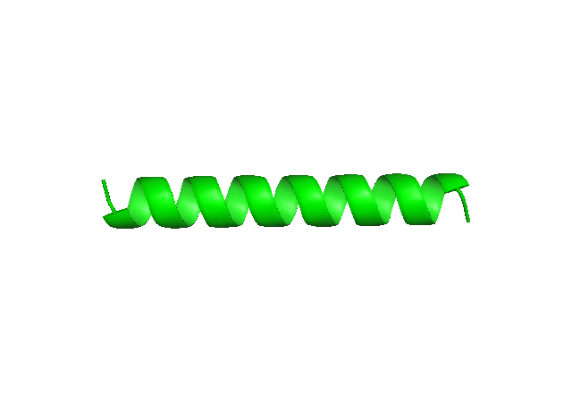
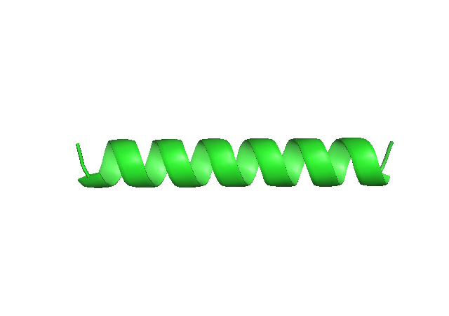
Insect membrane
Mammalian membrane
WT virus
E-1 Transmembrane Domain (TMD)
Deletion mutant
Modified E-1 TMD is unable to span membranes

Slide 6
Arbovax Technology Advantage
  Maximum immune response (like wild type)
  One dose, tetravalent immunization
  Cost effective manufacture
  Safe: no reversion to wild-type
  2012 and 2013 PNAS publications strongly support whole virus approach to Dengue vaccine^{1,2}
  ¹University of North Carolina School of Medicine. "Achilles heel of dengue virus identified: Target for future vaccines." ScienceDaily, 11 Apr. 2012. Web. 13 Apr. 2012.
²Comprehensive analysis of dengue virus-specific responses supports an HLA-linked protective role for CD8+ T cells. www.pnas.org/cgi/doi/10.1073/pnas.1305227110

Slide 7
Arbovax Technology Advantage
Technology can be rapidly adapted to other Arboviruses.
Transmembrane domain alignment within Alpha and Flaviviruses
Chikungunya vaccine aligned with Sindbis
  Vaccine candidate identified 1 month
Successfully tested in mice

Slide 8
Tetravalent Trial
Virus | Animal | Day 2 | Day 3 | Day 4 | Day 5 | Day 6 | Day 7 | Day 9 | Day 11
WT-Tet* | 1253 | DV2 | DV1,2,4 | DV1,2,3 | DV3,4 | DV3 | DV4 | DV2,4 | ---
 | 1272 | DV2,4 | DV1,2,4 | DV2,3 | DV3,4 | DV3 | DV4 | DV2,4 | DV4
 | 1407 | DV2,4 | DV1,2 | DV2,3 | DV3,4 | DV3 | DV4 | DV2,4 | DV2,4
 | 1427 | DV1,2,4 | DV1,2,4 | DV2,3 | DV3,4 | DV3 | DV4 | DV2,4 | DV2,4
TetV | 1095 | DV1,2 | DV1,2,3,4 | DV1,2,3,4 | DV2,4 | DV3 | DV2,3,4 | DV2,4 | DV2,4
 | 1114 | DV1,2,4 | DV1,2,3,4 | DV2 | DV2,3,4 | DV3 | DV2,3,4 | DV2,4 | DV2,4
 | 1225 | DV1,2,4 | DV1,2,3,4 | DV1,2,3,4 | DV2,3,4 | DV2,3 | DV2,3,4 | DV2,4 | DV2,4
 | 1463 | DV1,2 | DV1,2,3,4 | DV1,2,3,4 | DV2,3,4 | DV2,3 | DV2,3,4 | DV2,4 | DV2,4

Slide 9
Strong Immune Response
DENV1
DENV2
DENV3
DENV4

Slide 10
Tetravalent Trial
Groups | Serotype | Sero-Conversion
 |  | Pre-Challenge* | Post-Challenge
HR-DV-Tet Vaccine | DV1 | 100% (16/16) | 100% (4/4)
 | DV2 | 100% (16/16) | 100% (4/4)
 | DV3 | 100% (16/16) | 100% (4/4)
 | DV4 | 100% (16/16) | 100% (4/4)
Naïve | DV1 | NA | 75% (3/4)
 | DV2 | NA | 75% (3/4)
 | DV3 | NA | 100% (4/4)
 | DV4 | NA | 100% (4/4)

Slide 11
Tetravalent Trial
Sero-conversion of 75% is the benchmark for LAV sero-conversion
Animal sero-conversion rates are very high compared to other LAVs
DV2 has 100% of pre challenge and high PRNT sero-conversion titers which were not seen with any chimeric LAV
Animals inoculated with HR DV tetravalent vaccine respond rapidly with increased IgG following challenge.
To date no other LAV platform has performed this favorably with or without a vaccination boost.

Slide 12
Additional Target: Chikungunya Virus
Causes flu-like symptoms and painful arthritis-like joint swelling that may persist for years
Emerging threat in Asia, India, South America and Caribbean
CDC reporting over 600 cases in North America, as of Aug 2014
Transmitted by A. Albopictus (tiger mosquito) found in over 30 U.S. states
No commercially available vaccine for the prevention of this disease

Slide 13
Chikungunya Preclinical Development
Mice are an excellent model for trials
  Display all human symptoms
Began with five host range mutants injected into mice (N=225)
Monitored injection site, foot and ankle swelling
Efficacy measured by:
  Virus titer
  Presence of virus neutralizing antibodies
Determined that one mutant (TM17-2) is a good vaccine candidate

Slide 14
Assay of Infection after Challenge
 | Naïve | MR44 | TM17-1 | TM17-2
Virus in serum | + | + | + | -
Virus in ankle | + | - | - | -
Virus in quad | + | + | + | -
NAb | + | - | - | +
Inflammation | + | - | - | -

Slide 15
Chikungunya Study Conclusions
TM17-2 is an excellent candidate to move forward:
  No swelling at the site of infection
  Viremia less than wild-type
  No virus became established in the joints or muscles
  Good neutralizing Ab response (immunogenic)
  No challenge virus replicated (protection)
  No virus in serum, ankle or quad
  Five fold increase in NAb after challenge
  Pre-IND discussion with FDA completed early 2014
  Candidate is ready to move forward to phase 1 human trial

Slide 16
Current Status
Paper published in Journal of Virology 2014
US FDA review of Dengue and Chikungunya pre-IND submission cleared move forward to human phase 1 trial
30 subjects, 6 month phase 1 trials expected late 2015
Phase 2 trials to follow

Slide 17
Arbovax ®
Advanced technology for insect-borne virus vaccines
www.arbovax.com.
Thank You
Notes:
17

