Slide 1
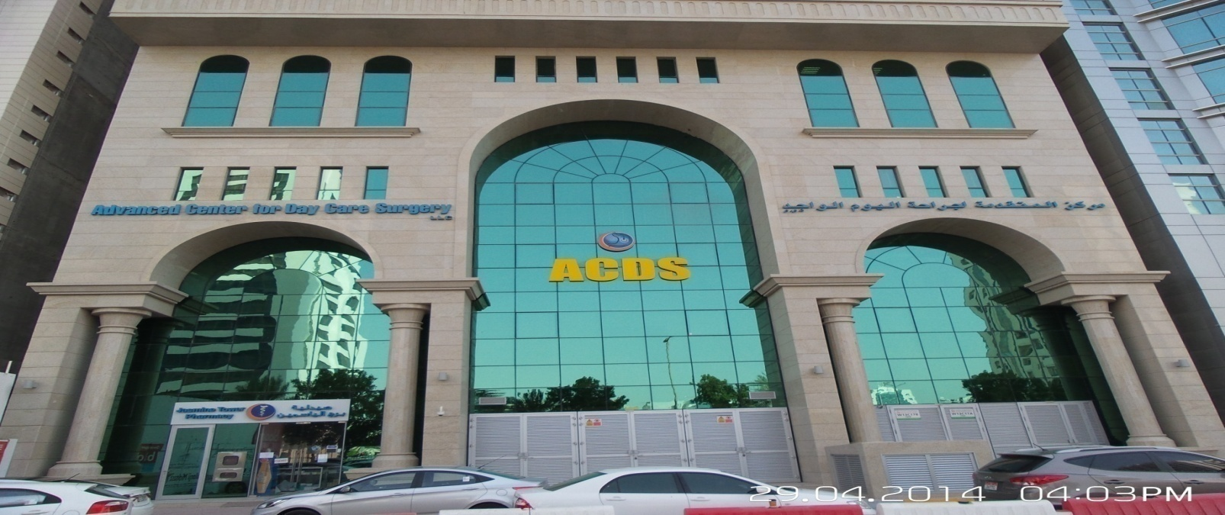

Observational study in liver disease 1978-2016
MAKKI H FAYADH FRCPEd,FRCP London
Consultant physician & gastroenterologist
ACDS
makkihf@yahoo.com
www.acds.ae
GASTRO 2016

Slide 2
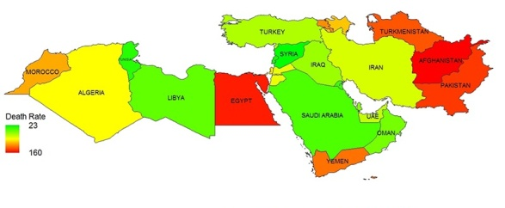
The middle east past present ? FUTURE ???

Slide 3
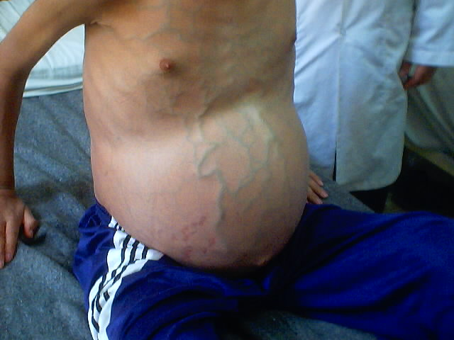
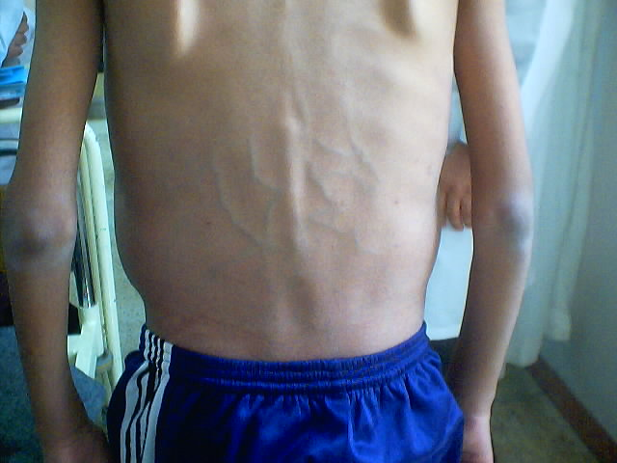
Liver disease burden in the middle east
The overall burden of GIT diseases is highest in Afghanistan, Pakistan, and Egypt.
Diarrheal diseases have been replaced by gastrointestinal cancers and cirrhosis in most countries in the region.
In some countries including Afghanistan, Pakistan, Turkmenistan, Egypt, and Yemen, communicable GIT diseases are still among top causes of mortality and morbidity in addition to non-communicable GIT-LIVER and cancers.
These countries are experiencing the double burden.
In the Gulf GCC countries ,Jordan& Iraq cancers are increasing

Slide 4
A trip with a patient story 1960-2008
S.H Male Iraqi high ranking ministerial post in Iraq
1962 Acute hepatitis
Delayed resolution
Liver biopsy after 6 months Non A non B hepatitis ? Auto immune hepatitis
1995 elevated liver enzymes HCV positive
Treated Interferon
1998 treated pegylated inteferon & ribavirin cleared the virus
Severe depression
Died 2008 age 83

Slide 5
IRAQ
1978 viral hepatitis committee
1984 HEPATITIS b VACCINATION PLASMA DERIVED
1986 INITIATION OF LIVER TRANSPLANT PROGRAM
STOPPED WAR
1988 ARAM PLAN FOR PAN ARAB LIVER PROGRAM
ABORTED WAR

Slide 6
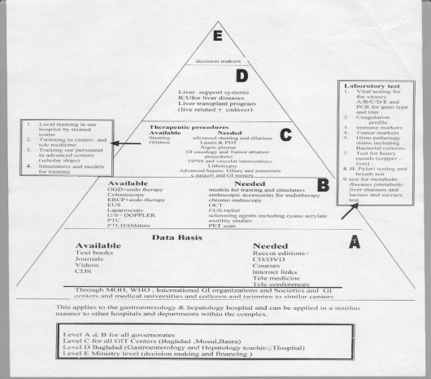
IRAQ
VACCINATION HEP B 1984
SYLIMARINE 1988
INTERFERON 1988 FOR NON A NON B
HCV 1991
PLAN FOR CENTERS 1994

Slide 7
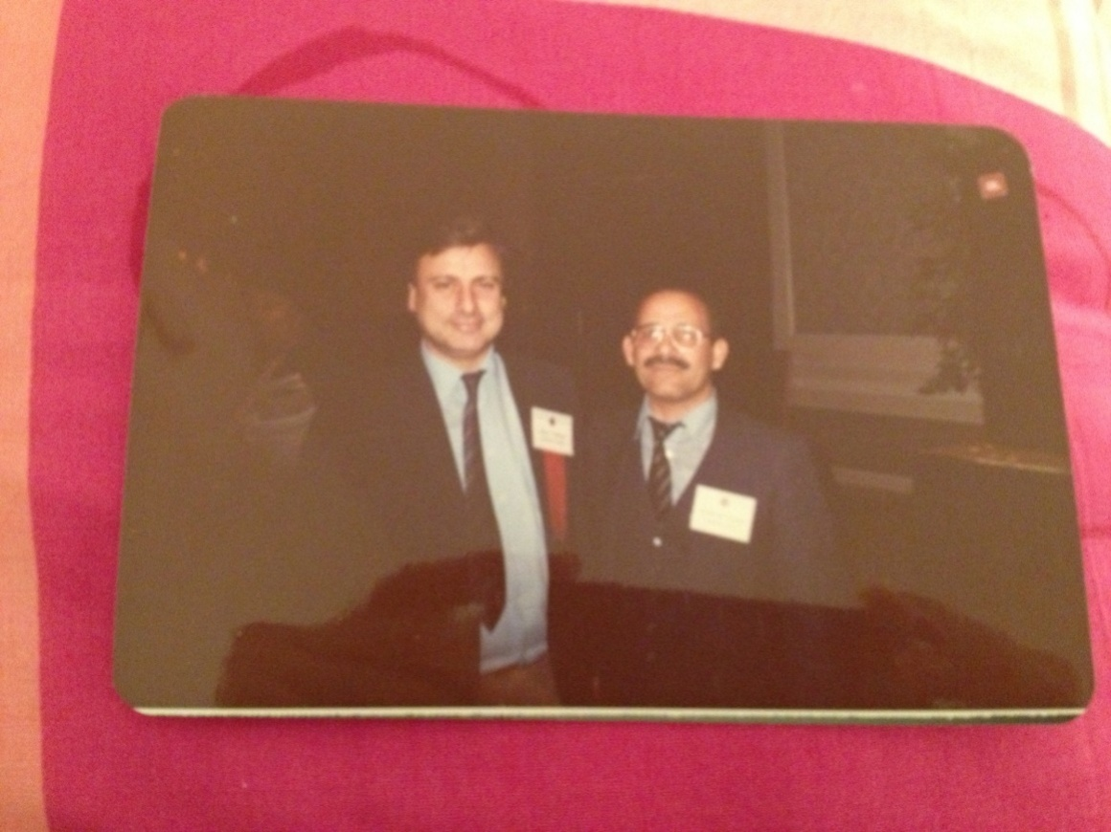
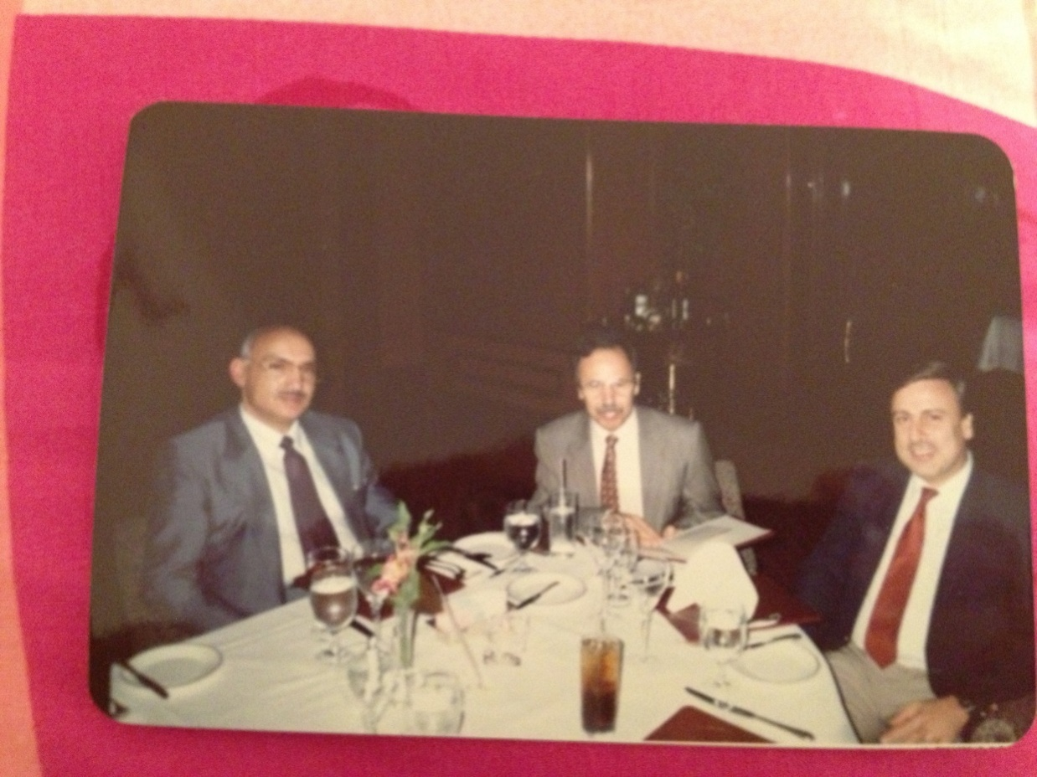
1988-1ST ARAB LIVER GROUP
1988-1ST ARAB LIVER GROUP

Slide 8
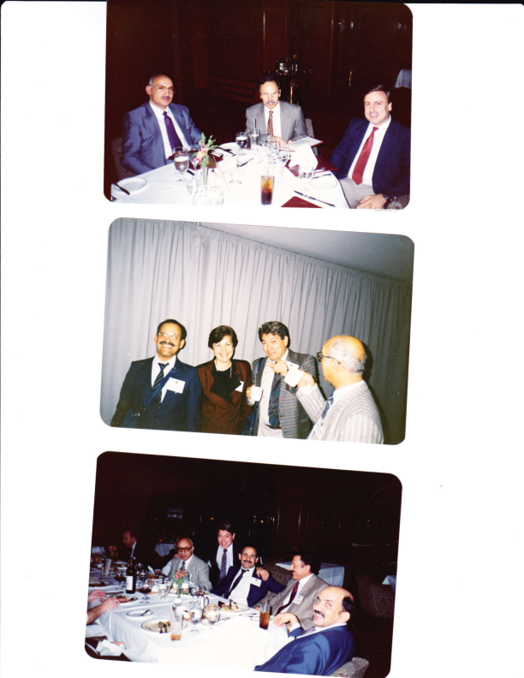
FIRST ARAB LIVER GROUP 1988…………………………………….2013
HOUSTON TEXAS 1988
NEXT MEETING SCHEDULED 1990 POSTPONED - GULF WAR 1990 & POSTPONED -TILL NOW 2013
RECOMMENDATIONS 1988
ARAB RESEARCH
ARAB DATA BASE IN LIVER DISEASES
SUBSPECIALTY ARAB BOARD IN LIVER DISEASES.

Slide 9
1988-IST ARAB LIVER GROUP

Slide 10
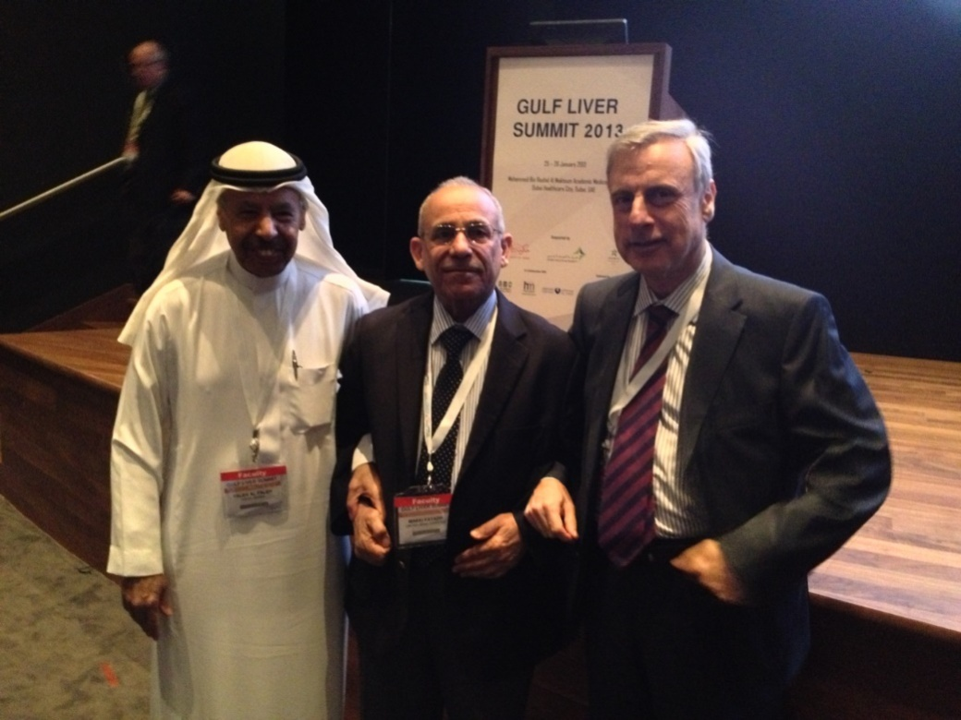
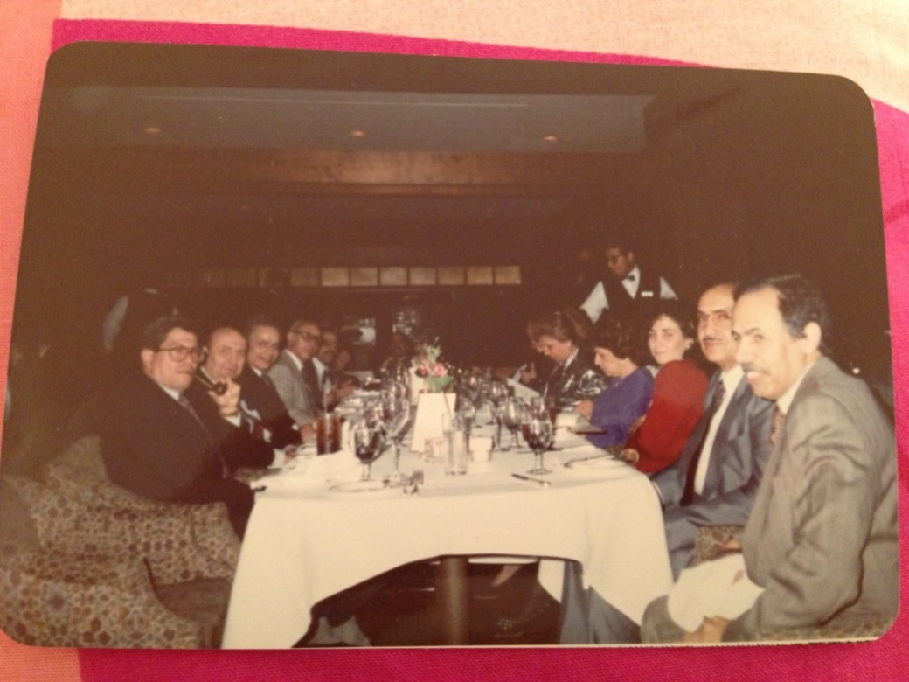
1988---------------------------2013

Slide 11
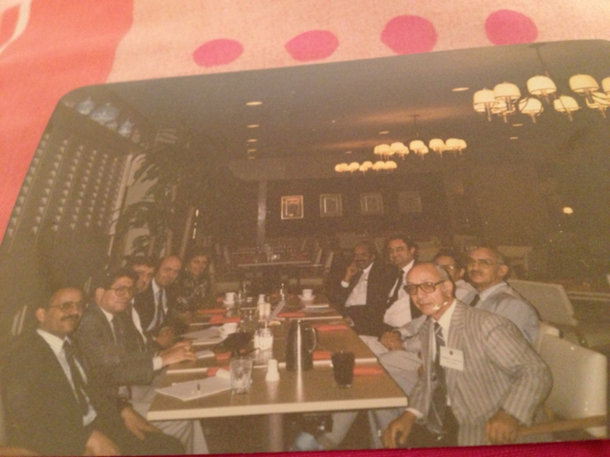
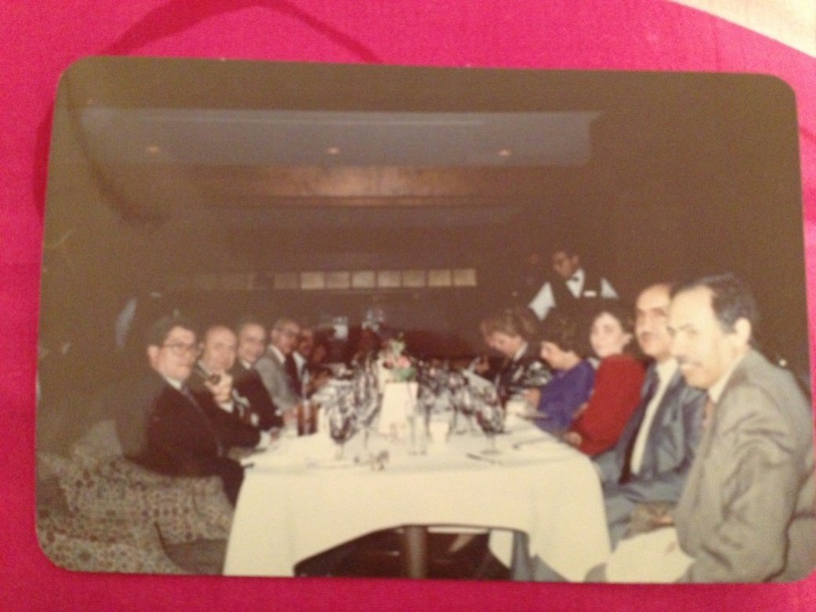
THE CREAM OF OUR AREA

Slide 12
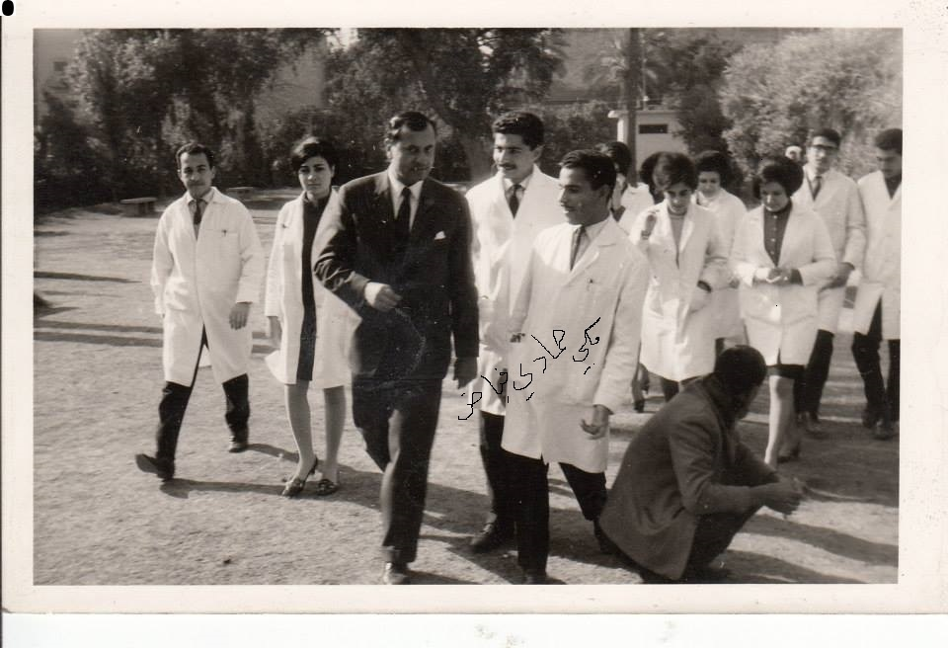
BAGHDAD MEDICAL COLLEGE always ask why ?

Slide 13
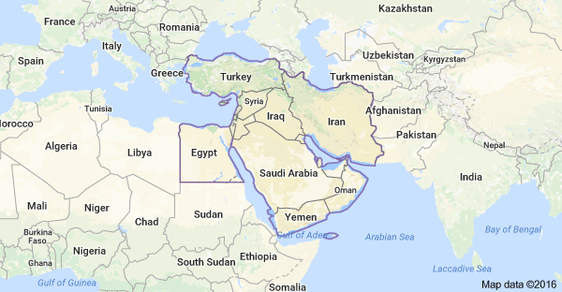
THE MIDDLE EAST

Slide 14
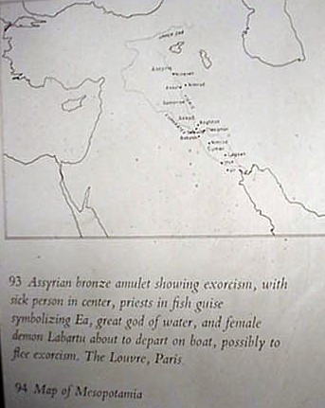
الاشوريون The Assyrians

Slide 15

MIDDLE EAST COMLEX ?????

Slide 16
The middle east past present ? FUTURE ???

Slide 17
Liver disease maps :burden in The middle east countries variable
Some countries such as Afghanistan and Pakistan are still facing gastrointestinal infectious diseases,
Countries with better economy experienced the obvious transition from communicable to non-communicable diseases.

Slide 18
Liver disease burden in the middle east
The overall burden of GIT diseases is highest in Afghanistan, Pakistan, and Egypt.
Diarrheal diseases have been replaced by gastrointestinal cancers and cirrhosis in most countries in the region.
In some countries including Afghanistan, Pakistan, Turkmenistan, Egypt, and Yemen, communicable GIT diseases are still among top causes of mortality and morbidity in addition to non-communicable GIT-LIVER and cancers.
These countries are experiencing the double burden.
In the Gulf GCC countries ,Jordan& Iraq cancers are increasing

Slide 19
Improving the infrastructure of health care system including cancer registries and electronic recording of outpatient care is a necessity for better surveillance of GIT &liver diseases.
In contrast to expensive treatment, prevention is feasible and inexpensive.
The health care systems in the region can be strengthened for prevention and control

Slide 20
Liver disease burden
Disease burden is an important indicator of the state of health of a population.
It can be measured as the frequency (eg, incidence and prevalence) of a condition or its effects including fatal and non-fatal health loss from disease (eg, disability-adjusted life years) as well as the financial costs (eg, direct healthcare costs and indirect healthcare expenditures related to lost income because of premature death).

Slide 21
Chronic hepatitis B and C
Chronic hepatitis B and C are the main causes of liver cirrhosis and progression to hepatocellular carcinoma.
Liver cirrhosis is among the top four causes of death in all countries in MENA except for Bahrain.
The death rate caused by cirrhosis in Egypt is by far the highest in the world, followed by Pakistan, Afghanistan, Yemen, and Morocco. Pakistan is specifically experiencing an epidemic of cirrhosis.

Slide 22
PRIMARY LIVER CANCER HCC
A PREVETABLE CANCER
Hepatocellular carcinoma is another complication of chronic hepatitis.
It is estimated that 78% of all cases are attributable to either chronic HBV or HCV infections.
In another report, 55% of global hepatocellular carcinoma is attributed to chronic HBV infection.
This figure is 89% in endemic regions.
Pakistan is specifically experiencing a significant rise in hepatocellular carcinoma secondary to HBV and HCV infections.

Slide 23
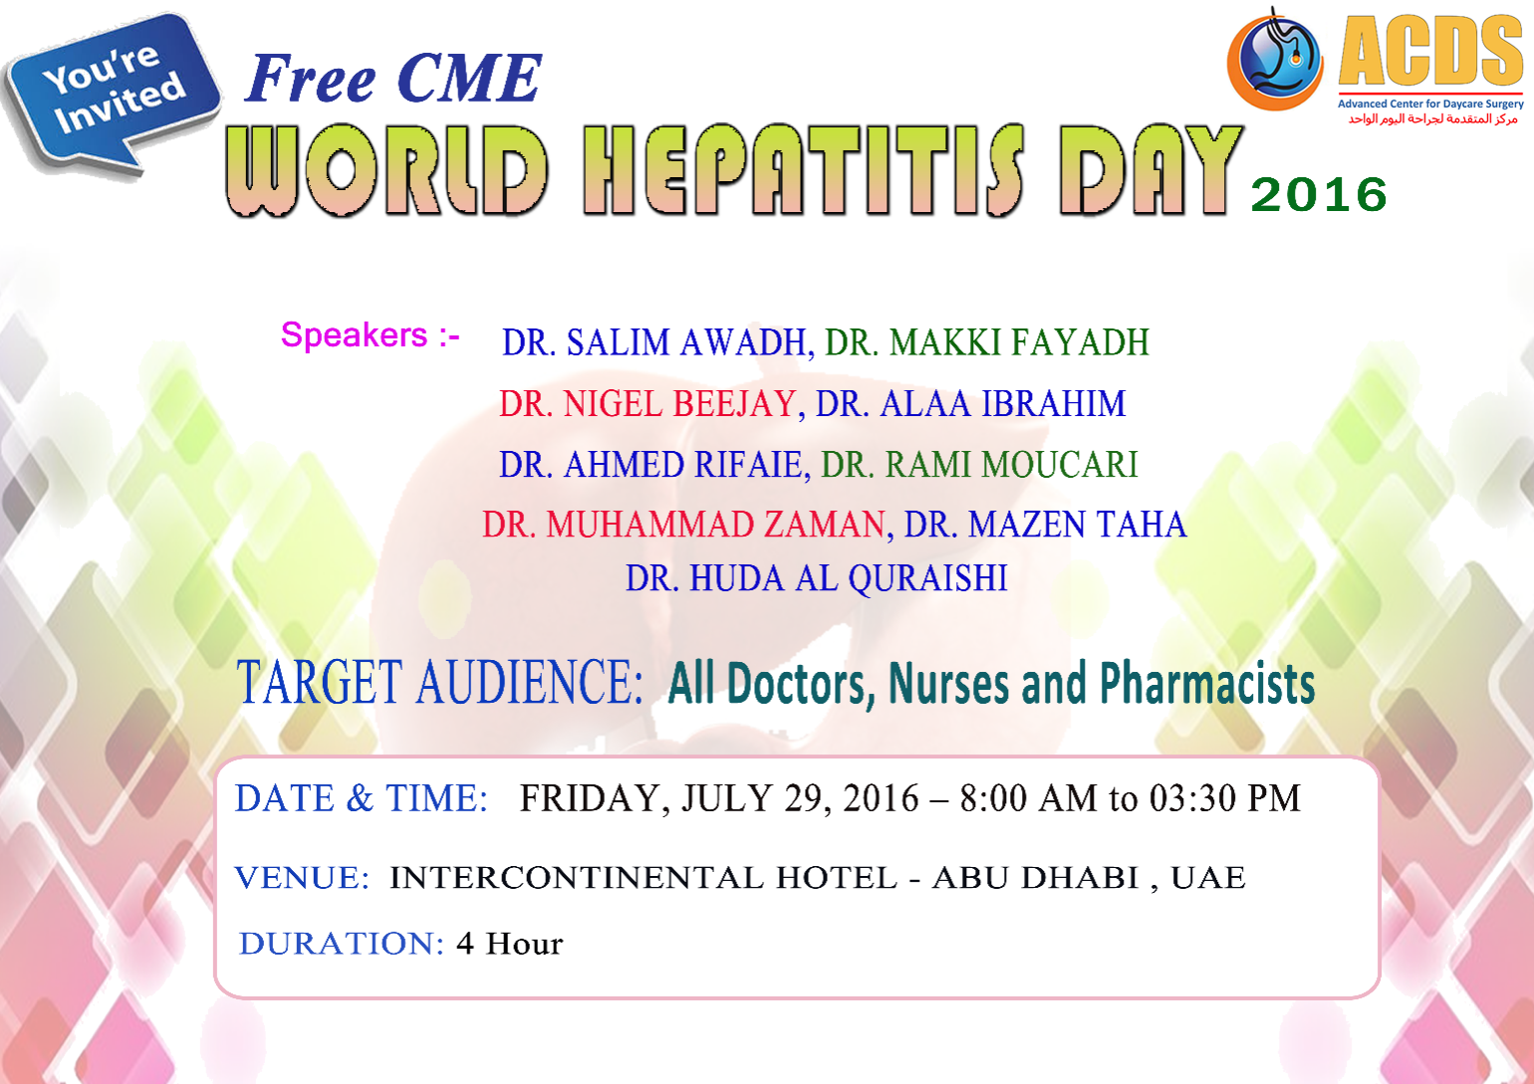
2016 JULY

Slide 24

WORLD HEPATITIS DAY 2016
When: July 29, 2016
This event was organized by the Advanced Center for Day Care Surgery and endorsed by the Emirates Society of Gastroenterology and Hepatology, sponsored by ABBVIE with Speakers from ACDS, Tawam Hospital, SKMC, Rashid Hospital, Burjeel Hospital and Advance Cure Center. Topics presented: Hepatitis C Genotype I-Huda Al Quraishi, Hepatitis C Genotype 4-Nigel Beejay, Hepatitis C Genotype 3-Salim Awadh, Hepatitis B, When to treat?Rami Moucari, Autoimmune hepatitis-Salim Awadh & Khalid Osman, Acute Liver Failure with and without Pregnancy-Salim Awadh, Case presentations - Makki Fayadh, Fatty Liver and Cancer -Nigel Beejay, Focal Liver Lesion in Cirrhotic Liver -Muhammad Zaman, Iron Overload and the Liver- Makki Fayadh, Celiac Disease and the Liver -Salim Awadh, Inflammatory Bowel Disease and the Liver -Mazen Taha.
ACCREDITED 4 HRS CME BY HAAD. KINDLY POST IT IN THE WORLD GASTROENTEROLOGY
ORGANIZATION AND CC TO DR. MARYAM AL KATHRI AND TO US.
ATTENDED BY 120 DOCTOR AND NURSES IN THE WHOLE UAE

Slide 25
WORLD HEPATITIS DAY 2016 UAE RECOMMENDATIONS
1. TO TREAT ALL HCV CARRIER.
2. SCREEN HEALTH CARE WORKERS FOR ANTI HBS AB, ANTI HB CORE TOTAL AND HCV.
3. SURVEILLANCE FOR LIVER CANCER IN ALL HEPATITIS B & C CARRIER AND FATTY LIVER DISEASE IF ASSOCIATED WITH FIBROSIS.
4. MAKE TREATMENT AVAILABLE FOR HEPATITIS C FOR ALL WHO NEED IT WITH A MINIMUM COST AND TRY TO USE PANGENOTIPIC MEDICATION.
5. PRIMARY SCLEROSING CHOLANGITISIS ASSOCIATED WITH ULCERATIVE COLITIS AND
IGG4 DISEASE SHOWED BE EXCLUDED.
6. CELIAC DISEASE IS MORE RECOGNIZED IN UAE BUT STILL NEED MORE AWARENESS
AND INITIAL DATA PREVELENCE OF 2.3% CAN BE ASSOCIATED LIVER DISEASE.
7. FOCAL LIVER LESION NEED TO BE DETECTED EARLY AND TREATED EARLY
8. HEPATITIS A& E NEED MORE PUBLIC AWARENESS AND MORE HYGIENIC ENVIRONMENT.
9. AUTOIMMUNE HEPATITIS AND SUB TYPES WERE REVIEWED.
10. LIVER DISEASE IN PREGNANCY DIAGNOSIS AND MANAGEMENT WERE DISCUSSED.
11. IRON OVER LOAD WAS ADDRESSED AND THE NEED TO DO IRON AND TRANSFERRITIN AND IF POSITIVE, GENETIC TEST TO BE ADDED.
12. CASE PRESENTATION INCLUDED ACUTE HEPATITIS,FLARE UP AFTER IMMUNOSUPPRESSION
AUTOIMMUNE HEPATITIS, IRON OVER LOAD, 2 CASE OF PRIMARY SCLEROSINGCHOLANGITIS, AND CELIAC DISEASE.

Slide 26
MENA REGION
The rates of stomach cancer are highest in Afghanistan, Iran, and Turkmenistan.
Cancer of stomach is followed by liver cancer, colorectal cancer, esophageal cancer, pancreatic cancer, and gall bladder and hepatobilliary cancer in the entire region.
Liver cancer is among the top four causes of death in 18 countries

Slide 27
UAE Seroprevalence of HBV amongst Health Care workers in Sharjah (any marker)
Nationality | Total Number (n) | Positive cases (n) | Percentage
ISC / SEA | 346 | 104 | 30.0
North African Arabs | 178 | 48 | 26.9
Gulf Area | 111 | 26 | 23.4
Middle East Arabs | 129 | 30 | 23.2
Europeans | 67 | 11 | 26.4
Dajani et al. Em Med J. 1987;5:100-107

Slide 28
UAE HBV Carrier rates: Population groups
Seroprevalence of HBV carriers in UAE cohort. Dajani, Fadlullah, Butt, et al 2nd Emirates GI conference 1988.

Slide 29
UAE HBV carrier rates according to blood bank statistics
Seroprevalence of HBV carriers in UAE cohort. Dajani, Fadlullah, Butt, et al 2nd Emirates GI conference 1988.

Slide 30
UAE HBV carrier rate by age group
Seroprevalence of HBV carriers in UAE cohort. Dajani, Fadlullah, Butt, et al 2nd Emirates GI conference 1988.

Slide 31
HBV carrier rate in the UAE citizen
Military (n=955), non-military (n=492)
 | Total Number | HBsAg +ve | Percentage
Total Number | 1447 | 30 | 2.1
Males | 1092 | 24 | 2.2
Females | 355 | 6 | 1.7
Hepatitis A,B,C,D and E Seroprevalence in the UAE citizen Al Boloushi et al; 3rd Emirates GI conference 1995:153

Slide 32
The genotype distribution in UAE
The genotype distribution for 108 patients [UAE nationals] with chronic HBV infection was as follows;
Genotype D 80 %
Genotype A 15 %
Genotype C 1 %
Genotype F 1 %
Genotype A and F 1 %
Genotype A and D 1 %
Unknown Genotype 1 %

Slide 33
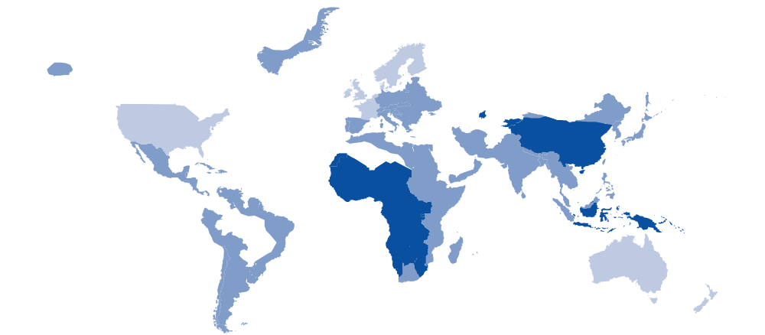
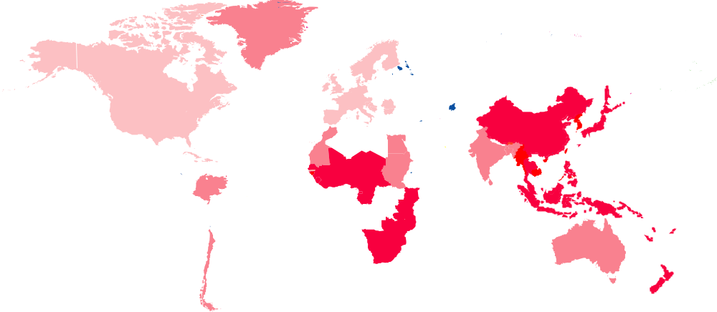
Geographic Distribution of HBV Carriers and Incidence of Hepatoma
Prevalence of HBV carriers
Annual incidence of hepatoma
<1%
1-10%
>10%
unknown
incidence/100,000 population
1-3
3-10
10-150
unknown
Notes:
Geographic distribution of HBV carriers and incidence of HCC
HBV prevalence varies around the world; the most endemic regions being Asia, the Pacific and sub-Saharan Africa. A significant correlation between the prevalence of HBV and incidence of hepatocellular carcinoma can be observed. HBV is the single most important cause of primary liver cancer.
Yu MC, Yuan JM, Govindarajan S, Ross RK. Epidemiology of hepatocellular carcinoma. Can J Gastroenterol 2000;14:703-9.

Slide 34
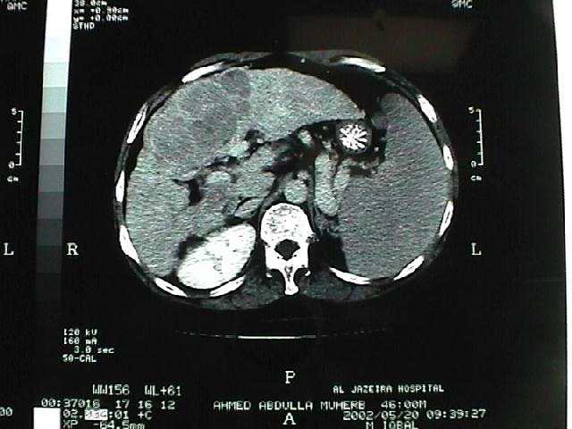
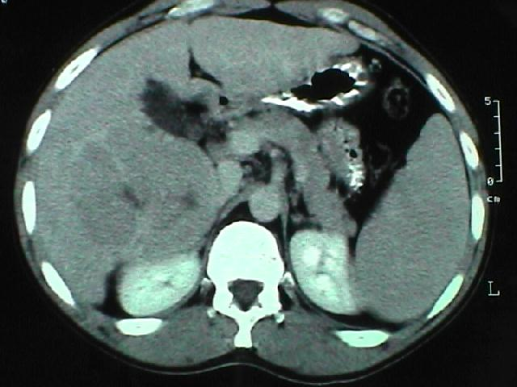
HCC : [HEP B ]
1-MULTIFOCAL 2-NODULAR

Slide 35
Familial transmission in UAE
Family A- [Abu dhabi]---- 23 3 families
Family B [Al-Ain] 11 2 families
Family C [Dubai] 11 2 families
Family D [Ras-alkhaima] 9 2 families
Family E [Sharjah] 7 2 families
Family F [Fujaira ] 6 1 family
Family G [Oman] 7 1 family
Family H [Saudi] 4 1 family
Family I [Syria] 5 1 family

Slide 37
HEPATITIS-C
Epidemiology – Middle East
EASL 2005

Slide 38
Hepatitis C: A Global Health Problem
About 300 Million Carriers Worldwide
EAST
EUROPE
10 M
U.S.A.
3-4 M
WEST
EUROPE
5 M
FAR EAST ASIA
60 M
SOUTH EAST ASIA
30-35 M
AFRICA
30-40 M
AMERICAS
12-15 M
AUSTRALIA
0.2 M
SOURCE, WHO

Slide 39
HCV genotypes
Chronic Hepatitis C affects more than 300 million people worldwide
The clinical significance of HCV genotypes that are not common in the USA, Europe, or Japan has received minimal attention because most scientific investigations are being conducted in these countries.
Genotype 4 is the predominant genotype in
Middle Eastern Countries

Slide 40
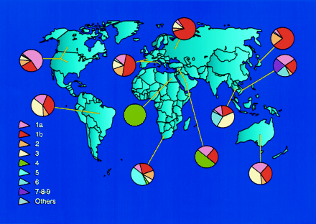
Worldwide geographic distribution of HCV genotypes and subtypes

Slide 41
Prevalence of Genotype 4 among HCV infected Middle Eastern Patients
* Eastern province of Syria
Hasan et al. Hepatogastroenterology 2002
Shobokshi et al. Saudi Med J 2003
Ray SC,et al,J.Infect.Dis.2000;182:698-707

Slide 42
Genotypes in UAE nationals
Awadh S, Jazeera Hospital AXD 2004

Slide 43

Hepatitis C Prevalence in Blood Donors
Reported from:
USA 0.5%
Canada 0.6%
Japan 1.4%
Korea 0.6%
Egypt 11-19%
Australia 0.4%
UAE * 0.7%
Salem S. 4th Emirates GI Conference 2002
Notes:
done

Slide 44
GENOTYPE 4 SUBTYPES IN UAE

Slide 45
GENOTYPE 4 SUBTYPES
Non-European countries (Central Africa or the Middle East), living in France were mainly infected with G4 subtypes 4f, 4k, 4r
Egypt :- G4 subtypes 4a, 4d, 4c
Saudi Arabia ;- G 4c /4d [33%;],4h [14%];,4e 7%;
UAE G 4c /4d [42%];,4h [29%]; 4e [29%];

Slide 46
HCV genotype
HCV genotype… 54.3% 4a
28.7% 4b/c
14.9% 1
0.5% 2
1.1% 3
Frank et al . In press

Slide 47
HCV in National Rehabilitation Center
Abu Dhabi, 2003-2004
n= 64
Total number of HCV patients :- 20 (31%)
Total number of IV drug addicts:- 23
Hepatitis +ve patients 20
Hepatitis -ve patients 3
HCV+ve 19(95%)
HBV+ve 1(5%)

Slide 48
ALT at presentation in UAE nationals with Hepatitis C-G4

Slide 49
UAE nationals blood transfusion induced Hepatitis C
ALT level in UAE national Hepatitis C Patients
UAE nationals drug users induced Hepatitis C

Slide 50
Viral load at presentation

Slide 51
Liver biopsies at presentation

Slide 52
HCV Patients with Genotype 4 Post Liver Transplantation
26% of HCV genotype-4 patients developed either severe fibrosis or cirrhosis versus 6.7% in the genotype non-4 group (P =.04).
A statistically significant greater fibrosis progression rate was observed in genotype-4 than genotype non-4 patients.
5 year cumulative rates for the development of cirrhosis or severe liver fibrosis = 84% in genotype-4 and 24% in genotype non-4 patients (P =.02).
Liver Transplantation 9(8): 796-804. August 2003.

Slide 53
HCV Patients with Genotype 4 Post Liver Transplantation
5-year survival rates for patients with genotypes 1, 2/3, and 4 were 72%, 80%, and 79%, respectively
5-year survival for patients who underwent transplantation for HCV genotype-4 was similar to that of genotype non-4;
However, more severe fibrosis and rapid fibrosis progression was observed after transplantation in genotype-4 patients
Liver Transplantation 9(8): 796-804. August 2003.

Slide 54
MOST COMMON ASSOCIATED DISEASES IN UAE NATIONALS WITH HEPATITIS C-G4
Diabetes Mellitus….22 %
Skin Lesions (Psoriasis, Lichen Planus, Vitiligo..)…. 14 %
Hypothyroidism…4%
Hyperthyroidism…1%
Glomerulonephritis…2%

Slide 55
Epidemiology of Hepatitis C in UAE
Conclusions
1-HCV is not as common in UAE nationals compared to other nationalities.
2-Most common HCV genotypes in UAE nationals are types 1,4,3 respectively
3-The source of transmission of type 1 & 4 is blood transfusion while IVD drug users is the main source of transmission of G3.
4-Normal ALT is more prevalent in transfusion induced
Hepatitis C than IVD drug users.
5- Viral load is NOT correlated to the underlying genotype.

Slide 56
Conclusion
The geographic distribution and diversity of HCV genotypes may provide clues about the historical origin of HCV
Steatosis is a feature of Genotype 3 but fibrosis is a feature of Genotype 4
Genotyping may be a useful tool for tracing the source of an HCV outbreak
Subtype is useful to determine which subtype may be relevant in the development of HCC

Slide 57
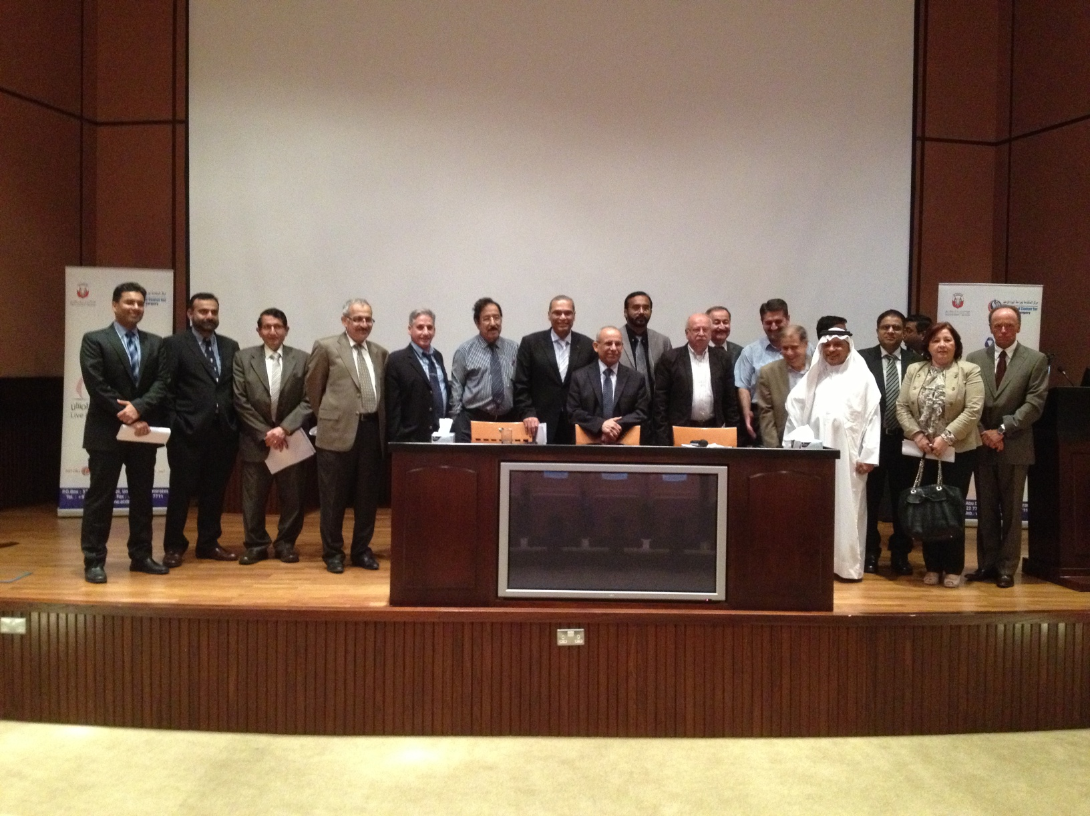
LIVER CANCER RECOMMENDATIONS

Slide 58
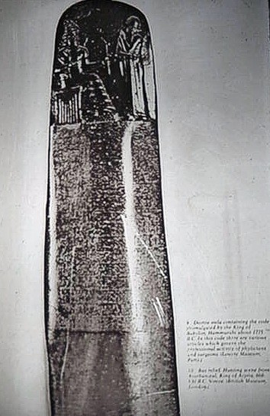
The Practice of medicine in Iraq date back to over 5000 years.
The first medical law and the sanitary drainage system and toilets were established that time .
Surgical instruments were used
اول قوانين طبيه قبل 5000 سنه.

Slide 59
The liver and the Biliary tree and the inferior vena cava , liver viens , the pylorus, the pancreas ,were described in full details.وصفوا امراض البطن وتشريحه

Slide 60
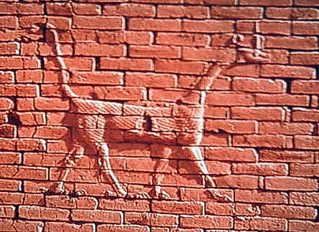
They used the followings:-
Liquorice for heart burn, other herbs mixed in honey and yoghurt.
They used Castor oil, psyllium ,Beer.
For abdominal distention they used equal parts of marihuana with mustard mint, Castor oil, almond oil, rice, and others, 10 shaykals each.
The shekels is the Babylonian unit of measurement.
الشيكل وحدة القياس البابليه

Slide 61
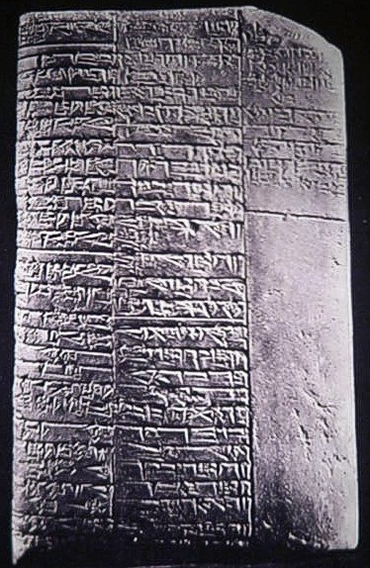
They used large number of herbs.
They used a variety of local suppositories .
Pocket medical books were also used with prognostic markers e.g. a man with belly pain, vomiting and absolute constipation will die.استعملوا اللبوس-التحاميل وكتب الجيب الطبيه

Slide 62
Iraqi git 1960-2016
In the sixties pioneers in Baghdad medical colleage specialy the late Professor Zuhair Kassir and Professor Zuhair Bahrani started weakley G.I.T meetings with their colleagues which continued to the seventies stopped 1976.

Slide 63
1978-1992
Viral hepatitis groups
Program for liver disease control
Git society
Git board
Journal
Data
Plan
pyramid of developement

Slide 64
IRAQI RESEARCH
HEPATITIS
HYDATID ATTEMPTED VACCINE PROGRAM KHALIG NAJI
CELIAC DISEASE LOCALLY MADE AGENTS-CELIAC FOOD
TB CROHNS
CANCERS DATA COLLECTION ON DEPLETED URANIUM
PROBIOTICS PROGRAM 1994
PAN ARAB COMMUNICATION

Slide 65

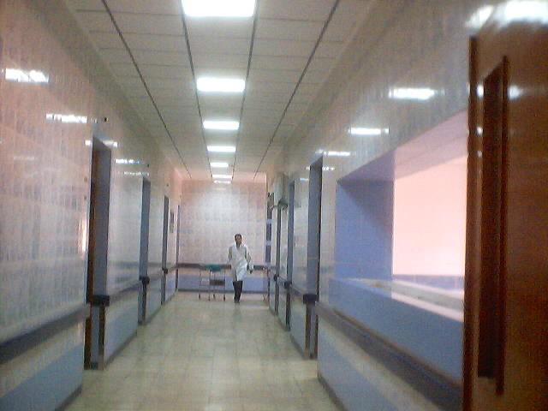
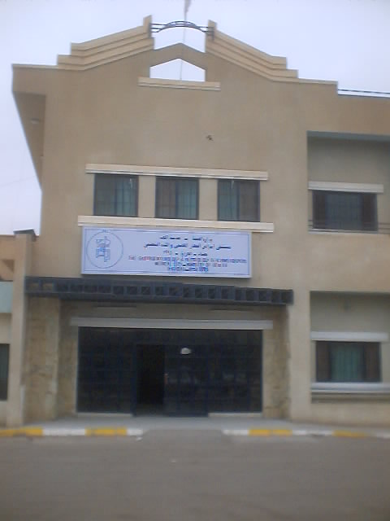
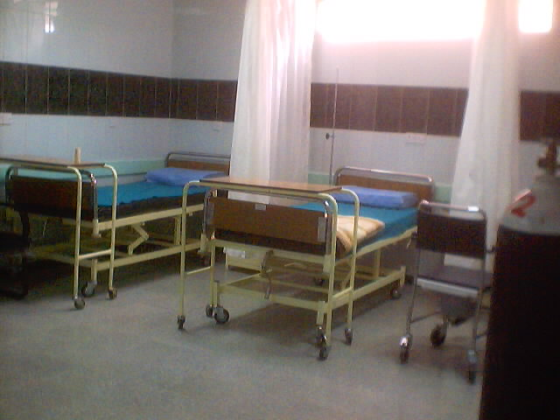
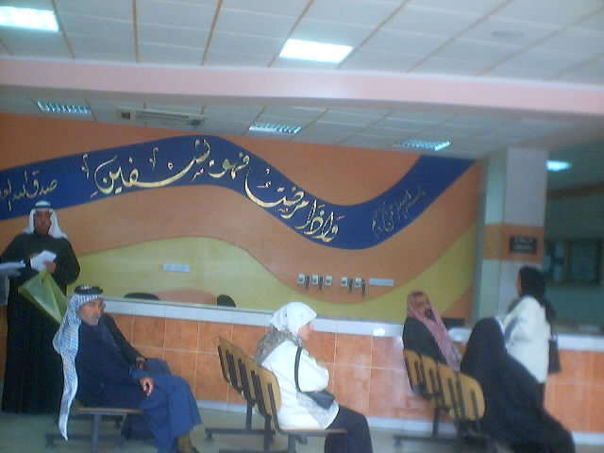
LOCALLY MADE 120 BED HOSPITAL
500,000 $ ONLY
3 centers

Slide 66
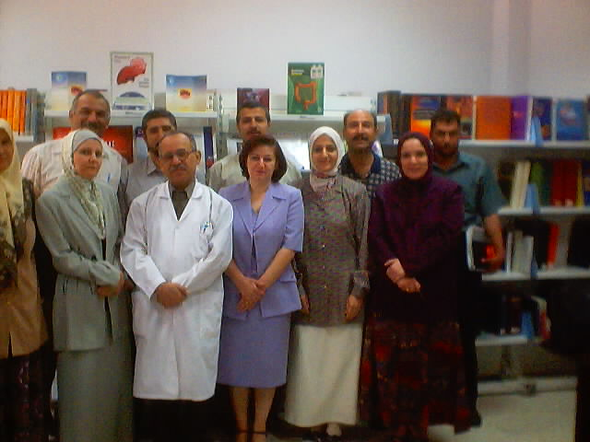
MDT PATHOLOGIST GASTROENTEROLOGISTSSURGEONS PEDIATRICIANS ONCOLOGISTS

Slide 67

خطتنا لتطوير الجهاز الهضمي فى العراق
PLAN FOR IRAQI GIT UPGRADING

Slide 68

Z.Kassir
Z.Bahrani
Makki Fayadh
A. Shubber
M. AL-Hilli
M. Madhat

Slide 69
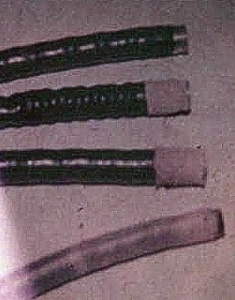
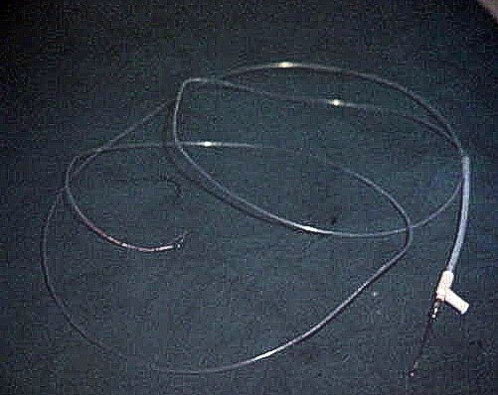
ERCP-EXPIRED CONTRAST 7 YEARS IT WORKED?
1990-2003 SIEGE

Slide 70
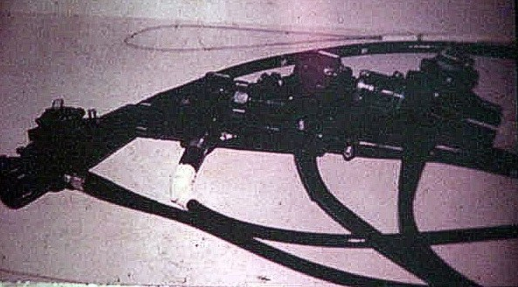

Slide 71
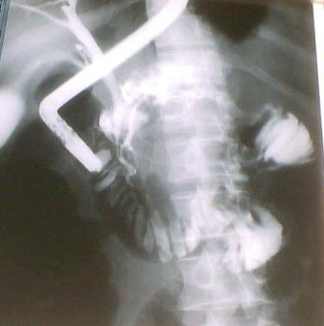
ERCP CONTRAST EXPIRED 7 YEASRS
EXPIRED SCOPES & CONTRAST

Slide 72
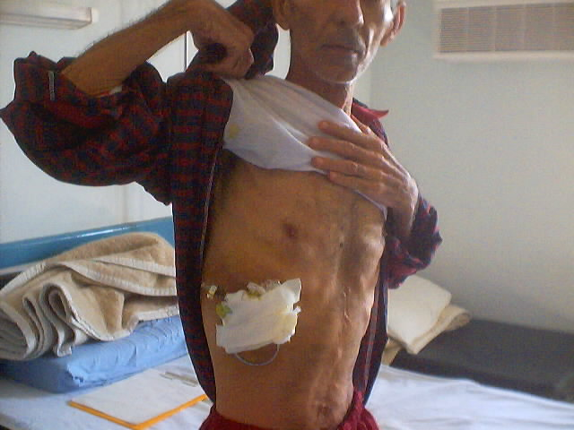
Biliary drainage ?

Slide 73
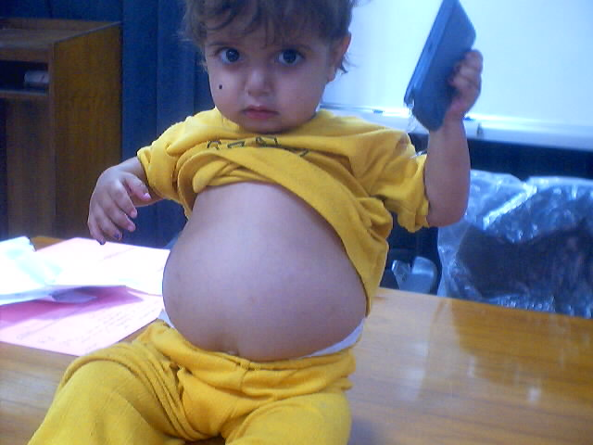
Glycogen storage disease

Slide 75
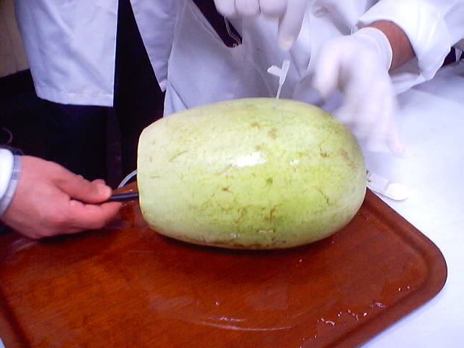
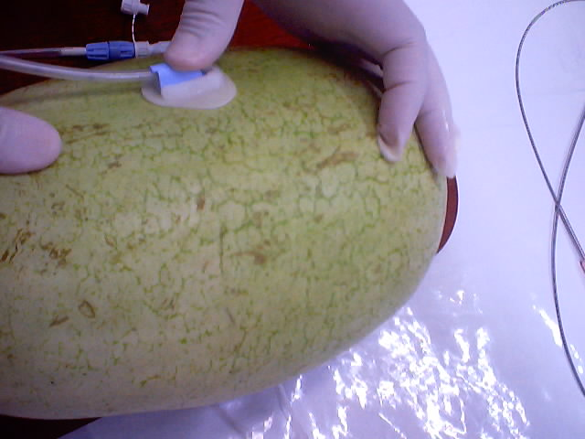
Pan Arab gastroenterology hepatology

Slide 76
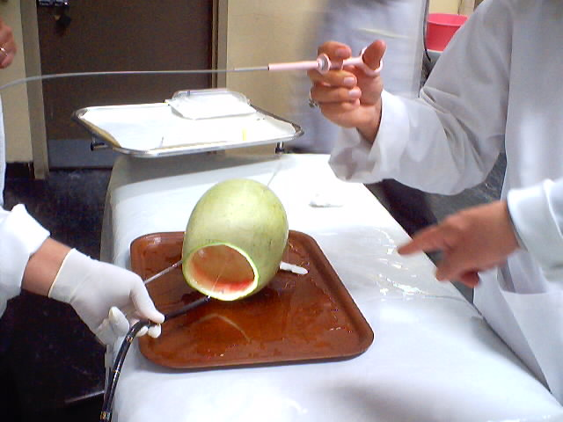
Water melon cheep training

Slide 77
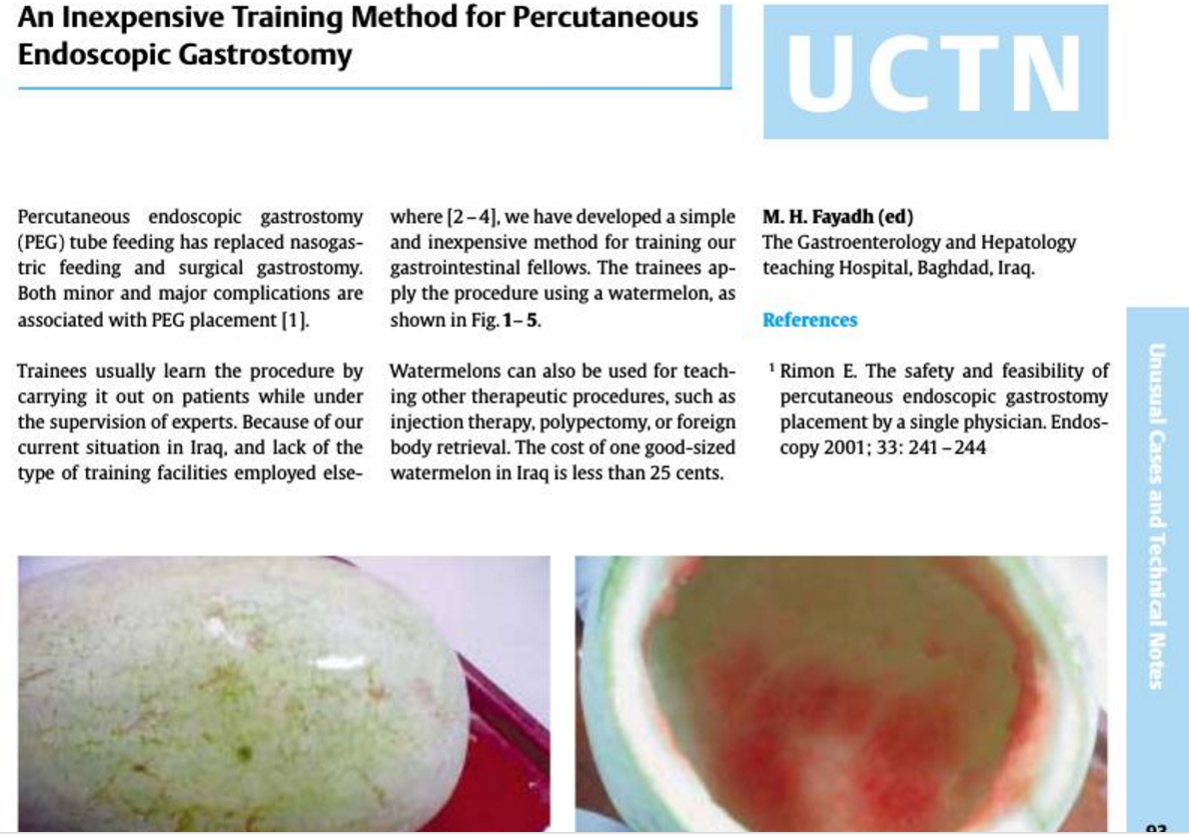
Watermelon is your teacher….

Slide 78
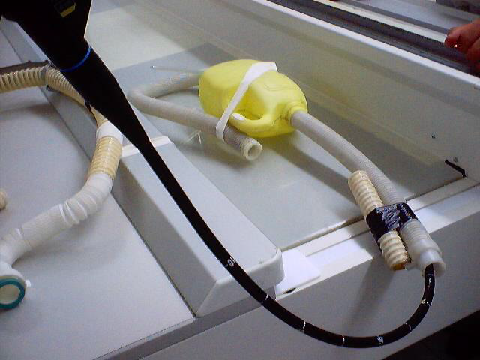
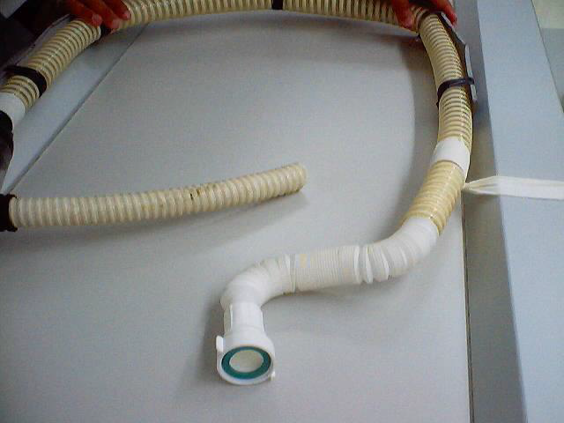
TRAINING

Slide 80
Medical Team
S. Farhan
Surgical Team
S. Abd AL Nabi

Slide 81
خطتنا لتطوير الجهاز الهضمي فى العراق
PLAN FOR IRAQI GIT UPGRADING

Slide 82
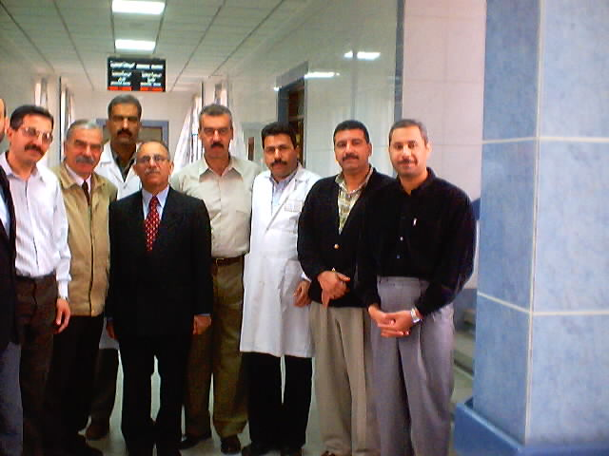
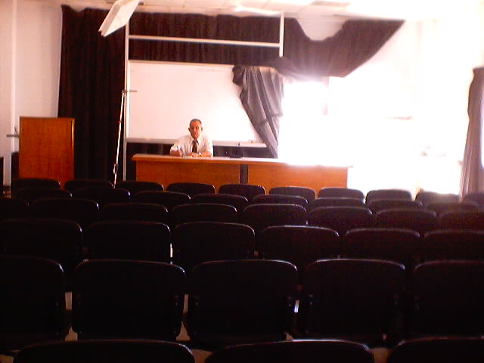
AFTER END OF BOMBING 2003 COUNTING LOSSES

Slide 83
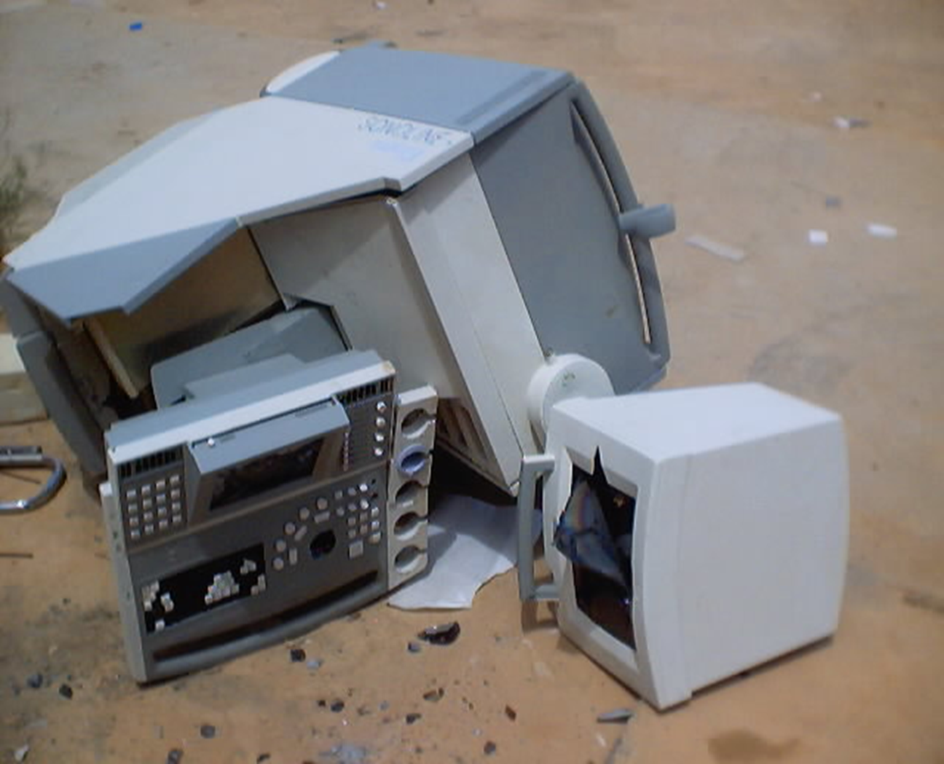
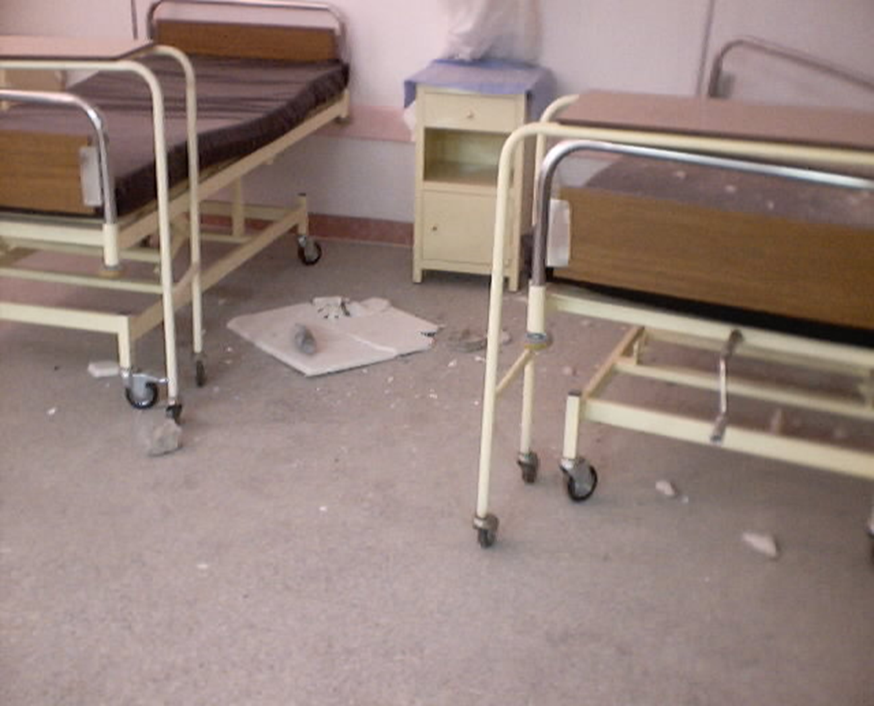
THE WARS

Slide 84
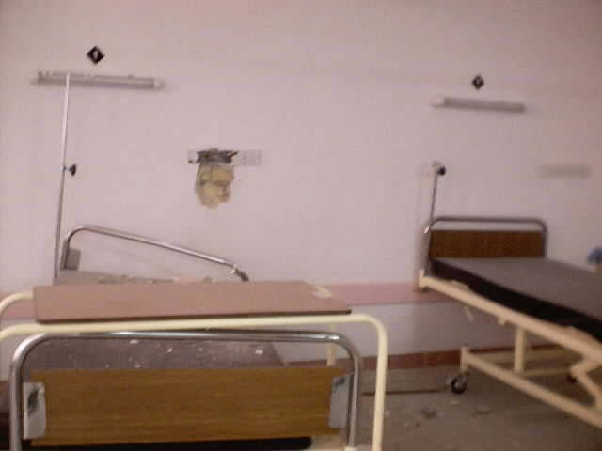
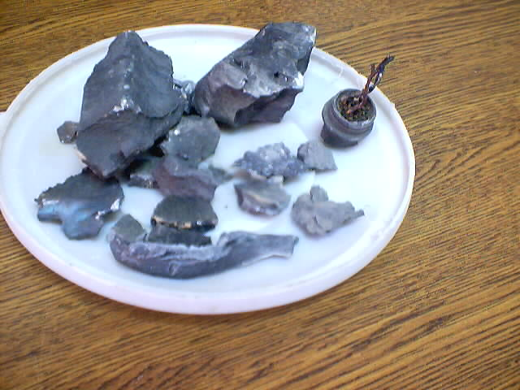

Slide 85
POST WAR IRAQ GIT
The battle for the Gastroenterology Hospital in Baghdad 2003
The first time in history alchemical (FORMALDEHYDE)
Used in defense

Slide 86
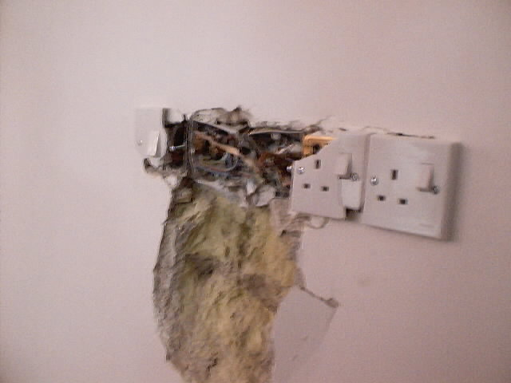

Slide 87
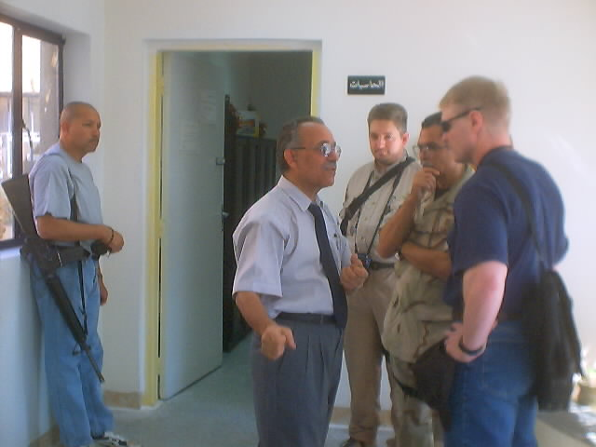

Searching for chemical weapons

Slide 88


TALKS-GUARDIA
TALKS-THEY ONLY WRITE WHAT THEY WERE TOLD??
TALKS ONLY

Slide 89


Slide 90
The battle for the Gastroenterology Hospital in Baghdad 2003
The first time in history alchemical (FORMALDEHYDE)
Used in defense
*MakkiH.Fayadh
Background:
TheIraqisocietyofgastroenterologyandhepatologywasestablishedin1992after13yearsofstrugglewiththeIraqigovernmentofficialswhichendedinthehighcourtinfavorofthesocietyestablishment.
Sinceit’sestablishmentin1992,thesocietymemberssucceededinconvincingtheofficialsinestablishingthegastroenterologyandhepatologyteachinghospitalin1995.
Thehospital,hundredbeds,wasestablishedwithinthebigmedicalcitycomplex(3000beds)inBaghdadontheremainsoftheoldjamhoreehospital.ThecomplexextendsbetweentwobridgesontheriverTigrisandcomposedof7buildingsinadditiontoBaghdadmedicalcollege&theministryofhealthbuildingandacrossthebridge,theministryofdefence.
Between1995–2003,manydevelopmentsoccurred:
Establishmentof the gastroenterologyboardstudy1996.
Established the surgical gastroenter-ologyboardstudy1999.

Slide 91



For these people we worked itching high liver enzymes ? What is the diagnosis

Slide 92
The Gastroenterology and Hepatology teaching Hospital consist of (120 medical and surgical beds)1994
One floor for the medical words with 4 endoscopy procedure rooms , and 4 interventional endoscopy and radiology procedure rooms.
Specialized clinics for :-
liver disease clinic
colitis clinic
celiac clinic
Paediatric GIT clinic
GIT oncology clinic
Pain clinic
The other floor is for the surgical words , with 4 operating rooms and intensive care unit of 8 beds .
Fully equipped lecture room for 100 attendants .
Fully equipped library with electronic data and computer connection to all departments and audiovisual transmission to the lecture room from the operating theaters and endoscopy rooms.

Slide 93
HOME MADE AUDIO VISUAL

Slide 94
The Iraqi board of GI surgery was established 1999.
The Iraqi journal of gastroenterology was published 2001.
The society and Center organized 4 big conferences and monthly symposia with weakly G.I.T meetings

Slide 95

Case presentations
EX PRESIDENT HEALTH,SENIOR SURGEON TRAINER

Slide 96
IRAQI INVENTIONS
CONDOMS TO DILATE ACHALASIA
WATER MELON TO TRAIN ENDOSCOPIC GASTROSTOMY
OLD CAMERAS TO MAKE CLOSE CIRCUIT TV
DRAINAGE PIPES FROM OLD WASHING MACHINES TO MAKE DEMOS-FOR COLONOSCOPY-GASTROSCOPY-ERCP

Slide 97


ACHALASIA NO DILATOR

Slide 98

Achalasia dilation condoms sent as aids ??? I USED FOR DILATION IT WORKED ??

Slide 99
the battle for the Gastroenterology Hospital in Baghdad 2003 3
IJGE Issue 6 Vol. 1 2006 the battle for the Gastroenterology Hospital in Baghdad 2003 3 The battle for the Gastroenterology Hospital in Baghdad 2003 The first time in history a chemical ( FORMALDEHYDE) Used in defense
*Makki H. Fayadh

Slide 100
BEFORE WAR

Slide 101
2004 NATIONAL CENTER FOR LIVER DISEASES
NATIONAL CENTER FOR LIVER DISEASE 2004
تم استحداث مركز وطني لدراسات وبحوث وعلاج أمراض الكبد الحادة والمزمنة يرتبط بدائرة الخدمات الصحية المتخصصة وحسب بيانوحسب بيان وزارة الصحة المرقم 52 في 13/3/2004 .

Slide 102
IRAQI GIT SOCIETY
1-PROMOTE GIT TRAINING
2-DATA BASE FOR OUR DISEASES
HEPATITIS B AND C
HELICOBACTER PYLORI STUDIES IN HUMANS AND ANIMALS
LIVER TRANSPLANT IN DOGS
PREVENT CANCERS OF
STOMACH
COLON
LIVER

Slide 103
IRAQ
1978 IRAQI SOCIETY
1980 ERCP
1984 HEPATITIS B VACCINATION PROGRAM
1989 LIVER UNITS
1992 GIT SOCIETY ESTABLISHES
1994 IRAQI GIT CENTER ESTABLISHED
1996 IRAQI BOARD OF GASTROENTEROLOGY ESTABLISHED

Slide 104
1998 IRAQI SURGICAL GIT BOARD
1999 IRAQI JOURNAL OF GASTROENTEROLOGY
2001
PROGRAM FOR ALL IRAQ GIT DEVELOPMENT
THE PYRAMID

Slide 105

GIT PYRAMID PLANNED ABCDE

Slide 106
LESSONS FROM IRAQ
1. gastro esophageal reflux disease is the leading cause of dyspepsia in addition to peptic ulcer disease.
2. Ulcerative colitis and to lesser extent Crohn’s disease are rising in Iraq.
3. Chronic liver diseases are very prevalent and account for 2/3rds of the admissions in the Center, the important causes is in the following order :-
Hepatitis B , alcohol, Hepatitis C, immune hepatitis , metabolic diseases.
HbsAg carrier rates in Iraq vary between 1.5-7% .
HCV Carrier rates of about 1%.

Slide 107
LESSONS FROM IRAQ
4. Pancreatico biliary tumours are frequent,specially pancreatic cacinoma and cholanigocarcinoma , occurring at younger ages.
5. Biliary obstruction , the causes are:-
  stones.
  post operative strictures .
  cholangio carcinomas.
6. Coeliac disease is frequently seen both in children and adults.

Slide 108
LESSONS FROM IRAQ
7. Biopsy interpretations of inflammatory bowel disease and mal absorption states pause a problem because of the prevalence of local disease like parasites and GIT pathogens .
8. laparoscopy proved very useful in the evaluation of ascites and for shortening hospital stay and avoiding lengthy investigations.
9. Endosonography (EUS ) proved very useful in the evaluation of sub mucosal GIT lesions

Slide 109
LESSONS FROM IRAQ
10. imaging techniques including U/S ,MRI ,CT scan proved very useful but in many times conflicting results occur, further training is needed especially contrast enhancement and dynamic studies .
11. GIT and liver cancers are increasing and occurs at younger ages and more undifferentiated and we lack method to deal with liver secondaries.

Slide 110
LESSONS FROM IRAQ
12. interventional endoscopic and radiologic proccdures are done increasingly in the center including :-
Esophageal dilation and stenting.
Biliary stenting.
Endoscopic hemostasis.
Endoscopic resections for polyps and Endoscopic
mucosal resections (EMR).
Percutancus drainge and stenting.

Slide 111
LESSONS FROM IRAQ
13. The mortality in the center showed that chronic liver disease comprised two thirds followed by malignant disease which mecessitate :-
Establishment of liver transplantation program.
Upgrade the surgical and radiological techniques in
the management of primary and secondary tumors.

Slide 112
The Spectrum of GIT diseases in Iraq
1995 -2003
Of 157606 outpatient and 5416 inpatient admitted the following results were noted:-
1- gastro esophageal reflux disease is the leading cause of dyspepsia in addition to peptic ulcer disease.
2- Ulcerative colitis and to lesser extent crohn’s disease are rising in Iraq.
3- Chronic liver diseases are very prevalent and account for 2/3rds of the admissions, the important causes is in the following order , Hepatitis B , alcohol, Hepatitis C, immune hepatitis , metabolic diseases.
4- HbsAg carrier rates in Iraq vary between 1.5-7% and HCV Carrier rates of about 0.5-1%.
5- GIT and liver cancers are increasing and occurs at younger ages and tend to be more undifferentiated.
6- Biliary obstruction , the causes are stones, post operative and cholangiocarcinomas.
7- Coeliac disease is frequently seen both in children and adults.

Slide 113
In-patients[1995-2001]
5416 - Total admissions.
1800 - Liver Diseases (33%).
1186 - Cancers (22%).
780 - Biliary Diseases (14%).
500 - Intestinal Diseases (9%).
115 - Esophageal Diseases (2%).
100 - Pancreatic Diseases (1.8%).

Slide 114
STUDIES IN IRAQ

Slide 115
Iraq Najaf
Total number 579
Total HCV 343 (NAJAF 280)
Genotype 1 = 70 28%
Genotype 4 = 120 60%
Other types &mixed types= 10 % 5%
Without genotype =142

Slide 116
Cancers 1995 - 2001
5416 patients admitted.
1186 patients had malignant diseases (22%) .
617male patients .
569 females patients M/F ratio =1.08.
Pancraticoampullary 262 (22%).
Cholangiocarcinoma and GB cancer 236(19.8%).
Liver secondaries 216 (18%).
Cholangiocarcinoma 117(9.8%).
Colorectal cancer 114(9.6%).
Non Hodgkins Lymphoma 109(9.1%).
Gastric cancer 101(8.5%).
Hepatocellular carcinoma (HCC) 67(5.6%).
Malignant Ascites 48(4%).
Esophageal cancer 22(1.8%).
Gall bladder cancer 19(1.6%).
Hodgkins disease 11(0.9%).

Slide 118
WAR & GIT PRACTICE IN IRAQ
The war affected our center drastically and especially damages were done to all the facilities including windows ,doors through the shelling of the neighboring ministry of defense which was followed by looting which included loss of the air-conditioning facilities and patients furniture and some of the medical equipment and the only two operative laparoscope’s .
The damages were done to the center after the allied forces entered the medical complex and the center was looted because of loss of security but luckily we could preserve most of the important endoscopic and operative instruments and we maintained our work without interruption .

Slide 119
TALKS-GUARDIA
TALKS-THEY ONLY WRITE WHAT THEY WERE TOLD??
TALKS ONLY

Slide 120
Prevalence rates of viral hepatitis infections in refugee Kurds from Iraq and Turkey. POST WAR
Chironna M, Germinario C, Lopalco PL, Carrozzini F, Barbuti S, Quarto M.
Source
Dept. of Internal Medicine and Public Health, Hygiene Section, University of Bari, Policlinico, Piazza G. Cesare 11, I-70124 Bari, Italy. m.chironna@igiene.uniba.it
RESULTS:
Overall seroprevalence for
anti-HAV was 94.4% and
14.8% for anti-HEV.
A significantly higher prevalence for anti-HEV was found among Iraqis (17.5%) compared to Turkish immigrants (10.0%).
The prevalence of hepatitis B surface antigen (HBsAg) and total anti-HBc (core) was 6.8% and 35.6% in Turkish Kurds and 2.2% and 12.7% in Iraqis, respectively.
Only 10% of children aged up to 10 years and 2.8% of subjects aged 11-20 years had been vaccinated against HBV, the majority of them coming from Iraq.
One subject was confirmed as positive for anti-HCV (0.1%) and HCV-RNA and analysis showed a 4c/4d genotype.

Slide 121
WHO EMRO
Iraq
﻿
Viral hepatitis
Share on facebook Share on twitter
Hepatitis is an inflammation of the liver, most commonly caused by a viral infection. There are five main hepatitis viruses, referred to as types A, B, C, D and E. These five types are of greatest concern because of the burden of illness and death they cause and the potential for outbreaks and epidemic spread. In particular, types B and C lead to chronic disease in hundreds of millions of people and, together, are the most common cause of liver cirrhosis and cancer.
Hepatitis A and E are typically caused by ingestion of contaminated food or water. Hepatitis B, C and D usually occur as a result of parental contact with infected body fluids. Common modes of transmission for these viruses include receipt of contaminated blood or blood products, invasive medical procedures using contaminated equipment and for hepatitis B transmission from mother to baby at birth, from family member to child, and also by sexual contact.
Acute infection may occur with limited or no symptoms, or may include symptoms such as jaundice (yellowing of the skin and eyes), dark urine, extreme fatigue, nausea, vomiting and abdominal pain.
Based on the WHO-supported study in 2006, hepatitis A is hyper-endemic in Iraq. 96.4% of people at one stage have been exposed to hepatitis A. Hepatitis E is also endemic with prevalence of 20.3%; both hepatitis B and C have a low/very low endemicity (1.6% and 0.4%, respectively).

Slide 123
Age

Slide 124
Age

Slide 125
Pancreaticoampullary carcinoma
No.=262 patients.
170males.
92 females.
M/F ratio=2.01
Mean age=58 years

Slide 126
Results-Liver secondaries
No.=216 patients.
135 males.
81 female.
M/F ratio=1.66
Mean age=53 years

Slide 127
Results-Cholangiocarcinoma
No.=117 patients.
65 males.
52 females.
M/F ratio=1.25
Mean age=58.3

Slide 128
Liver Diseases
1995-2001
Of 5416 patients admitted.
1800 patients admitted with liver diseases (33%).
Chronic Liver Diseases 1670 patients (93%).
Acute Liver Diseases 130 patients (7%).

Slide 129
Chronic Liver Disease-1670
1000 patients liver cirrhosis (60%).
670 patients chronic active hepatitis (40%) .

Slide 130
Chronic Liver Disease-viral
Viral diseases - 483 patients (29%). M/F ratio=2.9
Male=360(75%)
Female=123(25%)
HBV - 298 patients (61%).
HCV - 158 patients (39%)
HCV

Slide 131
Results -Chronic Liver Disease

Slide 132
Results-Chronic Liver Disease
Alcoholic Liver Disease 66 patients (3.6%).
All were males.
  35 patients (53%) alcoholic cirrhosis.
31 patients (47%) chronic alcoholic hepatitis.

Slide 133
Results-Chronic Liver Disease
Metabolic Liver Diseases 68 patients(3.7%).
51 patients Wilson’ disease [35 males ,16 females].
8 patients Haemochromatosis
All are males.
7 patients had Glycogen storage Disease GSD .
2 amyloidosis
H

Slide 134
Results-Chronic Liver Disease
Vascular Liver Disease 61 patients (3.6%)
Budd’ Chiari Syndrome 27 patients.
Portal Vein Thrombosis 32 patients.
Inferior Vena Cava thrombosis -39 patients (2.2%).
Females =27, males =12 patients.

Slide 135
Results - Acute Liver Disease

Slide 136
Biliary diseases
1169 patients (21.5%) of admission.
854 females and 315 males with a F/M ratio = 2.7
Endoscopic therapy were done in 53%.
Different surgical interventions were carried out in the center in 34%.

Slide 137
Biliary diseases

Slide 138
Mortality
Total No. 419
Chronic liver diseases 244(58.2%).
Malignant diseases 63(15.03%).
Pancreatico biliary diseases 37(8.8%).
Post operative 35(8.3%).
Acute liver failure 27(6.4%).
Intestinal diseases 13(3.1%).

Slide 139
Chronic liver diseases
244
Cryptogenic 175(71.2%)
Viral 37 (15.2%)
HBV 33
HCV 4
Alcoholic 14(5.3%)
Wilson 9(3.6%)
Immune hepatitis 6(2.5%)
Budd – Chiari syndrome 3(1.2%)

Slide 140
CLD-224 Patients
Hepatic Encephalopathy - 100 patients
Bleeding Esophageal Varices - 51 patients
Hepatorenal syndrome - 36 patients
Septicemia - 23 patients
Portal Vein Thrombosis - 9 patients
Hepatoma - 7 patients
Tuberculosis - 7 patients

Slide 141
RESULTS
Pancreatico-Biliary Disease

Slide 142
Malignant Diseases 70 patients
Lymphoma 13 patients
Liver secondaries 12 patients
Cholangiocarcinoma 11 patients
Ca. Colon 8 patients
Ca. Stomach 6 patients
Ca. Pancreas 6 patients
Hepatoma 5 patients
Dissaminated Ca. 5 patients
Malignant Ascitis one patient
Ca. Esophagus one patient
Others 2 patients
(total=70)

Slide 143
Acute Liver Failure-27 Patients
Viral Hepatitis HEV 5 Patients
HAV 4 Patients
Drug Hepatitis(2patients) Anti.T.B
Paracetamol
Fatty Liver of Pregnancy 6 patients
Undetermined 10 patients

Slide 144
UAE DATA ON LIVER CANCER
80% of the admissions were for late and very advanced disease admitted mainly to the intensive care units.
There was a need for surveillance for the following groups.
    All liver cirrhotic patients
    Non cirrhotic with Hepatitis B & C/ Hemochromatosis
    NASH, including fatty liver and Steatohepatitis

Slide 145

MORPHOLOGIC CLASSIFICATION OF
HYDATID LIVER CYSTS
The ultrasound classiﬁcation described by Gharbi et al. H.A. Gharbi (Tunisia), Seems to be most widely accepted.
Professor-Hassen Gharbi (Tunisia)

Slide 146

WHO Informal Working Group on Echinococcosis standardized ultrasound classification of echinococcal cysts

Slide 147
HERBAL EFFECTS ON THE LIVER
Selected data from our area
IRAQ 40% of hepatitis causes unknown ? HERBAL
Veno occlusive disease was reported from the middle of the country , the cause was Crotalaia & Senecium
Yemen Kat was blamed for hepatotoxicity
The explanations were either contamination from pestisides or the Qat itself.
UAE Herbal medicines for obesity caused some cases of liver injury
cases of liver injury occurred due to herbal remedies for obesity, herbs were adulterated by medications.
Clinics for weight reduction use herbal drugs mixed with other drugs

Slide 148
Herbal treatment for migraine treated by Dr GOOGLE
L.W a 46 years old German lady married with 2 children, the youngest is 16 years.
Long history of migraine, GOOGLE SEARCH
she self treated herself through internet search for herbal medication for migraine which was claimed to be natural and harmless. Acute hepatitis induced by herbal
medication for migraine BUTTERBUR ( petadolex)

Slide 149
DR GOOGLE
Internet search by the patient preventive treatment of migraine
ANTIHYPERTENSIVES Beta blockers Calcium channel blockers ACE inhibitors/ARBs
ANTIDEPRESSANTS
ANTICONVULSANTS Valproate Gabapentin Topiramate
OTHER AGENTS
Botulinum toxin
Butterbur (petadolex)was chosen
Coenzyme Q10 Feverfew Methysergide Nonsteroidal antiinflammatory drugs
Opioids Riboflavin

Slide 150



Slide 151




PETADOLEX

Slide 152
Laboratory tests
18/10/2006
Liver functions
ALT 1630
SGOT 394
Alk Phosphatase 268
Gamma GT 187
Bilirubin total 8.2 mgm/dl direct 6.8
Albumin 3.9 grams
Renal function
Urea 11, Creatinine 0.5

Slide 153
Markedly improved over the following 4 weeks and back to normal 30 days later.

Slide 154

Kath and kath chewing
80% of Yemenis use Kath
20% of acute hepatitis in Yemen is associated with Kat or pesticides used
Cathinone has structural similarity with amphetamine, and both share common pharmacodynamic features

Slide 155

Khat a growing concern even in the UK

Slide 156
Hepatobiliary manifestations of inflammatory bowel disease

Slide 157
CASE STUDY
A FEMALE PATIENT WITH ELEVATED LIVER ENZYMES AND COLITIS
48 years old Iraqi female
Referred with
18 months bariatric surgery-sleeve gastroplasty-25 kg wt loss.
Discovered elevated liver enzymes
Vague discomfort right upper quadrant
Normal bowel habits
Arhralgia-low backacke

Slide 158

SLEEVE GASTRIC SURGERY

Slide 159
LOST 25 KG IN 18 MONTHS
MANAGEMENT IN DUBAI
FATTY LIVER
AUTO IMMUNE HEPATITIS
STARTED
PREDNISOLONE 20 MGM, IMURAN 100 MGM

Slide 160
INVESTIGATIONS -DUBAI
MRI MRCP-Inconlusive-
U/s-fatty liver and ct scan
Suspected lymph nodes perigastric ?
? inflammatory
ALT 70
ALP 320
GGT 380
ANA 1/80 N 40
ASM AB 1/40 N 10

Slide 161
EVALUATION IN DUBAI
Labelled as autoimmune hepatitis based on low titer ANA positivity,positve anti smooth ab
POSITIVE p ANCA
Very high iIGE over 3000

Slide 162
INITIAL EVALUATION
DETAILED HISTORY
Uncle ulcerative colitis
F.H -diabetes strong
Gestational diabetes
Ulcerative colitis 1996 treated irregularly for 1 year with salazopyrine and stopped evere since

Slide 163


MRI MRCP INCONCLUSIVE

Slide 164

ERCP
DOMINANT STRICTURE RIGHT HEPATIC DUCT
DIAGNOSIS
?? CHOLANGIO CARCINOMA-BIOPSY COULD NOT BE TAKEN –TIGHT STRICTURE
BRUSH AND FLUID CYTOLOGY-
NO MALIGNANT CELLS

Slide 165

NARROW RHD DOMINANT STRICTURE

Slide 166

Narrow RHD-bx forceps cannot open

Slide 167

PATCHY CHANGES

Slide 168


Slide 169
Colonoscopy
PAN COLITIS WITH ILEAL INVOLVEMENT
BX COLITIS WITH EXCESS EOSINOPHILS
LABORATORY
EOSINOPHILIA 18%
POSITIVE P ANCA
ELEVATED CEA

Slide 170


Colon biopsy-EXCESS EOSINOPHILS

Slide 171
PROBLEMS IN MIDDLE EAST
PARASITES
RISING CANCER
RISING IBD

Slide 172
DIAGNOSIS: COLITIS-SCLEROSING CHOLANGITIS? DOMINANT STRICTURE? CHOLANGIO CARCINOMS
Management: and follow up
Because of the high liver enzymes and the active colitis and narrowing of intrahepatic ducts and significant eosinophilia
? A sclerosing cholangitis, ??? parasites??? Cholangiocarcinoma needed to be adressed
Blood taken for parasites chlonorchis sinensis and opisthorchiscand liver flukes neg results
Given short course for parasites vermox bid for 3 days

Slide 173
FINAL DIAGNOSIS
Primary sclerosing cholangitis on the back ground of chronic ulcerative colitis ??
complicated by cholangiocarcinoma ??
Brush cytology negative
? Significance of eosinophil infiltrates?

Slide 174
DD
EOSINOPHILIC GASTROENTEROPATHY
PARASITES
CHLONORCHIS SINESIS
OPISTHORCHIS
OTHER PARASITES - Strongyloides , Enterobius , Trichuris trichiura (whipworm)
DRUGS
FASCIOLA HEPATICA
IGG 4 DISEASE

Slide 175
IBD &ELEVATED LIVER ENZYMES
Patients with IBD and a cholestatic pattern of liver biochemical test elevations should undergo imaging of the hepatobiliary system because of the relatively high pretest probability of PSC.
Ultrasonography or computed tomography (CT) may be useful for planning further diagnostic and therapeutic strategies in selected patients, but they are usually insufficient for a diagnosis of PSC because normal findings do not exclude the diagnosis.

Slide 176

How common is liver disease in people who have ulcerative colitis?
"UC has been reported in 25% to 90% of patients with PSC.
The true prevalence of UC in PSC is probably closer to 90% when rectal and sigmoid biopsies are routinely obtained.
More than 7% of patients with UC may have PSC."

Slide 177
? Eosinophilic gastrointestinal disorders
Eosinophilic esophagitis
Eosinophilic gastroenteritis-the entire gastrointestinal system can be involved: from the esophagus to the colon and even the biliary tract
Eosinophilic colitis
Food allergy

Slide 178
Approximately 5 percent of patients with ulcerative colitis develop PSC
Ulcerative colitis is present in 90 percent of patients with PSC

Slide 179
DRUG-INDUCED HEPATOTOXICITY
Most of the drugs used in the medical management of inflammatory bowel disease (IBD) have been associated with liver toxicity.
The following are among the reactions that can be seen:

Slide 180
STEATOSIS
Steatosis, or fatty liver disease, is seen in up to 50 percent of abnormal liver biopsies in patients with inflammatory bowel disease (IBD).
Patients often present with hepatomegaly. The etiology is probably multifactorial, with malnutrition and corticosteroids being of primary importance. Steatosis is often related to disease severity and may be reversed with treatment of the underlying IBD

Slide 182
References
Makki H. Fayadh etal , Iraqi Journal of Gastroenterology and Hepatology (supplement) Nov-2002;3(1)82.
Berger SA, Marr JS. Human Parasitic Diseases Sourcebook. Jones and Bartlett Publishers: Sudbury, Massachusetts, 2006.
Tappe, Dennis, August Stich, and Matthias Frosch. "Emergence of Polycystic Neotropical Echinococcosis." Emerging Infectious Disease 14.2 (2008): 292-97. Web. 21 February 2010.
Lee YM, Kaplan MM. Primary sclerosing cholangitis. N Engl J Med 1995; 332:924.
Fausa O, Schrumpf E, Elgjo K. Relationship of inflammatory bowel disease and primary sclerosing cholangitis. Semin Liver Dis 1991; 11:31.

Slide 183
References
Akram Pourshams, MD Digestive Diseases Research Center, Digestive Disease Research Institute, Shariati Hospital, N. Kargar St. Tehran, Iran
Angulo P, Lindor KD. Primary sclerosing cholangitis. Hepatology 1999; 30:325.
Molodecky NA, Kareemi H, Parab R, et al. Incidence of primary sclerosing cholangitis: a systematic review and meta-analysis. Hepatology 2011; 53:1590.

Slide 184
Bambha K, Kim WR, Talwalkar J, et al. Incidence, clinical spectrum, and outcomes of primary sclerosing cholangitis in a United States community. Gastroenterology 2003; 125:1364.
Kaplan GG, Laupland KB, Butzner D, et al. The burden of large and small duct primary sclerosing cholangitis in adults and children: a population-based analysis. Am J Gastroenterol 2007; 102:1042.
Lindkvist B, Benito de Valle M, Gullberg B, Björnsson E. Incidence and prevalence of primary sclerosing cholangitis in a defined adult population in Sweden. Hepatology 2010; 52:571.
Bergquist A, Lindberg G, Saarinen S, Broomé U. Increased prevalence of primary sclerosing cholangitis among first-degree relatives. J Hepatol 2005; 42:252.
Escorsell A, Parés A, Rodés J, et al. Epidemiology of primary sclerosing cholangitis in Spain. Spanish Association for the Study of the Liver. J Hepatol 1994; 21:787.
Tung BY, Brentnall T, Kowdley KV, et al. Diagnosis and prevalence of ulcerative colitis in patients with sclerosing cholangitis (abstract). Hepatology 1996; 24:169A.
Chironna M, Germinario C, Lopalco PL, Carrozzini F, Barbuti S, Quarto M

Slide 185
HIGH VIT B12
HLADQ 2 POSITIVE
MTHFR a 1298c

