Slide 1
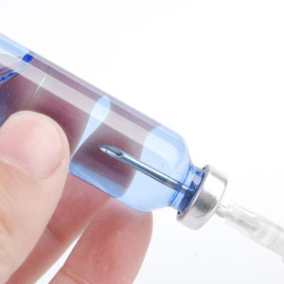
About OMICS Group
OMICS Group is an amalgamation of Open Access Publications and worldwide international science conferences and events. Established in the year 2007 with the sole aim of making the information on Sciences and technology ‘Open Access’, OMICS Group publishes 700+ online open access scholarly journals in all aspects of Science, Engineering, Management and Technology journals. OMICS Group has been instrumental in taking the knowledge on Science & technology to the doorsteps of ordinary men and women. Research Scholars, Students, Libraries, Educational Institutions, Research centers and the industry are main stakeholders that benefitted greatly from this knowledge dissemination. OMICS Group also organizes 1000+ International conferences annually across the globe, where knowledge transfer takes place through debates, round table discussions, poster presentations, workshops, symposia and exhibitions.

Slide 2
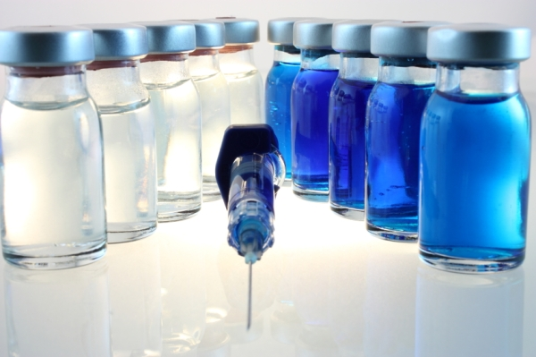
OMICS International Conferences
OMICS International is a pioneer and leading science event organizer, which publishes around 700+ open access journals and conducts over 500 Medical, Clinical, Engineering, Life Sciences, Pharma scientific conferences all over the globe annually with the support of more than 1000 scientific associations and 30,000 editorial board members and 3.5 million followers to its credit.
OMICS Group has organized 1000+ conferences, workshops and national symposiums across the major cities including San Francisco, Las Vegas, San Antonio, Omaha, Orlando, Raleigh, Santa Clara, Chicago, Philadelphia, Baltimore, United Kingdom, Valencia, Dubai, Beijing, Hyderabad, Bengaluru and Mumbai.

Slide 3
The Review
of Flexible Production Platforms for Pharma/Biopharmaceutical Processing
Maik W. Jornitz, President G-CON Manufacturing Inc.

Slide 4
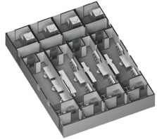
Agenda
Current Situation and Future Indicators
Past & Current
  Facilities
  Processes
Future
  Needs
  Possibilities
  Example cases

Slide 5
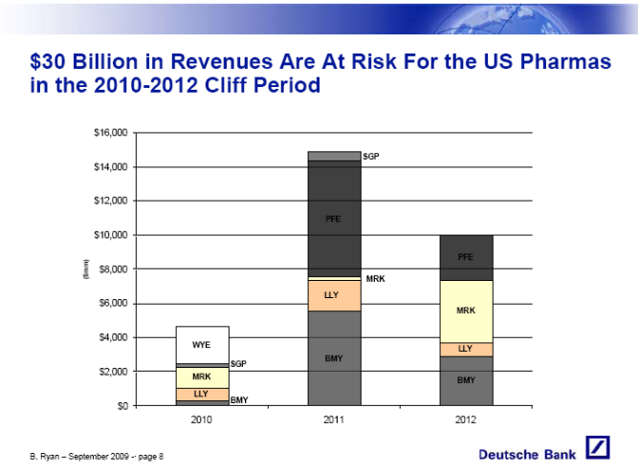
Current Situations & Trends in the Industry
Patent cliff for small molecules is reality and affects large molecule industry with coming biosimilars
“Blockbuster” drug product era is changing into multi-product, targeted or personalized drug period
Global expansion push to secure APIs and capture local markets
Process volumes become lower and manufacturing requires to become more flexible for better facility and capacity utilization
Single-use equipment lacks still the flexibility, when used in traditional facility lay-out

Slide 6
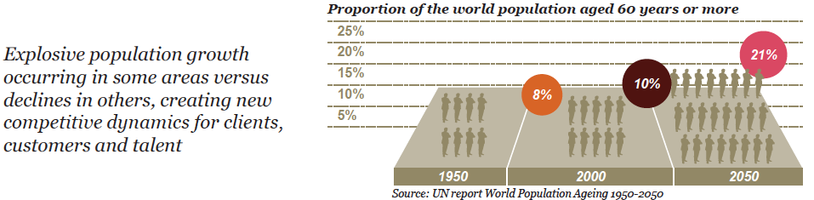
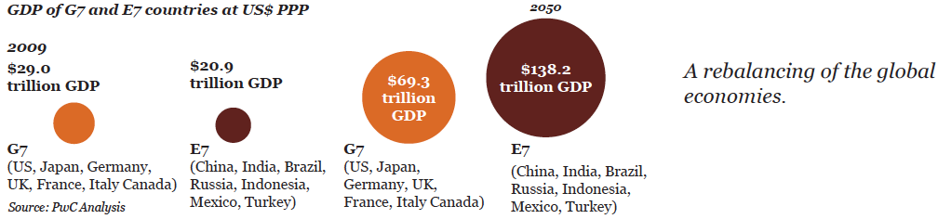
Global Capacity Indicators
Courtesy: PwC, PDA Annual Meeting 2015
A rising middle class and aging population in the E7 countries, will demand appropriate healthcare from their governments, respectively the governments will want to produce medicinal products in their countries !

Slide 7
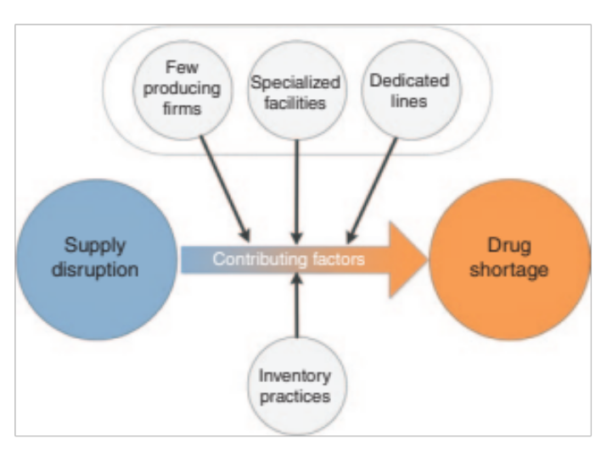

Global Capacity Indicators, cont.
Drug shortage is still a major problem…in the U.S. !
Source: J.Woodcock et al., nature publishing group, 2013
From blockbuster to personalized medicine… how do we handle the processing, containment and logistics !

Slide 8
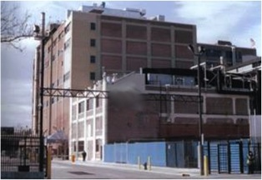
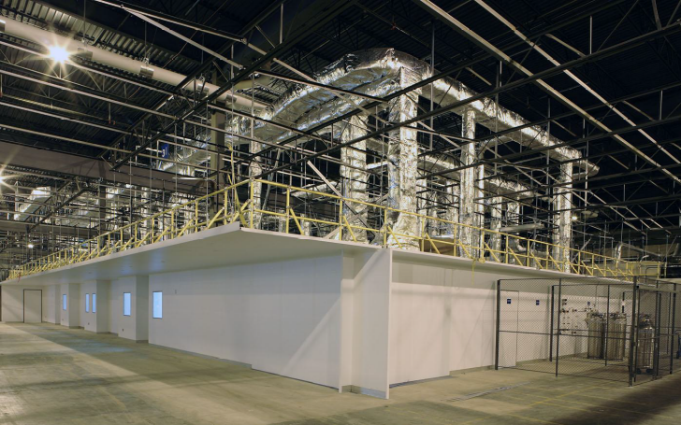
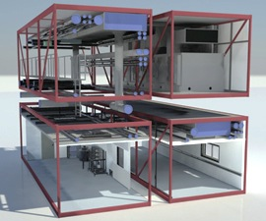
Past & Current Options - Facilities
=
Traditional Hardwall
=
Modular - Stick Built
Offsite Built Modular
High CAPEX/higher OPEX
Long time-to-run
Product dedicated
Inflexible/non-scalable
Extensive qualification needs
Difficult containment
Difficult to clone
=

Slide 9
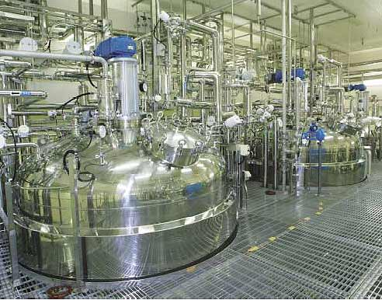
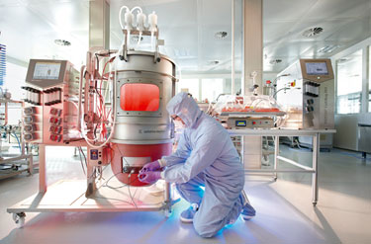
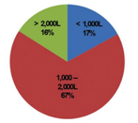
Past & Current Processes
From large scale stainless steel to medium volume single-use
De-risking
Higher flexibility
Faster turn-around
Closed systems
Advanced PAT
10kL
2kL

Slide 10
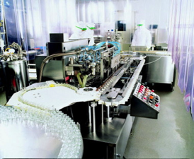
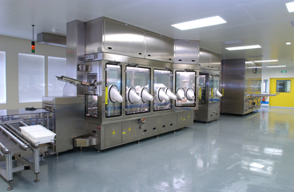
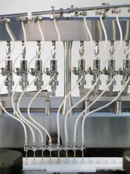
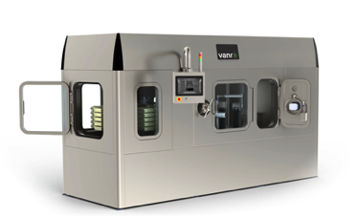
Past & Current Processes
From Curtain to Isolator or RABS & from Vial to Needle to Needle to Vial

Slide 11
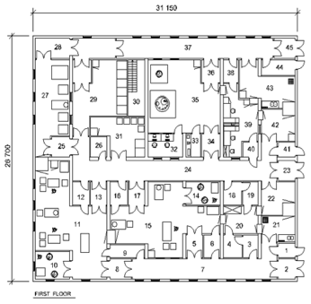
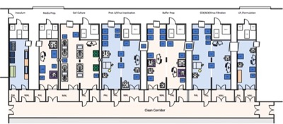
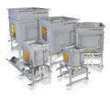
The Benefits of SUT Voided
Single-use technology processes create flexibility & speed, but…
Courtesy Stedim
Courtesy G-CON Manufacturing
…is only as flexible as the surrounding infrastructure !

Slide 12
New Facility & Process Needs Voiced
“Until now, modular facilities have reproduced traditional architecture with regard to embedding utilities piping and HVAC ducts in the interspace between the physical module limits and the suspended ceiling making refurbishment, if required, extremely complicated.
The new approach is to segregate pre-assembled modules into laboratory and utility modules, which are designed such that they permit even simpler and faster construction, qualification, validation and maintenance, respectively….”
Alain Pralong, VP New Product Introduction & Industrialization, GSK
“The pharmaceutical industry has been so slow to adopt approaches embraced by other industries, but I think the time is now,” FDA Commissioner Margaret Hamburg said during a tour of Vertex’s new continuous manufacturing line in South Boston, which would be one of the first such facilities to go into production if a new cystic-fibrosis drug is approved in mid-2015.
Margaret Hamburg, FDA Commissioner

Slide 13

Future - Possibilities
Gaining full efficiency from single-use technology
Autonomous cleanroom spaces
Movable infrastructures
Fast deployable, prefabricated unit operations
Clonable in-country/for country facility platforms
Processing spaces for new treatment options
“Modular” cleanroom and facility designs

Slide 14
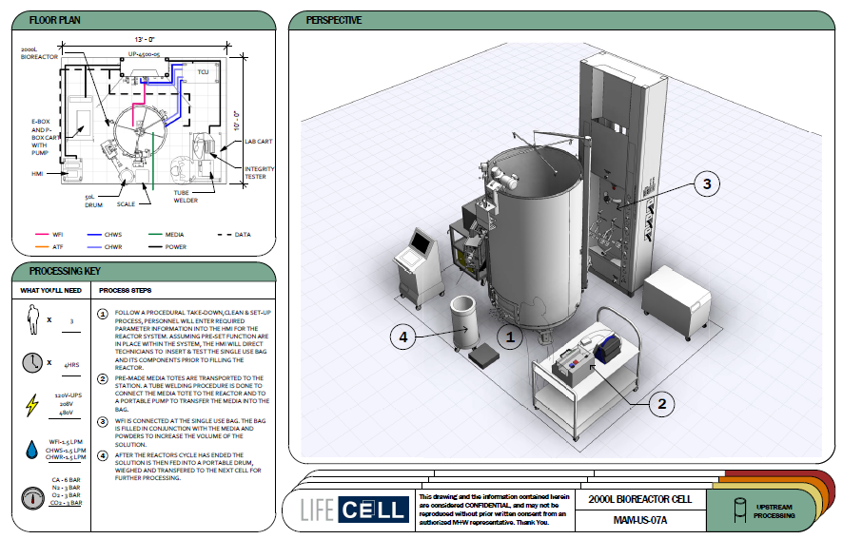
Standardizing Our Thought & Design Process
Standardize process unit operations by design, which can then integrated into a total manufacturing solution
Courtesy: M+W

Slide 15
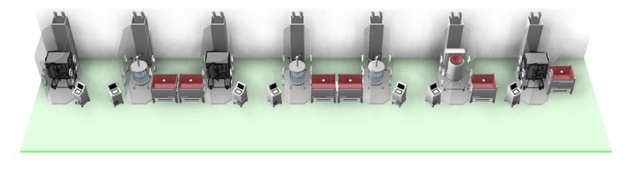
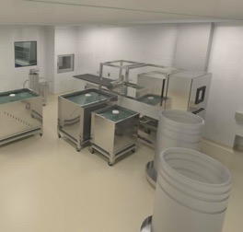
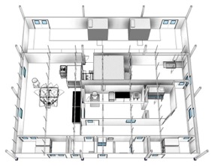
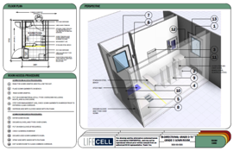
Modular Process Unit Operation Designs
Develop modular and standardized design components (‘building blocks’), which can then be integrated into a contextual solution.
LifeCells, standardized room designs, quality tested
Courtesy: M+W

Slide 16
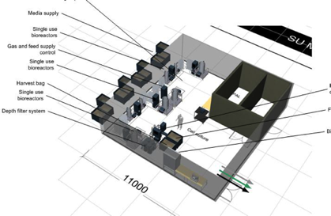
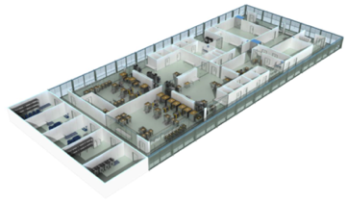
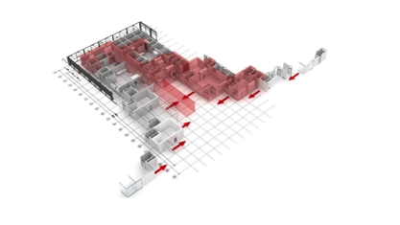
Pre-designed Structures
Cost and time reduction throughout the design phases
Courtesy: NNE

Slide 17
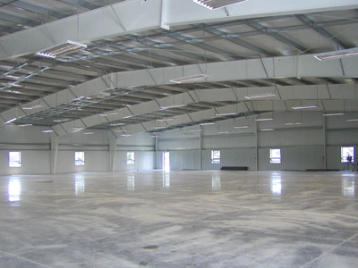
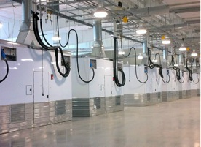
Future Building & Cleanroom Infrastructure
Instead of building a shell around the process, the process is integrated into the shell

Slide 18
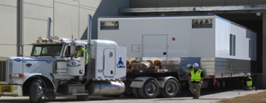
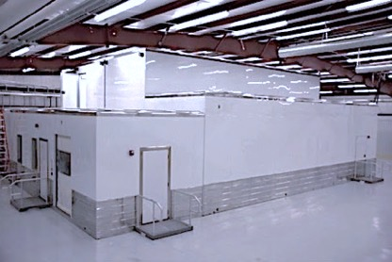
Prefabricated Cleanrooms allow Faster Build
Off-site, prefabricated, turnkey cleanroom structures
Built in 3 months
Built in 8 months

Slide 19
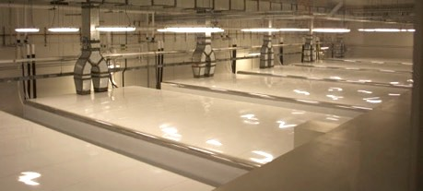
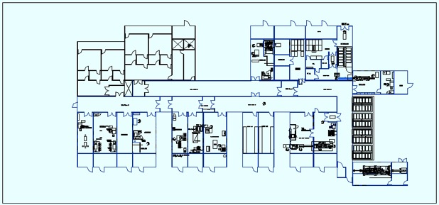
New Cleanroom Concepts allow Facility Platforms
HVAC autonomous cleanroom units allow multi-product purposes
50,000 egg/day facility platform

Slide 20
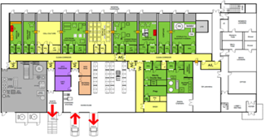
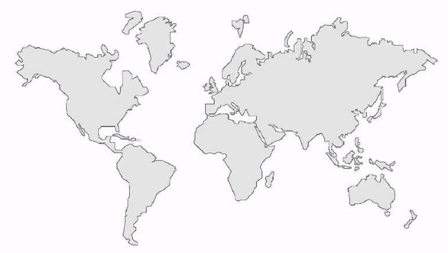
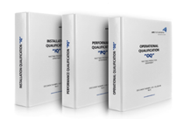
Facility Platforms allow Cloning
Benefits:
Known entity/process
Known headaches
Known qualification/validation
Known filing needs

Slide 21
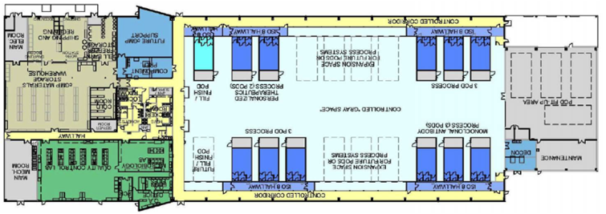

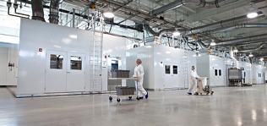
New Segregation allows Multipurpose Sites
Benefits:
Shared overheads
Leasing possibilities
Start-up clusters
Courtesy: Kalon

Slide 22
Conclusion
Current facility/process designs become obsolete and do not meet pressing industry requirements
Multi-product/multi-purpose facilities are requested
Facility deployment requires to be rapid and shortened by 2-3 years
Single-use process technology supports new demands, but require the right cleanroom/facility infrastructure to be utilized to the fullest

Slide 23
Thank You !
A pessimist sees the difficulty in every opportunity; an optimist sees the opportunity in every difficulty.
Sir Winston Churchill
Questions?
mwjornitz@gconbio.com

Slide 24
Let us meet again..
We welcome you all to our future conferences of OMICS International
2nd International Conference and Expo
on
Parenterals and Injectables
On
October 24-26, 2016 at Istanbul, Turkey
http://parenterals-injectables.pharmaceuticalconferences.com/

