Slide 1

About OMICS Group
OMICS Group International is an amalgamation of Open Access publications and worldwide international science conferences and events. Established in the year 2007 with the sole aim of making the information on Sciences and technology ‘Open Access’, OMICS Group publishes 400 online open access scholarly journals in all aspects of Science, Engineering, Management and Technology journals. OMICS Group has been instrumental in taking the knowledge on Science & technology to the doorsteps of ordinary men and women. Research Scholars, Students, Libraries, Educational Institutions, Research centers and the industry are main stakeholders that benefitted greatly from this knowledge dissemination. OMICS Group also organizes 300 International conferences annually across the globe, where knowledge transfer takes place through debates, round table discussions, poster presentations, workshops, symposia and exhibitions.

Slide 2
About OMICS Group Conferences
OMICS Group International is a pioneer and leading science event organizer, which publishes around 400 open access journals and conducts over 300 Medical, Clinical, Engineering, Life Sciences, Pharma scientific conferences all over the globe annually with the support of more than 1000 scientific associations and 30,000 editorial board members and 3.5 million followers to its credit.
OMICS Group has organized 500 conferences, workshops and national symposiums across the major cities including San Francisco, Las Vegas, San Antonio, Omaha, Orlando, Raleigh, Santa Clara, Chicago, Philadelphia, Baltimore, United Kingdom, Valencia, Dubai, Beijing, Hyderabad, Bengaluru and Mumbai.

Slide 3
Measuring USER EXPERIENCE DURING A DRIVING SIMULATION WITH MINARGUS
Automobile Engineering September 01-02, 2015
Valencia, Spain
Maik Auricht¹ Rainer Stark²
¹ Technische Universität Berlin
² Fraunhofer IPK, Berlin
Notes:
Automotive engineer
TU Berlin
Internships within automotive industry
Trying to bring two fields of research together: psychology and validation of mechatronic products in early phases

Slide 4
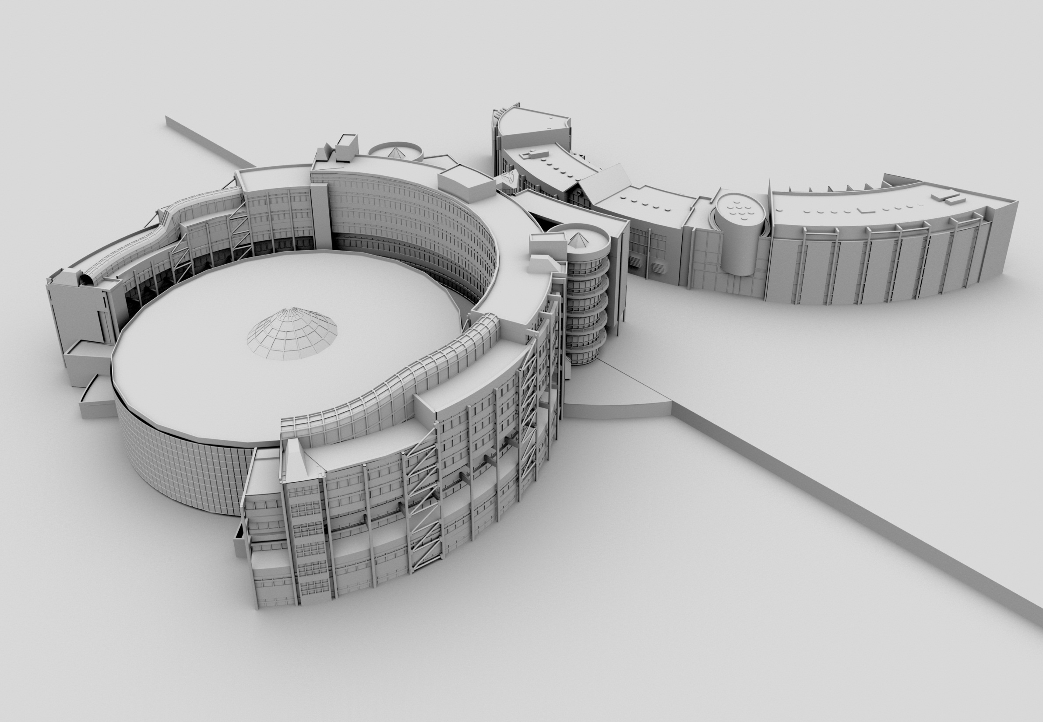


Fraunhofer-Gesellschaft
Institute for Production
Systems and Design Technology (IPK)
Technische Universität Berlin
School of Mechanical Engineering
and Transportation Systems (IWF)
Virtual Product Creation
Prof. Dr.-Ing. R. Stark
Industrial Information Technology
Prof. Dr.-Ing. R. Stark
Product development methods and processes
Major research fields:
Product development methods and processes
  Product modelling and functional validation
  Product modelling and functional validation
  Intuitive interaction with virtual prototypes
  Intuitive interaction with virtual prototypes
  Information management for product creation
  Information management for product creation
  Digital manufacturing operations and factory processes
Source of Picture: Fraunhofer IPK, Alina Goldberg
DQS-zertifiziert nach
DIN EN ISO 9001
© Fraunhofer

Slide 5
Motivation
„With its analysis of more than 300 innovations Oliver Wyman shows that, among other hybrid drives, sequential multi-stage turbocharger, LEDs, intelligent driver-machine interface and electromagnetic brake technologies have the potential to success. Electronics continues to be the central 'enabler' and drivers for 60 percent of all innovations, with the focus shifted from individual applications to system applications that combine multiple components. As new features are often created by an intelligent combination of existing components and modules. Almost all the core features of the car will improve: Fuel efficiency (up to 30 percent), emissions, active and passive safety, connectivity and infotainment, vehicle dynamics and performance characteristics, comfort, flexibility and space - while improving cost-benefit ratio for buyers . “
DANNENBERG, J.; BURGARD, J. (2007): 2015 car innovation - Innovationsmanagement in der Automobilindustrie, Oliver Wyman (Hg.)
Notes:
Let me start with a quotation of a Studies of innovations and their trends
That shows the importance of the validation of mechatronic products and their functions

Slide 6
Motivation
Almost every car is equipped with Advanced Driver Assistance Systems (ADAS)
It occurs, that drivers are not satisfied with the system
That can have different reasons:
  A: Usability aspects (such as Effectiveness or Efficiency)
  B: System does not work correctly (technical aspects)
  C: System has interdependencies with other assistance systems (similar to B)
  D: User experience issues (such as subjective feelings, motivational aspects)
There are different validation methods for the reason A-C in the early phases of the product development process
However, there are no running validation methods for reason D
Reason D is more a validation problem rather than a verification problem*
*Verification: Are we building the system right? | Validation: Are we building the right system?
Notes:
Ford Focus with most systems in the compact car class
Product recalls

Slide 7
Structure of the presentation
Validation methods for Advanced Driver Assistance Systems
User Experience
Driving Simulators
State of the art
Pilot questionnaire
Results of the
questionnaire
Development of a new tool to
perform User Experience tests
MINARGUS: A new tool to measure UX and control the simulation

Slide 8
Structure of the presentation
Validation methods for Advanced Driver Assistance Systems
User Experience
Driving Simulators
State of the art
Pilot questionnaire
Results of the
questionnaire
Development of a new tool to
perform User Experience tests
MINARGUS: A new tool to measure UX and control the simulation

Slide 9
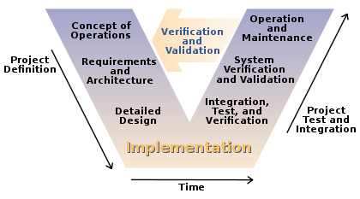
State of the art
Validation methods for Advanced Driver Assistance Systems (ADAS)
During development ADAS are tested with different validation methods:
  A: Model-in-the-Loop (MiL)*
  B: Software-in-the-Loop (SiL)
  C: Hardware-in-the-Loop (HiL)
  D: Vehicle-in-the-Loop (ViL)
  E: Field tests
During all tests, driving simulators are used in different maturity levels
E
D
A
C
B
* Model in the Loop (MiL) is the simulation of an embedded system in an early development phase.
Notes:
Don‘t want to go into much detail, I want to mention there are different validation methods
But where comes the human into the game?

Slide 10
Structure of the presentation
Validation methods for Advanced Driver Assistance Systems
User Experience
Driving Simulators
State of the art
Pilot questionnaire
Results of the
questionnaire
Development of a new tool to
perform User Experience tests
MINARGUS: A new tool to measure UX and control the simulation

Slide 11
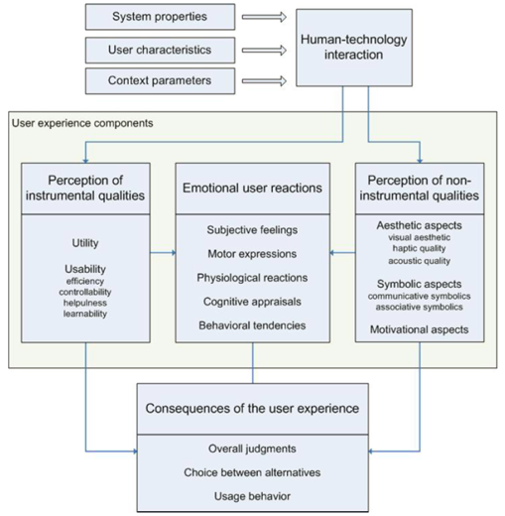
State of the art
User Experience
“By “experience” we mean all the aspects of how people use an interactive product: the way it feels in their hands, how well they understand how it works, how they feel about it while they’re using it, how well it serves their purposes, and how well it fits into the entire context in which they are using it.” [1]
User Experience is more than Usability
It consideres emotions, subjective feelings, aesthetic aspects, etc.
Questionnaires to measure the UX:
  AttrakDiff
  Affect Grid
  mDES
  VisAwi
  Etc.
Source: [2]
Notes:
We should start with the question what is user experience? According to Alben experience are all the aspects of how people use an interactive product: the way it feels in their hands, how well they understand how it works, how they feel about it while they’re using it, how well it serves their purposes, and how well it fits into the entire context in which they are using it.”

Slide 12
Structure of the presentation
Validation methods for Advanced Driver Assistance Systems
User Experience
Driving Simulators
State of the art
Pilot questionnaire
Results of the
questionnaire
Development of a new tool to
perform User Experience tests
MINARGUS: A new tool to measure UX and control the simulation

Slide 13
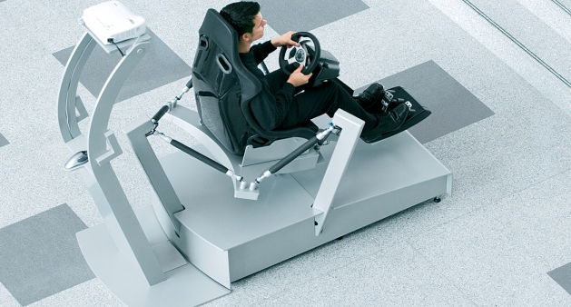
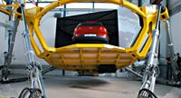
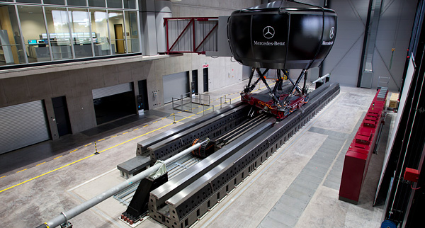
State of the art
Driving simulators
Separation in static and dynamic simulators
Static simulators are often use in early phases (MiL)
Dynamic simulators provide G-forces and thus enhance the user feeling
There are different price ranges depending on the maturity:
  Small driving seats (e.g. Festo Airmotion Ride 50k€)
  Hydraulic hexapod-systems (e.g. DLR driving simulator 2M€)
  Full range simulators (e.g. Daimler 40M€)
The visualisation reaches from simple monitors up to 360° projection
Source: Daimler
Source: DLR
Source: Festo

Slide 14
Structure of the presentation
Validation methods for Advanced Driver Assistance Systems
User Experience
Driving Simulators
State of the art
Pilot questionnaire
Results of the
questionnaire
Development of a new tool to
perform User Experience tests
MINARGUS: A new tool to measure UX and control the simulation

Slide 15
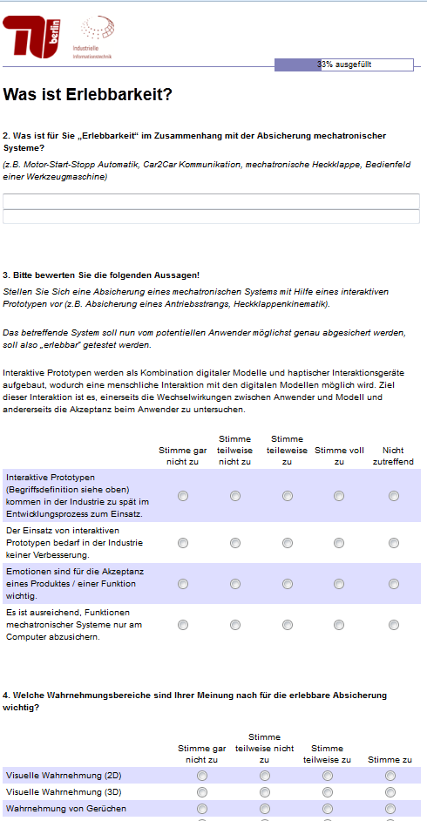
Pilot study
Setup
First pilot study
Exploratory questionnaire
5 closed questions
15 open questions
Participants:
  36 experts (Virtual Product Creation)
  Average age: 31
8 weeks duration

Slide 16
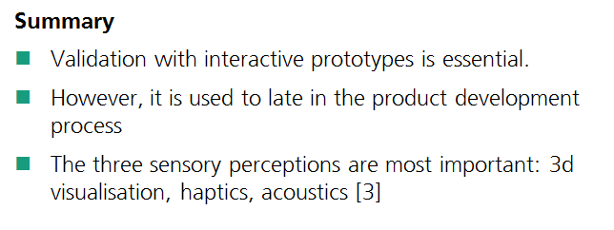
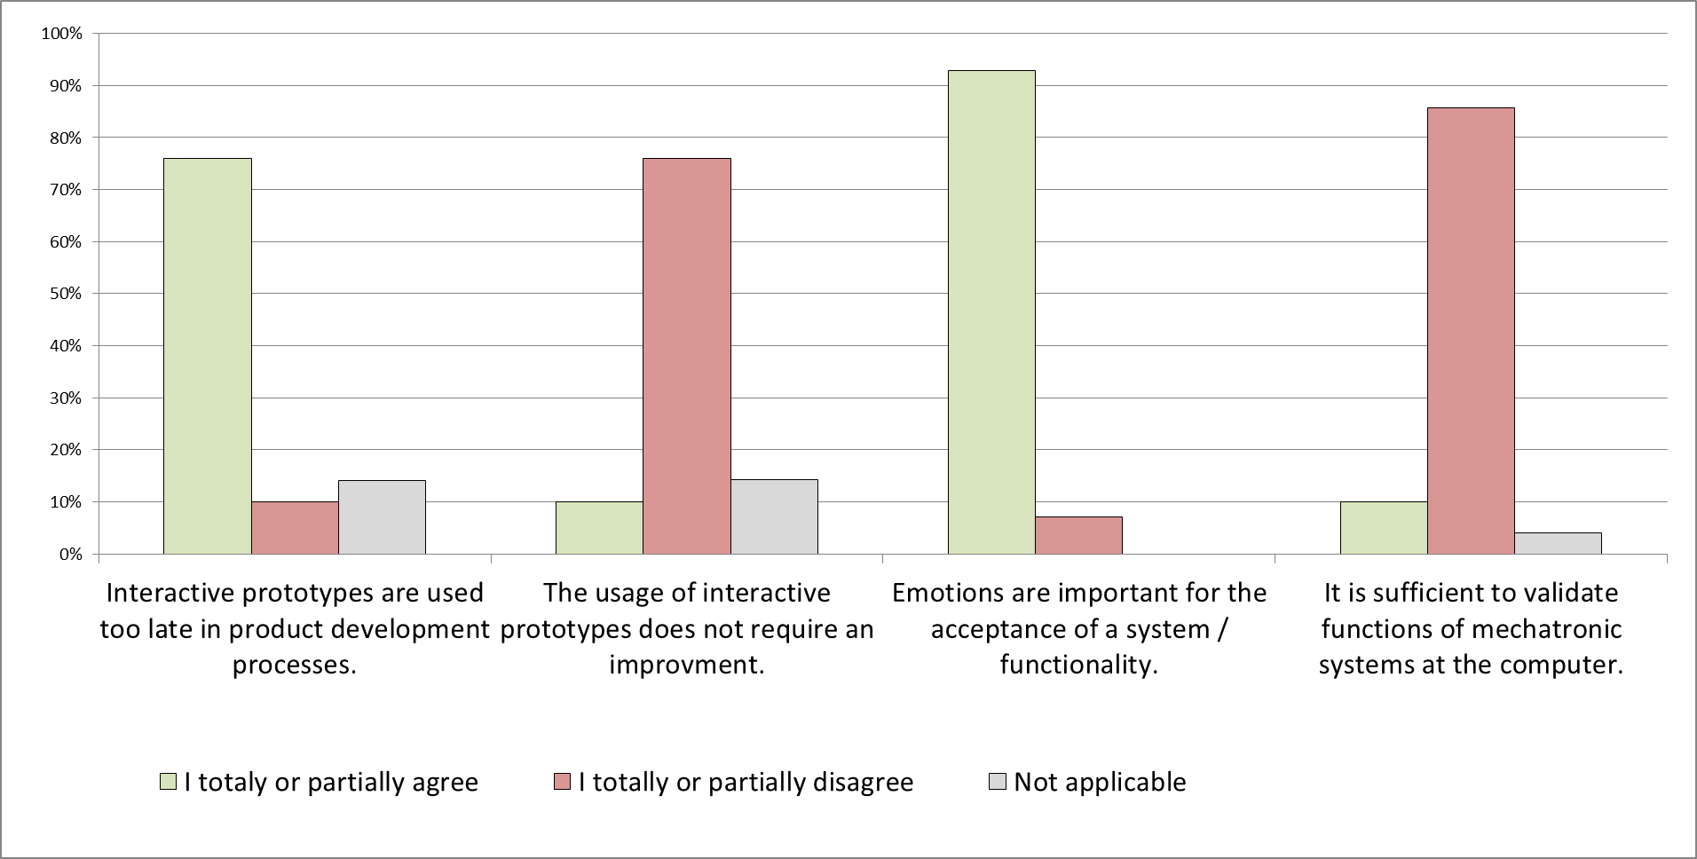
Pilot study
Results
Notes:
Just want to show one diagramm, the full evaluation is already published

Slide 17
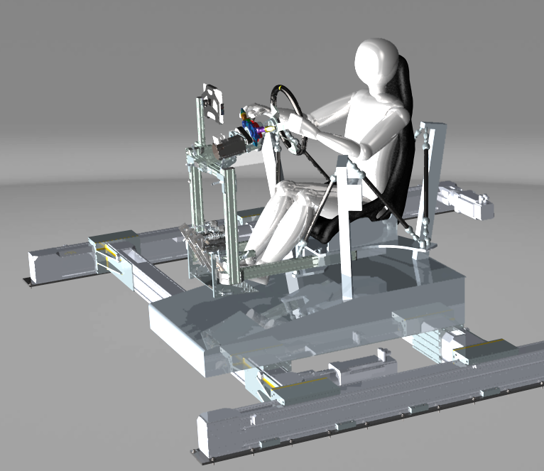

What is the big aim? Why do I need a new tool?
The aim is to change parameter during a driving simulation
Dependent variables are the components of UX
Configuration is complete if you have best UX-values
Driving simulation with Model-in-the-Loop of the ADAS
Capturing the User Experience
Optimal parameter set
Parameter changing of the ADAS model
13

Slide 18
Structure of the presentation
Validation methods for Advanced Driver Assistance Systems
User Experience
Driving Simulators
State of the art
Pilot questionnaire
Results of the
questionnaire
Development of a new tool to
perform User Experience tests
MINARGUS: A new tool to measure UX and control the simulation

Slide 19
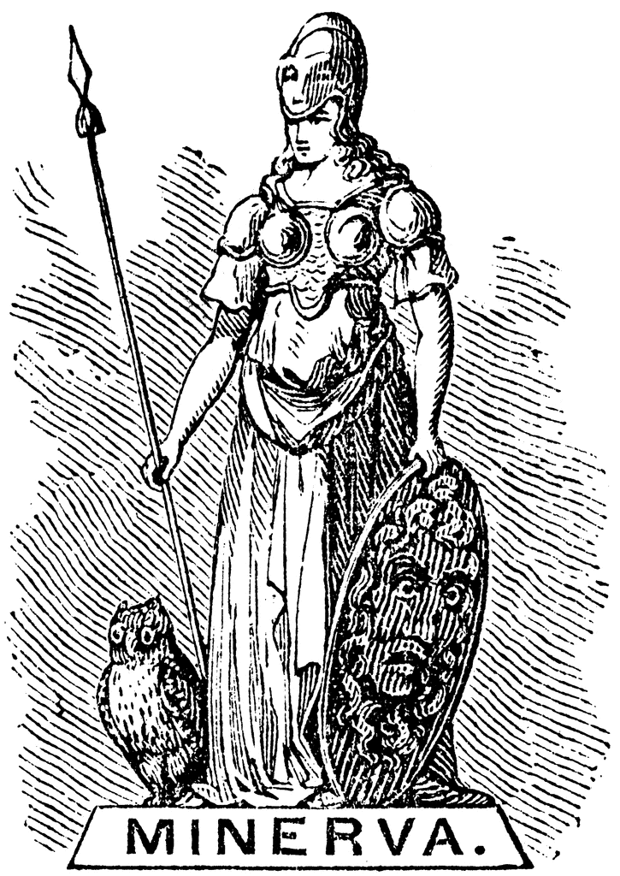

MINARGUS
What is MINARGUS?
A tool which brings together the Engineering part and the Physiological measurement
Why is it called MINARGUS?
MINARGUS = Minerva (Roman goddes of wisdom) + Argus Panoptes (Greek mythology: 100-eyed giant)
What is MINARGUS capable of?
It allows the visualization of all measured data and allows the direct parameter sweep within the simulation model

Slide 20
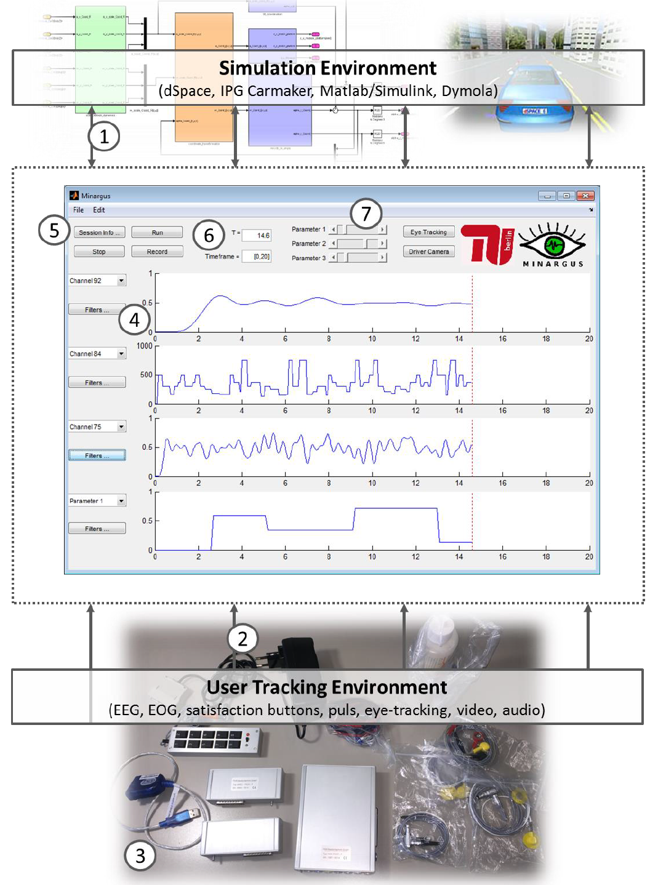
MINARGUS
1: Direct connection to Matlab
2: Connection the User Tracking Environment
3: Physiological measurement system (PAR-PORT)
4: Visualization of the channels (e.g. EEG, EKG)
5,6: Standard functionalities (save, jump to times etc)
7: Parameter changes of the simulation model
3

Slide 21
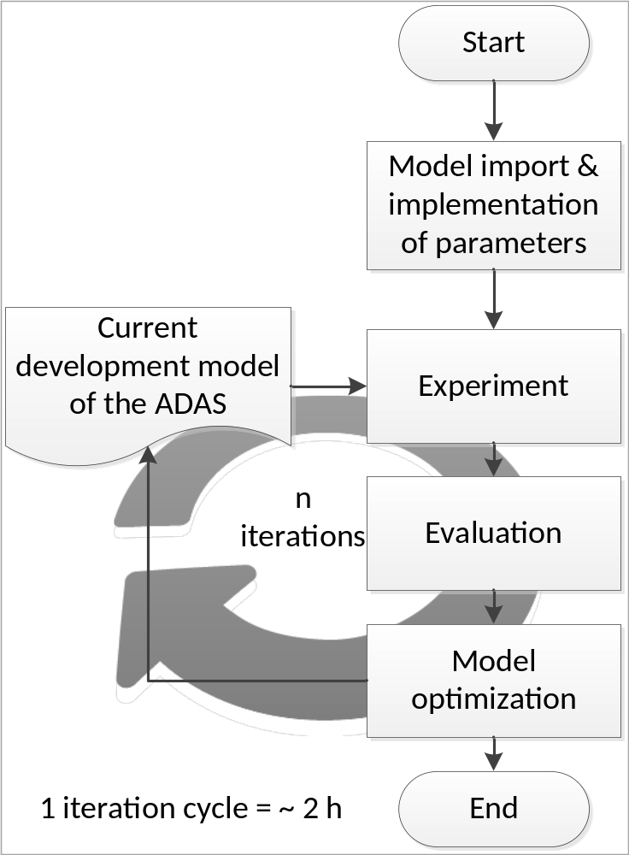
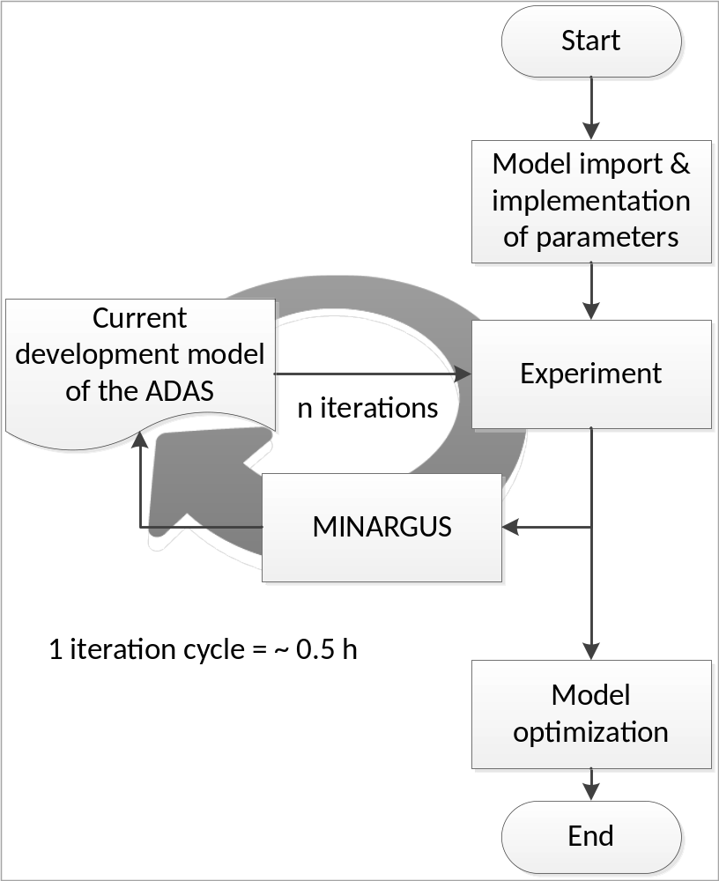
Change of validation process
The current process
The improved process with MINARGUS

Slide 22
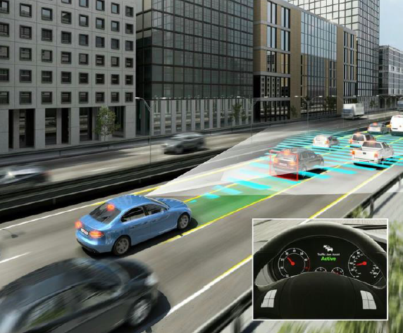
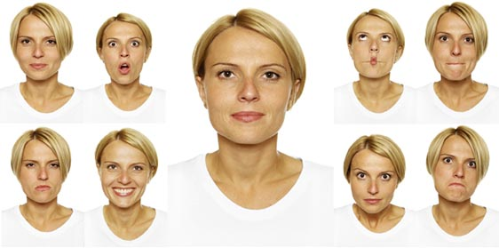
MINARGUS: An example (1/2)
The developer defines the test and the parameters, which need to be optimized
  Using the example of the Traffic Jam Assist, defined parameters can be the starting acceleration or the starting delay
  Both parameters are highly important for the UX: A high starting acceleration and a short delay indicate an aggressive driving behavior of the system and could cause discomfort
  Whereas a small starting acceleration and a long delay could cause discomfort in terms of being forced to interact because of the behind driving cars
These parameters are defined together with the experimental designer
The experimental designer now builds up the UX test with all its constraints (test procedure, test design, questionnaires, etc.)
Traffic Jam Assist, Source: Bosch, 2014
Emotions, Source: KIT, 2014

Slide 23
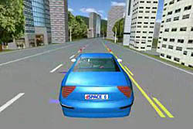
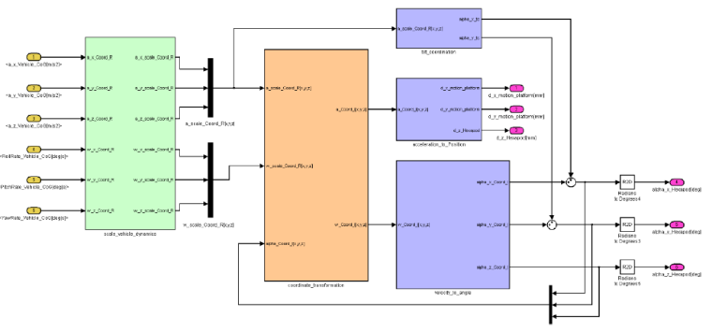
MINARGUS: An example (2/2)
After defining the parameters, they are then integrated in the simulation model
The model and the simulation environment must allow real-time simulation because of adjustments to the parameters
In most cases there is a complete model of the car and the environment (streets, other cars, etc.)
In this stage testing can be conducted
The test subject drives a virtual car in a simulator, which ideally covers all important sense areas
Once the test has been performed, the results can be evaluated. The model optimization is the final step
Motion Desk, Source: dSpace, 2014
Automotive Simulation Model,
Source: dSpace, 2014

Slide 24
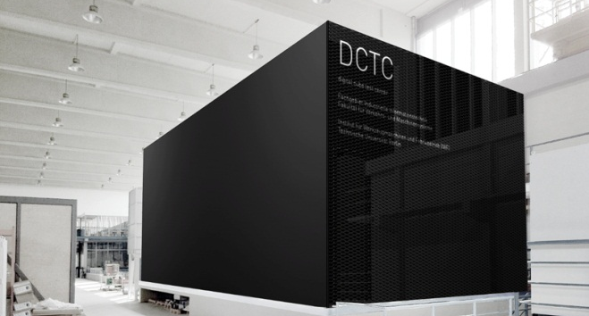
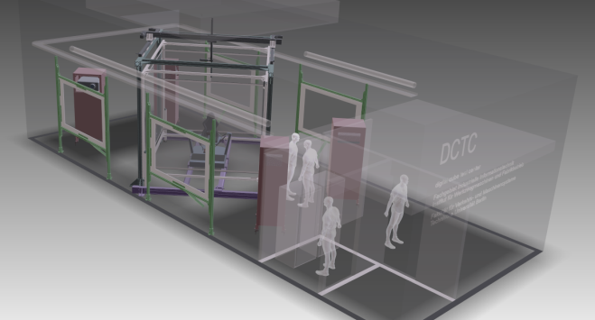
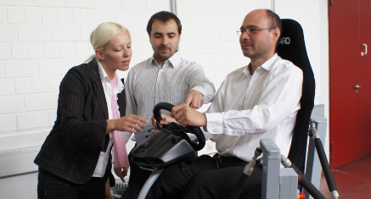
Outlook
The presented tool shows a possible integration of psychological measurement methods into existing engineering validation methods
The usage of the tool can reduce the validation cycle time by ~1,5h
Developers, validation engineers and human factor experts work now more closer
Nevertheless the tool needs to be evaluated
In 2015 there will be a study to prove the functionalities of the tool
The new tool will be evaluated within the Digital Cube Test Center (DCTC) at the Technische Universität Berlin
Digital Cube Test Center
Digital Cube Test Center
Festo Airmotion Ride
Notes:
The show process is just the basis

Slide 25
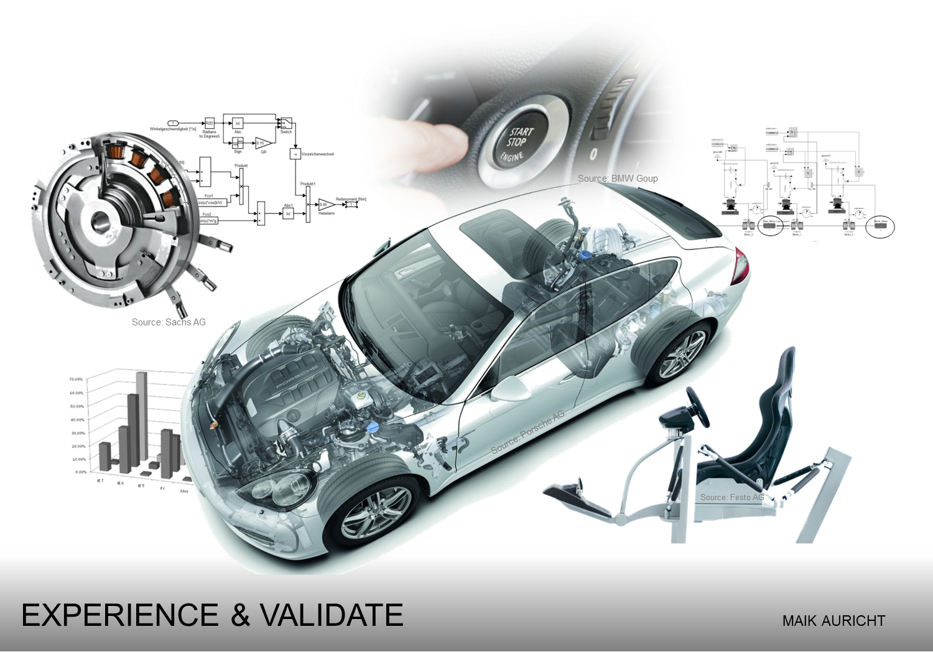
Thanks.

Slide 26
Sources
[1] Alben L. Quality of experience: defining the criteria for effective interaction design. interactions 1996;3:11–5
[2] Mahlke S. User Experience of Interaction with Technical Systems: Theories, Methods, Empirical Results, and their Application to the Development of Interactive Systems. Dissertation. Berlin; 2008.
[3] Auricht M, Dittrich E, Brandenburg S, Stark R. Engineering meet UX: Ingenieurstechnische Absicherungsmethoden treffen auf User Experience Forschung. In: Dittrich E, Doria L, Gross A, Günzler T, Smieszek H, editors. Proceedings of the 10. Berliner Werkstatt Mensch-Maschine-Systeme: Grundlagen und Anwendungen der Mensch-Maschine-Interaktion. 10. Berliner Werkstatt Mensch-Maschine-Systeme, 10th ed. Berlin: TU Berlin; 2013.

