Slide 1
About OMICS Group
OMICS Group is an amalgamation of Open Access Publications and worldwide international science conferences and events. Established in the year 2007 with the sole aim of making the information on Sciences and technology ‘Open Access’, OMICS Group publishes 500 online open access scholarly journals in all aspects of Science, Engineering, Management and Technology journals. OMICS Group has been instrumental in taking the knowledge on Science & technology to the doorsteps of ordinary men and women. Research Scholars, Students, Libraries, Educational Institutions, Research centers and the industry are main stakeholders that benefitted greatly from this knowledge dissemination. OMICS Group also organizes 500 International conferences annually across the globe, where knowledge transfer takes place through debates, round table discussions, poster presentations, workshops, symposia and exhibitions.

Slide 2
OMICS International Conferences
OMICS International is a pioneer and leading science event organizer, which publishes around 500 open access journals and conducts over 500 Medical, Clinical, Engineering, Life Sciences, Pharma scientific conferences all over the globe annually with the support of more than 1000 scientific associations and 30,000 editorial board members and 3.5 million followers to its credit.
OMICS Group has organized 500 conferences, workshops and national symposiums across the major cities including San Francisco, Las Vegas, San Antonio, Omaha, Orlando, Raleigh, Santa Clara, Chicago, Philadelphia, Baltimore, United Kingdom, Valencia, Dubai, Beijing, Hyderabad, Bengaluru and Mumbai.

Slide 3
Identification of Aconitine Artefact in Alcoholic Extracts
Drug Discovery, Frankfurt, Germany, August 2015
Mai Ahmed

Slide 4
Aconitine
Notes:
Norditerpenoid alkaloid a c19 carbon skeleton, highly toxic LD50 1mg/Kg, The main structural features responsible of its high toxicity are the ester groups at C-8 acetate and C-14 benzoate.

Slide 5
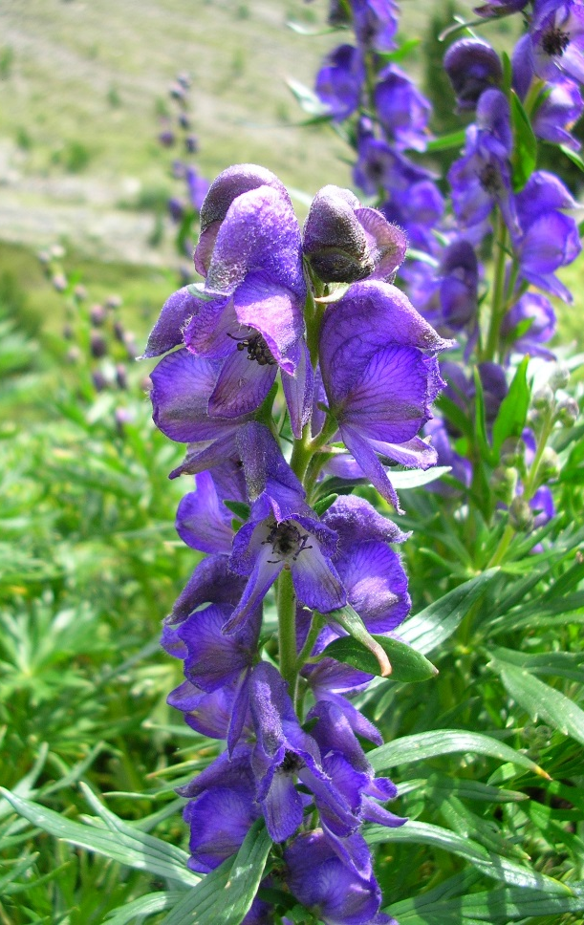
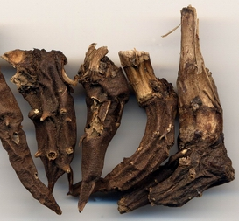
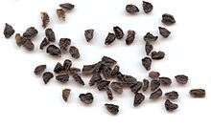
Aconitum napellus
Notes:
Known as Monkshood because of the flower shape and also known as wolfsbane and historically it was used in poisoning the arrows to kill the wolves

Slide 6
Extraction of diterpenoid alkaloids from A. napellus seeds
defatted ground seeds
acetone
methanol
macerate
Acid-base cycle
AN-alkaloids-MeOH
AN-alkaloids-Acetone
Notes:
Using 0.1 M HCl and basification was done by ammonia but H2SO4 and NaCO3 or NaHCO3 also can be used instead

Slide 7
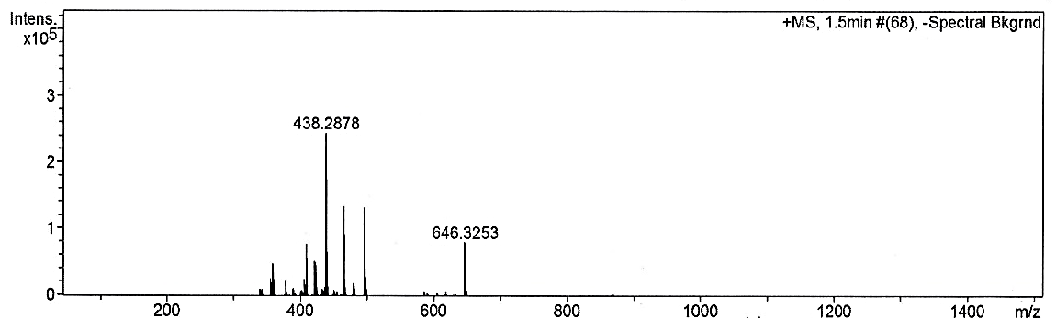
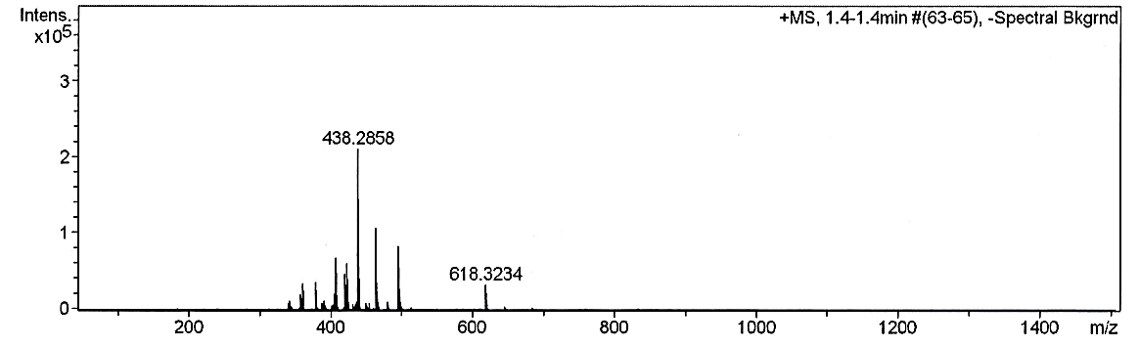
HRMS data of A. napellus extracts
Both extracts showed the same alkaloidal profile except for an extra peak at MH⁺ 618 in the methanolic extract.
AN-alkaloids-MeOH
AN-alkaloids-Acetone

Slide 8
HRMS data of the aconitine artefact
14-O-benzoyl-8-O-methylaconine MH⁺ 618.3278
C₃₃ H₄₈ N O₁₀
-(CO)
N-deethylaconitine MH⁺ 618.68
C₃₂ H₄₃ N O₁₁
-(C₂H₄)
Notes:
8-O-methylated analogue of aconitine

Slide 9
Semi-synthesis of aconitine artefact
Aconitine was refluxed in methanol (at 65 ºC for 6 hrs), purified by HPLC using C18 Gemini column 5µ 250 x 10 mm (mobile phase: acetonitrile : water with 0.3% conc. NH₃ [9:1 v/v], 3 mL/min; sample 100 µL, UV detection at λ = 232 nm), R_{t} 8 min. 10 mg were purified and NMR data were recorded in CDCl₃ using a Bruker 500 MHz NMR machine.

Slide 10
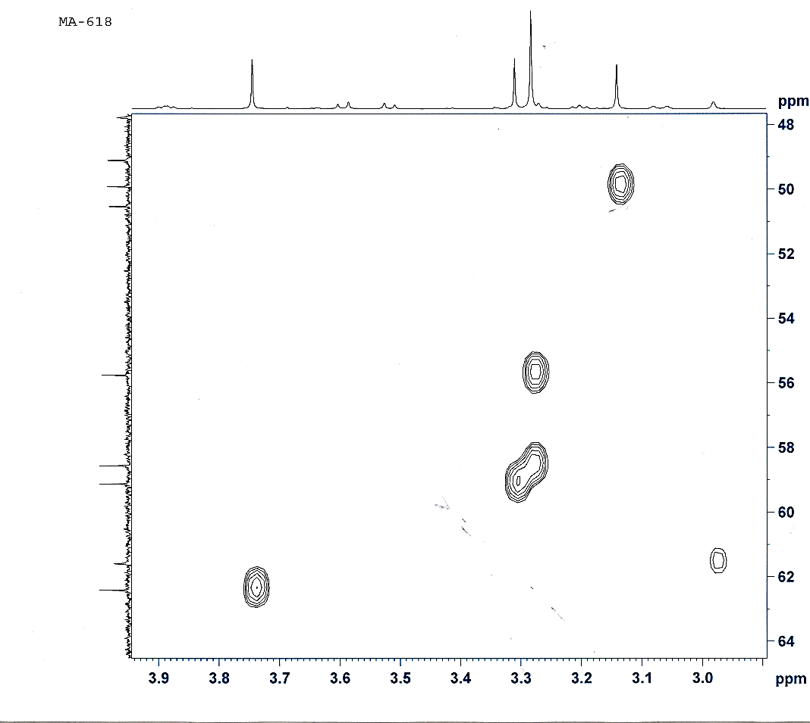
NMR data of aconitine artefact
The ¹³C-NMR data revealed the presence of 33 carbon
atoms while the DEPT experiment showed the presence
of 5 methylenes, and 6 quaternary carbons.
The NMR data revealed the presence of N-ethyl
fragment, 5 methoxyl groups and absence of
acetoxyl group.
Quaternary C-8 resonates at δC 82.4 in 14-O-benzoyl-
8-O-methylaconine and at δC 92.2 in (8-acetoxy)
aconitine.
Notes:
Here the HSQC exp showed the presence of 5 methoxy groups where the new one formed is at 3.14. This was confirmed by storing aconitine in d4 MeOH and isolating the deuterated derv. Recording the NMR data in proton exp this peak disappeared and in carbon as well because of the extensive splitting by the 3 deuteriums but in deuterium observe exp showed a peak at the same chemical shift 3.14.

Slide 11
Aconitine and its artefacts
aconitine
artefact
deuterated artefact
Notes:
2nI+1 the C signal disappeared because of the large loss in its intensity as result of the peak splitting into septet 1.3.6.7.6.3.1

Slide 12
Aconitine reacted with different alcohols
High Resolution Time-of-Flight mass spectra were obtained on a Bruker Daltonics micrOTOF spectrometer using electrospray ionisation (ESI).
Alcohol | Artefact | m/z (found) | Molecular formula
methanol | 14-O-benzoyl-8-O-methylaconine | 618.3291 Da | C₃₃ H₄₈ N O₁₀ requires 618.3278
d₄-methanol | 14-O-benzoyl-8-O-trideuteriated methylaconine | 621.3490 Da | C₃₃ H₄₅ D₃ N O₁₀ requires 621.3461
ethanol | 14-O-benzoyl-8-O-ethylaconine | 632.3459 Da | C₃₄ H₅₀ N O₁₀ requires 632.3429
d₆-ethanol | 14-O-benzoyl-8-O-pentadeuteriated ethylaconine | 637.3759 Da | C₃₄ H₄₅ D₅ N O₁₀ requires 637.3743

Slide 13

Grob-type fragmentation
It takes place when the free electron pair of the nitrogen atom and C_{α}-X bond are oriented
anti-parallel to the C_{β}-C_{ɣ} bond which undergoes cleavage.
ɣ
β
α
MeOH
aconitine
14-O-benzoyl-8-O-methylaconine

Slide 14
Conclusions
Alcoholic solvents should be avoided in any extraction procedure for aconitine and diester- diterpenoid alkaloids. Isolation of 8-O-alkylated diterpenoid alkaloids is most probably due to artefact formation. Medicinal formulations such as tinctures that involve extracts in ethanol are likely to suffer extensive degradation of diester alkaloids during preparation and/or storage and, on this occasion, be less toxic than the parent alkaloids.

Slide 15
Let us meet again..
We welcome you to our future conferences of OMICS International
2nd International Conference and Expo
on
Drug Discovery & Designing
On
October -31 November-02, 2016 at Istanbul, Turkey
http://drug-discovery.pharmaceuticalconferences.com/

