Slide 1
About OMICS Group
OMICS Group International is an amalgamation of Open Access publications and worldwide international science conferences and events. Established in the year 2007 with the sole aim of making the information on Sciences and technology ‘Open Access’, OMICS Group publishes 400 online open access scholarly journals in all aspects of Science, Engineering, Management and Technology journals. OMICS Group has been instrumental in taking the knowledge on Science & technology to the doorsteps of ordinary men and women. Research Scholars, Students, Libraries, Educational Institutions, Research centers and the industry are main stakeholders that benefitted greatly from this knowledge dissemination. OMICS Group also organizes 300 International conferences annually across the globe, where knowledge transfer takes place through debates, round table discussions, poster presentations, workshops, symposia and exhibitions.

Slide 2
About OMICS Group Conferences
OMICS Group International is a pioneer and leading science event organizer, which publishes around 400 open access journals and conducts over 300 Medical, Clinical, Engineering, Life Sciences, Pharma scientific conferences all over the globe annually with the support of more than 1000 scientific associations and 30,000 editorial board members and 3.5 million followers to its credit.
OMICS Group has organized 500 conferences, workshops and national symposiums across the major cities including San Francisco, Las Vegas, San Antonio, Omaha, Orlando, Raleigh, Santa Clara, Chicago, Philadelphia, Baltimore, United Kingdom, Valencia, Dubai, Beijing, Hyderabad, Bengaluru and Mumbai.

Slide 3

Sensing Heavy Metals for Environmental Monitoring
Mahnaz M. Abdi, Amir Reza Sadrolhosseini, Min Min Aung Aishah Abdullah
Department of Chemistry, Faculty of Science, Universiti Putra Malysia, Selangor, Malaysia

Slide 4
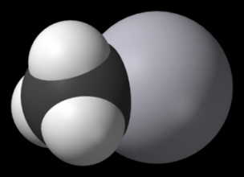


Heavy metal poisoning
Heav metals:
Any metal with high relative atomic mass, density greater than 4 g/cm³
have a tendency to Bioaccumulate
High amounts of mercury can damage the central nervous system which can cause memory loss, lack of coordination, kidney problem, reproductive problems, and possibly death.
Lead is especially dangerous for unborn babies and young children causing potentially permanent learning and behavior disorders
H₃C-Hg⁺X⁻

Slide 5



Minamata disease (neurological syndrome) it caused from methylmercury in the industrial wastewater from the Chisso Corporation’s chemical factory, Japan in1956.
Heavy metal poisoning
The crippled hand of a Minamata disease victim

Slide 6


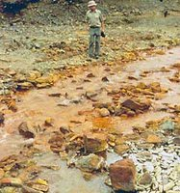

Source of heavy metals
Water: drinking water (lead pipe), leaching from metal mine can cause river pollution
Food: accumulation of mercury in fish tissue, lead-soldered cans
Air: metal processing factory such as smeltery and battery manufacturers, leaded gasoline.
dust and soil: leaching of metal ions from the soil into lakes and rivers by acid rain.
chipped or flaking paint
Acid mine drainage (AMD)
Abandoned mining
China Pollution River

Slide 7
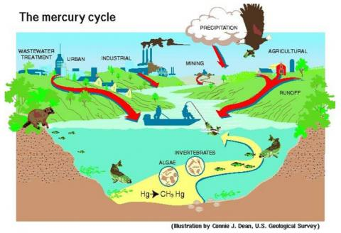

Slide 8
Surface Plasmon Resonance
Photodetector
θ
θ
Dielectric
(PPy-CHI)
Metal
Metal
Analyte
Before analyte binding:
Refractive index: n, k
After binding:
n_{new} = n+Δn k_{new} = k+Δk
Ref
θ

Slide 9

Conducting polymers
Dopping (+e)
Undopping(-e)

Slide 10
Composite of Polypyrrole-Chitosan (Ppy-CHI) as Sensing area
Chitosan is a biodegradable, biocompatible, nontoxic and low-cost polymer
PPy-CHI is a composite of electrochemical polymerization of pyrrole in the presence of chitosan
Enhance mechanical and electrical properties in the presence chitosan
Capable for using in sensitive optical sensors helping SPR(surface plasmon resonance) technique

Slide 11
Set-up for electrodeposition of
bio-composite films.
1.2 ^{volt}
3.123^{A}
current
Working Electrode (Gold)
Potentiostate
Counter Electrode
Reference Electrode

Slide 12
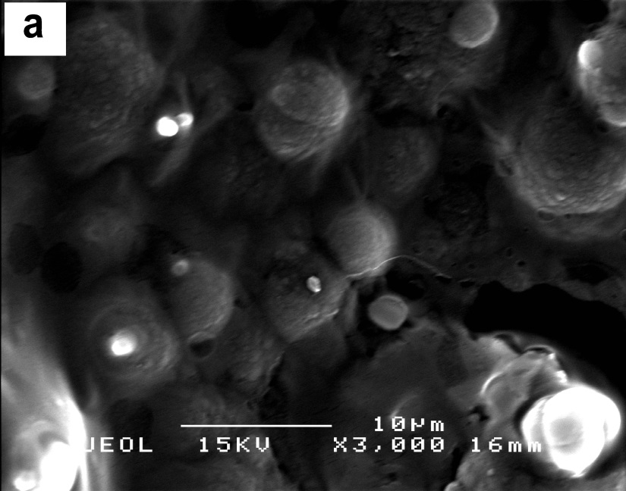
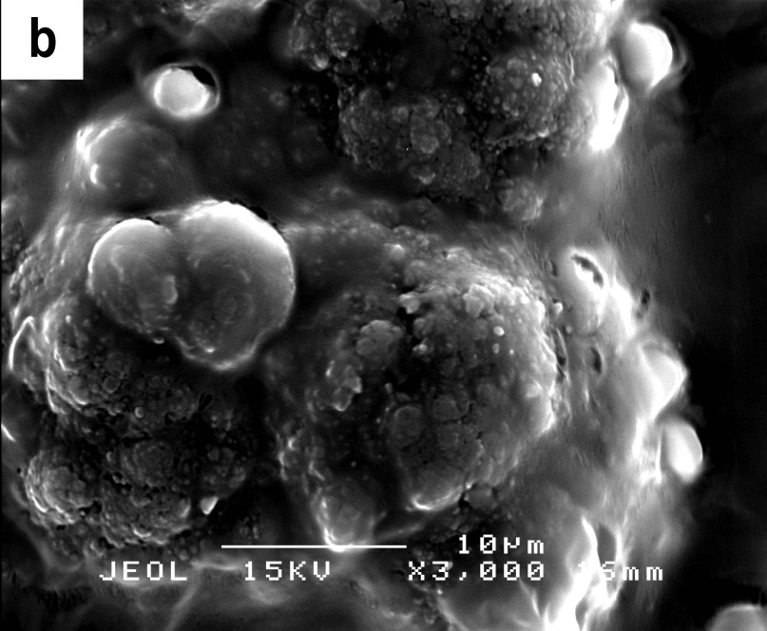
SEM images of the (a) PPy and (b) PPy-CHI (magnification: 3000X)
globular morphology can be observed in PPy. Using CHI to prepare conducting polymer composite leads to agglomeration of the resulting composiote polymer

Slide 13
XRD diffractograms of CHI, PPy and PPy-CHI composite films.

Slide 14
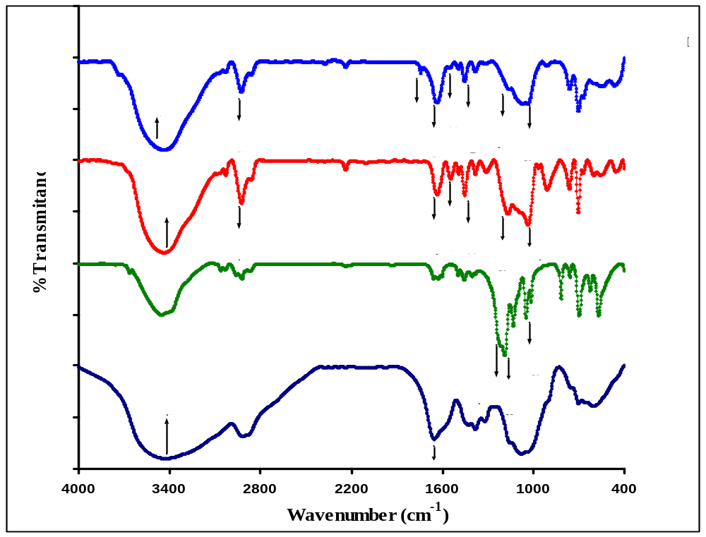
FT-IR spectra of CA (chitosan acetate), p-toluene sulfonic acid sodium salt (p-TS),
PPy (polypyrrole) and PPy-CHI (polypyrrole-chitosan) films.

Slide 15
Suggested structure
The band at 1174 cm⁻¹: p-TS has some interaction with CHI and This interaction caused a longer chain for p-TS and subsequently offered higher conductivity for composite film.

Slide 16
Set up configuration for SPR measurements
He-Ne laser
Neutral Density Filter
Chopper
Polarizer
Silicon Detector
Ref
θ
Prism
Δθ
Cell
Heavy metal
sample
Gold
Polymer layer
(PPy or PPy-CHI)
Concentration

Slide 17
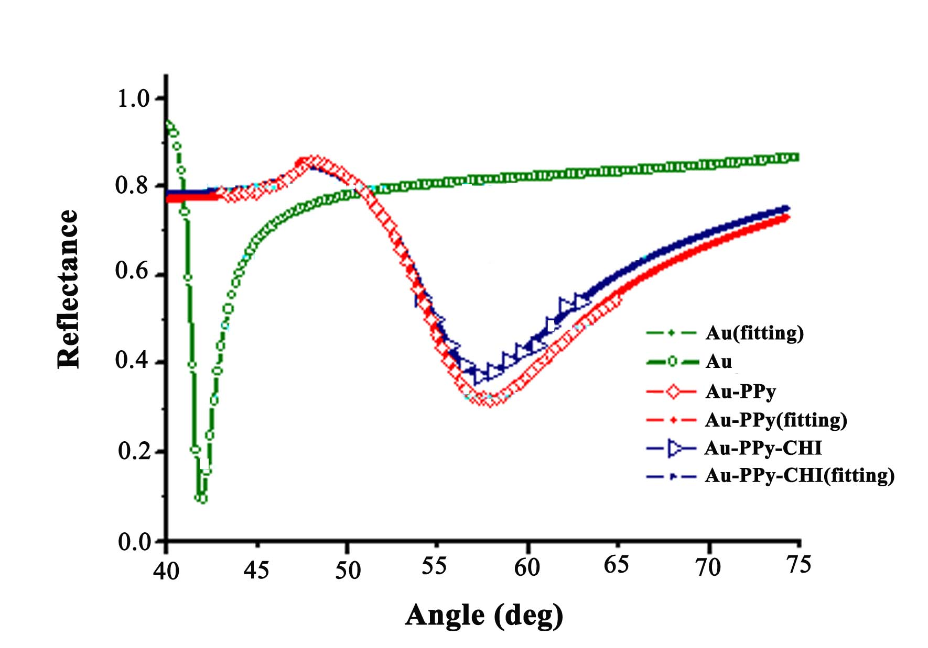
PPy
PPy-CHI
SPR angular profiles for DDW on the Au, Au-PPy and Au- PPy-CHI surface.
Since the SPR angle shifted clearly to the right and produced a sharp peak of resonance angle, this conducting polymer is capable for using in sensitive optical sensors.

Slide 18
Mercury
Filled symbols (PPy surface)
Open symbols (PPy-CHI)
The sensograms for 0.5-12 ppm Mercury
binding on polymer surface

Slide 19
Lead
Filled symbols: (PPy surface)
Open symbols: (PPy-CHI)
The sensograms for 0.5-12 ppm lead binding on polymer surface

Slide 20
Standard calibration curves of ions concentration for PPy and PPy-CHI films
Correlation coefficient R is greater than 0.97
Chitosan is used as a sensitivity enhancement agent for detecting the ions, so lower concentrations of ions could be readily detected with less interference.
Both slopes of Pb²⁺ ion are higher than their Hg²⁺ counterparts. Pb²⁺ binds to the polymer film most strongly and the sensors (PPy and PPy-CHI) are more sensitive to Pb²⁺

Slide 21
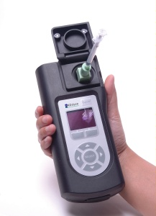

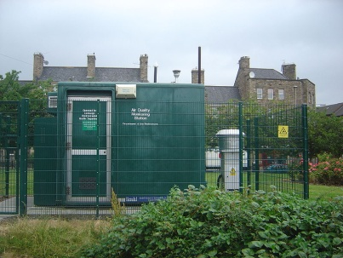
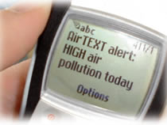

Potential Product/ Technology Application(s)
Detection and measuring the heavy metal in:
Waste water treatment system of the factory
Metal processing manufactory
smeltery factories
battery manufacturers.
Pollution monitoring laboratory
Air quality measurment station
Air quality measurment station
21
Notes:
9/23/2014
21

Slide 22

Thank you
Thank you
22
Notes:
9/23/2014
22

Slide 23
Let Us Meet Again
We welcome you all to our future conferences of OMICS Group International
Please Visit:
www.omicsgroup.com
www.conferenceseries.com
www.pharmaceuticalconferences.com

